Slide 1
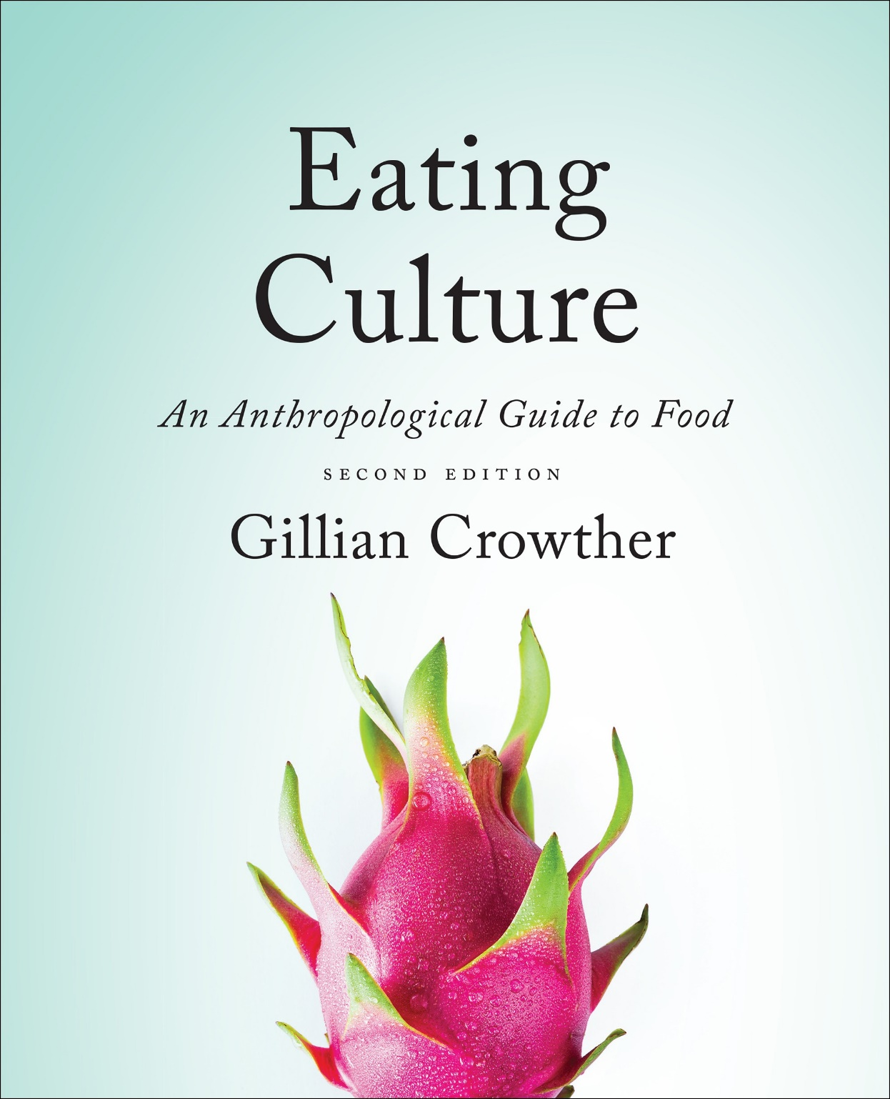
Diet and Evolution:
A Review
use your up/down arrow keys and/or
your space bar to advance the slides
Tim Roufs
© 2010-2022

Slide 2
Diet and Evolution:
A Review
Tim Roufs
© 2010-2022

Slide 3
Tim Roufs
© 2010-2022
www.d.umn.edu/cla/faculty/troufs/anthfood/aftexts.html#title

Slide 4
NOTE:
This is a very long set of slides.
You might want to watch part now, and other parts later.
After the introductory type slide sets they get a lot shorter.

Slide 5
Diet and Human Evolution
Exploring the Diets of Extinct Humans Through Paleontology
Teeth
Skulls and Jaws
The Postcranial Skeleton
What Is Adaptation?
Using Chemistry to Infer the Diets of Extinct Hominini
Our Place in Nature
A Brief Who's Who of the Early Hominini
What Did Early Hominini Eat?
What Can We Say About the Diets of Fossil Homo?
Summary
Highlight: Lactose Intolerance

Slide 6
hominids
“We are what they ate.”
The Cultural Feast, 2nd ed., p. 17

Slide 7
now
“hominins” / hominini
hominids
“We are what they ate.”
The Cultural Feast, 2nd ed., p. 17

Slide 8
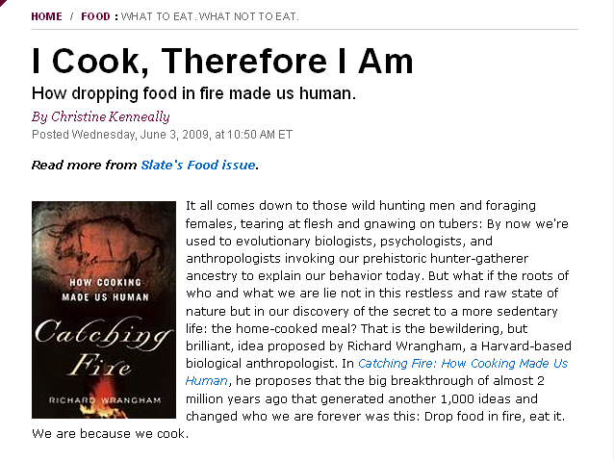
Slate
www.slate.com/id/2219162/

Slide 9
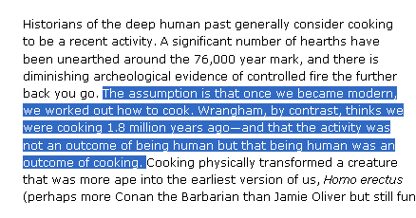
www.slate.com/id/2219162/

Slide 10
optional reading
www.slate.com/id/2219162/

Slide 11
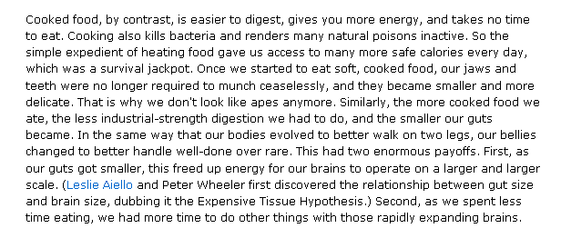
optional reading
www.slate.com/id/2219162/

Slide 12
hominids
are two-legged primates
prehistoric and contemporary
now
“hominins / hominini”
The Cultural Feast, 2nd ed., p. 20

Slide 13
Diet and Human Evolution
Exploring the Diets of Extinct Humans Through Paleontology
Teeth
Skulls and Jaws
The Postcranial Skeleton
What Is Adaptation?
Using Chemistry to Infer the Diets of Extinct Hominini
Our Place in Nature
A Brief Who's Who of the Early Hominini
What Did Early Hominini Eat?
What Can We Say About the Diets of Fossil Homo?
Summary
Highlight: Lactose Intolerance

Slide 14
Diet and Human Evolution
Exploring the Diets of Extinct Humans Through Paleontology
Teeth
Skulls and Jaws
The Postcranial Skeleton
What Is Adaptation?
Using Chemistry to Infer the Diets of Extinct Hominini
Our Place in Nature
A Brief Who's Who of the Early Hominini
What Did Early Hominini Eat?
What Can We Say About the Diets of Fossil Homo?
Summary
Highlight: Lactose Intolerance
Exploring the Diets of Extinct Humans Through Paleontology

Slide 15
Diet and Human Evolution
Exploring the Diets of Extinct Humans Through Paleontology
Teeth
Skulls and Jaws
The Postcranial Skeleton
What Is Adaptation?
Using Chemistry to Infer the Diets of Extinct Hominini
Our Place in Nature
A Brief Who's Who of the Early Hominini
What Did Early Hominini Eat?
What Can We Say About the Diets of Fossil Homo?
Summary
Highlight: Lactose Intolerance
Exploring the Diets of Extinct Humans Through Paleontology
paleontology
paleobotanists
paleontologists
primates
prosimians (“pre-monkeys”)

Slide 16
Diet and Human Evolution
Exploring the Diets of Extinct Humans Through Paleontology
Teeth
Skulls and Jaws
The Postcranial Skeleton
What Is Adaptation?
Using Chemistry to Infer the Diets of Extinct Hominids
Our Place in Nature
A Brief Who's Who of the Early Hominids
What Did Early Hominids Eat?
What Can We Say About the Diets of Fossil Homo?
Summary
Highlight: Lactose Intolerance
paleontologists study fossilized remains
of extinct animals and plants
paleobotanists specialize in the study of fossilized remains of plants

Slide 18
Diet and Human Evolution
Exploring the Diets of Extinct Humans Through Paleontology
Teeth
Skulls and Jaws
The Postcranial Skeleton
What Is Adaptation?
Using Chemistry to Infer the Diets of Extinct Hominini
Our Place in Nature
A Brief Who's Who of the Early Hominini
What Did Early Hominini Eat?
What Can We Say About the Diets of Fossil Homo?
Summary
Highlight: Lactose Intolerance
Exploring the Diets of Extinct Humans Through Paleontology
paleontology
paleobotanists
paleontologists
primates
prosimians (“pre-monkeys”)

Slide 19
^{“Primates”}
a biological “Order” comprised of
^{prosimians}
^{(“pre-monkeys”)}
^{monkeys}
^{apes}
^{humans}

Slide 20
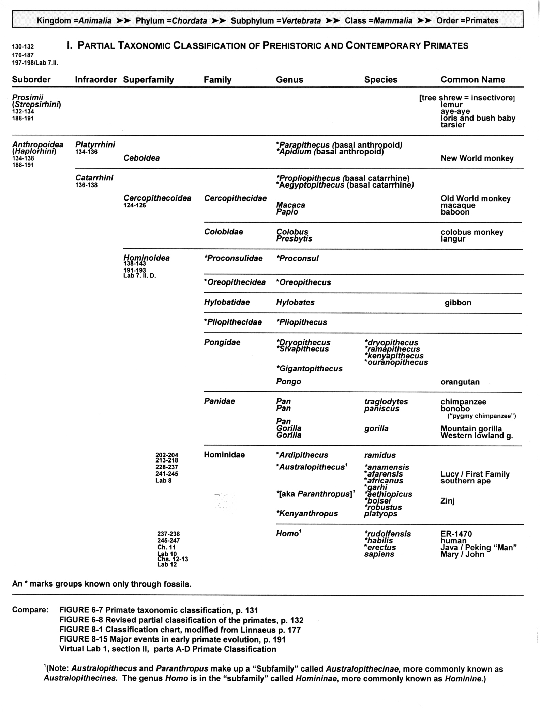
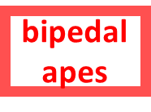
pre-monkeys
prosimians
monkeys
monkeys
apes
apes
humans
humans

Slide 21
^{“Hominoids”}
^{= all living and extinct}
^{apes and humans}
^{aka Hominoidea}
The Cultural Feast, 2nd ed., p. 20

Slide 22
prosimians
Hominoids
monkeys
apes
humans

Slide 23
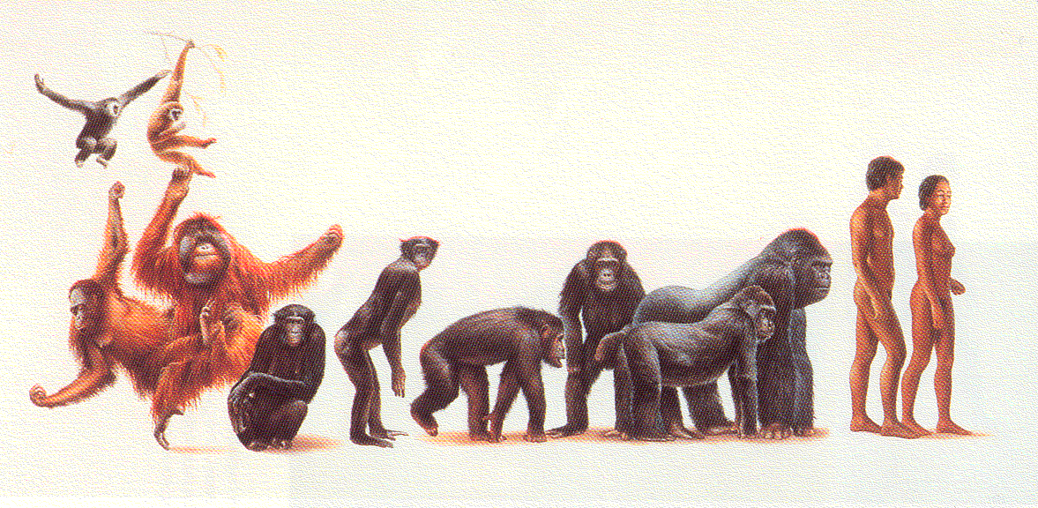
Hominoids
gibbons
humans
bonobos
chimps
orangutans
gorillas
Campbell and Loy, Humankind Emerging, 8th ed., p. 138 ff.

Slide 24
^{“Hominini”}
= modern humans and their nearest predecessors
^{aka Hominidae}
The Cultural Feast, 2nd ed., p. 20.

Slide 25
^{TRADITIONAL}
^{CLASSIFICATION}

Slide 26
prosimians
pre-monkeys

Slide 27
prosimians
monkeys

Slide 28
prosimians
monkeys
apes

Slide 29
prosimians
monkeys
apes
bipedal
apes

Slide 30
prosimians
monkeys
apes
bipedal
apes
humans

Slide 31
prosimians
monkeys
and these were
“hominids”
(until 1980)
apes
bipedal
apes
humans

Slide 32
^{TRADITIONAL}
^{CLASSIFICATION}
prosimians
monkeys
and these were
“hominids”
(until 1980)
apes
bipedal
apes
humans

Slide 33
pre-monkeys
prosimians
monkeys
monkeys
apes
apes
humans
humans

Slide 34
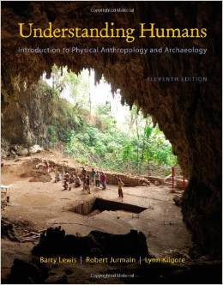
Cf.,
Understanding Humans: Introduction to Physical Anthropology and Archaeology,
11th ed.
Barry Lewis, Robert Jurmain, and Lynn Kilgore
Belmont, CA: Wadsworth Publishing
©2012

Slide 35
^{NEW CLASSIFICATION}
^{“Hominini”}
= “colloquial term for members of the “tribe” Hominini, the evolutionary group that includes modern human and now-extinct bipedal relatives”

Slide 36
^{TRADITIONAL}
^{CLASSIFICATION}
prosimians
monkeys
these were
“hominids”
(until 1980)
apes
bipedal
apes
humans

Slide 37
^{NEW}
^{CLASSIFICATION}
prosimians
monkeys
now these are
”hominins”
apes
Hominins
bipedal
apes
humans

Slide 38
^{NEW}
^{CLASSIFICATION}
prosimians
monkeys
now these are
”hominins”
apes
the
bipeds
are in one “tribe”
(ape AND human)
Hominins
bipedal
apes
”hominins”
humans

Slide 39
meet “Lucy”,
the most famous of the prehistoric hominini . . .

Slide 40
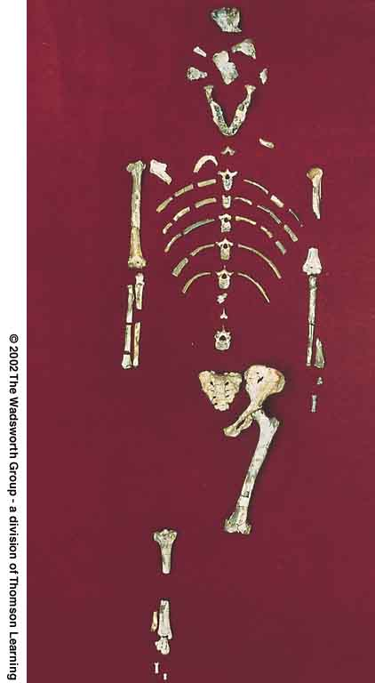
^{for e.g.,}
^{Lucy}
^{and}
^{“The First Family”}
Understanding Physical Anthropology and Archaeology, 9th ed., p. 206

Slide 41
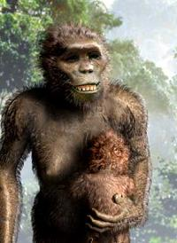
^{for e.g.,}
^{Lucy}
^{and}
^{“The First Family”}
Understanding Physical Anthropology and Archaeology, 9th ed., p. 206

Slide 42
“Lucy" and "The First Family"
from: Hadar, Ethiopia (“Site 333” on the Awash River)
aka: Australopithecus afarensis
age: 3.9 – 2.9 mya
discovered: 1975-1976

Slide 43
we’ll meet more hominini later . . .
first, some of their characteristics . . .

Slide 45
useful markers of the earliest
hominines include:
adaptations for bipedalism . . .
reduced canine length (teeth) . . .
and these relate to food . . .

Slide 46
useful markers of the earliest
hominines include:
adaptations for bipedalism . . .
reduced canine length (teeth) . . .
and these relate to food . . .

Slide 47
Diet and Human Evolution
Exploring the Diets of Extinct Humans Through Paleontology
Teeth
Skulls and Jaws
The Postcranial Skeleton
What Is Adaptation?
Using Chemistry to Infer the Diets of Extinct Hominini
Our Place in Nature
A Brief Who's Who of the Early Hominini
What Did Early Hominini Eat?
What Can We Say About the Diets of Fossil Homo?
Summary
Highlight: Lactose Intolerance
Exploring the Diets of Extinct Humans Through Paleontology
Teeth
Skulls and Jaws
The Postcranial Skeleton

Slide 49
teeth

Slide 50
Diet and Human Evolution
Exploring the Diets of Extinct Humans Through Paleontology
Teeth
Skulls and Jaws
The Postcranial Skeleton
What Is Adaptation?
Using Chemistry to Infer the Diets of Extinct Hominini
Our Place in Nature
A Brief Who's Who of the Early Hominini
What Did Early Hominini Eat?
What Can We Say About the Diets of Fossil Homo?
Summary
Highlight: Lactose Intolerance
Exploring the Diets of Extinct Humans Through Paleontology
Teeth
Skulls and Jaws
The Postcranial Skeleton

Slide 51
Diet and Human Evolution
Exploring the Diets of Extinct Humans Through Paleontology
Teeth
Skulls and Jaws
The Postcranial Skeleton
What Is Adaptation?
Using Chemistry to Infer the Diets of Extinct Hominini
Our Place in Nature
A Brief Who's Who of the Early Hominini
Highlight: Lactose Intolerance
Exploring the Diets of Extinct Humans Through Paleontology
Teeth are obviously related to food and food gathering

Slide 52
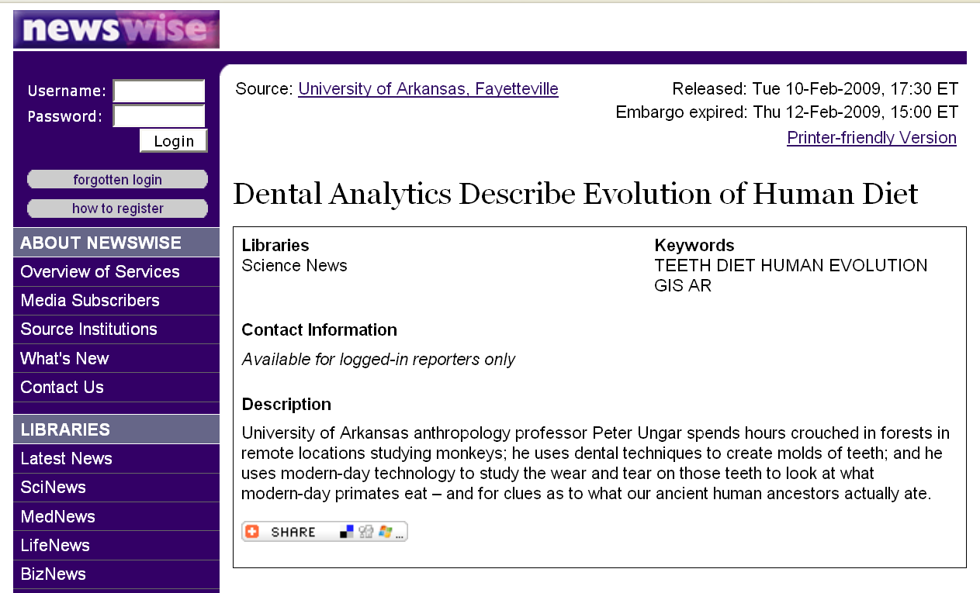
www.newswise.com/articles/view/549004/?sc=rssn

Slide 53
useful markers of the earliest
hominids / hominini:
adaptations for bipedalism …
reduced canine length …
and this is though mostly
to relate to a change in diet

Slide 54
apes (and monkeys)
still possess conical, daggerish canines which project well beyond the surface of the opposite teeth . . .

Slide 55
apes (and monkeys)
still possess conical, daggerish canines which project well beyond the surface of the opposite teeth . . .
so they can’t easily grind sideways with their peaked molar teeth . . .

Slide 56
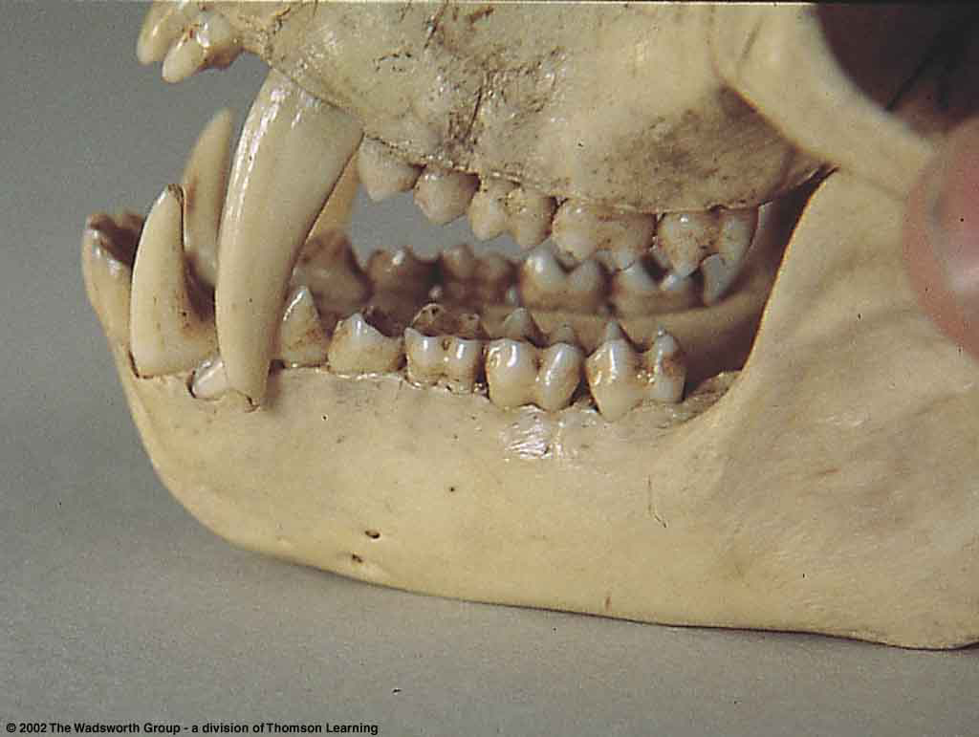
their canines lock, and they cannot easily grind sideways with their peaked molars . . .
Teeth of a male patas monkey
Understanding Physical Anthropology and Archaeology, 9th ed., p. 205

Slide 57
because of the overlap they have diastema . . .

Slide 58
diastema =
a space in the tooth row that accommodates one or more teeth from the opposite jaw

Slide 59
Teeth of a male patas monkey
Understanding Physical Anthropology and Archaeology, 9th ed., p. 205

Slide 60
diastema
Teeth of a male patas monkey
Understanding Physical Anthropology and Archaeology, 9th ed., p. 205

Slide 61
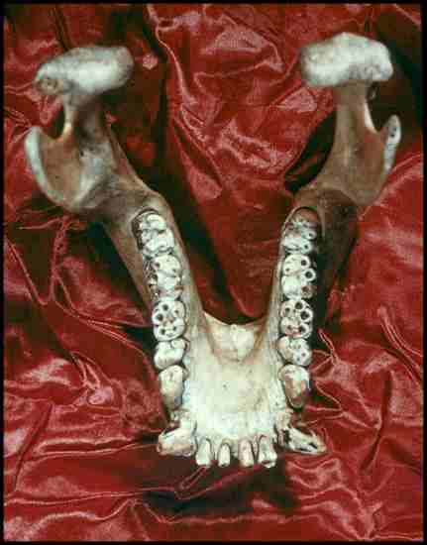
diastema

Slide 62
these big canine teeth are reduced in the
hominids / hominini . . .
and this is though mostly
to relate to a change in diet

Slide 63
there are also some related changes in the
skull and jaw . . .
you can see these by comparing the skull and jaw of a modern human to those of a gorilla . . .

Slide 64
there are also some related changes in the
skull and jaw . . .
you can see these by comparing the skull and jaw of a modern human to those of a gorilla . . .

Slide 65
add molars
grinding

Slide 66
skull and jaws

Slide 67
Diet and Human Evolution
Exploring the Diets of Extinct Humans Through Paleontology
Teeth
Skulls and Jaws
The Postcranial Skeleton
What Is Adaptation?
Using Chemistry to Infer the Diets of Extinct Hominini
Our Place in Nature
A Brief Who's Who of the Early Hominini
What Did Early Hominini Eat?
What Can We Say About the Diets of Fossil Homo?
Summary
Highlight: Lactose Intolerance
Exploring the Diets of Extinct Humans Through Paleontology
Teeth
Skulls and Jaws
The Postcranial Skeleton

Slide 68
Diet and Human Evolution
Exploring the Diets of Extinct Humans Through Paleontology
Teeth
Skulls and Jaws
The Postcranial Skeleton
What Is Adaptation?
Using Chemistry to Infer the Diets of Extinct Hominini
Our Place in Nature
A Brief Who's Who of the Early Hominini
What Did Early Hominini Eat?
What Can We Say About the Diets of Fossil Homo?
Summary
Highlight: Lactose Intolerance
Exploring the Diets of Extinct Humans Through Paleontology
Teeth
Skull and Jaws
The Postcranial Skeleton
= cranium

Slide 69
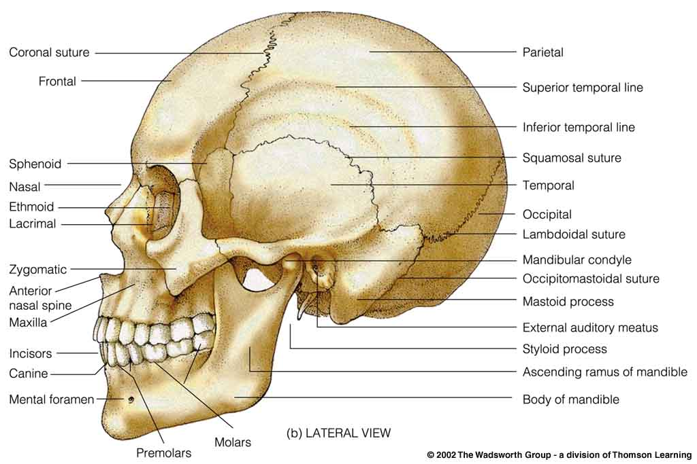
Modern human cranium
Understanding Physical Anthropology and Archaeology, 9th ed., p. 432

Slide 70
the lower jaw =
mandible
see also the related
“mandibular torus”

Slide 71
Modern mandible on a human cranium
Understanding Physical Anthropology and Archaeology, 9th ed., p. 432

Slide 72
in apes mandibles slant outward and downward, without a chin
(“prognathism”)

Slide 73
Diet and Human Evolution
Exploring the Diets of Extinct Humans Through Paleontology
Teeth
Skulls and Jaws
The Postcranial Skeleton
What Is Adaptation?
Using Chemistry to Infer the Diets of Extinct Hominini
Our Place in Nature
A Brief Who's Who of the Early Hominini
What Did Early Hominini Eat?
What Can We Say About the Diets of Fossil Homo?
Summary
Highlight: Lactose Intolerance
Exploring the Diets of Extinct Humans Through Paleontology
Teeth
Skulls and Jaws
Saggital crest
The Postcranial Skeleton

Slide 74
apes have a ridge running down the top of their skulls that’s called a
saggital crest . . .
that is where the jaw muscles attach . . .
and that feature is related to powerful chewing . . .

Slide 75
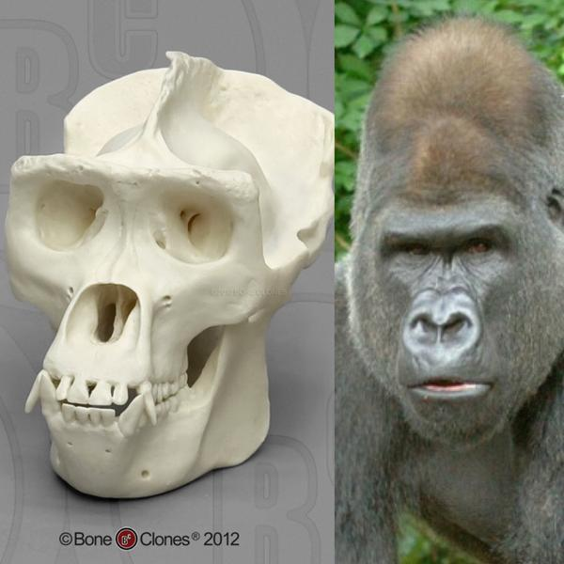
saggital crest
Western Lowland Gorilla (male)
source

Slide 76
and apes have a ridge running down the top of their skulls that’s called a
saggital crest . . .
that is where the jaw muscles attach . . .
and that feature is related to powerful chewing . . .

Slide 77
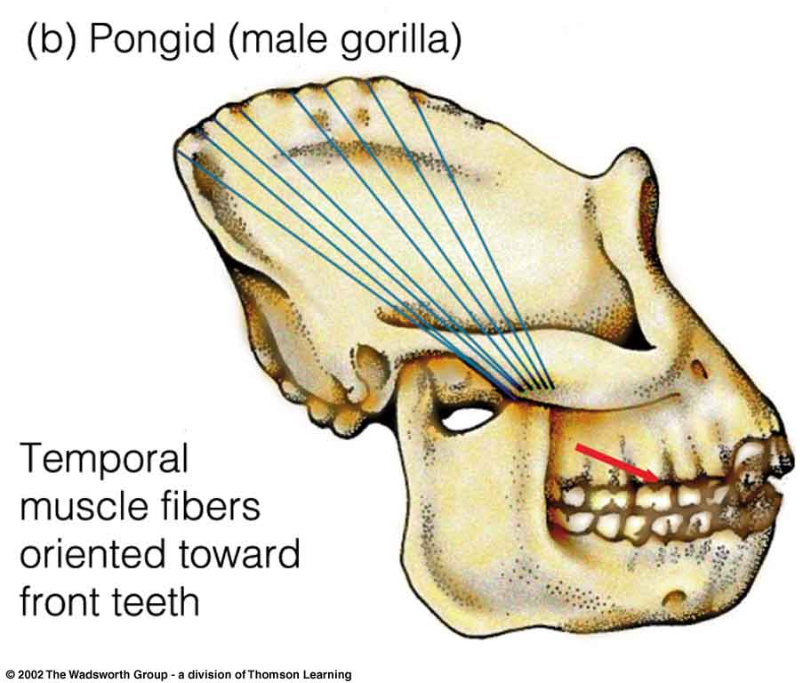
Pongid Prognathism
(Line of greatest muscle force is shown in red)
Understanding Physical Anthropology and Archaeology, 8th ed., p. 245

Slide 78
and apes have a ridge running down the top of their skulls that’s called a
saggital crest . . .
that is where the jaw muscles attach . . .
and that feature is related to powerful chewing . . .

Slide 79
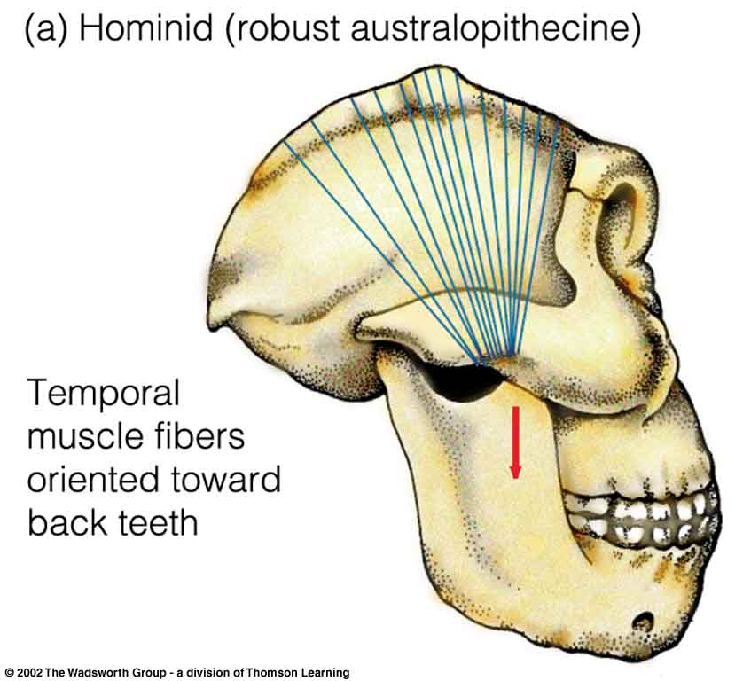
Satittal crests and temporal muscle orientations
^{Hominid compared to pongid}
(Line of greatest muscle force is shown in red)
Understanding Physical Anthropology and Archaeology, 8th ed., p. 245

Slide 80
apes have a “simian shelf” rather than a chin . . .
in humans lower jaw is comparatively small, but always has a distinct chin . . .

Slide 81
Note: no chin
Pongid Prognathism
(Line of greatest muscle force is shown in red)
Understanding Physical Anthropology and Archaeology, 8th ed., p. 245

Slide 82
apes have a “simian shelf” rather than a chin . . .
in humans the lower jaw is comparatively small, but they always have a distinct chin . . .

Slide 83
distinct chin
Modern human cranium
Understanding Physical Anthropology and Archaeology, 9th ed., p. 432

Slide 84
source
source

Slide 85
post-cranial

Slide 86
useful markers of the earliest
hominines:
adaptations for bipedalism . . .
reduced canine length (teeth) . . .
and these relate to food . . .

Slide 87
Diet and Human Evolution
Exploring the Diets of Extinct Humans Through Paleontology
Teeth
Skulls and Jaws
The Postcranial Skeleton
What Is Adaptation?
Using Chemistry to Infer the Diets of Extinct Hominini
Our Place in Nature
A Brief Who's Who of the Early Hominini
What Did Early Hominini Eat?
What Can We Say About the Diets of Fossil Homo?
Summary
Highlight: Lactose Intolerance
Exploring the Diets of Extinct Humans Through Paleontology
Teeth
Skulls and Jaws
The Postcranial Skeleton

Slide 88
postcranial =
below the head (with bipeds)
behind the head (with quadrupeds)

Slide 89
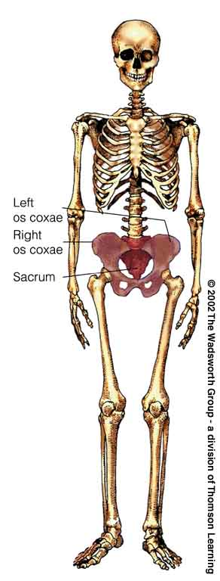
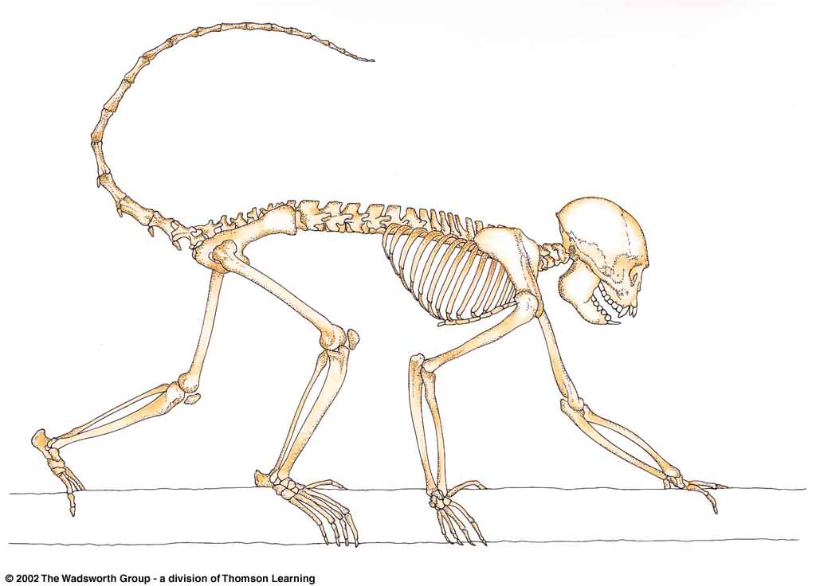
^{Postcrania}
New World monkey
modern human
Understanding Physical Anthropology and Archaeology, 8th ed., pp. 223, 128

Slide 90
NOTE:
anything called
-pithecus
is an ape
e.g.,
Homo sapiens
Moderns (Cro-magnon …)
Premoderns (Neandertal …)
165,000 ybp-present
500,000-28,000 ybp
Homo erectus
1.8 mya–25,000 ybp
Homo habilis
2.4-1.6 mya
Paranthropus
2. 5-1 mya
Australopithecus
4.25-2 mya
Sivapithecus
15-7 mya
dates are approximate
and follow Understanding Humans 2009

Slide 91
Homo sapiens
Moderns (Cro-magnon …)
Premoderns (Neandertal …)
165,000 ybp-present
500,000-28,000 ybp
Homo erectus
1.8 mya–25,000 ybp
Homo habilis
2.4-1.6 mya
Paranthropus
2. 5-1 mya
Australopithecus
4.25-2 mya
Sivapithecus
15-7 mya
dates are approximate
and follow Understanding Humans 2009

Slide 92
Homo sapiens
Moderns (Cro-magnon …)
Premoderns (Neandertal …)
165,000 ybp-present
modern-day apes are not bipeds
they’re brachiators
500,000-28,000 ybp
Homo erectus
1.8 mya–25,000 ybp
Homo habilis
2.4-1.6 mya
Paranthropus
2. 5-1 mya
Australopithecus
4.25-2 mya
as were the prehistoric –pithecines, like . . .
Sivapithecus
15-7 mya
dates are approximate
and follow Understanding Humans 2009

Slide 93
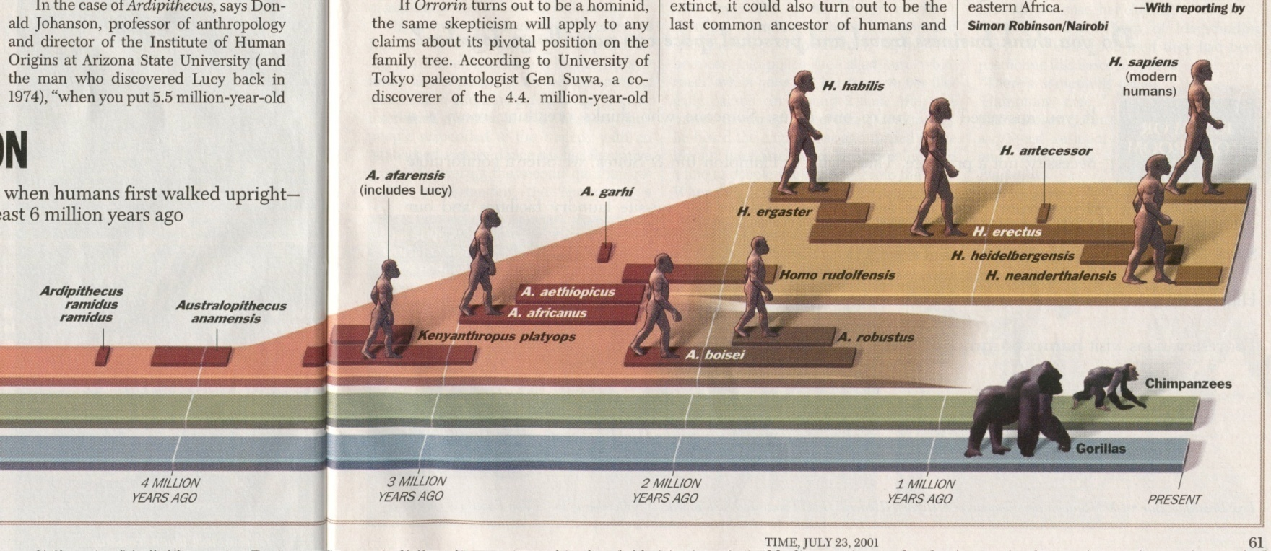
The first “real” ape
Sivapithecus
15-7 mya
Time 23 July 2001

Slide 94
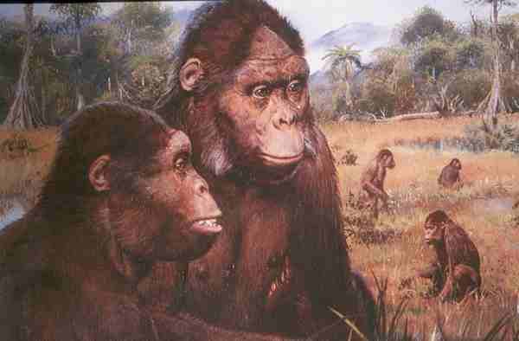
Sivapithecines

Slide 95
note activities . . .
Sivapithecines

Slide 96
Bipedal Locomotion
Sivapithecus
was not a biped . . .

Slide 97
Bipedal Locomotion
Why did bipedalism develop?
there are a lot of theories … several of them related to food procurement and use …

Slide 98
Bipedal Locomotion
Why bipedalism?
there are a lot of theories . . .
and several of them
relate to
food procurement and use . . .

Slide 99
Bipedal Locomotion
Why bipedalism?
Owen Lovejoy
for example, thinks it’s
ALL about food . . .
“provisioning hypothesis”

Slide 100
Bipedal Locomotion
Why bipedalism?
Owen Lovejoy
for example, thinks it’s
ALL about food . . .
and that’s his “provisioning hypothesis”

Slide 101
Lovejoy’s ideas on
bipedalism
specifically relate to
male help in carrying food
back to the “home base” . . .
a feature known as
“provisioning”

Slide 102
Lovejoy’s ideas on
bipedalism
specifically relate to
male help in carrying food
back to the “home base” . . .
a feature known as
“provisioning”

Slide 103
. . . male help
in
“provisioning”
this is Owen Lovejoy’s
“provisioning hypothesis”

Slide 104
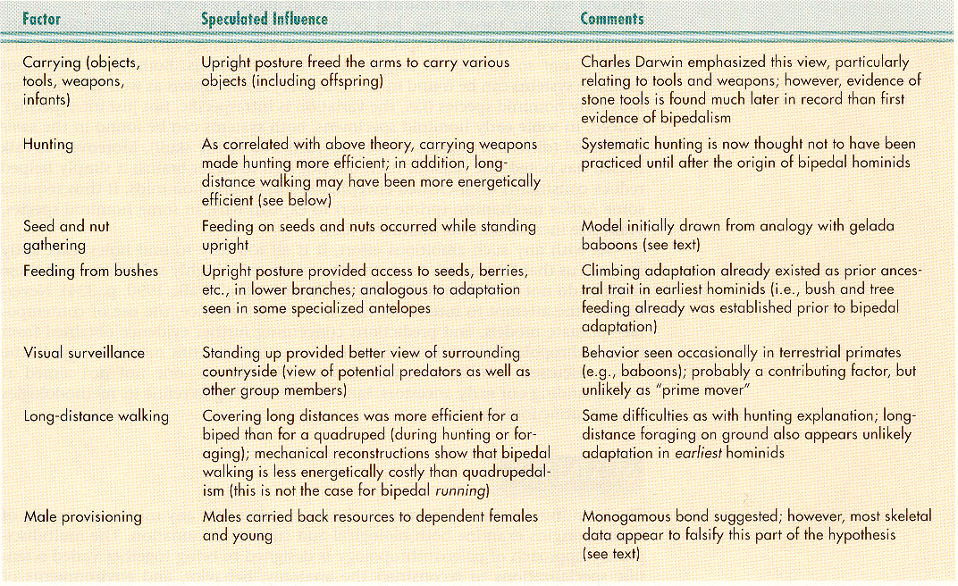
Possible Factors Influencing the
Initial Evolution of Bipedal Locomotion in Hominini
Understanding Physical Anthropology and Archaeology, 8th ed., p. 217

Slide 105
Possible Factors Influencing the
Initial Evolution of Bipedal Locomotion in Hominini
Understanding Physical Anthropology and Archaeology, 8th ed., p. 217

Slide 106
Owen Lovejoy notes that
bipedalism relates to
long-distance walking . . .
including carrying food
while provisioning

Slide 107
Possible Factors Influencing the
Initial Evolution of Bipedal Locomotion in Hominini
Understanding Physical Anthropology and Archaeology, 8th ed., p. 217

Slide 108
. . . and even non-bipeds
carry food . . .

Slide 109
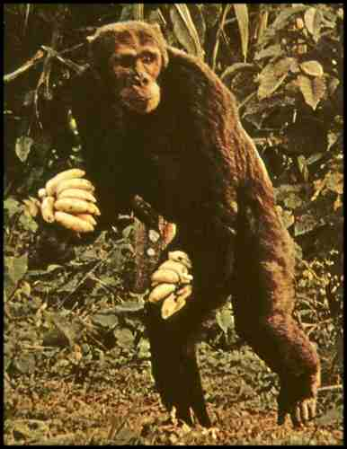
Chimpanzee
The Primates, Time-Life (1974) p. 71

Slide 110
Possible Factors Influencing the
Initial Evolution of Bipedal Locomotion in Hominini
Understanding Physical Anthropology and Archaeology, 8th ed., p. 217

Slide 111
and
bipedalism and vision
(visual surveillance) are related to the quest for food . . .

Slide 112
Possible Factors Influencing the
Initial Evolution of Bipedal Locomotion in Hominini
Understanding Physical Anthropology and Archaeology, 8th ed., p. 217

Slide 113
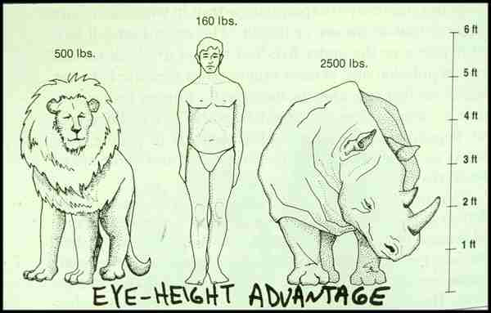
Eye-Height advantage of Bipedal Locomotion in Hunting . . .

Slide 114
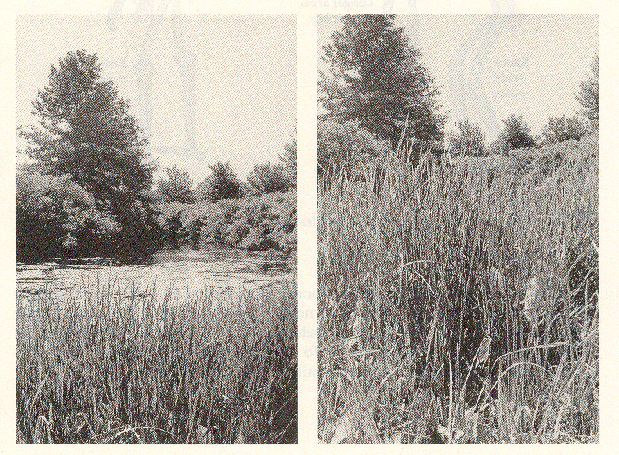
Eye-Height advantage of Bipedal Locomotion in Hunting . . .

Slide 115
Eye Level and Sight.
Humankind Emerging, 7th ed., p. 114

Slide 116
bipedalism is related to
seed and nut gathering
and
feeding from bushes . . .

Slide 117
Possible Factors Influencing the
Initial Evolution of Bipedal Locomotion in Hominini
Understanding Physical Anthropology and Archaeology, 8th ed., p. 217

Slide 118
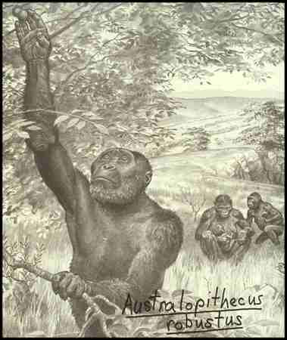

Slide 119
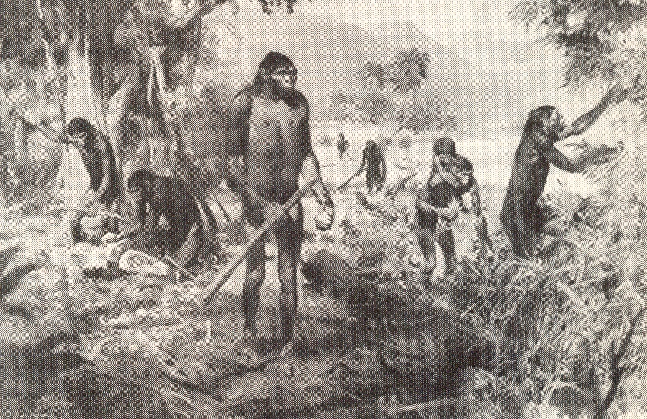
The Emergence of Humankind 4th Ed., p. 105

Slide 120
bipedalism is also related
to tool use . . .
including such simple tools as
a digging stick . . .
(aka a “dibble” or “coa”)

Slide 121
bipedalism is also related to hunting . . .

Slide 122
Possible Factors Influencing the
Initial Evolution of Bipedal Locomotion in Hominini
Understanding Physical Anthropology and Archaeology, 8th ed., p. 217

Slide 123
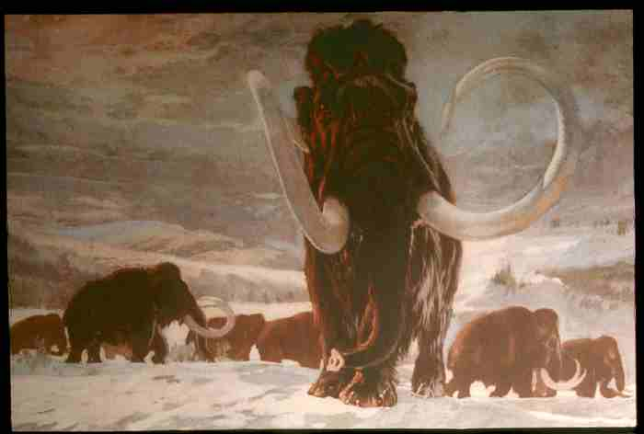
Hunting / Gathering /
Collecting
(foraging)

Slide 124
Possible Factors Influencing the
Initial Evolution of Bipedal Locomotion in Hominini
Understanding Physical Anthropology and Archaeology, 8th ed., p. 217

Slide 125
much of this
is summarized
in . . .
New York University Press 2005

Slide 126
another consequence of our primate heritage and enlarged brain is that we are blessed and cursed with an insensate
craving for sweets and fats
we seem especially fond of sweet-sour foods
in nature, ripe fruits and berries
we love animal fats and vegetable fats equally
nuts, seeds, oily fruits
Everyone Eats pp. 33-34

Slide 127
this is the best book on the subject . . .
Random House, 2013

Slide 128
these are high-calorie, easily digestible foods that are most easily found in a rich patch following a burn
Everyone Eats pp. 33-34

Slide 129
“So the human tendency to crave certain foods is biologically grounded.”
Everyone Eats pp. 33-34

Slide 130
all of these things resulted in cultural and physical adaptations to various environments, including microenvironments . . .

Slide 132
Diet and Human Evolution
Exploring the Diets of Extinct Humans Through Paleontology
Teeth
Skulls and Jaws
The Postcranial Skeleton
What Is Adaptation?
Using Chemistry to Infer the Diets of Extinct Hominini
Our Place in Nature
A Brief Who's Who of the Early Hominini
What Did Early Hominini Eat?
What Can We Say About the Diets of Fossil Homo?
Summary
Highlight: Lactose Intolerance

Slide 133
Diet and Human Evolution
Exploring the Diets of Extinct Humans Through Paleontology
Teeth
Skulls and Jaws
The Postcranial Skeleton
What Is Adaptation?
Using Chemistry to Infer the Diets of Extinct Hominini
Our Place in Nature
A Brief Who's Who of the Early Hominini
What Did Early Hominini Eat?
What Can We Say About the Diets of Fossil Homo?
Summary
Highlight: Lactose Intolerance
What Is Adaptation?

Slide 134
“There is a difference between
‘fine-tuning,’ via selection and adaptation, the features
that individuals of a species have,
and the emergence of those features in the first place.”
The Cultural Feast, 2nd ed., p. 24

Slide 135
“There is a difference between
‘fine-tuning,’ via selection and adaptation, the features
that individuals of a species have,
and the emergence of those features in the first place.”
The Cultural Feast, 2nd ed., p. 24

Slide 136
“There is a difference between
‘fine-tuning,’ via selection and adaptation, the features
that individuals of a species have,
and the emergence of those features in the first place.”
=
= evolution
The Cultural Feast, 2nd ed., p. 24

Slide 137
“Unfortunately,
Darwin confused adaptation
(the ‘fine-tuning’)
with evolution
(the emergence of novelty),
and this is still done today”
The Cultural Feast, 2nd ed., p. 24

Slide 138
“Darwin’s portrayal of natural selection is that it is a force that is constantly choosing variations
believed to be the most advantageous, thereby creating the ‘fittest’ individuals.”
“. . . but this may not be how things work in nature.”
The Cultural Feast, 2nd ed., p. 25

Slide 139
“. . . a more realistic way to look at selection [is]
to focus on the
elimination of the unfit
(say, by death)
rather than the selection of the fittest.”
The Cultural Feast, 2nd ed., p. 25

Slide 140
It’s not the “survival of the fittest” . . .
“The difference between these two views is important: Darwinian selection implies a constant culling and improvement of the cream of the crop, whereas the idea based on elimination of the unfit emphasizes the
survival of the just ‘OK’.”
The Cultural Feast, 2nd ed., p. 25

Slide 141
. . . and food is central to all of it . . .

Slide 142
. . . chimpanzee groups utilize foods efficiently in different
microenvironments

Slide 143
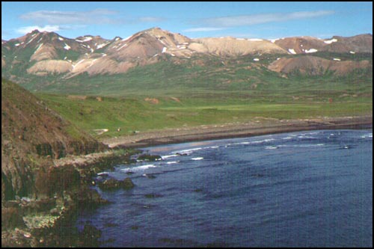
microenvironments

Slide 144
microenvironments

Slide 145
microenvironments

Slide 146
microenvironments

Slide 147
microenvironments

Slide 148
microenvironments

Slide 149
microenvironments

Slide 150
microenvironments

Slide 151
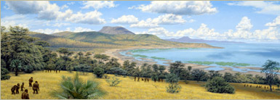
microenvironments
How many can you find in the following picture?
The African Savannah Illustration by Jay H. Matternes
http://www.amnh.org/exhibitions/atapuerca/africa/branches.php

Slide 152
microenvironments
The African Savannah Illustration by Jay H. Matternes
http://www.amnh.org/exhibitions/atapuerca/africa/branches.php

Slide 153
microenvironments
www.sciencedaily.com/releases/2009/02/090202140046.htm

Slide 154
. . . chimpanzee groups utilize foods efficiently in different microenvironments
. . . that is, they
are opportunistic feeders
“. . . if it’s a matter of their survival,
they can do it.”
The Cultural Feast, 2nd ed., p. 25

Slide 155
. . . effective adaptive food use
is a characteristic
of primates in general,
even monkeys . . .

Slide 156
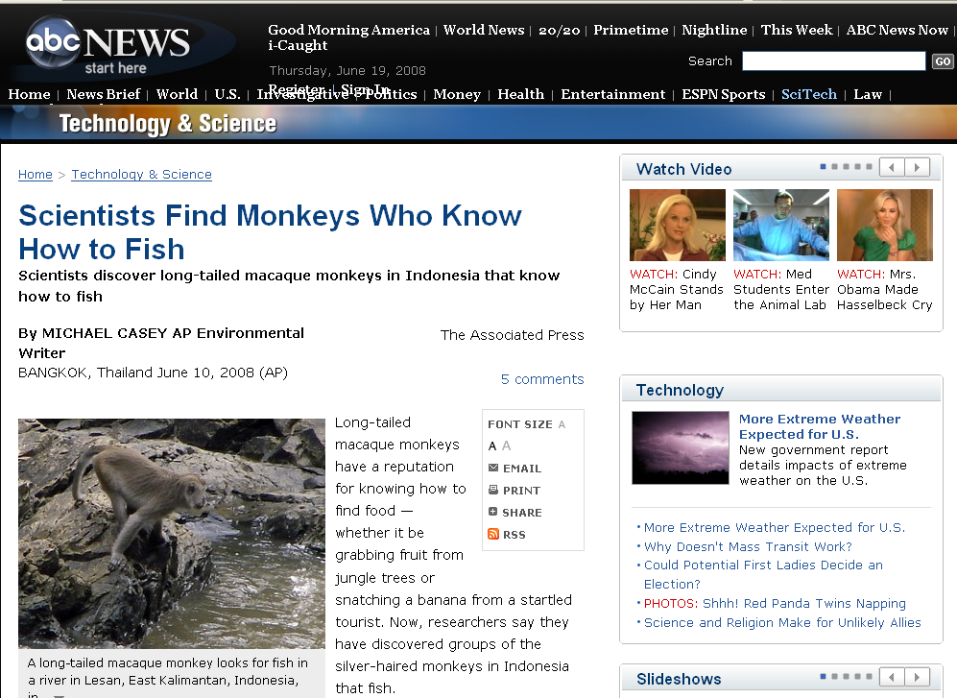
for e.g.,
abcnews.go.com/Technology/wireStory?id=5035837
Notes:
156

Slide 157
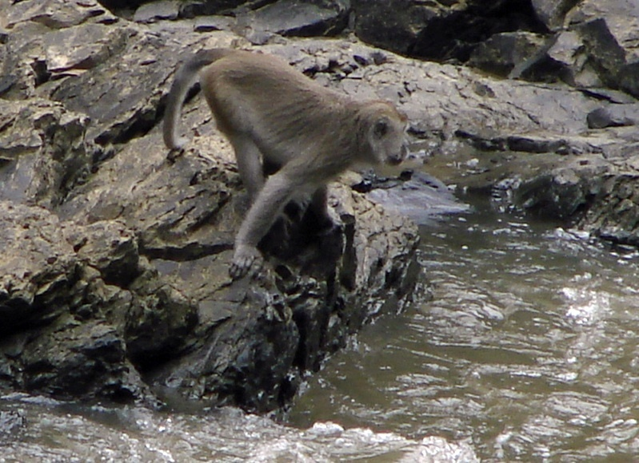
monkeys know how to fish
abcnews.go.com/Technology/wireStory?id=5035837
Notes:
157

Slide 158
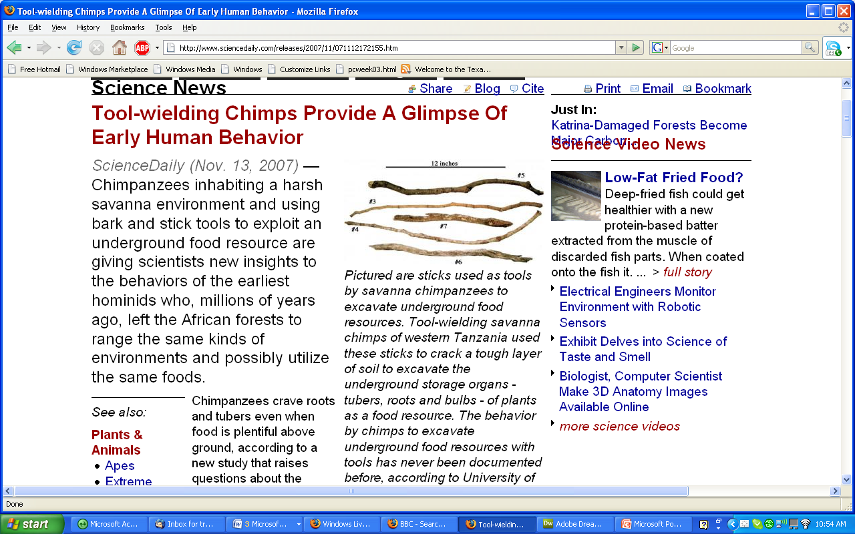
www.sciencedaily.com/releases/2007/11/071112172155.htm
Notes:
158

Slide 159
tidal pools offer luxury living
www.bolenhq.com/scubaandsnorkeling.htm
Notes:
159

Slide 160
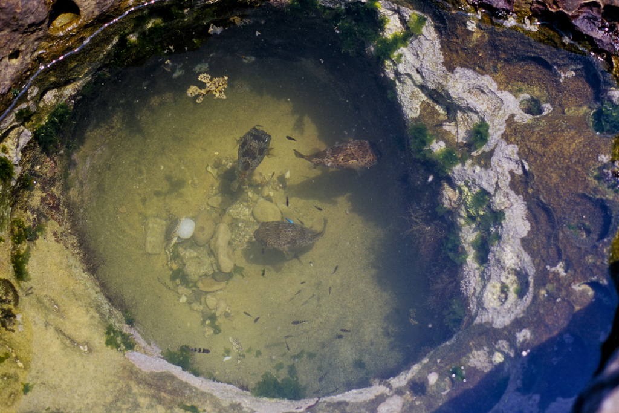
excellent food for the taking,
delivered twice a day to the tidal pools
http://tirugondar.wordpress.com/2008/08/03/yehliu-and-the-yehliu-geopark/
Notes:
160

Slide 161
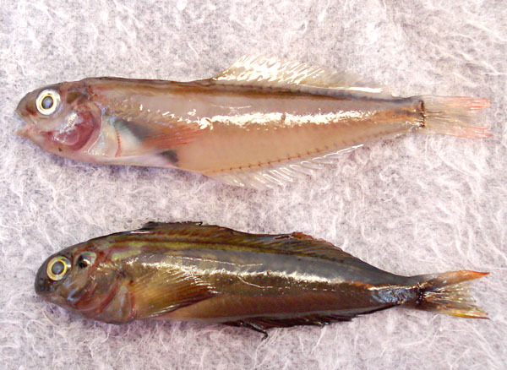
www.mexfish.com/fish/pfblen/pfblen.htm
Notes:
161

Slide 162
Panamic Fanged Blenny, Ophioblennius steindachneri: [Adults] are common and always found in tidal pools, even with extreme low tides, with plenty of water and a place to hide under a rock
. . . Collected in January 2008 in a dry El Tule Tidal pool, Km. 17, San Jose del Cabo, Mexico . . .
www.mexfish.com/fish/pfblen/pfblen.htm
Notes:
162

Slide 163
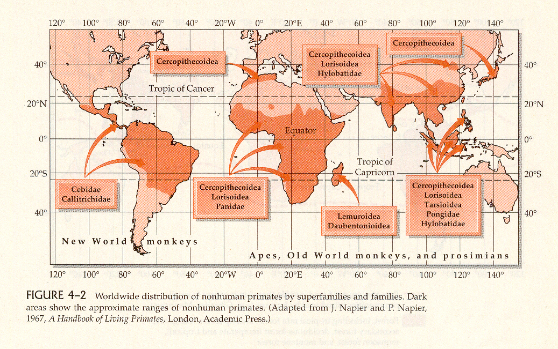
Primates are tropical and temperate climate creatures
Distribution of Nonhuman Primates
(mostly in the tropics and subtropics)
Humankind Emerging, 7th ed., p. 93

Slide 164
over the millennia there were a number of important food “revolutions” . . .

Slide 165
this is an excellent source for a discussion on food “revolutions” . . .
Simon & Schuster 2003

Slide 166
Eight Food “Revolutions”
Invention of Cooking
Discovery that Food is More Than Sustenance
The “Herding Revolution”
Snail Farming
Use of Food as a Means and Index of Social Differentiation
Long-Range Exchange of Culture
Ecological Revolution of last 500 years
Industrial Revolution of the 19th and 20th Centuries
Simon & Schuster 2003

Slide 167
Eight Food “Revolutions”
Invention of Cooking
Discovery that Food is More Than Sustenance
The “Herding Revolution”
Snail Farming
Use of Food as a Means and Index of Social Differentiation
Long-Range Exchange of Culture
Ecological Revolution of last 500 years
Industrial Revolution of the 19th and 20th Centuries
Simon & Schuster 2003

Slide 168
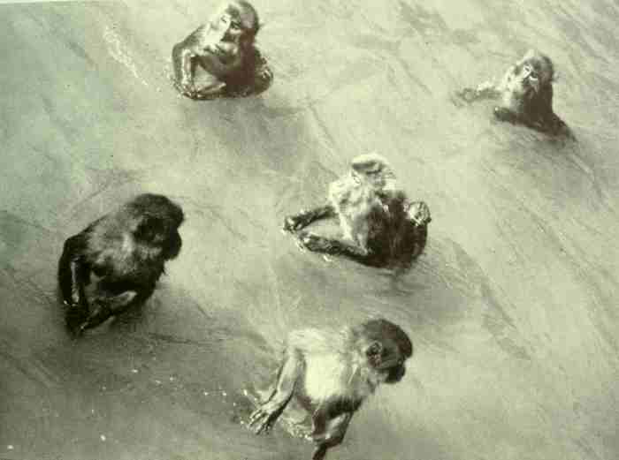
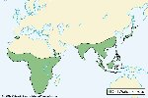
Old World Monkeys: Macaques

Slide 169
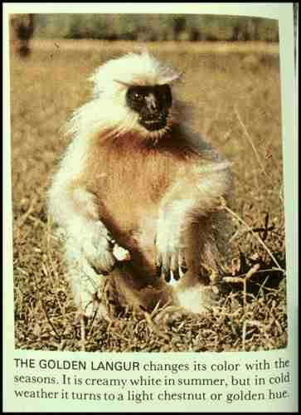
Old World Monkey: Golden Langur
The Primates, Time-Life (1974) p. 54

Slide 170
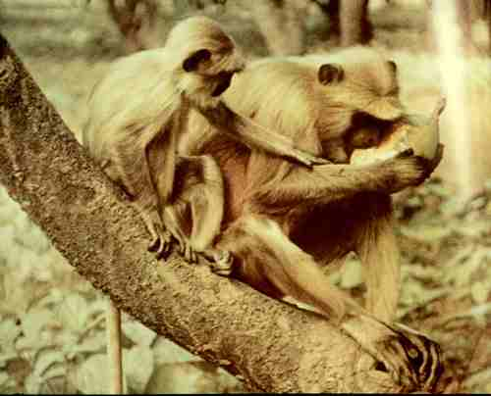
Old World Monkeys: Langurs
The Primates, Time-Life (1974) p. 100

Slide 171
. . . but remember always . . .
the hunter is also the hunted . . .

Slide 172
“tropic level”
is
an animal
or a plant’s position
in the food chain
The Cultural Feast, 2nd ed., p. 28

Slide 173
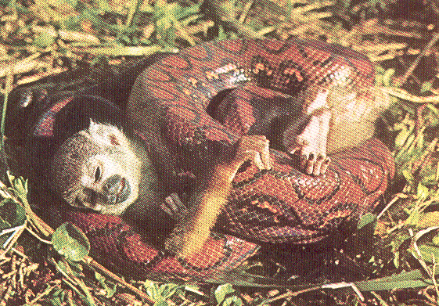
New World Monkey: Squirrel Monkey
The Primates, Time-Life (1974) p. 49

Slide 174
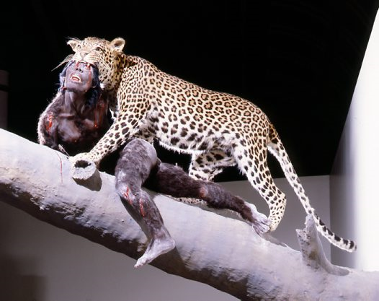
Reconstruction of the death of a hominin by a leopard,
based on fossils found in South Africa
http://australianmuseum.net.au/image/A-leopards-lunch/

Slide 175
http://www.msnbc.msn.com/id/10819471/
Notes:
175

Slide 176
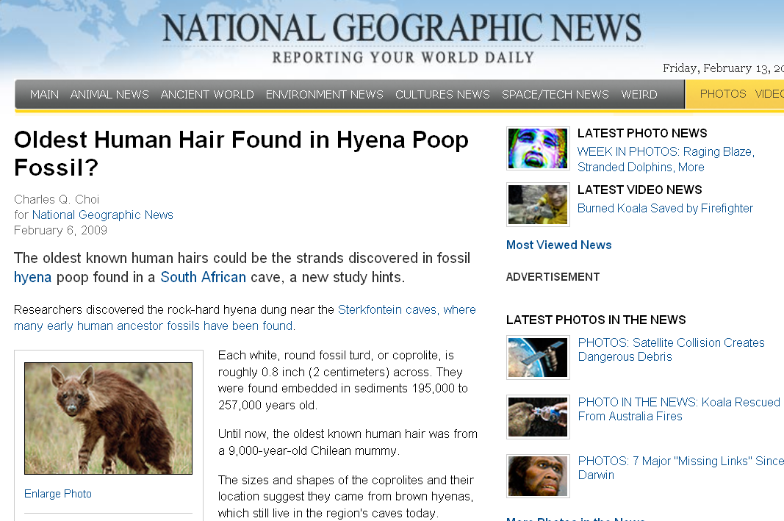
http://news.nationalgeographic.com/news/2009/02/090206-oldest-hair-hyenas.html
Notes:
176

Slide 177
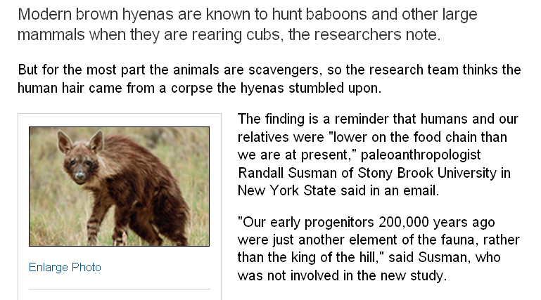
“tropic level”
http://news.nationalgeographic.com/news/2009/02/090206-oldest-hair-hyenas.html
Notes:
177

Slide 178
moral of the adaptation story:
“. . . aspects of an animal’s dietary and locomotory behavior cannot necessarily be reconstructed from features of its teeth and skeletal anatomy.”
“Looking at the ‘hardware’ alone may not give us much insight into the variety of diets for many existing and extinct primates.”
The Cultural Feast, 2nd ed., p. 26-27

Slide 179
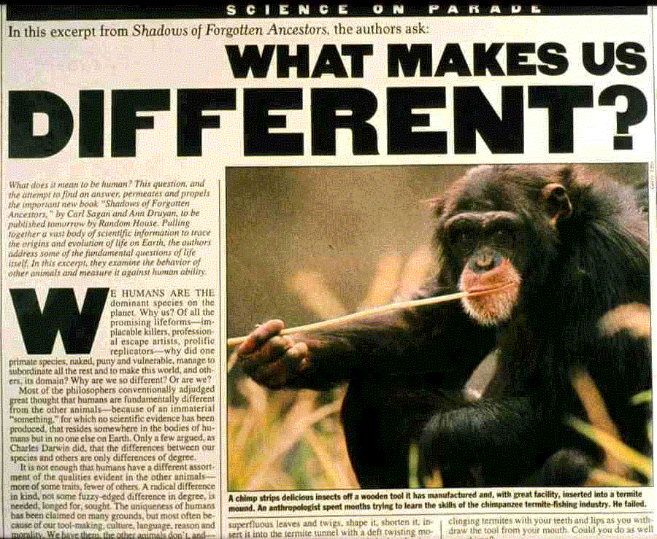

Slide 180
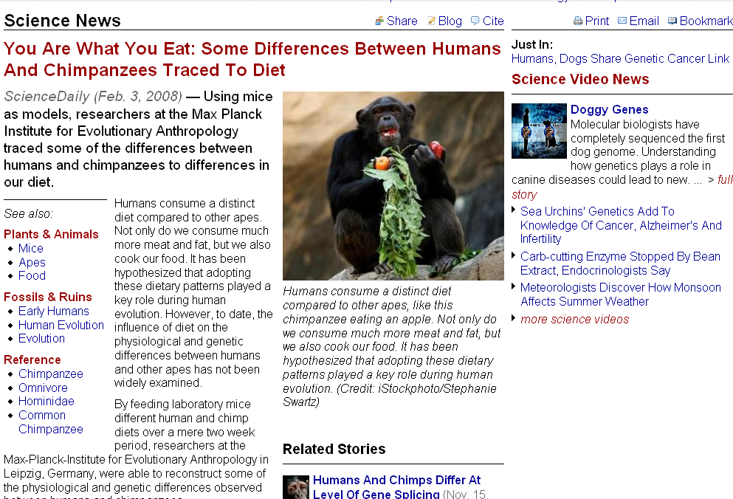
differences are traced to diet
www.sciencedaily.com/releases/2008/01/080130092139.htm
Notes:
180

Slide 181
Diet and Human Evolution
Exploring the Diets of Extinct Humans Through Paleontology
Teeth
Skulls and Jaws
The Postcranial Skeleton
What Is Adaptation?
Using Chemistry to Infer the Diets of Extinct Hominini
Our Place in Nature
A Brief Who's Who of the Early Hominini
What Did Early Hominini Eat?
What Can We Say About the Diets of Fossil Homo?
Summary
Highlight: Lactose Intolerance

Slide 182
Diet and Human Evolution
Exploring the Diets of Extinct Humans Through Paleontology
Teeth
Skulls and Jaws
The Postcranial Skeleton
What Is Adaptation?
Using Chemistry to Infer the Diets of Extinct Hominini
Our Place in Nature
A Brief Who's Who of the Early Hominini
What Did Early Hominini Eat?
What Can We Say About the Diets of Fossil Homo?
Summary
Highlight: Lactose Intolerance
Using Chemistry to Infer the Diets of Extinct Hominini

Slide 183
. . . in the last 20 years techniques for analyzing the chemistry of prehistoric bone and on other remains have become very reliable
carbon stable isotope analysis
nitrogen stable isotope analysis
isotopes are chemical elements that have the same atomic number but different atomic weights
The Cultural Feast, 2nd ed., p. 27

Slide 184
. . . in the last 20 years techniques for analyzing the chemistry of prehistoric bone and on other remains have become very reliable
on teeth (stable after eruption)
on bone (constantly rebuilding itself)
on stone tools and ceramics . . .
The Cultural Feast, 2nd ed., p. 27

Slide 185
. . . in the last 20 years techniques for analyzing the chemistry of prehistoric bone and on other remains have become very reliable
on teeth (stable after eruption)
on bone (constantly rebuilding itself)
on stone tools and ceramics . . .
The Cultural Feast, 2nd ed., p. 27

Slide 187
. . . microscopic and chemical analysis of residues and tissues preserved on the edges of stone tools have been brought to bear on identifying the animals on whom the tools were used . . .
The Cultural Feast, 2nd ed., p. 28

Slide 188
. . . and microscopic and chemical analysis has been used for
residue analysis on ceramics
to tell what foods were used . . .
The Cultural Feast, 2nd ed., p. 28

Slide 189
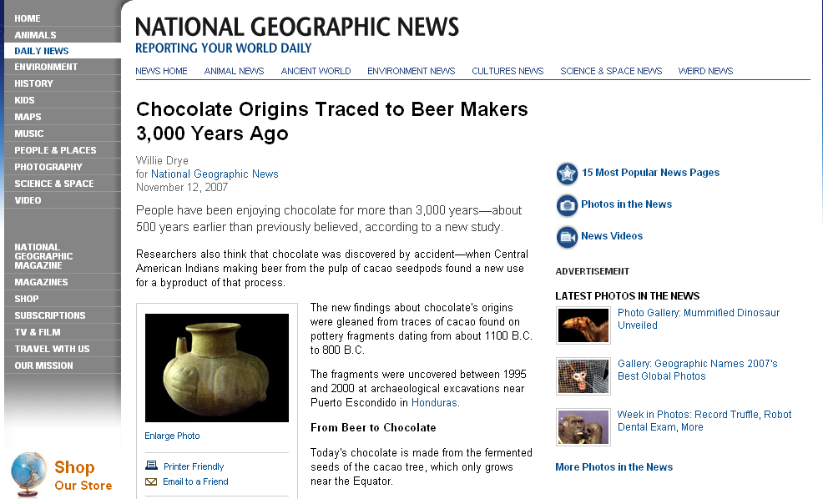
http://news.nationalgeographic.com/news/2007/11/071112-chocolate.html
Notes:
189

Slide 190
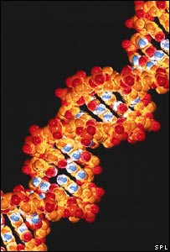
. . . and DNA studies are critical . . .
http://news.bbc.co.uk/2/hi/science/nature/7132794.stm

Slide 192
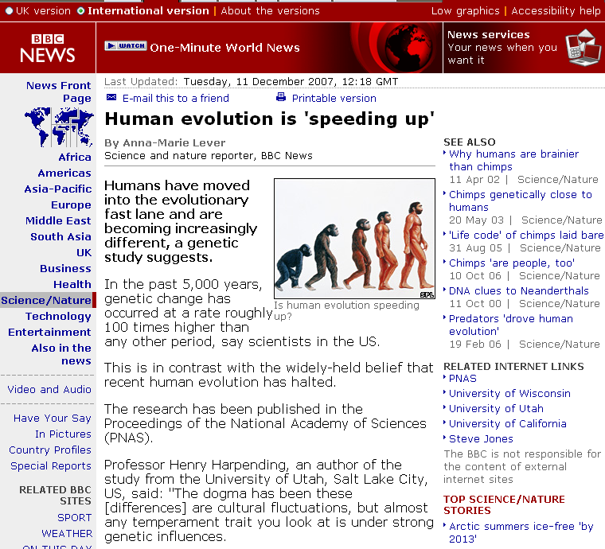
http://news.bbc.co.uk/2/hi/science/nature/7132794.stm

Slide 193
seven percent of human genes are undergoing rapid evolution
http://news.bbc.co.uk/2/hi/science/nature/7132794.stm

Slide 194
“The study looked specifically at genetic variations called
"single nucleotide polymorphisms,"
or SNPs.
These are single-point mutations,
or changes, in the genetic sequence of DNA on chromosomes.”
Seven percent of human genes are undergoing rapid evolution
http://news.bbc.co.uk/2/hi/science/nature/7132794.stm

Slide 195
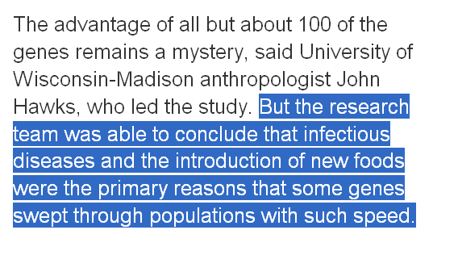
Seven percent of human genes are undergoing rapid evolution
http://www.latimes.com/news/nationworld/nation/la-sci-evolution11dec11,1,2206745.story?coll=la-headlines-nation&ctrack=2&cset=true

Slide 196
Seven percent of human genes are undergoing rapid evolution
http://www.latimes.com/news/nationworld/nation/la-sci-evolution11dec11,1,2206745.story?coll=la-headlines-nation&ctrack=2&cset=true

Slide 197
Seven percent of human genes are undergoing rapid evolution
http://www.latimes.com/news/nationworld/nation/la-sci-evolution11dec11,1,2206745.story?coll=la-headlines-nation&ctrack=2&cset=true

Slide 199
^{Some Important Terms}

Slide 200
tropic level
an animal
or a plant’s position
in the food chain
The Cultural Feast, 2nd ed., p. 28

Slide 201
photosynthesis
the chemical process green plants use to convert carbon dioxide and water, in the presence of sunlight, into organic compounds
The Cultural Feast, 2nd ed., p. 27

Slide 202
collagen
the predominant protein
in bones
and tooth pulps
The Cultural Feast, 2nd ed., p. 27

Slide 204
and looking at all of these sorts of things allows us to have a better understanding of prehistoric food use and its implications . . .

Slide 205
back to meeting more of the prehistoric bipeds
. . .

Slide 206
Diet and Human Evolution
Exploring the Diets of Extinct Humans Through Paleontology
Teeth
Skulls and Jaws
The Postcranial Skeleton
What Is Adaptation?
Using Chemistry to Infer the Diets of Extinct Hominini
Our Place in Nature
A Brief Who's Who of the Early Hominini
What Did Early Hominini Eat?
What Can We Say About the Diets of Fossil Homo?
Summary
Highlight: Lactose Intolerance

Slide 207
Diet and Human Evolution
Exploring the Diets of Extinct Humans Through Paleontology
Teeth
Skulls and Jaws
The Postcranial Skeleton
What Is Adaptation?
Using Chemistry to Infer the Diets of Extinct Hominini
Our Place in Nature
A Brief Who's Who of the Early Hominini
What Did Early Hominini Eat?
What Can We Say About the Diets of Fossil Homo?
Summary
Highlight: Lactose Intolerance
Our Place in Nature

Slide 208
bottom lines:
our family “tree”
is more like a bush
2. there is not a single unbroken line from early hominini to contemporary humans
The Cultural Feast, 2nd ed., p. 29

Slide 209
Possible evolutionary relationships of
Middle and Upper Pleistocene hominini.
Understanding Physical Anthropology and Archaeology, 9th ed., p. 271

Slide 210
Diet and Human Evolution
Exploring the Diets of Extinct Humans Through Paleontology
Teeth
Skulls and Jaws
The Postcranial Skeleton
What Is Adaptation?
Using Chemistry to Infer the Diets of Extinct Hominini
Our Place in Nature
A Brief Who's Who of the Early Hominini
What Did Early Hominini Eat?
What Can We Say About the Diets of Fossil Homo?
Summary
Highlight: Lactose Intolerance

Slide 211
Diet and Human Evolution
Exploring the Diets of Extinct Humans Through Paleontology
Teeth
Skulls and Jaws
The Postcranial Skeleton
What Is Adaptation?
Using Chemistry to Infer the Diets of Extinct Hominini
Our Place in Nature
A Brief Who's Who of the Early Hominini
What Did Early Hominini Eat?
What Can We Say About the Diets of Fossil Homo?
Summary
Highlight: Lactose Intolerance
A Brief Who's Who of the Early Hominini

Slide 212
“At least 18 hominid species are currently named in the literature.”
The Cultural Feast, 2nd ed., p. 29

Slide 213
“Who knows how many different genera and species of hominid really existed in the past?”
The Cultural Feast, 2nd ed., p. 30

Slide 214
Taxonomy
among the taxonomists there tends to be two camps . . .
“splitters”
and
“lumpers”

Slide 215
Taxonomy
among the taxonomists there tends to be two camps . . .
“lumpers”
tend to lump species into a few large groups . . .

Slide 216
“lumpers”
Campbell – Loy, Humankind Emerging, 7th ed., p. 236

Slide 217
Taxonomy
among the taxonomists there tends to be two camps . . .
“splitters”
tend to split species into many groups . . .

Slide 218
“splitters”
Campbell – Loy, Humankind Emerging, 7th ed., p. 236

Slide 219
introduce
all types

Slide 220
here is one common lumper-type classification . . .
The Cultural Feast, 2nd ed., p. 29

Slide 221
One Common Lumper-type Classification
Genus
species
Approximate Dates
Homo sapiens
erectus
rudolfensis
habilis
Paranthropus aethiopicus
boisei
robustus
Australopithecus africanus
afarensis
3 genera 9 species
0.5 mya - present
1.8 mya–25,000 ybp
2.4-1.9 mya
2.1-1.5 mya
2.7-2.5 mya
2.6-1.1 mya
2.0-1.2 mya
3.2-2 mya
3.9-2.9 mya
Campbell – Loy, Humankind Emerging, 7th ed., p. 236

Slide 222
One Common Lumper-type Classification
Homo sapiens
erectus
rudolfensis
habilis
Paranthropus aethiopicus
boisei
robustus
Australopithecus africanus
afarensis
3 genera 9 species
3.9-2.9 mya
Campbell – Loy, Humankind Emerging, 7th ed., p. 236

Slide 223
A Walk Through Hominid Evolution
Australopithicus
Time 23 July 2001

Slide 224
A Walk Through Hominid Evolution
Time 23 July 2001

Slide 225
^{Lucy}
^{and}
^{“The First Family”}
Understanding Physical Anthropology and Archaeology, 9th ed., p. 206

Slide 226
^{Lucy}
^{and}
^{“The First Family”}
Understanding Physical Anthropology and Archaeology, 9th ed., p. 206

Slide 227
“Lucy" and "The First Family"
from: Hadar, Ethiopia (“Site 333” on the Awash River)
aka: Australopithecus afarensis
age: 3.9 – 2.9 mya
discovered: 1975-1976

Slide 228
One Common Lumper-type Classification
Homo sapiens
erectus
rudolfensis
habilis
Paranthropus aethiopicus
boisei
robustus
Australopithecus africanus
afarensis
3 genera 9 species
3.2-2 mya
Campbell – Loy, Humankind Emerging, 7th ed., p. 236

Slide 229
and
“The Taung child”

Slide 230
http://news.nationalgeographic.com/news/2009/02/090202-nutcracker-jaws.html?source=rss

Slide 231
Australopithecus Hunting and Foraging

Slide 232
definite tool users

Slide 233
definite tool users

Slide 235
Life Nature Library, Early Man, p. 115.

Slide 237
Life Nature Library, Early Man, p. 114.

Slide 238
Life Nature Library, Early Man, p. 183.

Slide 250
manuport
a “natural” object carried from one place to another, such as a stone used in hunting or for grinding

Slide 251
. . . but REM always . . .
the hunter is also the hunted . . .
C. K. Brain . . .

Slide 253
REM:
tropic level
an animal
or a plant’s position
in the food chain
The Cultural Feast, 2nd ed., p. 28

Slide 254
back to meeting more of the prehistoric bipeds
. . .

Slide 255
One Common Lumper-type Classification
Homo sapiens
erectus
rudolfensis
habilis
Paranthropus aethiopicus
boisei
robustus
Australopithecus africanus
afarensis
3 genera 9 species
2.7-1.1 mya
Campbell – Loy, Humankind Emerging, 7th ed., p. 236

Slide 256
A Walk Through Hominid Evolution
Paranthropus
Time 23 July 2001

Slide 257
A Walk Through Hominid Evolution
Time 23 July 2001

Slide 258
“The Black Skull”
KNM-WT 17000
Australopithecus
aethiopicus
Lake Turkana,
East Africa
2.5 mya
1986
Turnbaugh, Jurmain, Kilgore, and Nelson, 8th ed., p. 237

Slide 259
www.archaeologyinfo.com/australopithecusaethiopicus.htm

Slide 260
“saggital crest”
“disharmonic face”

Slide 261
diet classifications
herbivorous (principally plants)
insectivorous (principally insects)
frugivorous (principally fruits)
graminivorous (principally grasses)
folivorous (principally leaf eating)
proteinivorous (principally protein eating)
carnivorous (chiefly meats)
omnivorous (“devours” “all”)
locavore (principally locally available foods)
there are lots of
diet classifications

Slide 262
diet classifications
herbivorous (principally plants)
insectivorous (principally insects)
frugivorous (principally fruits)
graminivorous (principally grasses)
folivorous (principally leaf eating)
proteinivorous (principally protein eating)
carnivorous (chiefly meats)
omnivorous (“devours” “all”)
locavore (principally locally available foods)
and Paranthropus
is mainly frugivorous

Slide 263
diet classifications
herbivorous (principally plants)
insectivorous (principally insects)
frugivorous (principally fruits)
graminivorous (principally grasses)
folivorous (principally leaf eating)
proteinivorous (principally protein eating)
carnivorous (chiefly meats)
omnivorous (“devours” “all”)
locavore (principally locally available foods)
and and folivorous

Slide 264
diet classifications
herbivorous (principally plants)
insectivorous (principally insects)
frugivorous (principally fruits)
graminivorous (principally grasses)
folivorous (principally leaf eating)
proteinivorous (principally protein eating)
carnivorous (chiefly meats)
omnivorous (“devours” “all”)
locavore (principally locally available foods)
other diet classifications include

Slide 265
diet classifications
herbivorous (principally plants)
insectivorous (principally insects)
frugivorous (principally fruits)
graminivorous (principally grasses)
folivorous (principally leaf eating)
proteinivorous (principally protein eating)
carnivorous (chiefly meats)
omnivorous (“devours” “all”)
locavore (principally locally available foods)

Slide 266
diet classifications
herbivorous (principally plants)
insectivorous (principally insects)
frugivorous (principally fruits)
graminivorous (principally grasses)
folivorous (principally leaf eating)
proteinivorous (principally protein eating)
carnivorous (chiefly meats)
omnivorous (“devours” “all”)
locavore (principally locally available foods)
but they are probably also eating insects and some small animals
. . . like Jane Goodall’s
chimps did

Slide 267
?
did they eat “ground meats” ?

Slide 270
most probably they are tool users

Slide 272
Australopithecine
Diet

Slide 273
Diet and Human Evolution
Exploring the Diets of Extinct Humans Through Paleontology
Teeth
Skulls and Jaws
The Postcranial Skeleton
What Is Adaptation?
Using Chemistry to Infer the Diets of Extinct Hominini
Our Place in Nature
A Brief Who's Who of the Early Hominini
What Did Early Hominini Eat?
What Can We Say About the Diets of Fossil Homo?
Summary
Highlight: Lactose Intolerance

Slide 274
Diet and Human Evolution
Exploring the Diets of Extinct Humans Through Paleontology
Teeth
Skulls and Jaws
The Postcranial Skeleton
What Is Adaptation?
Using Chemistry to Infer the Diets of Extinct Hominini
Our Place in Nature
A Brief Who's Who of the Early Hominini
What Did Early Hominini Eat?
What Can We Say About the Diets of Fossil Homo?
Summary
Highlight: Lactose Intolerance
What Did Early Hominini Eat?

Slide 275
early hominini lived in a
range of habitats,
including lake and river margins, woodland, bushland, and savanna
“Consequently, it is impossible to conceive of a specific
‘ancestral hominid diet. . . .’”
The Cultural Feast, 2nd ed., p. 33

Slide 276
Traditionally there have been two basic ideas about early hominid diets:
the robust australopiths were the most herbivorous
compared even to the gracile australopiths, the emergence of Homo was marked by a shift to a greater consumption of protein
The Cultural Feast, 2nd ed., p. 33

Slide 277
Swartkrans homo
findings do not
suggest a specialized plant diet
… that is, there is
no significant difference from that of the Paranthropus robustus
Paranthropus robustus
The Cultural Feast, 2nd ed., p. 33

Slide 278
Australopithecus afarensis
the relatively larger surface area of their molar teeth would have favored crushing foods
their relatively smaller incisors would have prevented them from eating foods (such as husked fruits) that require incisal preparation
their thicker mandibular bodies (corpora) would have withstood high occlusal loads
their thick molar enamel would have resisted cracking and abrasion
teeth show …
The Cultural Feast, 2nd ed., p. 33

Slide 279
Australopithecus afarensis
the relatively larger surface area of their molar teeth would have favored crushing foods
their relatively smaller incisors would have prevented them from eating foods (such as husked fruits) that require incisal preparation
their thicker mandibular bodies (corpora) would have withstood high occlusal loads
their thick molar enamel would have resisted cracking and abrasion
The Cultural Feast, 2nd ed., p. 33

Slide 280
Australopithecus afarensis
conclusion:
they would have had difficult dealing with tough foods
(such as tough fruits, leaves, and meat),
but would have been able to deal with abrasive as well as nonabrasive,
hard as well as brittle, and soft foods
(4.2-2.5 mya)
The Cultural Feast, 2nd ed., p. 33

Slide 281
All together
the very early hominini likely ate grasses and sedges directly, or insects, or both
(tools older than 2.5 mya are not yet known)
The Cultural Feast, 2nd ed., p. 33

Slide 282
it would seem also that Paranthropus, Australopithecus, and Homo
all ate tubers and termites
The Cultural Feast, 2nd ed., p. 34

Slide 283
Australopithecus garhi
apparently made stone tools
(2.4-2.5 mya)
and butchered large-mammals
(the earliest evidence of stone-tool production
and the oldest indication of hominid modification of animal bones)
The Cultural Feast, 2nd ed., p. 34

Slide 284
K. Milton
(1999)
“. . . even though early humans may have had the
gut anatomy and digestive kinetics
(motions or activities)
of herbivores,
they would have
supplemented their diets with
meat-derived proteins
The Cultural Feast, 2nd ed., p. 34

Slide 285
K. Milton
(1999)
suggests such a
dietary shift
with the emergence of early Homo
. . . but the tendency in the direction to supplement the diet with meat-derived proteins may have been common earlier
The Cultural Feast, 2nd ed., p. 34

Slide 286
Aiello and Wheeler
(1995)
argue that
increased consumption of animal products was essential to the evolution of the large hominid brain
. . . but some sources of protein were clearly part of some, if not all, early hominid dietary regimes millions of years before brain size increased significantly
The Cultural Feast, 2nd ed., p. 35

Slide 287
Homo habilis

Slide 288
One Common Lumper-type Classification
Homo sapiens
erectus
rudolfensis
habilis
Paranthropus aethiopicus
boisei
robustus
Australopithecus africanus
afarensis
3 genera 9 species
2.1-1.5 mya
Campbell – Loy, Humankind Emerging, 7th ed., p. 236

Slide 289
One Common Lumper-type Classification
Homo sapiens
erectus
rudolfensis
habilis
Paranthropus aethiopicus
boisei
robustus
Australopithecus africanus
afarensis
3 genera 9 species
2.1-1.5 mya
Campbell – Loy, Humankind Emerging, 7th ed., p. 236

Slide 290
One Common Homo Classification
Homo sapiens
moderns (Cro-magnon . . .)
pre-moderns (Neandertal . . .)
Homo erectus
Homo rudolfensis
Homo habilis
Campbell – Loy, Humankind Emerging, 7th ed., p. 236

Slide 291
A Walk Through Hominid Evolution
the first humans
Homo habilis
Time 23 July 2001

Slide 292
A Walk Through Hominid Evolution
Time 23 July 2001

Slide 293
Homo habilis
first human
2.4 mya ?

Slide 296
2.5 mya

Slide 297
stone tool makers
Homo habilis
2.5 mya

Slide 298
stone tool making
food revolution #1 ?
2.5 mya

Slide 299
"Oldowan" chopper
aka “pebble tool
Wikipedia

Slide 300
"Oldowan" chopper
aka “pebble tool
Wikipedia

Slide 301
"Oldowan" chopper
Wikimedia

Slide 302
Homo habilis

Slide 303
Olduvai butchering site
dark stones are tools

Slide 305
using stones to crack nuts

Slide 306
Olduvai circular camp ?

Slide 307
reconstructed hut

Slide 308
One Common Homo Classification
Homo sapiens
moderns (Cro-magnon . . .)
pre-moderns (Neandertal . . .)
Homo erectus
Homo rudolfensis
Homo habilis
1.8 mya–25,000 ybp
Campbell – Loy, Humankind Emerging, 7th ed., p. 236

Slide 309
A Walk Through Hominid Evolution
Homo erectus
Time 23 July 2001

Slide 310
A Walk Through Hominid Evolution
Time 23 July 2001

Slide 313
Homo erectus was probably able to make and control fire . . .

Slide 314
and because of that they cooked and ate different things . . .

Slide 315
http://msnbc.msn.com/id/4863378/

Slide 316
http://dsc.discovery.com/news/briefs/20051114/homocrunch_arc.html

Slide 317
2006
http://seedmagazine.com/news/2006/11/a_varied_menu_for_homos_cousin.php

Slide 318
Homo erectus

Slide 319
Homo erectus
Diet

Slide 320
Diet and Human Evolution
Exploring the Diets of Extinct Humans Through Paleontology
Teeth
Skulls and Jaws
The Postcranial Skeleton
What Is Adaptation?
Using Chemistry to Infer the Diets of Extinct Hominini
Our Place in Nature
A Brief Who's Who of the Early Hominini
What Did Homo Erectus Eat?
What Can We Say About the Diets of Fossil Homo?
Summary
Highlight: Lactose Intolerance

Slide 321
Diet and Human Evolution
Exploring the Diets of Extinct Humans Through Paleontology
Teeth
Skulls and Jaws
The Postcranial Skeleton
What Is Adaptation?
Using Chemistry to Infer the Diets of Extinct Hominini
Our Place in Nature
A Brief Who's Who of the Early Hominini
What Did Early Hominini Eat?
What Can We Say About the Diets of Fossil Homo?
Summary
Highlight: Lactose Intolerance
What Did Homo Erectus Eat?

Slide 322
Homo erecti
are hand axe people

Slide 323
One Common Homo Classification
Homo sapiens
moderns (Cro-magnon . . .)
pre-moderns (Neandertal . . .)
Homo erectus
Homo rudolfensis
Homo habilis
1.8 mya–25,000 ybp
Campbell – Loy, Humankind Emerging, 7th ed., p. 236

Slide 324
A Walk Through Hominid Evolution
Homo erectus
Time 23 July 2001

Slide 325
Diet and Human Evolution
Exploring the Diets of Extinct Humans Through Paleontology
Teeth
Skulls and Jaws
The Postcranial Skeleton
What Is Adaptation?
Using Chemistry to Infer the Diets of Extinct Hominini
Our Place in Nature
A Brief Who's Who of the Early Hominini
What Did Early Hominini Eat?
What Can We Say About the Diets of Fossil Homo?
Summary
Highlight: Lactose Intolerance

Slide 326
Diet and Human Evolution
Exploring the Diets of Extinct Humans Through Paleontology
Teeth
Skulls and Jaws
The Postcranial Skeleton
What Is Adaptation?
Using Chemistry to Infer the Diets of Extinct Hominini
Our Place in Nature
A Brief Who's Who of the Early Hominini
What Did Early Hominini Eat?
What Can We Say About the Diets of Fossil Homo?
Summary
Highlight: Lactose Intolerance
What Can We Say About the Diets of Fossil Homo?

Slide 327
Homo erectus

Slide 328
Hunting / Gathering
meat eating becomes increasingly more important from 1.8 mya onwards
(with the beginning of the pleistocene,
and the advent of Homo erectus)

Slide 329
www.d.umn.edu/cla/faculty/troufs/anth1602/pctimes.html#title
Notes:
329

Slide 330
Hunting / Gathering
complex interrelated and interacting changes occurred
biological
cultural / social

Slide 331
first evidence of
sustained meat eating . . .
was this part of the second great food revolution ?
ca. 1.8 mya

Slide 332
first evidence of
sustained meat eating . . .
was this part of the second great food revolution ?
ca. 1.8 mya

Slide 333
this is an excellent source for a discussion on food “revolutions” . . .
Simon & Schuster 2003

Slide 334
Eight Food “Revolutions”
Invention of Cooking
Discovery that Food is More Than Sustenance
The “Herding Revolution”
Snail Farming
Use of Food as a Means and Index of Social Differentiation
Long-Range Exchange of Culture
Ecological Revolution of last 500 years
Industrial Revolution of the 19th and 20th Centuries
Simon & Schuster 2003

Slide 335
Hunting / Gathering
hominid hunting
probably followed the hunting of lions
or wild dogs in the African savannah

Slide 336
Hunting / Gathering
lions, heyenas, and wild dogs
hunt in groups
share their food
hunt cooperatively

Slide 337
Hunting / Gathering
hunting affects social relationships

Slide 338
www.d.umn.edu/cla/faculty/troufs/anth1602/pchunt.html#title
Notes:
338

Slide 339
www.d.umn.edu/cla/faculty/troufs/anth1602/pchunt.html#title
Notes:
339

Slide 340
Homo erecti
are hand axe people

Slide 341
hand axes also changed the way they ate . . .

Slide 342
^{Acheulian biface (“hand axe”).}
Richard Effland, Maricopa College

Slide 343
^{KNM-WT15000}
^{from Nariokotome, Kenya:}
^{the most complete Homo erectus}
^{specimen yet found}
Understanding Physical Anthropology and Archaeology, 9th ed., p. 235

Slide 345
^{mandible fragment}

Slide 346
Alan Walker and colleagues suggest individual had too much
Vitamin A
(hypervitaminosis A) . . .
The Cultural Feast, 2nd ed., p. 35

Slide 347
consumption of honeybee broods qualify as carnivory
The Cultural Feast, 2nd ed., p. 35

Slide 348
“This suggests that meat eating was most likely part of the dietary repertoire of early hominini, including early species of Homo”
The Cultural Feast, 2nd ed., p. 35

Slide 349
^{Homo sapiens}
^{Homo erectus}
^{Homo}
^{habilis}
^{Australopithecus}

Slide 350
Torralba
Terra Amata

Slide 351
Major Sites: Europe
Homo erectus hunting in
the Ambrona Valley
Ambrona and Torralba, Spain
400,000 - 200,000 ? ybp
Acheulian tool tradition

Slide 352
Homo erectus migrations.
The Emergence of Man: The First Men (Little Brown, 1973), p. 111

Slide 353
Time-Life, Early Man, p. 92

Slide 354
Major Sites: Homo erectus in Europe
Ambrona and Torralba

Slide 355
Major Sites: Homo erectus in Europe
Ambrona and Torralba
both kill sites were littered with crude hand axes, cleavers, scrapers, and cutting tools
the elephant bones at both sites were buried in clays that were once treacherous marsh

Slide 356
Major Sites: Homo erectus in Europe
Ambrona and Torralba
were on important game trails between summer and winter grazing areas

Slide 357
People of the Earth, 10th ed., p. 97

Slide 358
Major Sites: Homo erectus in Europe
Ambrona and Torralba
the hunters preyed on migrating elephants each spring and fall, dispersing into smaller groups during the other seasons
others believe that the hunters were actually scavenging from animals naturally stuck in the mud

Slide 359
Major Sites: Homo erectus in Europe
Ambrona and Torralba
hunted elephants
but did not exploited small game, birds, fish, or sea mammals on any significant scale

Slide 360
Major Sites: Homo erectus in Europe
Torralba
yielded most of the left side of a large elephant that had been cut into small pieces

Slide 361
Major Sites: Homo erectus in Europe
Ambrona
yielded most of the remains of
30 - 35 dismembered elephants
concentration of broken food bones found all over the site
elephants had been broken open to expose the brains

Slide 362
Ambrona, Spain
Source: The Emergence of Man: The First Men (Little Brown, 1973), p. 93.

Slide 363
Homo erectus (Torralba-Ambrona, Spain)
Time-Life, Early Man, p. 87

Slide 364
Ambrona, Spain
The Emergence of Man: The First Men (Little Brown, 1973), p. 87

Slide 365
Living-floor Map, Torralba, Spain
The Emergence of Humankind, 4th ed., p. 110.

Slide 366
Homo erectus (Torralba-Ambrona, Spain)
Time-Life, Early Man, p. 94.

Slide 367
Homo erectus (Torralba-Ambrona, Spain)
Time-Life, Early Man, p. 96

Slide 368
Homo erectus (Torralba-Ambrona, Spain)
Time-Life, Early Man, p. 96

Slide 370
Homo erectus (Torralba-Ambrona, Spain)
Time-Life, Early Man, p. 93

Slide 371
Homo erectus (Torralba-Ambrona, Spain)
Time-Life, Early Man, p. 99

Slide 372
Homo erectus (Torralba-Ambrona, Spain)
Time-Life, Early Man, p. 98

Slide 373
!Kung san, Africa

Slide 374
Major Sites: Homo erectus in Europe
Terra Amata
Nice, France
400,000 - 300,000 ybp
most complete reconstruction of Middle Pleistocene life in Europe

Slide 375
Terra Amata, France
The Emergence of Man: The First Men (Little Brown, 1973), p. 119.

Slide 376
Terra Amata, France
Henry de Lumley, Prehistoric Times (W.H. Freeman, 1983), p. 86.

Slide 377
Living at Terra Amata, France
Henry de Lumley, Prehistoric Times (W.H. Freeman, 1983), p. 80

Slide 378
Fire Pit,Terra Amata, France
Henry de Lumley, Prehistoric Times (W.H. Freeman, 1983), p. 83

Slide 379
Terra Amata, France
Henry de Lumley, Prehistoric Times (W.H. Freeman, 1983), p. 83

Slide 380
Terra Amata, France
Henry de Lumley, Prehistoric Times (W.H. Freeman, 1983), p. 83

Slide 381
!Kung san, Africa

Slide 382
Major Sites: Homo erectus in Europe
Terra Amata
Henry de Lumley suggests several huts
6 - 15 meters by 4 - 6 meters
estimates that each hut could hold up to 15 people
a hearth in the center of each hut suggests control and use of fire

Slide 383
Major Sites: Homo erectus in Europe
Terra Amata
occupants = ?
no fossil remains allow their identification
Homo erectus?
archaic Homo sapiens?
Homo heidelbergensis?

Slide 385
Points and scrapers,Terra Amata, France
Henry de Lumley, Prehistoric Times (W.H. Freeman, 1983), p. 85

Slide 386
Choppers and picks,Terra Amata, France
Henry de Lumley, Prehistoric Times (W.H. Freeman, 1983), p. 83

Slide 387
Making a blade tool,Terra Amata, France
Henry de Lumley, Prehistoric Times (W.H. Freeman, 1983), p. 87

Slide 388
Peking

Slide 389
Major Sites: Homo erectus in Asia
Zhoukoudian, China

Slide 390
“Peking Man”
aka Homo erectus pekinensis
aka Sinanthropus

Slide 391
A Walk Through Hominid Evolution
Homo erectus
Time 23 July 2001

Slide 392
Zhoukoudian Homo erectus
The Emergence of Humankind 4th Ed., p. 105

Slide 393
Zhoukoudian people were geographically isolated
and
this shows up in food-related features associated with heavy chewing . . .

Slide 394
Zhoukoudian people were geographically isolated
and
this shows up in food-related features associated with heavy chewing . . .

Slide 395
Mongoloid shovel-shaped incisors
taurodontism
molars and premolars with enlarged pulp cavities extending downward into fused roots
mandibular torus
heavy bony ridge on inside of lower jaw from canine to first molar on each side
extra foraminia mentalia
2 - 5 openings in lower jawbone through which pass the nerves and blood vessels

Slide 396
Shovel-shaped incisors, shown here
in a modern Homo sapiens sapiens
Understanding Physical Anthropology and Archaeology, 8th ed., p. 263
Shovel-shaped incisors, shown here in a modern Homo sapiens sapiens
Understanding Physical Anthropology and Archaeology, 8th ed., p. 263

Slide 397
Mongoloid shovel-shaped incisors
taurodontism
molars and premolars with enlarged pulp cavities extending downward into fused roots
mandibular torus
heavy bony ridge on inside of lower jaw from canine to first molar on each side
extra foraminia mentalia
2 - 5 openings in lower jawbone through which pass the nerves and blood vessels

Slide 399
Mongoloid shovel-shaped incisors
taurodontism
molars and premolars with enlarged pulp cavities extending downward into fused roots
mandibular torus
heavy bony ridge on inside of lower jaw from canine to first molar on each side
extra foraminia mentalia
2 - 5 openings in lower jawbone through which pass the nerves and blood vessels

Slide 401
Mongoloid shovel-shaped incisors
taurodontism
molars and premolars with enlarged pulp cavities extending downward into fused roots
mandibular torus
heavy bony ridge on inside of lower jaw from canine to first molar on each side
extra foraminia mentalia
2 - 5 openings in lower jawbone through which pass the nerves and blood vessels

Slide 402
Zhoukoudian Homo erectus
Homo erectus
sometimes has 3
on each side
^{foraminia mentalia}

Slide 403
Homo sapiens sapiens
has 1 on each side

Slide 404
Major Sites: Asia
Zhoukoudian, China
had larger cranial capacity
830 - 1300 cc
avg. = 1075
had fire
lived in caves
had better tools
seemed inclined to eat their neighbor

Slide 405
Major Sites: Asia
Zhoukoudian, China
had larger cranial capacity
830 - 1300 cc
avg. = 1075
had fire
lived in caves
had better tools
seemed inclined to eat their neighbor

Slide 406
Zhoukoudian cave of Homo erectus
http://cssa.mit.edu/worldheritage/img/zkd/big/zkd-08b.jpg

Slide 407
Major Sites: Asia
Zhoukoudian, China
had larger cranial capacity
830 - 1300 cc
avg. = 1075
had fire
lived in caves
had better tools
seemed inclined to eat their neighbor

Slide 408
Major Sites: Asia
Zhoukoudian, China
had larger cranial capacity
830 - 1300 cc
avg. = 1075
had fire
lived in caves
had better tools
seemed inclined to eat their neighbor
fire improves the efficiency of hunting . . . and of digesting food . . .

Slide 409
Zhoukoudian Homo erectus

Slide 410
Zhoukoudian Homo erectus
The First Men (Little Brown, 1973), p. 26

Slide 411
Major Sites: Asia
Zhoukoudian, China
and fire improves the efficiency of digestibility of meat
had larger cranial capacity
830 - 1300 cc
avg. = 1075
had fire
lived in caves
had better tools
seemed inclined to eat their neighbor
fire improves the efficiency of hunting

Slide 412
Zhoukoudian Homo erectus
www.gridclub.com/fact_gadget/1001/human_world/prehistoric_people/639.html

Slide 413
Zhoukoudian Homo erectus
The First Men (Little Brown, 1973), p. 26

Slide 414
Zhoukoudian Homo erectus
The First Men (Little Brown, 1973), p. 26

Slide 415
Major Sites: Asia
Zhoukoudian, China
had larger cranial capacity
830 - 1300 cc
avg. = 1075
had fire
lived in caves
had better tools
seemed inclined to eat their neighbor

Slide 416
Major Sites: Asia
Zhoukoudian, China
had larger cranial capacity
830 - 1300 cc
avg. = 1075
had fire
lived in caves
had better tools
seemed inclined to eat their neighbor
better tools improves the efficiency of food procurement

Slide 417
Zhoukoudian Homo erectus
Quartzite chopper Flint point Flint Awl Graver or Burin
Chinese Tools from Middle Pleistocene sites
Understanding Physical Anthropology and Archaeology, 8th ed., p. 268

Slide 418
Zhoukoudian Homo erectus

Slide 419
Zhoukoudian Homo erectus
http://cssa.mit.edu/worldheritage/img/zkd/big/zkd-08b.jpg

Slide 420
Zhoukoudian Homo erectus
http://cssa.mit.edu/worldheritage/img/zkd/big/zkd-08b.jpg

Slide 421
Homo erectus

Slide 422
Movius Line
the Movius Line separates
the flake chopping tool traditions from the
core chopping tools . . .
Campbell and Loy, Humankind Emerging, 7th ed, p. 334

Slide 423
Major Sites: Asia
Zhoukoudian, China
had larger cranial capacity
830 - 1300 cc
avg. = 1075
had fire
lived in caves
had better tools
seemed inclined to eat their neighbor

Slide 424
Major Sites: Asia
Zhoukoudian, China
had larger cranial capacity
830 - 1300 cc
avg. = 1075
had fire
lived in caves
had better tools
seemed inclined to eat their neighbor
they appear to have practiced cannibalism

Slide 425
this is an excellent source for a discussion on food “revolutions” . . .
Simon & Schuster 2003

Slide 426
Eight Food “Revolutions”
Invention of Cooking
Discovery that Food is More Than Sustenance
The “Herding Revolution”
Snail Farming
Use of Food as a Means and Index of Social Differentiation
Long-Range Exchange of Culture
Ecological Revolution of last 500 years
Industrial Revolution of the 19th and 20th Centuries
Simon & Schuster 2003

Slide 428
http://english.pravda.ru/science/19/94/377/14863_cannibalism.html

Slide 430
http://news.bbc.co.uk/2/hi/health/2937187.stm

Slide 431
Types of Cannibalism
survival
gustatory
ritualistic or Incorporative

Slide 432
Types of Cannibalism
survival
gustatory
ritualistic or Incorporative
people are forced into cannibalism because of circumstances

Slide 434
nutritional values . . .

Slide 435
Types of Cannibalism
survival
gustatory
ritualistic or Incorporative

Slide 436
Types of Cannibalism
survival
gustatory
ritualistic or Incorporative
people eat others because they enjoy the taste, or because other humans are just part of their normal diet

Slide 440
Marvin Harris discusses
human cannibalism
. . .

Slide 441
Marvin Harris discusses
human cannibalism
. . .

Slide 442
cannibalism
Moula-Gercy, France
“Bones Offer Evidence of a Neanderthal - Eat - Neanderthal World”
78 fragments from 6 skeletons
ca. 100,000 ybp
30 September 1999

Slide 443
(ABACNEWS.com/MagellanGeographix)

Slide 444
Fragment of
a Neandertal Thigh bone
(UCAL Berkeley / AP Photo)

Slide 445
Types of Cannibalism
survival
gustatory
ritualistic or Incorporative

Slide 446
Types of Cannibalism
survival
gustatory
ritualistic or Incorporative
eat others for religious or other spiritual or traditional reasons

Slide 447
cannibalism ?
Homo erectus
Java stratigraphy
Modern deposits and bones
Sampoeng stratum (Neolithic)
Ngandong stratum (Upper Pleistocene)
Trinil stratum (Middle Pleistocene)
Djetis stratum (Lower Pleistocene)
Three or more strata (Pliocene)

Slide 448
Homo erectus
“Java Man”
The First Men (NY: Little, Brown, 1973), p. 42.

Slide 449
Heidelberg

Slide 450
One Common Homo Classification
Homo sapiens
moderns (Cro-magnon . . .)
pre-moderns (Heidelberg . . .)
Homo erectus
Homo rudolfensis
Homo habilis
Campbell – Loy, Humankind Emerging, 7th ed., p. 236

Slide 451
A Walk Through Hominid Evolution
Premoderns
Homo heidelbergensis . . .
Time 23 July 2001

Slide 452
A Walk Through Hominid Evolution
Time 23 July 2001

Slide 453
Homo erectus
European
Atapuerca (Spain)
Gran Dolina
Heidelberg (Germany)
Homo heidelbergensis

Slide 454
http://www.mnh.si.edu/anthro/humanorigins/ha/mauer.htm

Slide 455
http://www.archaeologyinfo.com/homoheidelbergensis.htm

Slide 456
Neandertal

Slide 457
One Common Homo Classification
Homo sapiens
moderns (Cro-magnon . . .)
pre-moderns (Neandertal . . .)
Homo erectus
Homo rudolfensis
Homo habilis
Campbell – Loy, Humankind Emerging, 7th ed., p. 236

Slide 458
A Walk Through Hominid Evolution
Premoderns
Neandertal . . .
Time 23 July 2001

Slide 459
A Walk Through Hominid Evolution
Time 23 July 2001

Slide 460
a good issue featuring Neandertals
. . .
January 1996

Slide 461
http://www.livescience.com/othernews/060908_humans_odd.html
Notes:
461

Slide 462
http://dsc.discovery.com/news/2008/02/27/neanderthal-cannibalism.html
Notes:
462

Slide 463
Fossil Discoveries of Neandertal
Understanding Physical Anthropology and Archaeology, 9th Ed., pp. 260-261.

Slide 464
Neandertal types
“Classic”
“Progressive”
(aka “Generalized”)

Slide 465
Neandertal types
“Classic”
“Progressive”
(aka “Generalized”)

Slide 466
Gibraltar I: Reconstruction of a ca. four-year-old Neandertal
Reconstruction artist Elisabeth Daynes

Slide 467
“Classic”
“Progressive”
(aka “Generalized”)
Fossil Discoveries of Neandertal
Understanding Physical Anthropology and Archaeology, 9th Ed., pp. 260-261.

Slide 468
Neandertal types
“Classic”
“Progressive”
(aka “Generalized”)

Slide 469
“Classic”
“Progressive”
(aka “Generalized”)
Fossil Discoveries of Neandertal
Understanding Physical Anthropology and Archaeology, 9th Ed., pp. 260-261.

Slide 470
“Classic” Neandertal
are adapted to cold climates
physically
culturally

Slide 471
“Classic” Neandertal
are adapted to cold climates
physically
culturally

Slide 472
“Classic” Neandertal
are adapted to cold climates
physically
culturally
they are short, stocky people with short arms and legs
other secondary physical traits, like their noses, are adapted

Slide 475
For information on Neandertal tooth wear see
The Cultural Feast, 2nd ed., pp. 36-37

Slide 476
Add striations
info

Slide 477
“Classic” Neandertal
are adapted to cold climates
physically
culturally

Slide 478
“Classic” Neandertal
are adapted to cold climates
physically
culturally
they are especially adapted in many behavioral ways to surviving in cold climates

Slide 479
“Classic” Neandertal
are adapted to cold climates
physically
culturally
they are a very creative, inventive people (contrary to popular stereotypes)

Slide 480
“Classic” Neandertal
are adapted to cold climates
physically
culturally
they developed a number of creative cultural inventions and practices that helped them survive in harsh climates.
these involved . . .

Slide 481
“Classic” Neandertal
are culturally
adapted to cold climates
hunting
technology
food
clothing
shelter

Slide 482
http://www.bilimutopya.com.tr/arsiv/2002/10/bilimgun.htm

Slide 483
www.d.umn.edu/cla/faculty/troufs/anth1602/pcneand.html#title

Slide 484
animals hunted by Neandertals

Slide 485
Early Man (Time-Life Nature Library, 1973), p. 134.

Slide 486
The Neanderthals (NY: Time-Life, 1973), p. 165.

Slide 487
Early Man (Time-Life Nature Library, 1973), p. 132.

Slide 488
The Neanderthals (NY: Time-Life, 1973), p. 31.

Slide 489
The Neanderthals (NY: Time-Life, 1973), p. 29.

Slide 490
Neandertals hunted ice age megafauna
. . . like the wooly mammoth . . . similar to our elephants . . .

Slide 491
www.nature.ca/notebooks/english/woolly.htm

Slide 493
http://www.nytimes.com/2006/12/05/science/05nean.html?_r=2&\1ref=science&\1oref=slogin&oref=slogin

Slide 494
The Neanderthals (NY: Time-Life, 1973), p. 32.

Slide 495
bolas ?
The Neanderthals (NY: Time-Life, 1973), pp. 36-37.

Slide 496
“Opportunistic hunting”
http://www.newscientist.com/news/news.jsp?id=ns99993085

Slide 497
January 1996

Slide 498
“Classic” Neandertal
trauma—injury—was a major part of their life . . .
they had a dangerous lifestyle . . .

Slide 499
“Classic” Neandertal
their broken bones, for e.g., were very much like those
of modern-day bucking-bronco rodeo riders . . .

Slide 500
National Geographic, January 1996.

Slide 501
they hunted dangerous megafauna face-to-face, with thrusting (not thrown) spears . . .
Early Man (Time-Life Nature Library, 1973), p. 126.

Slide 502
^{Bear}
^{Neandertal}
Early Man (Time-Life Nature Library, 1973), p. 126.

Slide 503
The Neanderthals (NY: Time-Life, 1973), p. 35.

Slide 504
“Classic” Neandertal
and they used a new lithic technology—blade technology . . .
called Levallois flakes and points . . .

Slide 505
Early Man (Time-Life Nature Library, 1973), p. 114.

Slide 506
“Classic” Neandertal
are culturally
adapted to cold climates
hunting
technology
food
clothing
shelter
religion ? / beliefs

Slide 507
“Classic” Neandertal
are culturally
adapted to cold climates
hunting
technology
food
clothing
shelter
religion ? / beliefs
Neandertal hunting seems to involve religious or spiritual aspects . . .

Slide 508
this is an excellent source for a discussion on food “revolutions” . . .
Simon & Schuster 2003

Slide 509
Eight Food “Revolutions”
Invention of Cooking
Discovery that Food is More Than Sustenance
The “Herding Revolution”
Snail Farming
Use of Food as a Means and Index of Social Differentiation
Long-Range Exchange of Culture
Ecological Revolution of last 500 years
Industrial Revolution of the 19th and 20th Centuries
Simon & Schuster 2003

Slide 510
Anthropology Today, p. 183.

Slide 511
Neandertal Cave Bear Cult, Austria
Poirier, In Search of Ourselves, p. 179.

Slide 512
Bear skulls apparently stacked in a pit
supports the idea that the cave bear
was the center of a Neandertal cult,
Drachenloch, Switzerland
Campbell – Loy, Humankind Emerging, 7th Ed., p. 441.

Slide 513
Early Man (Time-Life Nature Library, 1973), p. 127.

Slide 514
“Classic” Neandertal
are culturally
adapted to cold climates
hunting
technology
food
clothing
shelter
religion ? / beliefs
Neandertal (and Cro-magnon) hunting is well represented in novels . . .

Slide 515
my personal choice . . .
works by Elizabeth Marshall Thomas . . .
daughter of anthropologist Lorna Marshall and sister of ethnographic filmmaker John Marshall (The Hunters)
Houghton Mifflin Harcourt 2012

Slide 516
Houghton Mifflin Harcourt 2012

Slide 517
Houghton Mifflin Harcourt 2015

Slide 518
but more popular are the works of Jean Auel . . .
Houghton Mifflin Harcourt 2012

Slide 519
Bantam 1980

Slide 520
Crown, 1985

Slide 521
The epic “Earth’s Children” series includes 6 volumes
https://en.wikipedia.org/wiki/The_Clan_of_the_Cave_Bear

Slide 522
. . . where super-hero Ayla meets Neandertal . . .
https://en.wikipedia.org/wiki/The_Clan_of_the_Cave_Bear

Slide 523
. . . where super-hero Ayla meets Neandertal . . .
https://klandorsrealm.wordpress.com/2013/12/22/neanderthal-genome-news-jean-m-auels-earths-children-series/

Slide 524
in Auel’s works you get a good idea of how Neandertals
(and Cro-magnon) procured and used food . . .
https://en.wikipedia.org/wiki/The_Clan_of_the_Cave_Bear

Slide 525
https://en.wikipedia.org/wiki/The_Clan_of_the_Cave_Bear

Slide 526
and, of course, obtaining and using food is much more difficult in cold climates, with long harsh winters . . .
https://en.wikipedia.org/wiki/The_Clan_of_the_Cave_Bear

Slide 527
. . . the archaeological site of Shanidar in Iraq plays an important role in Clan of the Cave Bear . . .
https://en.wikipedia.org/wiki/The_Clan_of_the_Cave_Bear

Slide 528
Kurdish shepherds helping with excavations at Shanidar, Iraq
Campbell-Loy, Humankind Emerging, 7th Ed., p. 446.

Slide 529
The Neanderthals (NY: Time-Life, 1973), p. 113.

Slide 530
The Neanderthals (NY: Time-Life, 1973), p. 107.

Slide 531
Moderns
Homo sapiens sapiens

Slide 532
Ayla is a Cro-magnon . . .
a “Modern” . . .
a Homo sapiens sapiens . . .
https://en.wikipedia.org/wiki/The_Clan_of_the_Cave_Bear

Slide 533
One Common Homo Classification
Homo sapiens
moderns (Homo sapiens . . .)
pre-moderns (Neandertal . . .)
Homo erectus
Homo rudolfensis
Homo habilis
Campbell – Loy, Humankind Emerging, 7th ed., p. 236

Slide 534
A Walk Through Hominid Evolution
Moderns
Homo sapiens sapiens
Time 23 July 2001

Slide 535
A Walk Through Hominid Evolution
Time 23 July 2001

Slide 537
^{Clovis}
^{Folsom}
^{Plano}
^{Dalton}
Major types of North American Paleo-Indian projectile points
Understanding Physical Anthropology and Archaeology (9th ed), p. 315.

Slide 538
www.abc.net.au/science/articles/2007/10/18/2062789.htm?site=science&topic=ancient

Slide 539
164,0000 ybp
http://dsc.discovery.com/news/2007/10/17/makeup-ancient-human.html

Slide 540
164,0000 ybp
http://news.bbc.co.uk/2/hi/science/nature/7049597.stm

Slide 541
Monte Verde, Chile, 14,0000 ybp
http://news.nationalgeographic.com/news/bigphotos/15550150.html
Notes:
541

Slide 542
8,400 ybp
www.d.umn.edu/cla/faculty/troufs/anth1602/pckennewick.html#title

Slide 543
we’ll see this film in class
video:
The Desert People
www.d.umn.edu/cla/faculty/troufs/anth1602/pchunt.html#title

Slide 544
we’ll see this film in class
video:
The Desert People
www.d.umn.edu/cla/faculty/troufs/anth1602/pchunt.html#title

Slide 545
“. . . regardless of the actual number of hominid species resent in the Middle and Upper Paleolithic . . . throughout the Paleolithic, all hominini survived by hunting and gathering wild resources.”
The Cultural Feast, 2nd ed., p. 38

Slide 546
“It is only at about 9-11 kya
that we see a major change,
which is primarily restricted to the Near east, with the appearance of settlements and the
domestication of plants, animals,
or both.”
The Cultural Feast, 2nd ed., p. 38

Slide 547
Time line for Ch.16 "Food Production”
Understanding Physical Anthropology and Archaeology, 9th Ed., p. 333

Slide 548
Time line for Ch.16 "Food Production”
Understanding Physical Anthropology and Archaeology, 9th Ed., p. 333

Slide 549
Food in Historical Perspective:
Dietary Revolutions
food
collection
food
production
ca., 12,000 ybp
people ate
a wide variety
of foraged foods
people eat
a small number
of domesticated plants and animals

Slide 550
“A number of authors have suggested that modern humans have a
twenty-first-century diet
and a Paleolithic body.”
“… the likelihood that there is a single, limited ‘Paleolithic’ physiology
is incorrect.”
parting thoughts . . .
The Cultural Feast, 2nd ed., p. 38

Slide 551
“A number of authors have suggested that modern humans have a
twenty-first-century diet
and a Paleolithic body.”
“. . . the likelihood that there is a single, limited ‘Paleolithic’ physiology
is incorrect.”
The Cultural Feast, 2nd ed., p. 38

Slide 552
“Paleolithic humans, like contemporary humans, exploited
many different types of environments and diets,
and probably developed
different ways of adapting.”
The Cultural Feast, 2nd ed., p. 38

Slide 553
futuristic “look”
at
food and hominid evolution …
from Rebeca Méndez and Brandon Chou
UCLA

Slide 554
what does the future hold ?
it’s hard to say . . .
but some still speculate . . .

Slide 555
what does the future hold ?
it’s hard to say . . .
but some still speculate . . .

Slide 556
what does the future hold ?
it’s hard to say . . .
but some still speculate . . .

Slide 557
http://classes.design.ucla.edu/Spring08/150B/site/student/4/brandon_chau1980

Slide 558
summary

Slide 559
Diet and Human Evolution
Exploring the Diets of Extinct Humans Through Paleontology
Teeth
Skulls and Jaws
The Postcranial Skeleton
What Is Adaptation?
Using Chemistry to Infer the Diets of Extinct Hominini
Our Place in Nature
A Brief Who's Who of the Early Hominini
What Did Early Hominini Eat?
What Can We Say About the Diets of Fossil Homo?
Summary
Highlight: Lactose Intolerance

Slide 560
Diet and Human Evolution
Exploring the Diets of Extinct Humans Through Paleontology
Teeth
Skulls and Jaws
The Postcranial Skeleton
What Is Adaptation?
Using Chemistry to Infer the Diets of Extinct Hominini
Our Place in Nature
A Brief Who's Who of the Early Hominini
What Did Early Hominini Eat?
What Can We Say About the Diets of Fossil Homo?
Summary
Highlight: Lactose Intolerance
Summary

Slide 561
“. . . it is difficult to reconstruct the diets of extinct animals, including hominids.”
The Cultural Feast, 2nd ed., p. 38

Slide 562
“. . . the origin of species, if recognized by the emergence of novel features, occurs rapidly, not gradually.”
“Adaptation and natural selection
relate to the survival,
not the origin of species.”
The Cultural Feast, 2nd ed., p. 39

Slide 563
“. . . the origin of species, if recognized by the emergence of novel features, occurs rapidly, not gradually.”
“Adaptation and natural selection
relate to the survival,
not the origin of species.”
The Cultural Feast, 2nd ed., p. 39

Slide 564
Hominini, then as now “. . . were probably very opportunistic consumers
and exploiters of their immediate circumstances.”
The Cultural Feast, 2nd ed., p. 39

Slide 565
“. . . [they] appear to have
consumed a large variety of foods, and changed diet
in response to what was available, while not necessarily changing any of the anatomical hardware.”
The Cultural Feast, 2nd ed., p. 39

Slide 566
“One should not confuse
an animal’s
capacity for opportunism
with evolutionary process.”
The Cultural Feast, 2nd ed., p. 39

Slide 567
“. . . we cannot think of there being either a generic
‘hominid diet’
or specific ‘hominid diets.’”
The Cultural Feast, 2nd ed., p. 39

Slide 568
Clues to what hominini might have eaten have been sought by studying:
carbon and nitrogen stable isotopes in hominid bones and teeth
tooth enamel thickness
tooth morphology
tooth wear
dietary behavior of other primates
animal bones and shells from archaeological sites
The Cultural Feast, 2nd ed., p. 37

Slide 569
Clues to how hominini might have been able to exploit their environment in search of food come from studying:
hominid cranial and postcranial skeletal anatomy
locomotory and positional behavior of other primates
The Cultural Feast, 2nd ed., p. 37

Slide 570
Diet and Human Evolution
Exploring the Diets of Extinct Humans Through Paleontology
Teeth
Skulls and Jaws
The Postcranial Skeleton
What Is Adaptation?
Using Chemistry to Infer the Diets of Extinct Hominini
Our Place in Nature
A Brief Who's Who of the Early Hominini
What Did Early Hominini Eat?
What Can We Say About the Diets of Fossil Homo?
Summary
Highlight: Lactose Intolerance

Slide 571
Diet and Human Evolution
Exploring the Diets of Extinct Humans Through Paleontology
Teeth
Skulls and Jaws
The Postcranial Skeleton
What Is Adaptation?
Using Chemistry to Infer the Diets of Extinct Hominini
Our Place in Nature
A Brief Who's Who of the Early Hominini
What Did Early Hominini Eat?
What Can We Say About the Diets of Fossil Homo?
Summary
Highlight: Lactose Intolerance
lactose intolerance
was a very important development in later prehistoric times . . .
it illustrates a number of things about adaptation, and explains much about the role of dairy products in modern-day cultures . . .

Slide 572
Diet and Human Evolution
Exploring the Diets of Extinct Humans Through Paleontology
Teeth
Skulls and Jaws
The Postcranial Skeleton
What Is Adaptation?
Using Chemistry to Infer the Diets of Extinct Hominini
Our Place in Nature
A Brief Who's Who of the Early Hominini
What Did Early Hominini Eat?
What Can We Say About the Diets of Fossil Homo?
Summary
Highlight: Lactose Intolerance
lactose intolerance
we will look at this separately as we go through the semester . . .
pay close attention when you see discussions of lactose intolerance . . .

Slide 573
Diet and Human Evolution
Exploring the Diets of Extinct Humans Through Paleontology
Teeth
Skulls and Jaws
The Postcranial Skeleton
What Is Adaptation?
Using Chemistry to Infer the Diets of Extinct Hominini
Our Place in Nature
A Brief Who's Who of the Early Hominini
What Did Early Hominini Eat?
What Can We Say About the Diets of Fossil Homo?
Summary
Highlight: Lactose Intolerance
Highlight: Lactose Intolerance
futuristic “look” at
food and hominid evolution …
from Rebeca Méndez and Brandon Chou
UCLA

Slide 574
For more information see the class Prehisoric Diets Web Page . . .
https://www.d.umn.edu/cla/faculty/troufs/anth1602/pcdiet.html#title

Slide 575
Diet and Evolution:
A Review
Tim Roufs
© 2010-2022

Slide 576
Spring
2003
http://www.gastronomica.org/gastro/pages/sample3.2.html

