Slide 1
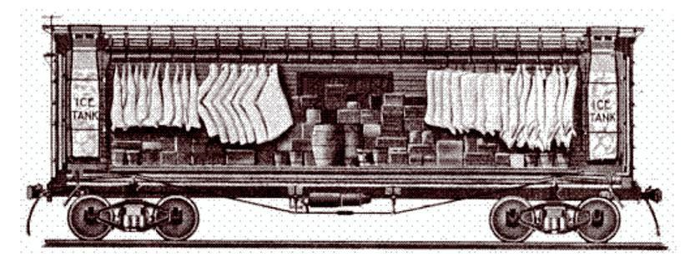
Food in Historical Perspective:
Early Technologies —
Transportation
Refrigeration
Canning
Anthropology of Food
University of Minnesota Duluth
Tim Roufs
©2010-2024
Vicksburg Historical Society
http://en.wikipedia.org/wiki/Refrigerator_car

Slide 2
Food in Historical Perspective: Dietary Revolutions
Food in Historical Perspective:
Dietary Revolutions
  The Agricultural Revolution
  The Search for Spices
  The Industrial Revolution
  Transportation, Refrigeration, and Canning
  The Scientific Revolution
  Modern-Day Adaptations
  Summary
  Highlight: Vegetarian Diets: Then and Now

Slide 3
  Food and the Industrial Revolution
    by 1850 it was becoming clear that the ever-increasing number of urban laborers needed to be supplied with more abundant, cheaper food
      if not, they would be unable to continue to provide the labor needed for the new industrialized economy
      the situation was first recognized in England, but was soon noted in other European countries and the United States as well
The Cultural Feast, 2nd Ed., p. 63

Slide 4
  Food and the Industrial Revolution
    technological advancements . . .
      made food cheaper . . .
      expanded the
      variety of foods available . .
      kept foods fresh longer . . .
The Cultural Feast, 2nd Ed., p. 63

Slide 5
Food in Historical Perspective: Dietary Revolutions
Food in Historical Perspective:
Dietary Revolutions
  The Agricultural Revolution of the Neolithic Era
  The Search for Spices
  The Industrial Revolution
  Transportation, Refrigeration, and Canning
  The Scientific Revolution
  Modern-Day Adaptations
  Summary
  Highlight: Vegetarian Diets: Then and Now
  Transportation
  Refrigeration
  Canning
  Unforeseen Drawbacks of Food Processing

Slide 6
  transportation
      land transport was limited . . .
      canals . . .
        English, James Brindley, 1761 . . .
        U.S., Erie, 1825 . . .
      steamboats . . .
        Scottish, James Watt (1736 –1819)
        Robert Fulton 1803
      “edge rail” railroads . . .
        English, William Jessop (1745 – 1814), 1803
        U.S. transcontinental, 1869

Slide 7
  transportation
      land transport was limited . . .
      canals . . .
        English, James Brindley, 1761 . . .
        U.S., Erie, 1825 . . .
      steamboats . . .
        Scottish, James Watt (1736 –1819)
        Robert Fulton 1803
      “edge rail” railroads . . .
        English, William Jessop (1745 – 1814), 1803
        U.S. transcontinental, 1869
but that all changed . . .
and an excellent example relating to food, including the effects of the change on interconnected cultures, is . . .

Slide 8
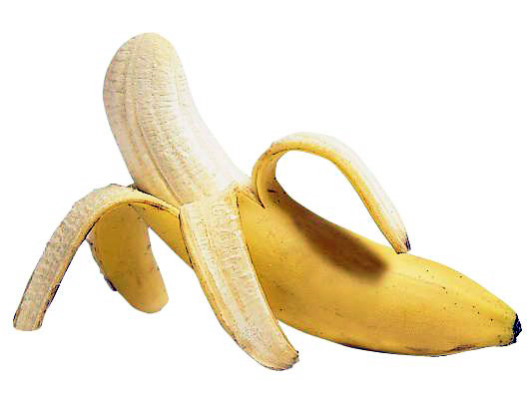

Slide 9
the banana,
in a way, tells it all . . .

Slide 10
the banana,
in a way, tells it all . . .
. . . all of what was made possible
in the late 19th and early- and mid-20th centuries with the arrival of
new technologies . . .

Slide 11
including the advances in communications,
and in mass marketing through “advances”
in advertising technologies . . .

Slide 12

http://en.wikipedia.org/wiki/Chiquita

Slide 13
who doesn’t know Chiquita?
http://en.wikipedia.org/wiki/Chiquita

Slide 14
As an aside: How many know the current Chiquita banana
— the Cavendish —
is about to disappear?
http://en.wikipedia.org/wiki/Chiquita

Slide 15
back to business . . .
http://en.wikipedia.org/wiki/Chiquita

Slide 16
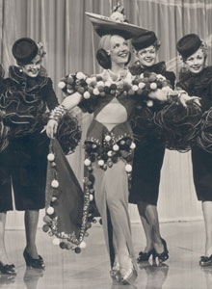
Carmen Miranda
(1909-1955)
became one of the great advertising legends of all time
http://en.wikipedia.org/wiki/Chiquita
http://en.wikipedia.org/wiki/Carmen_Miranda

Slide 17

Carmen Miranda
http://en.wikipedia.org/wiki/Chiquita

Slide 18
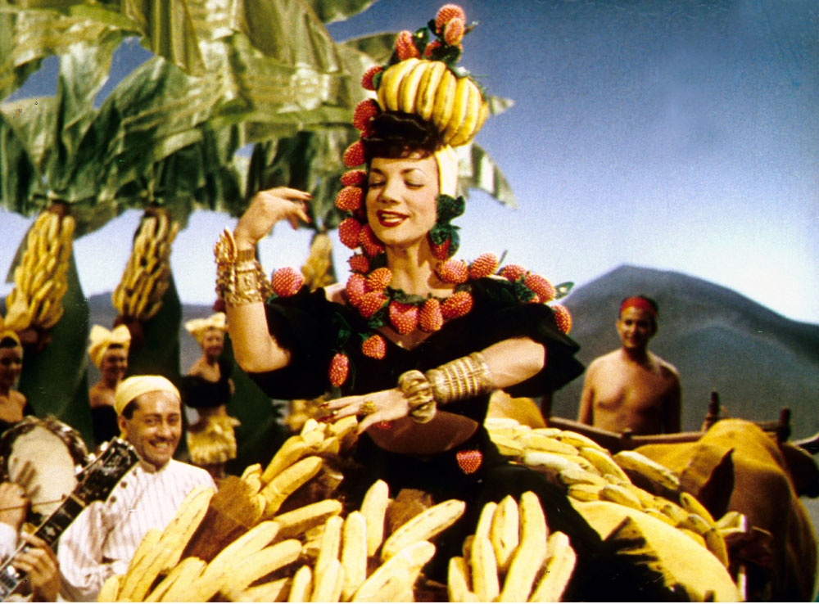
“Bananas will eternally be grateful for the marketing they got through Carmen Miranda”
http://www.riomate.com/1693/news/2010/08/31/carmen-miranda-forever

Slide 19

“Bananas will eternally be grateful for the marketing they got through Carmen Miranda”
and vice versa
http://www.riomate.com/1693/news/2010/08/31/carmen-miranda-forever

Slide 20

. . . speaking of singers capitalizing on the banana
in the non-fruit marketplace . . .
anyone that knows
Harry Belafonte
knows “The Banana Boat Song”
(Day-o, Day-ay-ay-o . . .)
and vice versa

Slide 21
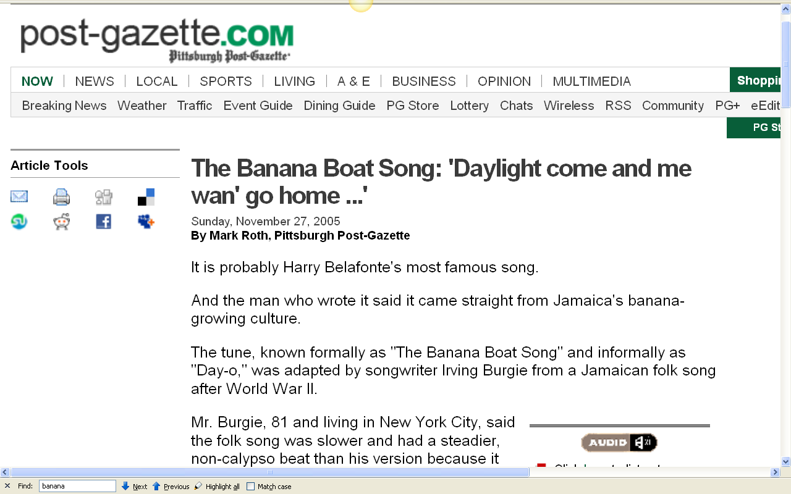
http://www.post-gazette.com/pg/05331/612548.stm

Slide 22
back to business . . .
http://en.wikipedia.org/wiki/Chiquita

Slide 23
fruit companies became powerful players in world food production through their skillful development and integration of communication and advertising with evolving transportation technologies in rail and shipping . . .
and
with other technologies such as refrigeration . . .

Slide 24
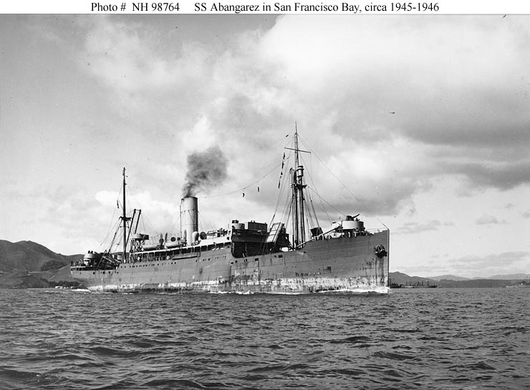
This United Fruit Company banana carrier was built in Ireland in 1909
http://en.wikipedia.org/wiki/United_Fruit_Company

Slide 25
fruit companies became powerful players in world food production through their skillful development and integration of communication and advertising with evolving transportation technologies in rail and shipping . . .
and
with other technologies such as refrigeration . . .
and they even combined that with a little pleasure . . .

Slide 26
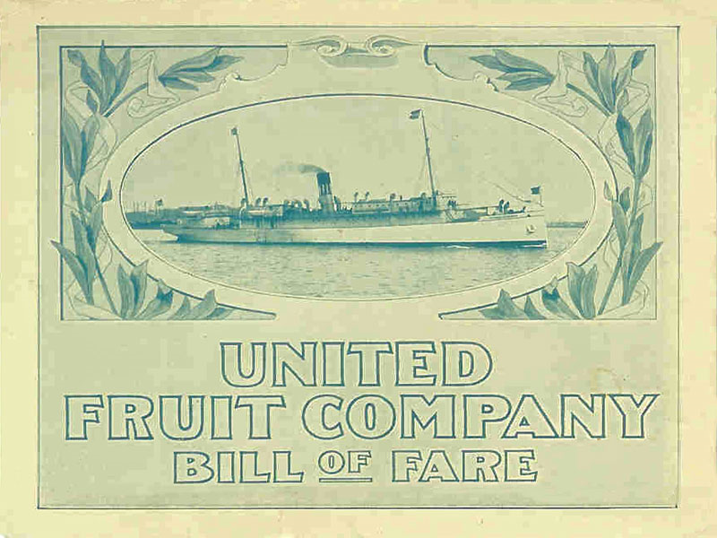
http://www.guidetobelize.info/en/travel/belize-train-railway-guide.shtml

Slide 27
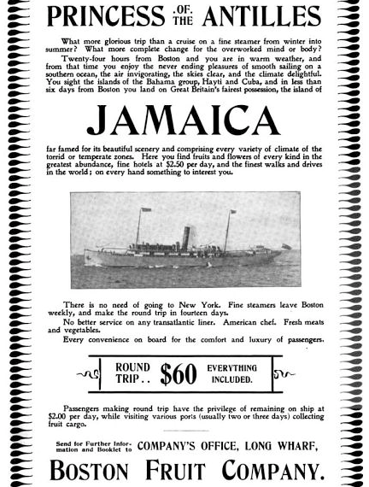
http://en.wikipedia.org/wiki/Boston_Fruit_Company#Shipping

Slide 28
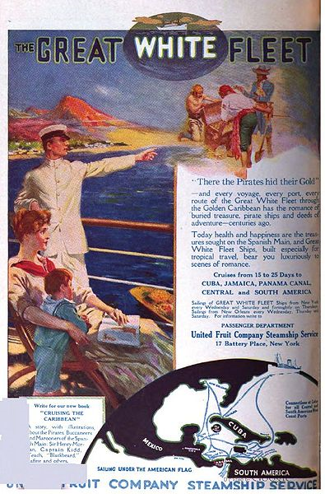
http://en.wikipedia.org/wiki/File:United_Fruit_Ad_1916.jpg

Slide 29
and the corporate and industrial history
leading up to
“The Banana Republics” is legendary . . . unfortunately in a negative way

Slide 30
and it was all “made possible”
with the development of modern-day technologies,
in road building,
railroad expansion,
the development of modern refrigeration and refrigerated shipping,
communications advances,
and the like . . .

Slide 31
the banana
was a major player
in the 19th and 20th centuries
with virtually every “unit of analysis”
discussed the first week of the semester . . .
(see slide set “Units of Analysis”)

Slide 32
one of the best examples of the role of technology in the development of modern food companies involves the banana industry . . . disgraceful as it is in the eyes of most observers . . .

Slide 33

Dan Koeppe’s
Banana
tells it best
(from an Anth of Food point of view)
NY: Penguin Hudson, 2008

Slide 34
the industry started off with
road building in Costa Rica in 1871 . . .
it grew up around
the expansion of the railroad . . .
and became legendary
with the establishment of refrigerated shipping . . .

Slide 35
unfortunately the legends are mostly negative . . .
involving what some — probably most — would consider the worst of everything modern food production and distribution has to offer . . .
exploitation . . .
disgraceful treatment of employees . . .
dependence on a limited number of species leading to the disappearance of some . . .
(and the current species, Cavendish is on the fast track to becoming “extinct” as an international trade product)
illegalities on virtually every level and degree . . .
corporate and individual lapses of ethics in many dimensions . . .
and the list goes on . . .

Slide 36
linguistically,
the term
“banana republic”
might even say it all . . .

Slide 37
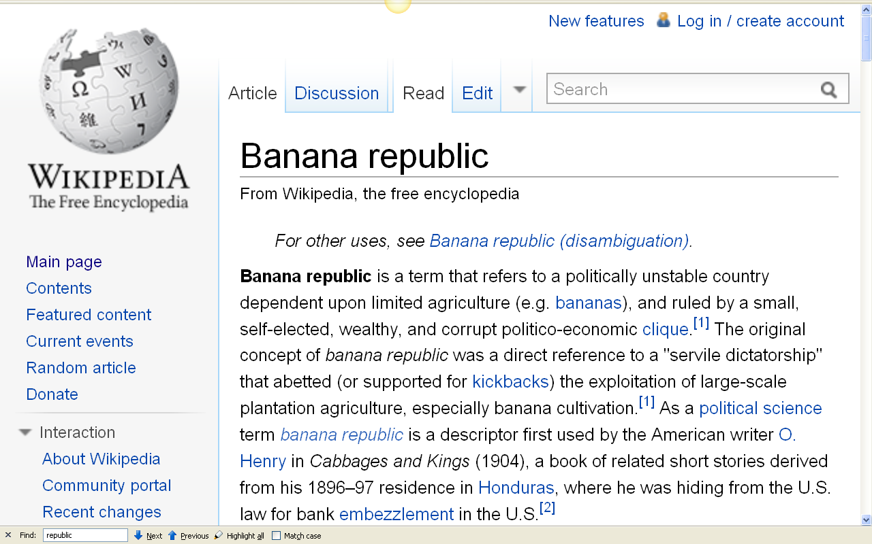
http://en.wikipedia.org/wiki/Banana_republic

Slide 38

if you are still looking at a class project an anthropological comparison of the banana and sugar industries
and their cultural ramifications,
could make an excellent one . . .
NY: Penguin Hudson, 2008
NY: Penguin, 1986

Slide 39
and you might even be able to put a personal “slant” on the topic by including one or more perspectives
relevant to your own major
— from Accounting, to Advertising, to Zoology . . .
NY: Penguin Hudson, 2008
NY: Penguin, 1986

Slide 40
Food in Historical Perspective: Dietary Revolutions
Food in Historical Perspective:
Dietary Revolutions
  The Agricultural Revolution of the Neolithic Era
  The Search for Spices
  The Industrial Revolution
  Transportation, Refrigeration, and Canning
  The Scientific Revolution
  Modern-Day Adaptations
  Summary
  Highlight: Vegetarian Diets: Then and Now
  Transportation
  Refrigeration
  Canning
  Unforeseen Drawbacks of Food Processing

Slide 41
Refrigerated Freight Car ca. 1870
Vicksburg Historical Society
http://en.wikipedia.org/wiki/Refrigerator_car

Slide 42
“The refrigerated railroad car was patented by J. B. Sutherland of Detroit, Michigan in 1867. He designed an insulated car with ice bunkers in each end. Air came in on the top, passed through the bunkers, and circulated through the car by gravity, controlled by the use of hanging flaps that created differences in air temperature.
Workers sometimes placed salt in the bunkers to accelerate
the melting of the ice and lower the temperature of the load.”
Refrigerated Freight Car ca. 1870
Vicksburg Historical Society
http://en.wikipedia.org/wiki/Refrigerator_car

Slide 43
some suggest
that refrigerated railroad cars effectively put an end to
the glory days of the cowboy era in America
Refrigerated Freight Car ca. 1870
Vicksburg Historical Society
http://en.wikipedia.org/wiki/Refrigerator_car

Slide 44
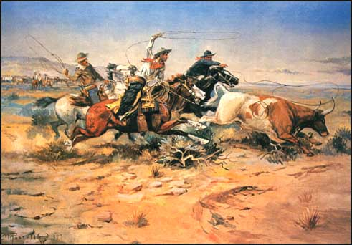
"Herd Quitters“
Charles Marion Russell
(1864–1926)
http://en.wikipedia.org/wiki/Cowboy

Slide 45
"Herd Quitters“
Charles Marion Russell
(1864–1926)
http://en.wikipedia.org/wiki/Cowboy

Slide 46
  refrigeration
      the icehouse . . .
      the icebox . . .
        patented in 1803, but was little used until 1820s
        cutting ice . . .
      the mechanical refrigerator . . .
        patented as early as 1834
        but only became commonplace in the U.S.A. more than a century later
The Cultural Feast, 2nd Ed., p. 64

Slide 47
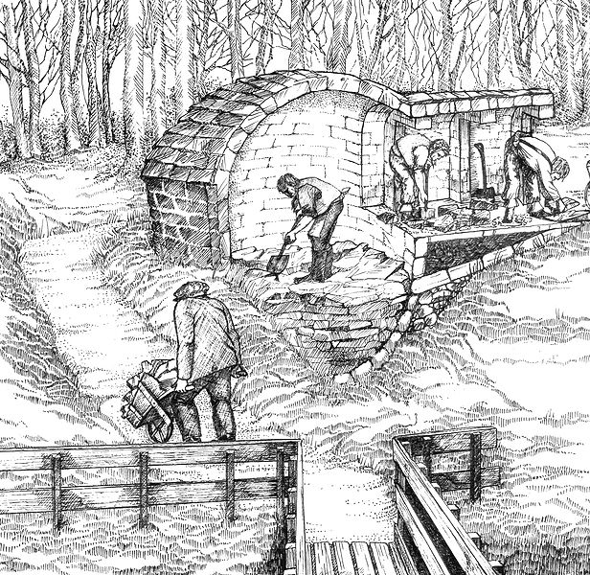
ice houses of one form or another have been around for a long time . . .
and even in the mid 1950s
they were still wonderful places to sneak away to and play
(as most people then still didn’t have air conditioning)
Stocking the Eglinton ice house
http://en.wikipedia.org/wiki/Eglinton_Castle

Slide 48
Stocking the Eglinton ice house
http://en.wikipedia.org/wiki/Eglinton_Castle

Slide 49
the use of ice — and even the making ice cream — (early on brought in usually for nobility from high altitudes)
has ancient origins . . .
Stocking the Eglinton ice house
http://en.wikipedia.org/wiki/Eglinton_Castle

Slide 50
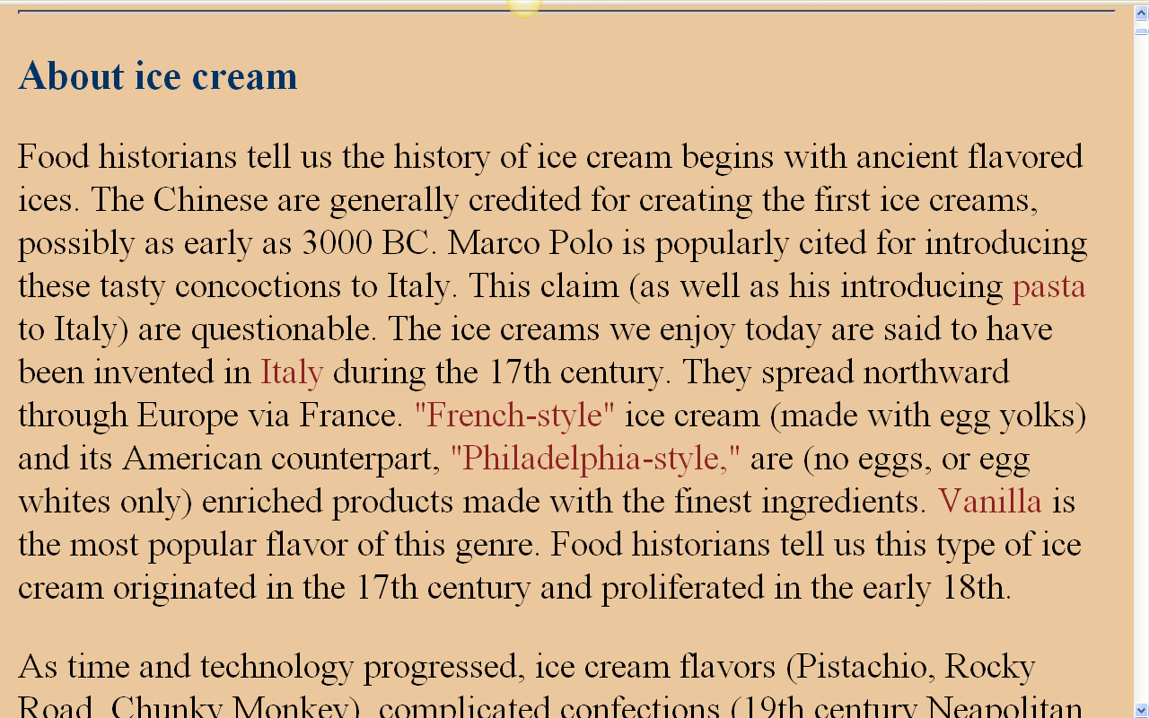
http://www.foodtimeline.org/foodicecream.html

Slide 51
what change the world most profoundly was the commercialization of ice, and the invention of mechanical refrigeration . . .
Stocking the Eglinton ice house
http://en.wikipedia.org/wiki/Eglinton_Castle

Slide 52
  refrigeration
      the icehouse . . .
      the icebox . . .
        was patented in 1803, but was little used until 1820s
        usually used ice cut from a lake or river . . .
      the mechanical refrigerator . . .
        patented as early as 1834
        but only became commonplace in the U.S.A. more than a century later
The Cultural Feast, 2nd Ed., p. 64

Slide 53
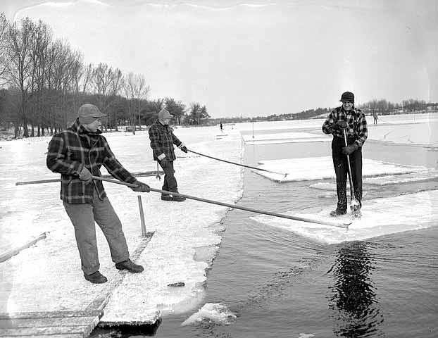
Ice cutting, Cedar Lake, Minneapolis
1/20/1947
Minnesota Historical Society
Location no. HD7.7 p72

Slide 54
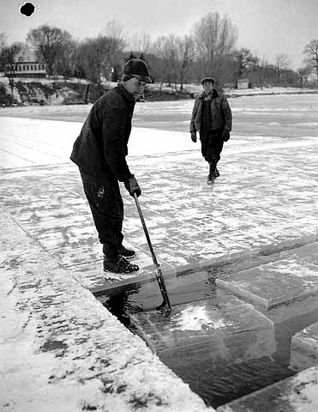
Ice cutting, Cedar Lake, Minneapolis
1/20/1947
Minnesota Historical Society
Location no. HD7.7 p72

Slide 55
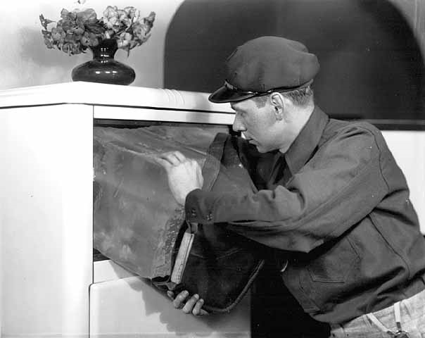
Cedar Lake Ice and Fuel Company employee putting ice in to an ice box, Minneapolis
ca. 1930
Minnesota Historical Society
Location no. HD7.7 p77
Negative no. 7941-B

Slide 56
the first job my father had was working for his older brother delivering ice, like you see here
people would put a sign in their window indicating how many pounds of ice they wanted on the day, and the delivery person would carry a big chunk of that size inside with a pair of wrought-iron “ice tongs”
Cedar Lake Ice and Fuel Company employee putting ice in to an ice box, Minneapolis
ca. 1930
Minnesota Historical Society
Location no. HD7.7 p77
Negative no. 7941-B

Slide 57
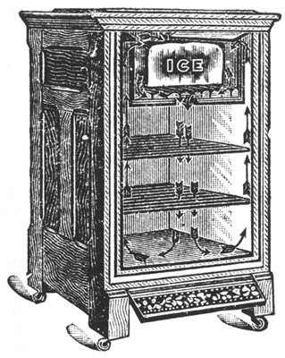
  refrigeration
      the icehouse . . .
      the icebox . . .
        patented in 1803, but was little used until 1820s
        cutting ice . . .
        Mark Roufs . . .
      mechanical refrigerator . . .
        patented as early as 1834
        more than a century later became commonplace in U.S.A.
1902
cost: $15 to $50
cost of ice: penny a pound
The Cultural Feast, 2nd Ed., p. 64

Slide 58
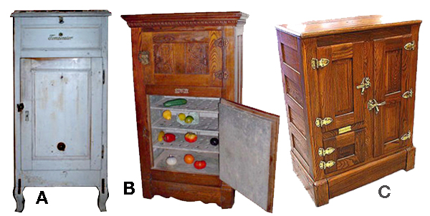
Old Norwegian icebox.
The ice was placed in the drawer above the door.
B. Typical Victorian icebox highboy model.
Note tin or zinc shelving and door lining.
C. An exclusive oak cabinet icebox that would be found in the well-to-do homes.
Note the fancy hardware and latches. Ice goes in the left upper door.
Wikipedia

Slide 59
  refrigeration
      the icehouse . . .
      the icebox . . .
        patented in 1803, but was little used until 1820s
        cutting ice . . .
      the mechanical refrigerator . . .
        was patented as early as 1834
        but only became commonplace in the U.S.A. more than a century later
The Cultural Feast, 2nd Ed., p. 64

Slide 60
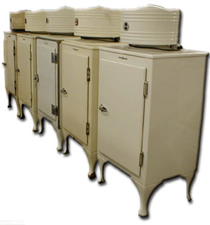
The General Electric Monitor-style refrigerator
more like an icebox with its refrigerating mechanisms on top
antiqueappliances.com

Slide 61
“Hermetically sealed and permanently lubricated, the GE Monitor Top refrigerator remains the most recognized and most dependable refrigerator ever built. Hundreds, if not thousands, of these units remain in service today, offering their owners ‘quiet’, ‘dependable’ and ‘service free’ refrigeration.”
The General Electric Monitor-style refrigerator
more like an icebox with its refrigerating mechanisms on top
http://homefront.yuku.com/topic/1115
antiqueappliances.com

Slide 62
The GE Monitor top refrigerator is perhaps the most recognized of vintage refrigerators. Built on the principal of a French industrialist concept for a hermetically sealed refrigeration system, the first models available to the general public, for residential use, were introduced in 1927, with the design remaining the same through 1936
“With a price tag of only $300, these first models were considered
“the first affordable refrigeration units
for the average family”
The General Electric Monitor-style refrigerator
more like an icebox with its refrigerating mechanisms on top
antiqueappliances.com

Slide 63
  refrigeration
      improved refrigeration plus faster transportation expanded available foodstuffs . . .
      vitamin deficiencies declined
      incidences of
      food poisoning decreased
The Cultural Feast, 2nd Ed., pp. 64-65

Slide 64
  refrigeration
      improved refrigeration plus faster transportation expanded available foodstuffs . . .
      vitamin deficiencies declined
      incidences of
      food poisoning decreased
The Cultural Feast, 2nd Ed., pp. 64-65

Slide 65
  refrigeration
      but food produced far from home “is not without its problems” . . .
        cf., The Cultural Feast, Ch. 6
        “Food Technologies:
        How People Get Their Food in Industrial Societies”
The Cultural Feast, 2nd Ed., pp. 64-65

Slide 66
Food in Historical Perspective: Dietary Revolutions
Food in Historical Perspective:
Dietary Revolutions
  The Agricultural Revolution of the Neolithic Era
  The Search for Spices
  The Industrial Revolution
  Transportation, Refrigeration, and Canning
  The Scientific Revolution
  Modern-Day Adaptations
  Summary
  Highlight: Vegetarian Diets: Then and Now
  Transportation
  Refrigeration
  Canning
  Unforeseen Drawbacks of Food Processing

Slide 67
  canning
      older methods of preserving food included . . .
          salting . . .
          fermenting . . .
          burying . . .
          dehydrating . . .
          smoking . . .
          freezing . . .
          dry freezing . . .
The Cultural Feast, 2nd Ed., p. 65

Slide 68
  canning
      vacuum-packed, airtight glass bottles for food . . .
        invented by Nicholas Appert
        1809
        for Napoleon, to supply food for his armies
        treated the process as a military secret
        French monopoly
The Cultural Feast, 2nd Ed., p. 65

Slide 69
  canning
      canning using tin cans . . .
        started in England
          in 1810 the Frenchman Peter Durand (also known as Pierre Durand) was granted a patent by King George III of England
            based his work on Nicolas Appert’s experiments
http://en.wikipedia.org/wiki/Canning

Slide 70
  canning
      canning using tin cans . . .
        started in England
          Peter Durand (also known as Pierre Durand) did not actually can foods himself but sold his patent to two other Englishmen who set up a commercial canning factory and by 1813 were producing their first canned goods for the British army
http://en.wikipedia.org/wiki/Canning

Slide 71
  canning
      canning using tin cans . . .
        by 1818 a canning factory was turning out corned and boiled beef, veal, carrots, and vegetable soup
        cheap
        convenient
        “didn’t get high marks for taste”
The Cultural Feast, 2nd Ed., p. 65

Slide 72
  canning
      canning using tin cans . . .
        by 1818 a canning factory was turning out corned and boiled beef, veal, carrots, and vegetable soup
        cheap
        convenient
        “didn’t get high marks for taste”
        safety was a problem
The Cultural Feast, 2nd Ed., p. 65

Slide 73
  canning
      canning using tin cans . . .
        in the initial stages of the canning industry, sterilization processes were poorly understood
          larger cans of meat were often contaminated
The Cultural Feast, 2nd Ed., p. 65

Slide 74
  canning
      canning using tin cans . . .
        by the end of the 19th century, canned foods were providing industrialized populations with a diversity of fruits, vegetables, and meats not previously obtainable
The Cultural Feast, 2nd Ed., p. 65

Slide 75

Paul Buffalo’s mother, an Indian medicine woman from Leech Lake, refused to eat canned goods . . .
http://www.d.umn.edu/cla/faculty/troufs/Buffalo/pbwww.html#title

Slide 76
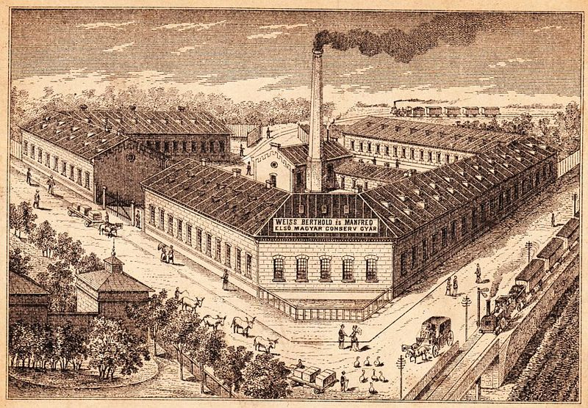
One of the first large canned food factories
Weiss brothers
Csepel-Budapest , 1885
http://en.wikipedia.org/wiki/Canning

Slide 77
  canning
      canning using canning jars . . .
        a final innovation,
        the mass production of canning jars in the second half of the 19th century, allowed for the economical home canning of food
The Cultural Feast, 2nd Ed., p. 65

Slide 78
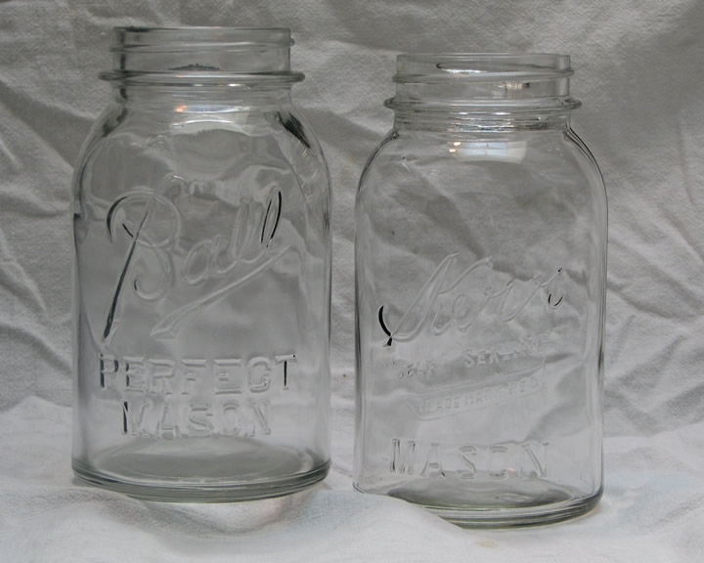
John Landis Mason
(1832 1902)
a native of Philadelphia,
a tinsmith,
patented the metal screw-on lid for fruit jars that have come to be known as “Mason jars”
"Patent Nov 30th 1858"
http://en.wikipedia.org/wiki/Mason_jars

Slide 79
Food in Historical Perspective: Dietary Revolutions
Food in Historical Perspective:
Dietary Revolutions
  The Agricultural Revolution of the Neolithic Era
  The Search for Spices
  The Industrial Revolution
  Transportation, Refrigeration, and Canning
  The Scientific Revolution
  Modern-Day Adaptations
  Summary
  Highlight: Vegetarian Diets: Then and Now
  Transportation
  Refrigeration
  Canning
  Unforeseen Drawbacks of Food Processing

Slide 80
  Unforeseen Drawbacks of Food Processing
    condensed milk . . .
      original canned condensed milk provided safe supply of nutrients to American Civil War soldiers
      but later brands made from skimmed milk lacked the fat-soluble vitamins A and D causing rickets in infants and children raised on canned skimmed milk
        poor families especially continued to use it because it was cheaper, in spite of warning labels
The Cultural Feast, 2nd Ed., p. 65

Slide 81
Food in Historical Perspective: Dietary Revolutions
Food in Historical Perspective:
Dietary Revolutions
  The Agricultural Revolution of the Neolithic Era
  The Search for Spices
  The Industrial Revolution
  Transportation, Refrigeration, and Canning
  The Scientific Revolution
  Modern-Day Adaptations
  Summary
  Highlight: Vegetarian Diets: Then and Now
  other
  Unforeseen Drawbacks of Food Processing
  also include . . .

Slide 82

  Unforeseen Drawbacks of Food Processing
    white bread . . .
stahlsbakery.com/

Slide 83
  Unforeseen Drawbacks of Food Processing
    white bread . . .
      from 1840 on nutrients, especially Vitamin B, were removed with iron roller milling
      the old mills removed the bran, but not the germ, from the wheat kernel
      the new iron roller mills removed both germ and bran
stahlsbakery.com/

Slide 84
  Unforeseen Drawbacks of Food Processing
    white bread . . .
      white “bleached” flour became socially preferred because its higher status
      white flour did not become rancid as quickly as wheat flours containing the oil of the germ
stahlsbakery.com/

Slide 85
  Unforeseen Drawbacks of Food Processing
    white bread . . .
      wheat eaters often had other foods available which supplied the missing vitamins, so the nutrient problems were not immediately evident
stahlsbakery.com/

Slide 86
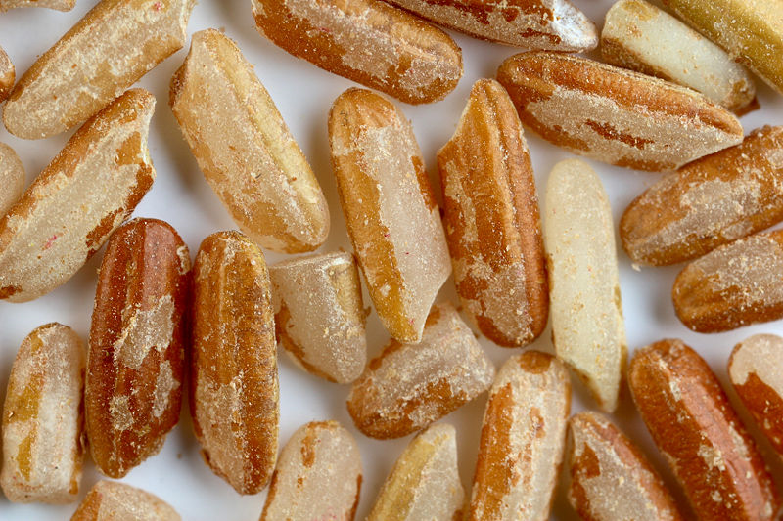
    rice . . .
http://en.wikipedia.org/wiki/Rice

Slide 87
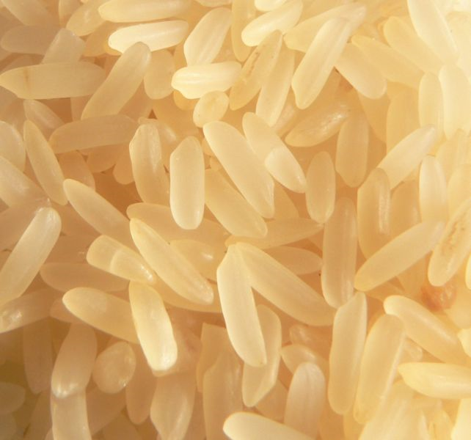
    rice . . .
http://en.wikipedia.org/wiki/Rice

Slide 88
    rice . . .
      new milling techniques removed most of the essential B vitamins
      as people switched to polished rice, beriberi swept through the population
        Vitamin B-1 deficiency disease that affects the nerves, heart and digestive tract
http://en.wikipedia.org/wiki/Rice

Slide 89
    rice . . .
      rice eaters in Southeast Asia and other places had more limited variety of foods available than the wheat eaters elsewhere, hence the negative health effects were “swift and corrosive”
http://en.wikipedia.org/wiki/Rice

Slide 90
  Unforeseen Drawbacks of Food Processing
    The 19th century pursuit for colonies was, in part, a search for overseas markets for the products of the expanding industrial revolution
The Cultural Feast, 2nd Ed., p. 66

Slide 91
  Unforeseen Drawbacks of Food Processing
    The 19th century pursuit for colonies was, in part, a search for overseas markets for the products of the expanding industrial revolution
      in order for European and North American nations to maintain their own markets, industrial development in overseas countries was retarded
        in part, colonies were denied the technical and managerial skills necessary for industrialization
        “As a result, large sections of Africa and Asia remained hundreds of years behind Western countries in terms of economic growth.”
The Cultural Feast, 2nd Ed., p. 66

Slide 92
  Unforeseen Drawbacks of Food Processing
    by the close of the 19th century, the social, economic, and dietary distinctions between “developed” and “underdeveloped” countries were clear
      the relationship between the developed and underdeveloped worlds, and its consequences for diet and disease in the modern world, is discussed in greater detail in
      Cf. The Cultural Feast, Chs. 9 and 10
          “Hunger in Global Perspective”
          “Addressing Global Food Issues”
The Cultural Feast, 2nd Ed., p. 66

Slide 93
Food in Historical Perspective: Dietary Revolutions
Food in Historical Perspective:
Dietary Revolutions
  The Agricultural Revolution of the Neolithic Era
  The Search for Spices
  The Industrial Revolution
  Transportation, Refrigeration, and Canning
  The Scientific Revolution
  Modern-Day Adaptations
  Summary
  Highlight: Vegetarian Diets: Then and Now

Slide 94
Food in Historical Perspective: Dietary Revolutions
Food in Historical Perspective:
Dietary Revolutions
  The Agricultural Revolution of the Neolithic Era
  The Search for Spices
  The Industrial Revolution
  Transportation, Refrigeration, and Canning
  The Scientific Revolution
  Modern-Day Adaptations
  Summary
  Highlight: Vegetarian Diets: Then and Now
  “The scientific revolution ultimately led to our current level of knowledge about human nutrition and enabled us to exert an unprecedented control over food supply, health, and physical well-being”

Slide 95
Food in Historical Perspective: Dietary Revolutions
Food in Historical Perspective:
Dietary Revolutions
  The Agricultural Revolution of the Neolithic Era
  The Search for Spices
  The Industrial Revolution
  Transportation, Refrigeration, and Canning
  The Scientific Revolution
  Modern-Day Adaptations
  Summary
  Highlight: Vegetarian Diets: Then and Now
  “The scientific revolution ultimately led to our current level of knowledge about human nutrition and enabled us to exert an unprecedented control over food supply, health, and physical well-being”
“The Scientific Revolution”
slide set brings us up-to-date on the food revolutions . . .

Slide 96
Food in Historical Perspective: Dietary Revolutions
Food in Historical Perspective:
Dietary Revolutions
  The Agricultural Revolution of the Neolithic Era
  The Search for Spices
  The Industrial Revolution
  Transportation, Refrigeration, and Canning
  The Scientific Revolution
  Modern-Day Adaptations
  Summary
  Highlight: Vegetarian Diets: Then and Now
  “The scientific revolution ultimately led to our current level of knowledge about human nutrition and enabled us to exert an unprecedented control over food supply, health, and physical well-being”
have a look

Slide 97
Food in Historical Perspective: Dietary Revolutions
Food in Historical Perspective:
Dietary Revolutions
  The Agricultural Revolution of the Neolithic Era
  The Search for Spices
  The Industrial Revolution
  Transportation, Refrigeration, and Canning
  The Scientific Revolution
  Modern-Day Adaptations
  Summary
  Highlight: Vegetarian Diets: Then and Now
  “The scientific revolution ultimately led to our current level of knowledge about human nutrition and enabled us to exert an unprecedented control over food supply, health, and physical well-being”
and for now . . .

Slide 98
Day, me say day, me say day, me say day
Me say day, me say day-ay-ay-o
Daylight come and me wan' go home”

Slide 99
Food in Historical Perspective:
Early Technologies —
Transportation
Refrigeration
Canning
Anthropology of Food
University of Minnesota Duluth
Tim Roufs
©2010-2024
Vicksburg Historical Society
http://en.wikipedia.org/wiki/Refrigerator_car

