Slide 1
this is a major work on the social, political, and nutritional consequences of “The Agricultural Revolution” . . .
and it’s a very good read
NY: Random House, 2010

Slide 2
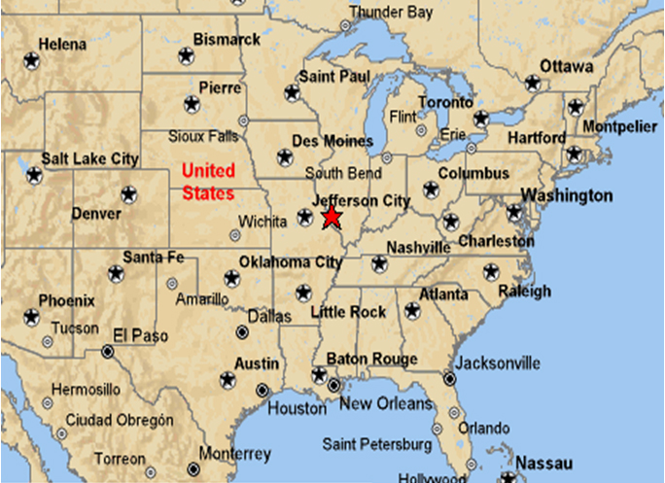
Nutritional Consequences
of the Agricultural Revolution:
A Comparison
of Foragers and Agriculturalists
(Indian Knoll and Hardin Village)
Anthropology of Food
University of Minnesota Duluth
Tim Roufs
©2009-2024

Slide 3
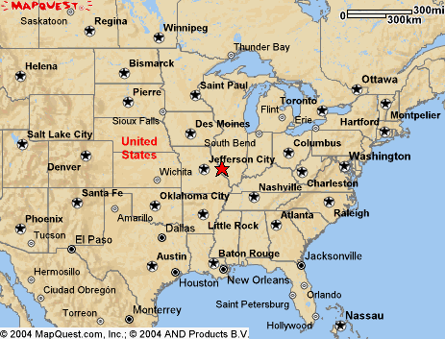
Hardin
Village
Kentucky
Indian
Knoll
Kentucky

Slide 4
Food in Historical Perspective: Dietary Revolutions
Food in Historical Perspective:
Dietary Revolutions
The Agricultural Revolution of the Neolithic Era
The Search for Spices
The Industrial Revolution
Transportation, Refrigeration, and Canning
The Scientific Revolution
Modern-Day Adaptations
Summary
Highlight: Vegetarian Diets: Then and Now

Slide 5
Food in Historical Perspective: Dietary Revolutions
Food in Historical Perspective:
Dietary Revolutions
The Agricultural Revolution of the Neolithic Era
The Search for Spices
The Industrial Revolution
Transportation, Refrigeration, and Canning
The Scientific Revolution
Modern-Day Adaptations
Summary
Highlight: Vegetarian Diets: Then and Now
Development of Agriculture in the Tehuacán Valley
Nutritional Consequences of the Agricultural Revolution: A Comparison of Foragers and Agriculturalists
Social and Political Consequences of the Agricultural Revolution

Slide 6
examples:
Tehuacán, Puebla, Mexico
pre-Columbian Kentucky
the changes toward dependence on agriculture was not always swift
in the short term, it was not always healthful
The Cultural Feast, 2nd Ed., p. 49

Slide 7
examples:
Tehuacán, Puebla, Mexico
pre-Columbian Kentucky
the changes toward dependence on agriculture was not always swift
in the short term, it was not always healthful
The Cultural Feast, 2nd Ed., p. 49

Slide 8
with
hunters and gatherers
times of food scarcity certainly exist but
famine is a relatively infrequent occurrence
and chronic malnutrition is even rarer
The Cultural Feast, 2nd Ed., p. 54

Slide 9
with the advent of agriculture,
the picture changes . . .
dependence on a small number of cultivated crops or domesticated animals increases the risk
of widespread famine
The Cultural Feast, 2nd Ed., p. 54

Slide 10
with the advent of agriculture,
the picture changes . . .
a less diversified diet makes it far harder to achieve an adequate balance of essential nutrients
especially protein and certain vitamins
(Cf., other slide sets for information on proteins and vitamins)
The Cultural Feast, 2nd Ed., p. 54

Slide 11
with the advent of agriculture,
the picture changes . . .
vitamin deficiency diseases are especially problematic in
grain-dependent communities
The Cultural Feast, 2nd Ed., p. 54

Slide 12
Claire Cassidy
(1980)
The Cultural Feast, 2nd Ed., p. 54

Slide 13
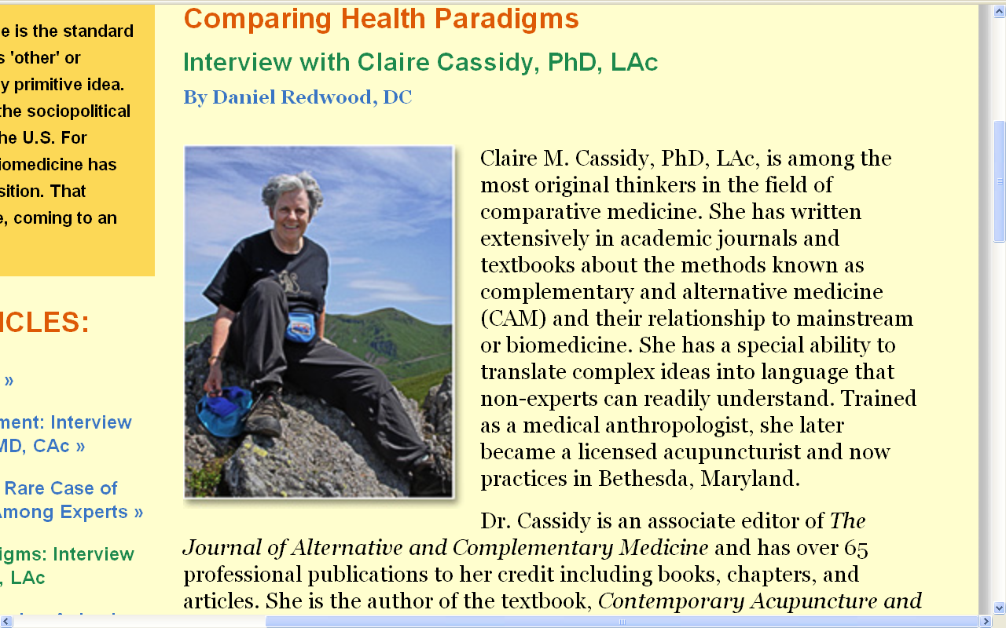
http://www.healthinsightstoday.com/articles/v1i2/cassidy_p1.html

Slide 14
Claire Cassidy (Ed.)
(1980)
Nutrition and Health in Agriculturalists and Hunters and Gatherers
NY: Redgrave
The Cultural Feast, 2nd Ed., p. 54

Slide 15
Claire Cassidy
(1980)
assessed the nutritional impact of the introduction of agriculture on pre-Columbian Native Americans
examined skeletal remains of two precontact villages in Kentucky
The Cultural Feast, 2nd Ed., p. 54

Slide 16
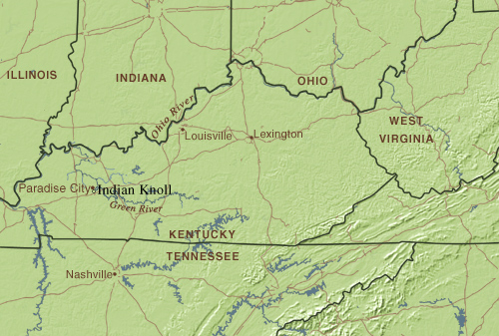
Hardin Village
www.metmuseum.org/toah/hd/knol/hd_knol.htm

Slide 17
Indian Knoll
Hardin Village
foragers
agriculturalists
ca. 5,000 ybp
ca. 1,000 ybp
The Cultural Feast, 2nd Ed., p. 54

Slide 18
Indian Knoll
Hardin Village
foragers
agriculturalists
ca. 5,000 ybp
ca. 1,000 ybp
The Cultural Feast, 2nd Ed., p. 54

Slide 19
Indian Knoll
Hardin Village
foragers
agriculturalists
ca. 5,000 ybp
ca. 1,000 ybp
had very different diets
The Cultural Feast, 2nd Ed., p. 54

Slide 20
Indian Knoll
Hardin Village
foragers
agriculturalists
ca. 5,000 ybp
ca. 1,000 ybp
had very different diets
The Cultural Feast, 2nd Ed., p. 54

Slide 21
Indian Knoll
Hardin Village
foragers
agriculturalists
ca. 5,000 ybp
ca. 1,000 ybp
people ate large quantities of river mussels and snails
and deer, small mammals, wild turkeys, box turtles, fish, and occasionally dog
The Cultural Feast, 2nd Ed., p. 54

Slide 22
Indian Knoll
Hardin Village
foragers
agriculturalists
ca. 5,000 ybp
ca. 1,000 ybp
similar sites suggest they also ate hickory nuts, walnuts, acorns, elderberries, persimmons,
sunflower seeds,
and other wild berries
The Cultural Feast, 2nd Ed., p. 54

Slide 23
Hardin Village
Indian Knoll
foragers
agriculturalists
ca. 5,000 ybp
ca. 1,000 ybp
people relied primarily on cultivated corn, beans, and squash
supplemented with deer, eel, small mammals, wild turkeys, box turtles, and wild plants
The Cultural Feast, 2nd Ed., p. 54

Slide 24
Claire Cassidy
(1980)
compared 296 skeletons from
Hardin Village and 285 skeletons from Indian Knoll in Kentucky
data on health was derived from careful analysis of the bones and teeth . . .
The Cultural Feast, 2nd Ed., p. 54

Slide 25
Indian Knoll
Hardin Village
foragers
agriculturalists
ca. 5,000 ybp
ca. 1,000 ybp
life expectancies for both sexes at all ages were lower at Hardin Village
The Cultural Feast, 2nd Ed., p. 54

Slide 26
Indian Knoll
Hardin Village
foragers
agriculturalists
ca. 5,000 ybp
ca. 1,000 ybp
life expectancies for both sexes at all ages were lower at Hardin Village
The Cultural Feast, 2nd Ed., p. 54

Slide 27
Indian Knoll
Hardin Village
foragers
agriculturalists
ca. 5,000 ybp
ca. 1,000 ybp
infant mortality was higher at Hardin Village
The Cultural Feast, 2nd Ed., p. 54

Slide 28
Indian Knoll
Hardin Village
foragers
agriculturalists
ca. 5,000 ybp
ca. 1,000 ybp
infant mortality was higher at Hardin Village
The Cultural Feast, 2nd Ed., p. 54

Slide 29
Indian Knoll
Hardin Village
foragers
agriculturalists
ca. 5,000 ybp
ca. 1,000 ybp
iron-deficiency anemia of sufficient duration to cause bone changes was absent at Indian Knoll
but was present at Hardin Village
50% of cases occurred in children under 5
The Cultural Feast, 2nd Ed., p. 54

Slide 30
Indian Knoll
Hardin Village
foragers
agriculturalists
ca. 5,000 ybp
ca. 1,000 ybp
iron-deficiency anemia of sufficient duration to cause bone changes was absent at Indian Knoll
but was present at Hardin Village
50% of cases occurred in children under 5
The Cultural Feast, 2nd Ed., p. 54

Slide 31
Indian Knoll
Hardin Village
foragers
agriculturalists
ca. 5,000 ybp
ca. 1,000 ybp
growth arrest episodes at Indian Knoll were periodic and more often of short duration and were possibly due to food shortages in late winter
those at Hardin Village occurred randomly and were more often of long duration, probably indicative of disease as a causative agent
The Cultural Feast, 2nd Ed., p. 54

Slide 32
Indian Knoll
Hardin Village
foragers
agriculturalists
ca. 5,000 ybp
ca. 1,000 ybp
growth arrest episodes at Indian Knoll were periodic and more often of short duration and were possibly due to food shortages in late winter
those at Hardin Village occurred randomly and were more often of long duration, probably indicative of disease as a causative agent
The Cultural Feast, 2nd Ed., p. 54

Slide 33
Indian Knoll
Hardin Village
foragers
agriculturalists
ca. 5,000 ybp
ca. 1,000 ybp
more children suffered infections at Hardin Village
The Cultural Feast, 2nd Ed., p. 55

Slide 34
Indian Knoll
Hardin Village
foragers
agriculturalists
ca. 5,000 ybp
ca. 1,000 ybp
more children suffered infections at Hardin Village
The Cultural Feast, 2nd Ed., p. 55

Slide 35
Indian Knoll
Hardin Village
foragers
agriculturalists
ca. 5,000 ybp
ca. 1,000 ybp
the syndrome of
periosteal inflammation
was more common at Hardin Village
a swelling of the outermost layer of the bone
The Cultural Feast, 2nd Ed., p. 55

Slide 36
Indian Knoll
Hardin Village
foragers
agriculturalists
ca. 5,000 ybp
ca. 1,000 ybp
the syndrome of
periosteal inflammation
was more common at Hardin Village
a swelling of the outermost layer of the bone
The Cultural Feast, 2nd Ed., p. 55

Slide 37
Indian Knoll
Hardin Village
foragers
agriculturalists
ca. 5,000 ybp
ca. 1,000 ybp
tooth decay was rampant at Hardin Village and led to early abscessing and tooth loss
decay was unusual at Indian Knoll and abscessing occurred later in life because of severe wear to the teeth
The Cultural Feast, 2nd Ed., p. 55

Slide 38
Indian Knoll
Hardin Village
foragers
agriculturalists
ca. 5,000 ybp
ca. 1,000 ybp
tooth decay was rampant at Hardin Village and led to early abscessing and tooth loss
decay was unusual at Indian Knoll and abscessing occurred later in life because of severe wear to the teeth
The Cultural Feast, 2nd Ed., p. 55

Slide 39
Indian Knoll
Hardin Village
foragers
agriculturalists
ca. 5,000 ybp
ca. 1,000 ybp
the differences in tooth wear rate and carries rate are very likely attributable to dietary differences between the two groups
The Cultural Feast, 2nd Ed., p. 55

Slide 40
and the winner . . .
Indian Knoll
Hardin Village
foragers
agriculturalists
ca. 5,000 ybp
ca. 1,000 ybp
better life expectancies
lower infant mortality
no iron-deficiency anemia
growth arrests periodic and short
fewer infections
less bone inflammation
less tooth decay and abscessing
The Cultural Feast, 2nd Ed., p. 55

Slide 41
and the winner . . .
Indian Knoll
Hardin Village
foragers
agriculturalists
ca. 5,000 ybp
ca. 1,000 ybp
better life expectancies
lower infant mortality
no iron-deficiency anemia
growth arrests periodic and short
fewer infections
less bone inflammation
less tooth decay and abscessing
The Cultural Feast, 2nd Ed., p. 55

Slide 42
and the winner . . .
Indian Knoll
Hardin Village
foragers
agriculturalists
ca. 5,000 ybp
ca. 1,000 ybp
better life expectancies
lower infant mortality
no iron-deficiency anemia
growth arrests periodic and short
fewer infections
less bone inflammation
less tooth decay and abscessing
The Cultural Feast, 2nd Ed., p. 55

Slide 43
and the winner . . .
Indian Knoll
Hardin Village
foragers
agriculturalists
ca. 5,000 ybp
ca. 1,000 ybp
better life expectancies
lower infant mortality
no iron-deficiency anemia
growth arrests periodic and short
fewer infections
less bone inflammation
less tooth decay and abscessing
The Cultural Feast, 2nd Ed., p. 55

Slide 44
and the winner . . .
Indian Knoll
Hardin Village
foragers
agriculturalists
ca. 5,000 ybp
ca. 1,000 ybp
better life expectancies
lower infant mortality
no iron-deficiency anemia
growth arrests periodic and short
fewer infections
less bone inflammation
less tooth decay and abscessing
The Cultural Feast, 2nd Ed., p. 55

Slide 45
and the winner . . .
Indian Knoll
Hardin Village
foragers
agriculturalists
ca. 5,000 ybp
ca. 1,000 ybp
better life expectancies
lower infant mortality
no iron-deficiency anemia
growth arrests periodic and short
fewer infections
less bone inflammation
less tooth decay and abscessing
The Cultural Feast, 2nd Ed., p. 55

Slide 46
and the winner . . .
Indian Knoll
Hardin Village
foragers
agriculturalists
ca. 5,000 ybp
ca. 1,000 ybp
better life expectancies
lower infant mortality
no iron-deficiency anemia
growth arrests periodic and short
fewer infections
less bone inflammation
less tooth decay and abscessing
The Cultural Feast, 2nd Ed., p. 55

Slide 47
and the winner . . .
Indian Knoll
Hardin Village
foragers
agriculturalists
ca. 5,000 ybp
ca. 1,000 ybp
better life expectancies
lower infant mortality
no iron-deficiency anemia
growth arrests periodic and short
fewer infections
less bone inflammation
less tooth decay and abscessing
The Cultural Feast, 2nd Ed., p. 55

Slide 48
and the winner . . .
Indian Knoll
Hardin Village
foragers
foragers
agriculturalists
ca. 5,000 ybp
ca. 1,000 ybp
better life expectancies
lower infant mortality
no iron-deficiency anemia
growth arrests periodic and short
fewer infections
less bone inflammation
less tooth decay and abscessing
The Cultural Feast, 2nd Ed., p. 55

Slide 49
Indian Knoll
Hardin Village
foragers
foragers
agriculturalists
ca. 5,000 ybp
ca. 1,000 ybp
Cassidy concluded that the
agricultural Hardin Villagers were less healthy
in Cassidy’s opinion most of the health conditions were related to dietary factors
especially the lack of animal protein in the agriculturalists’ diet
The Cultural Feast, 2nd Ed., p. 55

Slide 50
Indian Knoll
Hardin Village
foragers
foragers
agriculturalists
ca. 5,000 ybp
ca. 1,000 ybp
A.H. Goodman and G.J. Armelagos (2000) draw similar conclusions from the remains at neighboring Dickson’s Mounds in Illinois
“Disease and Death at Dr. Dickson’s Mounds” in A.H. Goodman, D.L. Dufour, & G.H. Pelto (Eds.), Nutritional Anthropology: Biocultural Perspectives on Food and Nutrition. Mountain View, CA: Mayfield.
The Cultural Feast, 2nd Ed., p. 55

Slide 51
“Mississippi Culture” A.D. 800 to ca., 1200 pop. 600-1170
Dickson Mounds,
Illinois
Hardin
Village,
Kentucky
Indian
Knoll,
Kentucky
Cahokia Mounds State Historic Site Collinsville, Illinois

Slide 52
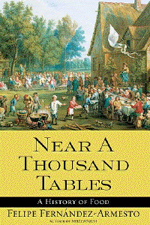
Ch. 4 “The Edible Earth:
Managing Plant Life for Food”
raises the question
“Why did they bother?”
Simon & Schuster 2003

Slide 53
Ch. 4 “The Edible Earth:
Managing Plant Life for Food”
raises the question
“Why did they bother?”

Slide 54
Ch. 4 “The Edible Earth:
Managing Plant Life for Food”
raises the question
That’s a very good question . . .

Slide 55
Ch. 4 “The Edible Earth:
Managing Plant Life for Food”
raises the question
What do you think?

Slide 56
the consequences of
“Neolithic”
(food production)
activities included
new settlement patterns
new technologies
profound biocultural effects

Slide 57
and the agricultural revolution in all parts of the world usually included . . .
population growth
establishment of large, sedentary villages
opportunity for increased social interaction
but with added health risks
The Cultural Feast, 2nd Ed., p. 55

Slide 58
Indian Knoll
Hardin Village
foragers
agriculturalists
ca. 5,000 ybp
ca. 1,000 ybp
despite a higher incidence of malnutrition and disease in the agricultural population, domestication of plants and animals was associated with population growth
The Cultural Feast, 2nd Ed., p. 55

Slide 59
Indian Knoll
Hardin Village
foragers
agriculturalists
ca. 5,000 ybp
ca. 1,000 ybp
“Hardin Village, like millions [sic.] of agricultural communities, increased significantly, growing from 100 to 300 people over a 150-year period”
The Cultural Feast, 2nd Ed., p. 55

Slide 60
Indian Knoll
Hardin Village
foragers
agriculturalists
ca. 5,000 ybp
ca. 1,000 ybp
“Thus, although overall health was poorer,
food production allowed a much larger population to live together than the previous way of life could sustain.”
The Cultural Feast, 2nd Ed., p. 55

Slide 61
Biocultural Consequences: Population
people clustered into villages
women had more children
even early settlements quickly reached considerable size

Slide 62
Social and Political Consequences
of the Agricultural Revolution
population growth
establishment of large, sedentary villages
opportunity for increased social interaction
but with added health risks
The Cultural Feast, 2nd Ed., p. 55

Slide 63
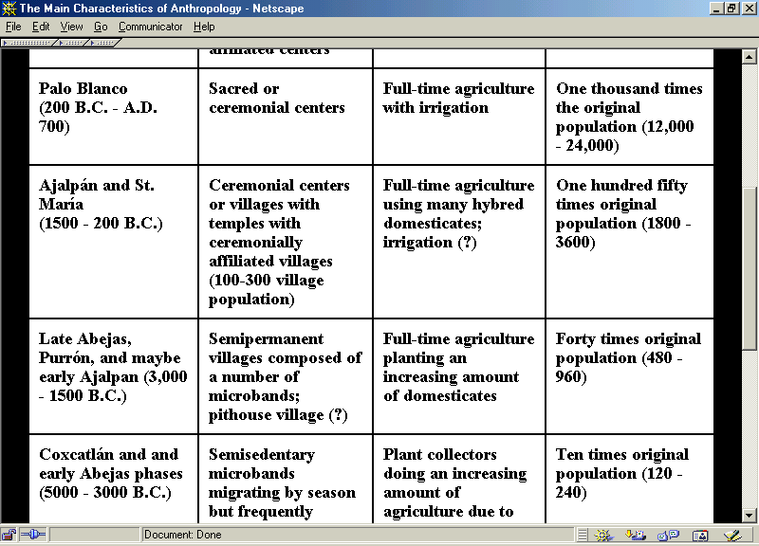
at Tehuacán, Mexico (see Tehuacán slide set for details)

Slide 64
Social and Political Consequences
of the Agricultural Revolution
population growth
establishment of large, sedentary villages
opportunity for increased social interaction
but with added health risks
The Cultural Feast, 2nd Ed., p. 55

Slide 65
Biocultural Consequences: Diet and Health
early food producers faced health risks due to close proximity to domesticated animals
dogs carry rabies
horses carry tetanus
pigs and poultry carry influenza
AIDs was derived from chimpanzees

Slide 66
Biocultural Consequences: Diet and Health
early food producers faced health risks due to close proximity to . . .
larger numbers of other humans

Slide 67
Biocultural Consequences: Population
around the world
population size
and density
increased
with the agricultural revolution

Slide 68
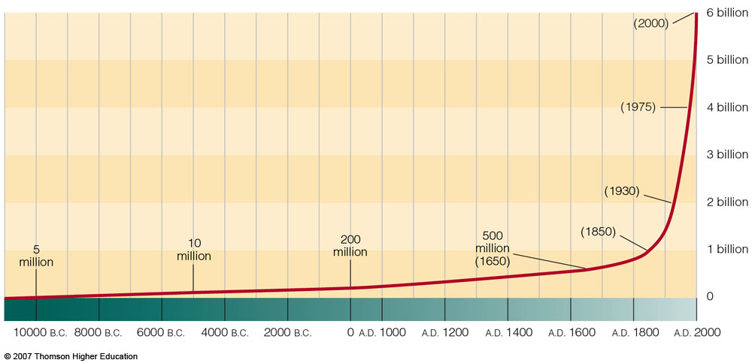
Biocultural Consequences: Population
World population growth
Understanding Physical Anthropology and Archaeology, 9th Ed., p. 365

Slide 69
Biocultural Consequences: Population
useful terms:
demographic increase
pertains to the size or rate of increase of human populations

Slide 70
Biocultural Consequences: Population
useful terms:
carrying capacity
is the population the environment
can sustain

Slide 71
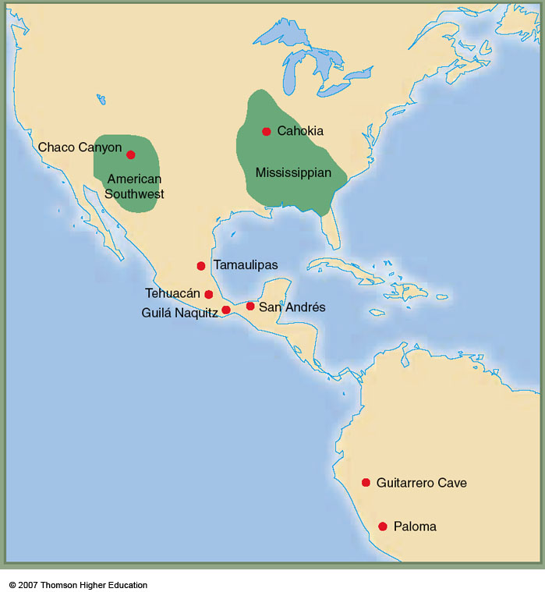
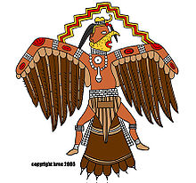
Mississippian
one of the best known Mississippian sites is the city of Cahokia near Collinsville, Illinois, not far from Indian Knoll and Hardin Village
Cahokia was the largest pre-Columbian city
in North America . . .
Understanding Physical Anthropology and Archaeology, 9th Ed., p. 358

Slide 72
Cahokia
Illinois

Slide 73
Cahokia
Illinois
Hardin
Village
Kentucky
Indian
Knoll
Kentucky

Slide 74
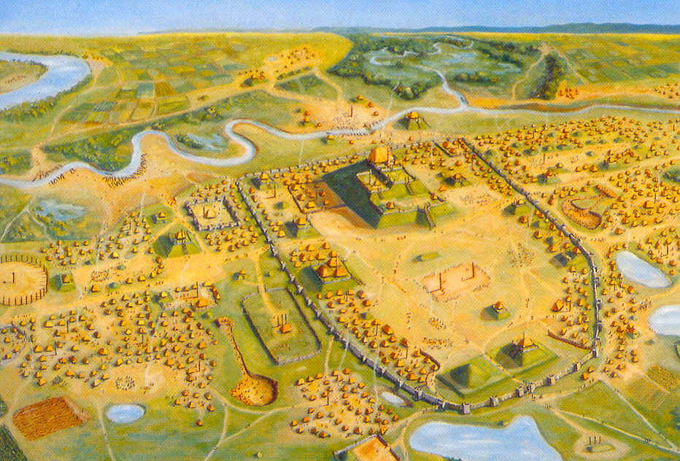
“In the 12th century [Cahokia] was as large as London!”
“It was the largest city in America until Philadelphia outgrew it in 1800! 1800! “
http://www.meredith.edu/nativeam/cahokia.htm
Cahokia William R. Iseminger Cahokia Mounds State Historic Site Collinsville, Illinois

Slide 75
Cahokia William R. Iseminger Cahokia Mounds State Historic Site Collinsville, Illinois

Slide 76
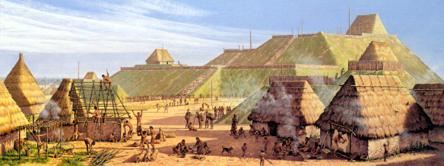
"Community Life“ at Cahokia Michael Hampshire Cahokia Mounds State Historic Site Collinsville, Illinois

Slide 77
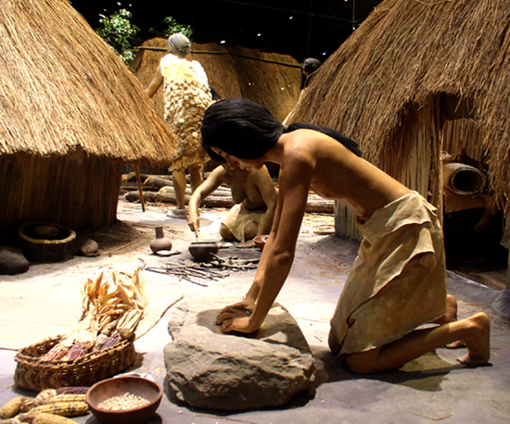
Woman Grinding Maize
Cahokia Mounds State Historic Site Collinsville, Illinois

Slide 78
Cahokia,
Illinois
A.D. 600 – 1400
2,200 acres
pop. 8,000 - 40,000
http://en.wikipedia.org/wiki/Cahokia

Slide 79
Cahokia,
Illinois
and at Cahokia, as elsewhere,
compared to hunting/gathering/foraging
agriculture and its concomitant sociocultural changes are not particularly healthy . . .

Slide 80
Cahokia,
Illinois
and as cities become as large as Cahokia, with a population of from 8,000 - 40,000 (depending on the timeframe) — as compared with a small village like Hardin Village, with 100-300 people — the problems with water safety, waste disposal, caring for the deceased, food security, infectious diseases, and the like, multiply exponentially . . .

Slide 81
“Mississippi Culture” A.D. 800 to ca., 1200 pop. 600-1170
Dickson Mounds,
Illinois
Hardin
Village,
Kentucky
Cahokia
Illinois
Indian
Knoll,
Kentucky
and the same was true even with small cities like around
Dickson Mounds, in Illinois, with an estimated population between 600-1200 people — problems with water safety, waste disposal, food security, infectious diseases, nutritional deficits, and the like, become major problems not present in the same way in hunting/gathering/foraging societies

Slide 82
and so for all these reasons, and more . . .
in the health and welfare contest
the winners will usually be . . .

Slide 83
and so for all these reasons, and more . . .
in the health and welfare contest
the winners will usually be . . .
foragers
foragers
agriculturalists
better life expectancies
lower infant mortality
no iron-deficiency anemia
growth arrests periodic and short
fewer infections
less bone inflammation
less tooth decay and abscessing
and a whole lot more . . .

Slide 84
and it’s a first round knockout when comparing traditional hunters and gatherers with modern sedentary Homo sapiens sapiens . . .
foragers
foragers
agriculturalists
better life expectancies
lower infant mortality
no iron-deficiency anemia
growth arrests periodic and short
fewer infections
less bone inflammation
less tooth decay and abscessing

Slide 85
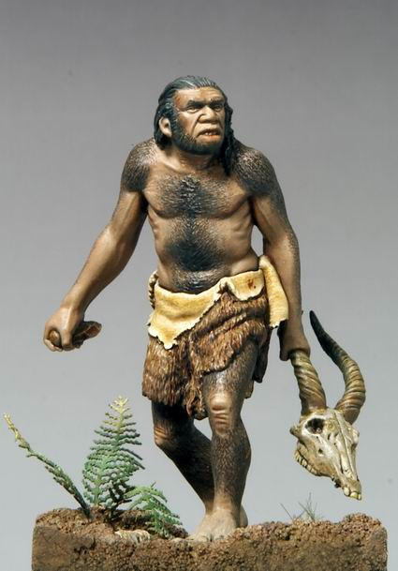
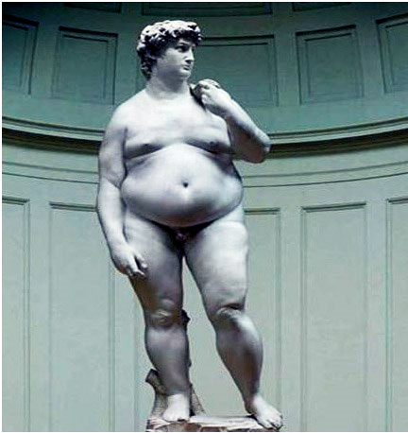
and it’s a first round knockout when comparing traditional hunters and gatherers with modern sedentary Homo sapiens sapiens . . .
foragers
foragers
agriculturalists
better life expectancies
lower infant mortality
no iron-deficiency anemia
growth arrests periodic and short
fewer infections
less bone inflammation
less tooth decay and abscessing
http://www.topnews.in/neanderthals-might-have-been-wiped-out-due-cannibalism-222988 http://mybroadband.co.za/vb/showthread.php/121380-Michelangelo-s-David

Slide 86
Nutritional Consequences
of the Agricultural Revolution:
A Comparison
of Foragers and Agriculturalists
(Indian Knoll and Hardin Village)
Anthropology of Food
University of Minnesota Duluth
Tim Roufs
©2009-2024

