Slide 1
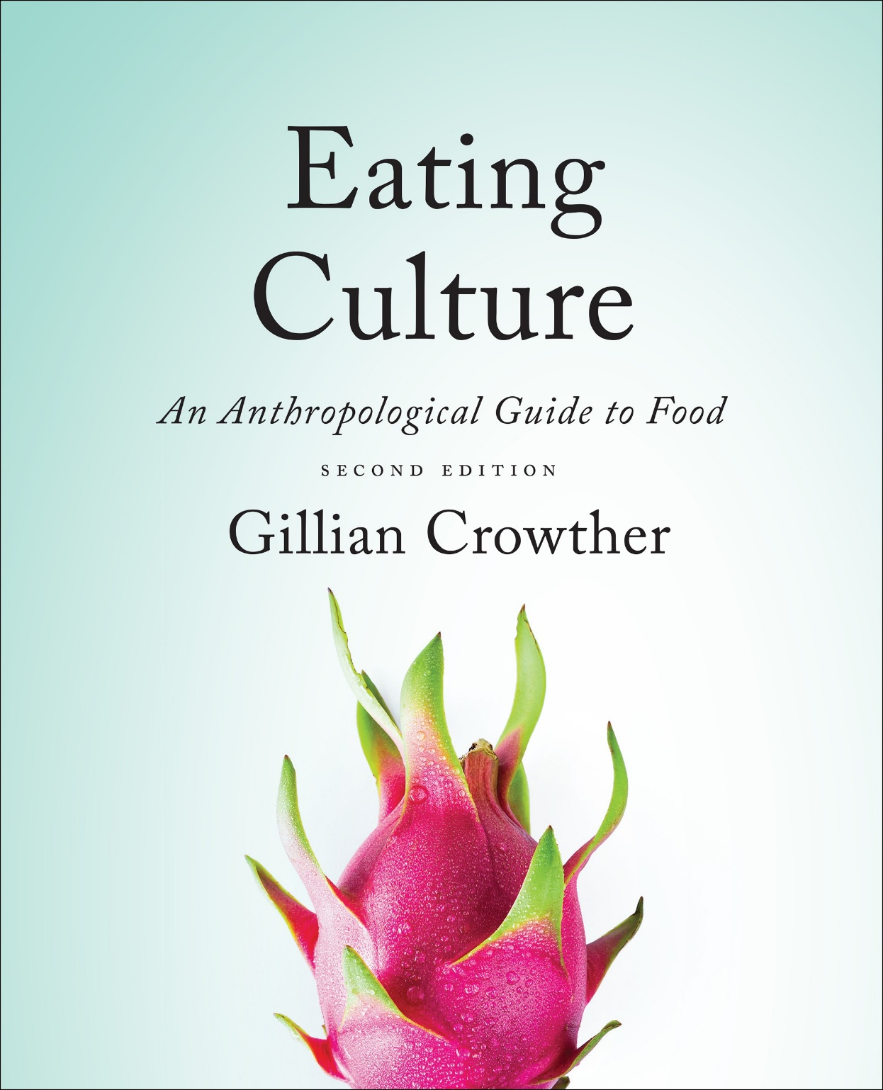
Diet and Evolution:
Using Chemistry
use your up/down arrow keys and/or
your space bar to advance the slides
Tim Roufs
© 2010-2024

Slide 2
Diet and Evolution:
Using Chemistry
Tim Roufs
© 2010-2024

Slide 3
Tim Roufs
© 2010-2024
www.d.umn.edu/cla/faculty/troufs/anthfood/aftexts.html#title

Slide 4
Diet and Human Evolution
  Exploring the Diets of Extinct Humans
  Through Paleontology
      Teeth
      Skulls and Jaws
      The Postcranial Skeleton
  What Is Adaptation?
  Using Chemistry to Infer the Diets
  of Extinct Hominini
  Our Place in Nature
  A Brief Who's Who of the Early Hominini
  What Did Early Hominini Eat?
  What Can We Say About the Diets of Fossil Homo?
  Summary
  Highlight: Lactose Intolerance

Slide 5
Diet and Human Evolution
  Exploring the Diets of Extinct Humans
  Through Paleontology
      Teeth
      Skulls and Jaws
      The Postcranial Skeleton
  What Is Adaptation?
  Using Chemistry to Infer the Diets
  of Extinct Hominini
  Our Place in Nature
  A Brief Who's Who of the Early Hominini
  What Did Early Hominini Eat?
  What Can We Say About the Diets of Fossil Homo?
  Summary
  Highlight: Lactose Intolerance
  Using Chemistry to Infer the Diets
  of Extinct Hominini

Slide 6
. . . in the last 20 years techniques for analyzing the chemistry of prehistoric bone and on other remains have become very reliable
carbon stable isotope analysis
nitrogen stable isotope analysis
isotopes are chemical elements that have the same atomic number but different atomic weights
The Cultural Feast, 2nd ed., p. 27

Slide 7
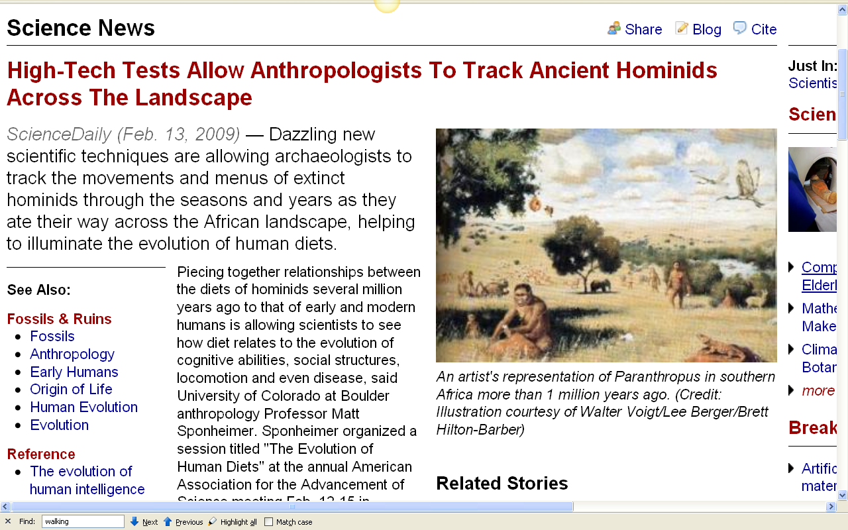
http://www.sciencedaily.com/releases/2009/02/090212150838.htm
Notes:
7

Slide 8
. . . in the last 20 years techniques for analyzing the chemistry of prehistoric bone and on other remains have become very reliable
on teeth (stable after eruption)
on bone (constantly rebuilding itself)
on stone tools and ceramics . . .
The Cultural Feast, 2nd ed., p. 27

Slide 9
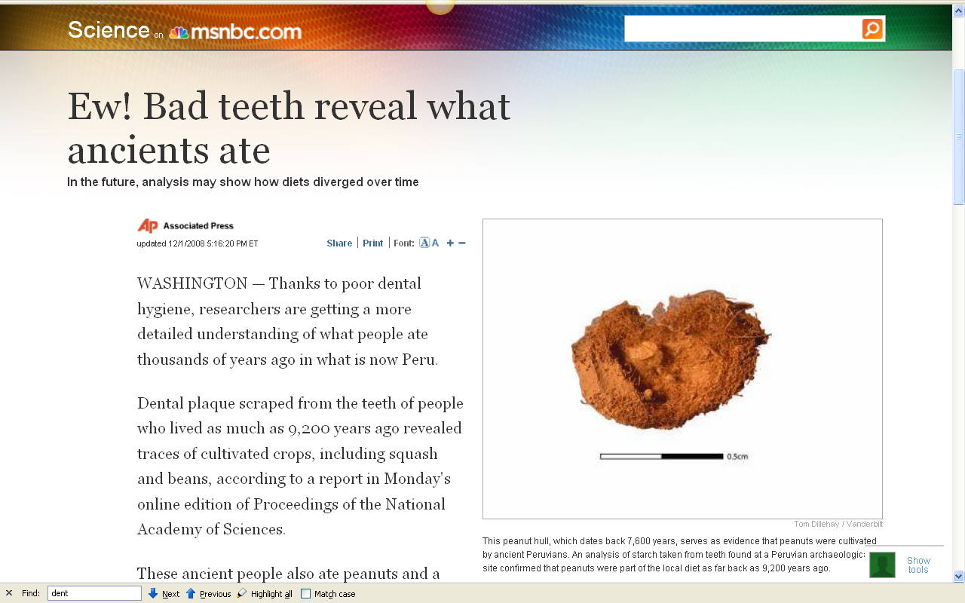
http://www.msnbc.msn.com/id/28000618/
Notes:
9

Slide 10
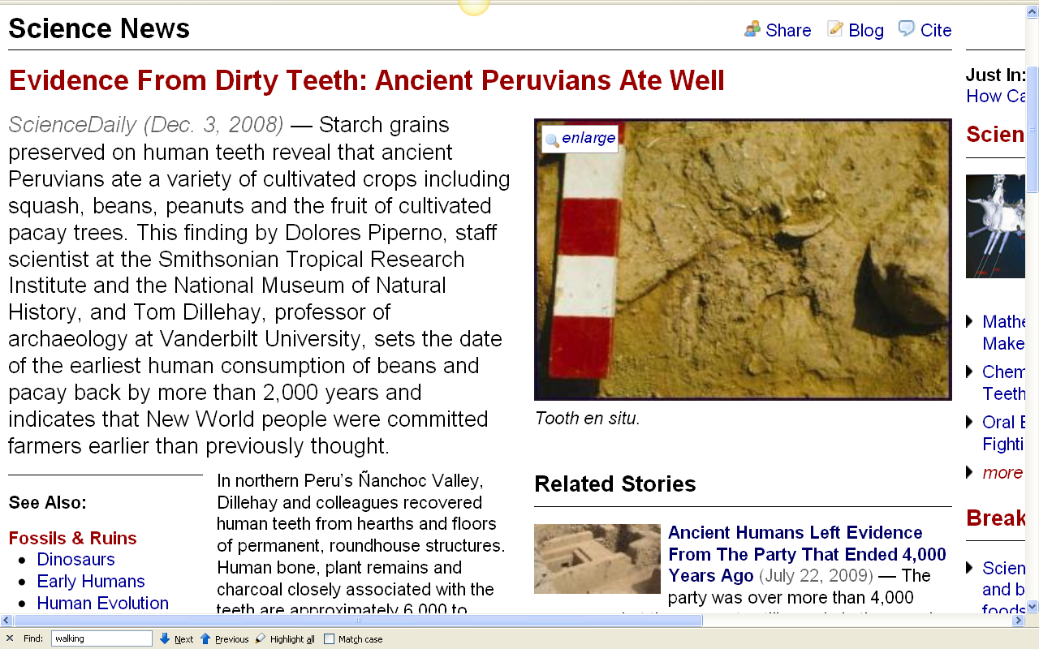
http://www.sciencedaily.com/releases/2008/12/081201200121.htm
Notes:
10

Slide 11
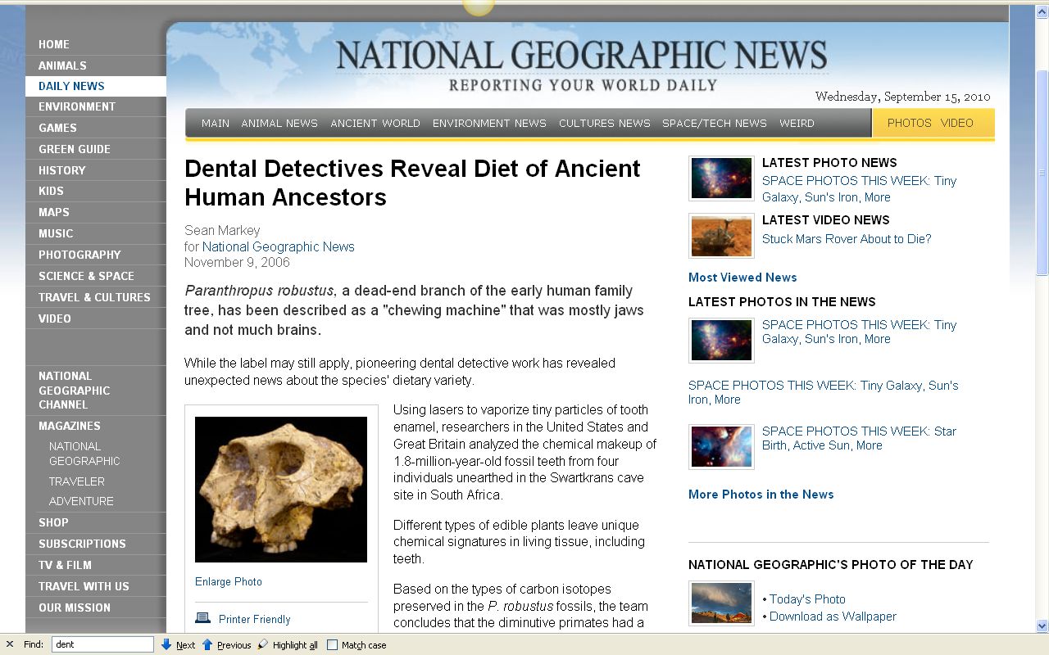
http://news.nationalgeographic.com/news/2006/11/061109-teeth-diet.html
Notes:
11

Slide 12
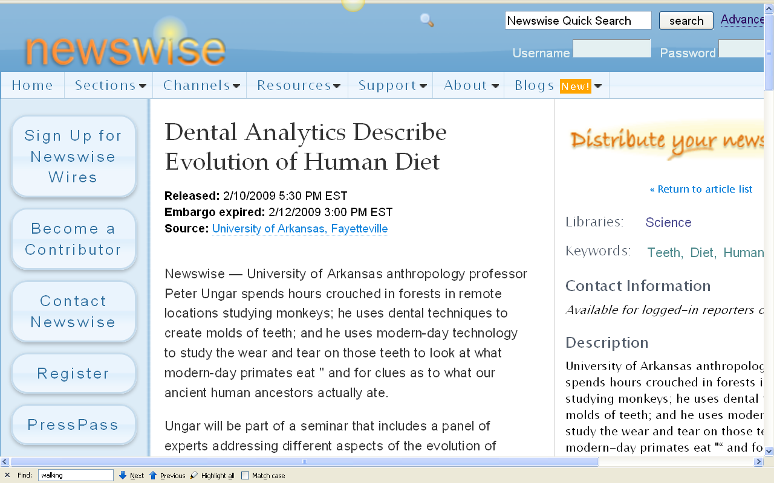
http://www.newswise.com/articles/view/549004/?sc=rssn
Notes:
12

Slide 13
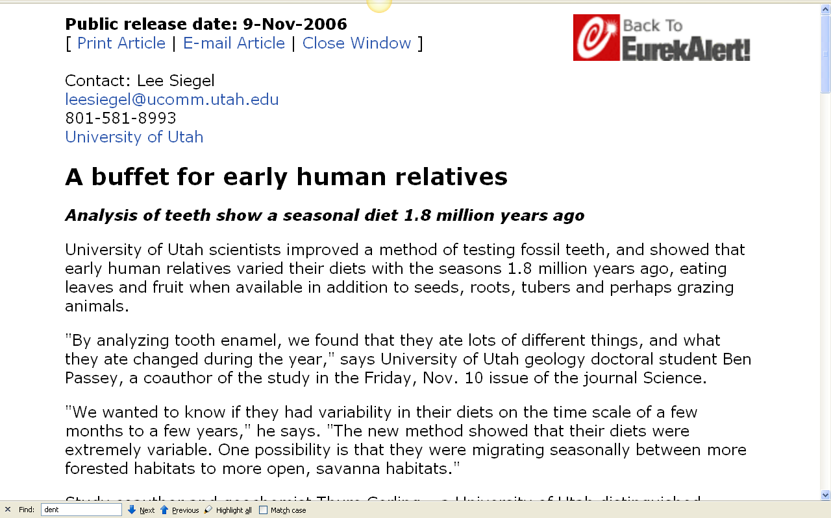
http://www.eurekalert.org/pub_releases/2006-11/uou-abf110306.php
Notes:
13

Slide 14
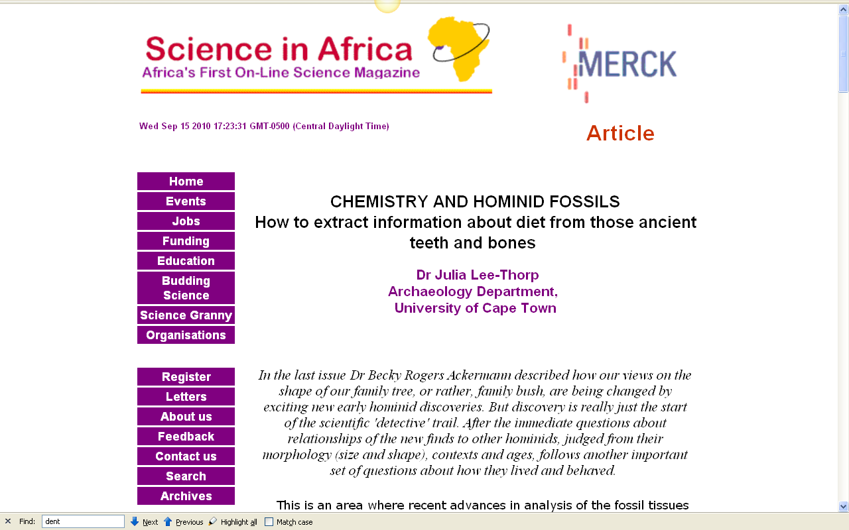
http://www.scienceinafrica.co.za/2001/december/hominids.htm
Notes:
14

Slide 15
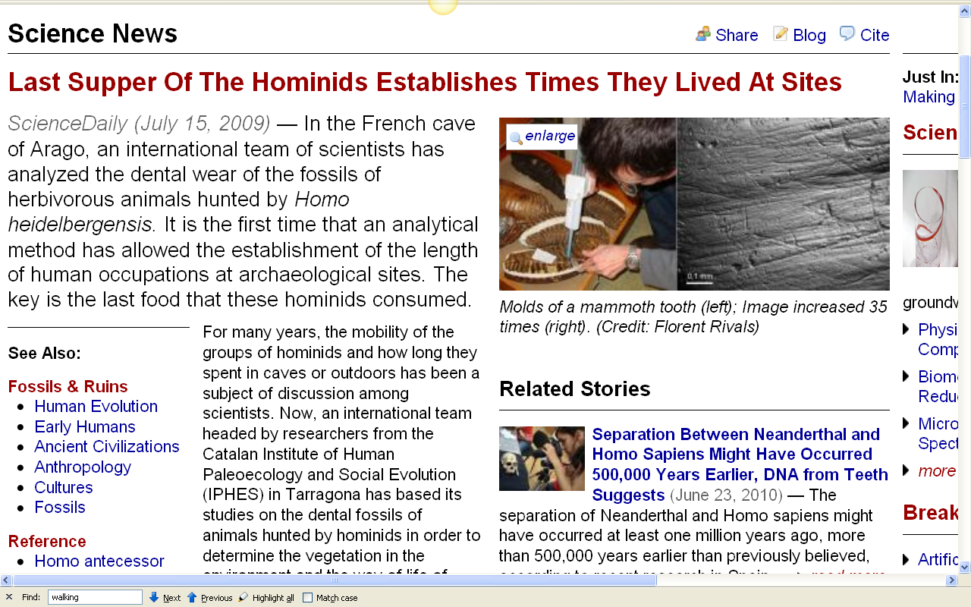
http://www.sciencedaily.com/releases/2009/07/090714103526.htm
Notes:
15

Slide 16
. . . in the last 20 years techniques for analyzing the chemistry of prehistoric bone and on other remains have become very reliable
on teeth (stable after eruption)
on bone (constantly rebuilding itself)
on stone tools and ceramics . . .
The Cultural Feast, 2nd ed., p. 27

Slide 17
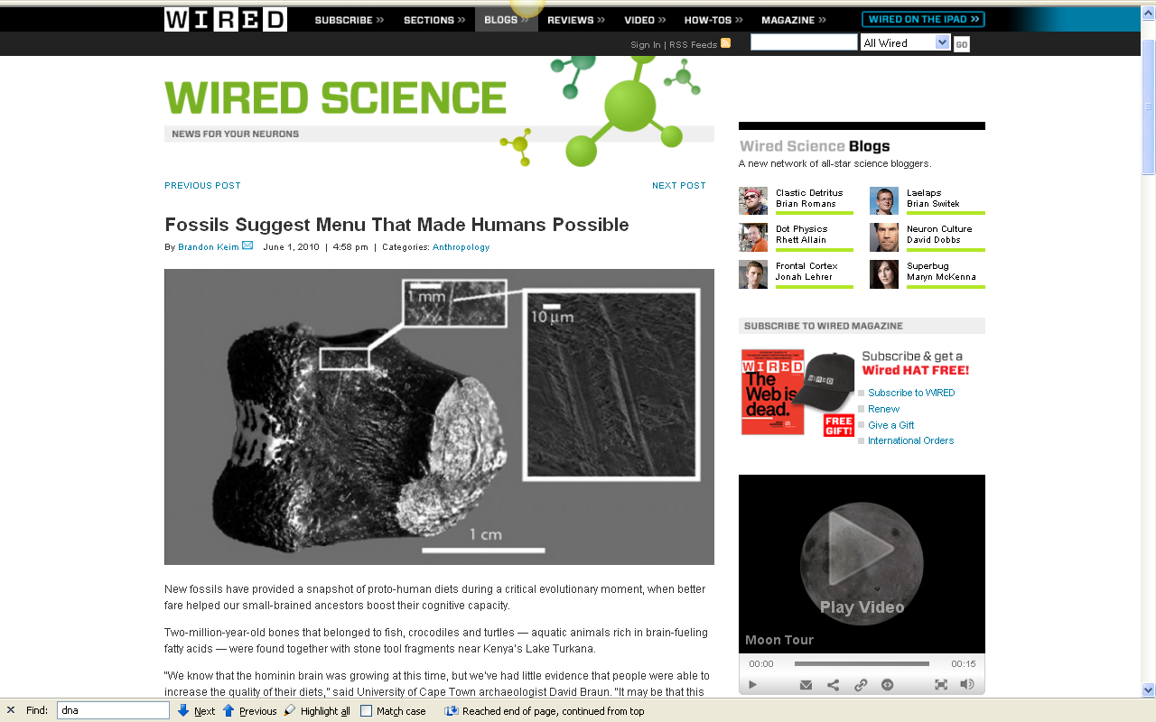
http://www.wired.com/wiredscience/2010/06/first-fish-diet/
Notes:
17

Slide 18
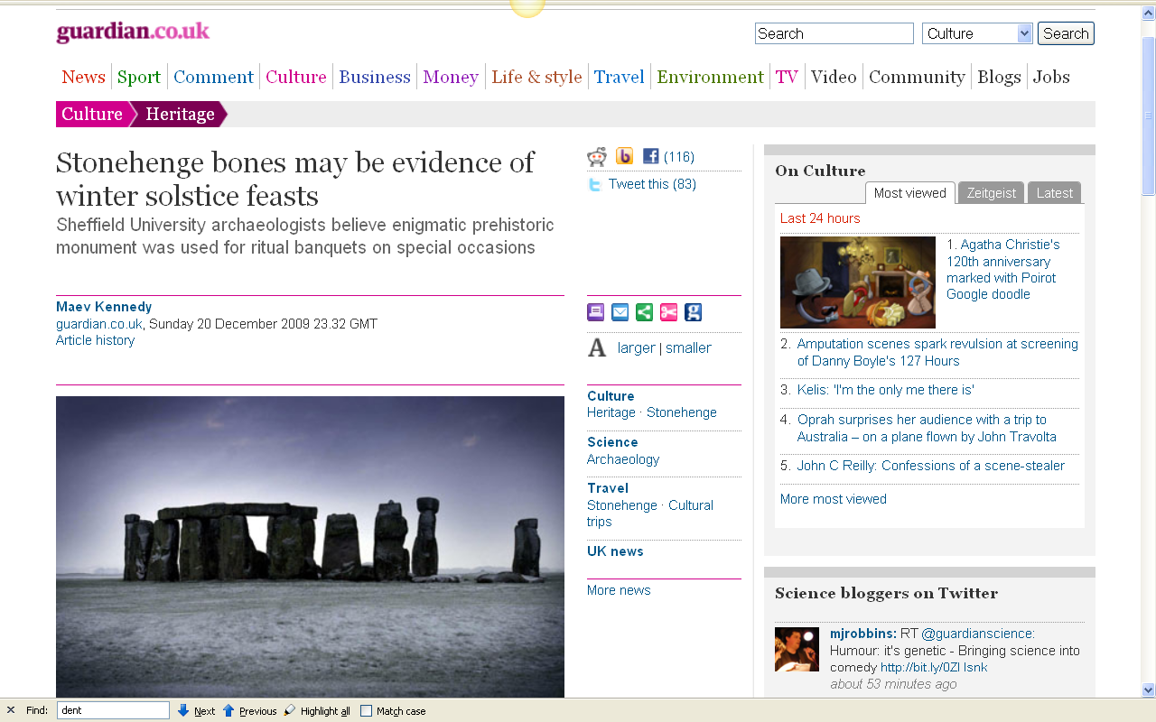
http://www.guardian.co.uk/culture/2009/dec/20/stonehenge-animal-bones-solstice-feast
Notes:
18

Slide 19
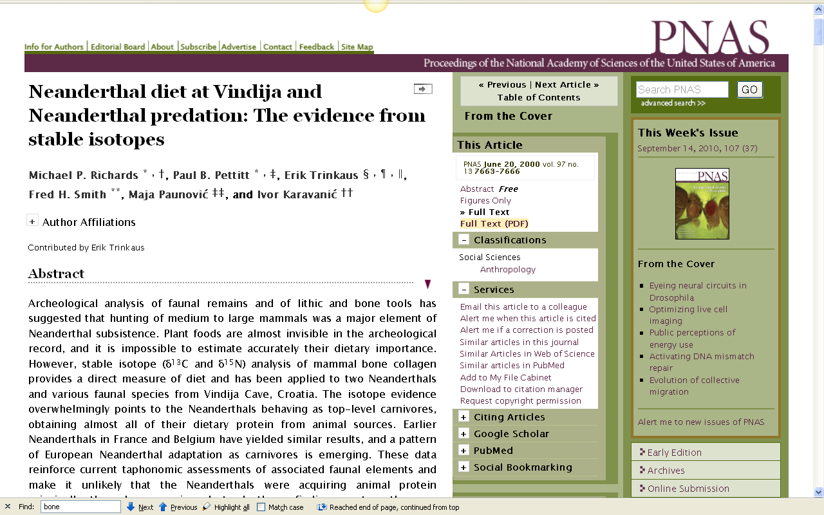
http://www.pnas.org/content/97/13/7663.full
Notes:
19

Slide 20
. . . in the last 20 years techniques for analyzing the chemistry of prehistoric bone and on other remains have become very reliable
on teeth (stable after eruption)
on bone (constantly rebuilding itself)
on stone tools and ceramics . . .
The Cultural Feast, 2nd ed., p. 27

Slide 21
. . . microscopic and chemical analysis of residues and tissues preserved on the edges of stone tools have been brought to bear on identifying the animals on whom the tools were used . . .
The Cultural Feast, 2nd ed., p. 28

Slide 22
. . . and microscopic and chemical analysis has been used for
residue analysis on ceramics
to tell what foods were used . . .
The Cultural Feast, 2nd ed., p. 28

Slide 23
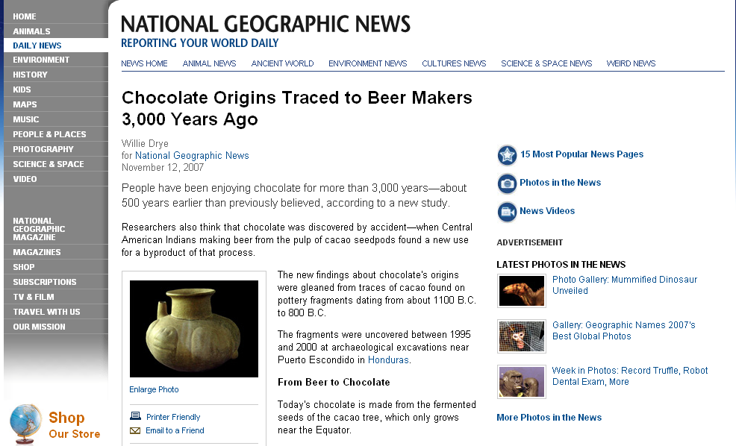
http://news.nationalgeographic.com/news/2007/11/071112-chocolate.html
Notes:
23

Slide 24
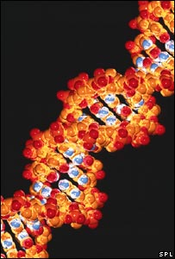
. . . and DNA studies are critical . . .
http://news.bbc.co.uk/2/hi/science/nature/7132794.stm

Slide 25
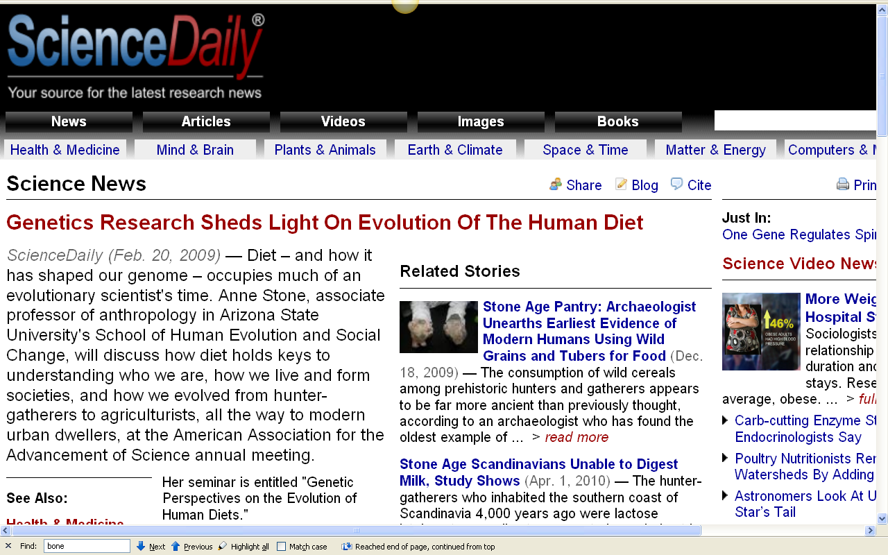
http://www.sciencedaily.com/releases/2009/02/090212150822.htm

Slide 26
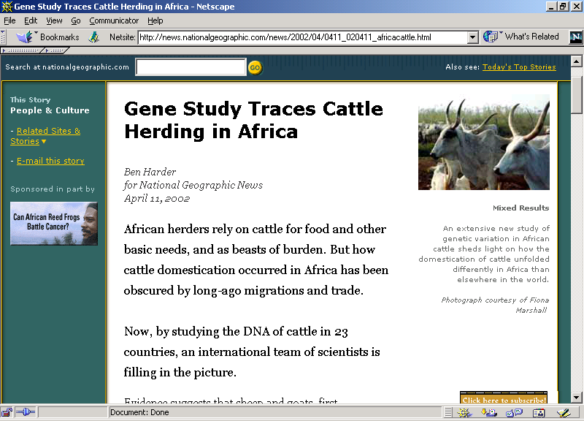

Slide 27
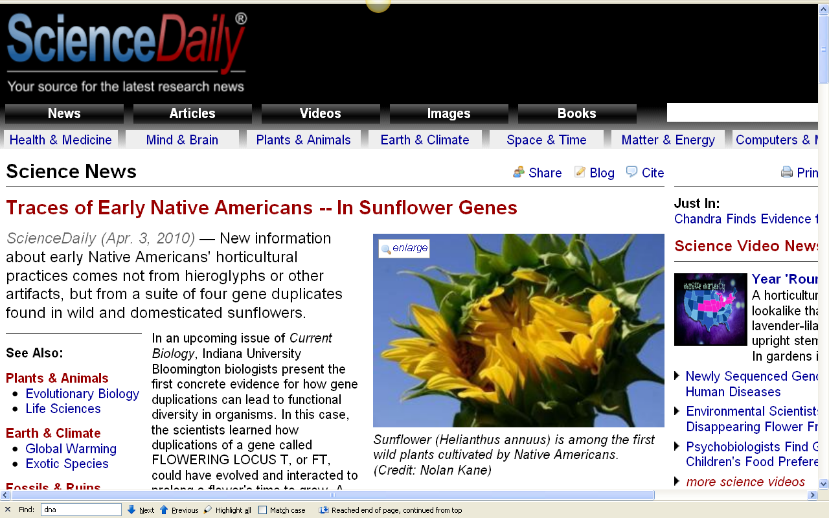
http://www.sciencedaily.com/releases/2010/04/100402110131.htm

Slide 28
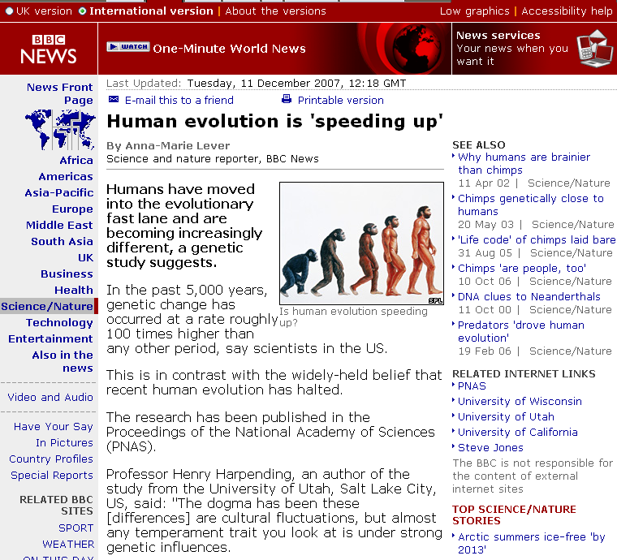
http://news.bbc.co.uk/2/hi/science/nature/7132794.stm

Slide 29
seven percent of human genes are undergoing rapid evolution
http://news.bbc.co.uk/2/hi/science/nature/7132794.stm

Slide 30
“The study looked specifically at genetic variations called
"single nucleotide polymorphisms,"
or SNPs.
These are single-point mutations,
or changes, in the genetic sequence of DNA on chromosomes.”
Seven percent of human genes are undergoing rapid evolution
http://news.bbc.co.uk/2/hi/science/nature/7132794.stm

Slide 31
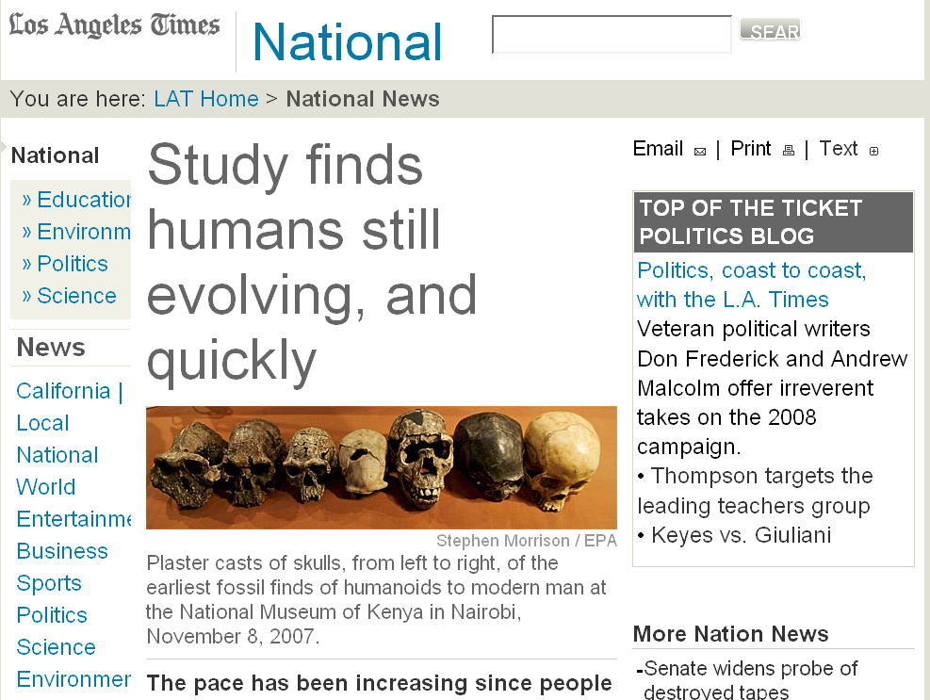
Seven percent of human genes are undergoing rapid evolution
http://www.latimes.com/news/nationworld/nation/la-sci-evolution11dec11,1,2206745.story?coll=la-headlines-nation&ctrack=2&cset=true

Slide 32
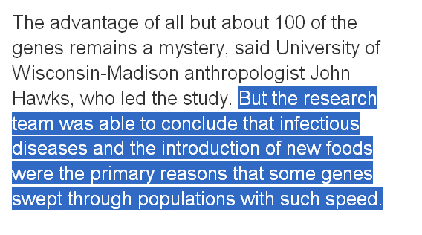
Seven percent of human genes are undergoing rapid evolution
http://www.latimes.com/news/nationworld/nation/la-sci-evolution11dec11,1,2206745.story?coll=la-headlines-nation&ctrack=2&cset=true

Slide 33
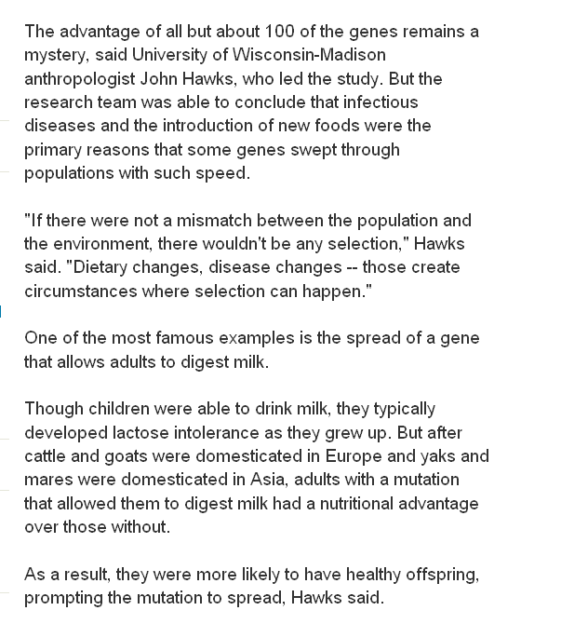
Seven percent of human genes are undergoing rapid evolution
http://www.latimes.com/news/nationworld/nation/la-sci-evolution11dec11,1,2206745.story?coll=la-headlines-nation&ctrack=2&cset=true

Slide 34
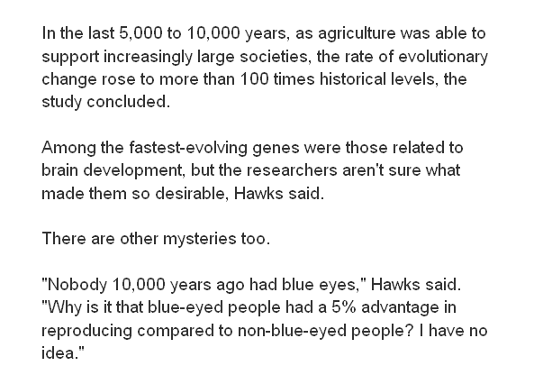
Seven percent of human genes are undergoing rapid evolution
http://www.latimes.com/news/nationworld/nation/la-sci-evolution11dec11,1,2206745.story?coll=la-headlines-nation&ctrack=2&cset=true

Slide 35
Seven percent of human genes are undergoing rapid evolution
http://www.latimes.com/news/nationworld/nation/la-sci-evolution11dec11,1,2206745.story?coll=la-headlines-nation&ctrack=2&cset=true

Slide 36
^{some important terms}

Slide 37
tropic level
an animal
or a plant’s position
in the food chain
The Cultural Feast, 2nd ed., p. 28

Slide 38
photosynthesis
the chemical process green plants use to convert carbon dioxide and water, in the presence of sunlight, into organic compounds
The Cultural Feast, 2nd ed., p. 27

Slide 39
collagen
the predominant protein
in bones
and tooth pulps
The Cultural Feast, 2nd ed., p. 27

Slide 40
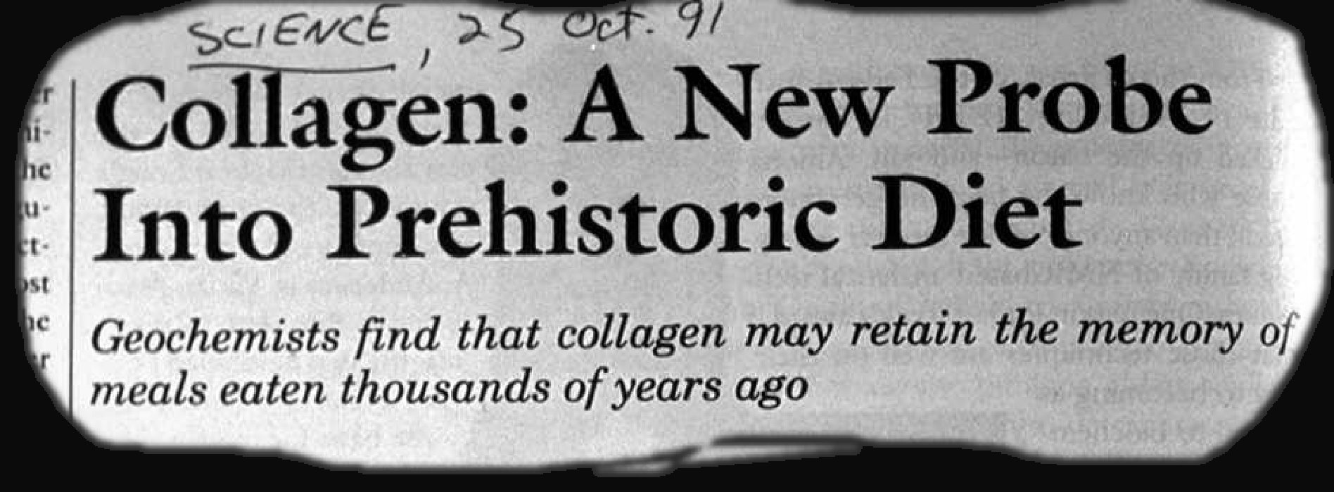

Slide 41
and looking at all of these sorts of things allows us to have a better understanding of prehistoric food use and its implications . . .

Slide 42
Diet and Human Evolution
  Exploring the Diets of Extinct Humans
  Through Paleontology
      Teeth
      Skulls and Jaws
      The Postcranial Skeleton
  What Is Adaptation?
  Using Chemistry to Infer the Diets
  of Extinct Hominini
  Our Place in Nature
  A Brief Who's Who of the Early Hominini
  What Did Early Hominini Eat?
  What Can We Say About the Diets of Fossil Homo?
  Summary
  Highlight: Lactose Intolerance

Slide 43
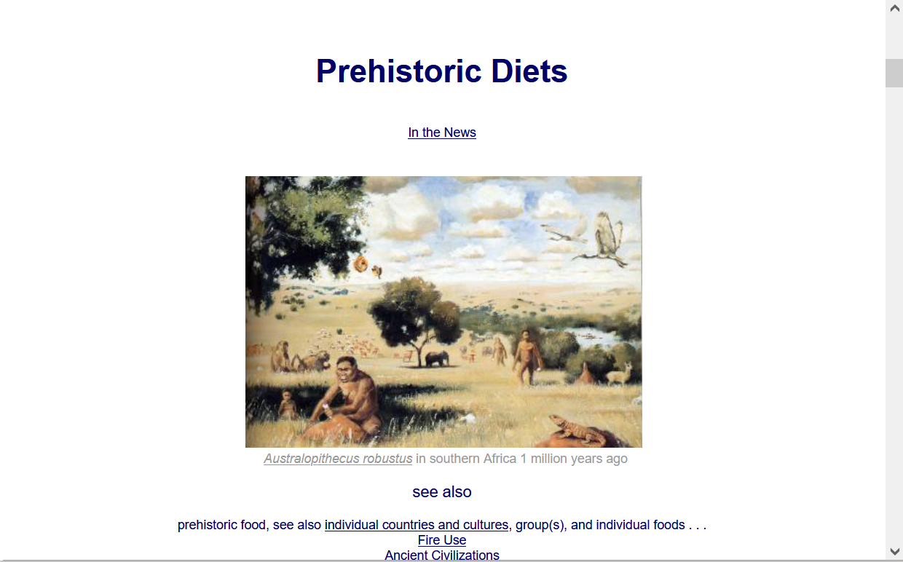
  For more information see the class Prehisoric Diets Web Page . . .
https://www.d.umn.edu/cla/faculty/troufs/anth1602/pcdiet.html#title

Slide 44
Diet and Evolution:
Using Chemistry
Tim Roufs
© 2010-2024

