Slide 1
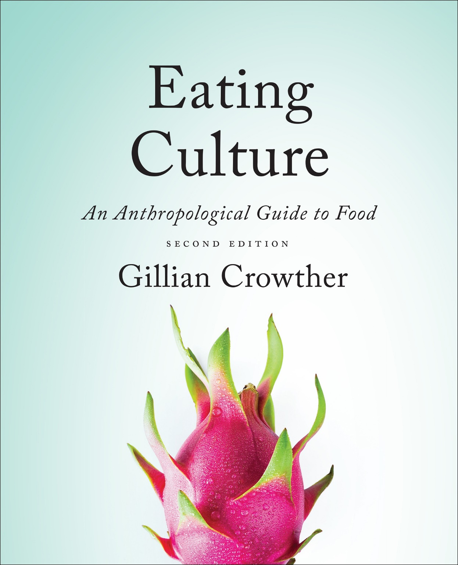
Diet and Evolution:
Our Place in Nature
use your up/down arrow keys and/or
your space bar to advance the slides
Tim Roufs
© 2010-2024

Slide 2
Diet and Evolution:
Our Place in Nature
Tim Roufs
© 2010-2024

Slide 3
Tim Roufs
© 2010-2024
www.d.umn.edu/cla/faculty/troufs/anthfood/aftexts.html#title

Slide 4
“Diet and Human Evolution”
Exploring the Diets of Extinct Humans Through Paleontology
Teeth
Skulls and Jaws
The Postcranial Skeleton
What Is Adaptation?
Using Chemistry to Infer the Diets of Extinct Hominids
Our Place in Nature
A Brief Who's Who of the Early Hominids
What Did Early Hominids Eat?
What Can We Say About the Diets of Fossil Homo?
Summary
Highlight: Lactose Intolerance

Slide 5
the main point:
the basic pattern of human evolution can not be seen as the simple linear transformation of one species into another, culminating in us . . .
The Cultural Feast, 2nd ed., p. 29

Slide 6
bottom lines:
our family “tree”
is more like a bush
2. there is not a single unbroken line from early hominins to contemporary humans
The Cultural Feast, 2nd ed., p. 29

Slide 7
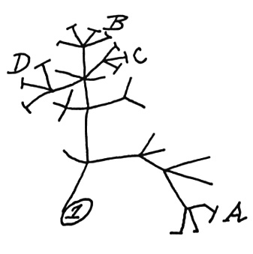
Darwin's first evolutionary tree
1837
notebook “B”
Cambridge University library
http://en.wikipedia.org/wiki/Charles_Darwin

Slide 8
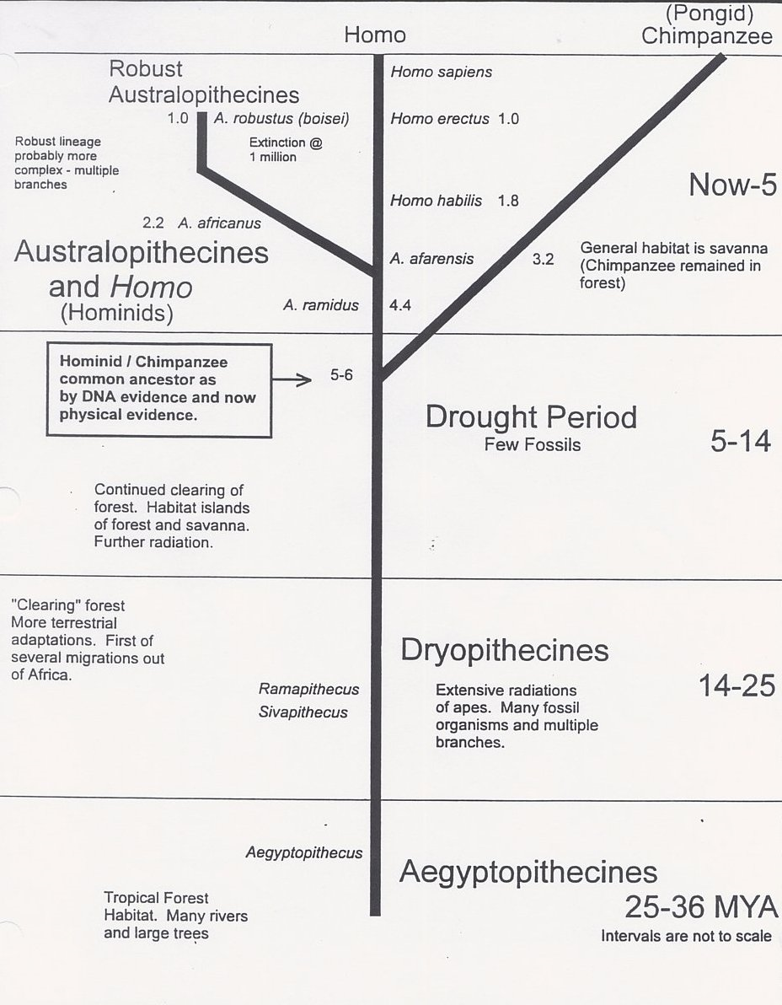
http://www.biorlz.info/pictures/evo.jpg

Slide 9
at least 18 hominin species are currently named in the literature
The Cultural Feast, 2nd ed., p. 29

Slide 10
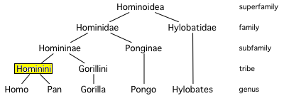
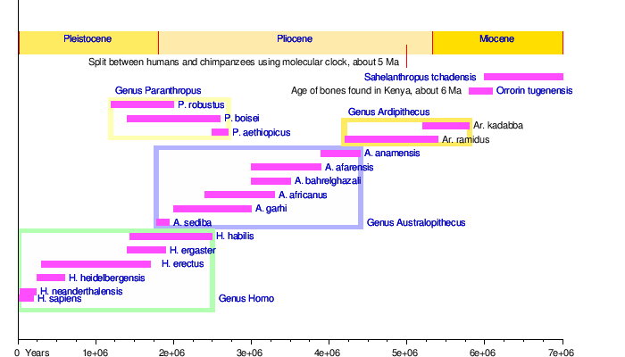
http://en.wikipedia.org/wiki/Hominini

Slide 11
http://en.wikipedia.org/wiki/Human_evolution

Slide 12
so this might be a better representation
of our past
than a “family tree” . . .

Slide 13
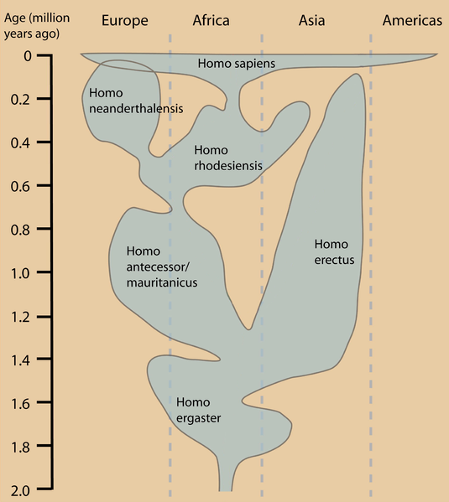
http://en.wikipedia.org/wiki/Human_evolution

Slide 14
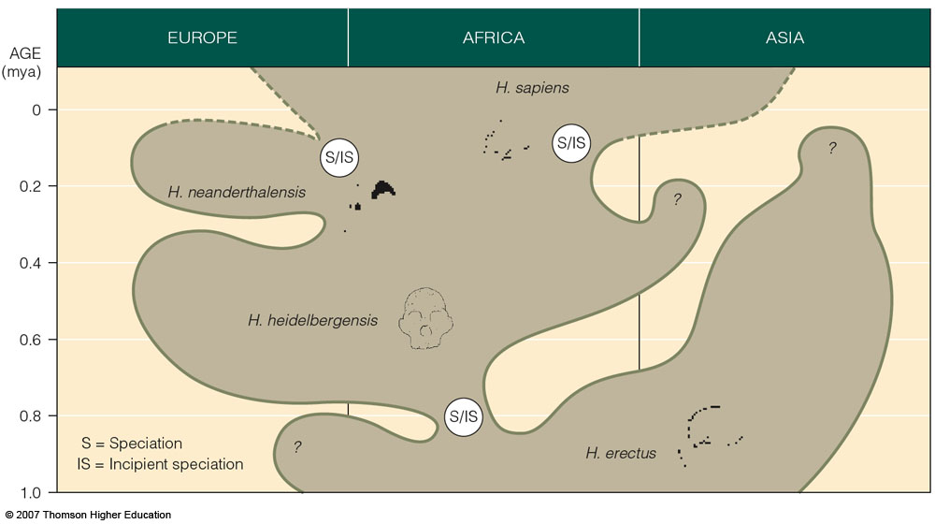
or something like this . . .
Possible evolutionary relationships of
Middle and Upper Pleistocene hominids
Understanding Physical Anthropology and Archaeology, 9th ed., p. 271

Slide 15
For more information see the class Prehisoric Diets Web Page . . .
https://www.d.umn.edu/cla/faculty/troufs/anth1602/pcdiet.html#title

Slide 16
Diet and Evolution:
Our Place in Nature
Tim Roufs
© 2010-2024

