Slide 1
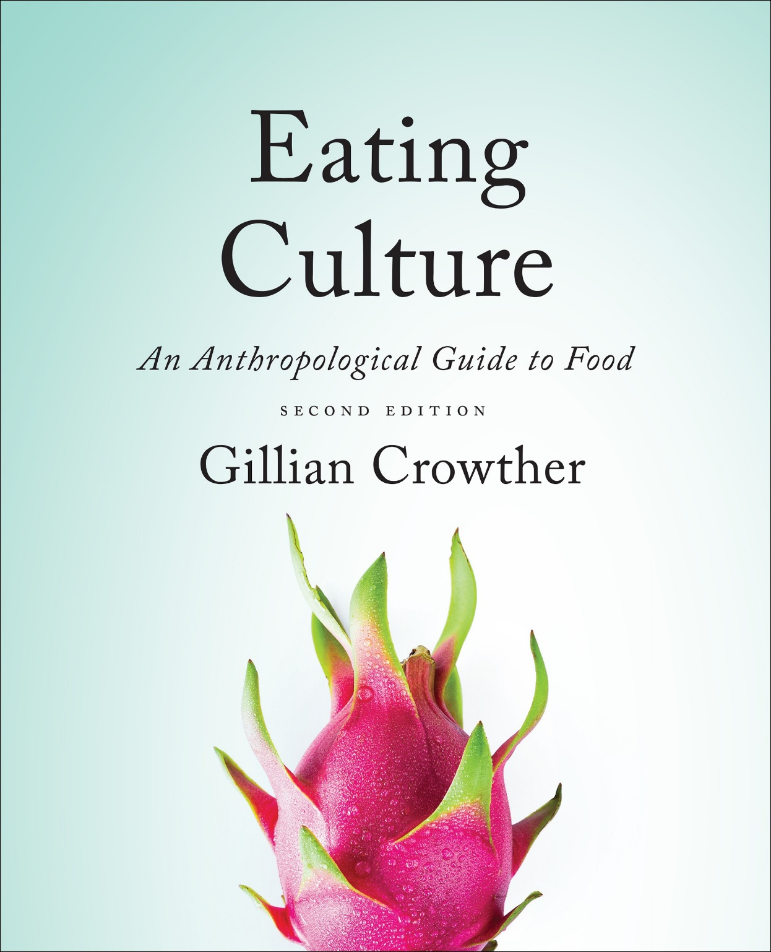
Diet and Evolution:
What Did Hominines Eat?
ca. 7 – 1.8 mya
use your up/down arrow keys and/or
your space bar to advance the slides
Tim Roufs
© 2010-2022

Slide 2
Diet and Evolution:
What Did Hominines Eat?
ca. 7 – 1.8 mya
Tim Roufs
© 2010-2022

Slide 3
Tim Roufs
© 2010-2022
www.d.umn.edu/cla/faculty/troufs/anthfood/aftexts.html#title

Slide 4
Diet and Human Evolution
Diet and Human Evolution
  Exploring the Diets of Extinct Humans
  Through Paleontology
      Teeth
      Skulls and Jaws
      The Postcranial Skeleton
  What Is Adaptation?
  Using Chemistry to Infer the Diets
  of Extinct Hominins
  Our Place in Nature
  A Brief Who's Who of the Early Hominins
  What Did Early Hominins Eat?
  What Can We Say About the Diets of Fossil Homo?
  Summary
  Highlight: Lactose Intolerance
ca. 7 – 1.8 mya

Slide 5
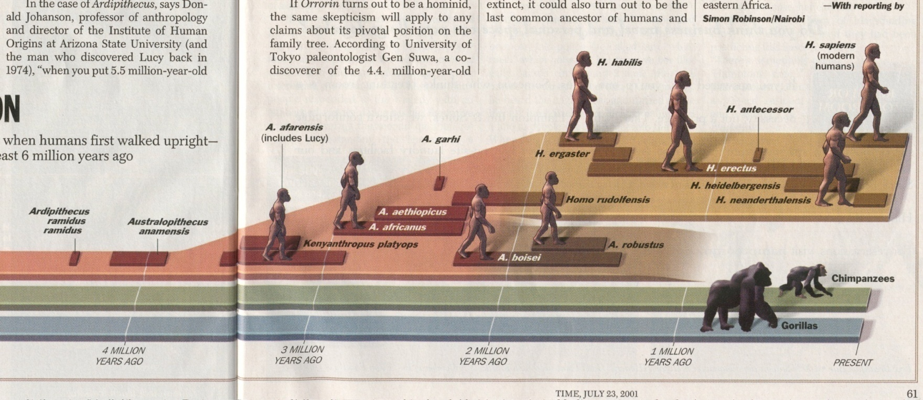
Early Hominins
ca. 7 – 1.8 mya
Time 23 July 2001

Slide 6
Diet and Human Evolution
early hominins lived in a
range of habitats,
including lake and river margins, woodland, bushland, and savanna
“Consequently, it is impossible to conceive of a specific
‘ancestral hominin diet . . .’”
The Cultural Feast, 2nd Ed., p. 33

Slide 7
Diet and Human Evolution
early hominins lived in a
range of habitats,
including lake and river margins, woodland, bushland, and savanna
“Consequently, it is impossible to conceive of a specific
‘ancestral hominin diet’ . . .”
The Cultural Feast, 2nd Ed., p. 33

Slide 8
and a quick glance
will show prehistoric folks ate quite a variety of things . . .
Notes:
8

Slide 9
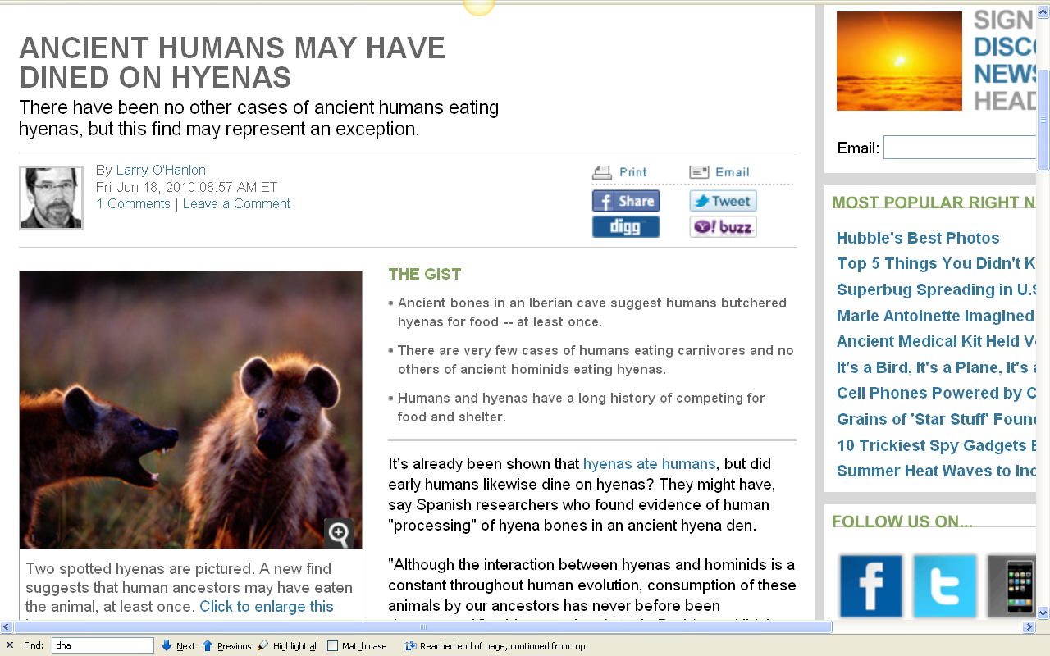
http://news.discovery.com/human/humans-hyenas-cave.html

Slide 10
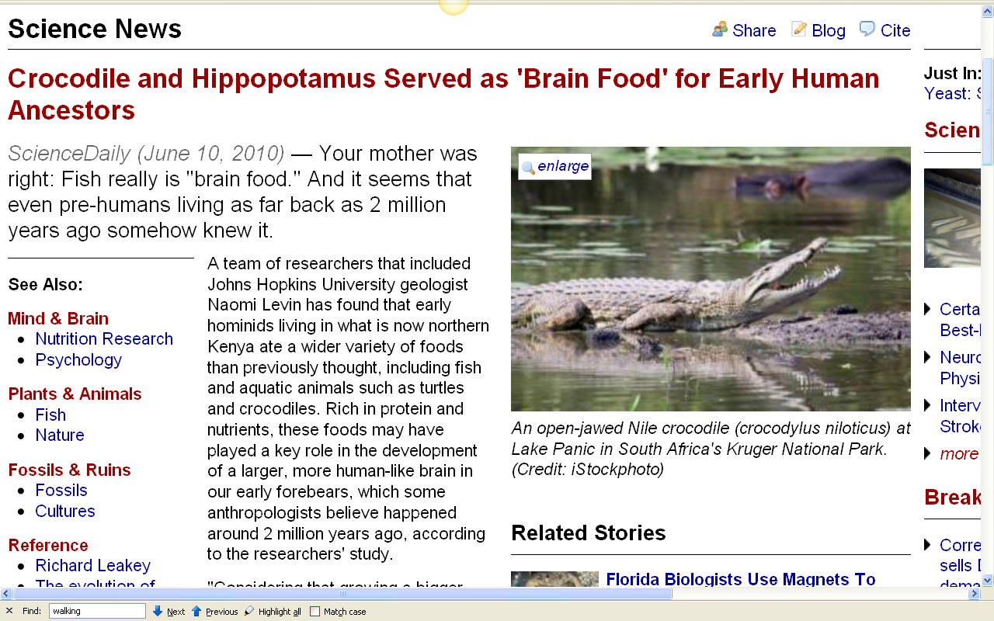
http://www.sciencedaily.com/releases/2010/06/100609122857.htm

Slide 11
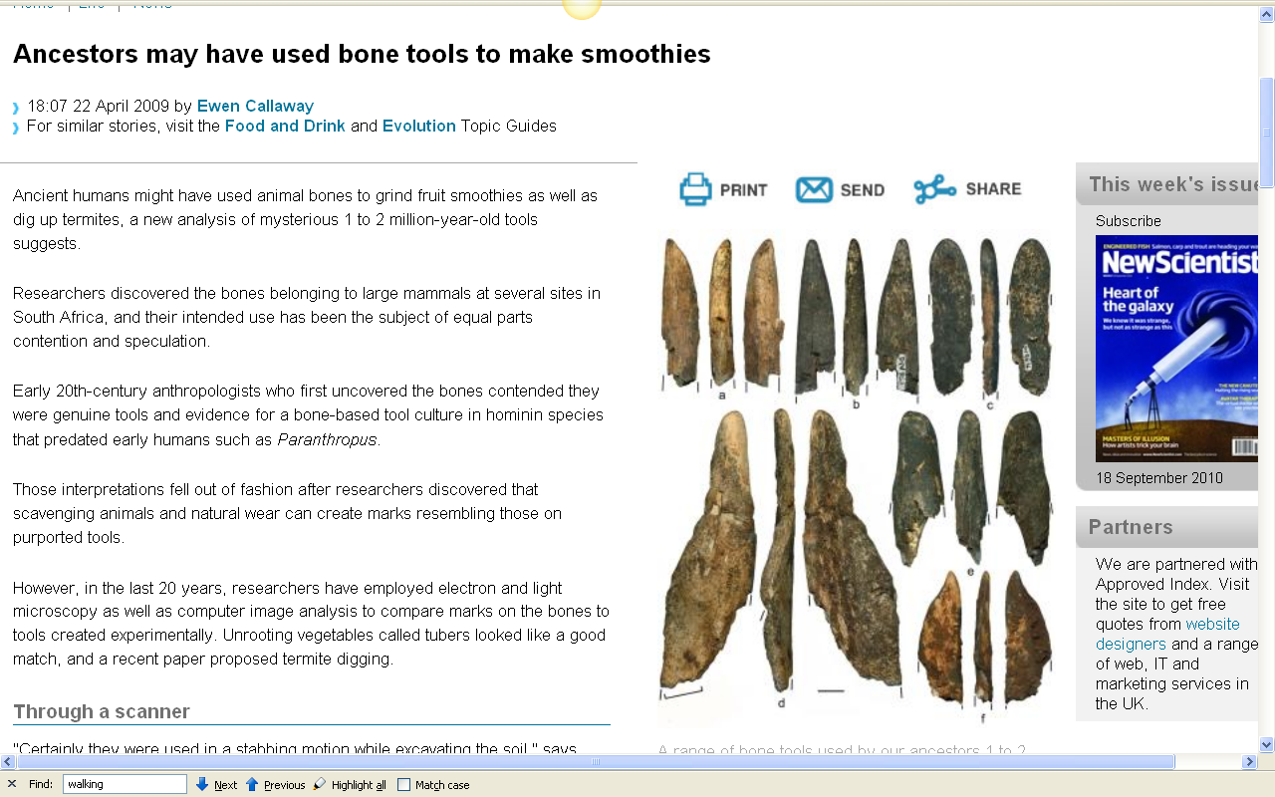
http://www.newscientist.com/article/dn17004-ancestors-may-have-used-bone-tools-to-make-smoothies.html?DCMP=OTC-rss&nsref=online-news

Slide 12
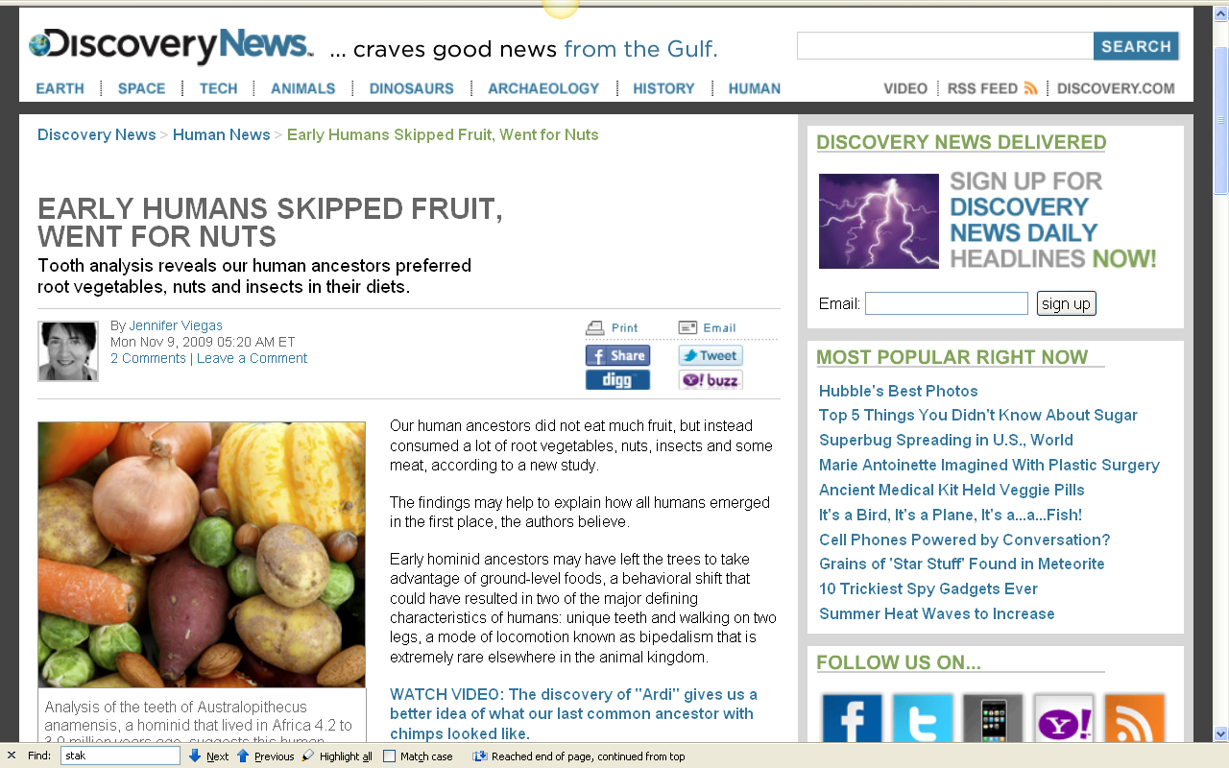
http://news.discovery.com/human/human-ancestor-diet-nuts.html

Slide 13
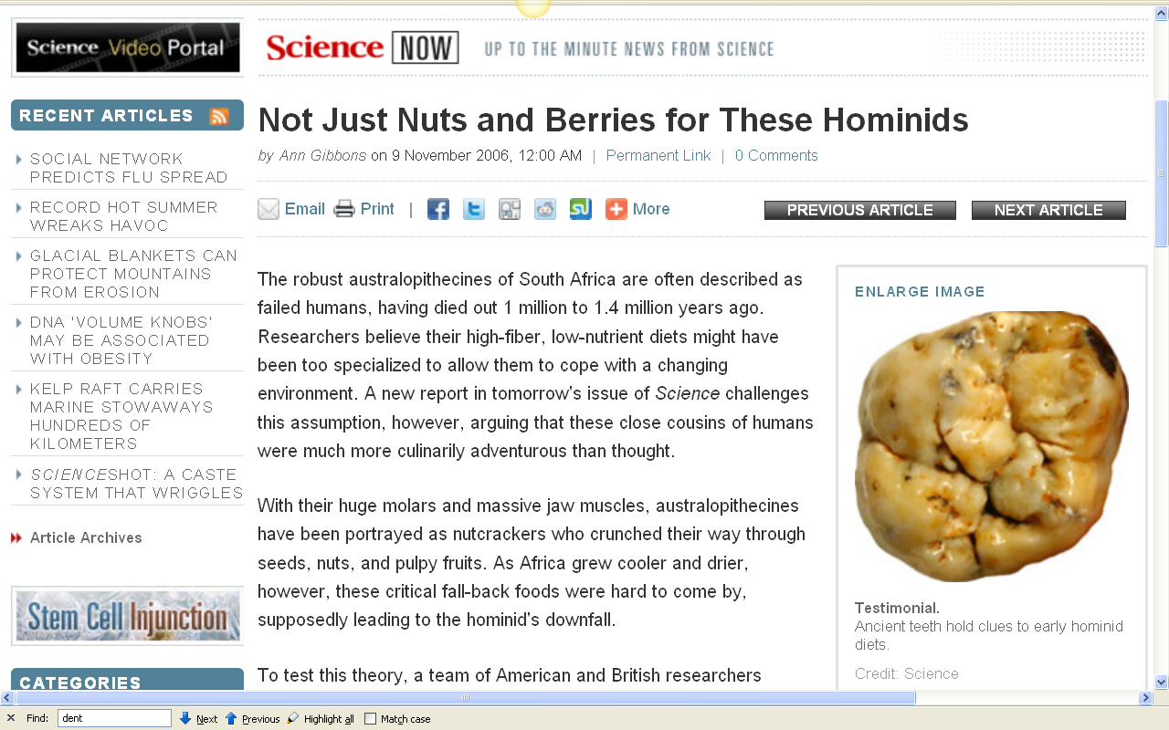
http://news.sciencemag.org/sciencenow/2006/11/09-01.html

Slide 14
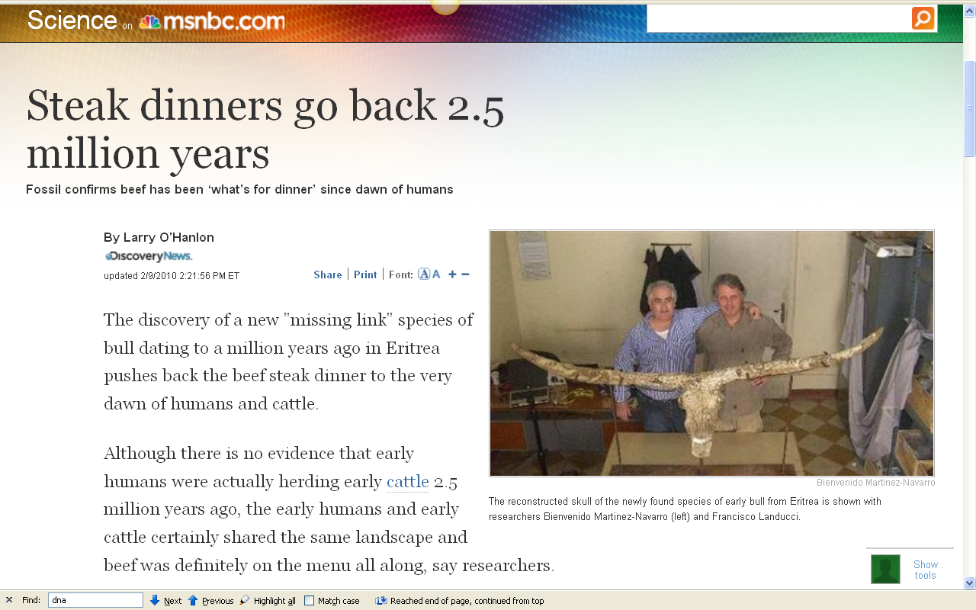
http://www.msnbc.msn.com/id/35313891/ns/technology_and_science-science/

Slide 15
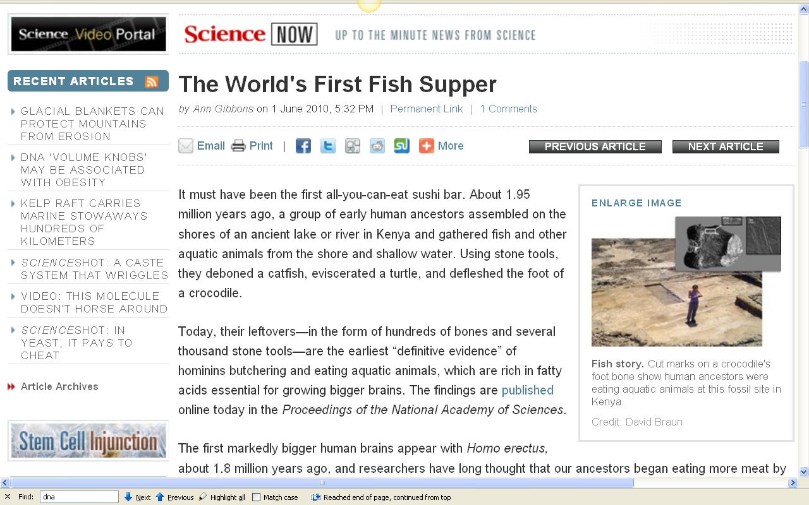
http://news.sciencemag.org/sciencenow/2010/06/the-worlds-first-fish-supper.html

Slide 16
Diet and Human Evolution
so it is clearly
. . . impossible to conceive of
a specific
ancestral hominin diet
The Cultural Feast, 2nd Ed., p. 33

Slide 17
Diet and Human Evolution
traditionally there have been two basic ideas about early hominin diets:
the robust Australopiths were the most herbivorous
compared even to the gracile Australopiths, the emergence of Homo was marked by a shift to a greater consumption of protein
The Cultural Feast, 2nd Ed., p. 33

Slide 18

Diet and Human Evolution
traditionally there have been two basic ideas about early hominin diets:
the robust Australopiths were the most herbivorous
compared even to the gracile Australopiths, the emergence of Homo was marked by a shift to a greater consumption of protein
“robust Australopiths” are also known as
(and known in The Cultural Feast as) . . .
“Paranthropus”
The Cultural Feast, 2nd Ed., p. 33

Slide 19
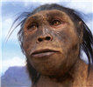
Diet and Human Evolution
traditionally there have been two basic ideas about early hominin diets:
the robust Australopiths were the most herbivorous
compared even to the gracile Australopiths, the emergence of Homo was marked by a shift to a greater consumption of protein
The Cultural Feast, 2nd Ed., p. 33

Slide 20
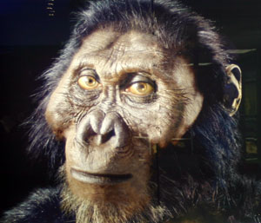
Diet and Human Evolution
but with regard to
Swartkrans (South Africa) Homo
(“Homo” = human)
the findings do not
suggest a specialized plant diet
. . . that is, there is
no significant difference from that of the Paranthropus robustus
Paranthropus robustus
The Cultural Feast, 2nd Ed., p. 33

Slide 21
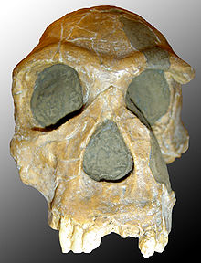
Diet and Human Evolution
and with regard to
Swartkrans (South Africa) Homo
(“Homo” = human)
here too findings do not
suggest a specialized plant diet
. . . that is, there is
no significant difference from that of the Paranthropus robustus
The Cultural Feast, 2nd Ed., p. 33

Slide 22
Diet and Human Evolution
with regard to
Swartkrans (South Africa) Homo
(“Homo” = human)
findings do not
suggest a specialized plant diet
. . . that is, there is
no significant difference from that of the Paranthropus robustus
The Cultural Feast, 2nd Ed., p. 33

Slide 23

Diet and Human Evolution
with regard to
Australopithecus afarensis
(“Lucy” and relatives)
the relatively larger surface area of their molar teeth would have favored crushing foods
their relatively smaller incisors would have prevented them from eating foods (such as husked fruits) that require incisal preparation
their thicker mandibular bodies (corpora) would have withstood high occlusal loads
their thick molar enamel would have resisted cracking and abrasion
teeth show …
The Cultural Feast, 2nd Ed., p. 33-34

Slide 24
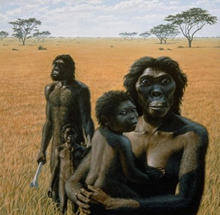
with regard to
Australopithecus afarensis
(“Lucy” and relatives)
the relatively larger surface area of their molar teeth would have favored crushing foods
their relatively smaller incisors would have prevented them from eating foods (such as husked fruits) that require incisal preparation
their thicker mandibular bodies (corpora) would have withstood high occlusal loads
their thick molar enamel would have resisted cracking and abrasion
teeth show …

Slide 25
Diet and Human Evolution
with regard to
Australopithecus afarensis
(“Lucy” and relatives)
conclusion:
they would have had difficulty dealing with tough foods
(such as tough fruits, leaves, and meat)
but would have been able to deal with abrasive as well as nonabrasive,
hard as well as brittle, and soft foods
(4.2-2.5 mya)
The Cultural Feast, 2nd Ed., p. 33-34

Slide 26
Diet and Human Evolution
taken all together
the very early hominins likely ate grasses and sedges directly,
or insects, or both
(tools older than 2.5 mya are not yet known)
The Cultural Feast, 2nd Ed., p. 33-34

Slide 27
Diet and Human Evolution
it would seem also that Paranthropus, Australopithecus, and Homo
all ate tubers and termites
The Cultural Feast, 2nd Ed., p. 34

Slide 28

Diet and Human Evolution
Australopithecus garhi
apparently made stone tools
(2.4-2.5 mya)
and butchered large-mammals
(based on the earliest evidence of stone-tool production
and the oldest indication of hominin modification of animal bones)
The Cultural Feast, 2nd Ed., p. 34

Slide 29
Diet and Human Evolution
K. Milton
(1999)
“. . . even though early humans may have had the
gut anatomy and digestive kinetics
(motions or activities)
of herbivores,
they would have
supplemented their diets with
meat-derived proteins”
The Cultural Feast, 2nd Ed., p. 34

Slide 30
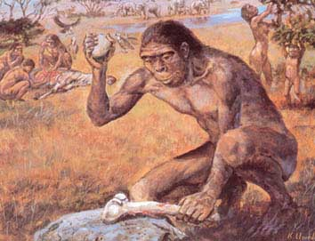
Homo habilis
http://www.avph.com.br/homohabilis.htm

Slide 31
Diet and Human Evolution
K. Milton
(1999)
suggests such a
dietary shift
with the emergence of early Homo
. . . but the tendency in the direction to supplement the diet with meat-derived proteins may have been common earlier
The Cultural Feast, 2nd Ed., p. 34

Slide 32
Diet and Human Evolution
Aiello and Wheeler
(1995)
argue that
increased consumption of animal products was essential to the evolution of the large hominin brain
. . . but some sources of protein were clearly part of some, if not all, early hominin dietary regimes millions of years before brain size increased significantly
The Cultural Feast, 2nd Ed., p. 34

Slide 33
Diet and Human Evolution
Aiello and Wheeler
(1995)
argue that
increased consumption of animal products was essential to the evolution of the large hominin brain
. . . but some sources of protein were clearly part of some, if not all, early hominin dietary regimes millions of years before brain size increased significantly
The Cultural Feast, 2nd Ed., p. 34

Slide 34
Diet and Human Evolution
thus . . .
while “. . . it is impossible to conceive of a specific
‘ancestral hominin diet’ . . .”
The Cultural Feast, 2nd Ed., p. 33

Slide 35
Diet and Human Evolution
it is clear that . . .
some sources of protein were part of some, if not all,
early hominin dietary regimes
for millions of years
The Cultural Feast, 2nd Ed., p. 34

Slide 36
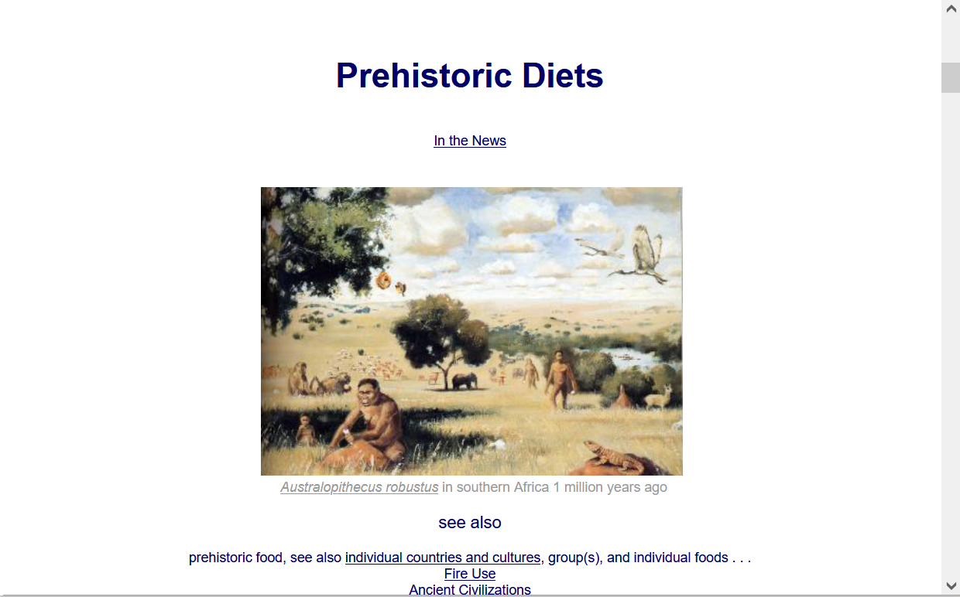
  For more information see the class Prehisoric Diets Web Page . . .
https://www.d.umn.edu/cla/faculty/troufs/anth1602/pcdiet.html#title

Slide 37
Diet and Evolution:
What Did Hominines Eat?
ca. 7 – 1.8 mya
Tim Roufs
© 2010-2022

