Slide 1
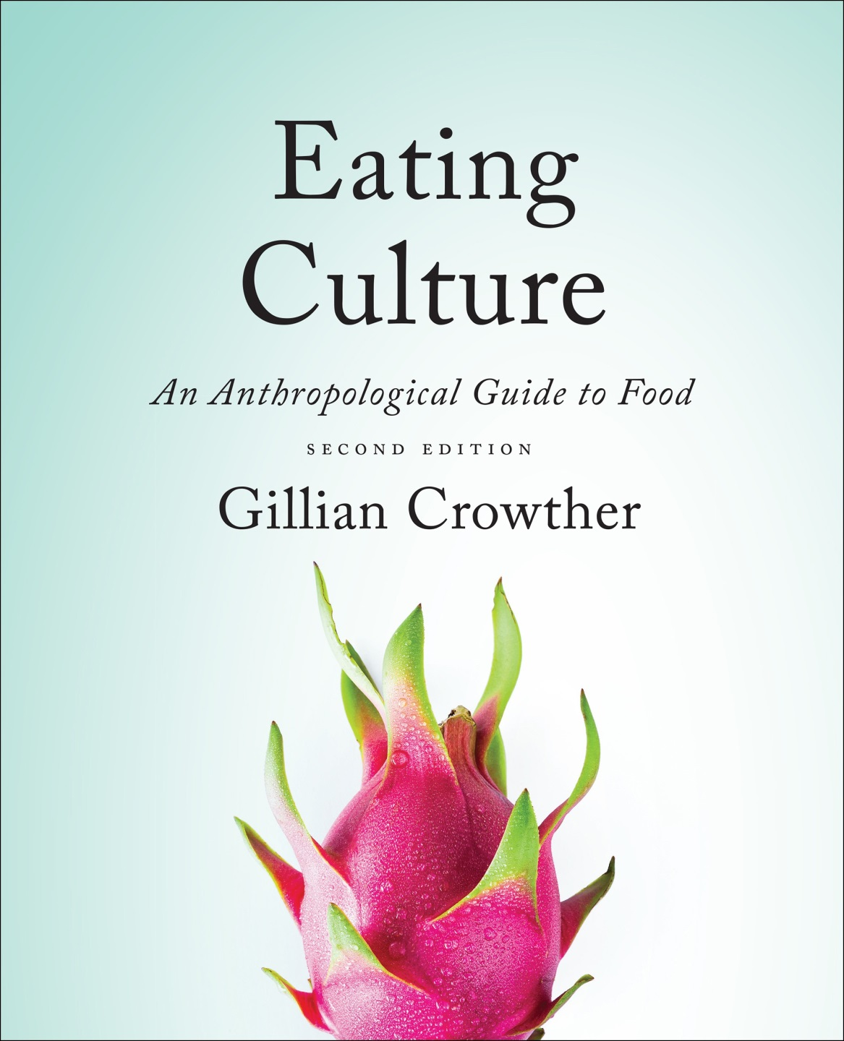
Cf. , Chapter 8
”GASTRO-ANOMIE
Global Indigestion?”:
Eating Disorders
Use your up / down arrow keys and / or
your space bar to advance the slides
Tim Roufs
© 2010-2024
www.d.umn.edu/cla/faculty/troufs/anthfood/aftexts.html#title

Slide 2
Cf. , Chapter 8
”GASTRO-ANOMIE
Global Indigestion?”:
Eating Disorders
Tim Roufs
© 2010-2024
www.d.umn.edu/cla/faculty/troufs/anthfood/aftexts.html#title

Slide 3
Tim Roufs
© 2010-2024
www.d.umn.edu/cla/faculty/troufs/anthfood/aftexts.html#title

Slide 4

Chapter 4
”Eating is a
Cultural Affair” —
Eating Disorders
pp.111-112
©Timothy G. Roufs 2010-2024

Slide 5
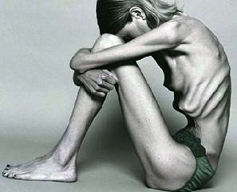
  Part of the explanation for eating disorders can be physical . . .

Slide 6
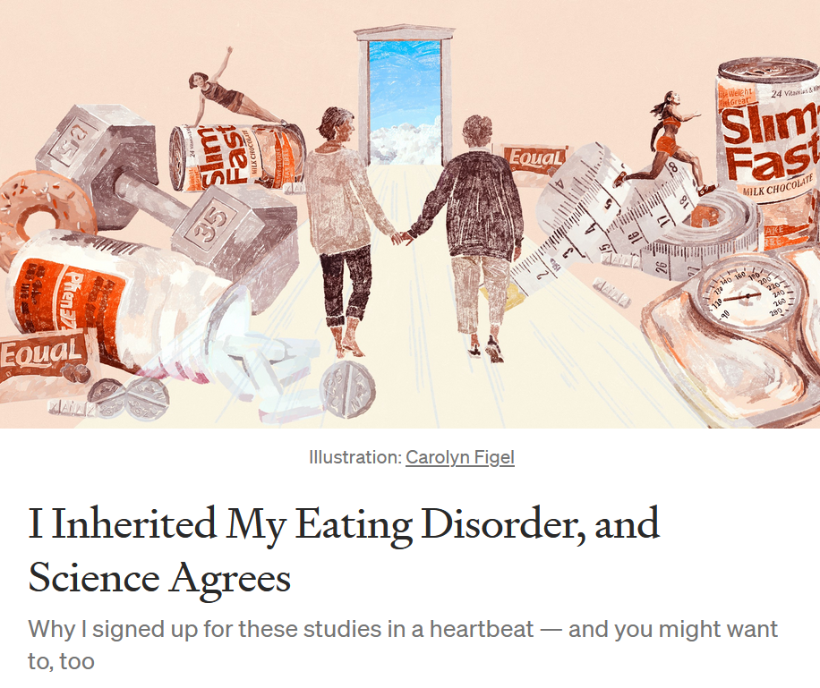

20 October 2021
https://news.illinoisstate.edu/2021/04/social-media-effects-on-body-image-and-eating-disorders/

Slide 7
  Part of the explanation for eating disorders can be physical . . .
  But most analysists focus on cultural and psychological factors . . .

Slide 8
  For example, numerous studies have shown that exposure to images [cultural] of ultrathin models can lead to body dissatisfaction and eventually to unhealthy eating behaviors and physical illness [physical] . . .
The Cultural Feast, 2nd ed., p. 115

Slide 9

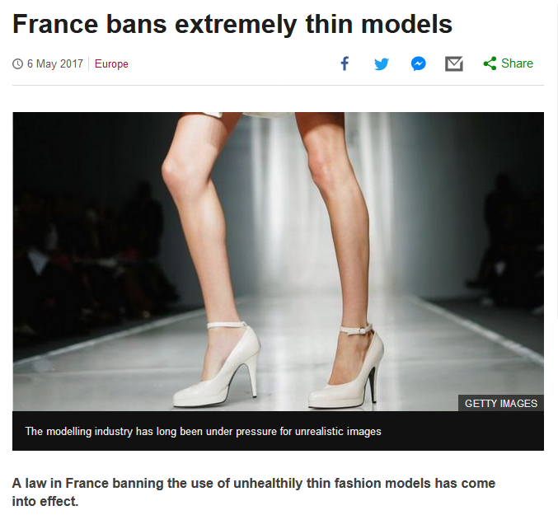
http://www.bbc.com/news/world-europe-39821036http://www.bbc.com/news/world-europe-39821036

Slide 10
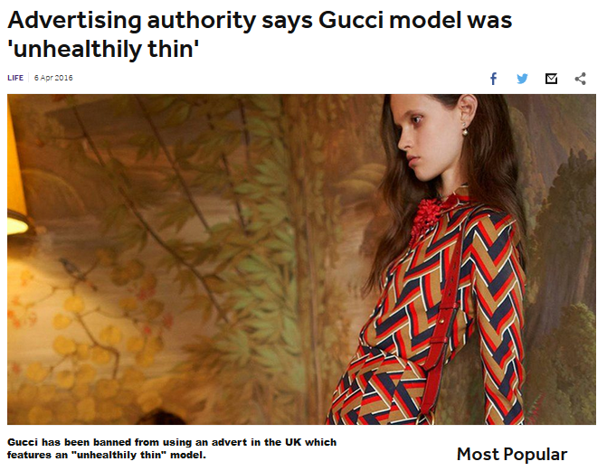
http://www.bbc.co.uk/newsround/35979565

Slide 11
Understanding Global Cultures
. . . ultimately anthropologists seek to study phenomena in terms of both physical and cultural aspects
. . .
. . . as well as other aspects, for e.g., the psychological
. . .

Slide 12
Understanding Global Cultures
. . . ultimately anthropologists seek to study phenomena in terms of both physical and cultural aspects
. . .
. . . as well as other aspects, for e.g., the psychological
. . .

Slide 13
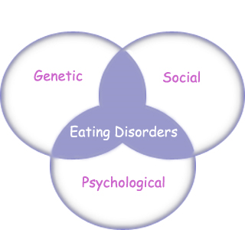
“Eating Disorders are about feelings, not food.”
The Eating Disorder Foundation
www.eatingdisorderfoundation.org/EatingDisorders.htm

Slide 14
  Different cultures have different ideals of beauty,
  ideal body image, . . .
  and rates of eating disorders . . .

Slide 15
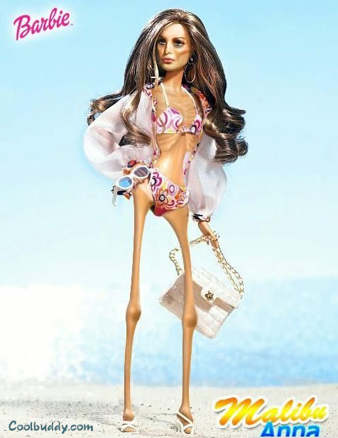
http://pamchi.files.wordpress.com/2007/06/anorexicbarbie.jpg

Slide 16
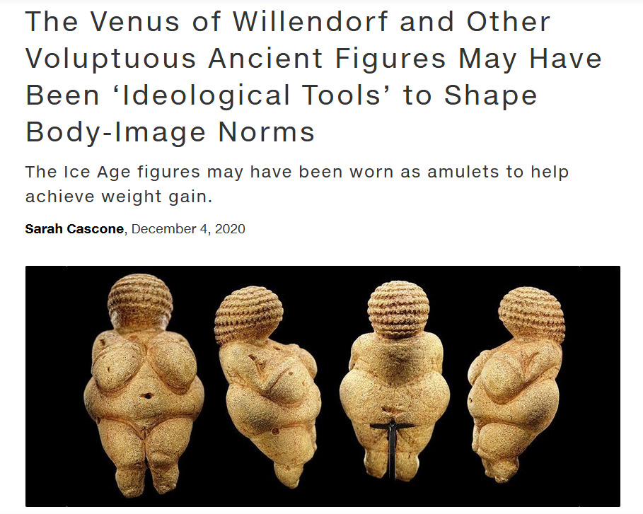
https://news.artnet.com/art-world/venus-figurines-obesity-1928873

Slide 17
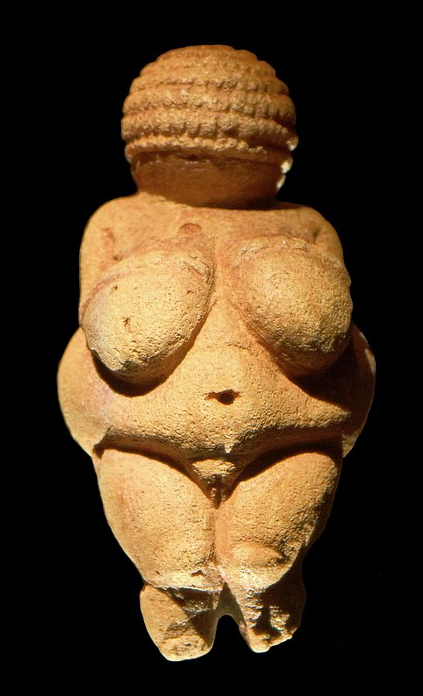
Venus of Willendorf
https://en.wikipedia.org/wiki/Venus_of_Willendorf

Slide 18
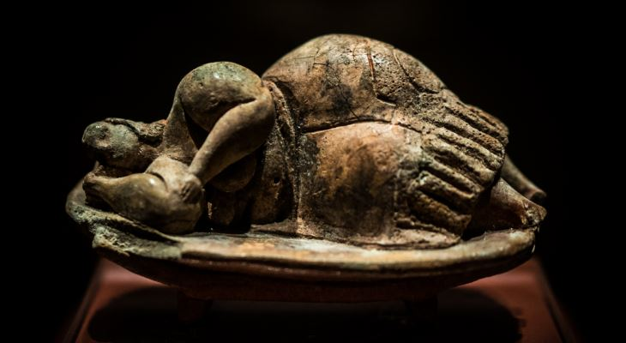
The Dreaming Goddess of Malta
https://www.guidememalta.com/en/5-things-you-didn-t-know-about-malta-gozo-s-prehistoric-temples

Slide 19
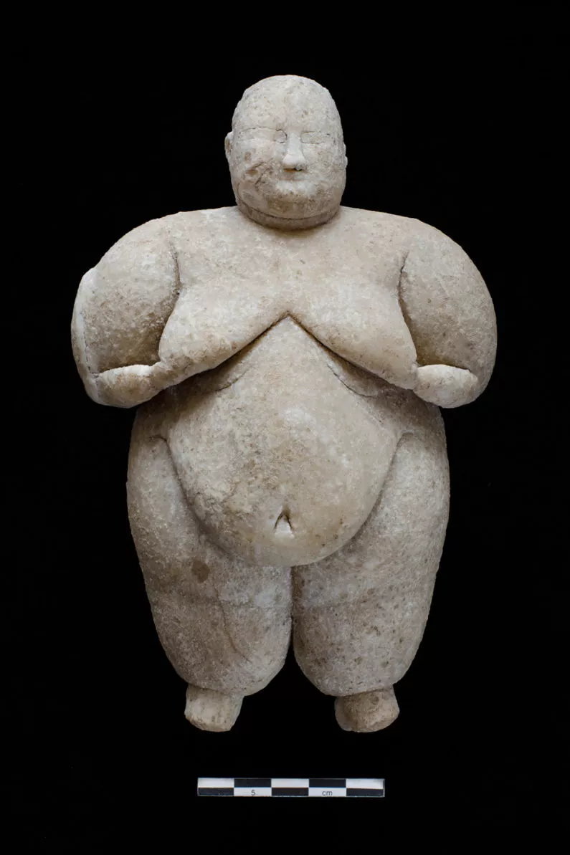
Neolithic Goddess, Çatalhöyük, Turkey
Turkeyhttps://www.livescience.com/56515-neolithic-goddess-figurine-uncovered.html

Slide 20
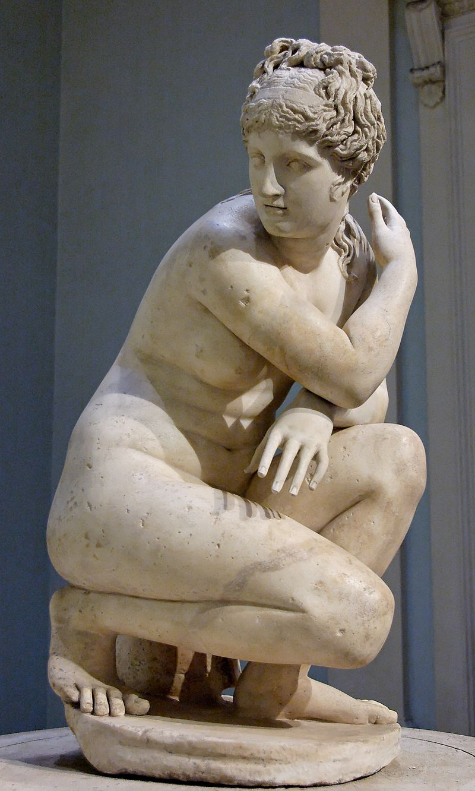
The Lely's Venus, copy of Hellenistic statue
https://en.wikipedia.org/wiki/Lely_Venus

Slide 21
Chapter 4: “Eating is a Cultural Affair” — Body Image and Health
  In some—maybe even many—a culture’s fatness is valued as a sign of wealth, and thinness as evidence that women are poor and undernourished
The Cultural Feast, 2nd ed., p. 105

Slide 22
Leblouh
(Arabic: البلوح‎, romanized: lə-blūḥ)

Slide 23

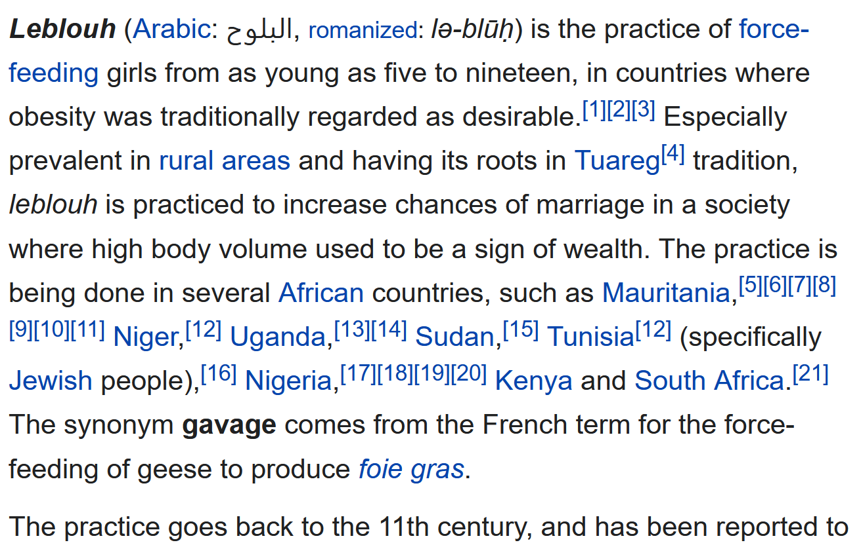


Leblouh
https://en.wikipedia.org/wiki/Leblouh

Slide 24
but things are changing around the world as globalization sets in . . .

Slide 25
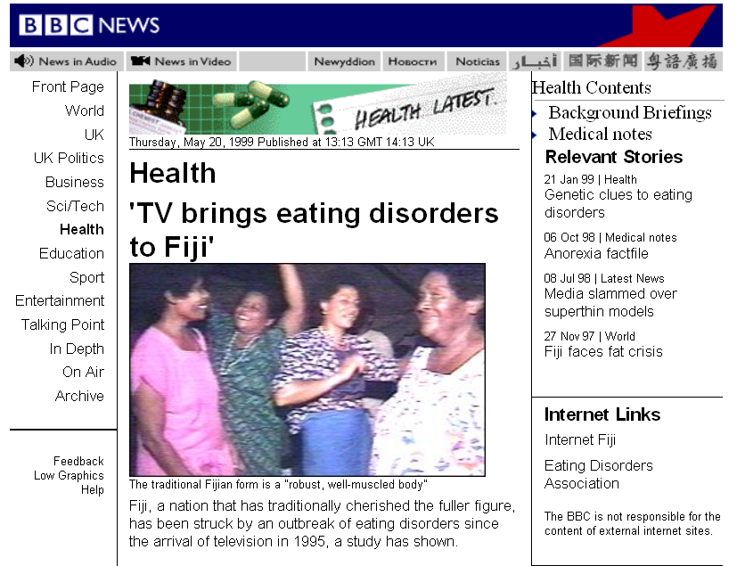
http://news.bbc.co.uk/2/hi/health/347637.stm

Slide 26
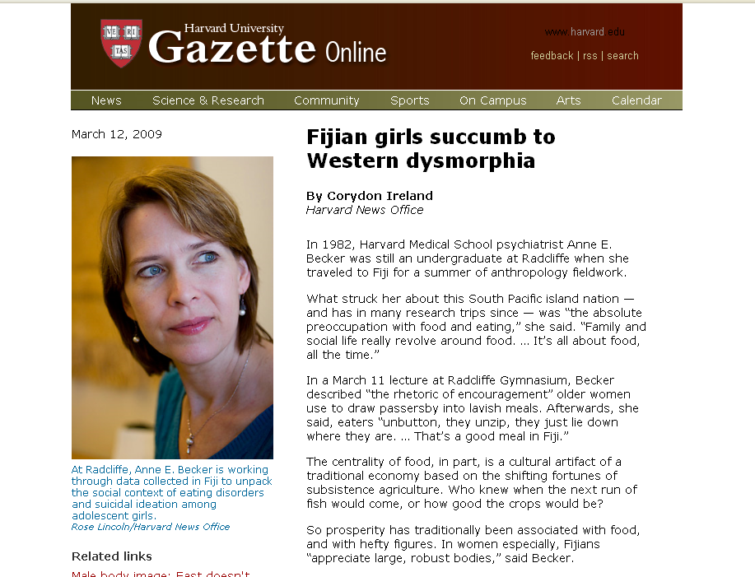
http://www.news.harvard.edu/gazette/2009/03.19/11-dysmorphia.html

Slide 27
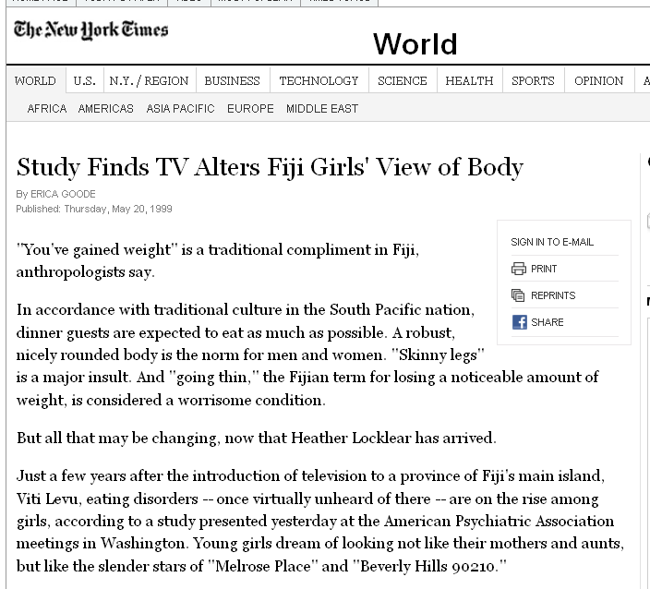
http://www.nytimes.com/1999/05/20/world/study-finds-tv-alters-fiji-girls-view-of-body.html?sec=health

Slide 28
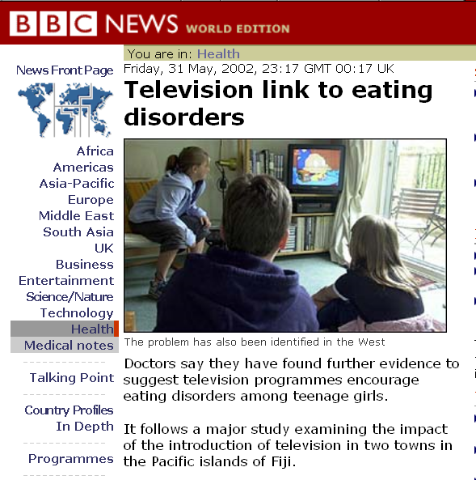
http://news.bbc.co.uk/2/hi/health/2018900.stm

Slide 29

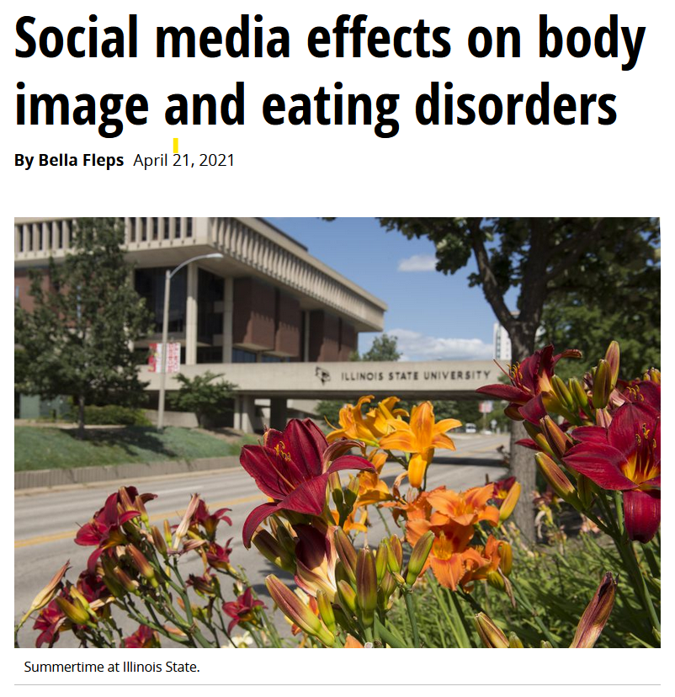
21 April 2021
https://news.illinoisstate.edu/2021/04/social-media-effects-on-body-image-and-eating-disorders/

Slide 30
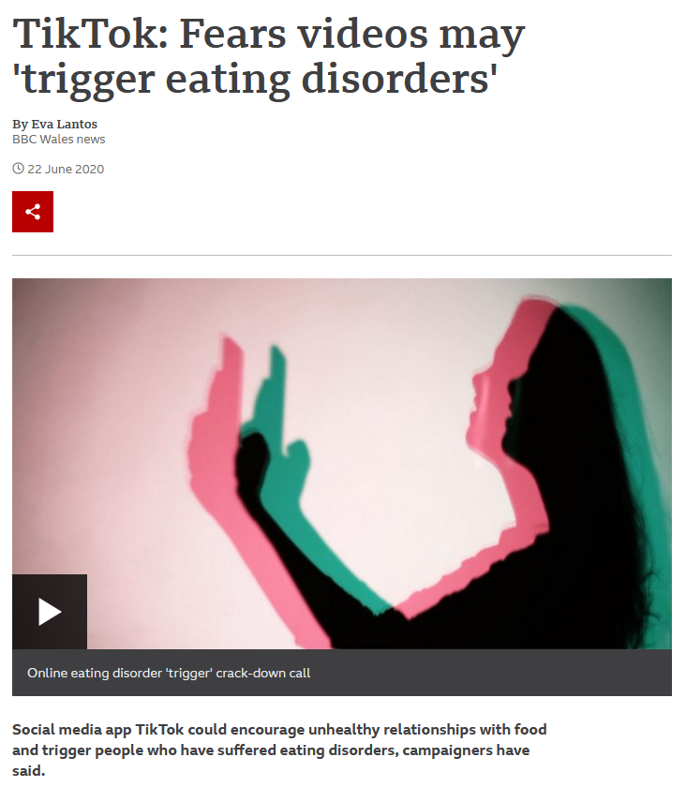
22 June 2022
https://www.bbc.com/news/uk-wales-52919914

Slide 31
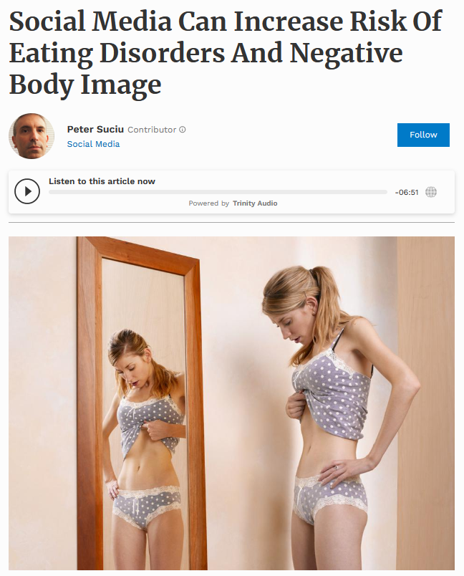

24 Feb 2021
Source: Forbes

Slide 32

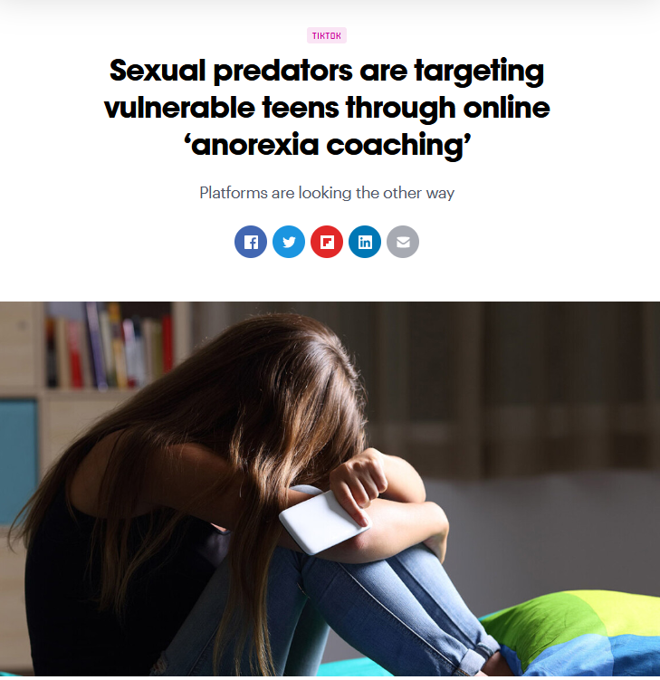

26 July 2021
https://thenextweb.com/news/sexual-predators-vulnerable-teens-anorexia-coaching-syndication

Slide 33
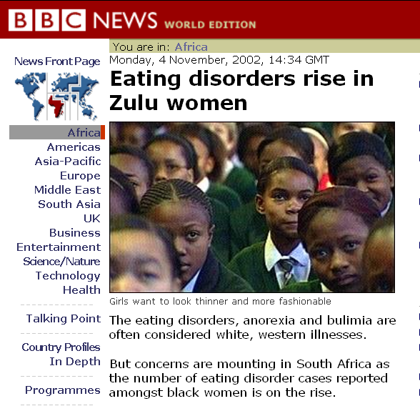
http://news.bbc.co.uk/2/hi/africa/2381161.stm

Slide 34
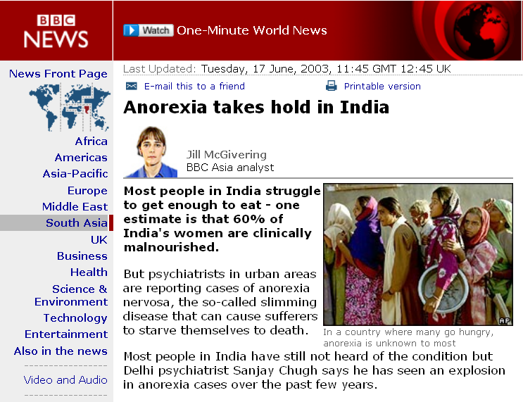
http://news.bbc.co.uk/2/hi/south_asia/2978216.stm

Slide 35
Chapter 4: “Eating is a Cultural Affair” — Body Image and Health
  cultural notions about
  ideal body size and shape have important implications for the public’s health
The Cultural Feast, 2nd ed., p. 105

Slide 36
Chapter 4: “Eating is a Cultural Affair” — Body Image and Health
  and they’re changing worldwide
The Cultural Feast, 2nd ed., p. 105

Slide 37
  The Obesity Epidemic
  Disordered Body Image and Eating Behaviors
  Eating Disorders
    Anorexia nervosa
    Bulimia nervosa
    Binge eating
    Orthorexia nervosa
    Selective Eating Disorder (SED)
    Pica
    Others
  What Causes Eating Disorders?
  Applications

Slide 38
Chapter 4: “Eating is a Cultural Affair” — Body Image and Health
  The Obesity Epidemic
  Disordered Body Image and Eating Behaviors
  Eating Disorders
    Anorexia nervosa
    Bulimia nervosa
    Binge eating
    Orthorexia nervosa
    Selective Eating Disorder (SED)
    Pica
    Others
  What Causes Eating Disorders?
  Applications

Slide 39
Chapter 4: “Eating is a Cultural Affair” — Body Image and Health
  The Obesity Epidemic
  Disordered Body Image and Eating Behaviors
  Eating Disorders
    Anorexia nervosa
    Bulimia nervosa
    Binge eating
    Orthorexia nervosa
    Selective Eating Disorder (SED)
    Pica
    Others
  What Causes Eating Disorders?
  Applications

Slide 40
  Anorexia nervosa
  and related eating disorders
  are classic examples
  of the relationship between
  culture and biology . . .
  between “nurture” and “nature” . . .

Slide 41
  teenage girls, dancers, wrestlers, skaters, gymnasts, and other competitive athletes, homosexual men, and men and women in the military have higher-than-average rates of eating disorders
The Cultural Feast, 2nd ed., p. 112

Slide 42
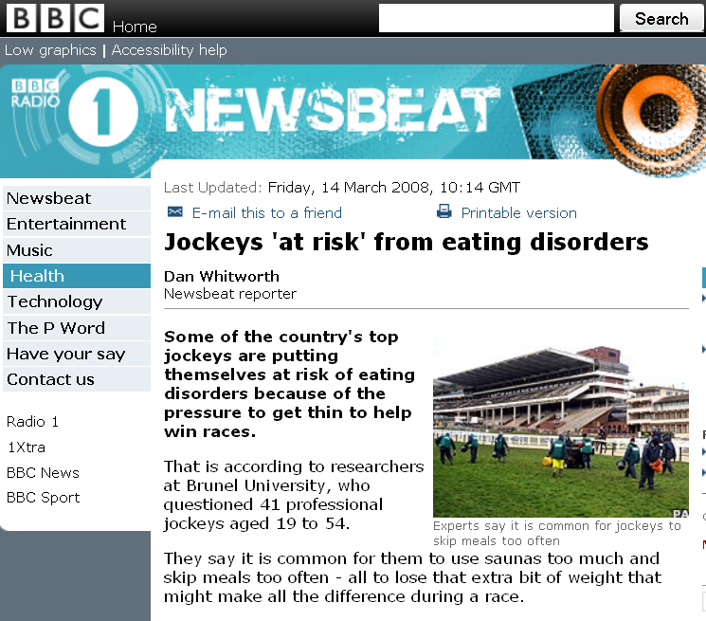
for example
http://news.bbc.co.uk/newsbeat/hi/health/newsid_7295000/7295839.stm

Slide 44
  but eating disorders occur in all segments of society . . .
The Cultural Feast, 2nd ed., p. 112

Slide 45

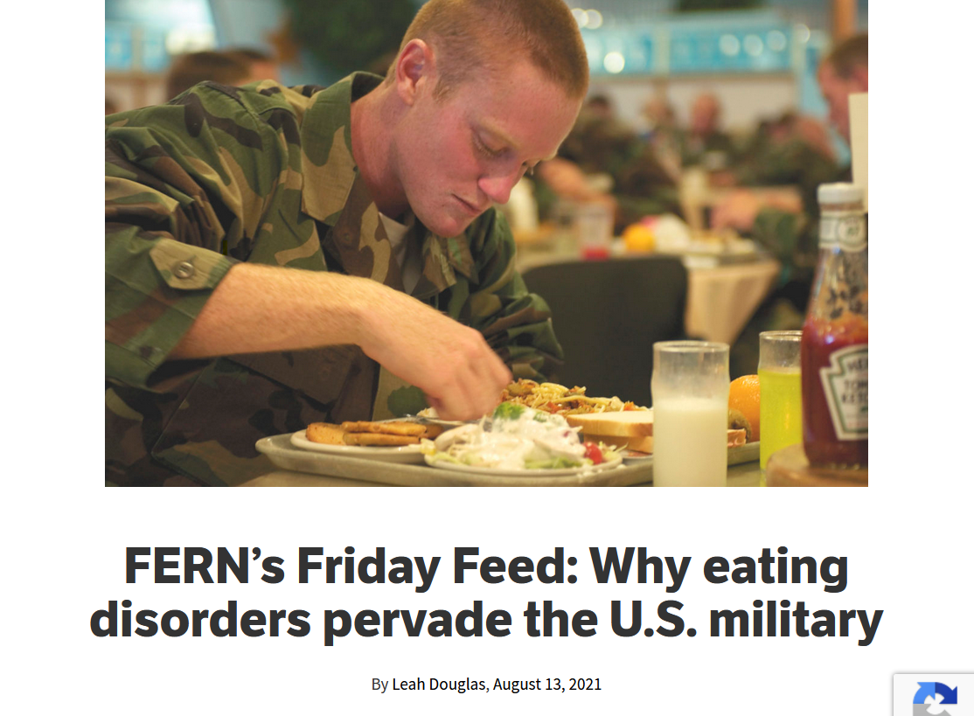
Source

Slide 46
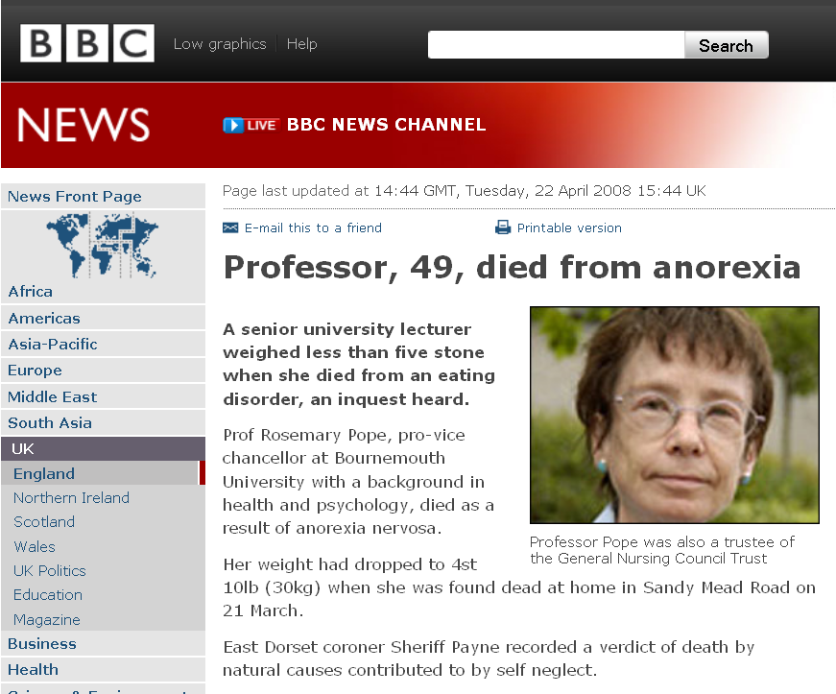
http://news.bbc.co.uk/2/hi/uk_news/england/dorset/7360470.stm

Slide 47
1 stone = 14 pounds
http://news.bbc.co.uk/2/hi/uk_news/england/dorset/7360470.stm

Slide 48
and Professor Pope
was one of the highest ranking
nurses in Great Britain
http://news.bbc.co.uk/2/hi/uk_news/england/dorset/7360470.stm

Slide 49
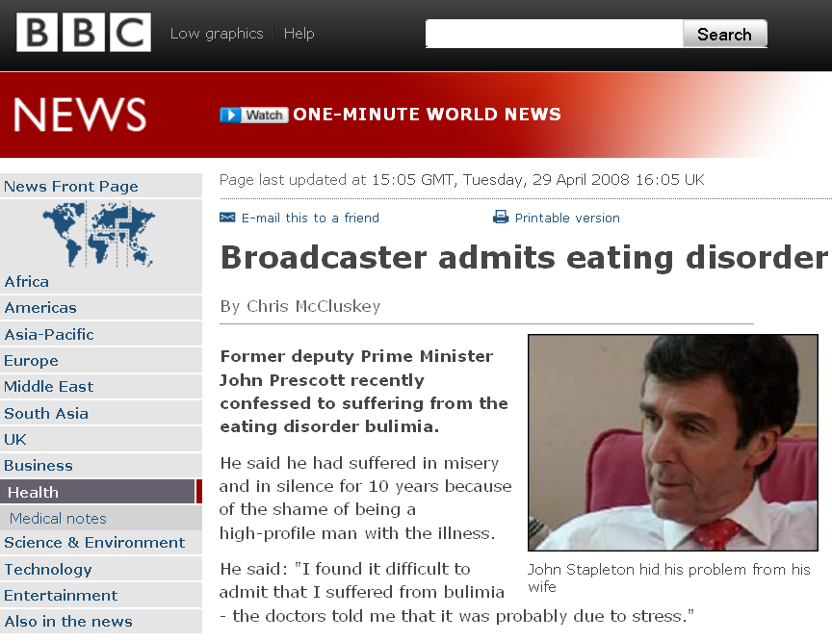
http://news.bbc.co.uk/2/hi/health/7373846.stm

Slide 50
John Prescott was a deputy Prime Minister of Britain
http://news.bbc.co.uk/2/hi/health/7373846.stm

Slide 51
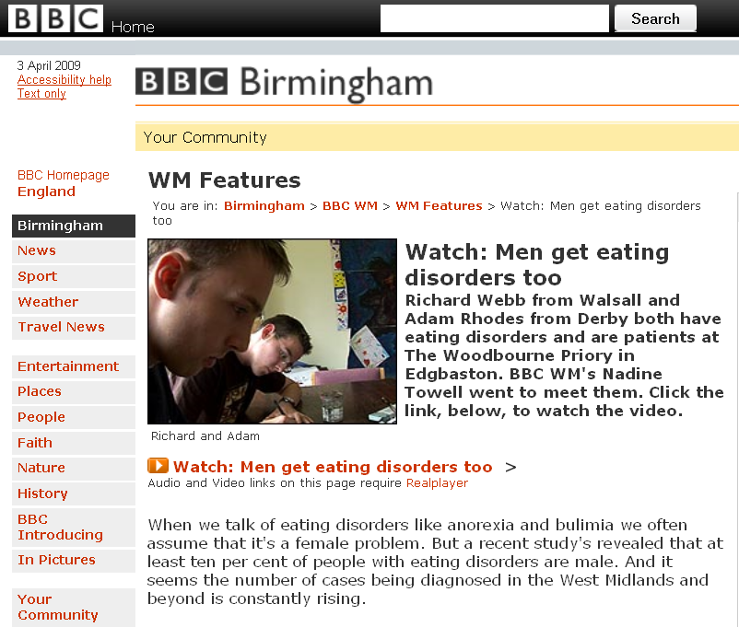


http://www.bbc.co.uk/birmingham/content/articles/2007/09/11/wm_video_feature.shtml

Slide 52

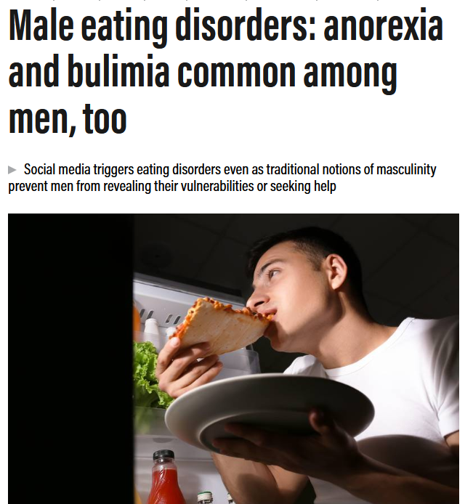
26 July 2021
https://www.thenationalnews.com/lifestyle/wellbeing/2021/07/27/male-eating-disorders-anorexia-and-bulimia-common-among-men-too/

Slide 53
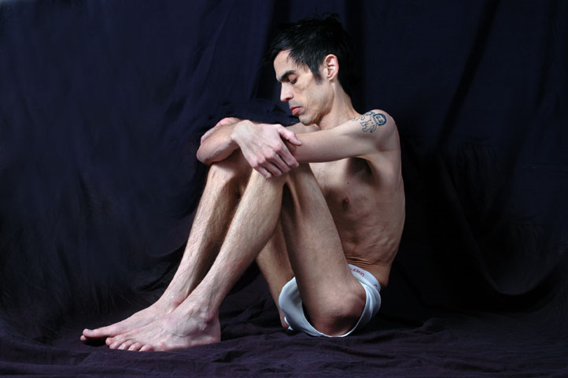
http://health.taragana.net/articles/neda-launches-star-program-to-support-people-suffering-from-eating-disorders/

Slide 54
it’s not a pretty picture
http://health.taragana.net/articles/neda-launches-star-program-to-support-people-suffering-from-eating-disorders/

Slide 55
and help is being offered now to many groups . . .
http://health.taragana.net/articles/neda-launches-star-program-to-support-people-suffering-from-eating-disorders/

Slide 57
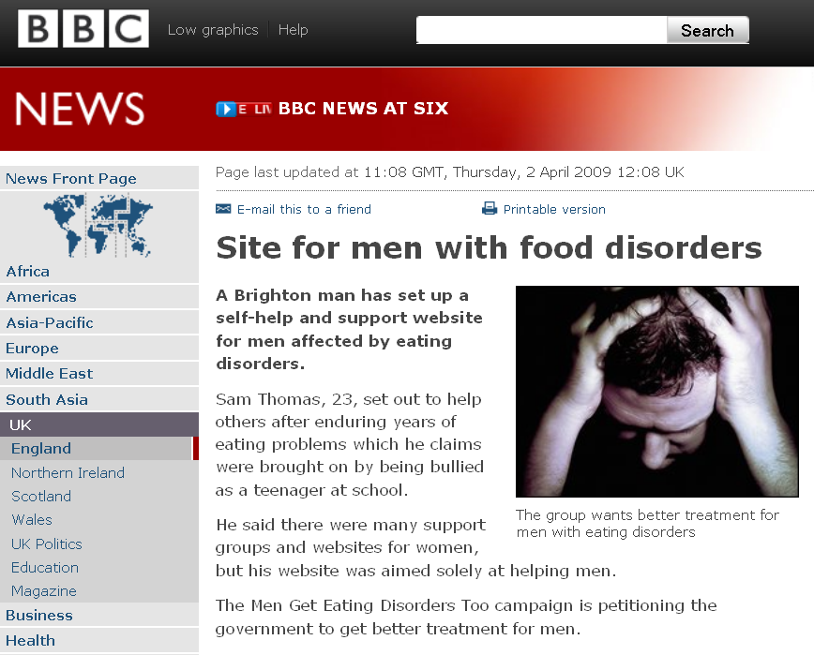
http://news.bbc.co.uk/2/hi/uk_news/england/sussex/7978845.stm

Slide 58
You probably know someone battling with anorexia nervosa.

Slide 59
One afternoon during a face-to-face class a police officer and two people from the UMD health clinic arrived at the door of our classroom, Cina 214.
They came to get the girl that sat by the window, in the second seat from the lectern.
They came to tell her that her roommate died.

Slide 60
Her roommate died,
of anorexia,
in the hospital,
after a long time of having the medical staff struggle to keep her alive.
The student who died was a poplar student.
Lots of people knew her as she worked in the UMD Bookstore.
And basically watched her slowly die.

Slide 61
You probably know someone battling with anorexia nervosa.
Most people in America do . . .

Slide 62
You probably know someone battling with anorexia nervosa.
Most people in America do . . .
or someone with a related
eating disorder problem . . .

Slide 63
R.I.P.
Beth Kwapik
Secretary
Sociology-Anthropology Department
University of Minnesota Duluth

Slide 64
R.I.P.
Beth Kwapik
Secretary
Sociology -Anthropology Department
University of Minnesota Duluth
Beth died from complications arising from having her stomach “stapled”

Slide 65
R.I.P.
Beth Kwapik
Secretary
Sociology -Anthropology Department
University of Minnesota Duluth
I found it difficult to believe that she even though about such a thing as having her stomach “stapled”

Slide 66
more people than you might suspect are
"Dying to be Thin"
www.wsoctv.com/news/17262427/detail.html

Slide 67
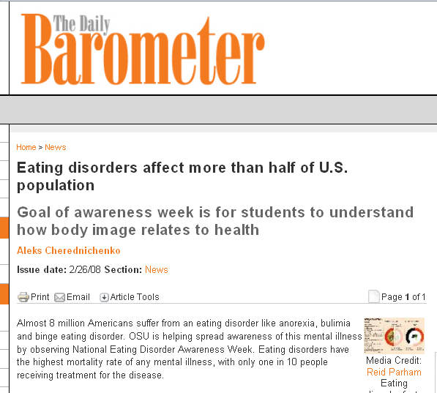
http://media.barometer.orst.edu/media/storage/paper854/news/2008/02/26/News/Eating.Disorders.Affect.More.Than.Half.Of.U.s.Population-3234616.shtml

Slide 68
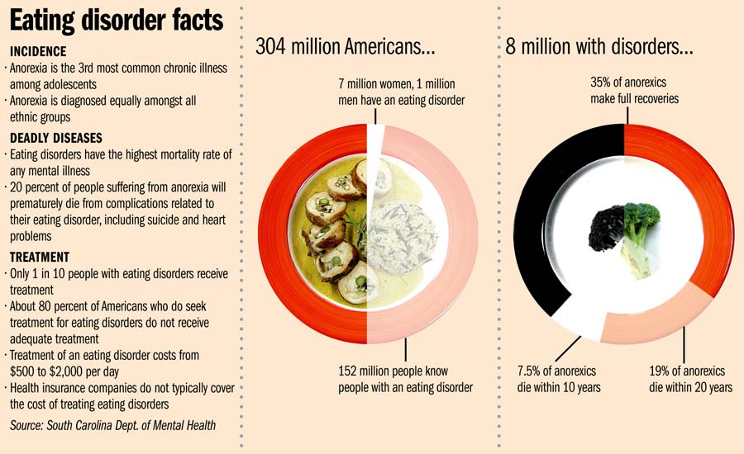
http://media.barometer.orst.edu/media/storage/paper854/news/2008/02/26/News/Eating.Disorders.Affect.More.Than.Half.Of.U.s.Population-3234616.shtml

Slide 69
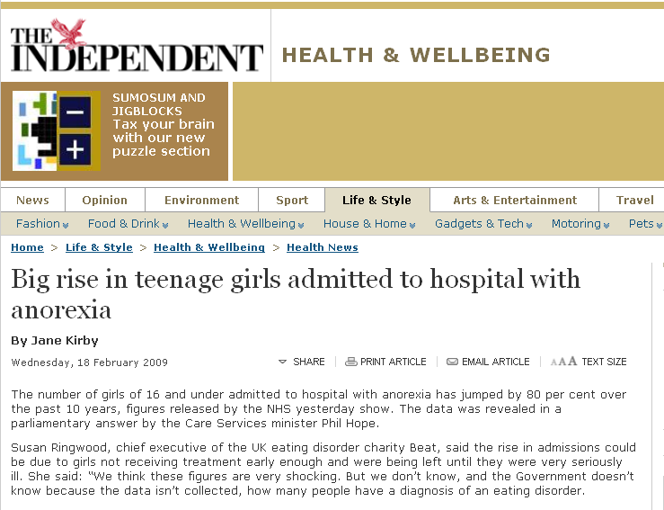
http://www.independent.co.uk/life-style/health-and-wellbeing/health-news/big-rise-in-teenage-girls-admitted-to-hospital-with-anorexia-1624881.html

Slide 70
  And eating disorders are on the rise . . .

Slide 71
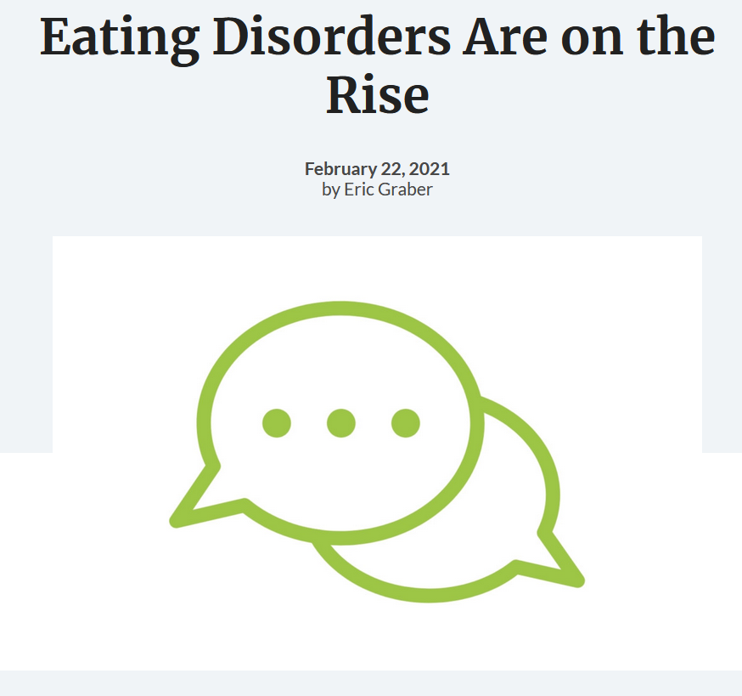
22 February 2021
https://nutrition.org/eating-disorders-are-on-the-rise/

Slide 72
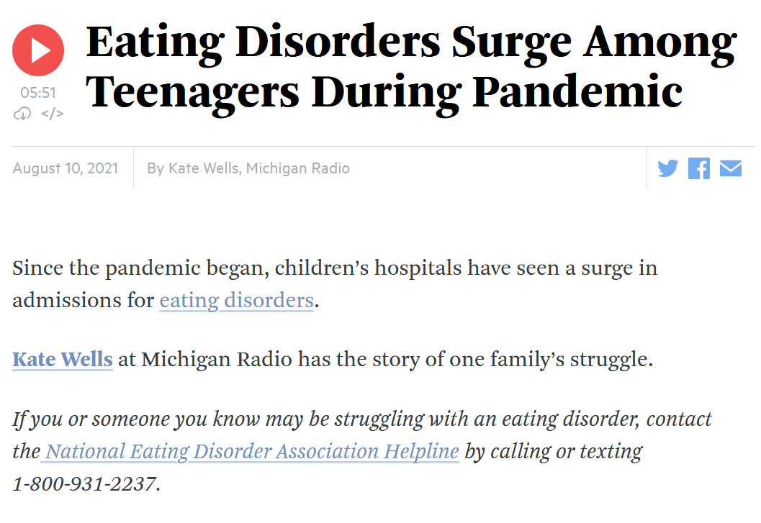
10 August 2021
https://www.wbur.org/hereandnow/2021/08/10/eating-disorders-teenagers

Slide 73
Chapter 4: “Eating is a Cultural Affair” — Body Image and Health
  Anorexia nervosa,
  is self-induced starvation and a phobia of gaining weight . . .
      found in ca. 1% of female adolescents in the U.S.
      and percentage estimates are even higher for teen girls from middle- and upper-class Euro- American families
  (Mehler 1996)
The Cultural Feast, 2nd ed., p. 111

Slide 74
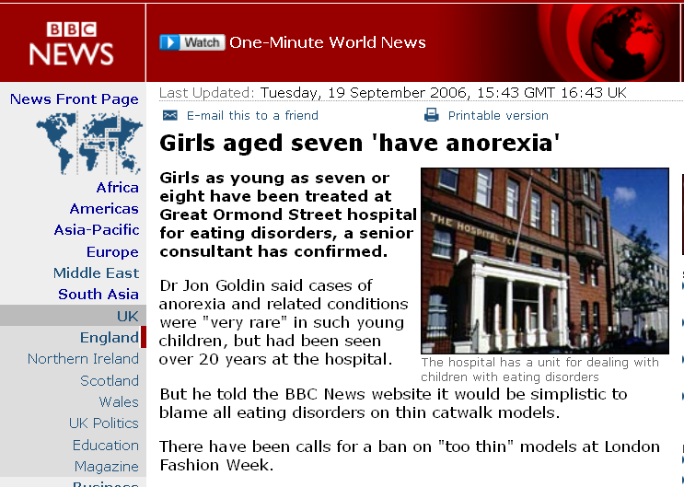
http://news.bbc.co.uk/2/hi/uk_news/england/london/5360768.stm

Slide 75
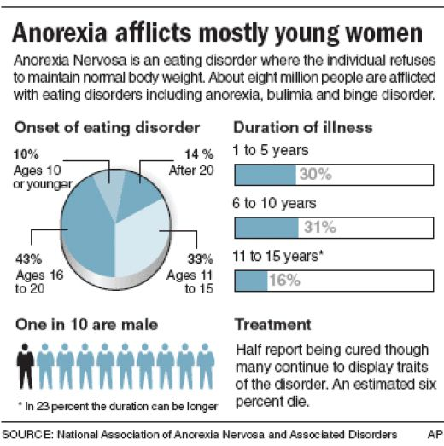
http://hubpages.com/hub/eating-disorder

Slide 76
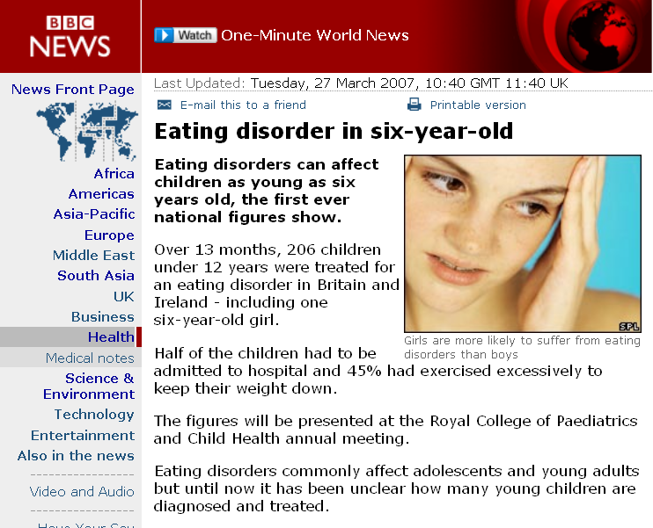
http://news.bbc.co.uk/2/hi/health/6498345.stm

Slide 77
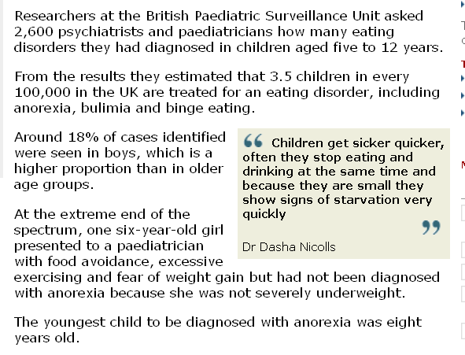
http://news.bbc.co.uk/2/hi/health/6498345.stm

Slide 78
http://news.bbc.co.uk/2/hi/health/6498345.stm

Slide 79
http://news.bbc.co.uk/2/hi/health/6498345.stm

Slide 80
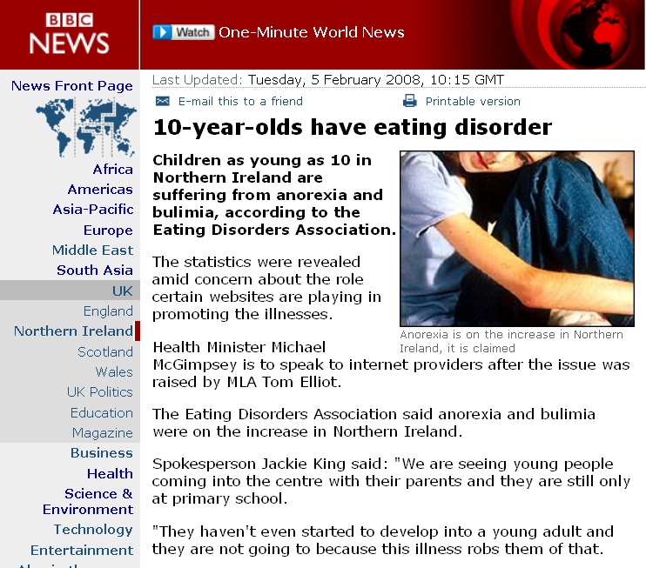
http://news.bbc.co.uk/2/hi/uk_news/northern_ireland/7227898.stm
http://news.bbc.co.uk/2/hi/health/7824298.stm

Slide 81
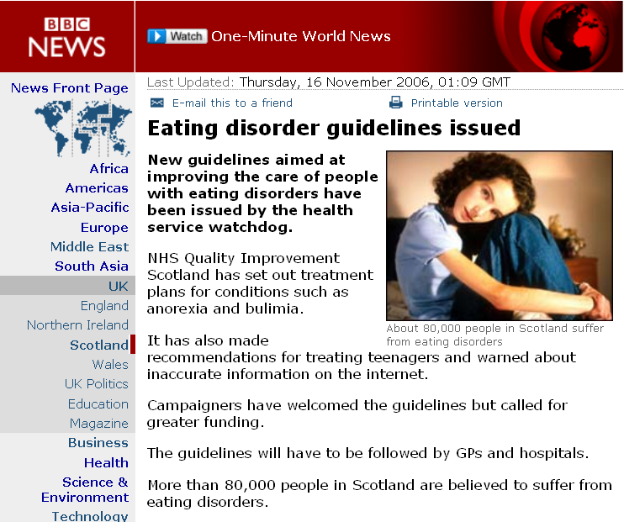
http://news.bbc.co.uk/2/hi/uk_news/scotland/6153016.stm
http://news.bbc.co.uk/2/hi/health/7824298.stm

Slide 82
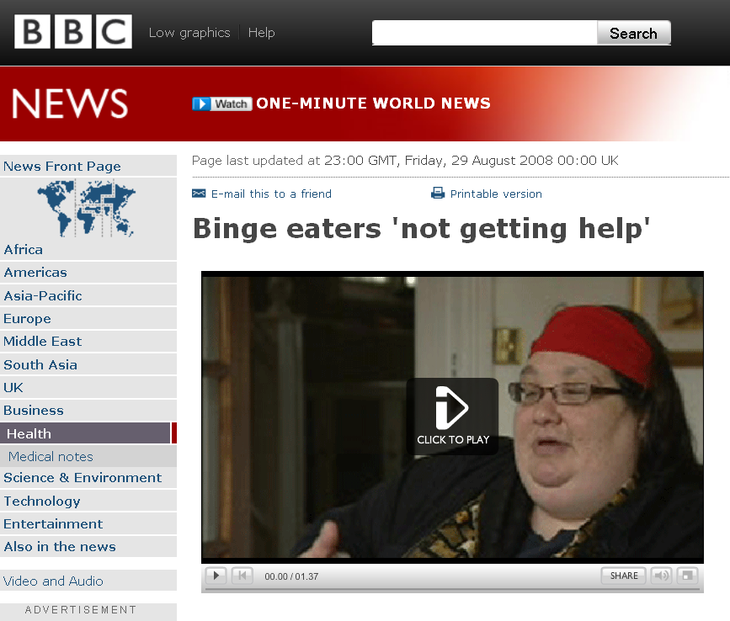
http://news.bbc.co.uk/2/hi/health/7587515.stm

Slide 83
Experts believe over-eating may be a bigger problem than either anorexia or bulimia
http://news.bbc.co.uk/2/hi/health/7587515.stm

Slide 84
Chapter 4: “Eating is a Cultural Affair” — Body Image and Health
  Anorexia nervosa,
  self-induced starvation and a phobia of gaining weight . . .
      although still relatively rare, some believe the problem of anorexia is becoming more common among teen boys
  (Mehler 1996)
The Cultural Feast, 2nd ed., p. 111

Slide 85
Chapter 4: “Eating is a Cultural Affair” — Body Image and Health
  Although self-induced starvation has been reported for centuries,
  it was rarely associated with
  a fear of being fat
      some religious aesthetics, for e.g., fasted to express their religiosity
      Chinese Taoists and others fasted to extend their longevity, separate themselves from the mundane world, and encourage mystical experiences
  (Rieger et al. 2001)
The Cultural Feast, 2nd ed., p. 111

Slide 86
Chapter 4: “Eating is a Cultural Affair” — Body Image and Health
  Although self-induced starvation has been reported for centuries,
  it was rarely associated with
  a fear of being fat
      some religious aesthetics, for e.g., fasted to express their religiosity
      Chinese Taoists and others fasted to extend their longevity, separate themselves from the mundane world, and encourage mystical experiences
  (Rieger et al. 2001)
The Cultural Feast, 2nd ed., p. 111

Slide 87
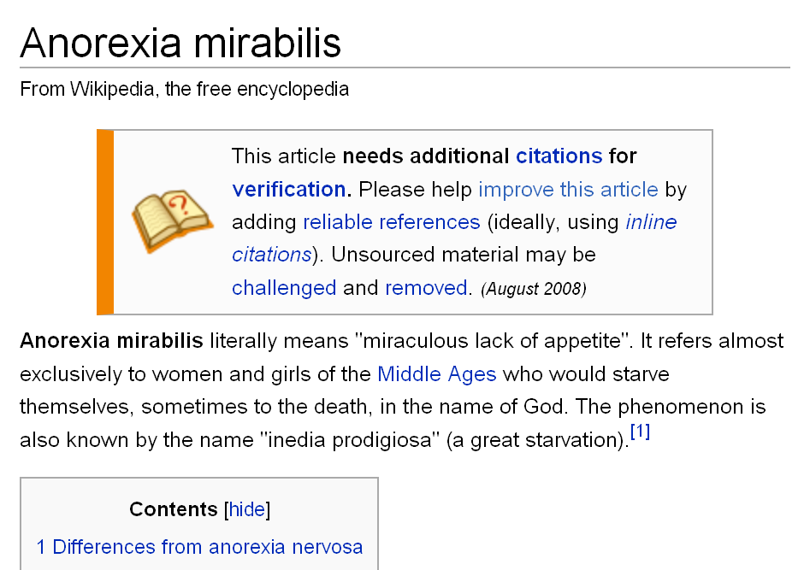
http://en.wikipedia.org/wiki/Anorexia_mirabilis

Slide 88
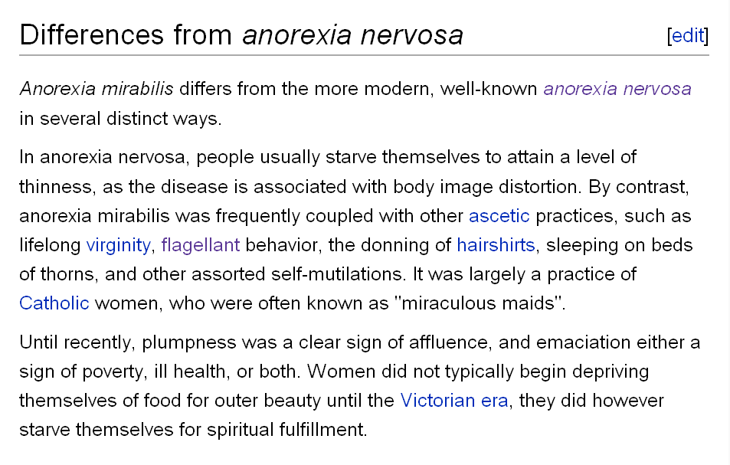
http://en.wikipedia.org/wiki/Anorexia_mirabilis

Slide 89
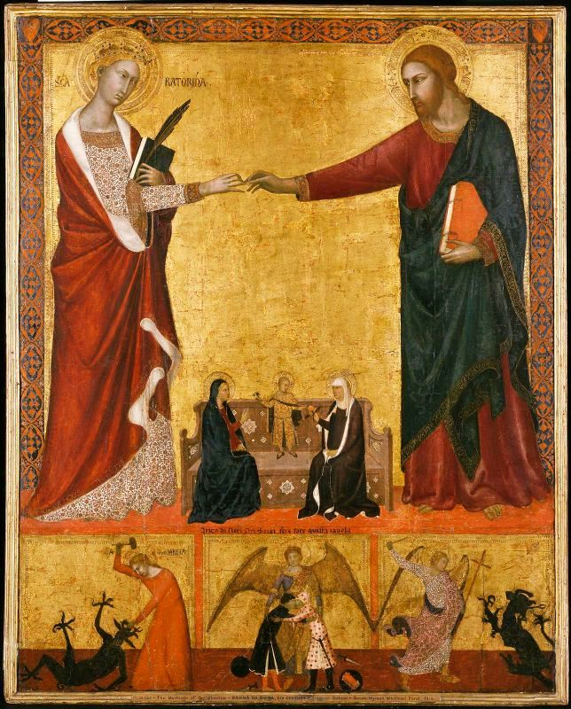
Catherine of Siena
http://en.wikipedia.org/wiki/Anorexia_mirabilis

Slide 90
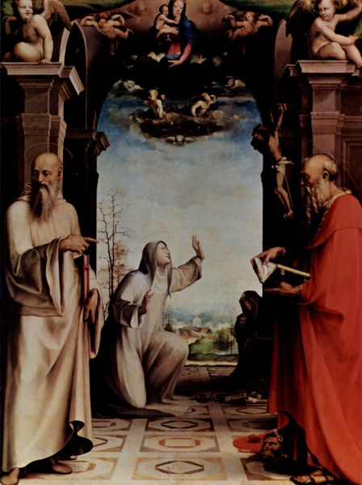
St. Catherine of Siena
Domenico Beccafumi, ca. 1515
http://en.wikipedia.org/wiki/Anorexia_mirabilis

Slide 91
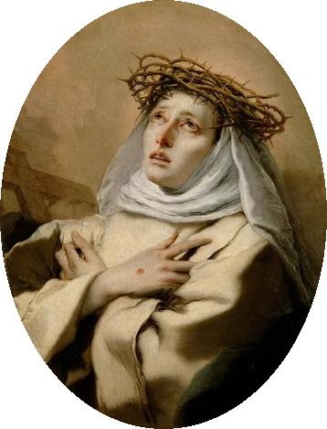
Catherine of Siena
http://en.wikipedia.org/wiki/Anorexia_mirabilis

Slide 92
Chapter 4: “Eating is a Cultural Affair” — Body Image and Health
  Although self-induced starvation has been reported for centuries, it was rarely associated with
  a fear of being fat
      some religious aesthetics, for e.g., fasted to express their religiosity
      Chinese Taoists and others fasted to extend their longevity, separate themselves from the mundane world, and encourage mystical experiences
The Cultural Feast, 2nd ed., p. 111

Slide 93

道教
http://en.wikipedia.org/wiki/File:TaoismSymbol.PNG

Slide 94
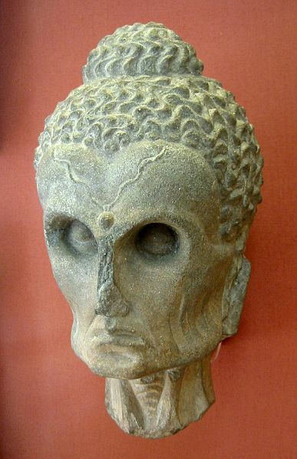
Buddha. 2-3th century CE.
British Museum
http://en.wikipedia.org/wiki/Buddhism

Slide 95
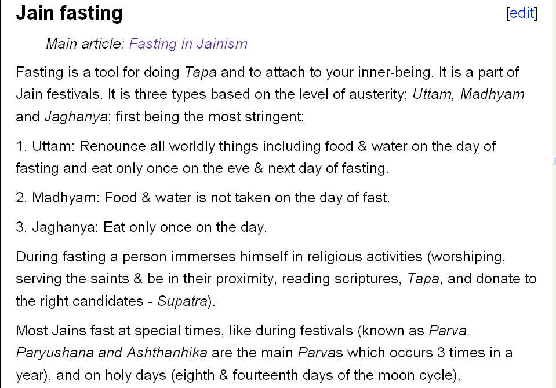
India
http://en.wikipedia.org/wiki/Jainism#Jain_fasting

Slide 96

Palitana Tirtha, India
http://en.wikipedia.org/wiki/Jainism#Jain_fasting

Slide 97
Chapter 4: “Eating is a Cultural Affair” — Body Image and Health
  Although self-induced starvation has been reported for centuries, it was rarely associated with
  a fear of being fat
  These forms of fasting appear to differ significantly from the type found in Western societies today
  (Rieger et al. 2001)
The Cultural Feast, 2nd ed., p. 111

Slide 98
  Anorexia is a devastating disease

Slide 99
  the anorexic may lose between 15% and 60% of her normal body weight, losing significant amounts of muscle as well as fat
The Cultural Feast, 2nd ed., p. 112

Slide 100
  signs of chronic starvation appear . . .
The Cultural Feast, 2nd ed., p. 112

Slide 101
  signs of chronic starvation appear . . .
  menses stop
  a covering of soft hair appears on the skin
  the heart rate slows
  she feels cold even in warm surroundings
The Cultural Feast, 2nd ed., p. 112

Slide 102
  excessive exercise combined with anorexia often leads to joint problems, especially in dancers and athletes
  the skin may become dry and scalp hair thin
  the stomach is often bloated
  memory may become impaired
  thinking may become confused
The Cultural Feast, 2nd ed., p. 112

Slide 103
  Anorexia can cause . . .
The Cultural Feast, 2nd ed., p. 112

Slide 104
  Anorexia can cause . . .
  kidney failure
  serious gastrointestinal problems
  abdominal pain
  neurological complications
  hormonal imbalance
  osteoporosis
The Cultural Feast, 2nd ed., p. 112

Slide 105
  Anorexia can cause . . .
  serious heart problems
  blood disorders
  brain damage
  a permanent reduction in stature
  psychological trauma
  loss of self-esteem
The Cultural Feast, 2nd ed., p. 112

Slide 106
  between 4% and 20% die . . .
The Cultural Feast, 2nd ed., p. 112

Slide 107
  between 4% and 20% die . . .
    usually from heart failure or suicide
The Cultural Feast, 2nd ed., p. 112

Slide 108
http://hubpages.com/hub/eating-disorder

Slide 109

20 April 2021
https://www.health.com/money/eating-disorder-treatment-costs

Slide 110
And there are allied practical problems . . .

Slide 111

7 August 2021
https://www.bbc.com/news/uk-northern-ireland-57841203

Slide 112
  be aware
  of the signs and criteria for diagnosing
  anorexia nervosa . . .

Slide 113
  Criteria for Diagnosis of Anorexia . . .
  refusal to maintain normal body weight
  intense fear of gaining weight or becoming fat, even though underweight . . . or the denial of the seriousness of the current low body weight
  disturbance in the way in which one’s body weight or shape is experienced
  amenorrhea in females past puberty
  (the absence of at least three consecutive menstrual cycles)
The Cultural Feast, 2nd ed., p. 111

Slide 114
  Two types of Anorexia include . . .
  Restricting type
    the person does not regularly engage in binge eating or purging behavior
  Binge eating / purging type
    the person does regularly engages in binge eating or purging behavior
The Cultural Feast, 2nd ed., p. 111

Slide 115
  Anorexia nervosa
  and related eating disorders
  are classic examples
  of the relationship between
  culture and biology . . .
  between “nurture” and “nature” . . .

Slide 116
Chapter 4: “Eating is a Cultural Affair” — Body Image and Health
  The Obesity Epidemic
  Disordered Body Image and Eating Behaviors
  Eating Disorders
    Anorexia nervosa
    Bulimia nervosa
    Binge eating
    Orthorexia nervosa
    Selective Eating Disorder (SED)
    Pica
    Others
  What Causes Eating Disorders?
  Applications

Slide 117
  Bulimia nervosa . . .
  purging by vomiting or the use of laxatives and diuretics
The Cultural Feast, 2nd ed., p. 112

Slide 118
  Bulimia nervosa . . .
  . . . is far more common
  than anorexia
  reported by ca. 3% of women and 10% of female college students
The Cultural Feast, 2nd ed., p. 112

Slide 119
  Bulimia nervosa . . .
  . . . usually starts in early adolescence when youth try to restrict their diets fail,
  binge, and then purge
The Cultural Feast, 2nd ed., p. 112

Slide 120
Chapter 4: “Eating is a Cultural Affair” — Body Image and Health
  The Obesity Epidemic
  Disordered Body Image and Eating Behaviors
  Eating Disorders
    Anorexia nervosa
    Bulimia nervosa
    Binge eating
    Orthorexia nervosa
    Selective Eating Disorder (SED)
    Pica
    Others
  What Causes Eating Disorders?
  Applications

Slide 121
  Binge eating . . .
  . . . often start with relative small amounts of food
  (from 100-1000 calories)
  but may go up to over 5,000 calories in just a few hours
The Cultural Feast, 2nd ed., p. 112

Slide 122
  . . . binges are followed by vomiting and use of laxatives, diet pills,
  and / or drugs to reduce water retention
The Cultural Feast, 2nd ed., p. 112

Slide 123
  Bulimia nervosa . . .
  . . . bulimics average ca. 14 binge-purging episodes a week . . .
  . . . with some vomiting as many as four times a day . . .
The Cultural Feast, 2nd ed., p. 112

Slide 124
  Bulimia nervosa . . .
  victims usually develop severe tooth decay from destruction of the tooth enamel by the acid in their vomit
  the strain of vomiting can break blood vessels in their eyes
  gums may become diseased
  pimples or rashes may break out on the face
The Cultural Feast, 2nd ed., p. 112

Slide 125
  Other health problems include . . .
  a constant sore throat
  swollen glands near the cheeks
  liver, heart, and kidney damage
  dehydration
  stomach rupture
The Cultural Feast, 2nd ed., p. 112

Slide 126
  Bulimia nervosa . . .
  . . . binges are followed by vomiting and use of laxatives, diet pills,
  and / or drugs to reduce water retention
  (Rieger et al. 2001)
The Cultural Feast, 2nd ed., p. 112

Slide 127
  be aware
  of the signs and criteria for diagnosing
  Bulimia nervosa . . .

Slide 128
  Criteria for Diagnosis of Bulimia . . .
  recurrent episodes of binge eating
    eating an amount of food that is definitely larger than most people would eat during that same time period
    a sense of a lack of control over eating during the heavy eating episode
      i.e., the feeling that one cannot stop eating or control what or how much one is eating
The Cultural Feast, 2nd ed., p. 113

Slide 129
  Criteria for Diagnosis of Bulimia . . .
  recurrent inappropriate compensatory behavior in order to prevent weight gain
    self-induced vomiting
    misuse of laxatives, diuretics enemas, or other medications
    excessive exercise
The Cultural Feast, 2nd ed., p. 113

Slide 130
  Criteria for Diagnosis of Bulimia . . .
  binge eating and inappropriate compensatory behaviors that both occur, on average, at least twice a week for three months
  self-evaluation unduly influenced by body shape and weight
  the disturbance does not occur exclusively during episodes of anorexia nervosa
The Cultural Feast, 2nd ed., p. 113

Slide 131
  Two types of Bulimia include . . .
  Purging type
    the person regularly engages in self-induced vomiting or the misuse of laxatives, diuretics, or enemas
  Nonpurging type
    the person uses other inappropriate compensatory behaviors, such as fasting or excessive exercise, but does not regularly engage in self-induced vomiting or the misuse of laxatives, diuretics, or enemas
The Cultural Feast, 2nd ed., p. 113

Slide 132
Chapter 4: “Eating is a Cultural Affair” — Body Image and Health
  The Obesity Epidemic
  Disordered Body Image and Eating Behaviors
  Eating Disorders
    Anorexia nervosa
    Bulimia nervosa
    Binge eating
    Orthorexia nervosa
    Selective Eating Disorder (SED)
    Pica
    Others
  What Causes Eating Disorders?
  Applications

Slide 133

http://en.wikipedia.org/wiki/Orthorexia_nervosa

Slide 134

http://news.bbc.co.uk/2/hi/uk_news/magazine/4389849.stm

Slide 135

http://news.bbc.co.uk/2/hi/uk_news/magazine/4389849.stm

Slide 136
http://news.bbc.co.uk/2/hi/uk_news/magazine/4389849.stm

Slide 137


http://news.bbc.co.uk/2/hi/uk_news/magazine/4389849.stm

Slide 138
Orthorexics prefer market stalls to checkouts
http://news.bbc.co.uk/2/hi/uk_news/magazine/4389849.stm

Slide 139
Chapter 4: “Eating is a Cultural Affair” — Body Image and Health
  The Obesity Epidemic
  Disordered Body Image and Eating Behaviors
  Eating Disorders
    Anorexia nervosa
    Bulimia nervosa
    Binge eating
    Orthorexia nervosa
    Selective Eating Disorder (SED)
    Pica
    Others
  What Causes Eating Disorders?
  Applications

Slide 140

http://en.wikipedia.org/wiki/Selective_eating_disorder

Slide 141
Chapter 4: “Eating is a Cultural Affair” — Body Image and Health
  The Obesity Epidemic
  Disordered Body Image and Eating Behaviors
  Eating Disorders
    Anorexia nervosa
    Bulimia nervosa
    Binge eating
    Orthorexia nervosa
    Selective Eating Disorder (SED)
    Pica
    Others
  What Causes Eating Disorders?
  Applications

Slide 142

“Pica is a medical disorder
characterized by an appetite for substances largely non-nutritive
(e.g., clay, coal, soil, feces, chalk, paper, soap, mucus, ash, gum, etc.) . . . or foods, such as food ingredients. . . .”
http://en.wikipedia.org/wiki/Pica_(disorder)

Slide 143

http://en.wikipedia.org/wiki/Pica_(disorder)

Slide 144

http://news.bbc.co.uk/2/hi/africa/7596067.stm

Slide 145

http://www.bbc.co.uk/radio4/hometruths/0207zinasarowiwa.shtml

Slide 146

http://news.bbc.co.uk/2/hi/health/3503967.stm

Slide 147

http://news.bbc.co.uk/2/hi/health/7370524.stm

Slide 148
Chapter 4: “Eating is a Cultural Affair” — Body Image and Health
  The Obesity Epidemic
  Disordered Body Image and Eating Behaviors
  Eating Disorders
    Anorexia nervosa
    Bulimia nervosa
    Binge eating
    Orthorexia nervosa
    Selective Eating Disorder (SED)
    Pica
    Others
  What Causes Eating Disorders?
  Applications

Slide 149

Wannarexia
http://en.wikipedia.org/wiki/Category:Eating_disorders

Slide 150

http://en.wikipedia.org/wiki/Wannarexia

Slide 151
Opsophagos
http://en.wikipedia.org/wiki/Category:Eating_disorders

Slide 152

http://en.wikipedia.org/wiki/Wannarexia

Slide 153
when I was a little boy I had a craving for and regularly ate the burnt ends of matches
I can remember doing that . . .

Slide 154
when I was a little boy I had a craving for and regularly ate the burnt ends of matches
I can remember doing that . . .
but I didn’t know until recently that the eating of burnt matches is called
cautopyreiophagia

Slide 155

I ate them plain,
without ketchup
image source

Slide 156
Cf. , Chapter 8
”GASTRO-ANOMIE
Global Indigestion?”:
Eating Disorders
Tim Roufs
© 2010-2024
www.d.umn.edu/cla/faculty/troufs/anthfood/aftexts.html#title

Slide 157
Chapter 4
”Eating is a
Cultural Affair” —
Eating Disorders
pp.111-112
©Timothy G. Roufs 2010-2024

