Slide 1
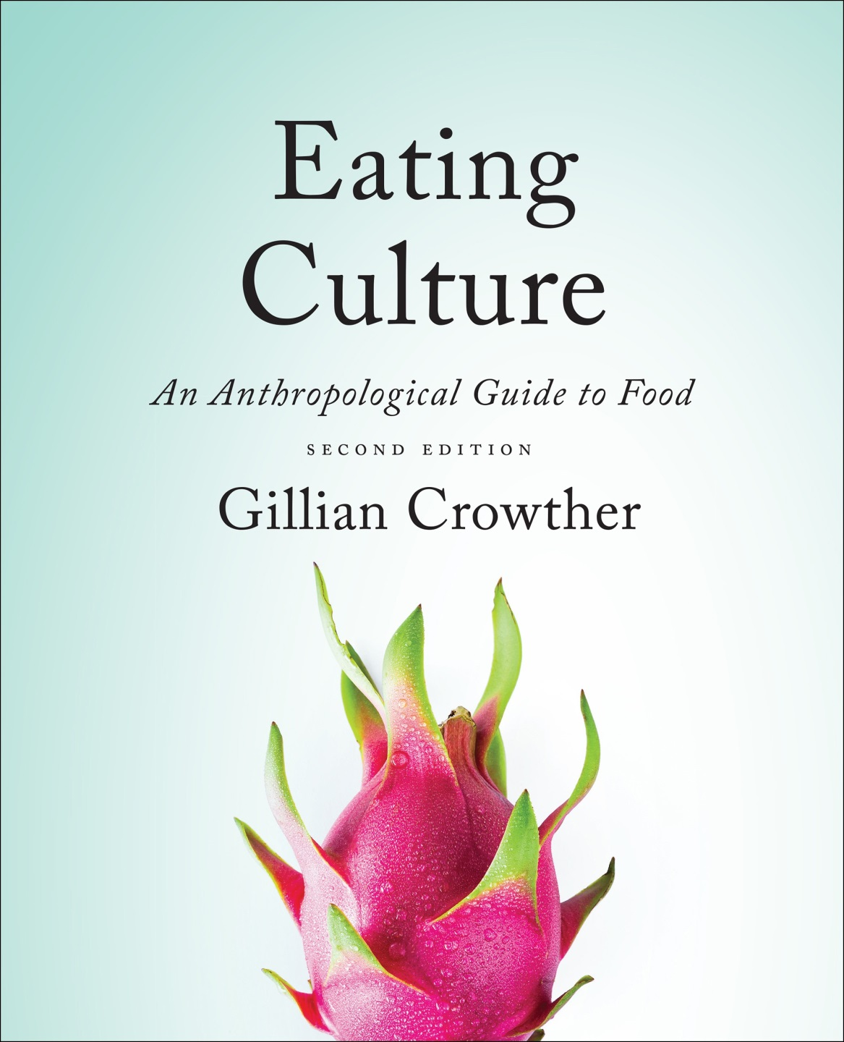
Cf. , Chapter 8
”GASTRO-ANOMIE
Global Indigestion?”:
What Causes
Eating Disorders
Use your up / down arrow keys and / or
your space bar to advance the slides
Tim Roufs
© 2010-2024
www.d.umn.edu/cla/faculty/troufs/anthfood/aftexts.html#title

Slide 2
Cf. , Chapter 8
”GASTRO-ANOMIE
Global Indigestion?”:
What Causes
Eating Disorders
Tim Roufs
© 2010-2024
www.d.umn.edu/cla/faculty/troufs/anthfood/aftexts.html#title

Slide 3
Tim Roufs
© 2010-2024
www.d.umn.edu/cla/faculty/troufs/anthfood/aftexts.html#title

Slide 4
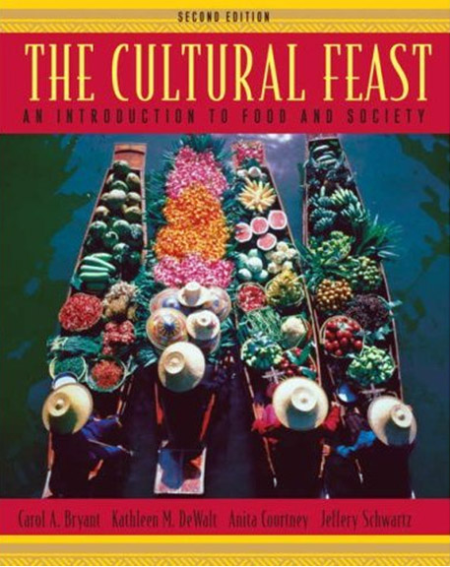
Chapter 4
”Eating is a
Cultural Affair” —
What Causes Eating Disorders?
pp.112-116
©Timothy G. Roufs 2010-2024

Slide 5
“Eating is a Cultural Affair” — Body Image and Health
  The Obesity Epidemic
  Disordered Body Image and Eating Behaviors
  Eating Disorders
    Anorexia nervosa
    Bulimia nervosa
    Binge eating
    Orthorexia nervosa
    Selective Eating Disorder (SED)
    Pica
    Others
  What Causes Eating Disorders?
  Applications

Slide 6
trying to determine the cause of eating disorders is a great example of
the holistic nature of anthropology . . .
(remember that from Week 1?)

Slide 7
eating disorders involve . . .
socio-cultural
biophysical
psychological
components . . .

Slide 8
eating disorders involve . . .
and one can occasionally throw in a little linguistics and archaeology
to boot

Slide 9
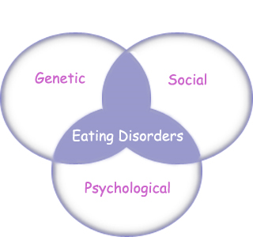
“Eating Disorders are about feelings, not food.”
The Eating Disorder Foundation
www.eatingdisorderfoundation.org/EatingDisorders.htm

Slide 10
“Eating Disorders are about feelings, not food.”
The Eating Disorder Foundation

Slide 11
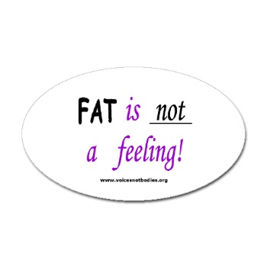
Eating Disorders Awareness Sticker
http://bumperstickers.cafepress.com/item/eating-disorders-awareness-sticker-oval/7048402

Slide 12
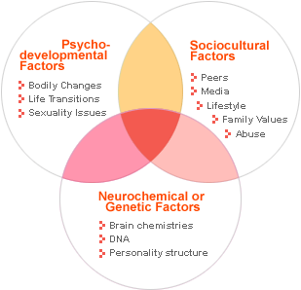
“Eating Disorders are about feelings, not food.”
The Alliance for Eating Disorder Awareness
www.eatingdisorderinfo.org/Causes/WhyDoPeopleDevelopEatingDisorders/tabid/992/Default.aspx

Slide 13
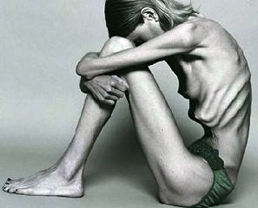
  Theories of Eating Disorders involve . . .
  biological explanations
  psychological explanations
  sociocultural explanations
  feminist orientations explanations
  (Banks 1992; Thompson et al. 1999b)
The Cultural Feast, 2nd ed., p. 113

Slide 14
  Theories of Eating Disorders . . .
  biological
  psychological
  sociocultural
  feminist orientations
  (Banks 1992; Thompson et al. 1999b)
The Cultural Feast, 2nd ed., p. 113

Slide 15
“Eating Disorders are about feelings, not food.”
The Eating Disorder Foundation
www.eatingdisorderfoundation.org/EatingDisorders.htm

Slide 16
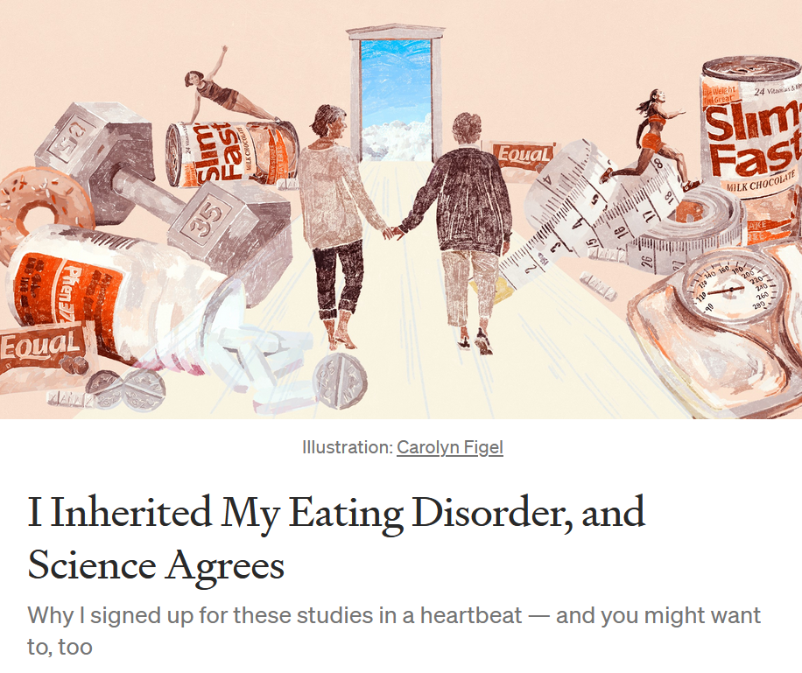

20 October 2021
https://news.illinoisstate.edu/2021/04/social-media-effects-on-body-image-and-eating-disorders/

Slide 17
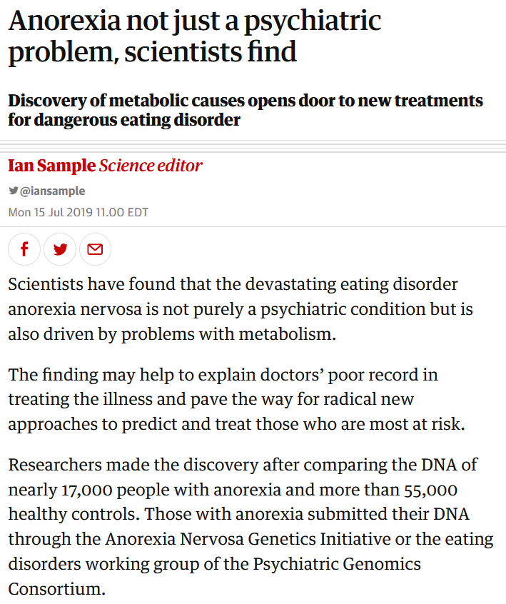

15 July 2019
https://www.theguardian.com/science/2019/jul/15/anorexia-not-just-a-psychiatric-problem-scientists-find?CMP=Share_iOSApp_Other

Slide 18
“Eating is a Cultural Affair” — Body Image and Health
  Biological explanations usually focus on abnormal hormonal balance and other biochemical changes observed in people with anorexia
      of special interest are changes in a tiny portion of the brain called the hypothalamus that regulates appetite and weight control
The Cultural Feast, 2nd ed., p. 113

Slide 19
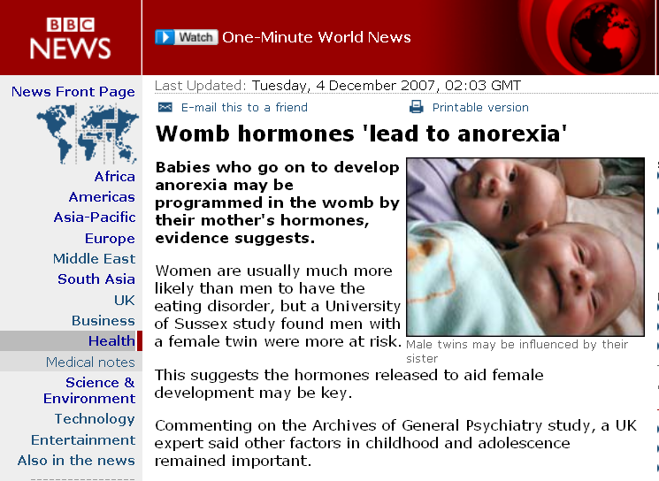
http://news.bbc.co.uk/2/hi/health/7124697.stm

Slide 20
“Eating is a Cultural Affair” — Body Image and Health
  Biological explanations usually focus on abnormal hormonal balance and other biochemical changes observed in people with anorexia
      brain scans show that people with anorexia have high levels of certain proteins secreted during stress that may indirectly bock appetite
The Cultural Feast, 2nd ed., p. 113

Slide 21
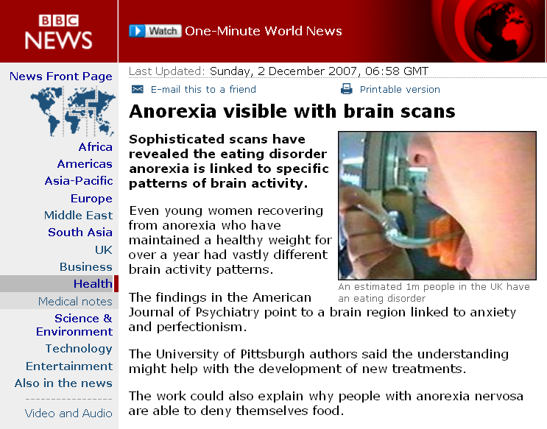
http://news.bbc.co.uk/2/hi/health/7120564.stm

Slide 22
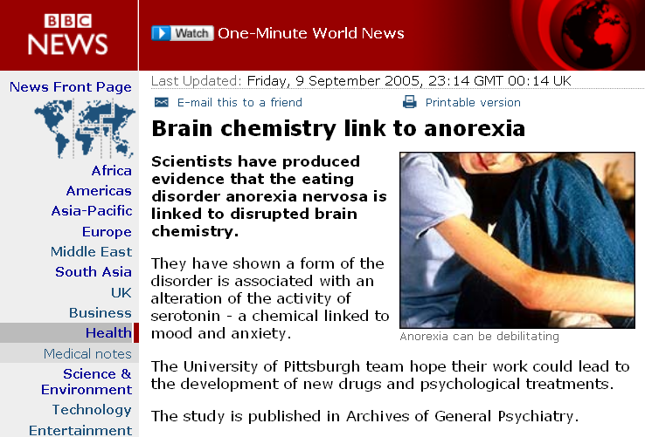
http://news.bbc.co.uk/2/hi/health/4215298.stm

Slide 23
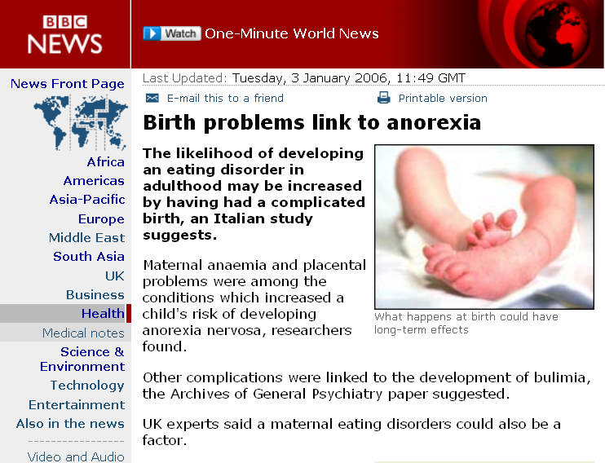
http://news.bbc.co.uk/2/hi/health/4577338.stm

Slide 24
“Eating is a Cultural Affair” — Body Image and Health
  Biological explanations usually focus on abnormal hormonal balance and other biochemical changes observed in people with anorexia
      other substances that stimulate appetite and reproductive hormones are abnormally low in anorexics
The Cultural Feast, 2nd ed., p. 113

Slide 25
“Eating is a Cultural Affair” — Body Image and Health
  Biological explanations usually focus on abnormal hormonal balance and other biochemical changes observed in people with anorexia
      most experts believe excessive weight loss and restrictive dieting cause these changes
The Cultural Feast, 2nd ed., p. 113

Slide 26
“Eating is a Cultural Affair” — Body Image and Health
  Biological explanations usually focus on abnormal hormonal balance and other biochemical changes observed in people with anorexia
      however, menstrual changes have occurred before weight loss began in some girls, suggesting that brain chemical abnormalities may contribute to the development of anorexia in some teens
The Cultural Feast, 2nd ed., p. 113

Slide 27
  Theories of Eating Disorders . . .
  biological
  psychological
  sociocultural
  feminist orientations
The Cultural Feast, 2nd ed., p. 113

Slide 28
“Eating Disorders are about feelings, not food.”
The Eating Disorder Foundation
www.eatingdisorderfoundation.org/EatingDisorders.htm

Slide 29
“Eating is a Cultural Affair” — Body Image and Health
  among the most common theories is the view that anorexia is a symptom of other psychiatric problems, especially anxiety disorders,
  and obsessive-compulsiveness
The Cultural Feast, 2nd ed., p. 114

Slide 30
“Eating is a Cultural Affair” — Body Image and Health
  emotional problems are very common among people with anorexia and bulimia . . .
  however, it is unclear if these cause eating disorders
  or
  result from them
The Cultural Feast, 2nd ed., p. 114

Slide 31
“Eating is a Cultural Affair” — Body Image and Health
  emotional problems are very common among people with anorexia and bulimia . . .
  however, it is unclear if these cause eating disorders
  or
  result from them ???
The Cultural Feast, 2nd ed., p. 114

Slide 32
“Eating is a Cultural Affair” — Body Image and Health
  phobias and
  obsessive-compulsiveness
  usually develop before the eating disorders begin . . .
  whereas anxiety attacks
  tend to occur afterward
  (MDConsult 2002)
The Cultural Feast, 2nd ed., p. 114

Slide 33
“Eating is a Cultural Affair” — Body Image and Health
  phobias and
  obsessive-compulsiveness
  usually develop before the eating disorders begin . . .
  whereas anxiety attacks
  tend to occur afterward
  (MDConsult 2002)
The Cultural Feast, 2nd ed., p. 114

Slide 34
“Eating is a Cultural Affair” — Body Image and Health
  approximately one-third of people with bulimia and two-thirds of those with anorexia suffer from obsessive-compulsiveness . . .
  persistent, recurring thoughts and repetitive routines associated with dieting and weight gain
  (MDConsult 2002)
The Cultural Feast, 2nd ed., p. 114

Slide 35
“Eating is a Cultural Affair” — Body Image and Health
  approximately one-third of people with bulimia and two-thirds of those with anorexia suffer from obsessive-compulsiveness . . .
  persistent, recurring thoughts and repetitive routines associated with dieting and weight gain
  (MDConsult 2002)
The Cultural Feast, 2nd ed., p. 114

Slide 36
“Eating is a Cultural Affair” — Body Image and Health
  they may . . .
  exercise excessively
  weigh every bite of food
  cut food into small pieces
  chew each morsel a specified number of times
  (MDConsult 2002)
The Cultural Feast, 2nd ed., p. 114

Slide 37
“Eating is a Cultural Affair” — Body Image and Health
  Other psychological characteristics associated with eating disorders
  are . . .
  narcissism
    sensitivity to criticism and the need for a great deal of admiration from others
  borderline personality disorders
    difficulty controlling anger
    fears
    impulses
  (MDConsult 2002)
The Cultural Feast, 2nd ed., p. 114

Slide 38
“Eating is a Cultural Affair” — Body Image and Health
  depression is also common among people with eating disorders . . .
  but it is more likely to be the result rather than the cause of the problem
  (MDConsult 2002)
The Cultural Feast, 2nd ed., p. 114

Slide 39
“Eating is a Cultural Affair” — Body Image and Health
  depression is also common among people with eating disorders . . .
  treating the depression rarely cures bulimia or anorexia . . .
  but weight gain often relieves depression
  (MDConsult 2002)
The Cultural Feast, 2nd ed., p. 114

Slide 40
“Eating is a Cultural Affair” — Body Image and Health
  re parent-child relations . . .
  bulimia and anorexia nervosa appear to be more common among children raised in a critical family environment . . .
  especially when parents encourage them to diet, tease them about their weight, or try to dominate them in other ways
  (Lunner et al. 2000)
The Cultural Feast, 2nd ed., p. 114

Slide 41
“Eating is a Cultural Affair” — Body Image and Health
  re parent-child relations . . .
  teens who suffer form bulimia are more likely than teens without the disorder to report that their mothers invade their personal privacy and relate to them in a jealous or competitive manner
  (Rorty et al. 2000)
The Cultural Feast, 2nd ed., p. 114

Slide 42
“Eating is a Cultural Affair” — Body Image and Health
  re parent-child relations . . .
  bulimia is also more common among girls whose fathers are detached . . .
  perhaps making them feel worthless
  (Rorty et al. 2000)
The Cultural Feast, 2nd ed., p. 114

Slide 43
“Eating is a Cultural Affair” — Body Image and Health
  re parent-child relations . . .
  bulimia is also more common among girls whose fathers treat them in a sexual or seductive manner . . .
  (Rorty et al. 2000)
The Cultural Feast, 2nd ed., p. 114

Slide 44
“Eating is a Cultural Affair” — Body Image and Health
  re parent-child relations . . .
  many studies show increased eating disorders among teens whose parents show excessive concerns about their weight, eating, and appearance . . .
  (Rorty et al. 2000)
The Cultural Feast, 2nd ed., p. 114

Slide 45
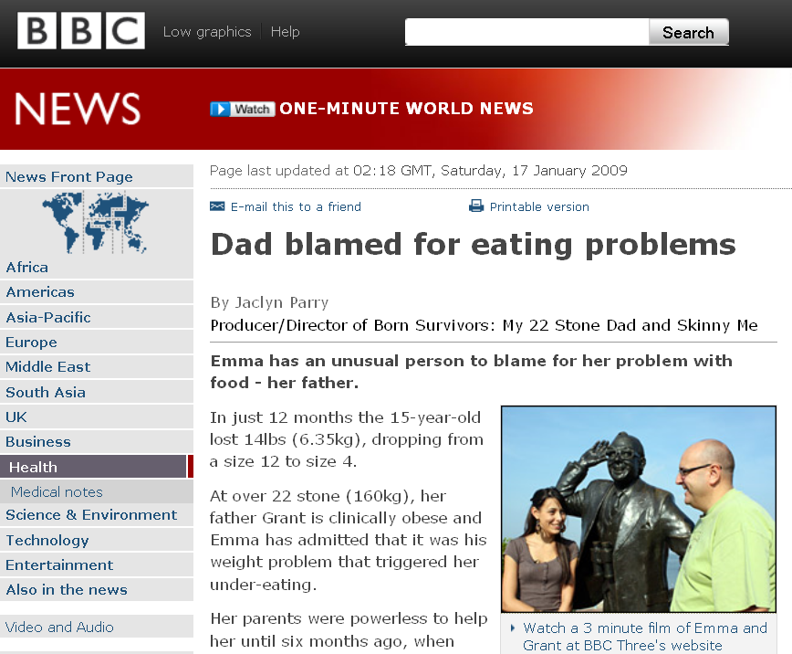
http://news.bbc.co.uk/2/hi/health/7824298.stm
http://news.bbc.co.uk/2/hi/health/7824298.stm

Slide 46
“Eating is a Cultural Affair” — Body Image and Health
  re parent-child relations . . .
  children who are sexually abused are also much more likely than those who are not to develop disordered eating patterns . . .
  (Neumark-Sztainer et al. 2000)
The Cultural Feast, 2nd ed., p. 114

Slide 47
“Eating is a Cultural Affair” — Body Image and Health
  re parent-child relations . . .
  In contrast, young people raised in cohesive families with good parent-child communication area less likely to develop these problems
  (Thompson et al. 2000)
The Cultural Feast, 2nd ed., p. 114

Slide 48
  Theories of Eating Disorders . . .
  biological
  psychological
  sociocultural
  feminist orientations
  (Banks 1992; Thompson et al. 1999b)
The Cultural Feast, 2nd ed., p. 113

Slide 49
“Eating Disorders are about feelings, not food.”
The Eating Disorder Foundation
www.eatingdisorderfoundation.org/EatingDisorders.htm

Slide 50
“Eating is a Cultural Affair” — Body Image and Health
  Sociocultural theories propose that the value Western societies place on thinness and self-control leads to eating disorders
The Cultural Feast, 2nd ed., p. 114

Slide 51
the three major contemporary debates
Biological Determinism vs. Cultural Constructionism
(“nature vs. nurture”)
(“learned vs. inherited”)
Ideationism vs. Cultural Materialism
Individual Agency vs. Structuralism
(“free will” vs. “power structures”)

Slide 52
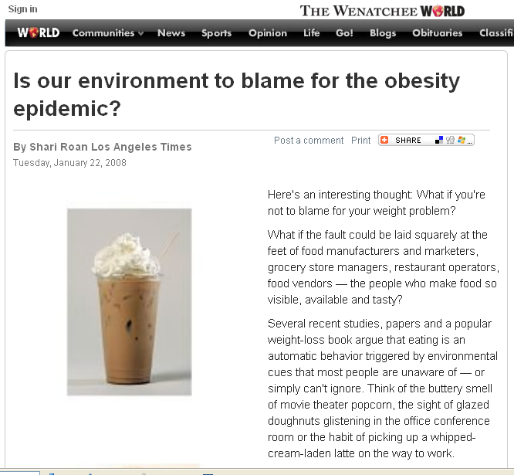
http://www.wenatcheeworld.com/news/2008/jan/22/is-our-environment-to-blame-for-the-obesity/
Notes:
52

Slide 53
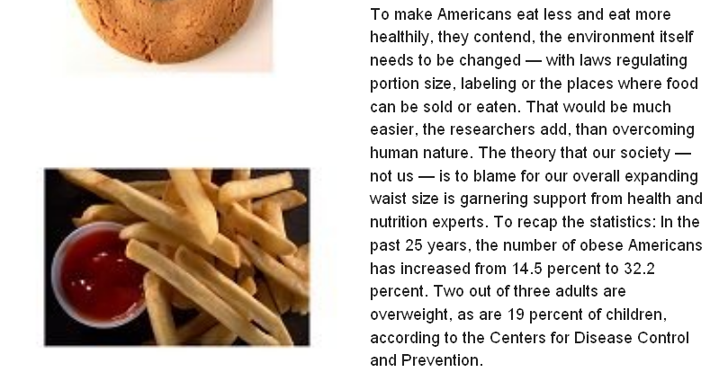
http://www.wenatcheeworld.com/news/2008/jan/22/is-our-environment-to-blame-for-the-obesity/
Notes:
53

Slide 54
  Numerous studies have shown that exposure to images [cultural] of ultrathin models can lead to body dissatisfaction and eventually to unhealthy eating behaviors and physical illness [physical] . . .
The Cultural Feast, 2nd ed., p. 115

Slide 55

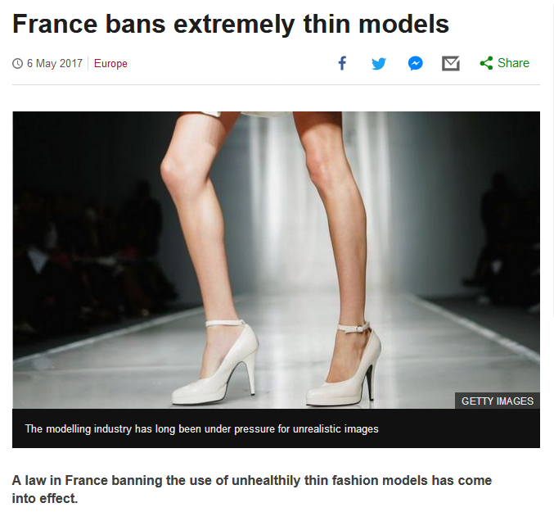
http://www.bbc.com/news/world-europe-39821036http://www.bbc.com/news/world-europe-39821036

Slide 56
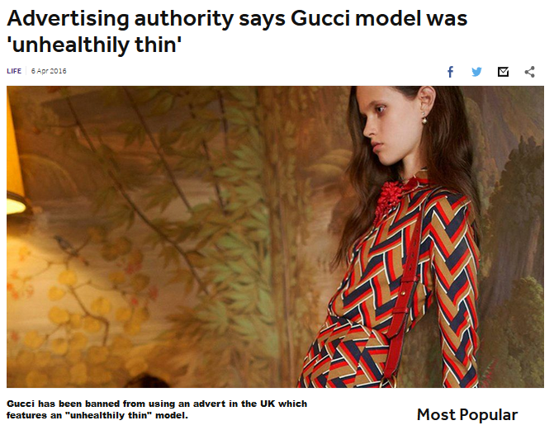
http://www.bbc.co.uk/newsround/35979565

Slide 57
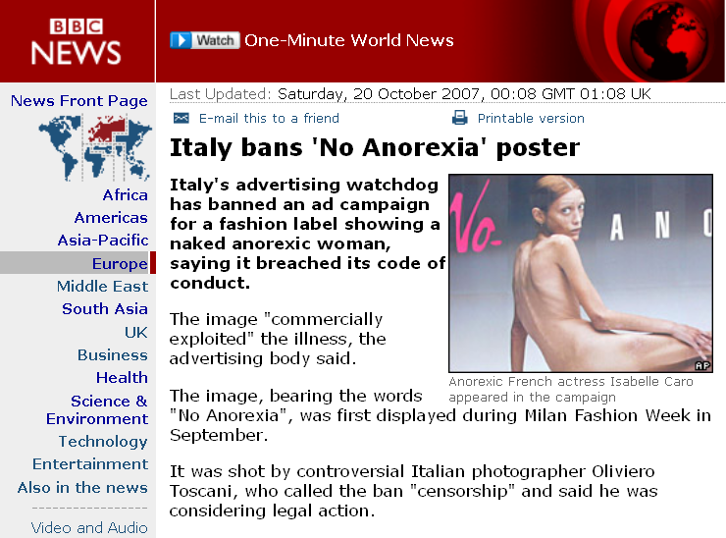
http://news.bbc.co.uk/2/hi/europe/7053725.stm

Slide 58
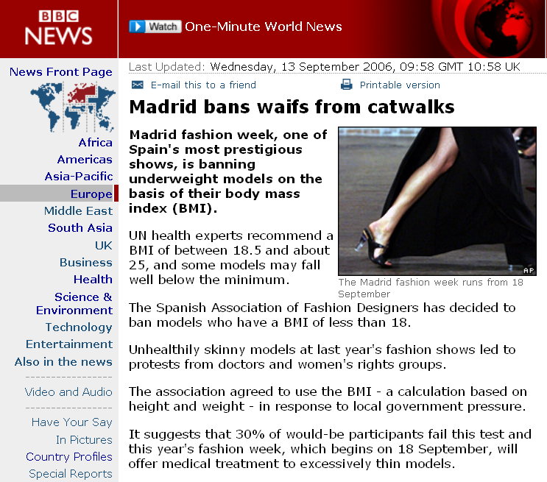
http://news.bbc.co.uk/2/hi/europe/5341202.stm

Slide 59
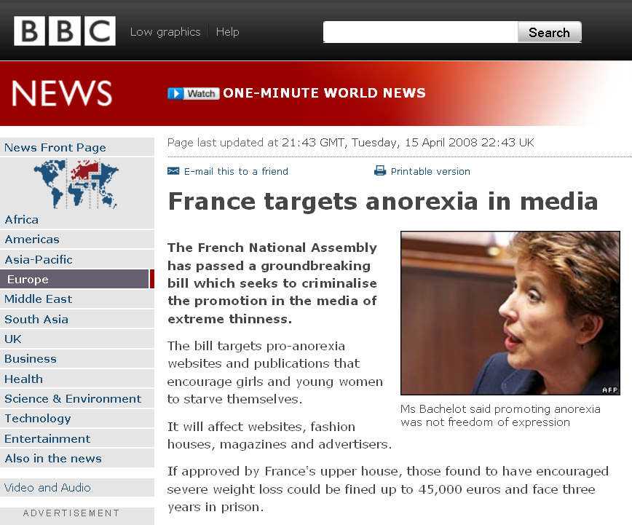
http://news.bbc.co.uk/2/hi/europe/7349607.stm

Slide 60
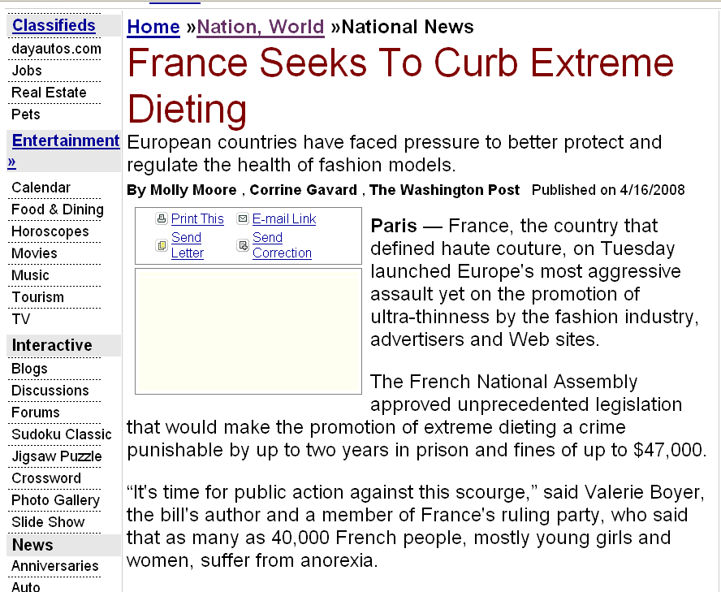
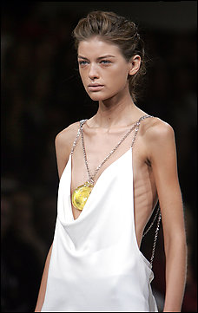
http://theday.com/re.aspx?re=716e5482-a35a-4d6e-8ed6-bac5d1a0d04f
Notes:
60

Slide 61
“Eating is a Cultural Affair” — Body Image and Health
  sociologists and anthropologists point out that the cult of thinness and disorders such as anorexia nervosa and bulimia are found predominantly in Western societies
The Cultural Feast, 2nd ed., p. 114

Slide 62
  Different cultures have different ideals of beauty,
  ideal body image, . . .
  and rates of eating disorders . . .

Slide 63
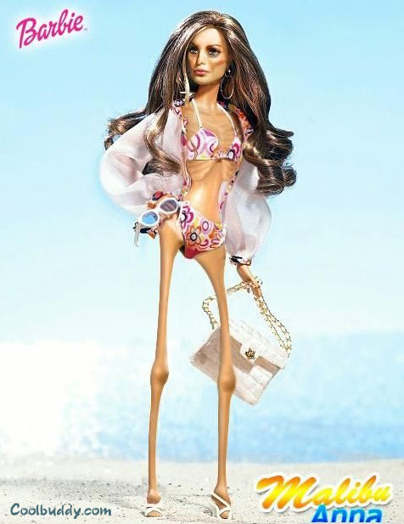
http://pamchi.files.wordpress.com/2007/06/anorexicbarbie.jpg

Slide 64
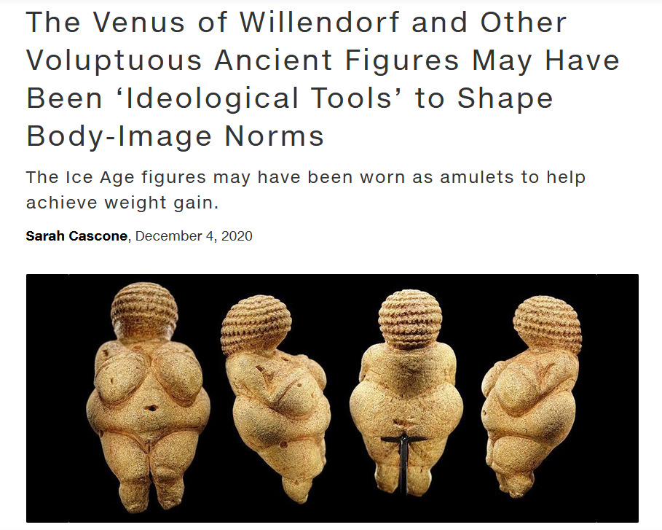
https://news.artnet.com/art-world/venus-figurines-obesity-1928873

Slide 65
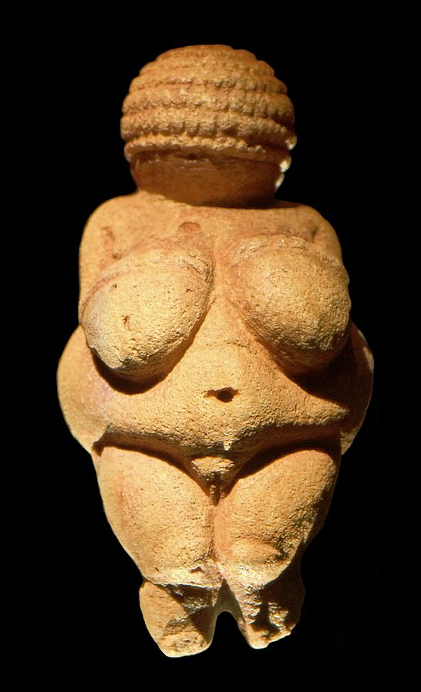
Venus of Willendorf
https://en.wikipedia.org/wiki/Venus_of_Willendorf

Slide 66
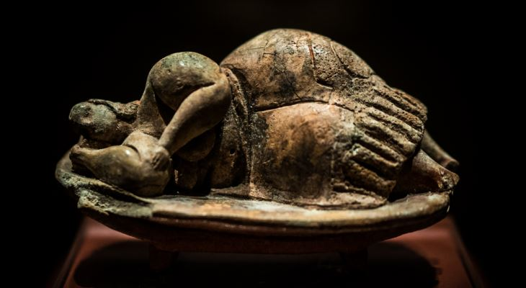
The Dreaming Goddess of Malta
https://www.guidememalta.com/en/5-things-you-didn-t-know-about-malta-gozo-s-prehistoric-temples

Slide 67
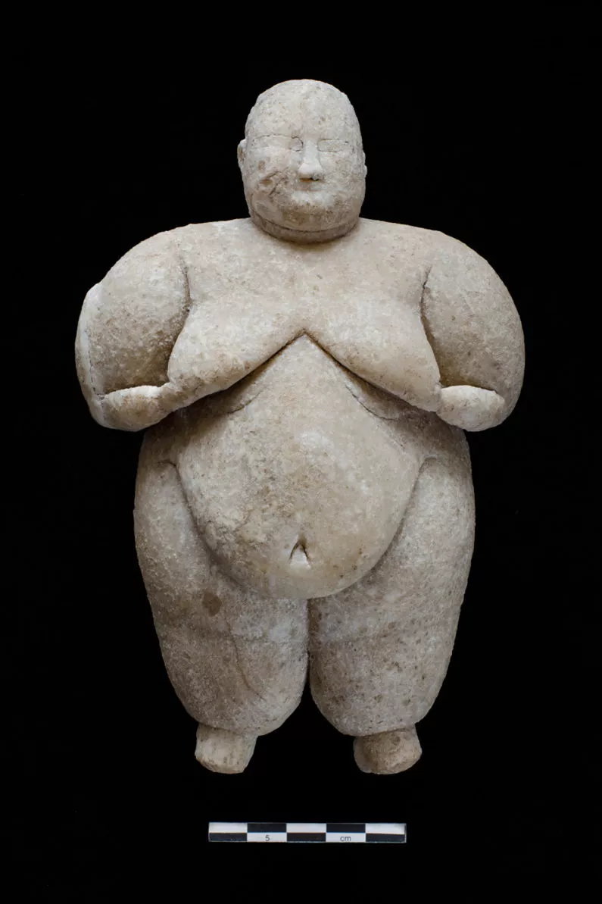
Neolithic Goddess, Çatalhöyük, Turkey
Turkeyhttps://www.livescience.com/56515-neolithic-goddess-figurine-uncovered.html

Slide 68
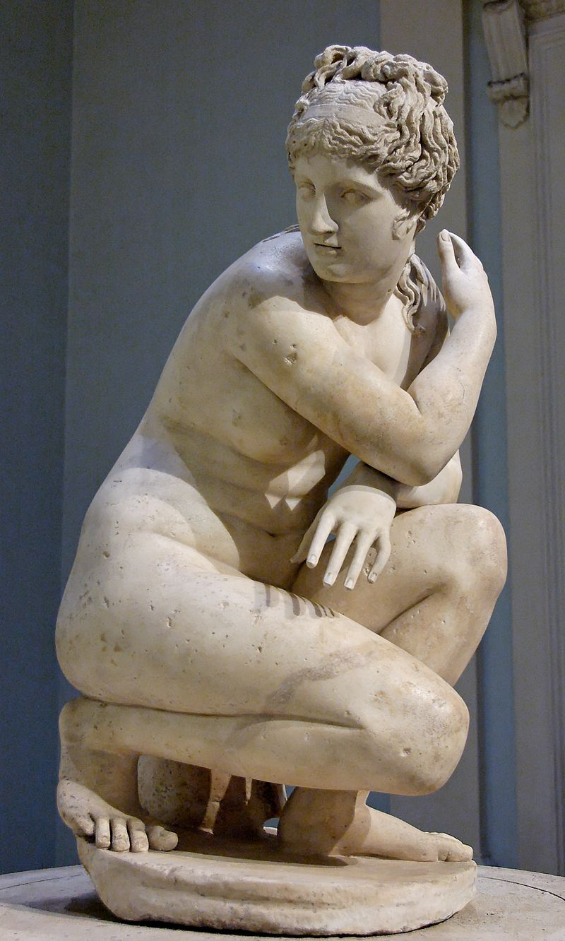
The Lely's Venus, copy of Hellenistic statue
https://en.wikipedia.org/wiki/Lely_Venus

Slide 69
Chapter 4: “Eating is a Cultural Affair” — Body Image and Health
  In some—maybe even many—a culture’s fatness is valued as a sign of wealth, and thinness as evidence that women are poor and undernourished
The Cultural Feast, 2nd ed., p. 105

Slide 70
Leblouh
(Arabic: البلوح‎, romanized: lə-blūḥ)

Slide 71

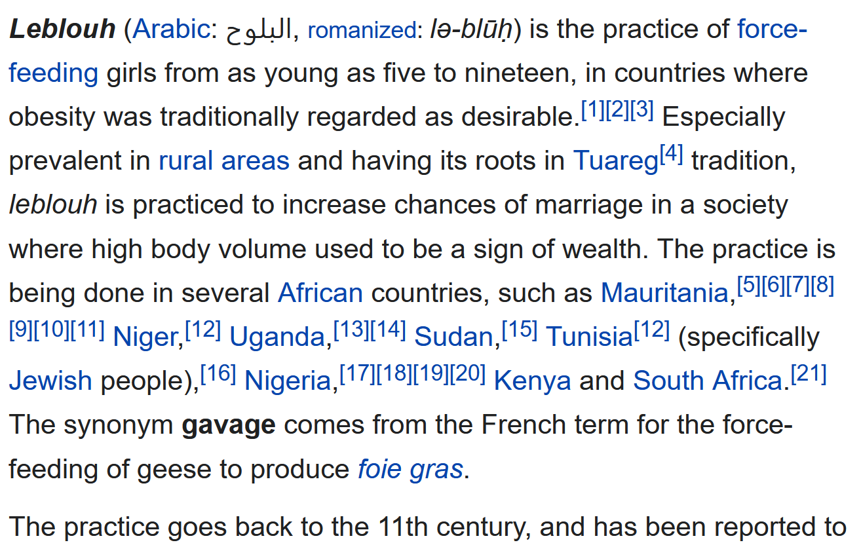


Leblouh
https://en.wikipedia.org/wiki/Leblouh

Slide 72
“Eating is a Cultural Affair” — Body Image and Health
  but that is changing with the globalization (i.e. Westernization)
  of other cultures . . .
The Cultural Feast, 2nd ed., p. 114

Slide 73
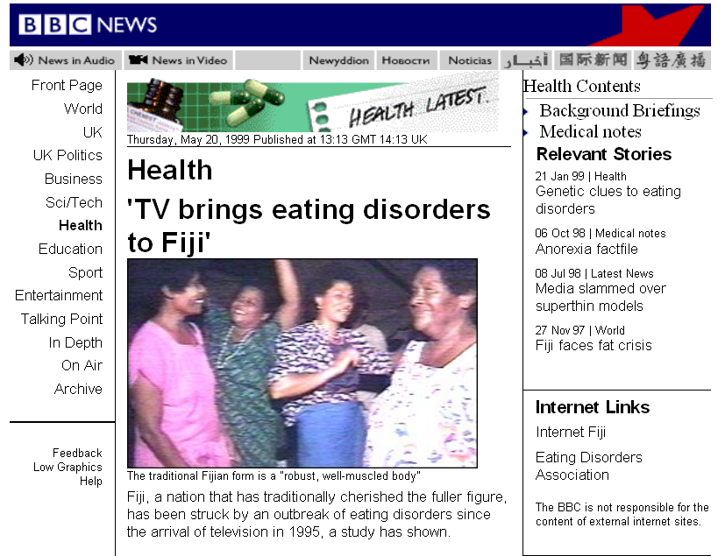
http://news.bbc.co.uk/2/hi/health/347637.stm

Slide 74
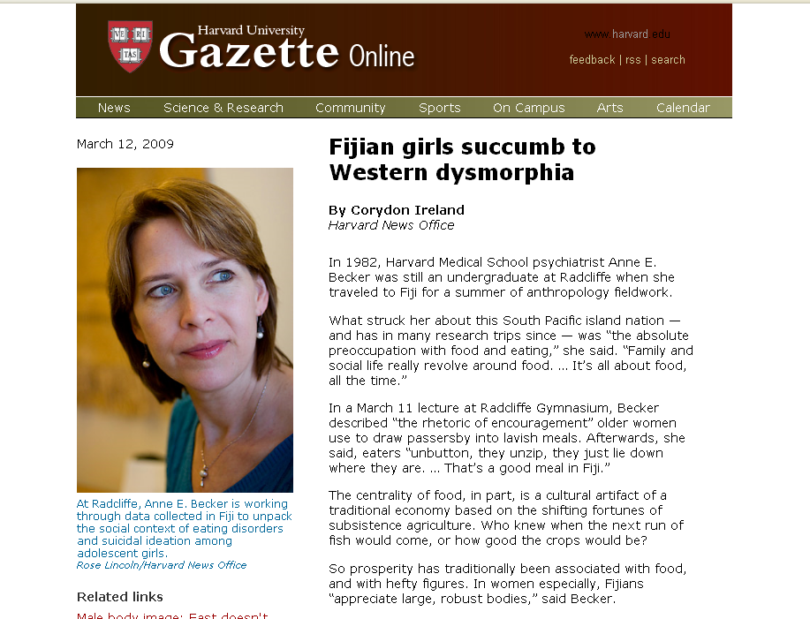
http://www.news.harvard.edu/gazette/2009/03.19/11-dysmorphia.html

Slide 75
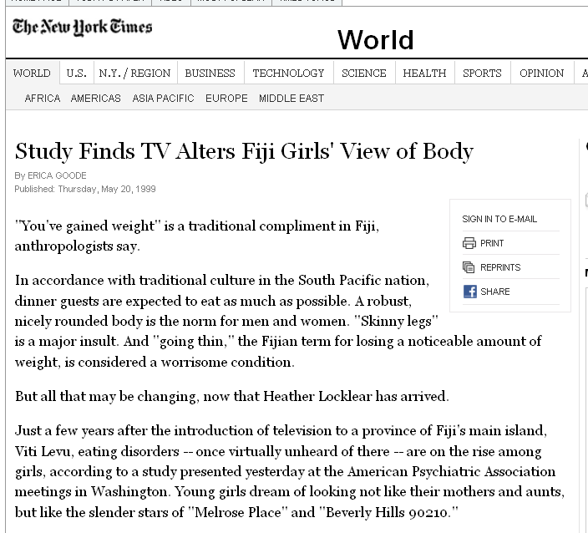
http://www.nytimes.com/1999/05/20/world/study-finds-tv-alters-fiji-girls-view-of-body.html?sec=health

Slide 76
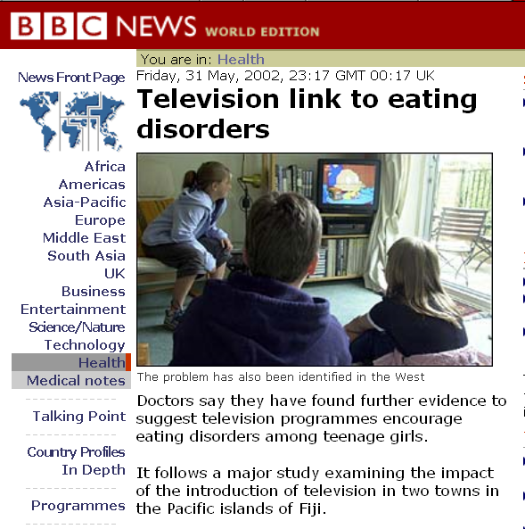
http://news.bbc.co.uk/2/hi/health/2018900.stm

Slide 77

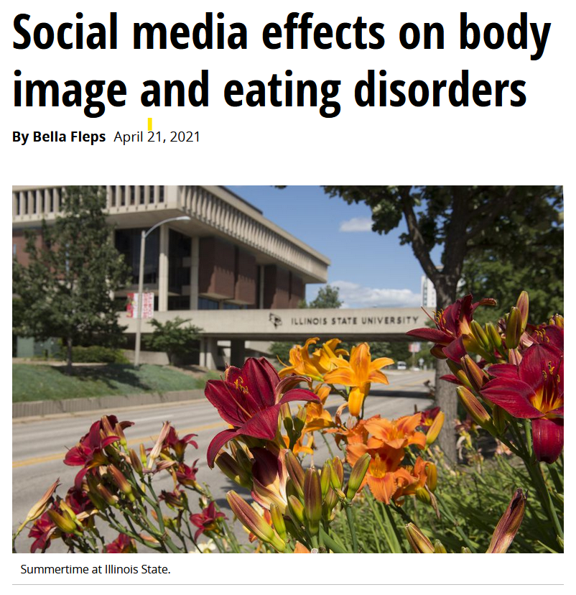
21 April 2021
https://news.illinoisstate.edu/2021/04/social-media-effects-on-body-image-and-eating-disorders/

Slide 78
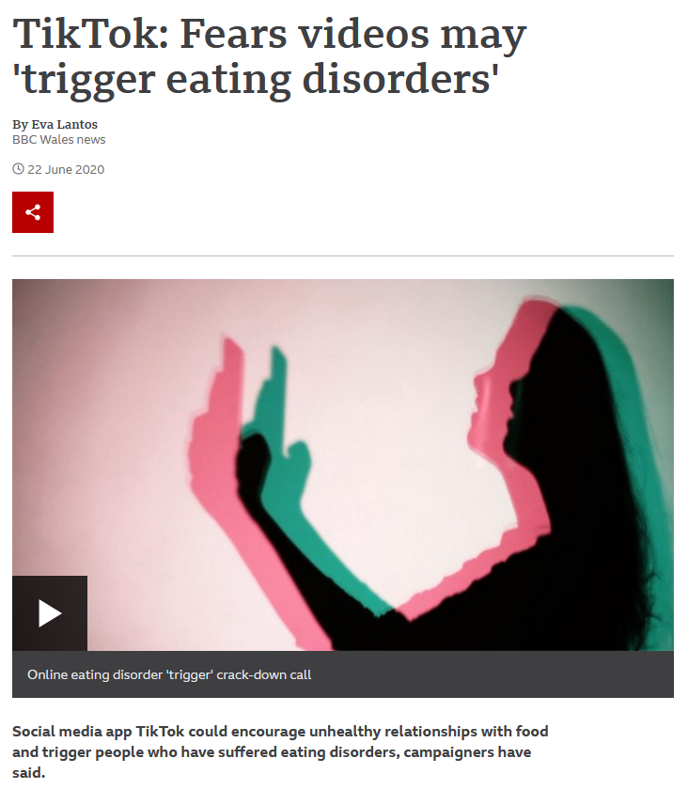
22 June 2022
https://www.bbc.com/news/uk-wales-52919914

Slide 79
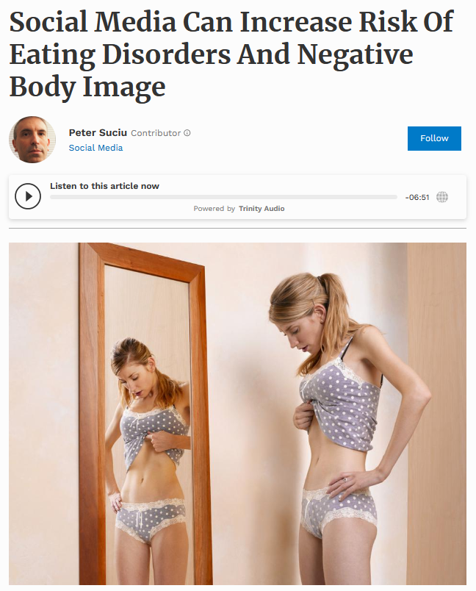

24 Feb 2021
Source: Forbes

Slide 80

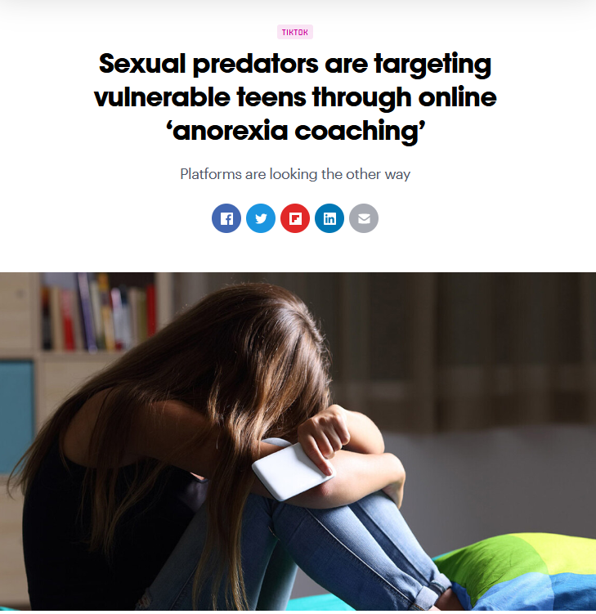

26 July 2021
https://thenextweb.com/news/sexual-predators-vulnerable-teens-anorexia-coaching-syndication

Slide 81
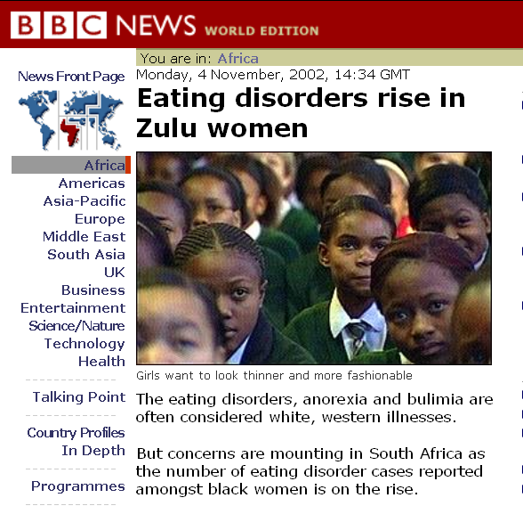
http://news.bbc.co.uk/2/hi/africa/2381161.stm

Slide 82
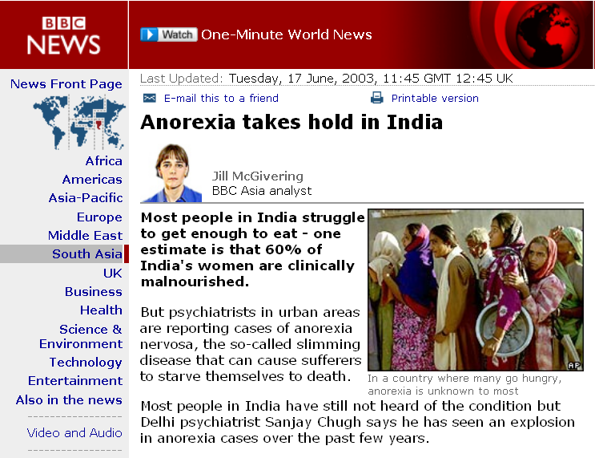
http://news.bbc.co.uk/2/hi/south_asia/2978216.stm

Slide 83
Chapter 4: “Eating is a Cultural Affair” — Body Image and Health
  cultural notions about
  ideal body size and shape have important implications for the public’s health
The Cultural Feast, 2nd ed., p. 105

Slide 84
Chapter 4: “Eating is a Cultural Affair” — Body Image and Health
  and they’re changing worldwide
The Cultural Feast, 2nd ed., p. 105

Slide 85
“Eating is a Cultural Affair” — Body Image and Health
  a slimmer body has been the norm in the United States and Canada for almost a century, and this idealization of thinness may serve as a counterbalance against the tendency to gain weight in societies with abundant, stable food supplies where people can gain weight easily and obesity is common
  Cf., Ch. 4 of The Cultural Feast
The Cultural Feast, 2nd ed., p. 114

Slide 86
“Eating is a Cultural Affair” — Body Image and Health
  according to sociocultural theorists,
  the media plays a powerful role
  in transmitting
  the cult of thinness . . .
The Cultural Feast, 2nd ed., pp. 114-115

Slide 87
“Eating is a Cultural Affair” — Body Image and Health
  television, radio, magazine, and other print messages use anorexic models whose pictures have been airbrushed and computer-altered to create unachievable standards of beauty
The Cultural Feast, 2nd ed., p. 115

Slide 88

        “Along with disparaging fatness, Americans are scared of fatness because it can sneak up on anyone.”
          “It is nearly impossible to read a newspaper or watch a TV program without hearing something new about the growing rates of obesity in the United States.”
Sherrie A. Inness, Secret Ingredients, Palgrave Macmillan, 2006, p. 171

Slide 89
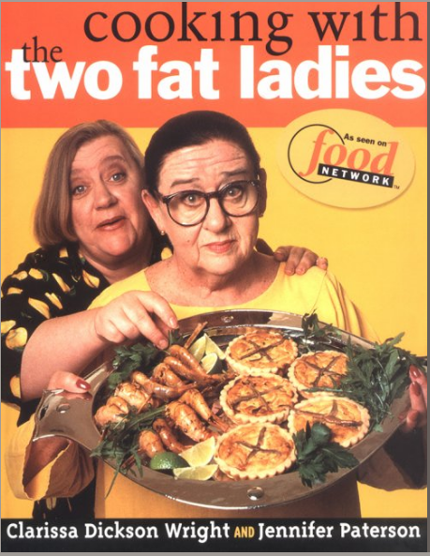
Clarissa
Dickson
Wright
Jennifer
Patterson
you’ve seen that with
The Two Fat Ladies
Cooking With the Two Fat Ladies, Clarkson Potter, 1998

Slide 90
        “[The] fantasy world where no woman carries any extra weight impacts how real women perceive their bodies.
        They see so many unrealistically slender bodies that they begin to assume that their bodies should be similarly thin.
        This feeling is aggravated because American culture is inundated with ways to slenderize,
        many focused on women.”
Sherrie A. Inness, Secret Ingredients, Palgrave Macmillan, 2006, p. 173

Slide 91
        “Every diet book possible
        fills bookstores.
        Health clubs and gymnasiums
        inundate cities and towns
        from coast to coast.
        TV shows and tabloids
        are replete with ways to diet.”
Sherrie A. Inness, Secret Ingredients, Palgrave Macmillan, 2006, p. 173

Slide 92
        “Losing weight obsesses our culture . . . so [women] feel that they must strive for thinness, whatever the cost.”
          anorexia and bulimia are rampant because women feel such a desire to lose weight
          even if a woman is not anorexic, she is still apt to wish to lose five or ten pounds
Sherrie A. Inness, Secret Ingredients, Palgrave Macmillan, 2006, p. 173

Slide 93
        “Losing weight obsesses our culture . . . so [women] feel that they must strive for thinness, whatever the cost.”
          anorexia and bulimia
          are rampant because women feel such a desire to lose weight
          even if a woman is not anorexic, she is still apt to wish to lose five or ten pounds
Sherrie A. Inness, Secret Ingredients, Palgrave Macmillan, 2006, p. 173

Slide 94
        “In a society where women’s eating is constantly under scrutiny, one of the tragic end results is
        anorexia and bulimia.”
Sherrie A. Inness, Secret Ingredients, Palgrave Macmillan, 2006, p. 186

Slide 95
        “What explains the Two Fat Ladies’ appeal
        around the globe?”
        “. . . the Ladies were
        resolutely anti-diet. . . .”
        “In their world, one did not have to worry about following the latest diet.”
Sherrie A. Inness, Secret Ingredients, Palgrave Macmillan, 2006, p. 176

Slide 96
        Writing about the death of Robert Atkins,
        “the diet guru”
        Clarissa wrote . . .
            “The legacy of today’s ultra-thin
            ‘heron chic’ models
            — and of celebrity diet gurus —
            is anorexia . . .”
Sherrie A. Inness, Secret Ingredients, Palgrave Macmillan, 2006, p. 177

Slide 97
“Eating is a Cultural Affair” — Body Image and Health
  some social scientists blame a capitalistic society for the increase in anorexia and bulimia . . .
  weight-control products
  diet industry ($33 billion)
  cosmetic industry ($20 billion)
  cosmetic surgery industry ($300 billion)
  fitness industry
  (Colditz 1992)
The Cultural Feast, 2nd ed., p. 115

Slide 98
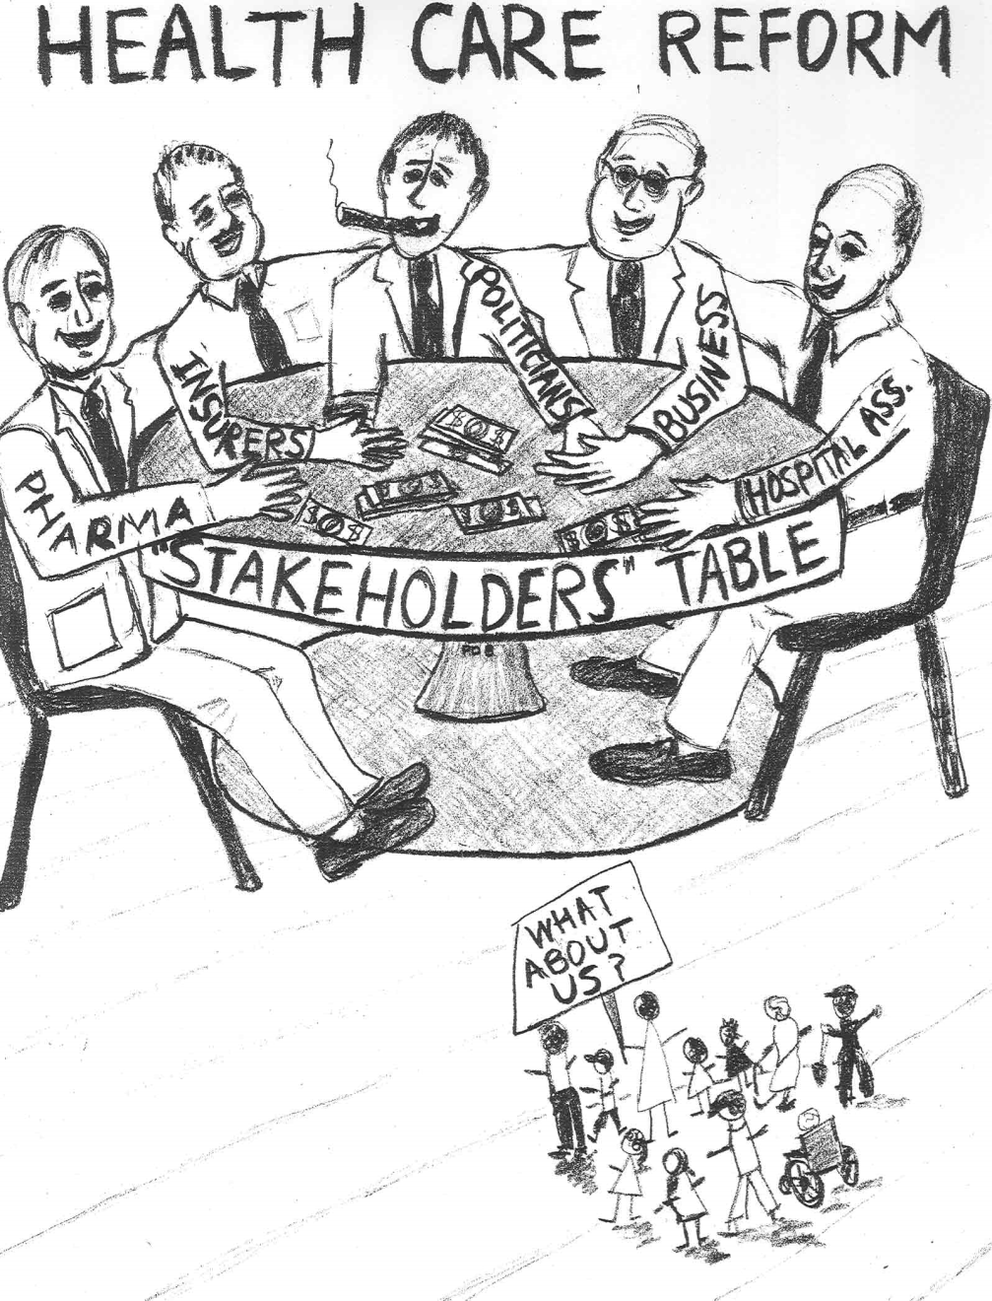
http://www.freerepublic.com/focus/f-news/2201659/posts

Slide 99
“Eating is a Cultural Affair” — Body Image and Health
  “These industries have developed a ‘sure-fire’ formula for success: Standardize a thin idea of beauty that the majority of women can never attain, but make it look so appealing that they actually seek it out. The pursuit of thinness and the subsequent failure of most women in this pursuit construct an indefinite marketing of consumers.”
  (Germov and Williams 1999:121)
The Cultural Feast, 2nd ed., p. 115

Slide 100
“profit motives” are archetypal examples of . . .
Biological Determinism vs. Cultural Constructionism
(“nature vs. nurture”)
(“learned vs. inherited”)
Ideationism vs. Cultural Materialism
Individual Agency vs. Structuralism
(“free will” vs. “power structures”)

Slide 101
  Theories of Eating Disorders . . .
  biological
  psychological
  sociocultural
  feminist orientations
  (Banks 1992; Thompson et al. 1999b)
The Cultural Feast, 2nd ed., p. 113

Slide 102
“Eating is a Cultural Affair” — Body Image and Health
  feminist scholars have also entered the debate, proposing that eating disorders are a natural response to pathological societal pressures to be thin rather than a manifestation of psychiatric illness
  (Bordo 1993; Thompson et al. 1999)
The Cultural Feast, 2nd ed., p. 115

Slide 103
“Eating is a Cultural Affair” — Body Image and Health
  although the feminist scholars recognize that many men are concerned about their weight, they argue that body imagery has special meaning for women
  (Bordo 1993; Thompson et al. 1999)
The Cultural Feast, 2nd ed., pp. 115-166

Slide 104
“Eating is a Cultural Affair” — Body Image and Health
  women grow up knowing that attractiveness is a key to attracting men
  they expect others to evaluate themselves in terms of their appearance and begin to watch their own bodies as outside observers
  women also learn that dieting and appetite control are necessary to achieve society’s standards of beauty
  (McKinley 1999)
The Cultural Feast, 2nd ed., p. 116

Slide 105
“Eating is a Cultural Affair” — Body Image and Health
  feminists note that today’s women are conflicted because they are socialized to seek equal opportunity in education and employment but, at the same time, must maintain the sexual identity of a pleasing wife and mother . . .
  (Bordo 1993; Thompson et al. 1999)
The Cultural Feast, 2nd ed., pp. 115-166

Slide 106
“Eating is a Cultural Affair” — Body Image and Health
  the result is . . .
  confusion
  body dissatisfaction
  low self esteem
  ambivalence about eating
  (McKinley 1999)
The Cultural Feast, 2nd ed., p. 116

Slide 107
“Eating is a Cultural Affair” — Body Image and Health
  by restricting their rate, women gain a sense of control that is otherwise thwarted in a male-dominated society
  (Beardsworth and Keil 1997; Thompson et al. 1999)
The Cultural Feast, 2nd ed., p. 116

Slide 108
“Eating is a Cultural Affair” — Body Image and Health
  “anorexia nervosa is considered a rebellion against misogynistic societal norms that demean women by objectifying their bodies, and the anorexic’s decision to lose weight is seen as a
  symbolic protest against . . . “
  male domination
  a rigid sexual division of labor
  “the traditional female role”
  [presumably the white middle-class female role]
  (Banks 1992)
The Cultural Feast, 2nd ed., p. 116

Slide 109
“Eating is a Cultural Affair” — Body Image and Health
  other feminists argue that eating disorders represent anxieties about success and femininity
  starvation stops menstruation and delays their bodies’ maturation, “allowing them to return to the less threatening prepubescent body and avoiding becoming a sexually mature, autonomous person in a world they see as dangerous for women”
  (Beardsworth and Keil 1997; Thompson et al. 1999)
The Cultural Feast, 2nd ed., p. 116

Slide 110
“Eating is a Cultural Affair” — Body Image and Health
  of course, each of these theories has its shortcomings . . .
  no single theory, for instance, explains why only a small proportion of women develop eating disorders whereas others gain excess weight or stay within healthy limits
The Cultural Feast, 2nd ed., p. 116

Slide 111
“Eating is a Cultural Affair” — Body Image and Health
  most likely,
  a combination of factors, such as young people’s susceptibility to social pressure or their feelings of worthlessness or shame, mediate the effects of media exposure to cultural ideals of thinness
  (Banks 1992; Murray, Waller, and Legg 2000; Thompson et al. 1999)
The Cultural Feast, 2nd ed., p. 116

Slide 112
“Eating Disorders are about feelings, not food.”
The Eating Disorder Foundation
www.eatingdisorderfoundation.org/EatingDisorders.htm

Slide 113
“Eating is a Cultural Affair” — Body Image and Health
  the study of
  twins who are raised together and twins who are raised separately . . .
  suggests that a combination of biological, psychological and sociocultural factors work together to create eating disorders
  (Bulik et al. 2000)
The Cultural Feast, 2nd ed., p. 116

Slide 114
“Eating is a Cultural Affair” — Body Image and Health
  twins studies suggest that a combination of genetic factors
  and environmental factors contributes to the development of eating disorders . . .
        parental influence
        peers
        etc.
  (Bulik et al. 2000)
The Cultural Feast, 2nd ed., p. 116

Slide 115
“Eating is a Cultural Affair” — Body Image and Health
  As a result . . .
  researchers are testing comprehensive models that examine the combined effects of people’s . . .
    global psychological makeup . . .
    social pressure . . .
    body image
    levels of dissatisfaction on people’s actual weight and disordered eating practices
  (Thompson et al. 1999)
The Cultural Feast, 2nd ed., p. 116

Slide 116
“Eating is a Cultural Affair” — Body Image and Health
  As a result . . .
  researchers are testing comprehensive models that examine the combined effects of people’s . . .
    global psychological makeup . . .
    social pressure . . .
    body image
    levels of dissatisfaction on people’s actual weight and disordered eating practices
  (Thompson et al. 1999)
The Cultural Feast, 2nd ed., p. 116

Slide 117
“Eating is a Cultural Affair” — Body Image and Health
The bottom Line: All of these factors are involved . . . and more . . .
    global psychological makeup
      self-esteem
      emotional problems
      susceptibility to external feedback
    social pressure
      media exposure
      teasing by relatives, peers and friends
    body image
    levels of dissatisfaction on people’s actual weight and disordered eating practices
The Cultural Feast, 2nd ed., p. 116

Slide 118
Cf. , Chapter 8
”GASTRO-ANOMIE
Global Indigestion?”:
What Causes
Eating Disorders
Tim Roufs
© 2010-2024
www.d.umn.edu/cla/faculty/troufs/anthfood/aftexts.html#title

