Slide 1
The USDA
Food Guide Pyramid
(1992-2011)
and
MyPlate
(2011-)
Anthropology of Food University of Minnesota Duluth
Tim Roufs ©2014-2024

Slide 2
The 1992 USDA food pyramid

Slide 3
the food pyramid of
The United States
Department of Agriculture
is one of the most widely recognized logos in the world . . .
. . . right next to

Slide 4
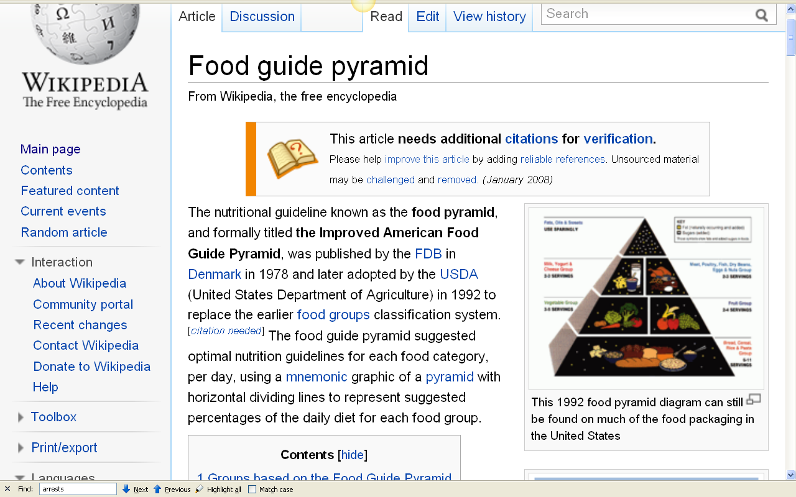
http://en.wikipedia.org/wiki/Food_guide_pyramid

Slide 5
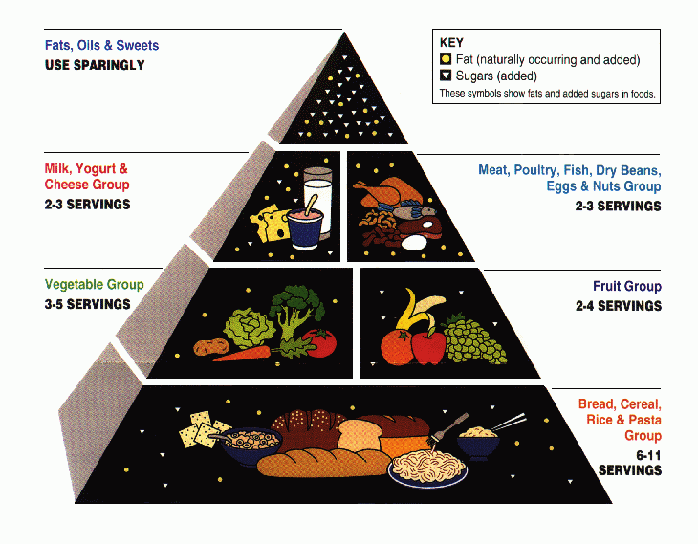
the 1992 “Food Guide Pyramid”

Slide 6
this is the old (1992) version
the 1992 “Food Guide Pyramid”

Slide 7
the 1992 Food Guide Pyramid was replaced by MyPyramid
on 19 April 2005

Slide 8
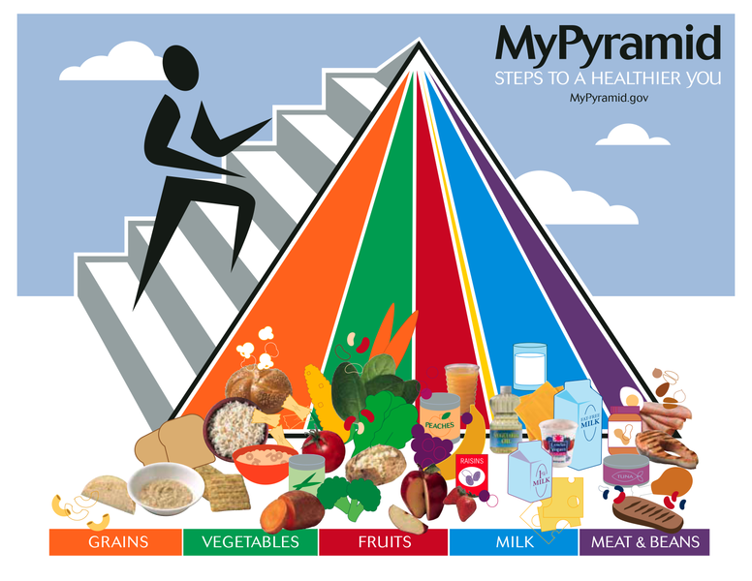
The 2005 USDA food guide pyramid

Slide 9
the 2005 MyPyramid was in turn replaced by MyPlate
on 2 June 2011

Slide 10
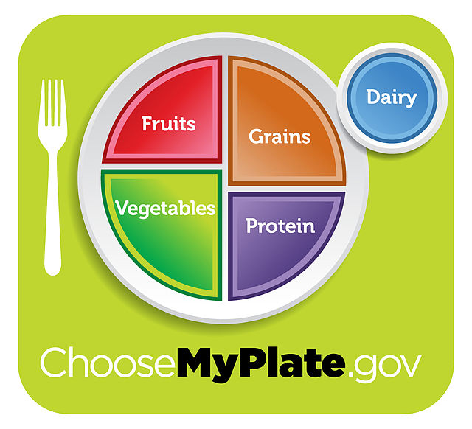
MyPyramid was replaced by MyPlate on 2 June 2011

Slide 11
Worldwide, food guide “pyramids” come in
versions for
all countries and cuisines
and in all sizes and shapes . . .

Slide 12
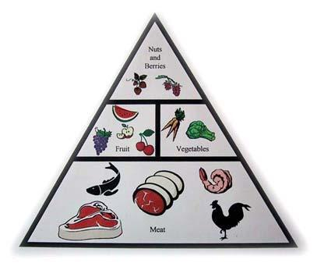
Paleolithic Diet Food Pyramid
http://www.wineinyourdiet.com/My_own_popular_diet_articles/paleolithic_diet.php

Slide 13
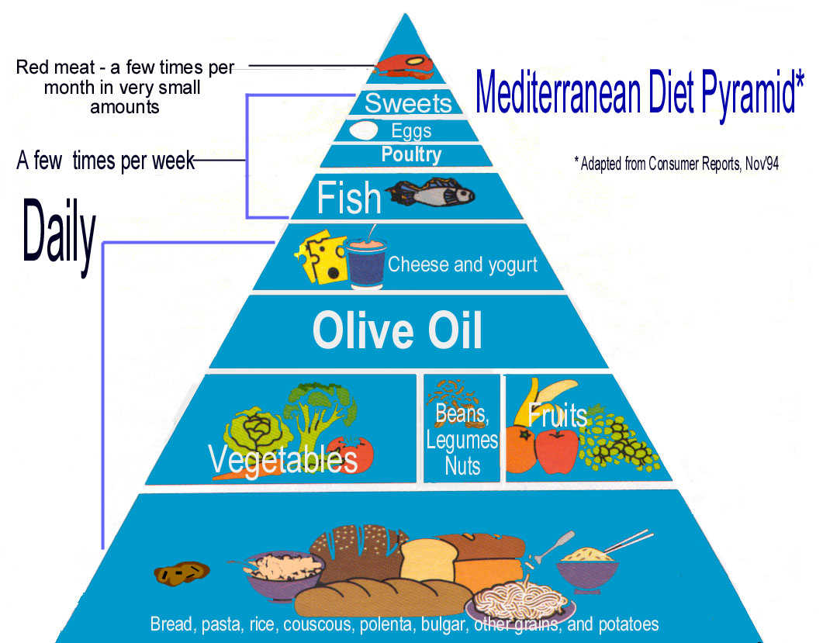
Notes:
13

Slide 14
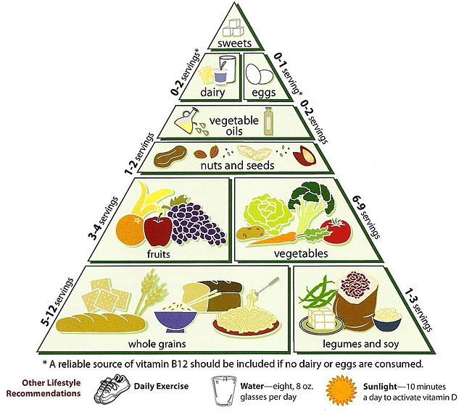
Vegetarian Food Pyramid
http://en.wikipedia.org/wiki/Vegetarian_Diet_Pyramid

Slide 15
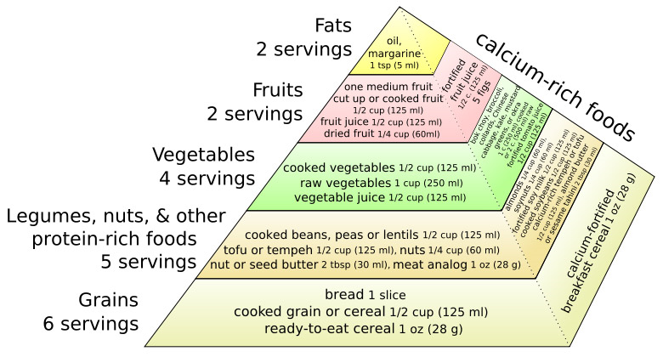
A vegan version of the food guide pyramid
http://en.wikipedia.org/wiki/Vegetarian_Diet_Pyramid

Slide 16
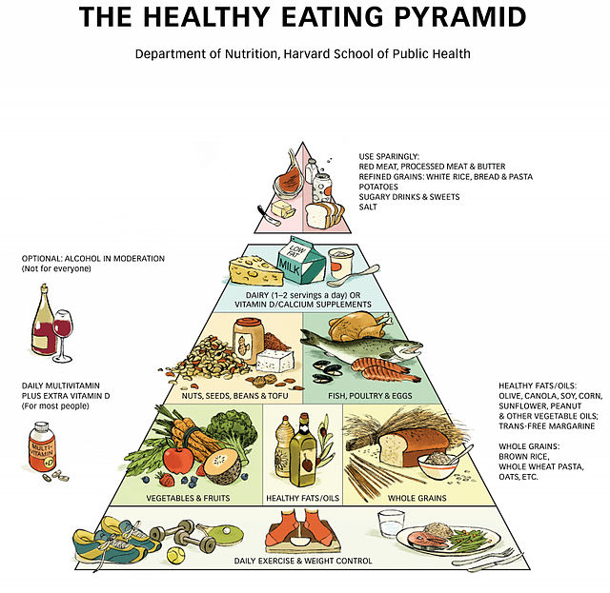
http://en.wikipedia.org/wiki/Healthy_eating_pyramid

Slide 17
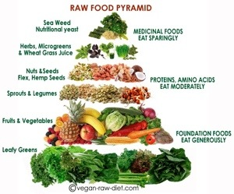
http://tierragoesgreen.com/2014-2024/04/a-real-food-pyramid/

Slide 18
Some examples of
food “pyramids”
around the world. . .

Slide 19
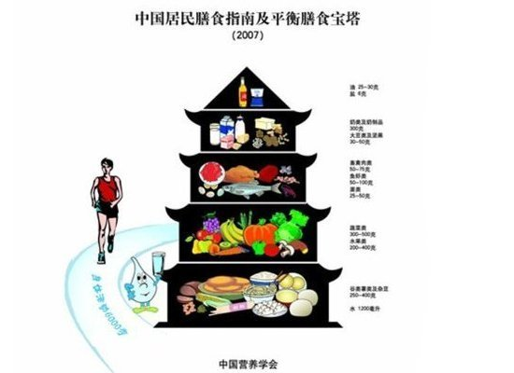
China's Food Pagoda
http://www.huffingtonpost.com/food-republic/food-pyramids-around-the-world_b_874409.html

Slide 20
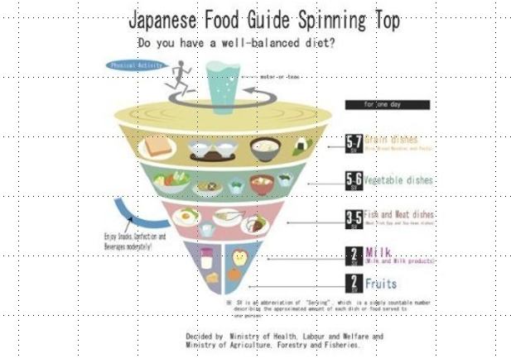
Japan's Spinning Top
http://www.huffingtonpost.com/food-republic/food-pyramids-around-the-world_b_874409.html

Slide 21
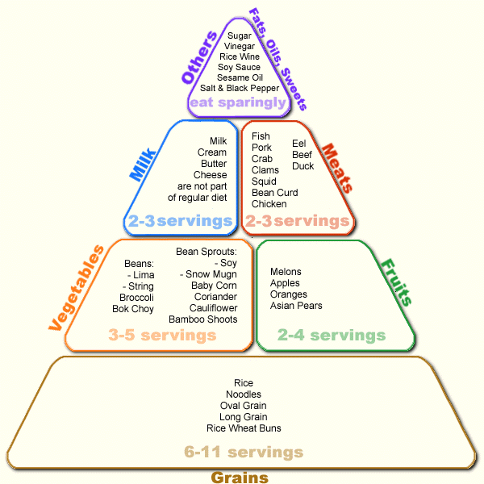
Japanese Food Guide Pyramid www.ethnicfoodsco.com/Japan/JapaneseFoodPyramid.htm

Slide 22
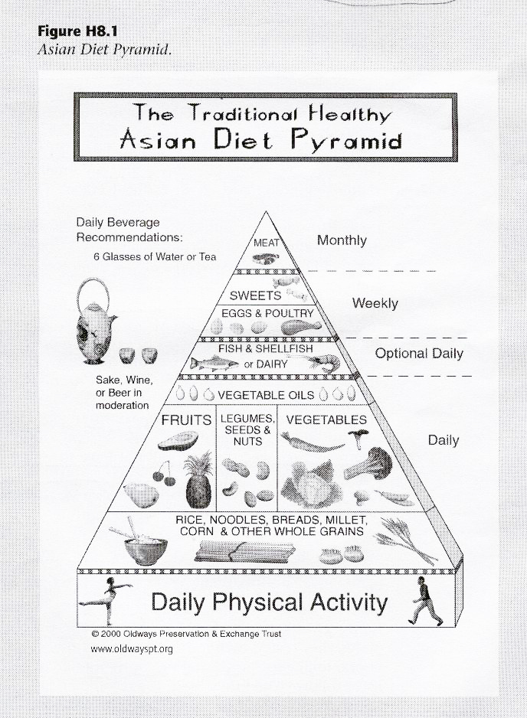
Asian Diet Food Guide Pyramid

Slide 23
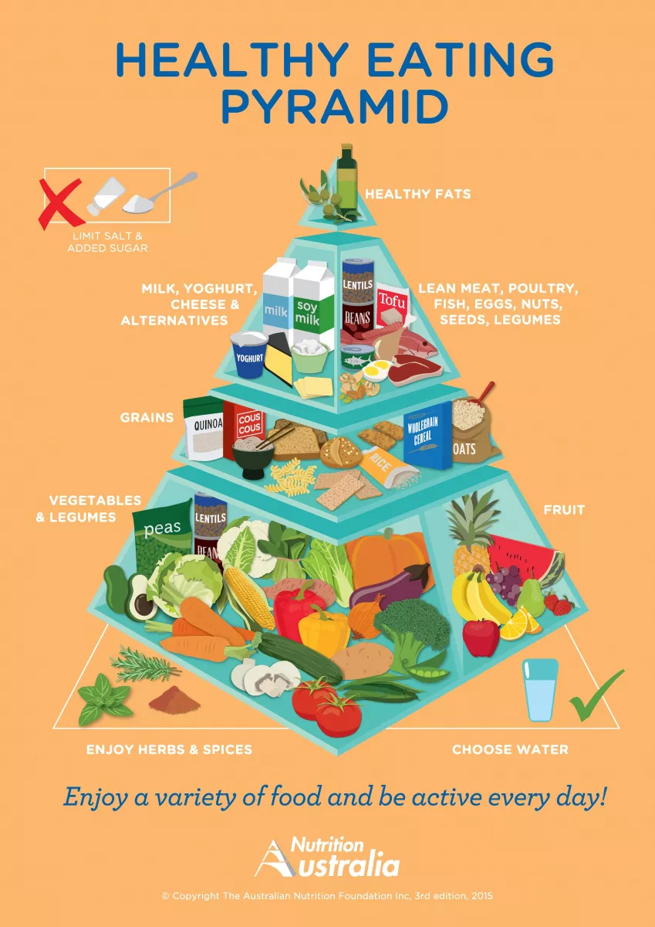
Australia
https://www.treehugger.com/what-food-pyramids-around-world-4868722

Slide 24
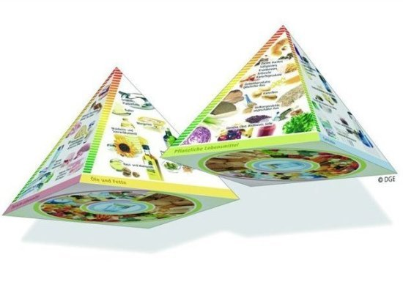
Germany's 3D Pyramid
http://www.huffingtonpost.com/food-republic/food-pyramids-around-the-world_b_874409.html

Slide 25
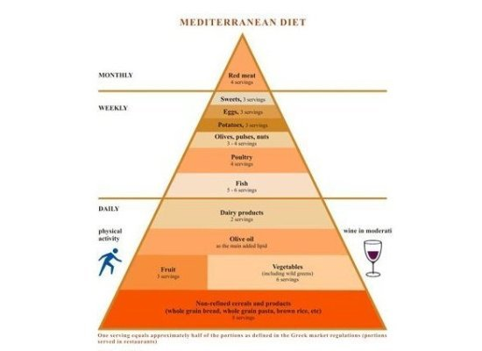
Greece's Food Pyramid
http://www.huffingtonpost.com/food-republic/food-pyramids-around-the-world_b_874409.html

Slide 26
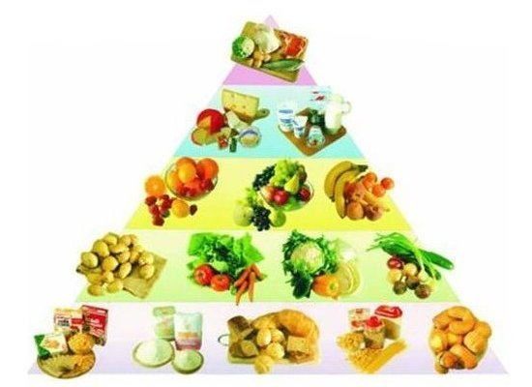
Poland's Food Pyramid
http://www.huffingtonpost.com/food-republic/food-pyramids-around-the-world_b_874409.html

Slide 27
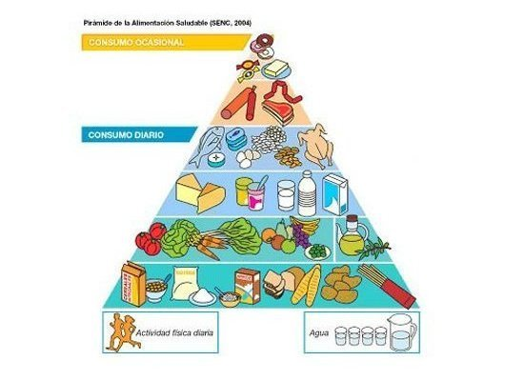
Spain's Food Pyramid
http://www.huffingtonpost.com/food-republic/food-pyramids-around-the-world_b_874409.html

Slide 28
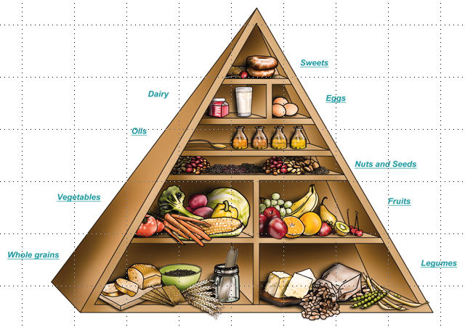
Spain's Food Pyramid
http://www.chiefdelphi.com/media/photos/22549

Slide 29
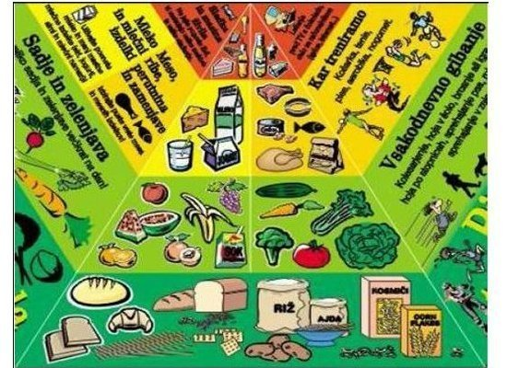
Slovenia's Food Pyramid
http://www.huffingtonpost.com/food-republic/food-pyramids-around-the-world_b_874409.html

Slide 30
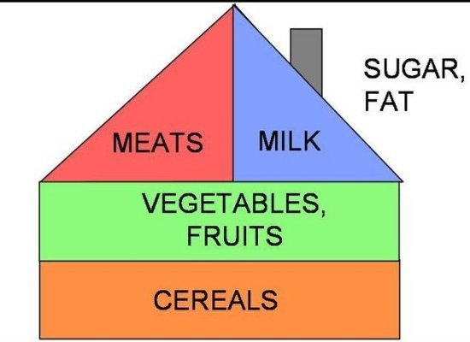
Hungary's Food House
http://www.huffingtonpost.com/food-republic/food-pyramids-around-the-world_b_874409.html

Slide 31
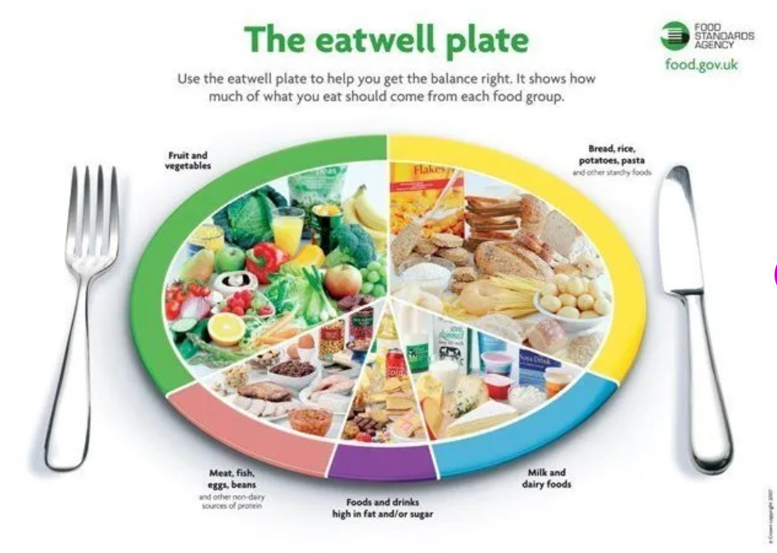
UK's Eatwell Plate
https://www.huffpost.com/entry/food-pyramids-around-the-world_b_874409

Slide 32
France's Food Stairs
https://www.huffpost.com/entry/food-pyramids-around-the-world_b_874409

Slide 33
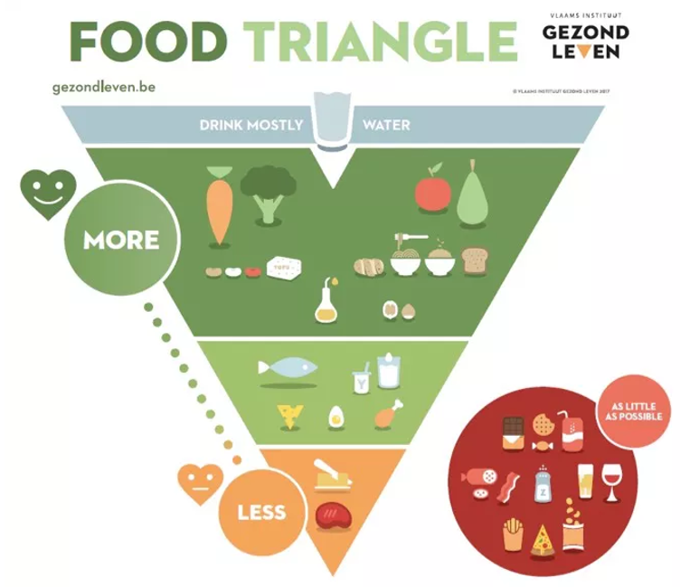
Belgium
https://www.treehugger.com/what-food-pyramids-around-world-4868722

Slide 34
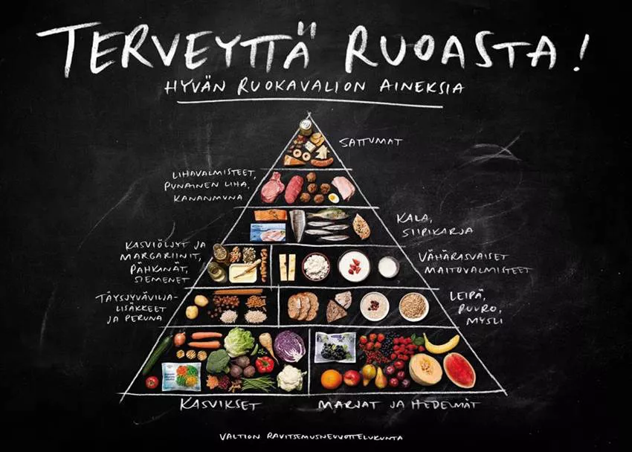
Finland
https://www.treehugger.com/what-food-pyramids-around-world-4868722

Slide 35
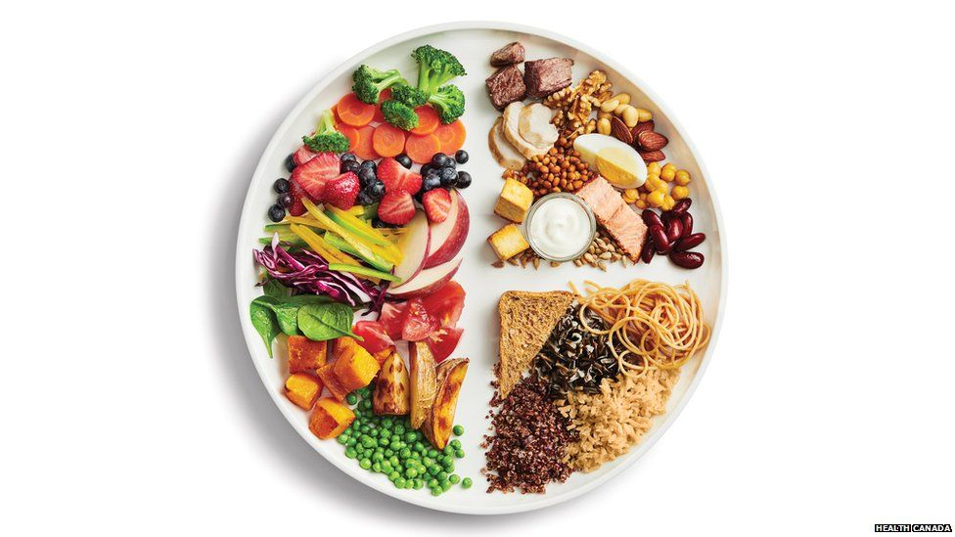
Canada’s guide does away with food groups entirely, and instead encourages people to eat a variety of unprocessed foods.
Missing, for e.g., is a daily dose of dairy.
Canada
https://www.bbc.com/news/world-us-canada-46964549

Slide 36
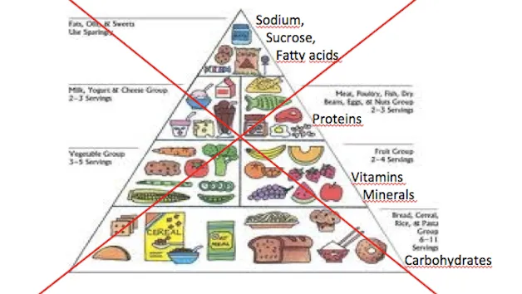
So does Brazil, where "eating is a natural part of social life"
Brazil
https://www.vox.com/2015/2/20/8076961/brazil-food-guide

Slide 37
Brazil, where "eating is a natural part of social life"
https://www.vox.com/2015/2/20/8076961/brazil-food-guide

Slide 38
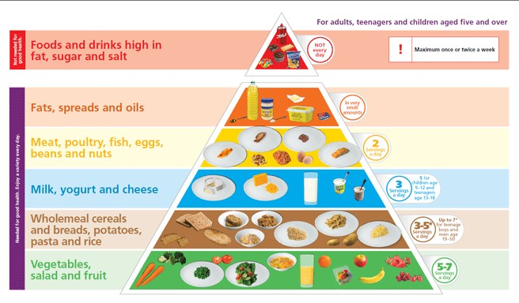
Ireland
https://www.image.ie/editorial/did-you-know-that-ireland-has-revamped-the-food-pyramid-74533

Slide 39
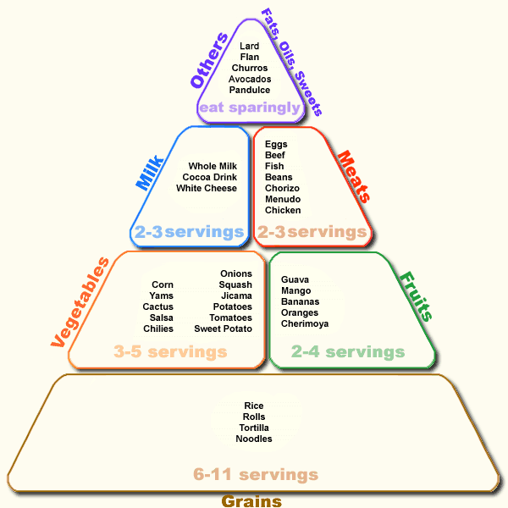
Mexican Food Guide Pyramid
www.semda.org/info/images/July99_new.gif

Slide 40
and lots of places continue to have alternate food guide pyramids that they follow in daily life . . .

Slide 41
and lots of places continue to have alternate food guide pyramids that they follow . . .
The current USDA food pyramid

Slide 42
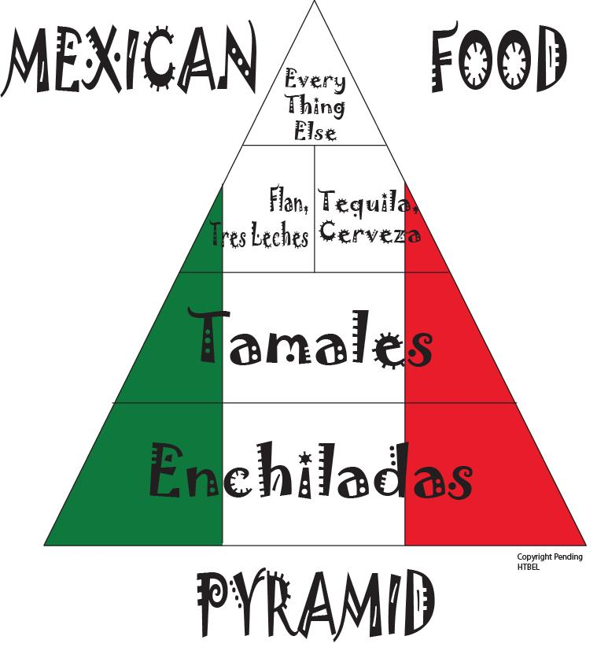
Notes:
42

Slide 43
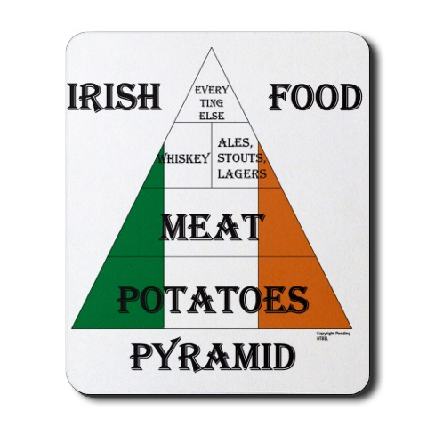
Notes:
43

Slide 44
Notes:
44

Slide 45
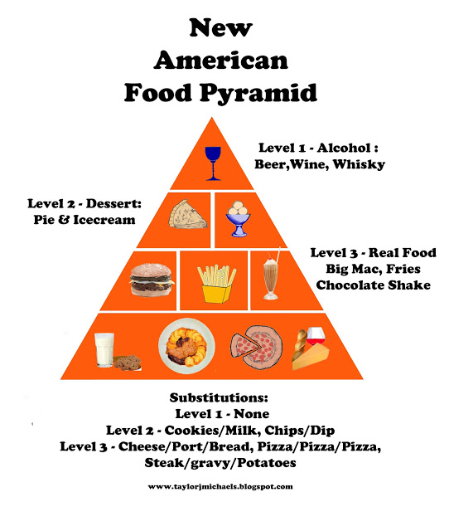
Spain's Food Pyramid
http://taylorjmichaels.blogspot.com/2013/03/new-american-food-pyramid.html

Slide 46
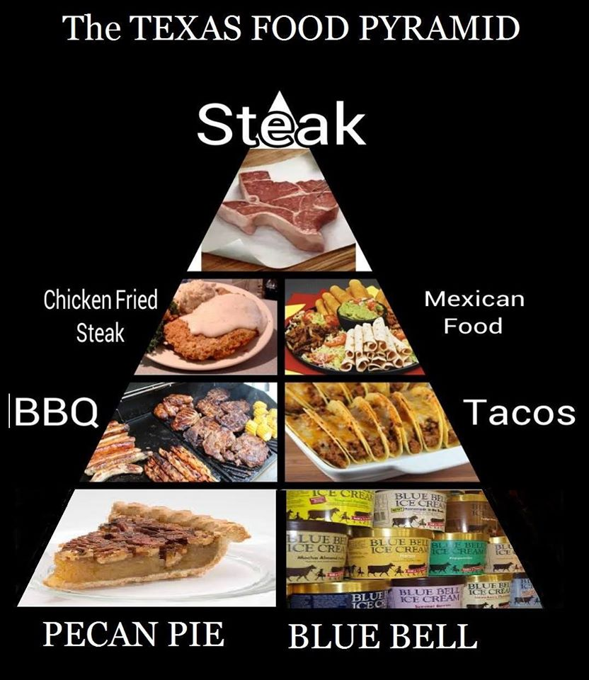
http://ktemnews.com/texas-food-pyramid/

Slide 47
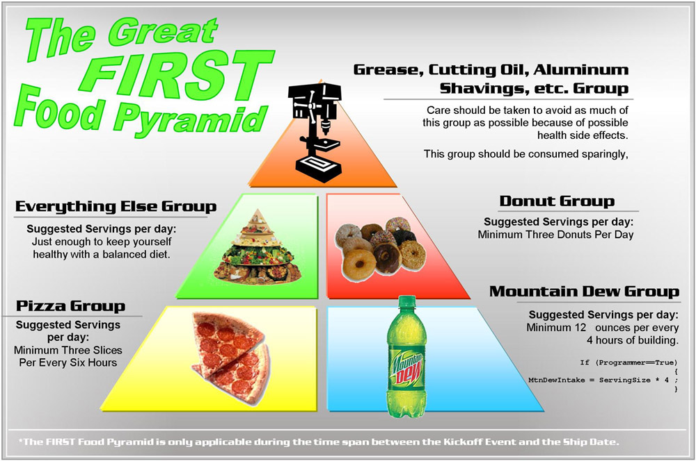
http://www.chiefdelphi.com/media/photos/22549

Slide 48
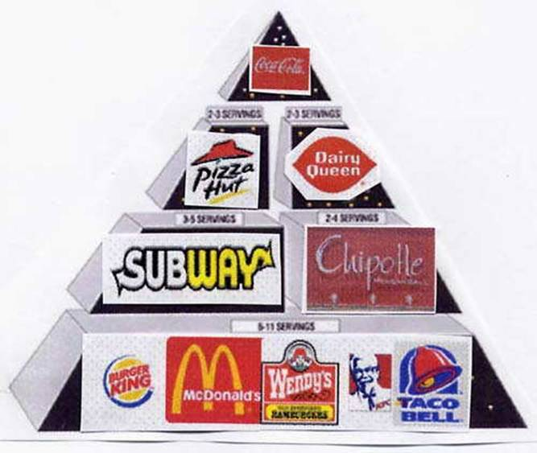
http://fatboydiet.tumblr.com/post/34577921658/follow-this-food-pyramid-and-youll-be-massive-in

Slide 49
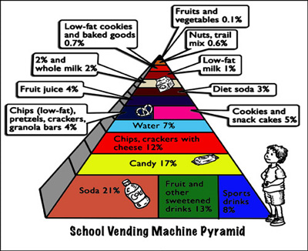
July 19, 2009
http://www.ceche.org/mol/Spring-05/inside.html
Notes:
49

Slide 50
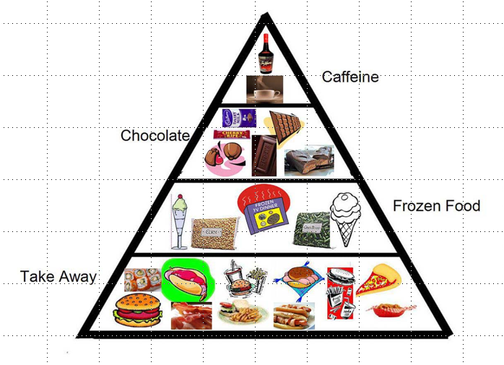
Notes:
50

Slide 51
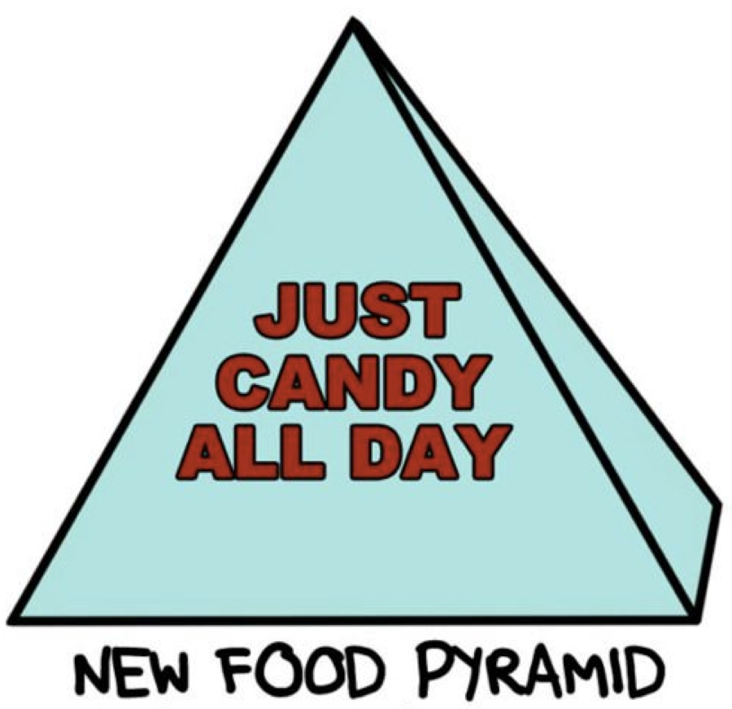
https://www.pinterest.com/pin/465981892667133701/

Slide 52
and there are many speciality
food “pyramids” . . .

Slide 53
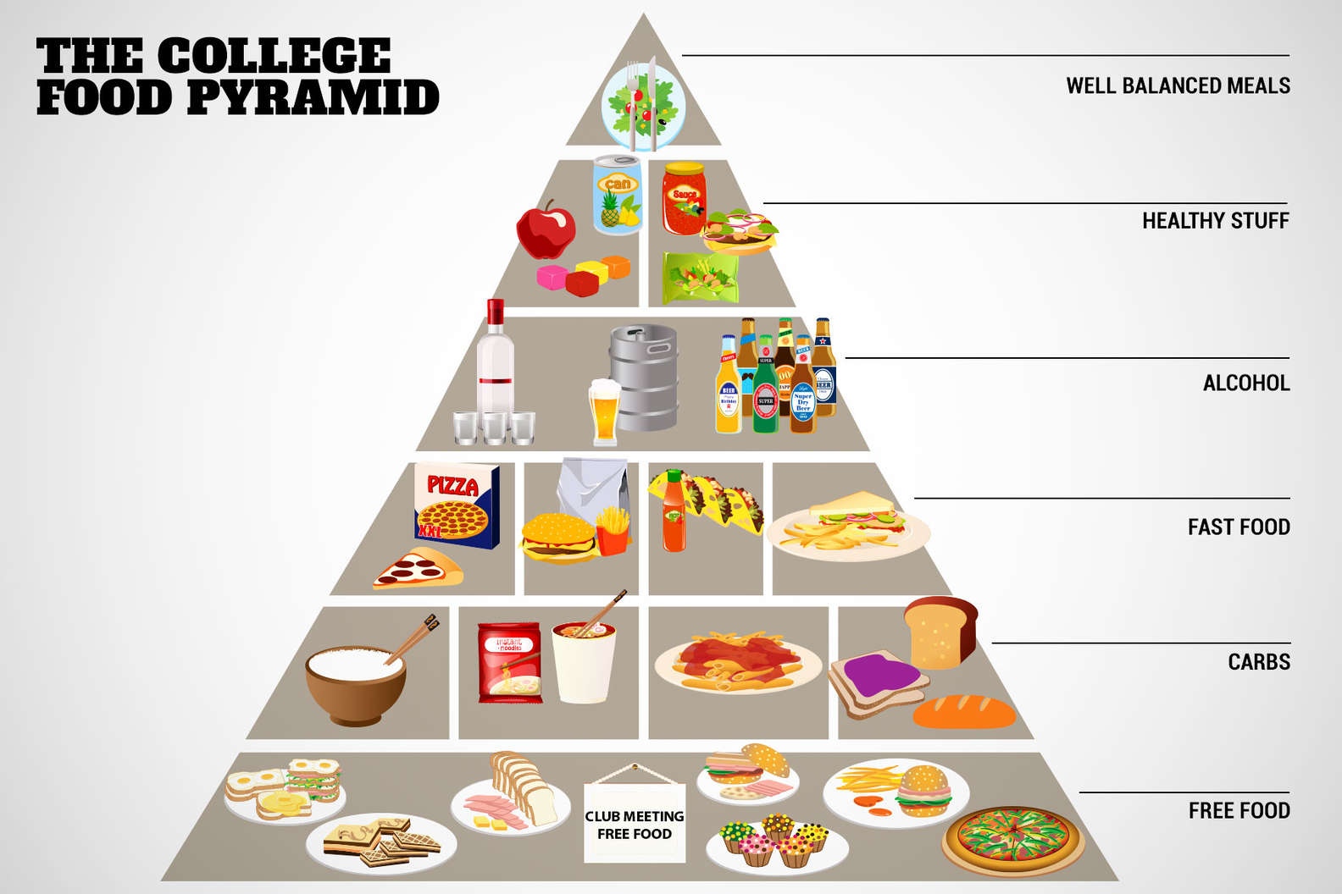
source

Slide 54
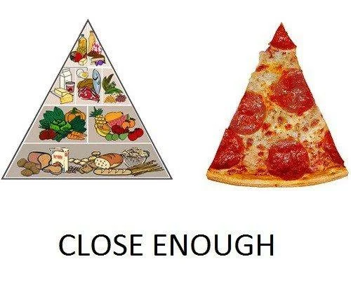
source

Slide 55
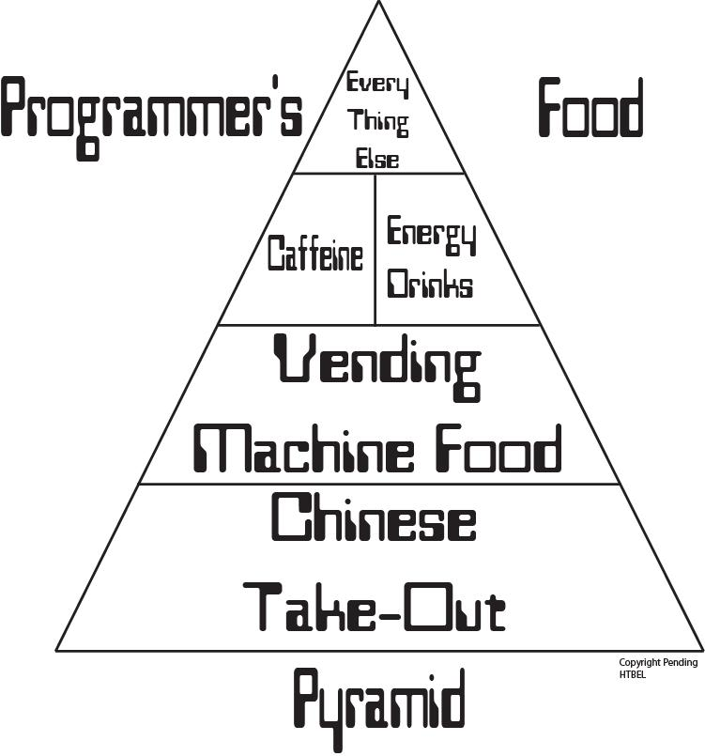
Notes:
55

Slide 56
Notes:
56

Slide 57
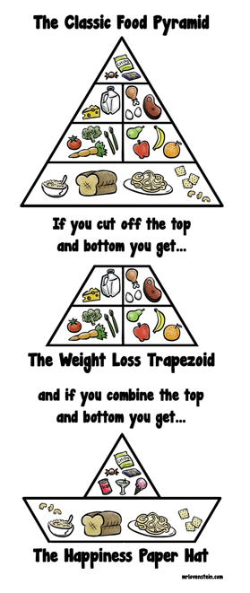
source

Slide 58
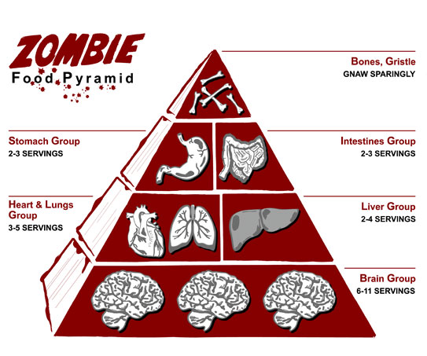
source

Slide 59
and special
food “pyramids”
for COVID lockdowns . . .

Slide 60
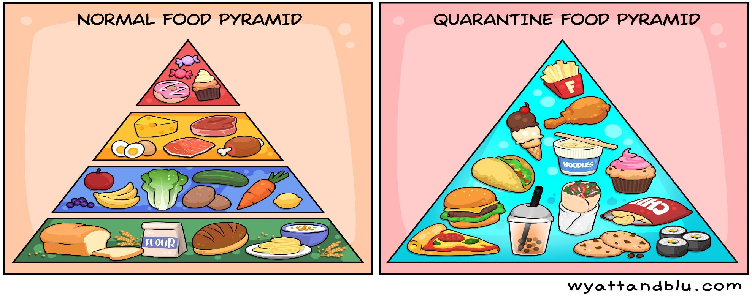
source

Slide 61
And, of course,
there is lots of
food “pyramid” merchandise . . .

Slide 62
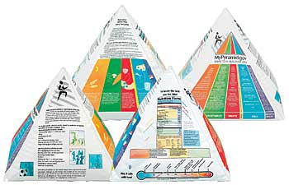
Inflatable USDA Food Guide Pyramid
www.ethnicfoodsco.com/Japan/JapaneseFoodPyramid.htm

Slide 64
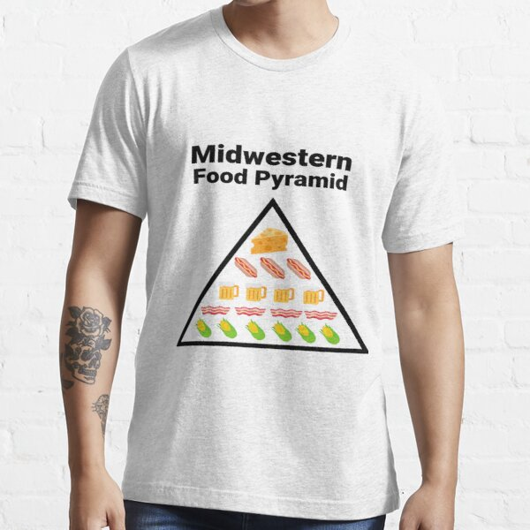

Slide 68
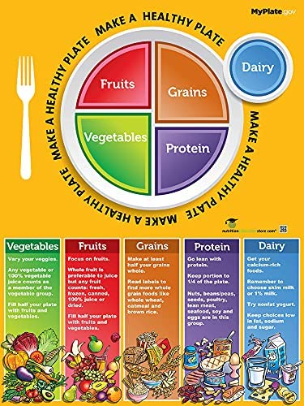

Slide 69
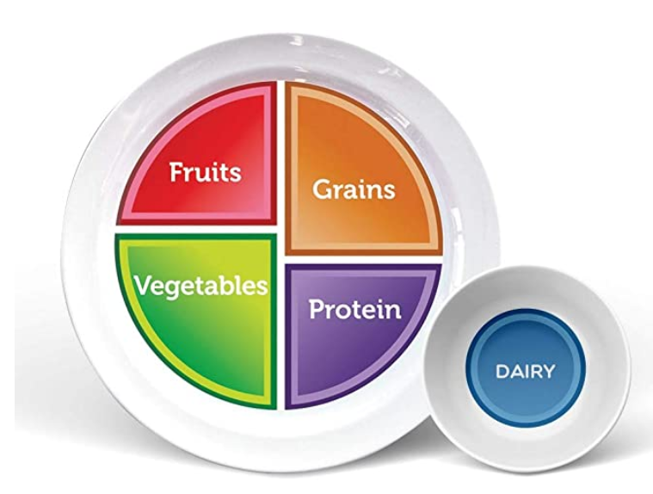
Health Beet Portion Control Plate

Slide 70
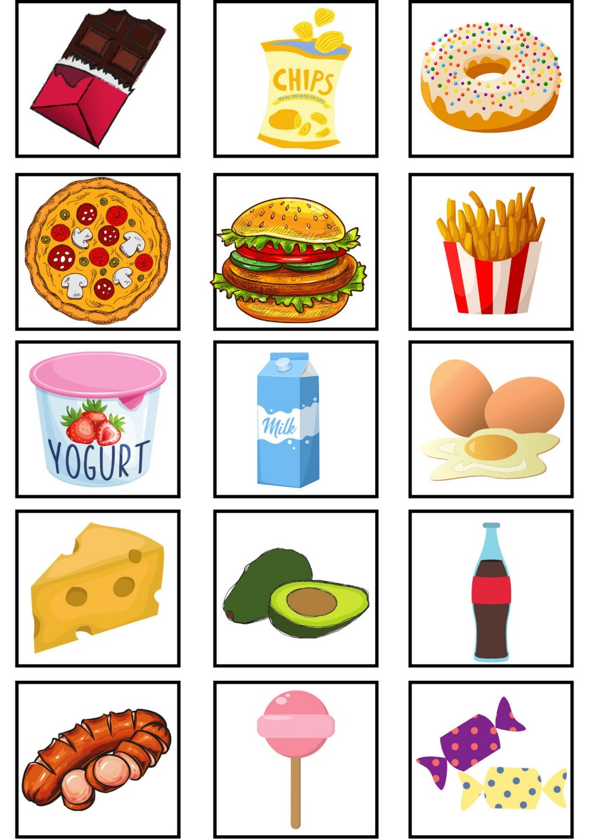
Memory game - Food (card game also known as Concentration or Pairs)

Slide 71
Healthy Helpings MyPlate Game

Slide 72
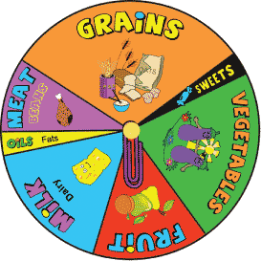

Slide 73
50x60 Plush Fleece Blankets ($48.74)

Slide 74
And, of course . . .

Slide 75
Food Pyramid Tattoos . . .

Slide 76
They are all basically associated with . . .

Slide 77
. . . in one way or another . . .
Inflatable USDA Food Guide Pyramid
www.ethnicfoodsco.com/Japan/JapaneseFoodPyramid.htm

Slide 78
. . . with The USDA
whose job it is
to promote
U.S.
Agriculture . . .

Slide 79
. . . The United States Department of Agriculture . . .

Slide 80
. . .
whose job it is
to promote
U.S.
Agriculture . . .

Slide 81
. . . with The USDA
whose job it is
to promote
U.S.
Agriculture . . .
Being that it is established by law as
“The United States Department of Agriculture”

Slide 82
not to be confused with
United States
Food and Drug Administration

Slide 83
the
United States
Food and Drug Administration
is responsible for regulating and supervising the safety of foods, dietary supplements, etc.

Slide 84
promotes
U.S.A.
agriculture
regulates
U.S.A.
food safety
Inflatable USDA Food Pyramid
www.ethnicfoodsco.com/Japan/JapaneseFoodPyramid.htm

Slide 85
. . . and, in addition, . . .

Slide 86
EPA
. . . The EPA is charged with related things like . . .
http://en.wikipedia.org/wiki/Epa

Slide 87
protecting U.S.A.
human health and the environment
EPA
http://en.wikipedia.org/wiki/Epa

Slide 88
promotes
U.S.A.
agriculture
regulates
U.S.A.
food safety

Slide 89
is charged to
protect U.S.A.
human health and the environment
promotes
U.S.A.
agriculture
regulates
U.S.A.
food safety

Slide 90
e.g., Factory Farming
(CAFOs)
has environmental impacts
and health risks . . .
EPA
http://en.wikipedia.org/wiki/CAFO

Slide 91
e.g., Factory Farming
(CAFOs) and decisions affect
animal welfare,
food ethics . . .
EPA
http://en.wikipedia.org/wiki/CAFO

Slide 92
And, in addition, there’s . . .

Slide 93
and to the
federal regulators
you must also add

Slide 94
is charged to
protect U.S.A.
human health and the environment
promotes
U.S.A.
agriculture
regulates
U.S.A.
food safety
and to the
federal regulators
you must also add

Slide 95
is charged to
protect U.S.A.
human health and the environment
promotes
U.S.A.
agriculture
regulates
U.S.A.
food safety
Centers for Disease Control and Prevention
“works to protect public health and safety by providing information to enhance health decisions”

Slide 96
is charged to
protect U.S.A.
human health and the environment
an excellent work that sorts all of this out is Marion Nestle’s . . .
promotes
U.S.A.
agriculture
regulates
U.S.A.
food safety
Centers for Disease Control and Prevention
“works to protect public health and safety by providing information to enhance health decisions”

Slide 97
is charged to
protect U.S.A.
human health and the environment
and, of course,
The United States
Supreme Court
overrides everybody . . .
promotes
U.S.A.
agriculture
regulates
U.S.A.
food safety
Centers for Disease Control and Prevention
“works to protect public health and safety by providing information to enhance health decisions”

Slide 98
So as is usually [always?]
the case . . .
the Food “Pyramid” and related matters
are rife
with politics . . .

Slide 99
an excellent treatment of this question can be found in . . .
Marion Nestle
Food Politics: How the Food Industry Influences Nutrition and Health
University of California Press 2007

Slide 100
Marion Nestle
Food Politics: How the Food Industry Influences Nutrition and Health
University of California Press 2007
Marion Nestle provides one of the best discussions
— perhaps THE best discussion—
of the Food Guide Pyramid, and of the USDA
(including the politics of the pyramid)

Slide 101
Marion Nestle
Unsavory Truth: How Food Companies Skew the Science of What We Eat
Basic Books 2018
“America's leading nutritionist exposes how the food industry corrupts scientific research for profit”

Slide 102
and . . .
Marion Nestle
What to Eat
North Point Press
2007

Slide 103
Marion [No Relation to the Company] Nestle

Slide 104
While MyPlate “is the latest in over 110 years of nutrition guides from the USDA”, many version of The Food Pyramid remain in use around the world

Slide 105
http://www.pinterest.com/pin/118641771407221944/

Slide 106
http://www.cartoonaday.com/new-usda-food-plate-pyramid-replacement/

Slide 107
The USDA
Food Guide Pyramid
(1992-2011)
and
MyPlate
(2011-)
Anthropology of Food University of Minnesota Duluth
Tim Roufs ©2014-2024

