Slide 1

use your up/down arrow keys and/or
your space bar to advance the slides
Lactose Intolerance
Tim Roufs
© 2010-2024
Carol A. Bryant, Kathleen M. DeWalt,
Anita Courtney and Jeffrey Schwartz
The Cultural Feast:
An Introduction to Food and Society, 2nd Ed.
Belmont, CA: Thompson Wadsworth, 2003

Slide 2
Lactose Intolerance
Tim Roufs
© 2010-2024
Carol A. Bryant, Kathleen M. DeWalt,
Anita Courtney and Jeffrey Schwartz
The Cultural Feast:
An Introduction to Food and Society, 2nd Ed.
Belmont, CA: Thompson Wadsworth, 2003

Slide 3
Lactose Intolerance
Tim Roufs
© 2010-2024
Carol A. Bryant, Kathleen M. DeWalt,
Anita Courtney and Jeffrey Schwartz
The Cultural Feast:
An Introduction to Food and Society, 2nd Ed.
Belmont, CA: Thompson Wadsworth, 2003

Slide 4
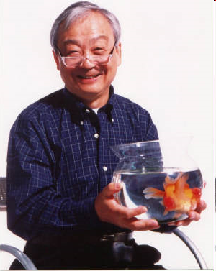
William T. Liu, Ph.D.
Professor Emeritus
1930 - 2008

Slide 5
I was a research assistant for Bill Liu
for two years at the University of Notre Dame . . .
and as research advisors do, he had an impact on me way beyond questions related to research . . .
but, of course, some of those items also become items of future personal research . . .
William T. Liu, Ph.D.
Professor Emeritus
1930 - 2008

Slide 6
One day I made coffee (and coming from Minnesota I made what many others consider strong coffee),
and Prof. Liu, a kind and gentle man, said,
“Tim, I can not drink your coffee.”
William T. Liu, Ph.D.
Professor Emeritus
1930 - 2008

Slide 7
“I’m sorry,” said I, “I’ll remember not to make it so strong next time. . . .”
“No no,” said Prof. Liu, “it’s not how strong that’s a problem . . .
it’s the cream.”
William T. Liu, Ph.D.
Professor Emeritus
1930 - 2008

Slide 8
“The cream?” said I, product of a small Midwestern German dairy-farming village
“Yes,” said Prof. Liu.
“I can’t drink milk.
I get sick.”
William T. Liu, Ph.D.
Professor Emeritus
1930 - 2008

Slide 9
  that was my real-life introduction to
  lactose intolerance
William T. Liu, Ph.D.
Professor Emeritus
1930 - 2008

Slide 10
about lactose intolerance . . .
The Cultural Feast, 2nd Ed., p. 40

Slide 11
  lactose intolerance
  is the inability to metabolize lactose,
  the sugar found in milk and other dairy products,
  because the required enzyme lactase is absent in the intestinal system
  (or its availability is lowered)
The Cultural Feast, 2nd Ed., p. 6

Slide 12
people with
lactase deficiency
symptoms
are known as
“lactose intolerant”
population-level difference
“in biological terms, these are differences in the frequency of genetic traits”
  e.g., the prevalence of
  lactase deficiency is different across populations
The Cultural Feast, 2nd Ed., p. 6

Slide 13
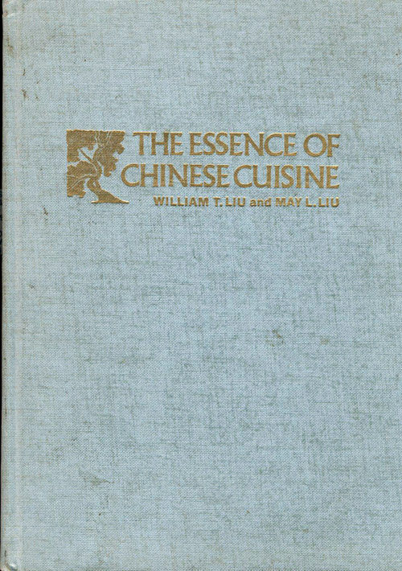
The Essence of Chinese Cuisine.
1970. William T Liu and May L. Liu.
Nashville/London: Aurora.
lactose-intolerant Bill Liu was co-author of a major Chinese cookbook for the English-speaking world . . .

Slide 14
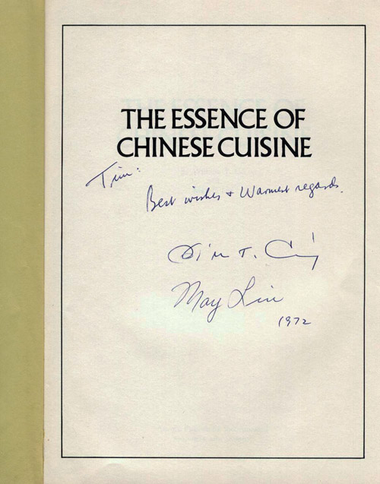
The Essence of Chinese Cuisine.
1970. William T Liu and May L. Liu.
Nashville/London: Aurora.

Slide 15

We’ll review Sherri Inness’s work and see the impact of Chinese and other minority and class-based cookbooks as a major agents in social change . . .
The Essence of Chinese Cuisine.
1970. William T Liu and May L. Liu.
Nashville/London: Aurora.

Slide 16

Chapter 2: “’Unnatural, Unclean, and Filthy’: Chinese-American Cooking Literature Confronting Racism in the 1950s”
Sherrie A. Inness
Secret Ingredients:
Race, Gender, and Class at the Dinner Table.
NY: Palgrave Macmillan 2005

Slide 17
Chapter 2
“Diet and Human Evolution”
Lactose Intolerance
Anthropology of Food
University of Minnesota Duluth
Tim Roufs
©2009-2010

Slide 18
“Diet and Human Evolution”
“Diet and Human Evolution”
  Exploring the Diets of Extinct Humans
  Through Paleontology
      Teeth
      Skulls and Jaws
      The Postcranial Skeleton
  What Is Adaptation?
  Using Chemistry to Infer the Diets
  of Extinct Hominids
  Our Place in Nature
  A Brief Who's Who of the Early Hominids
  What Did Early Hominids Eat?
  What Can We Say About the Diets of Fossil Homo?
  Summary
  Highlight: Lactose Intolerance

Slide 19
“Within a narrow range of variation, humans around the world share similar nutrient requirements and restrictions.”
  no human can digest cellulose
  no human can avoid toxic reactions caused by eating certain poisonous plants
  all humans require the same 50 or so essential nutrients to stay healthy
The Cultural Feast, 2nd Ed., p. 6

Slide 20
“Although there have been some specific adaptations of populations in particular environments, on the whole, humans are physiologically the same animals we were 10,000 years ago before the adoption of agriculture, animal husbandry, and food production technology.”
The Cultural Feast, 2nd Ed., p. 6

Slide 21
“Although there have been some specific adaptations of populations in particular environments, on the whole, humans are physiologically the same animals we were 10,000 years ago before
the adoption of agriculture, animal husbandry, and food production technology.”
The Cultural Feast, 2nd Ed., p. 6

Slide 22
“Although there have been some specific adaptations of populations in particular environments, on the whole, humans are physiologically the same animals we were 10,000 years ago before
the adoption of agriculture, animal husbandry, and food production technology.”
this is one of the important dates to remember . . .
The Cultural Feast, 2nd Ed., p. 6

Slide 23
ca. 10,000 years ago
(ca. 10,000 ybp)
or
10,000 B.C.
(10,000 B.C.E)
is one of those
“Dates to Remember” . . .

Slide 24
ca. 10,000 B.C. is usually one of the very first dates that you will see on any food timeline . . .
and it virtually always appears on any prehistoric timeline chronicling events of that era . . .

Slide 25
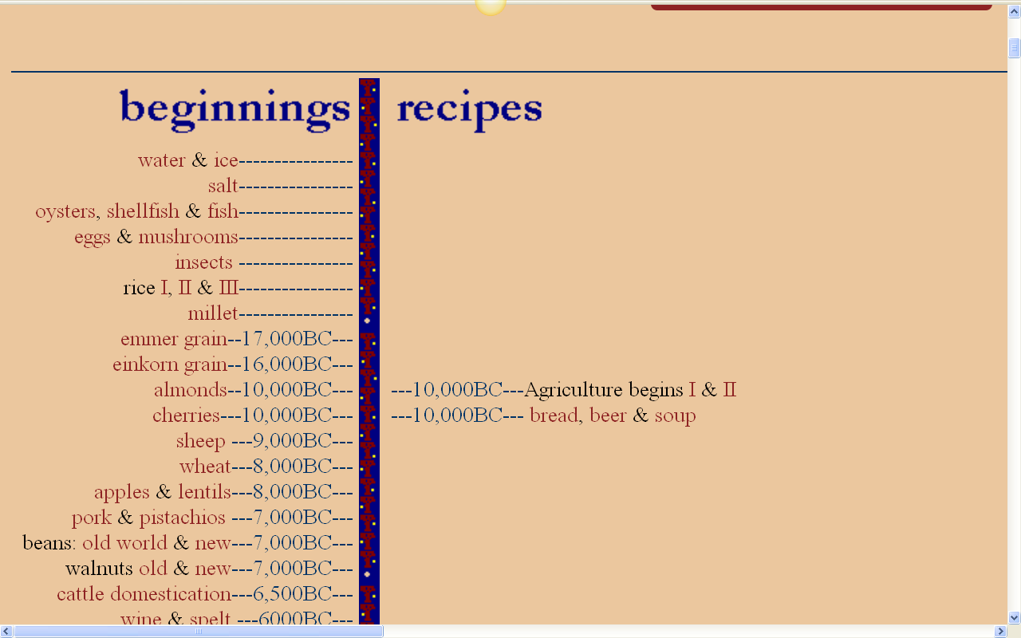
and 10,000 B.C. represents the
commonly accepted date for the “beginnings of agriculture”, i.e.,
the beginnings of
“The Agricultural Revolution”
http://www.foodtimeline.org/

Slide 26
“This [basic ancient physiology] has some interesting implications regarding
the impact that diets based on agriculture, animal husbandry, and food technology have on humans’ health and nutritional status.”

Slide 27
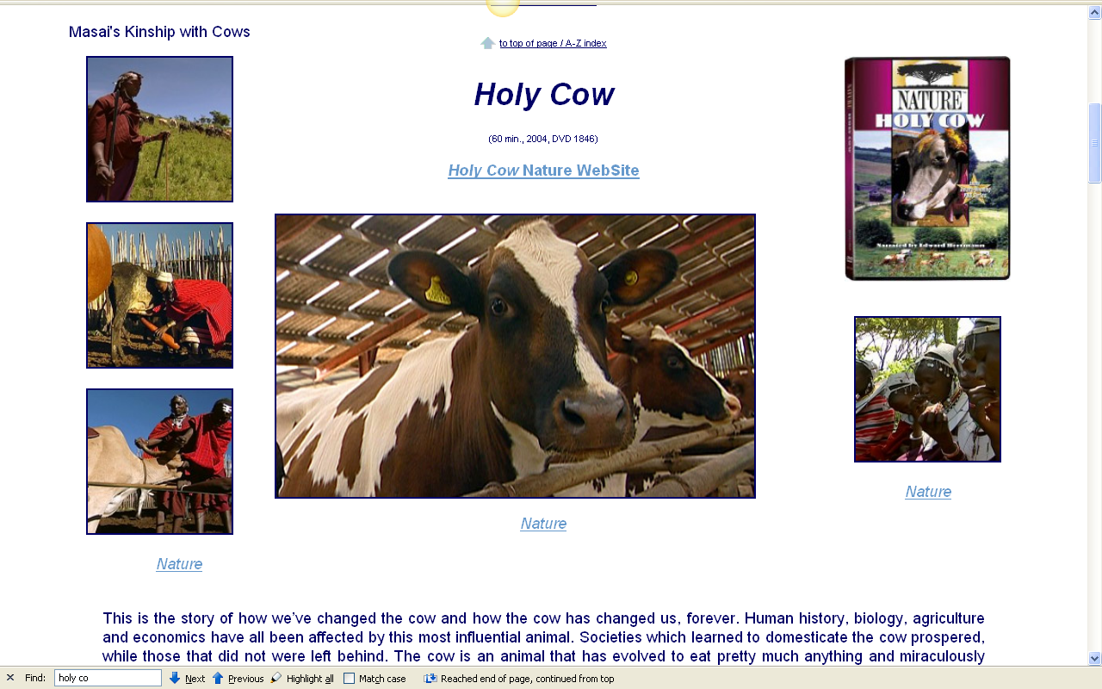
Cows were central in some regions — prehistoric and modern . . .

Slide 28
Cows and cows’ milk had an important impact on — prehistoric and modern humans . . .
“Diet and Human Evolution, highlights the importance of
lactose intolerance /
lactase deficiency
in both human evolution and in contemporary populations”
Chapter 2, pp. 40-47
of The Cultural Feast, 2nd ed.

Slide 29
Cows and cows’ milk had an important impact on — prehistoric and modern humans . . .
“Diet and Human Evolution, highlights the importance of
lactose intolerance /
lactase deficiency
in both human evolution and in contemporary populations”
Chapter 2, pp. 40-47
of The Cultural Feast, 2nd ed.

Slide 30
this is a
population-level difference
“in biological terms, these are differences in the frequency of genetic traits”
  e.g., the prevalence of
  lactase deficiency is different across populations

Slide 31
population-level difference
“in biological terms, these are differences in the frequency of genetic traits”
  e.g., the prevalence of
  lactase deficiency is different across populations
The Cultural Feast, 2nd Ed., p. 6

Slide 32
population-level difference
“in biological terms, these are differences in the frequency of genetic traits”
  e.g., the prevalence of
  lactase deficiency is different across populations
The Cultural Feast, 2nd Ed., p. 6

Slide 33
people with
lactase deficiency
symptoms
are known as
“lactose intolerant”
population-level difference
“in biological terms, these are differences in the frequency of genetic traits”
  e.g., the prevalence of
  lactase deficiency is different across populations
The Cultural Feast, 2nd Ed., p. 6

Slide 34
    mammalian milk
    contains the sugar lactose
    the body breaks this down with the enzyme lactase
      to the simple sugars
      glucose and galactase
    only then can it be absorbed into the bloodstream
The Cultural Feast, 2nd Ed., p. 40

Slide 35
    mammalian milk
    contains the sugar lactose
    the body breaks this down with the enzyme lactase
      to the simple sugars
      glucose and galactase
    only then can it be absorbed into the bloodstream

Slide 36
    mammalian milk
    contains the sugar lactose
    the body breaks this down with the enzyme lactase
      to the simple sugars
      glucose and galactase
    only then can it be absorbed into the bloodstream

Slide 37
    mammalian milk
    contains the sugar lactose
    the body breaks this down with the enzyme lactase
      to the simple sugars
      glucose and galactase
    only then can it be absorbed into the bloodstream

Slide 38
    mammalian milk
    contains the sugar lactose
    the body breaks this down with the enzyme lactase
      to the simple sugars
      glucose and galactase
    only then can it be absorbed into the bloodstream

Slide 39
    mammalian milk
    contains the sugar lactose
    the body breaks this down with the enzyme lactase
      to the simple sugars
      glucose and galactase
    only then can it be absorbed into the bloodstream

Slide 40
    mammalian milk
    contains the sugar lactose
    the body breaks this down with the enzyme lactase
      to the simple sugars
      glucose and galactase
    only then can it be absorbed into the bloodstream

Slide 41
glucose is the
“blood sugar”
that provides energy to the body
about 18% of that
is used by the brain
    mammalian milk
    contains the sugar lactose
    the body breaks this down with the enzyme lactase
      to the simple sugars
      glucose and galactase
    only then can it be absorbed into the bloodstream

Slide 42
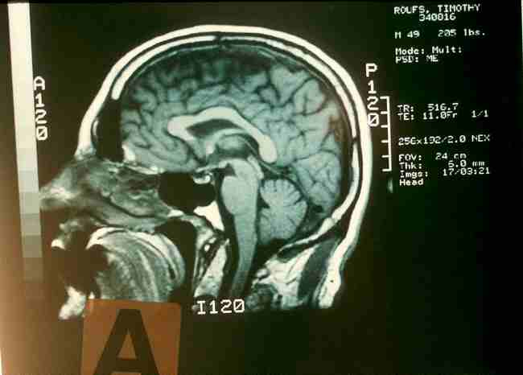
about 18% of a person’s glucose
is used by the brain

Slide 43
    mammalian milk
    contains the sugar lactose
    the body breaks this down with the enzyme lactase
      to the simple sugars glucose and galactase
    only then can it be absorbed into the bloodstream

Slide 44
    mammalian milk
    contains the sugar lactose
    the body breaks this down with the enzyme lactase
      to the simple sugars glucose and galactase
    only then can it be absorbed into the bloodstream

Slide 45
“sugar”
lactose
(“milk sugar”)
fructose
(“fruit sugar” – but it occurs in many foods and honey)
glucose
(“blood sugar” – major energy source of the body)
sucrose
(“table sugar” – fructose-and-glucose)

Slide 46

one of the classic books in Anthropology of Food
is . . .
Sidney W. Mintz
Sweetness and Power
NY: Penguin Books, 1986

Slide 47
back to lactose intolerance
The Cultural Feast, 2nd Ed., p. 40

Slide 48
    mammalian milk
    contains the sugar lactose
    the body breaks this down with the enzyme lactase
      to the simple sugars glucose and galactase
    only then can it be absorbed into the bloodstream
The Cultural Feast, 2nd Ed., p. 40

Slide 49
in human populations virtually all infants and young children can digest the lactose in milk
      “an obvious necessity for survival”
        human milk contains 7% lactose
The Cultural Feast, 2nd Ed., p. 40

Slide 50
    mammalian milk
    contains the sugar lactose
    the body breaks this down with the enzyme lactase
      to the simple sugars
      glucose and galactase
    only then can it be absorbed into the bloodstream
The Cultural Feast, 2nd Ed., p. 40

Slide 51
    without lactase,
    or with lower levels of lactase . . .
    lactose is not spliced into its simple, absorbable sugars
      and can stay in the intestine, “wreaking havoc by fermenting and causing an array of uncomfortable symptoms” . . .
The Cultural Feast, 2nd Ed., p. 40

Slide 52
    this fermentation process produces . . .
            carbon dioxide
            acids
            methane
            hydrogen
The Cultural Feast, 2nd Ed., p. 40

Slide 53
    the gas production
    can lead to . . .
          abdominal distension
          flatulence
          diarrhea
          intestinal pain
          and sometimes cramping
The Cultural Feast, 2nd Ed., p. 40

Slide 54
    these symptoms usually occur 30 minutes to 2 hours after milk intake
    but not all people who are lactase deficient have symptoms
      those who do are considered to be lactose intolerant
The Cultural Feast, 2nd Ed., p. 40

Slide 55
    these symptoms usually occur 30 minutes to 2 hours after milk intake
    but not all people who are lactase deficient have symptoms
      those who do are considered to be lactose intolerant
The Cultural Feast, 2nd Ed., p. 40

Slide 56
REM:
people with
lactase deficiency
symptoms
are known as
“lactose intolerant”
population-level difference
“in biological terms, these are differences in the frequency of genetic traits”
  e.g., the prevalence of
  lactase deficiency is different across populations
The Cultural Feast, 2nd Ed., p. 6

Slide 57
  lactose intolerance
  is the inability to metabolize lactose,
  the sugar found in milk and other dairy products,
  because the required enzyme lactase is absent in the intestinal system
  (or its availability is lowered)

Slide 58
“When relief agencies in the United States, Canada, and other national donated shipments of powdered milk to developing countries, they were surprised by the response.”
  The people of Columbia and Guatemala used it as whitewash
  the Indonesians took it as a laxative
  the Kanuri of West Africa believed it was a food of evil spirits
  many groups simply threw it away
The Cultural Feast, 2nd Ed., p. 40

Slide 59
“When relief agencies in the United States, Canada, and other national donated shipments of powdered milk to developing countries, they were surprised by the response.”
  The people of Columbia and Guatemala used it as whitewash
  the Indonesians took it as a laxative
  the Kanuri of West Africa believed it was a food of evil spirits
  many groups simply threw it away
The Cultural Feast, 2nd Ed., p. 40

Slide 60


Nabhan talks about this, and about how he became interested in lactose deficiency and related research . . .

Slide 61
Gary Paul Nabhan
  Why Some Like it Hot
      Favism / sickle cell anemia
      (G6PD)
      Sardinia
      Crete
      supertasters
      lactose intolerance
      alcohol tolerance
“Gary Paul Nabhan has been at the forefront of ethnobiology and nutritional ecology for three decades. His books and essays have won numerous awards . . . and have been translated into five languages. His original research that underlies [Why Some Like it Hot] has appeared in Nature, Science News, Slow, Journal of Clinical Nutrition, and Ecology of Food and Nutrition. A leader in the international Slow food Movement, Nabhan grows native crops, Navajo-Churro sheep, and heirloom turkeys at his home in rural Arizona.”

Slide 62
Gary Paul Nabhan
  Why Some Like it Hot looks at
      Favism / sickle cell anemia
      (G6PD)
      Sardinia
      Crete
      supertasters
      lactose intolerance
      alcohol tolerance

Slide 63
Gary Paul Nabhan
  Why Some Like it Hot looks at
      Favism / sickle cell anemia
      (G6PD)
      Sardinia
      Crete
      supertasters
      lactose intolerance
      alcohol tolerance

Slide 64
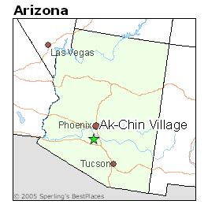
Gary Paul Nahban had a good friend in graduate school from the a Pima (Akimel O'odham) Reservation in Arizona (who he talks about at the beginning of Why Some Like it Hot)
The Cultural Feast, 2nd ed., p. 4

Slide 65
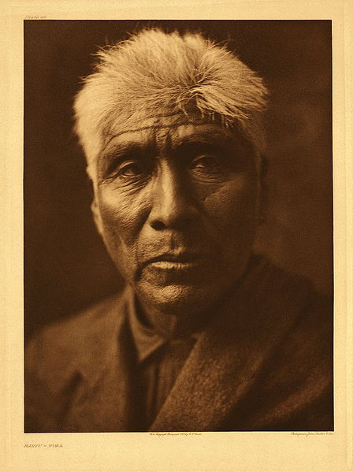
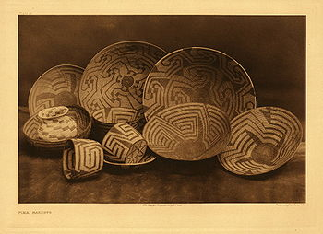
the Pima (Akimel O'odham) people
are very well-known in anthropology and in
Early American History
. . .
Kaviu
a Pima (Akimel O'odham) elder
ca.,1907 Edward S. Curtis
The Cultural Feast, 2nd ed., p. 4

Slide 66
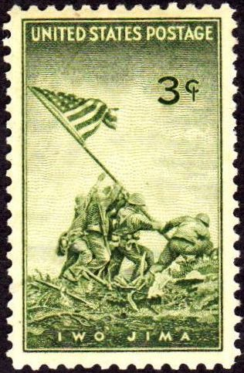
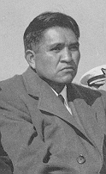
that reservation was also the home of
Ira Hayes
a hero of WWII
who was part of the
group that raised the flag
Iwo Jima, an event which became an icon of WWII
The Cultural Feast, 2nd ed., p. 4

Slide 67
      Favism / sickle cell anemia
      (G6PD)
      Sardinia
      Crete
      supertasters
      lactose intolerance
      alcohol tolerance
“After the war, Hayes accumulated a record of some fifty arrests for drunkenness.”
“The coroner concluded that Hayes's death was due to both exposure and alcohol.”
http://en.wikipedia.org/wiki/Ira_Hayes

Slide 68
Gary Paul Nabhan’s friend died.
And Gary Paul Nabhan promised his friend on his deathbed that he would try to research the situation of why so many of his friends’ people died of alcohol-related deaths . . .
and alcohol tolerance, lactose intolerance, favism,
and topics like that
became a major focus of Nabhan’s work . . .
eventually resulting in Nabhan’s current role as a major researcher in the area of Anthropology of Food—especially the bio-physical area and in matters pertaining to maintaining genetic diversity of crops, and of locavorism . . .

Slide 69



Gary Paul Nabhan’s friend died.
And Gary Paul Nabhan promised his friend on his deathbed that he would try to research the situation of why so many of his friends’ people died of alcohol-related deaths . . .
and alcohol tolerance, lactose intolerance, favism,
and topics like that
became a major focus of Nabhan’s work . . .
eventually resulting in Nabhan’s current role as a major researcher in the area of Anthropology of Food—especially the bio-physical area and in matters pertaining to maintaining genetic diversity of crops, and of locavorism . . .

Slide 70
Gary Paul Nabhan
  Why Some Like it Hot also deals with
      Favism / sickle cell anemia
      (G6PD)
      Sardinia
      Crete
      supertasters
      lactose intolerance
      alcohol tolerance
and Nabhan, true to his word, focused his early research on the physical anthropology of food . . .

Slide 71
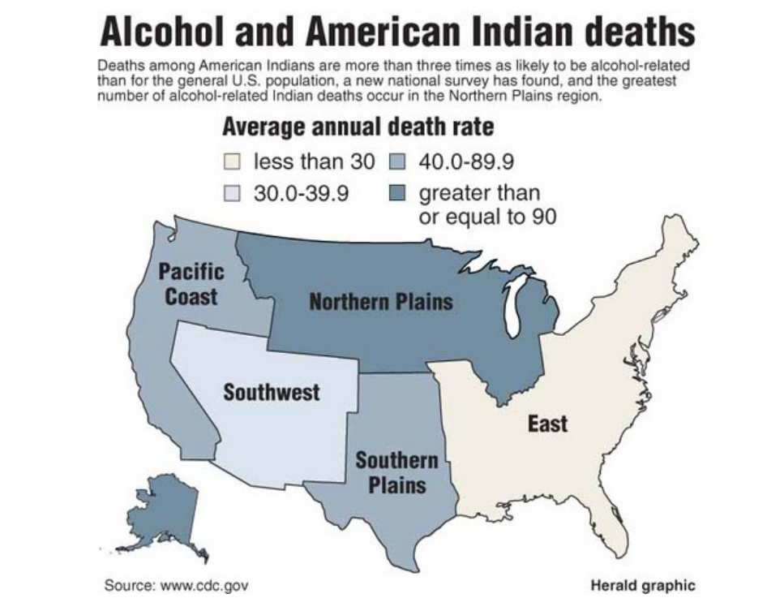
and discovered and uncovered some important
facts. . .
www.grandforksherald.com/articles/index.cfm?id=85362&section=homepage&CFID=78496208&CFTOKEN=18366292&jsessionid=8830e599e5944c3e5047

Slide 72
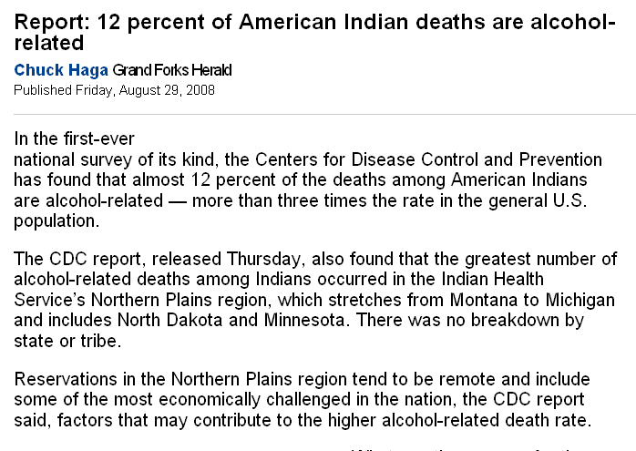
www.grandforksherald.com/articles/index.cfm?id=85362&section=homepage&CFID=78496208&CFTOKEN=18366292&jsessionid=8830e599e5944c3e5047

Slide 73
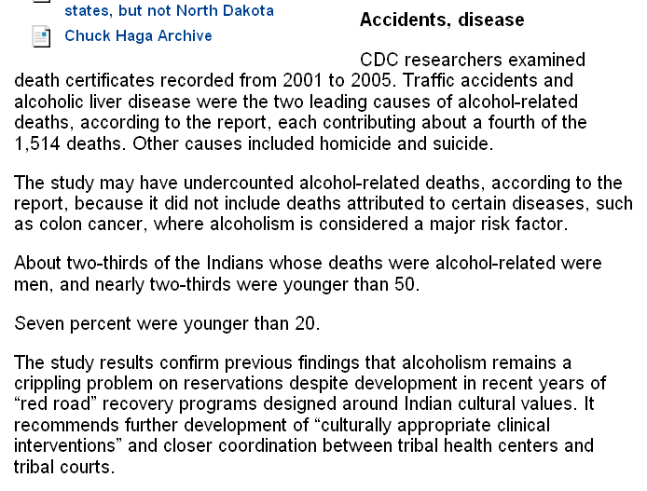
www.grandforksherald.com/articles/index.cfm?id=85362&section=homepage&CFID=78496208&CFTOKEN=18366292&jsessionid=8830e599e5944c3e5047

Slide 74
Gary Paul Nabhan
  Why Some like it hot
      Favism / sickle cell anemia
      (G6PD)
      Sardinia
      Crete
      supertasters
      lactose intolerance
      alcohol tolerance
we’ll have a brief look
at some of these
other issues later in the semester

Slide 75
for now
back to lactose intolerance
The Cultural Feast, 2nd Ed., p. 40

Slide 76
is used to be thought that
milk aversion was due to psychosomatic reasons
relating to things like the idea that “manipulating the udder of an animal was indeed a strange procedure”
especially when the “white animal secretion” when consumed could make a person ill
The Cultural Feast, 2nd Ed., p. 7

Slide 77
is used to be thought that
milk aversion was due to psychosomatic reasons
relating to things like the idea that “manipulating the udder of an animal was indeed a strange procedure”
especially when the “white animal secretion” when consumed could make a person ill
The Cultural Feast, 2nd Ed., p. 7

Slide 78
but that changed in the late 1960s
with the work of “pioneers” such as
F. J. Simoons
The Cultural Feast, 2nd Ed., pp. 40-41

Slide 79
F. J. Simoons
1970
“Primary adult lactose intolerance and the milking habit: A Problem in biological and cultural interrelations II: A cultural historical hypothesis.” American Journal of Digestive Diseases, 15, 673-695.
1983
“Geography and genetics as factors in the psychobiology of human food selection.” In L. M. Baker (Ed.), The Psychobiology of human food selection. Westport, CT: Avi Co.
The Cultural Feast, 2nd Ed., p. 7

Slide 80

a major work in Anth of Food is . . .
F. J. Simoons
1994
Eat not this Flesh,
Food Avoidances from Pre-history to Present.
Madison: University of Wisconsin Press.
The Cultural Feast, 2nd Ed., p. 7

Slide 81
“Studies of the distribution of lactose tolerance suggest that the gene’s frequency within a population
is related to a reliance on dairying and pastoralism that gives people easy access to milk products. . . .”
The Cultural Feast, 2nd Ed., p. 7

Slide 82
“Studies of the distribution of lactose tolerance suggest that the gene’s frequency within a population
is related to a reliance on dairying and pastoralism that gives people easy access to milk products. . . .”
The Cultural Feast, 2nd Ed., p. 7

Slide 83
“Studies of the distribution of lactose tolerance suggest that the gene’s frequency within a population
is related to a reliance on dairying and pastoralism that gives people easy access to milk products. . . .”
The Cultural Feast, 2nd Ed., p. 7

Slide 84
“Societies that have traditionally practiced dairying and milk consumption, mainly Northern Europeans and some herding groups in Africa and the Middle East, were found to have a low prevalence of lactase deficiency, whereas those whose ancestors did not rely on domestic animals and who avoided milk had high frequencies of deficiency.”
The Cultural Feast, 2nd Ed., p. 41

Slide 85
“Societies that have traditionally practiced dairying and milk consumption, mainly Northern Europeans and some herding groups in Africa and the Middle East, were found to have a low prevalence of lactase deficiency, whereas those whose ancestors did not rely on domestic animals and who avoided milk had high frequencies of deficiency.”
The Cultural Feast, 2nd Ed., p. 41

Slide 86
in a few of these latter populations lactase activity is present in adulthood
      these include mainly those of
      northern European ancestry
      and people descended from people in
      a few pockets of the Mediterranean
      and parts of central Africa
The Cultural Feast, 2nd Ed., p. 41

Slide 87
in a few of these latter populations lactase activity is present in adulthood
      these include mainly those of
      northern European ancestry
      and people descended from people in
      a few pockets of the Mediterranean
      and parts of central Africa
The Cultural Feast, 2nd Ed., p. 40

Slide 88
in human populations virtually all infants and young children can digest the lactose in milk
      “an obvious necessity for survival”
        human milk contains 7% lactose
The Cultural Feast, 2nd Ed., p. 40

Slide 89
as most children grow older, they produce less and less lactase
      between the ages of 3 and 7 most become lactase deficient
The Cultural Feast, 2nd Ed., p. 40

Slide 90
as most children grow older, they produce less and less lactase
      between the ages of 3 and 7 most become lactase deficient
The Cultural Feast, 2nd Ed., p. 40

Slide 91
research suggests a person’s ability do digest milk is under genetic control
      “inherited as an autosomal dominant trait”
        “autosomal“ refers to any chromosome other than a sex chromosome
The Cultural Feast, 2nd Ed., p. 42

Slide 92
research suggests a person’s ability do digest milk is under genetic control
      “inherited as an autosomal dominant trait”
        “autosomal“ refers to any chromosome
        other than a sex chromosome
The Cultural Feast, 2nd Ed., p. 42

Slide 93
research suggests a person’s ability do digest milk is under genetic control
      “inherited as an autosomal dominant trait”
        “autosomal“ refers to any chromosome
        other than a sex chromosome
The Cultural Feast, 2nd Ed., p. 42

Slide 94
Question:
“Why have some groups inherited a genetic trait that allows them to digest milk as adults, making them different from most of humanity and land animals?”
The Cultural Feast, 2nd Ed., p. 42

Slide 95
Question:
“Why have some groups inherited a genetic trait that allows them to digest milk as adults, making them different from most of humanity and land animals?”
The Cultural Feast, 2nd Ed., p. 42

Slide 96
“One of the best-supported explanations points to the advantages derived from milk consumption.”
“According to this cultural-historical hypothesis, all early foraging populations were lactase deficient.”
“About 10,000 years ago, humans began to domesticate animals, raising them for meat and hides.”
The Cultural Feast, 2nd Ed., p. 42

Slide 97
“One of the best-supported explanations points to the advantages derived from milk consumption.”
“According to this cultural-historical hypothesis, all early foraging populations were lactase deficient.”
“About 10,000 years ago, humans began to domesticate animals, raising them for meat and hides.”
The Cultural Feast, 2nd Ed., p. 42

Slide 98
“One of the best-supported explanations points to the advantages derived from milk consumption.”
“According to this cultural-historical hypothesis, all early foraging populations were lactase deficient.”
“About 10,000 years ago, humans began to domesticate animals, raising them for meat and hides.”
The Cultural Feast, 2nd Ed., p. 42

Slide 99
“One of the best-supported explanations points to the advantages derived from milk consumption.”
“According to this cultural-historical hypothesis, all early foraging populations were lactase deficient.”
“About 10,000 years ago, humans began to domesticate animals, raising them for meat and hides.”
The Cultural Feast, 2nd Ed., p. 42

Slide 100
“Domesticated animals offered another resource: milk.”
“However, to take advantage of this new food, people had to be able to produce lactase throughout adulthood.”
“At some unknown point in time,
a mutation occurred that enabled humans to produce the enzyme lactase and digest milk as adults.”
The Cultural Feast, 2nd Ed., p. 42

Slide 101
“Domesticated animals offered another resource: milk.”
“However, to take advantage of this new food, people had to be able to produce lactase throughout adulthood.”
“At some unknown point in time,
a mutation occurred that enabled humans to produce the enzyme lactase and digest milk as adults.”
The Cultural Feast, 2nd Ed., p. 42

Slide 102
“Domesticated animals offered another resource: milk.”
“However, to take advantage of this new food, people had to be able to produce lactase throughout adulthood.”
“At some unknown point in time,
a mutation occurred that enabled humans to produce the enzyme lactase and digest milk as adults.”
The Cultural Feast, 2nd Ed., p. 42

Slide 103
“In societies that made use of domesticated animals, individuals with this trait for tolerating lactose had an advantage in being better nourished than those who could not make use of this new resource.”
The Cultural Feast, 2nd Ed., p. 42

Slide 104
“As dairying practices developed in some societies, lactose-tolerant individuals survived in greater numbers and gave birth to more offspring to also inherited the same advantage.”
The Cultural Feast, 2nd Ed., p. 42

Slide 105
“Through natural selection,
the frequency of the genetic trait for digesting lactose increased in dairying societies until the majority of people were able to digest milk throughout adulthood.”
The Cultural Feast, 2nd Ed., p. 42

Slide 106
“Other explanations for why some
people have lactase activity into adulthood have been put forward.”
G. C. Cook has suggested that the ability to digest lactose originally evolved among desert nomads in the Arabian peninsula and was selected for because the trait would have helped people absorb the water and electrolytes in milk
    an important advantage in a hot, dry climate
The Cultural Feast, 2nd Ed., p. 42

Slide 107
“Other explanations for why some
people have lactase activity into adulthood have been put forward.”
G. C. Cook has suggested that the ability to digest lactose originally evolved among desert nomads in the Arabian peninsula and was selected for because the trait would have helped people absorb the water and electrolytes in milk
    an important advantage in a hot, dry climate
The Cultural Feast, 2nd Ed., p. 42

Slide 108
anyway, be that as it may . . .
in societies relying on dairying and pastoralism, individuals with the gene for continuing lactose digestion have had a greater chance of thriving and reproducing, passing on more of their genes to the next generation than those who cannot consume milk products
The Cultural Feast, 2nd Ed., p. 7

Slide 109
The map on p. 41 of
The Cultural Feast, 2nd ed. highlights populations in which older children and adults have difficult digesting lactose

Slide 110
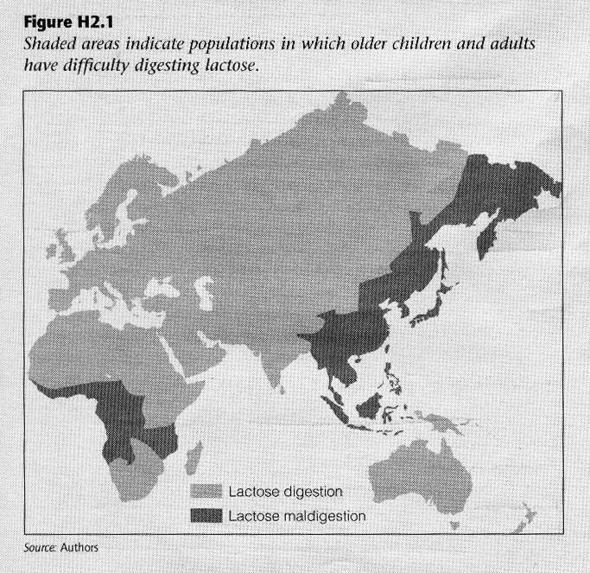
Maps like this are simplified versions of . . .
The Cultural Feast, 2nd Ed., p. 41

Slide 111
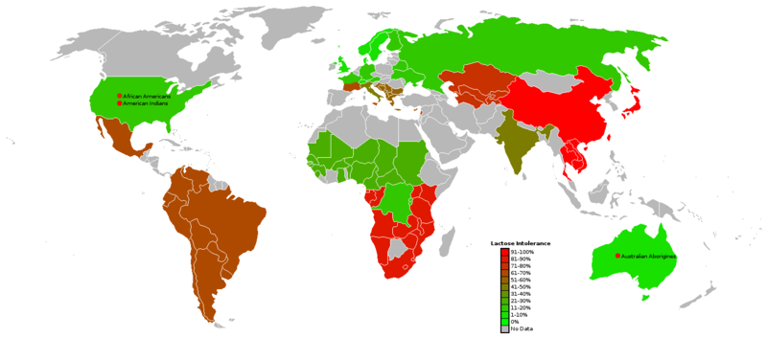
Lactose Intolerance by Region
(African countries are only a rough guess)
Wikipedia

Slide 112
The chart on p. 42 of
The Cultural Feast, 2nd ed. features the estimated incidence of
“Lactose Maldigestion”
among older children and adults in different population groups

Slide 113
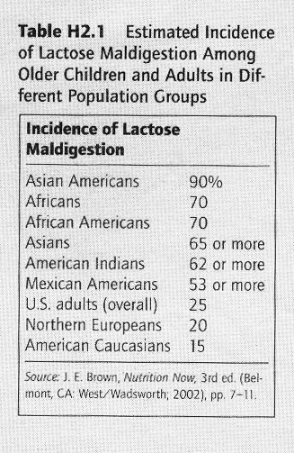
The Cultural Feast, 2nd Ed., p. 42

Slide 114
see Nabhan’s various works for more information . . .

Slide 115
this chart on p. 42 is a simplified version of . . .
The Cultural Feast, 2nd Ed., p. 42

Slide 116
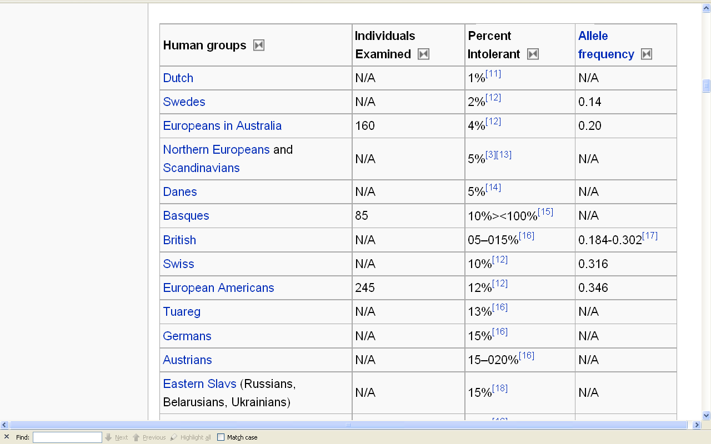
for e.g., have a look at . . .
Wikipedia

Slide 117
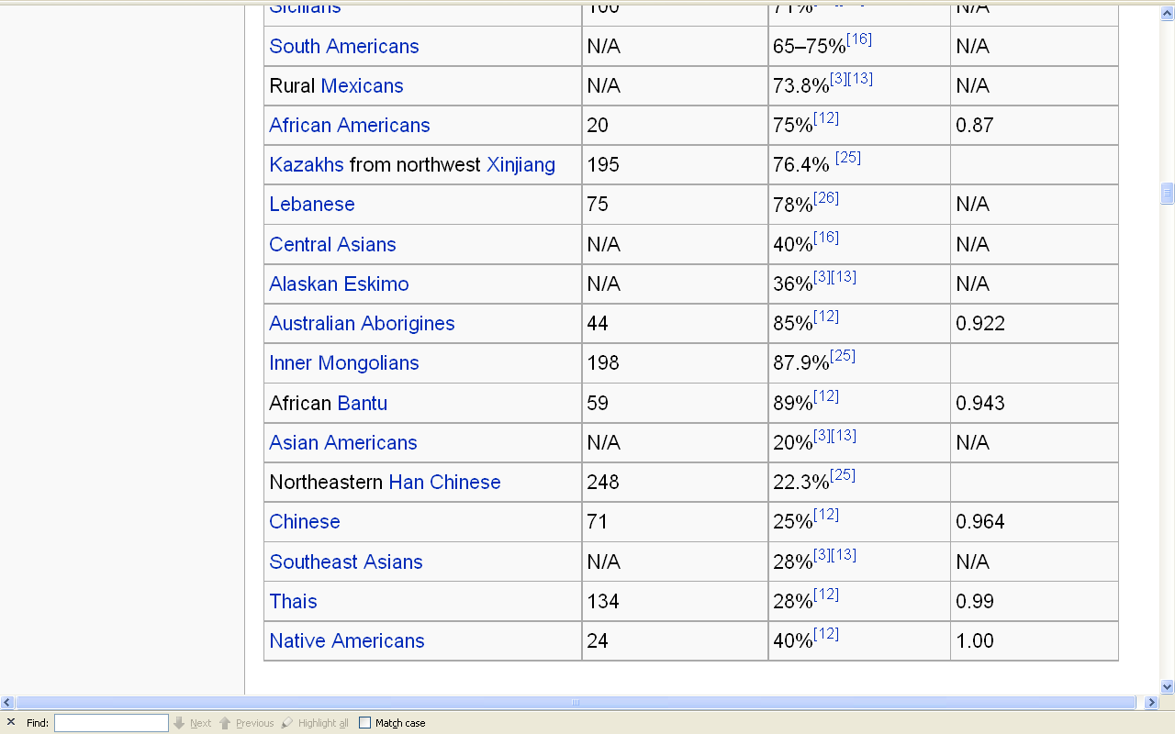
for e.g., have a look at . . .
Wikipedia

Slide 118
between 30 and 50 million Americans are lactose intolerant
      15% of European Americans
      53% of Mexican Americans
      62% of Native Americans
      80% of African Americans
      90% of Asian Americans
The Cultural Feast, 2nd Ed., p. 42

Slide 119


and lactose intolerance has become part of
the world of American politics . . .
http://www.bbc.co.uk/blogs/thereporters/markmardell/2010/02/why_a_republican_big_cheese_ba.html

Slide 120
and lactose intolerance has become part of
the world of American politics . . .
Should Milk Be Promoted So Widely?
      “Given that so many Americans have difficulty digesting milk, it is interesting that milk is seen as a staple food in America and included as a key food in all government dietary recommendations, as well as being served in the School Breakfast and Lunch Programs [SNAP] and distributed in the Special Supplemental Nutrition Program for Women, Infants and Children Program (WIC), both programs of the U.S. Department of Agriculture”
The Cultural Feast, 2nd Ed., p. 42

Slide 121
and lactose intolerance has become part of
the world of American politics . . .
Should Milk Be Promoted So Widely?
      “Given that so many Americans have difficulty digesting milk, it is interesting that milk is seen as a staple food in America and included as a key food in all government dietary recommendations, as well as being served in the School Breakfast and Lunch Programs [SNAP] and distributed in the Special Supplemental Nutrition Program for Women, Infants and Children Program (WIC), both programs of the U.S. Department of Agriculture”
The Cultural Feast, 2nd Ed., p. 42

Slide 122

Wikipedia

Slide 123
and lactose intolerance has become part of
the world of American politics . . .
Should Milk Be Promoted So Widely?
      “Given that so many Americans have difficulty digesting milk, it is interesting that milk is seen as a staple food in America and included as a key food in all government dietary recommendations, as well as being served in the School Breakfast and Lunch Programs [SNAP] and distributed in the Special Supplemental Nutrition Program for Women, Infants and Children Program (WIC), both programs of the U.S. Department of Agriculture”
The Cultural Feast, 2nd Ed., p. 42

Slide 124
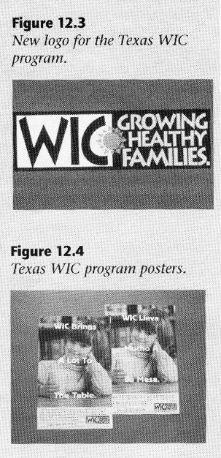
The Cultural Feast, 2nd Ed., p. 391

Slide 125
Should Milk Be Promoted So Widely?
The Cultural Feast, 2nd Ed., p. 43

Slide 126
Should Milk Be Promoted So Widely?
YES!
NO!
The Cultural Feast, 2nd Ed., p. 43

Slide 127
Should Milk Be Promoted So Widely?
      “According to Milton Mills of the National Medical Association, an organization of 20,000 African American physicians, the U.S. Dietary Guidelines, although it may be unintentional, are a form of institutionalized racism.”
YES!
NO!
The Cultural Feast, 2nd Ed., p. 43

Slide 128
Should Milk Be Promoted So Widely?
      “According to Milton Mills of the National Medical Association, an organization of 20,000 African American physicians, the U.S. Dietary Guidelines, although it may be unintentional, are a form of institutionalized racism.”
YES!
NO!
The Cultural Feast, 2nd Ed., p. 43

Slide 129
Should Milk Be Promoted So Widely?
      “The Congressional Black Congress wrote to President Clinton in 1999 stating that the U.S. Dietary Guidelines ‘demonstrated a consistent racial bias’”.
YES!
NO!
The Cultural Feast, 2nd Ed., p. 43

Slide 130
Should Milk Be Promoted So Widely?
      “The Congressional Black Congress wrote to President Clinton in 1999 stating that the U.S. Dietary Guidelines ‘demonstrated a consistent racial bias’”.
YES!
NO!
The Cultural Feast, 2nd Ed., p. 43

Slide 131
Should Milk Be Promoted So Widely?
      “The Physicians Committee for Responsible Medicine, a Washington, D.C.-based group that promotes preventive nutrition, alleges racial bias in the formulation of the Dietary Guidelines and the associated Food Guide Pyramid.“
        “They charge that American minorities are badly served by the Dietary Guidelines that take little notice of their particular needs and hold the position that the Dietary Guidelines should make dairy products optional.”
YES!
NO!
The Cultural Feast, 2nd Ed., p. 43

Slide 132
Should Milk Be Promoted So Widely?
      “The Physicians Committee for Responsible Medicine, a Washington, D.C.-based group that promotes preventive nutrition, alleges racial bias in the formulation of the Dietary Guidelines and the associated Food Guide Pyramid.“
        “They charge that American minorities are badly served by the Dietary Guidelines that take little notice of their particular needs and hold the position that the Dietary Guidelines should make dairy products optional.”
YES!
NO!
The Cultural Feast, 2nd Ed., p. 43

Slide 133
Should Milk Be Promoted So Widely?
      “The Physicians Committee for Responsible Medicine, a Washington, D.C.-based group that promotes preventive nutrition, alleges racial bias in the formulation of the Dietary Guidelines and the associated Food Guide Pyramid.“
        “They charge that American minorities are badly served by the Dietary Guidelines that take little notice of their particular needs and hold the position that the Dietary Guidelines should make dairy products optional.”
YES!
NO!
The Cultural Feast, 2nd Ed., p. 43

Slide 134
The 1992 USDA food pyramid

Slide 135
United States
Department of
Agriculture
The 1992 USDA food pyramid

Slide 136
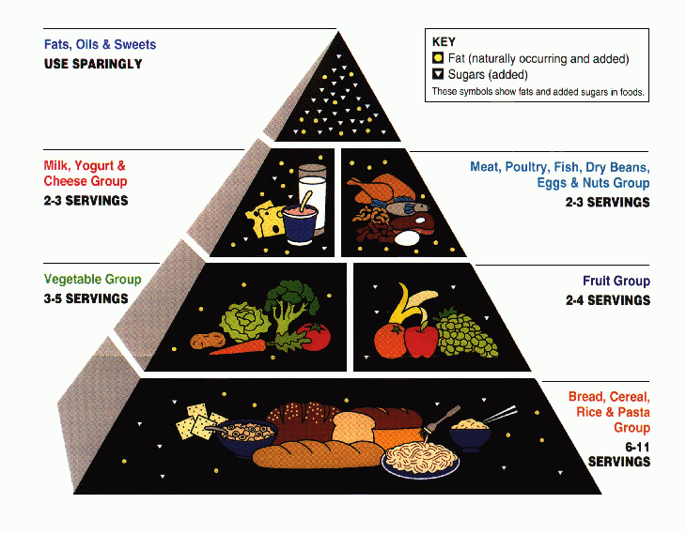
This is the old (1992) version
The 1992 USDA food pyramid

Slide 137
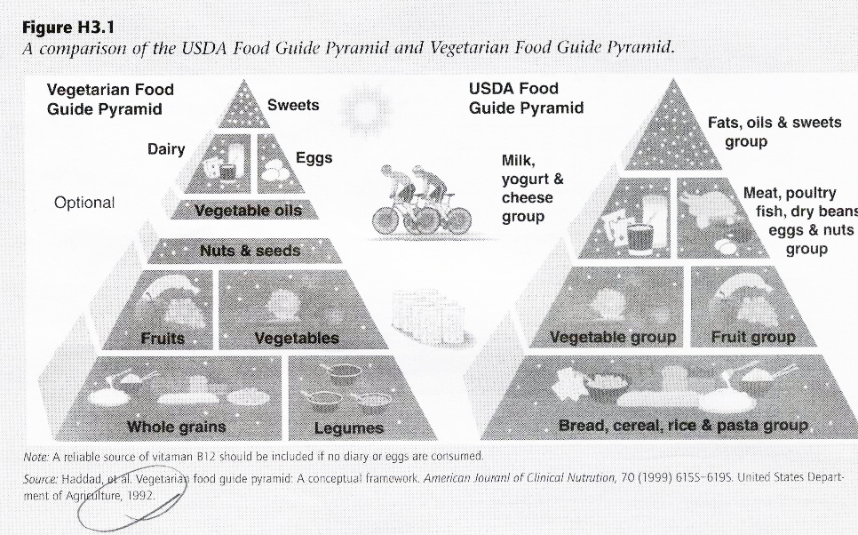
This is the old (1992) version
A comparison of the USDA Food Guide Pyramid and Vegetarian Food Guide Pyramid
The Cultural Feast, 2nd Ed., p. 82

Slide 138

3 cups of dairy products are recommended per day
(for adults)
The current USDA food pyramid

Slide 139
food pyramids come in
all cuisines
and all sizes and shapes . . .

Slide 140
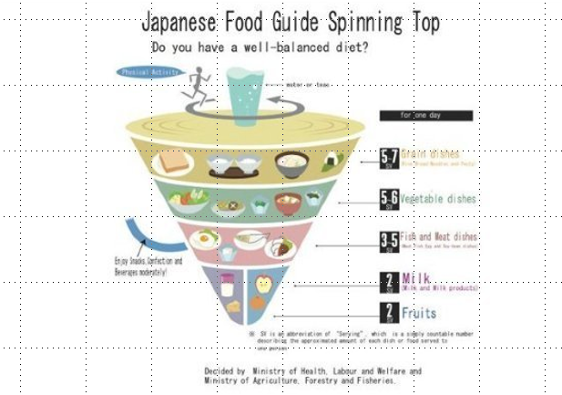
Japan's Spinning Top
http://www.huffingtonpost.com/food-republic/food-pyramids-around-the-world_b_874409.html

Slide 141
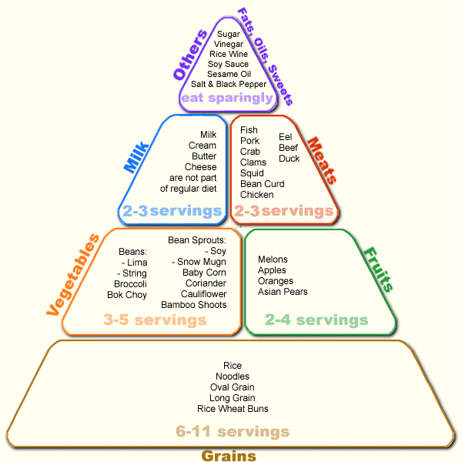
Japanese Food Pyramid
http://www.ethnicfoodsco.com/Japan/JapaneseFoodPyramid.htm

Slide 142
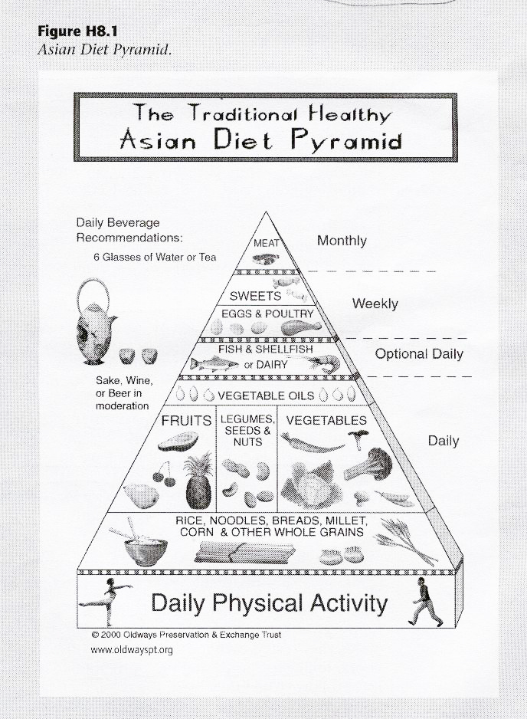
Asian Diet Pyramid
The Cultural Feast, 2nd Ed., p. 251

Slide 143
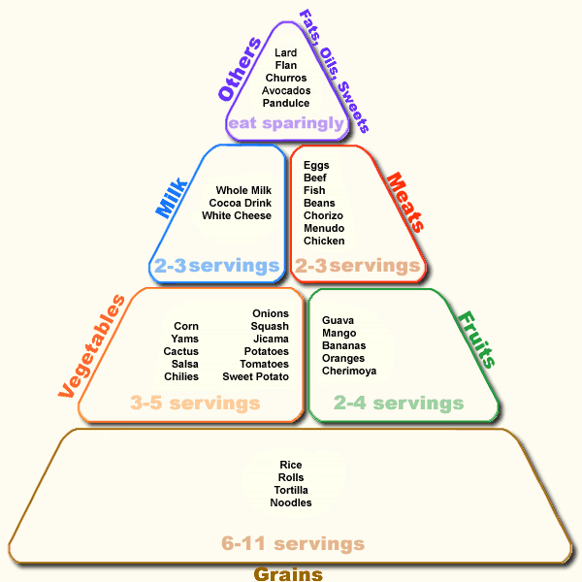
Mexican Food Pyramid
www.semda.org/info/images/July99_new.gif

Slide 144
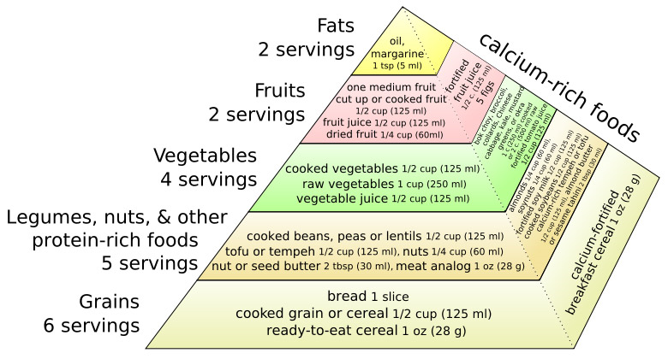
A vegan version of the food pyramid

Slide 145
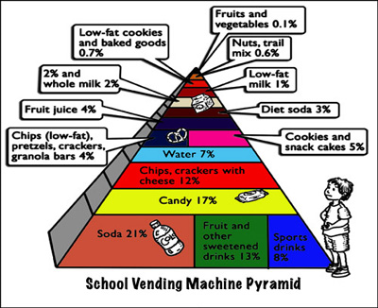
July 19, 2009
http://www.ceche.org/mol/Spring-05/inside.html
Notes:
145

Slide 146
They are all basically associated with . . .

Slide 147
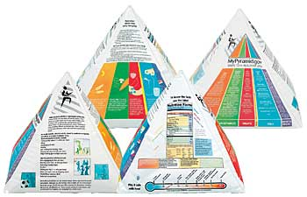
. . . in one way or another . . .
Inflatable USDA Food Guide Pyramid
www.ethnicfoodsco.com/Japan/JapaneseFoodPyramid.htm

Slide 148

. . . The United States Department of Agriculture . . .

Slide 149
. . .
whose job it is
to promote
U.S.
Agriculture . . .

Slide 150
. . . with The USDA
whose job it is
to promote
U.S.
Agriculture . . .
Being that it is established by law as
“The United States Department of Agriculture”

Slide 151

not to be confused with
United States
Food and Drug Administration

Slide 152
the
United States
Food and Drug Administration
is responsible for regulating and supervising the safety of foods, dietary supplements, etc.

Slide 153
promotes
U.S.A.
agriculture
regulates
U.S.A.
food safety
Inflatable USDA Food Pyramid
www.ethnicfoodsco.com/Japan/JapaneseFoodPyramid.htm

Slide 154
. . . and, in addition, . . .

Slide 155

EPA
. . . The EPA is charged with related things like . . .
http://en.wikipedia.org/wiki/Epa

Slide 156
protecting U.S.A.
human health
and the
environment
EPA
http://en.wikipedia.org/wiki/Epa

Slide 157
promotes
U.S.A.
agriculture
regulates
U.S.A.
food safety

Slide 158
is charged to
protect U.S.A.
human health
and the
environment
promotes
U.S.A.
agriculture
regulates
U.S.A.
food safety

Slide 159
e.g., Factory Farming
(CAFOs)
has environmental impacts
and health risks . . .
EPA
http://en.wikipedia.org/wiki/CAFO

Slide 160
e.g., Factory Farming
(CAFOs) and decisions affect
animal welfare,
food ethics . . .
EPA
http://en.wikipedia.org/wiki/CAFO

Slide 161
is charged to
protect U.S.A.
human health
and the
environment
EPA
but . . .
http://en.wikipedia.org/wiki/Epa

Slide 162
is charged to
protect U.S.A.
human health
and the
environment
EPA
but . . .
a big question for them is . . .
http://en.wikipedia.org/wiki/Epa

Slide 163

10 July 2008
http://www.msnbc.msn.com/id/25626294/

Slide 164
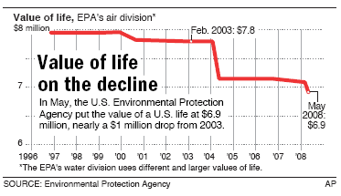
10 July 2008
$900,000
by the G. W. Bush
Administration
http://www.msnbc.msn.com/id/25626294/

Slide 165
10 July 2008
“The the EPA figure is not based on people's earning capacity, or their potential contributions to society, or how much they are loved and needed by their friends and family — some of the factors used in insurance claims and wrongful-death lawsuits.
Instead, economists calculate the value based on what people are willing to pay to avoid certain risks, and on how much extra employers pay their workers to take on additional risks.”
http://www.msnbc.msn.com/id/25626294/

Slide 166
10 July 2008
“Though it may seem like a harmless bureaucratic recalculation,
the devaluation has real consequences.”
http://www.msnbc.msn.com/id/25626294/

Slide 167
10 July 2008
“Dan Esty, a senior EPA policy official in the first Bush administration and now director of the Yale Center for Environmental Law and Policy, said that ‘it's hard to imagine that it has other than a political motivation.’"
http://www.msnbc.msn.com/id/25626294/

Slide 168
10 July 2008
“When drawing up regulations, government agencies put a value on human life and then weigh the costs versus the lifesaving benefits of a proposed rule. The less a life is worth to the government, the less the need for a regulation, such as tighter restrictions on pollution.”
http://www.msnbc.msn.com/id/25626294/

Slide 169
10 July 2008
“Consider, for example, a hypothetical regulation that costs $18 billion to enforce but will prevent 2,500 deaths. At $7.8 million per person (the old figure), the lifesaving benefits outweigh the costs. But at $6.9 million per person, the rule costs more than the lives it saves, so it may not be adopted.”
http://www.msnbc.msn.com/id/25626294/

Slide 170
And, in addition, there’s . . .

Slide 171

to the
federal regulators
you must also add

Slide 172
is charged to
protect U.S.A.
human health
and the
environment
promotes
U.S.A.
agriculture
regulates
U.S.A.
food safety
and to the
federal regulators
you must also add

Slide 173
is charged to
protect U.S.A.
human health
and the
environment
promotes
U.S.A.
agriculture
regulates
U.S.A.
food safety
Centers for Disease Control and Prevention
“works to protect public health and safety by providing information to enhance health decisions”

Slide 174
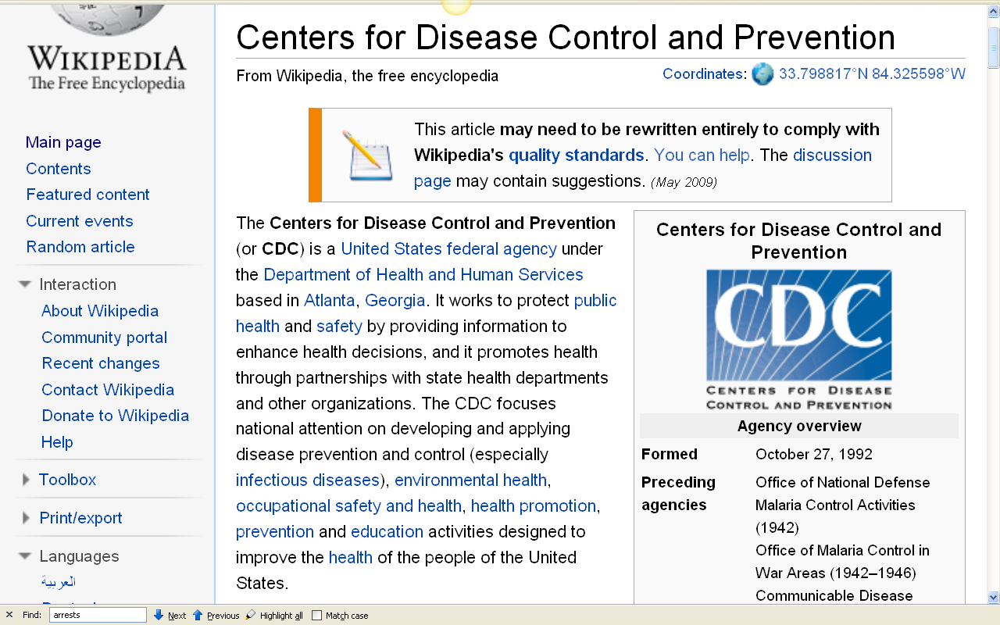
10 July 2008
http://en.wikipedia.org/wiki/Centers_for_Disease_Control_and_Prevention

Slide 175

is charged to
protect U.S.A.
human health
and the
environment
promotes
U.S.A.
agriculture
regulates
U.S.A.
food safety
an excellent work that sorts all of this out is Marion Nestle’s
Food Politics
(see more below)
Centers for Disease Control and Prevention
“works to protect public health and safety by providing information to enhance health decisions”

Slide 176
is charged to
protect U.S.A.
human health
and the
environment
and, of course,
The United States
Supreme Court
overrides everybody . . .
promotes
U.S.A.
agriculture
regulates
U.S.A.
food safety
Centers for Disease Control and Prevention
“works to protect public health and safety by providing information to enhance health decisions”

Slide 178
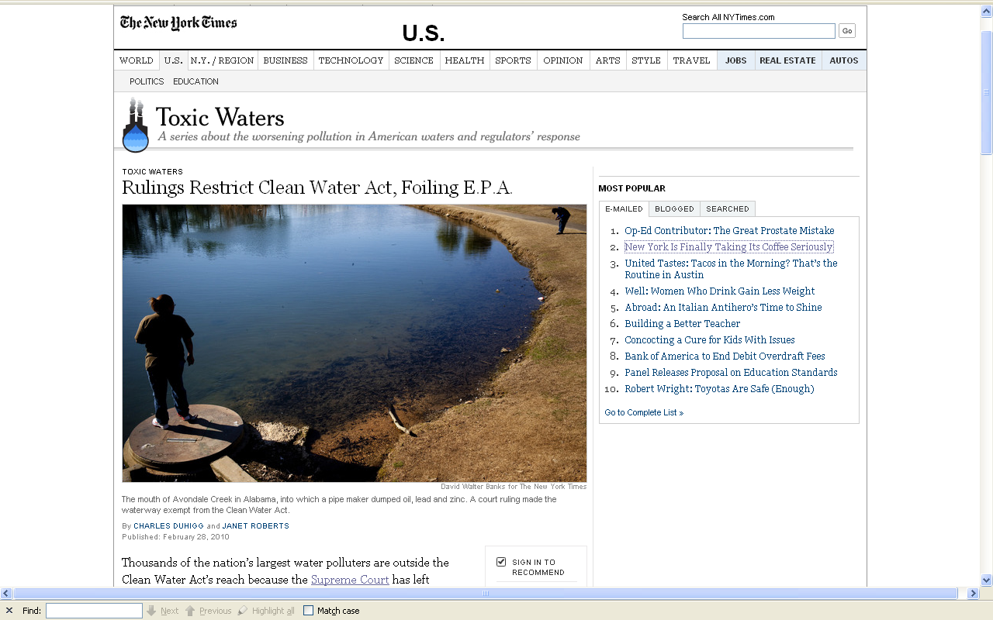
10 July 2008
http://www.nytimes.com/2010/03/01/us/01water.html?th&emc=th

Slide 179

10 July 2008
http://www.nytimes.com/2010/03/01/us/01water.html?th&emc=th

Slide 180
10 July 2008
http://www.nytimes.com/2010/03/01/us/01water.html?th&emc=th

Slide 181
10 July 2008
“When drawing up regulations, government agencies put a value on human life and then weigh the costs versus the lifesaving benefits of a proposed rule. The less a life is worth to the government, the less the need for a regulation, such as tighter restrictions on pollution.”
http://www.msnbc.msn.com/id/25626294/

Slide 182
. . . and when tighter restrictions on pollution are attempted the affected parties [legally] fight the regulations to
the US Supreme Court.
Net result:
the USDA
and the FDA
and the EPA
and the CDC
[fill in the blank __________________]
10 July 2008
http://www.msnbc.msn.com/id/25626294/

Slide 183
So as is usually [always?]
the case . . .
the question of milk and lactose intolerance (and related matters)
are rife
with politics . . .

Slide 184
an excellent treatment of this question can be found in . . .
Marion Nestle
Food Politics: How the Food Industry Influences Nutrition and Health
University of California Press 2007

Slide 185
Marion Nestle
Food Politics: How the Food Industry Influences Nutrition and Health
University of California Press 2007
Marion Nestle provides one of the best discussions
— perhaps THE best discussion—
of those sorts of matters, and of the USDA
(including the politics of milk and lactose intolerance)

Slide 186

Marion Nestle
Unsavory Truth: How Food Companies Skew the Science of What We Eat
Basic Books 2018
“America's leading nutritionist exposes how the food industry corrupts scientific research for profit”

Slide 187

and . . .
Marion Nestle
What to Eat
North Point Press
2007

Slide 188

Marion [No Relation to the Company] Nestle

Slide 189
back to the question of whether milk should be promoted so widely by the Government . . .
The Cultural Feast, 2nd Ed., p. 43

Slide 190
Should Milk Be Promoted So Widely?
YES!
NO!
The Cultural Feast, 2nd Ed., p. 43

Slide 191
Should Milk Be Promoted So Widely?
      “Dairy products have much to recommend them.“
        they are one of the most concentrated food sources of calcium, as well as one of the best absorbed
          dairy products provide 73% of the calcium in the U.S. food supply
          when dairy products are eliminated, calcium intake is often compromised
YES!
NO!
The Cultural Feast, 2nd Ed., p. 43

Slide 192
Should Milk Be Promoted So Widely?
      “Dairy products have much to recommend them. “
        they are one of the most concentrated food sources of calcium, as well as one of the best absorbed
          dairy products provide 73% of the calcium in the U.S. food supply
          when dairy products are eliminated, calcium intake is often compromised
YES!
NO!
The Cultural Feast, 2nd Ed., p. 43

Slide 193
Should Milk Be Promoted So Widely?
      “Dairy products have much to recommend them. “
        they also provide
                protein
                riboflavin (vitamin B₂)
                phosphorus
                vitamin A
                vitamin D
YES!
NO!
The Cultural Feast, 2nd Ed., pp. 43-44

Slide 194
Should Milk Be Promoted So Widely?
      “Dairy products have much to recommend them.“
        calcium is importance in the prevention of . . .
            hypertension
            osteoporosis
            periodontal (gum) disease
            possibly some types of cancer
            and in weight loss programs
YES!
NO!
The Cultural Feast, 2nd Ed., p. 43

Slide 195
Should Milk Be Promoted So Widely?
      the recommendations for calcium intake have continued to rise over the years
        1000 mg / day for adults 19-50
        1200 mg / day for those over age 50
        1300 mg / day for pregnant and nursing women
YES!
NO!
cf., Table, p. 44
The Cultural Feast, 2nd Ed., pp. 43-44

Slide 196
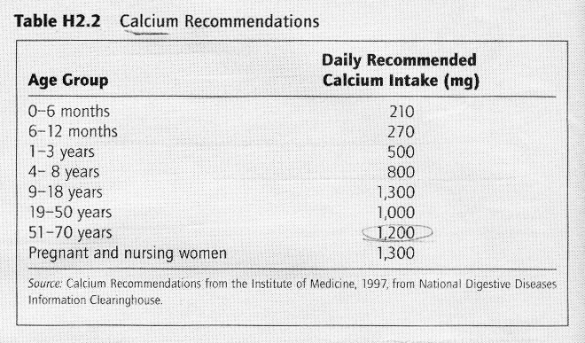
The Cultural Feast, 2nd ed., p. 44

Slide 197
other things to consider . . .
lactose tolerance
is not always predictable
      “In the Tokelauans of the Pacific, for e.g., there is a wide range in ability to handle lactose”
        Those who have some European ancestors,
        determined by constructing detailed genealogies,
        are more likely to be lactose absorbers than those who are not.”
The Cultural Feast, 2nd Ed., p. 40

Slide 198
other things to consider . . .
lactose tolerance
is not always predictable
      “In the Tokelauans of the Pacific, for e.g., there is a wide range in ability to handle lactose”
        Those who have some European ancestors,
        determined by constructing detailed genealogies,
        are more likely to be lactose absorbers than those who are not.”

Slide 199
other things to consider . . .
lactose digestion is not an
all-or-none phenomenon
      “recent evidence shows that people with low levels of lactase may be able to drink their milk and tolerate it too”
        one serving of milk with a meal or two servings of milk divided between meals throughout the day without experiencing lactose intolerant symptoms
The Cultural Feast, 2nd Ed., p. 40

Slide 200
other things to consider . . .
lactose digestion is not an
all-or-none phenomenon
      “in fact, only a small fraction of the lactose maldigesters have complete intolerance”
        many still make lactase in reduced amounts, which allows at least some dairy products to be digested
        there are also bacteria in the gut that digest a portion of the lactose, even when no lactase is present
The Cultural Feast, 2nd Ed., p. 40

Slide 201
other things to consider . . .
lactose digestion is not an
all-or-none phenomenon
      “in fact, only a small fraction of the lactose maldigesters have complete intolerance”
        many still make lactase in reduced amounts, which allows at least some dairy products to be digested
        there are also bacteria in the gut that digest a portion of the lactose, even when no lactase is present
The Cultural Feast, 2nd Ed., p. 40

Slide 202
is used to be thought that
milk aversion was due to psychosomatic reasons
The Cultural Feast, 2nd Ed., p. 45

Slide 203
is used to be thought that
milk aversion was due to psychosomatic reasons
(that is, that it was “all in your mind”)
The Cultural Feast, 2nd Ed., p. 45

Slide 204
is used to be thought that
milk aversion was due to psychosomatic reasons
and still, some individuals think they are lactose intolerant because of a belief that milk products disagree with them
for some, the idea of milk makes them sick, rather than the actual lactose level
The Cultural Feast, 2nd Ed., p. 45

Slide 205
is used to be thought that milk aversion was due to psychosomatic reasons
and still, some individuals think they are lactose intolerant because of a belief that milk products disagree with them
for some, the idea of milk makes them sick, rather than the actual lactose level
The Cultural Feast, 2nd Ed., p. 45

Slide 206
although adult lactase persistence is the result of genetics, biology alone does not entirely predict the variation in milk drinking in human populations
      the great deal of variation seen in milk drinking practices reflects a more complex biocultural interaction than would be implied by a single genetic trait
The Cultural Feast, 2nd Ed., p. 46

Slide 207
although adult lactase persistence is the result of genetics, biology alone does not entirely predict the variation in milk drinking in human populations
      the great deal of variation seen in milk drinking practices reflects a more complex biocultural interaction than would be implied by a single genetic trait
The Cultural Feast, 2nd Ed., p. 46

Slide 208
some definitions
The Cultural Feast, 2nd Ed., p. 43

Slide 209
primary lactase deficiency
secondary lactase deficiency
congenital lactase deficiency
milk allergy
The Cultural Feast, 2nd Ed., p. 43

Slide 210
primary lactase deficiency
secondary lactase deficiency
congenital lactase deficiency
milk allergy
The Cultural Feast, 2nd Ed., p. 43

Slide 211
primary lactase deficiency
secondary lactase deficiency
congenital lactase deficiency
milk allergy
    the most common type
    occurs as a normal physiological process in most mammals
    the production of lactase in the small intestine is reduced between the ages of 3 and 7 years
The Cultural Feast, 2nd Ed., p. 43

Slide 212
secondary lactase deficiency
secondary lactase deficiency
congenital lactase deficiency
milk allergy
    usually temporary
    low levels of lactase occur as a result of an underlying disease that affects the gastrointestinal tract
    even having stomach flu can temporarily decrease the amount of lactase made in the intestine
The Cultural Feast, 2nd Ed., p. 43

Slide 213
congenital lactase deficiency
secondary lactase deficiency
congenital lactase deficiency
milk allergy
    very rare genetic abnormality in which the enzyme lactase is very low or absent at birth
The Cultural Feast, 2nd Ed., p. 43

Slide 214
milk allergy
secondary lactase deficiency
congenital lactase deficiency
milk allergy
    some individuals have trouble digesting milk because they are allergic to milk protein
    their immune system responds to the proteins in dairy products
      rash, hives, wheezing, redness, stuffy nose, runny eyes
The Cultural Feast, 2nd Ed., p. 43

Slide 215
milk allergy
secondary lactase deficiency
congenital lactase deficiency
milk allergy
    some individuals have trouble digesting milk because they are allergic to milk protein
    their immune system responds to the proteins in dairy products
      rash, hives, wheezing, redness, stuffy nose, runny eyes
The Cultural Feast, 2nd Ed., p. 43

Slide 216
primary lactase deficiency
secondary lactase deficiency
congenital lactase deficiency
milk allergy
The Cultural Feast, 2nd Ed., p. 43

Slide 217
brief parting notes on other
population-level differences
The Cultural Feast, 2nd Ed., p. 8

Slide 218
population-level difference
“in biological terms, these are differences in the frequency of genetic traits”
  another example besides lactose intolerance is energy metabolism
The Cultural Feast, 2nd Ed., p. 8

Slide 219

energy metabolism
is often discussed nowadays as “bioenergetics”

Slide 220

and you might see this term in some Anth of Food research

Slide 221
population-level difference
“in biological terms, these are differences in the frequency of genetic traits”
  another example:
  distribution of skin color
The Cultural Feast, 2nd Ed., p. 6

Slide 222
“I hope they paid attention to the lactose intolerance part”

Slide 223
Lactose Intolerance
Tim Roufs
© 2010-2024
Carol A. Bryant, Kathleen M. DeWalt,
Anita Courtney and Jeffrey Schwartz
The Cultural Feast:
An Introduction to Food and Society, 2nd Ed.
Belmont, CA: Thompson Wadsworth, 2003

