Slide 1
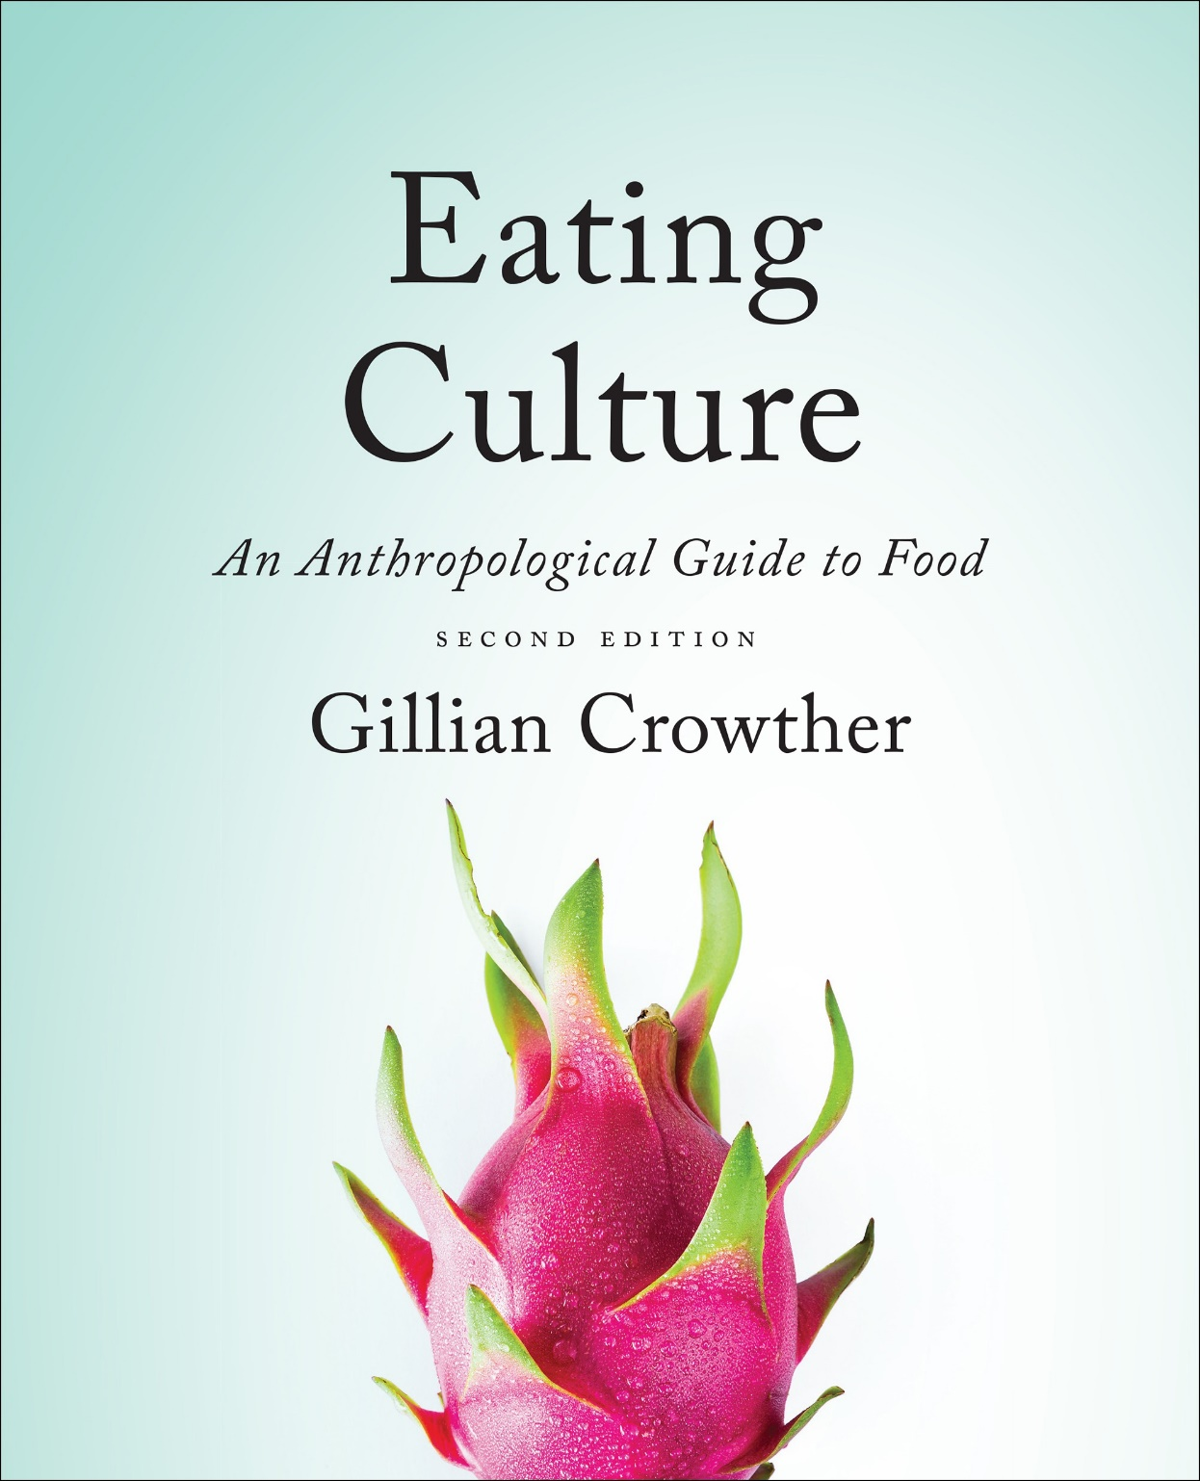
Nutritional Status
use your up/down arrow keys and/or
your space bar to advance the slides
Tim Roufs
© 2010-2024

Slide 2
Nutritional Status
Tim Roufs
© 2010-2024

Slide 3
Tim Roufs
© 2010-2024
www.d.umn.edu/cla/faculty/troufs/anthfood/aftexts.html#title

Slide 4
Biocultural Framework
for the Study of Diet and Nutrition
includes
individual
nutritional
needs
Nutritional Status
Biological Makeup
Human Nutrient Needs
Diet
Cuisine
The Environment
Physical Environment
Sociocultural Environment
Economic and Political Environment

Slide 5
Biocultural Framework
for the Study of Diet and Nutrition
Nutritional Status
Biological Makeup
Human Nutrient Needs
Diet
Cuisine
The Environment
Physical Environment
Sociocultural Environment
Economic and Political Environment
individual
nutritional
needs
“Individual Nutritional Status”
forms the core of the Biocultural model
NOTE: the unit of analysis is the individual
(see “Units of Analysis” slides for details)

Slide 6
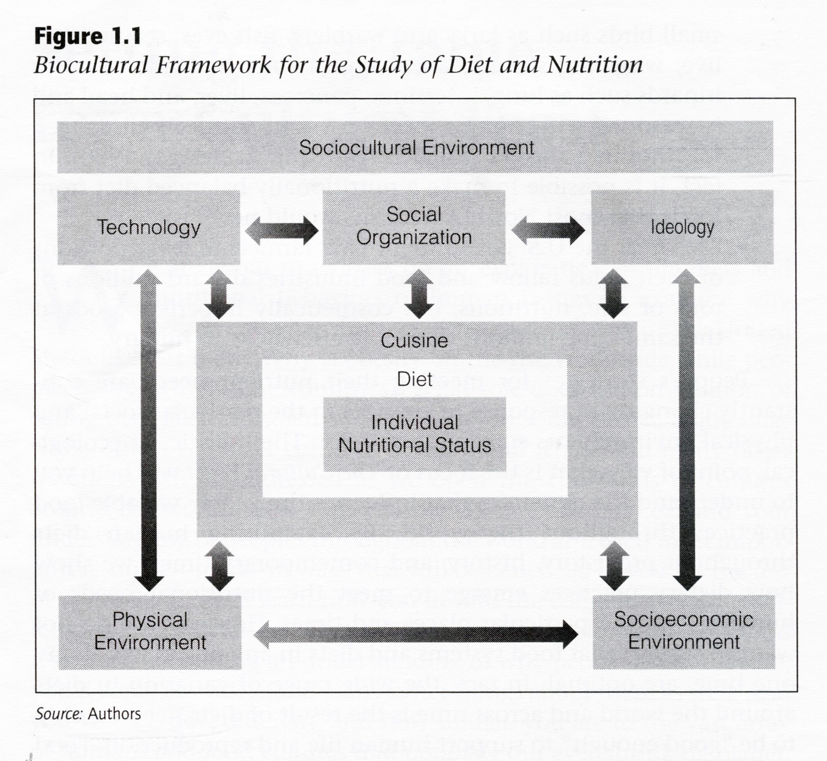
The Cultural Feast, 2nd Ed., p. 4

Slide 7
Nutritional status
refers to
“‘the health of an individual as it is influenced by the intake and utilization of nutrients’”
The Cultural Feast, 2nd Ed., p. 4

Slide 8
Nutritional status
refers to
‘the health of an individual as it is influenced by the intake and utilization of nutrients’”
The Cultural Feast, 2nd Ed., p. 4

Slide 9
Nutritional status
refers to
‘the health of an individual as it is influenced by the intake and utilization of nutrients’”
the key term again is . . .
The Cultural Feast, 2nd Ed., p. 4

Slide 10
nutrients
“chemicals that provide the energy, structure, and regulation of body processes and that are not completely synthesized in the body”
The Cultural Feast, 2nd Ed., p. 5

Slide 11
nutrients
“chemicals that provide the energy, structure, and regulation of body processes and that are not completely synthesized in the body”
The Cultural Feast, 2nd Ed., p. 5

Slide 12
nutrients
“chemicals that provide the energy, structure, and regulation of body processes and that are not completely synthesized in the body”
The Cultural Feast, 2nd Ed., p. 5

Slide 13
essential nutrients
are “nutrients that are indispensable for health and cannot be synthesized
by the human body,
but must be ingested”
therefore
you MUST get them from the food you eat
(if you want to remain alive / healthy)
The Cultural Feast, 2nd Ed., p. 5

Slide 14
we’ll have a closer look at the nature of nutrients and “essential nutrients” in
“Biological Makeup”
and we’ll have a closer look at
what nutrients you need in
“Human Nutrient Needs”

Slide 15
for right now
note how nutritional status is measured . . .
2. when trying to keep track of your nutritional intake for a day
(remembering, of course, that most experts nowadays usually focus on a time period much longer than a day, or even a few days, in assessing nutritional status)

Slide 16
(personal opinion)
the best recent short treatment on contemporary nutrition research is
Marion Nestle’s
“Issues in Nutrition and Nutrition Research”
in the Appendix of
Food Politics
pp. 395- 405

Slide 17
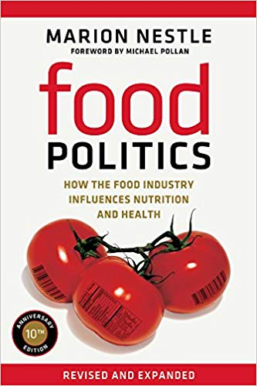
Nestle, Marion. Food Politics: How the Food Industry Influences Nutrition, Revised and Expanded Edition. Berkeley: University of California Press, 2013.

Slide 18
in
“Issues in Nutrition and Nutrition Research”
in Food Politics
(pp. 395- 405)
Marion Nestle talks about . . .

Slide 19
Main Characteristics
1. culture as a primary concept
2. comparative method as major approach to the study of human behavior
3. holism or the study of "humankind" as a whole, as a primary theoretical goal
4. fieldwork as a primary research technique, involving “participant observation” = how you get information
. . . how nutritional status
is measured using . . .
= tool

Slide 20
Main Characteristics
“24-hour diet surveys”
diet records
(self-reported, diary)
“food frequency questionnaires” (recorded retrospectively)
1. culture as a primary concept
2. comparative method as major approach to the study of human behavior
3. holism or the study of "humankind" as a whole, as a primary theoretical goal
4. fieldwork as a primary research technique, involving “participant observation” = how you get information
= tool
after Marion Nestle, Food Politics, Rev. Ed., 2007, pp. 401-405

Slide 21
Main Characteristics
studies of laboratory animals
biochemical research
(“test tube”)
epidemiological research (populations)
clinical studies of humans
(medical)
1. culture as a primary concept
2. comparative method as major approach to the study of human behavior
3. holism or the study of "humankind" as a whole, as a primary theoretical goal
4. fieldwork as a primary research technique, involving “participant observation” = how you get information
= tool
after Marion Nestle, Food Politics, Rev. Ed., 2007, pp. 401-405

Slide 22
“unobtrusive measures”
analysis of data on availability of commodities in the food supply
food supply data analysis
(U.S.A. production + imported)
(foods available for consumption)
(unknown: home garden production, hunting/fishing/foraging, amount of food wasted . . .)
food composition analysis . . .
after Marion Nestle, Food Politics, Rev. Ed., 2007, pp. 401-405

Slide 23
some terms to keep in mind . . .
(we’ll have a closer look at these in
“Diet” and other slide sets)

Slide 24
Biocultural Framework
for the Study of Diet and Nutrition
Nutritional Status
Biological Makeup
Human Nutrient Needs
Diet
Cuisine
The Environment
Physical Environment
Sociocultural Environment
Economic and Political Environment
individual
nutritional
needs

Slide 25
diet
“refers to the actual foods that individuals or groups consume to meet their nutrient needs”
The Cultural Feast, 2nd Ed., p. 9

Slide 26
“diet”
. . . at times the authors of The Cultural Feast use “diet” in the collective sense
. . . and at other times they are concerned with how the foods and dishes in a particular cultural and physical context affect the specific food intake of individuals living in that setting
The Cultural Feast, 2nd Ed., p. 9

Slide 27
“diet”
at times the authors use “diet” in the collective sense
and at other times they are concerned with how the foods and dishes in a particular cultural and physical context affect the
specific food intake of individuals living in that setting
The Cultural Feast, 2nd Ed., p. 9

Slide 28
Biocultural Framework
for the Study of Diet and Nutrition
Nutritional Status
Biological Makeup
Human Nutrient Needs
Diet
Cuisine
The Environment
Physical Environment
Sociocultural Environment
Economic and Political Environment
individual
nutritional
needs
note that in the
Biocultural Framework model
“Individual Nutritional Status”
is set within
“Diet”

Slide 29
The Cultural Feast, 2nd Ed., p. 4

Slide 30
REM:
“units of analysis”
in the case of your
Forum Discussion activity,
"How 'ya doin' with the nutrients?“
the unit of analysis is one person,
and that individual is YOU . . .

Slide 31
REM:
“units of analysis”
in the case of your
Forum Discussion activity,
"How 'ya doin' with the nutrients?“
the unit of analysis is one person,
and that individual is YOU . . .

Slide 32
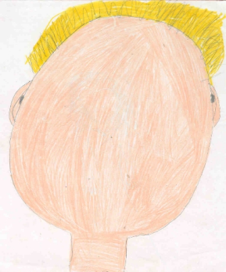
REM:
“units of analysis”
in the case of your
Forum Discussion activity,
"How 'ya doin' with the nutrients?“
the unit of analysis is one person,
and that individual is YOU . . .

Slide 33
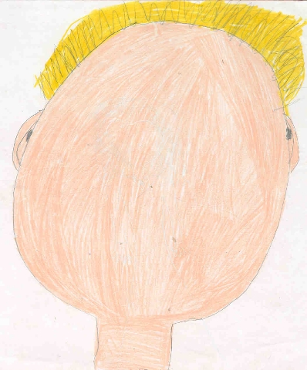
“units of analysis” may include:
one person
the family
the community
a region
a “culture area”
a culture / “subculture”
a nation
an item or action itself
a “cultural metaphor”

Slide 34
Main Characteristics
“24-hour diet survey”
diet records
(self-reported, diary)
“food frequency questionnaire” (recorded retrospectively)
1. culture as a primary concept
2. comparative method as major approach to the study of human behavior
3. holism or the study of "humankind" as a whole, as a primary theoretical goal
4. fieldwork as a primary research technique, involving “participant observation” = how you get information
doing a 24-hour diet survey,
your task for the
Forum Discussion:
"How 'ya doin' with the nutrients?“
while you are doing this survey
note how difficult the task is,
and what the quality of the final “data” might be
= tool
after Marion Nestle, Food Politics, Rev. Ed., 2007, pp. 401-405

Slide 35
As Marion Nestle points out,
One of the “ . . . most frequently used methods for directly determining dietary intake [is to] ask people to report what they ate or drank in the previous day
(24-hour diet survey, reported retrospectively). . . .”
-- Food Politics, p. 403

Slide 36
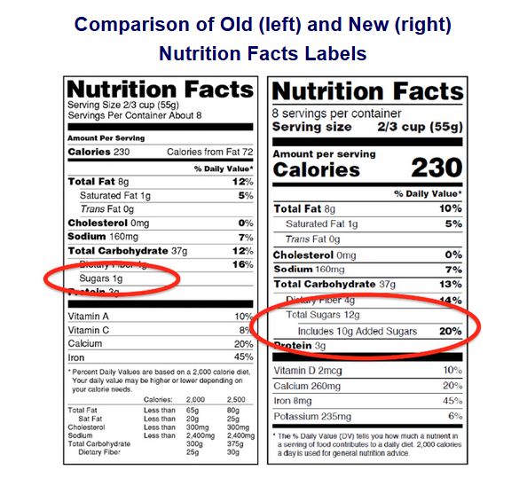
so have a look at the Forum Discussion,
and carry on with your “24-hour diet survey”

Slide 37
and be sure to also have a look at the slide set on “Human Nutrient Needs”
The Cultural Feast, 2nd Ed., p. 4

