Slide 1

use your up/down arrow keys and/or
your space bar to advance the slides
Federal Agencies
Regulating Food
Anthropology of Food
University of Minnesota Duluth
Tim Roufs ©2010-2024

Slide 2
Federal Agencies
Regulating Food
Anthropology of Food
University of Minnesota Duluth
Tim Roufs ©2010-2024

Slide 3

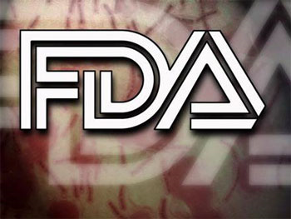


a primer on . . .

Slide 4
The 1992 USDA food pyramid

Slide 5
the United States
Department of Agriculture
is known widely
for its “food guide pyramid” . . .
one of the
most recognized logos in the world
The 1992 USDA food pyramid

Slide 6
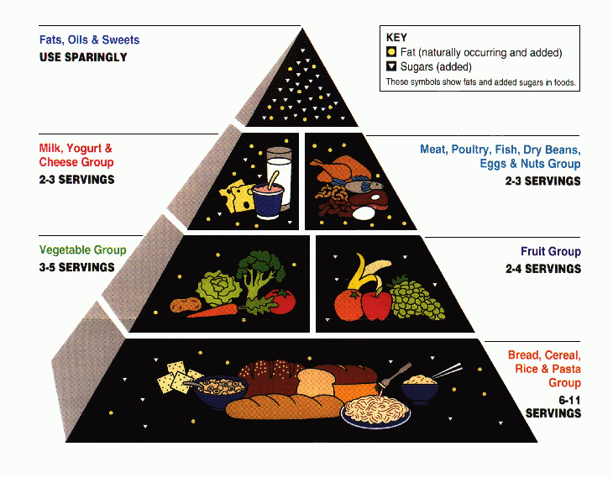
this is the old (1992) version
the 1992 “Food Guide Pyramid”

Slide 7
the 1992 Food Guide Pyramid
was replaced by
MyPyramid
on 19 April 2005

Slide 8
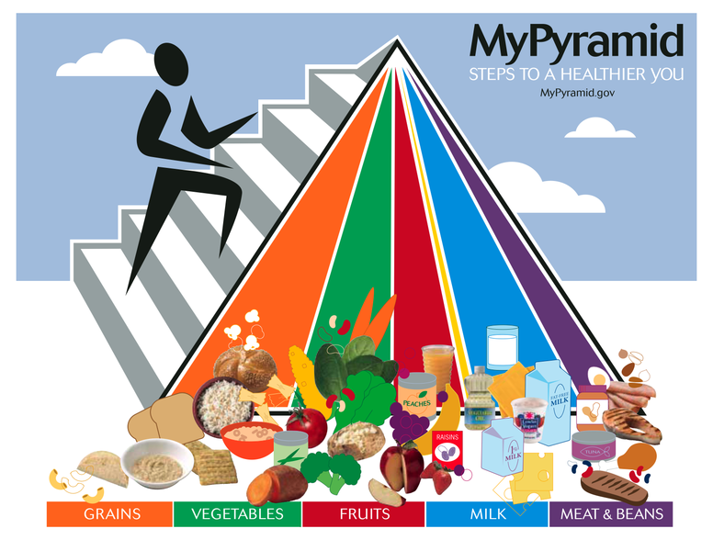
The 2005 USDA food guide pyramid

Slide 9
the 2005 MyPyramid
was replaced by
MyPlate
on 2 June 2011

Slide 10
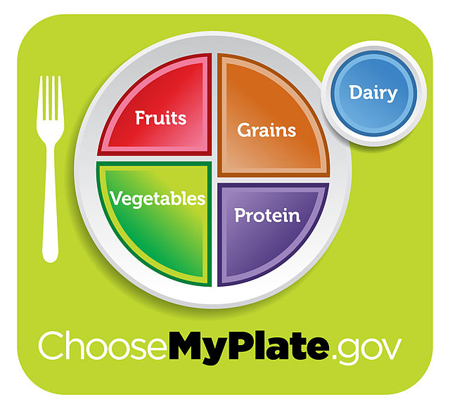
MyPyramid was replaced by MyPlate on 2 June 2011

Slide 11
Inflatable USDA Food Pyramid
http://www.ethnicfoodsco.com/Japan/JapaneseFoodPyramid.htm

Slide 12
United States
Department of
Agriculture
Inflatable USDA Food Pyramid
http://www.ethnicfoodsco.com/Japan/JapaneseFoodPyramid.htm

Slide 13
by law, the primary mission of the USDA is to promote U.S. agriculture

Slide 14
not to be confused with
United States
Food and Drug Administration

Slide 15
the
United States
Food and Drug Administration
is responsible for regulating and supervising the safety of foods, dietary supplements, etc.

Slide 16
promotes
U.S.A.
agriculture
regulates
U.S.A.
food safety
Inflatable USDA Food Pyramid
www.ethnicfoodsco.com/Japan/JapaneseFoodPyramid.htm

Slide 17
. . . and, in addition, . . .

Slide 18
EPA
. . . The EPA is charged with related things like . . .
http://en.wikipedia.org/wiki/Epa

Slide 19
protecting U.S.A.
human health
and the
environment
EPA
http://en.wikipedia.org/wiki/Epa

Slide 20
promotes
U.S.A.
agriculture
regulates
U.S.A.
food safety
and in addition
there is the

Slide 21
which is charged to
protect U.S.A.
human health
and the
environment
promotes
U.S.A.
agriculture
regulates
U.S.A.
food safety

Slide 22
e.g., Factory Farming
(CAFOs)
has environmental impacts
and health risks . . .
EPA
http://en.wikipedia.org/wiki/CAFO

Slide 23
e.g., Factory Farming
(CAFOs) and decisions affect
animal welfare,
food ethics . . .
EPA
http://en.wikipedia.org/wiki/CAFO

Slide 24
is charged to
protect U.S.A.
human health
and the
environment
EPA
but . . .
http://en.wikipedia.org/wiki/Epa

Slide 25
is charged to
protect U.S.A.
human health
and the
environment
EPA
but . . .
a big question for them is . . .
http://en.wikipedia.org/wiki/Epa

Slide 26
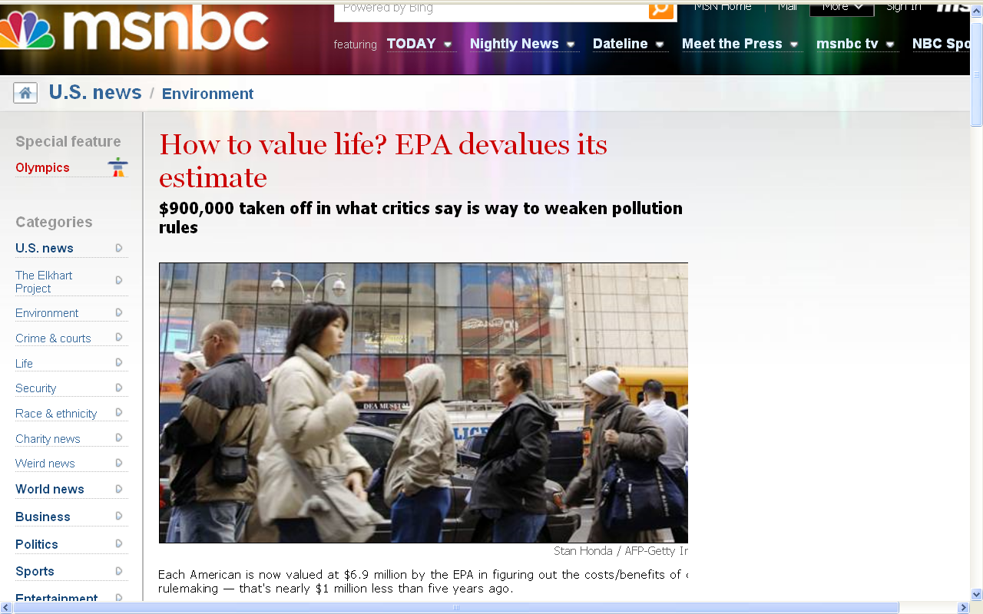
10 July 2008
http://www.msnbc.msn.com/id/25626294/

Slide 27
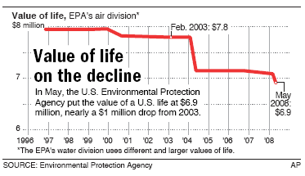
10 July 2008
http://www.msnbc.msn.com/id/25626294/

Slide 28
10 July 2008
human life
was officially devalued $900,000
by the G. W. Bush
Administration
http://www.msnbc.msn.com/id/25626294/

Slide 29
10 July 2008
So what?
http://www.msnbc.msn.com/id/25626294/

Slide 30
10 July 2008
“The the EPA figure is not based on people's earning capacity, or their potential contributions to society, or how much they are loved and needed by their friends and family — some of the factors used in insurance claims and wrongful-death lawsuits.
Instead, economists calculate the value based on what people are willing to pay to avoid certain risks, and on how much extra employers pay their workers to take on additional risks.”
http://www.msnbc.msn.com/id/25626294/

Slide 31
10 July 2008
“Though it may seem like a harmless bureaucratic recalculation,
the devaluation has real consequences.”
http://www.msnbc.msn.com/id/25626294/

Slide 32
10 July 2008
“Dan Esty, a senior EPA policy official in the first Bush administration and now director of the Yale Center for Environmental Law and Policy, said that ‘it's hard to imagine that it has other than a political motivation.’"
http://www.msnbc.msn.com/id/25626294/

Slide 33
10 July 2008
“When drawing up regulations, government agencies put a value on human life and then weigh the costs versus the lifesaving benefits of a proposed rule. The less a life is worth to the government, the less the need for a regulation, such as tighter restrictions on pollution.”
http://www.msnbc.msn.com/id/25626294/

Slide 34
10 July 2008
“Consider, for example, a hypothetical regulation that costs $18 billion to enforce but will prevent 2,500 deaths. At $7.8 million per person (the old figure), the lifesaving benefits outweigh the costs. But at $6.9 million per person, the rule costs more than the lives it saves, so it may not be adopted.”
http://www.msnbc.msn.com/id/25626294/

Slide 35
And, in addition, there’s . . .

Slide 36
to the list
federal regulators
you must also add

Slide 37
is charged to
protect U.S.A.
human health
and the
environment
promotes
U.S.A.
agriculture
regulates
U.S.A.
food safety
and to the
federal regulators
you must also add

Slide 38
is charged to
protect U.S.A.
human health
and the
environment
promotes
U.S.A.
agriculture
regulates
U.S.A.
food safety
Centers for Disease Control and Prevention
“works to protect public health and safety by providing information to enhance health decisions”

Slide 39
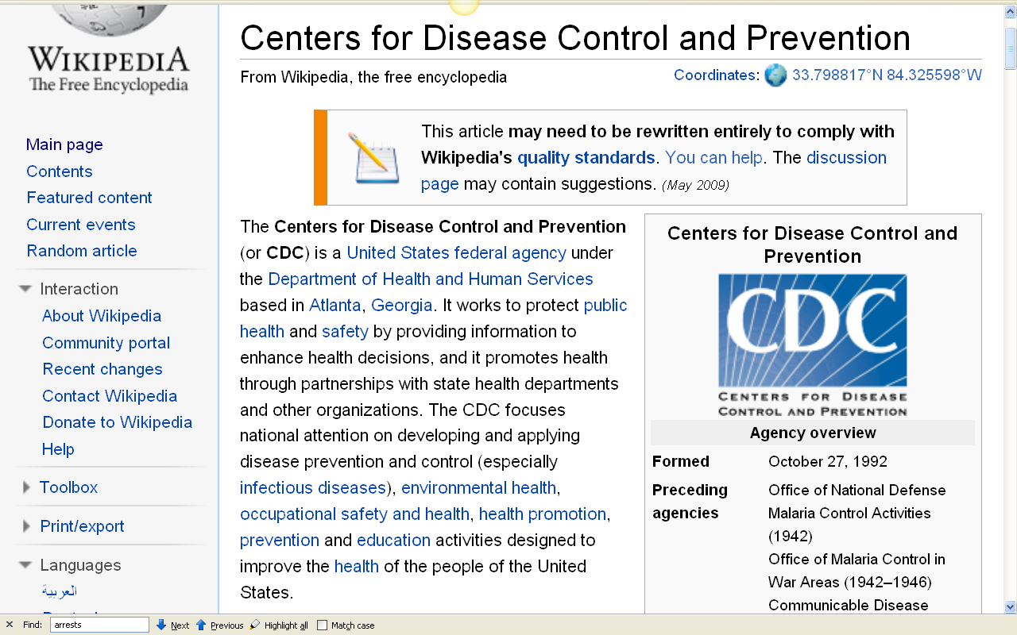
10 July 2008
http://en.wikipedia.org/wiki/Centers_for_Disease_Control_and_Prevention

Slide 40
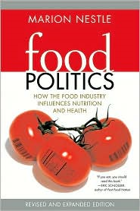
is charged to
protect U.S.A.
human health
and the
environment
promotes
U.S.A.
agriculture
regulates
U.S.A.
food safety
an excellent work that sorts all of this out is Marion Nestle’s
Food Politics
(see more below)
Centers for Disease Control and Prevention
“works to protect public health and safety by providing information to enhance health decisions”

Slide 41
is charged to
protect U.S.A.
human health
and the
environment
and, of course,
The United States
Supreme Court
overrides everybody . . .
promotes
U.S.A.
agriculture
regulates
U.S.A.
food safety
Centers for Disease Control and Prevention
“works to protect public health and safety by providing information to enhance health decisions”

Slide 42
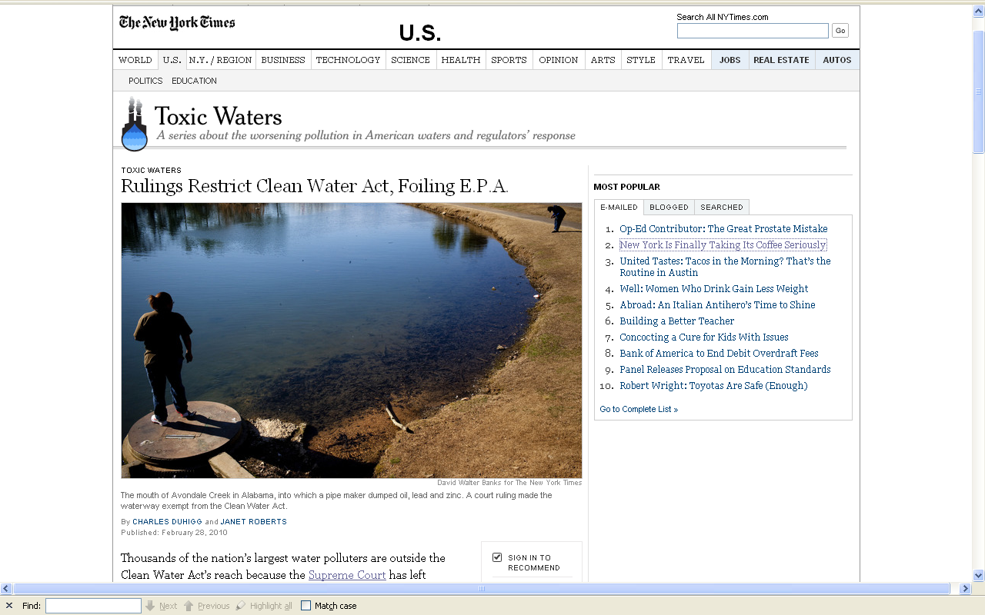
for e.g.,
10 July 2008
http://www.nytimes.com/2010/03/01/us/01water.html?th&emc=th

Slide 43
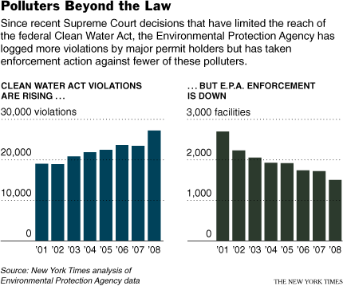
and results . . .
10 July 2008
http://www.nytimes.com/2010/03/01/us/01water.html?th&emc=th

Slide 44
and results . . . more violations and fewer enforcement actions . . .
10 July 2008
http://www.nytimes.com/2010/03/01/us/01water.html?th&emc=th

Slide 45
10 July 2008
“When drawing up regulations, government agencies put a value on human life and then weigh the costs versus the lifesaving benefits of a proposed rule. The less a life is worth to the government, the less the need for a regulation, such as tighter restrictions on pollution.”
http://www.msnbc.msn.com/id/25626294/

Slide 46
. . . and when tighter restrictions on pollution are attempted the affected parties [legally] fight the regulations to
the US Supreme Court.
Net result:
the USDA
and the FDA
and the EPA
and the CDC
[fill in the blank __________________]
10 July 2008
http://www.msnbc.msn.com/id/25626294/

Slide 47
So almost continually the questions of food and food safety and food security and environmental protection, and law, and marketing practices, and personal and corporate freedom (and, occasionally, responsibility), and basically you name it,
are rife with politics . . .

Slide 48
And all of these agencies have individual (often competing) jurisdictions, and none have responsibility for the whole, except, the Supreme Court.
politics reigns . . .

Slide 49
And with the infamous
“revolving door” practices
in Washington, many of these agencies are headed by and staffed with individuals who have come from the very industries and organizations that they are charged with regulating
(independent of which party is in office) . . .

Slide 50
Some interesting information
to think about . . .

Slide 51
$140,083,441
+
$193,508,666
=
$333,509,107
(That’s over a third of a billion dollars, not including political contributions to state candidates, or state lobbying efforts.)

Slide 52
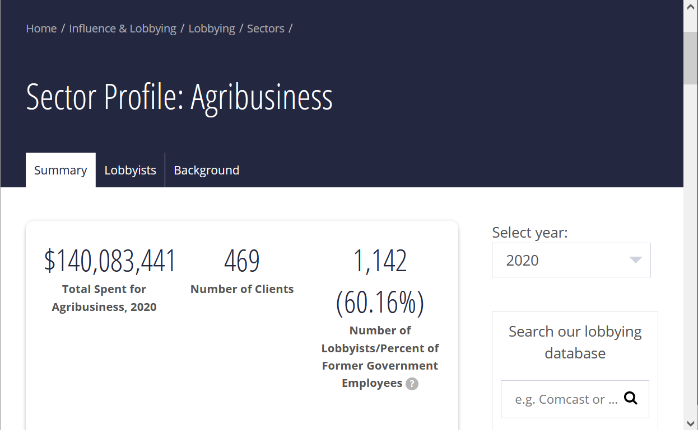







Agribusiness Lobbying 2020
check it out yourself at
https://www.opensecrets.org/federal-lobbying/sectors/

Slide 53
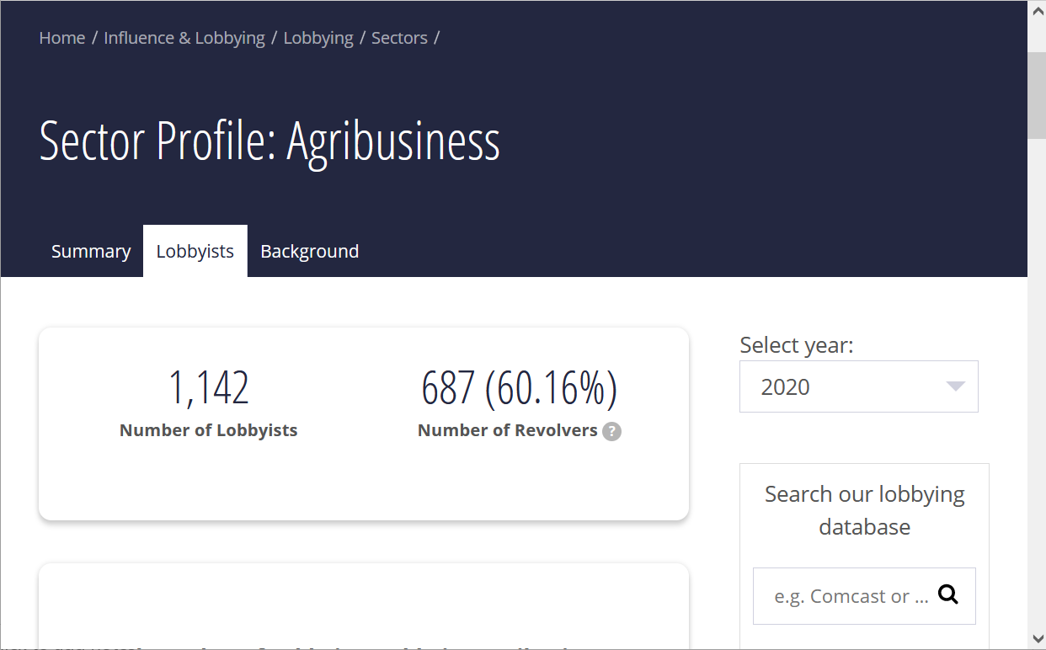

Agribusiness “Revolvers” 2020
check it out yourself at
https://www.opensecrets.org/federal-lobbying/sectors/

Slide 54
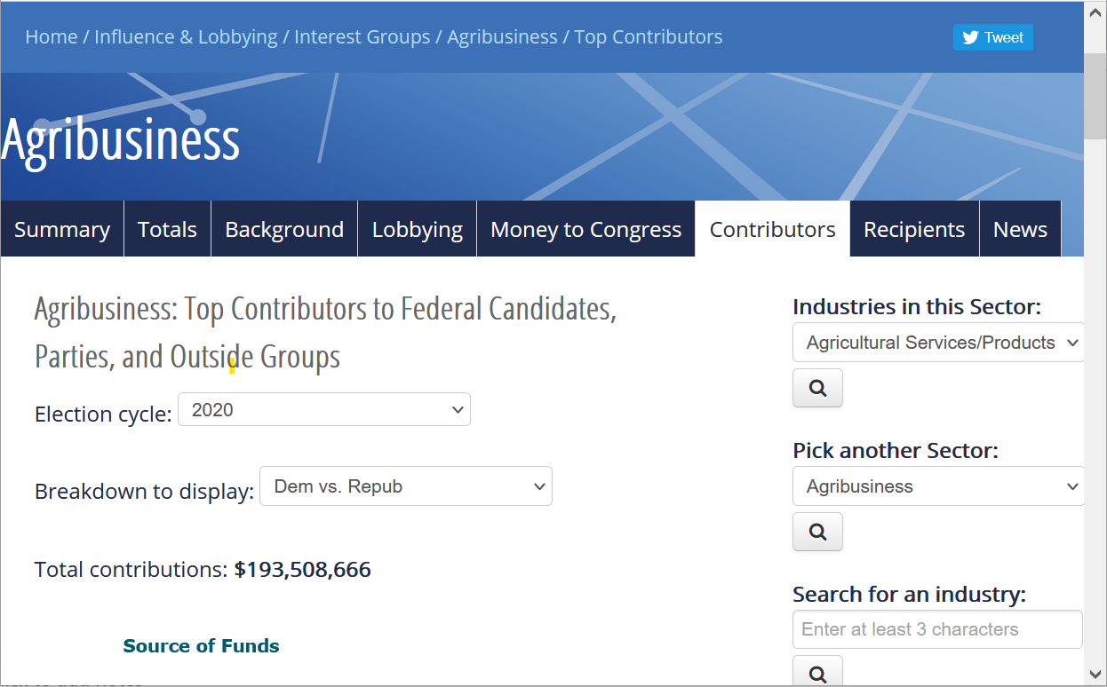

Agribusiness Federal Political Contributions 2020
check it out yourself at
https://www.opensecrets.org/

Slide 55
an excellent treatment of this question can be found in . . .
Marion Nestle
Food Politics: How the Food Industry Influences Nutrition and Health
University of California Press 2007

Slide 56
Marion Nestle
Food Politics: How the Food Industry Influences Nutrition and Health
University of California Press 2007
Marion Nestle provides one of the best discussions
— perhaps THE best discussion—
of those sorts of matters, and of the USDA
(including the politics of milk and lactose intolerance)

Slide 57
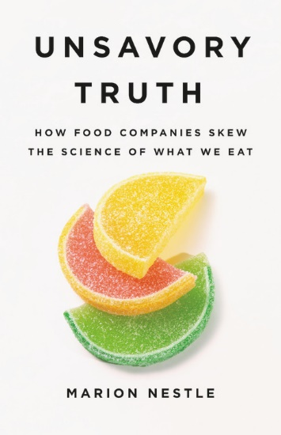
Marion Nestle
Unsavory Truth: How Food Companies Skew the Science of What We Eat
Basic Books 2018
“America's leading nutritionist exposes how the food industry corrupts scientific research for profit”

Slide 58
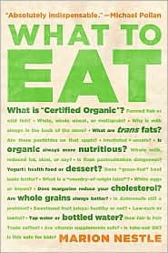
and . . .
Marion Nestle
What to Eat
North Point Press
2007

Slide 59
Check out
what Marion Nestle
has to say about it all . . .

Slide 60

Marion [No-Relation-to-the-Company] Nestle

Slide 61
use your up/down arrow keys and/or
your space bar to advance the slides
Federal Agencies
Regulating Food
Anthropology of Food
University of Minnesota Duluth
Tim Roufs ©2010-2024

