Slide 1
Deployment and Field Testing of Novel Water and Ice Sensor Systems on Bridge Decks
John F. Evans
Dept. of Chemistry and Biochemistry Swenson College of Science and Engineering University of Minnesota Duluth
Goals: Robust, Low Cost Sensors for Snow and Ice Detection
Technological Background: Time Domain Reflectometry
Engineering Approach: Plan for Implementation, Including Remote Deployment
Progress to Date

Slide 2
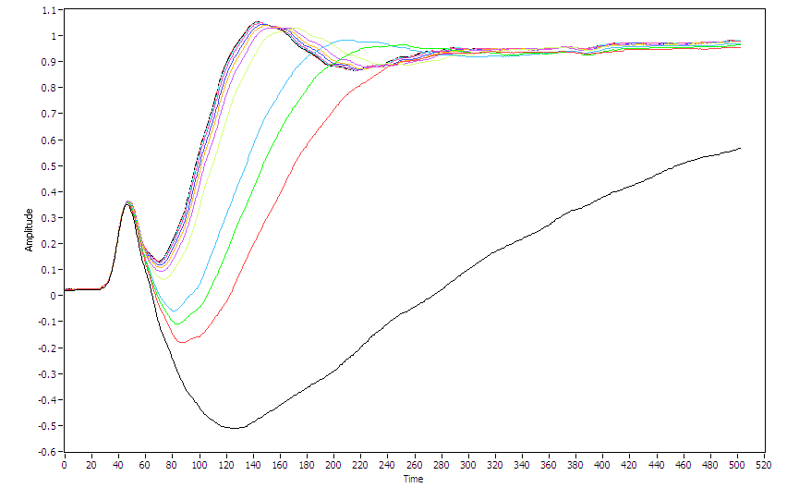
Ice
Water
Experiment conducted in Duluth lab (UMD Chemistry Department) on 4/9/10, Data sent to PI in Florida via cell phone in real time, Data analyzed in real time in Florida. Above shows captured waveforms during freezing cycle.

Slide 3
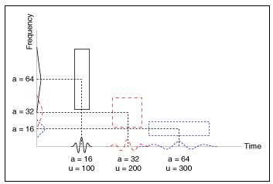
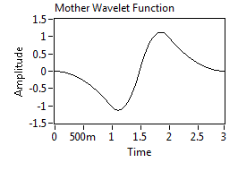
Advanced Signal Processing Techniques: Wavelet Filtering
Wavelet filtering allows the separation of the low and high frequency content of a signal.
Low-frequency signals require fine frequency resolution whereas high-frequency signals require fine time resolution during transformation to time-frequency domain.
The mother wavelet function used in our analysis.
The sharp peaks and non-periodic character of our waveforms make them good candidates for wavelet analysis as opposed to related techniques, such as the Fourier transform, which is more suitable for handling periodic signals.

Slide 4
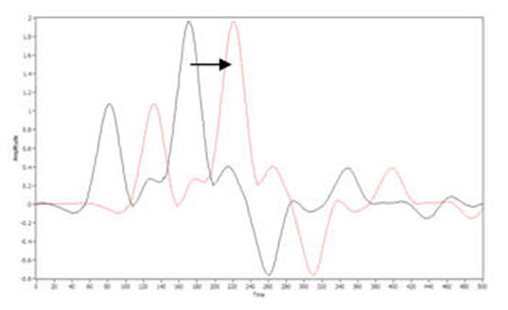
Regress Derivative Against Derivative
Of Standard
R²_{der}
Low f
Regress Low Freq Against Low Freq
Of Standard
R²_{lf}
Apply Wavelet Filter
Regress High Freq Against High Freq
Of Standard
R²_{hf}
High f
0 < FOM < 3

Slide 5
Scores from remote data processing showing detection of water to ice transition. Real time data regressed against previously acquired standards.

Slide 6
Prime Number Lengths Incorporated Into Sensor Designs
Allow for Constructive and Destructive Interference

Slide 7
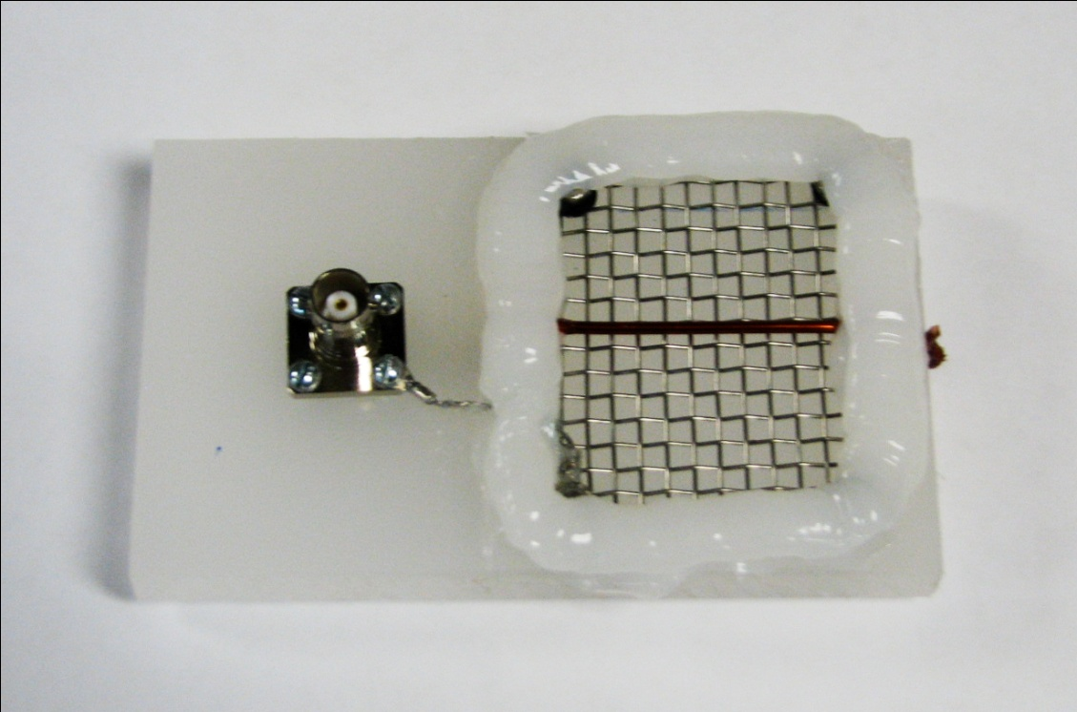
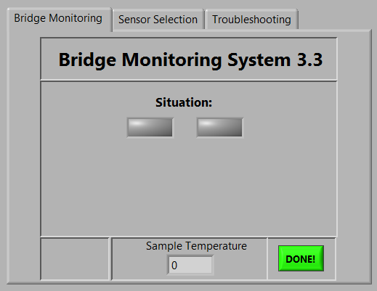
Revised Sensor Design
Revised Software

Slide 8
Goals: Vision for Distributed Systems
Direction of Traffic Flow
state response
Individual sensor
Local data acquisition system (data logger)
Communication link to central processing station

Slide 9
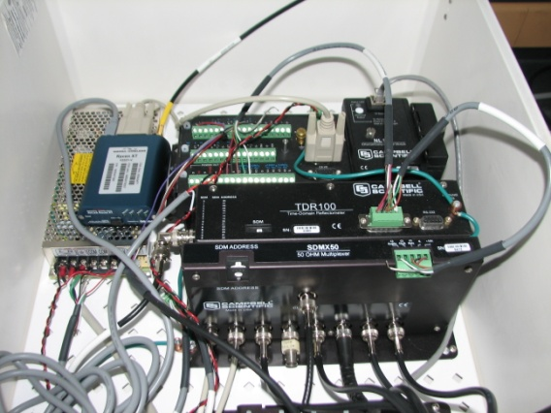
Deploy and test software and hardware for remote sensing system => Done!!
TDR
M P X
~$12K / bridge deck
Deployed Sensors
Cell Phone Communication
Central Processing Station

Slide 10
Tasks
Task 1: Sensor Redesign per Mn/DOT Requirements for Deployment
This task will involve a final redesign of our prototype sensor to meet installation requirements of the D-1 Mn/DOT engineers, so that they may be installed in a bridge deck in Task 2.
Deliverable: Summary of design and performance of deployable sensor.
Duration: 2 months
Task 2: Installation of Sensors and TDR System with Remote Power and Connectivity
This task will involve working with Mn/DOT personnel to deploy a system of eight multiplexed sensors and the complete TDR system to a bridge deck near Duluth, MN.
Deliverable: None.
Duration: 2 months
Task 3: Evaluation of Remote System performance over the Winter Season 2010-11
This task will involve continual evaluation of system performance relative to weather and road surface conditions for the coming winter season.
Deliverable: Report of deployed system performance.
Duration: 8 months
Task 4: Draft and Final Report Completion: A draft final report will be prepared following the ITS publication guidelines to document project activities, findings and recommendations. This report will be submitted through the publication process for technical and editorial review. A revised final report incorporating the review comments will be prepared and submitted for publication.
Deliverable: Draft and final reports
Duration: 6 months

