Slide 1
Developing an Intelligent Decision Support System for the Proactive Implementation of Traffic Safety Strategies
Hongyi Chen, Ph.D.
Assistant Professor
Mechanical and Industrial Engineering Department
University of Minnesota Duluth

Slide 2
The Research Problem
Goal: Continuously improving transportation safety and reducing crash rate through the implementation of traffic safety strategies
Challenges:
The implementation and maintenance of these strategies represents significant investment
Resources ($) are always limited
Research Question:
How to effectively and proactively implement the traffic safety strategies so that the overall improvement to the transportation safety is maximized while the total implementation and maintenance cost is minimized/under budget?

Slide 3
Research Objectives
Develop an algorithm to assess the effectiveness of a combination of safety strategies in reducing crash rate under various road and weather conditions.
Explore research methods to identify and assess the dependencies of safety improvements implemented in related locations
Develop an optimization model for systematic implementation of traffic safety strategies considering the dependencies.
Develop an intelligent decision support system based on the above algorithms and models. This system will have a GIS based user interface.

Slide 4
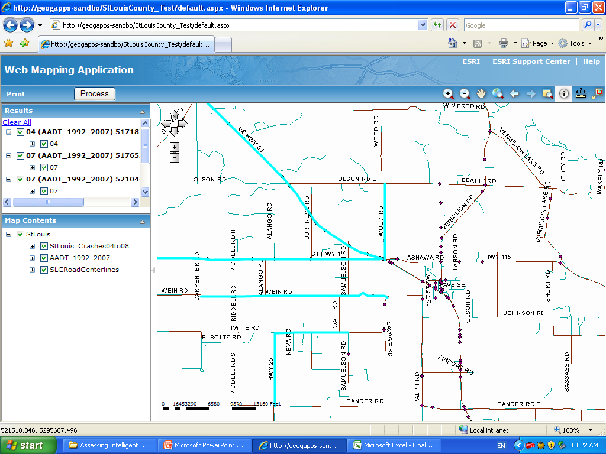
Decision Support System (1/4)
Next

Slide 5
Decision Support System (2/4)
ITS Strategies to Implement
LCPSI Strategies to Implement
Application Category
Road Geometry
Warning
Name
LCPSI 1
LCPSI 2
LCPSI 3
LCPSI 4
LCPSI 5
LCPSI 6
Name
ITS 1
ITS 2
ITS 3
ITS 4
ITS 5
ITS 6
Add
Add
Total Budget ($k)
210
Suggest

Slide 6
Decision Support System (3/4)
Sensitivity Analysis
Find Alternate Solution
Go Back to
Change Strategies
Total Budget ($k)
210

Slide 7
Decision Support System (4/4) -- ITS and LCPSI Strategies Implementation Data Base
Strategies Implemented
Location Implemented
ITS/LCPSI
County/City
Application Category
Road segment
Name
Intersection
Enter Notes here:
Click to Add New Strategies
Click to Add New Locations

Slide 8
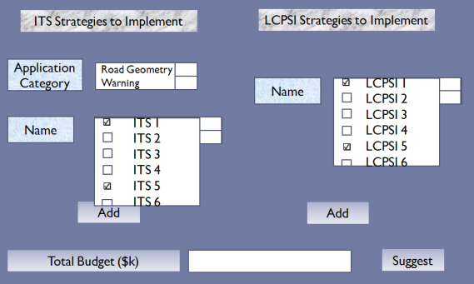
The Final Product to be Delivered
Data
Assessment Algorithm
Optimization Model
Crash modification functions, Dependence functions.
Other Information:
Cost, economic impact, etc.

Slide 9
Progress Update
Literature review
Research papers
The white papers for Safety Analyst software tool
Highway safety manual workshop slides
On going
Development of the algorithm
Mathematical analysis and proofs of the EB and Hauer’s coherent method
Hwy. 169 project
Data collection
Model designed for the before and after study and the optimization
GIS based software
Road segment prioritization
Working on intersection prioritization

Slide 10
Questions and Suggestions

Slide 11
Back Up Slides

Slide 12
N_{predicted}=N_{base condition}*[CMF₁*CMF₂*…*CMF_{n}]
Examples
Treating a rural highway for run-off-the-road crashes
Widening shoulder (CMF₁=0.8)
Install guardrails (CMF₂=0.8)
CMF_{1&2}=0.64?
Treating a horizontally curved road
Install speed limit signs
Straighten the road
Do both?

Slide 14
Technical Approach
Statistical Analysis and Operations Research
Empirical Bayes (EB) approach
Before and after
Treated and untreated
Conditional probability theory
Regression analysis
Integer linear programming

