Slide 1
Development of a Portable Work Zone
Traffic Safety Information System
using DSRC Based V2I and V2V Communication
M Imran Hayee, Ph. D.
ECE Department, University of Minnesota Duluth

Slide 2
Outline
What has been accomplished?
  Phase I
  Phase II
What is currently being accomplished?
  Phase III
What could be possible next phase?

Slide 3
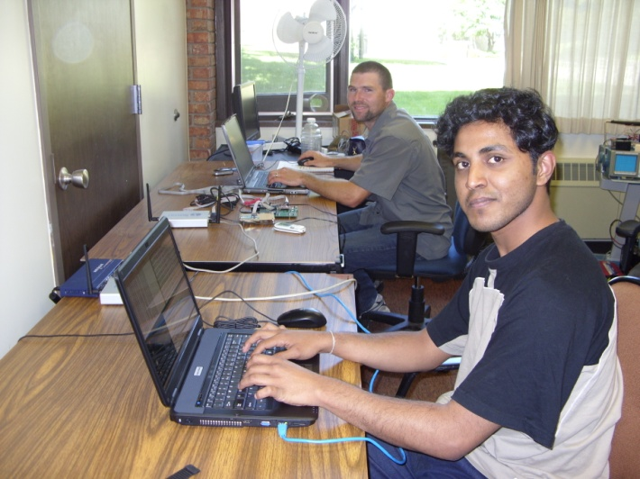
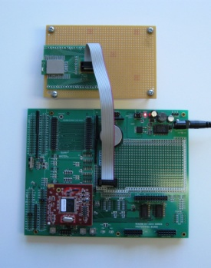
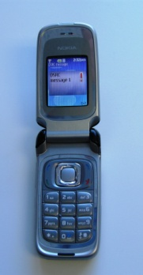
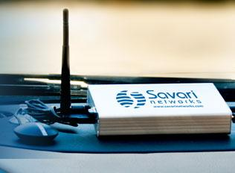
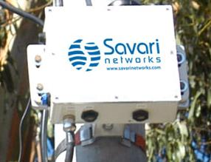
What Has Been Done? – Phase 1
Year: 2008 - 2009
BT enabled
Cell Phone
DSRC
RSU or OBU
CID
DSRC-OBU
MNDOT
Infrastructure
This system was developed and demonstrated in the field
Currently the Bluetooth enabled cell phone gets text messages

Slide 4
What Has Been Done? – Phase 2
Portable DSRC Based V2I Information System
Year: 2009 - 2010
Start of
Congestion
(varying)
Vehicle passing
Through
congested area
End of
Congestion
Distance to SoC
Vehicle approaching
Congested area
DSRC-OBU
Work Zone
DSRC-OBU
DSRC-RSU
SoC location and TT Broadcast from RSU
Two way DSRC communication to
acquire safety and traffic data
It was developed and successfully demonstrated in the field.
Can acquire in real time, important travel information e.g., TT and SoC location
Can communicate to the driver, both TT and distance to the SoC location
Uses BT enabled cell phone text messaging as user interface for the driver

Slide 5
System Setup
End of Congestion: Known
Start of RSU
Monitoring Range
Desired Location
Start of Congestion: Unknown
End of RSU
Monitoring Range
Work Zone Lane
RSU
Coverage range of RSU
RSU is placed such that the RSU monitoring range aligns with the end of the congestion.
At periodic intervals, a single OBU participation is requested by the RSU to monitor a vehicle’s speed and position through a congestion area.
RSU sends traffic alert message to OBUs indicating travel time through monitoring area.

Slide 6
DSRC Communication Protocol
RSU
OBU
RSU
OBU
INVITE
ACCEPT
BROADCAST
CHOSEN
NOTIFY
RSU initiates the communication by sending an INVITE message requesting OBU participation.
Each OBU receiving the INVITE message screens itself using the information in INVITE message and if passes the screening, it will respond with the ACCEPT message.
The RSU will screen the incoming ACCEPT messages to ensure that the OBU is on the monitored road, and sends CHOSEN message to the originating OBU of the first ACCEPT message to pass.
OBU periodically communicates NOTIFY messages until EoC point approaching is detected, then RSU is alerted before OBU ceases to send further NOTIFY messages.

Slide 7
Detection Problems and Solutions

Slide 8
Field Testing
(a)
(b)
X
The location accuracy of the GPS is the most important factor when determining the possible error in measurements.
The location accuracy error in turn causes errors in distance and direction measurements.

Slide 9
GPS Distance Accuracy
Urban Area – accuracy is +/- 3 m
Rural Area – accuracy is +/- 2 m

Slide 10
GPS Direction Accuracy
A
B
A
B
 | 5 m | 10 m | 15 m
Direction Error | 30 degrees | 14 degrees | 10 degrees
Direction Error decreases if distance is increased

Slide 11
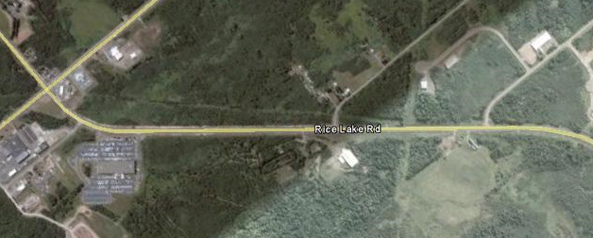
Field Demonstration
Start of Congestion: Unknown
End of Congestion: Known
Start of RSU
Monitoring Range
End of RSU
Monitoring Range
RSU
N
The field demonstration site was chosen at Rice Lake Rd, Duluth MN with the focus on providing a clear line of sight between RSU and the OBU.
The RSU is placed near the congestion end due to reduced range on one side due to signal blocking by back of the vehicle.

Slide 12
Traffic Safety Parameters
The traffic parameters - Start of Congestion location and the Travel Time are calculated by RSU
The update frequency is determined based upon the TT. If TT is larger, multiple vehicles are chosen at the same time to be monitored.

Slide 13
Field Demonstration Results
Congestion scenarios of varying start of congestion location and congestion depth were tested for different vehicle speeds.

Slide 14
What is Being Done? – Phase 3
The Range of the current system is limited to 1 km because of the DSRC antenna range. However the calculated traffic parameters of the system are more useful to the driver if its received earlier. Also congestion or a work zone area may exceed 1 km requiring more range to be covered.
In the current phase 3 (2010-2011), the objective is to utilize the V2V DSRC communication to the developed Portable Work-Zone Safety Message Relay System to
1. Increasing the Message Broadcast Range
2. Increasing the Work-zone Coverage Length

Slide 15
Increasing the Message Broadcast Range
1 km
Portable
DSRC RSU
1 km
1 km
V2I
V2I
V2V
V2V
We intend to increase the message broadcast range using V2V-assisted DSRC communication. To increase the message broadcast range, we propose to use the selected vehicles on the road approaching to work zone to help relay the traffic safety messages backwards to the vehicles following them, to achieve much longer message broadcast range without having an extensive DSRC roadside infrastructure.

Slide 16
Increasing the Work-zone Coverage Length
1 km
Portable
DSRC RSU
V2I
1 km
1 km
V2I
V2V
V2V
V2V
Similarly, we propose to use V2V-assisted communication to cover much longer work zones beyond the access range of one portable roadside DSRC unit. This will be accomplished with the help of selected vehicles present on the work zone well out of reach of the portable roadside DSCR unit to help facilitate V2V-assisted V2I traffic data exchange.

Slide 17
Progress of the Current Phase
Increasing the Message Broadcast Range
1. V2V communication.
2. Develop method for distance measurement adjustment vs. displacement.
3. Develop and test the V2V communication protocol for extended range.
4. Demonstrate the algorithm for distance adjustment in V2V environment
2. Increasing the Work-zone Coverage Length
1. Develop protocols for handling messages from other OBU’s in the OBU program.
2. Develop protocols for extending and contracting the monitored area.
3. Demonstrate the system in field.
Note: The green tasks have been done and the blue tasks are being worked on. The project is expected to finish in time (during June/July 2010 time frame)

Slide 18
Curve Fitting
Start of Congestion
Curved Road
Measured distance
Straight Road
The road curvature is statistically modeled by a polynomial fit, parameters of which can be communicated to the OBU so that it can adjust the measured displacement.

Slide 19
What Next?
1 km
Current: V2V assisted V2I
Portable
DSRC RSU
V2I
1 km
1 km
V2I
V2V
1 km
V2V
V2V
Portable
DSRC RSU
Pure V2V ?
V2I
1 km
1 km
V2I
V2V
V2V
V2V

