Slide 1
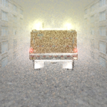
Snow Rendering for Interactive Snowplow Simulation Improving Driver Ability to Avoid Collisions When Following a Snowplow
Michele Olsen, Siddharth Deokar, and Peter Willemsen
Department of Computer Science
University of Minnesota Duluth

Slide 2
Research Objectives
Create knowledge to make winter driving safer
In snowing conditions
Following behind a snowplow can be dangerous!
Following cars can be dangerous!
Fog and snow complicate visual perception
Speed and motion detection likely misperceived!
Complicating factors are not well understood!
Through computer simulation environment
Better understand how we drive in snowing conditions
Attempt to reduce risk associated with following snowplows
Enable more effective training within snowing conditions

Slide 3
Winter Driving Simulation Framework Rear Lighting and Motion Detection Experiments

Slide 4
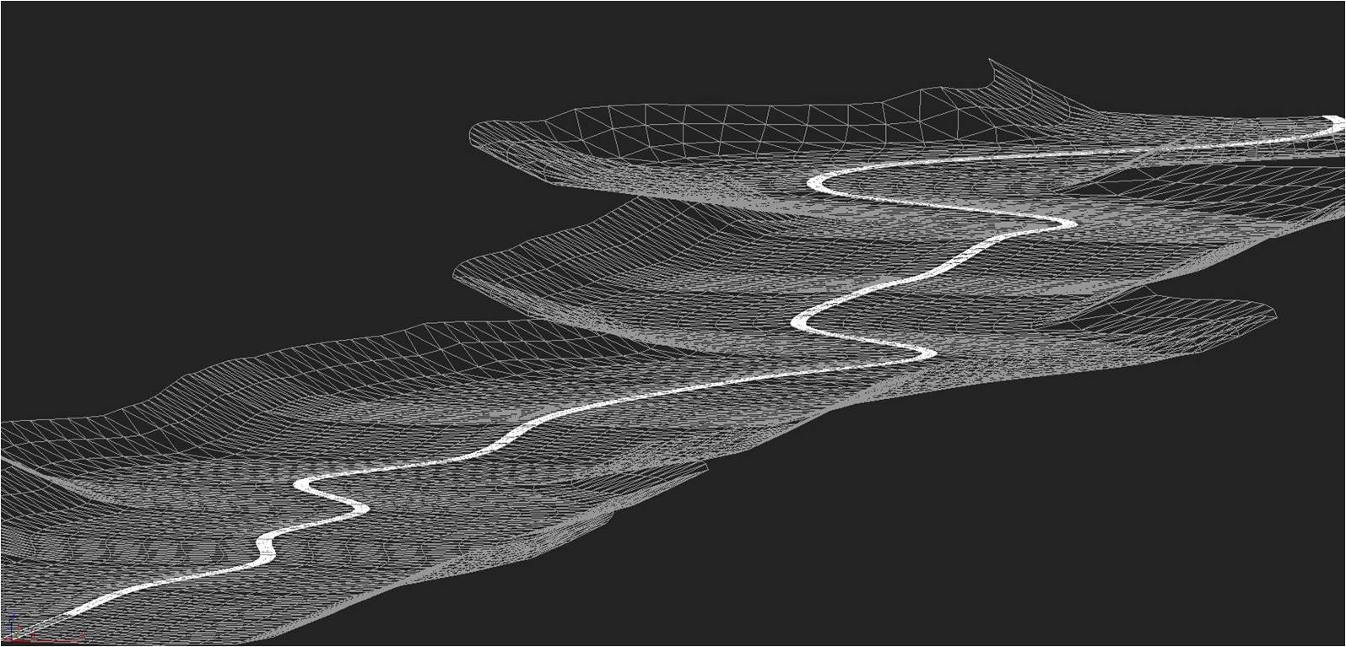
Winter Driving Simulation Framework
Subjects drive over 10km roadway following snowplow under varying low luminance contrast (fog) conditions, while rear lighting is varied to improve motion detection performance

Slide 5
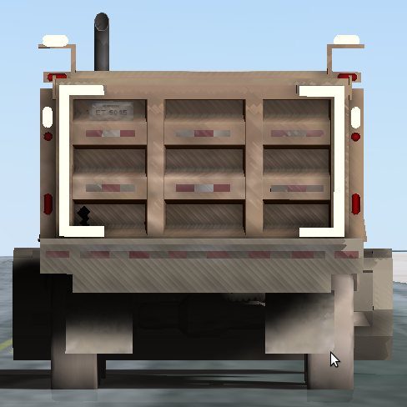
Experiment 1 – Do lights make a difference?
Compare alternative lighting configurations for improved reaction times
Flashing
Vertical Bars Only
Vertical Bars w/ Corners

Slide 6
Experiment 2 – Does enhancing contrast help
Compare best condition from Exp 1 with alternative scenarios that maximize contrast
Vertical Bars Best Condition from Previous Exp
Vertical Bars w/ Black Contrast

Slide 7
Ongoing Experiment – Distance vs. Orientation
With contrast enhanced lighting, try to generate knowledge for practical placement of lights.

Slide 8
Blowing Snow Simulation

Slide 9
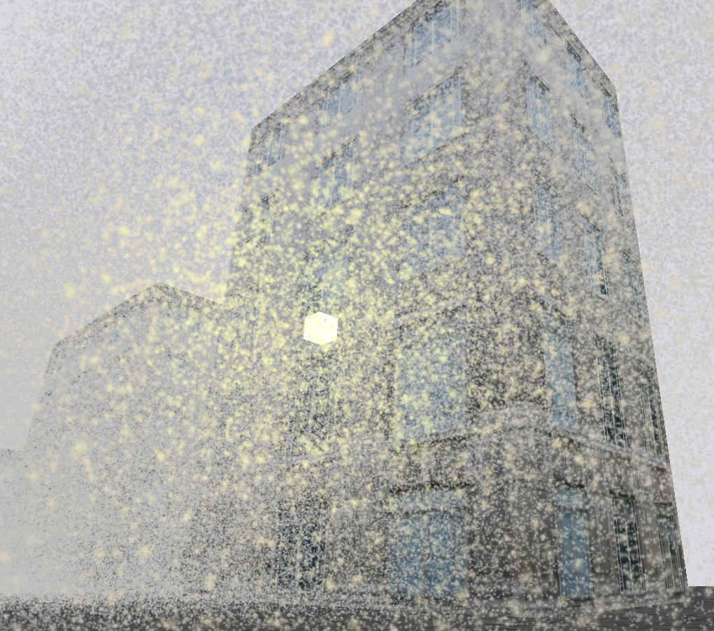
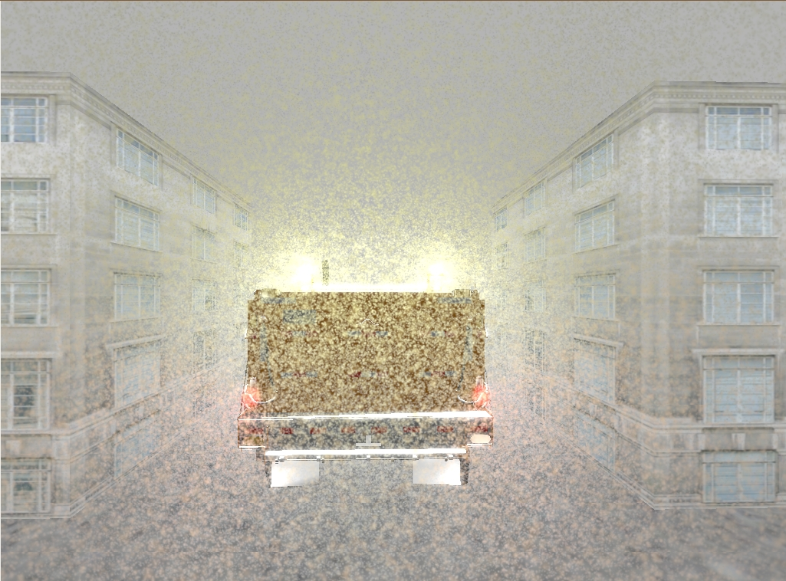
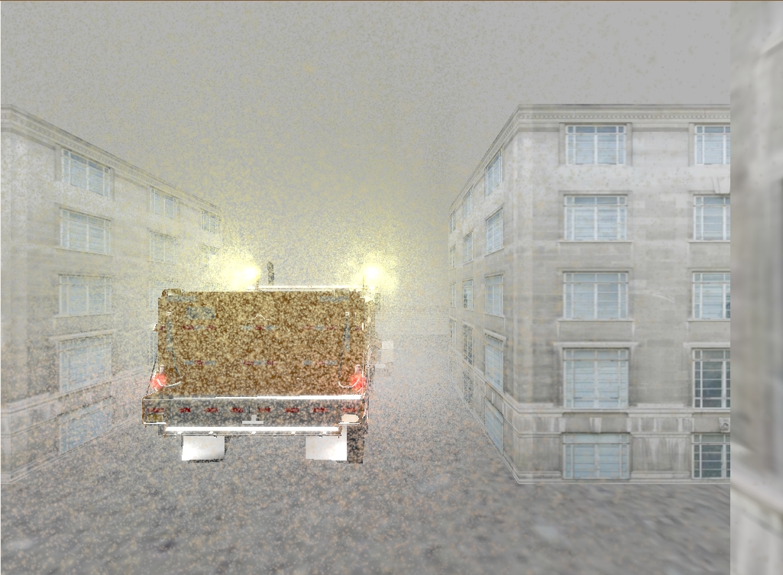
Current Results

Slide 10
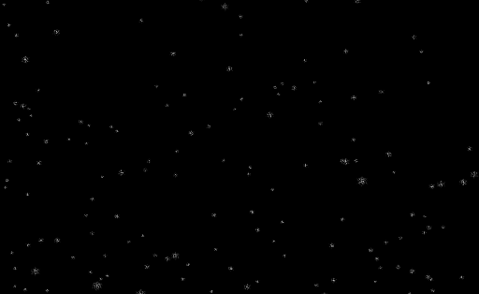
Snow Density Mapped to Visibility
Able to map visibility in real world to visibilty in simulation
Empirically calculated in simulation based on particle density and snow visual settings

Slide 11
Snow/Environment Interaction (Ongoing)
Refinement of geometry within simulation will improve interaction between blowing snow and snowplow
Implementing code base to deposit snow particles onto surfaces
E.g. windshields
Reduces visibility for drivers
Still work in progress

Slide 12
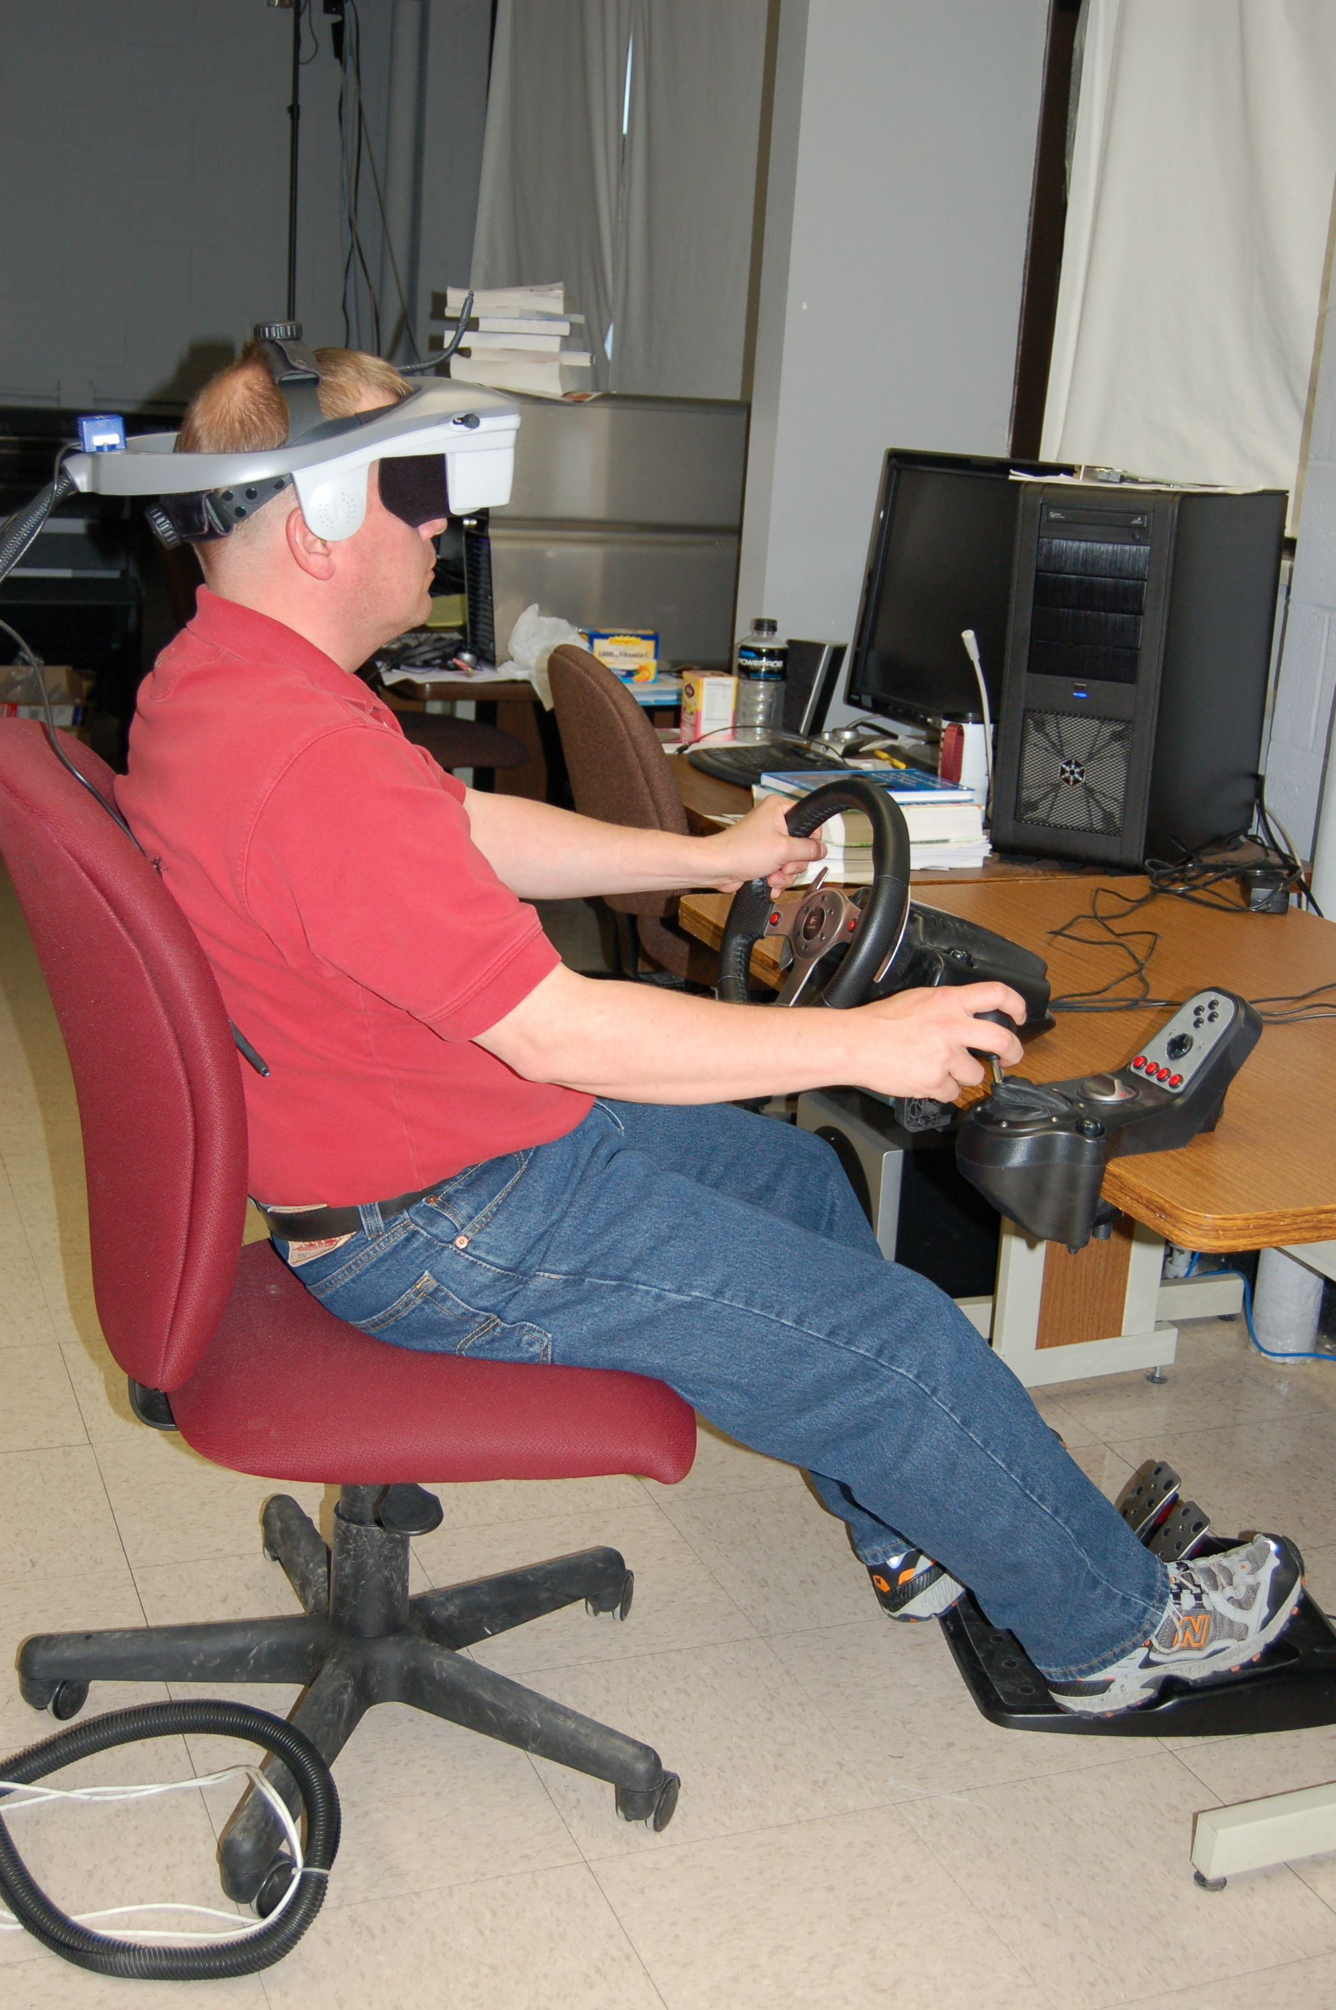
Forward Thinking Efforts
Complete integration of winter driving simulation framework with snowing model with VR Lab’s HMD
Refine outdoor light intensity model
Better model of daylight and nighttime lighting
Master’s student continuing this work
Investigating how blowing snow and fast dispersion modeling system could fit into MDSS
Maintenance Decision Support System
Live modeling of potential weather situations

Slide 13
Acknowledgements
Sara Erickson and Albert Yonas
Institute of Child Development, Department of Psychology
University of Minnesota
Daniel Schobert, Jennifer Carley
NATSRL, Eil Kwon

Slide 14
Comments?
Questions?

