Slide 1
Integrated Approach for Nonintrusive Detection of Driver Drowsiness
Xun Yu
Department of Mechanical and Industrial Engineering
University of Minnesota, Duluth

Slide 2
Project Background and Objective
Driver’s drowsiness is one of the major causes of deadly traffic accidents.
(NHTSA, more than 100,000 crashes are caused by drowsy drivers every year in the US)
Objective:
To detect driver drowsiness via biosensors on steering wheel.

Slide 3
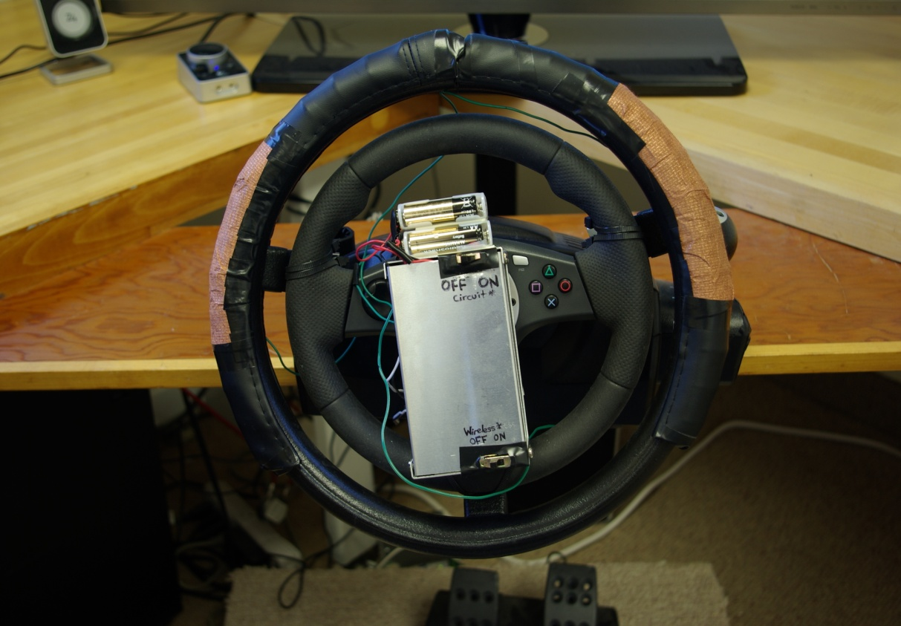
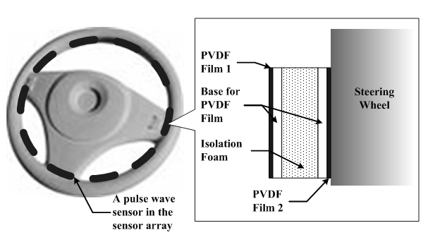
Previous Results
Heart rate measurement systems
- Method 1: using conductive fabric as electrodes to measure the electrocardiogram (ECG) signal
- Method 2: using piezo-polymer PVDF (polyvinylidene fluoride) films to measure the force aroused by the heart pulse wave signal

Slide 4
Previous Results
7 human subjects were tested on a driving simulator. HRV signal was analyzed and LF/HF ratio was chosen as the index of drive sleepiness stages.
The LF (low frequency)/HF (high frequency) ratio decreases with time, indicating a drowsiness trend.
However, LF/HF ratio has high variability and has different decrasing ratio for different drivers.

Slide 5
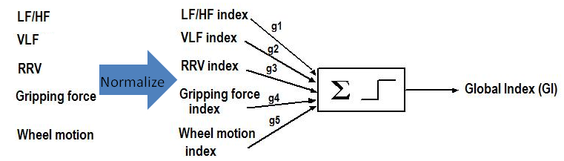
Proposed study
We propose to use multiple parameter to access the driver’s drowsiness
- LF/HF ratio of HRV signal, it will decrease with drowsiness
- VLF (very low frequency ) of HRV, it will decrease with drowsiness
- RRV (moving average of heart rate time-interval) of HRV signal, it
will increase with drowsiness
- Gripping force variability, it will decrease with drowsiness
- Steering wheel motion: steering angle and angular velocity phase will be used in this study for their high correlation with drowsiness.
Find these gains will be a major task of this study

Slide 6
System
Steering wheel signal
Heart pulse wave measurement
EEG Measurement as the “gold” standard

Slide 7
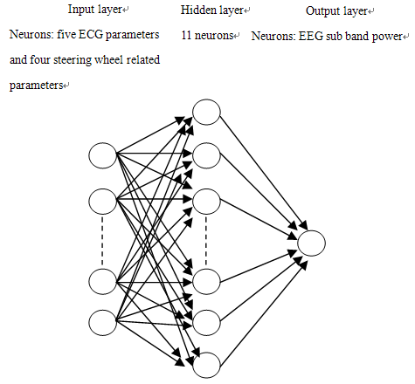
Correlation analysis between the EEG signal and ECG & steering wheel signal

Slide 8
Correlation analysis between the EEG signal and ECG & steering wheel signal
High correlation between EEG and the combined signal array!

Slide 9
Summary
The combined signal (ECG and steering wheel signal) has high correlation with EEG signal EEG signal is deemed as an accurate way of detecting driver drowsiness) → the combined signal could detect driver drowsiness more accurately that using ECG signal alone.
System modeling and tests are underway.

Slide 10
Intelligent Pavement for Traffic Flow Detection
Xun Yu, Ph.D
Department of Mechanical and Industrial Engineering
University of Minnesota Duluth

Slide 11
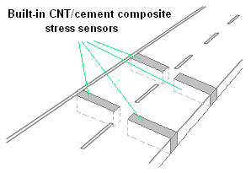
Objective and Research Approach
Enable the concrete pavement itself to have a sensing capability: traffic flow detection, pavement structural health monitoring, e.g., cracking detection.
Sections of a given roadway are paved with piezoresistive carbon-nanotube (CNT)/cement composites.
CNTs can also enhance the mechanical strength
Advantages:
Long service life and low maintenance cost
Spot and area detection possibilities for traffic flow behavior

Slide 12
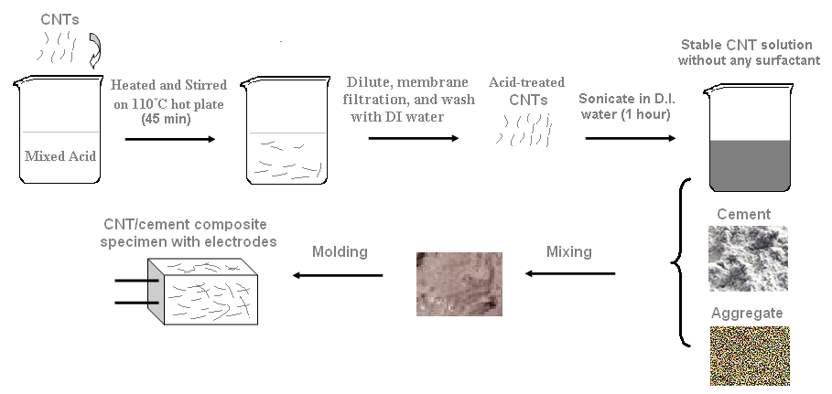
Experiments
Method #1: covalent surface modification with acid treatment
Method #2: non-covalent surface modification with surfactant,
Surfactants, such as sodium dodecyl sulfate (SDS) and dodecylbenzene sulfonate (NaDDBS), can be wrapped around the nanotubes, which in turn can render CNTs to be dispersed in water and mixable with cement

Slide 13
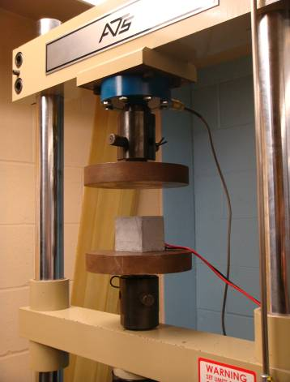
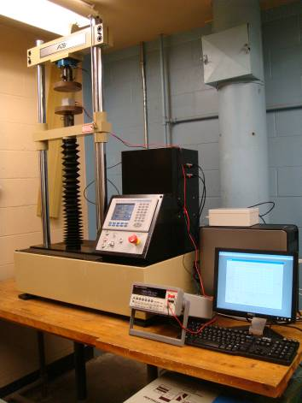
Lab Test
Experiment Set-up

Slide 14
Lab Test Results – Method #2 (NaDDBS)
CNT composite fabricated with method #2 (NaDDBS surfactant)
Piezoresistive response of the CNT/cement composite (CNT: 0.2 wt %)

Slide 15
Piezoresistive Response Mechanism
Several mechanisms can contribute to the composite’s piezoresistive property:
- Intrinsic CNT piezoresitive properties
- Contact resistance changes under stress
- Tunneling effect could be dominant (separation distance between CNTs decreases)
Nanotube
resistance
Matrix

Slide 16
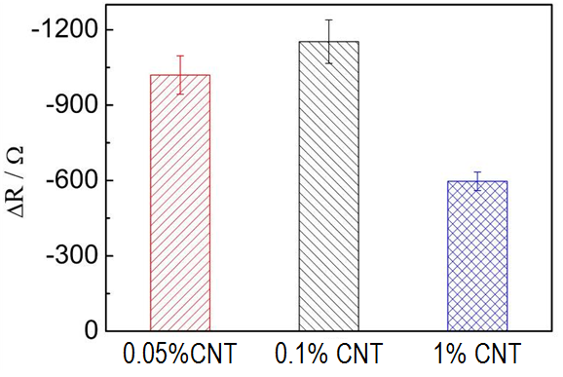
Effects of CNT doping level and water contend level
The piezoresitive sensitivity does not increase linearly with CNT doping level and water content level.
High CNT doping level can shorten the tunneling channel, but it will be stabilized if over the percolation threshold.
The field emission effect on the nanotube tip can be enhanced by the adsorption of water molecules

Slide 17
Future Challenges and Plan
Challenges:
Need effective large-scale CNT/cement composite fabrication methods
Need to study the piezoresistive response of CNT enhanced concrete (which has 15~20% of cement)
Configuration design for wide area detection
Work plan:
Address above challenges
Road tests
Explore the civil structural health monitoring application (working with Mn/DOT on a FHWA project)

Slide 18
Acknowledgement
Funding supported by the Northland Advanced Transportation Systems Research Laboratory, University of Minnesota Duluth, ITS of the University of Minnesota.
Dr. Eil Kwon
Dr. Baoguo Han (Research Associate in our group)

Slide 19
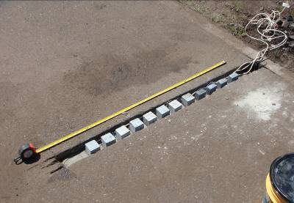
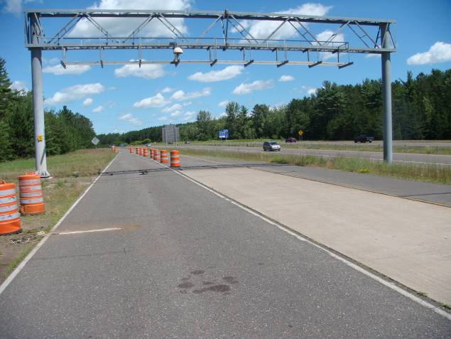
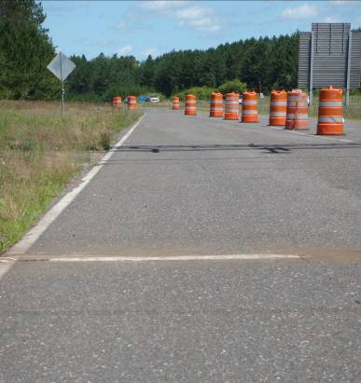
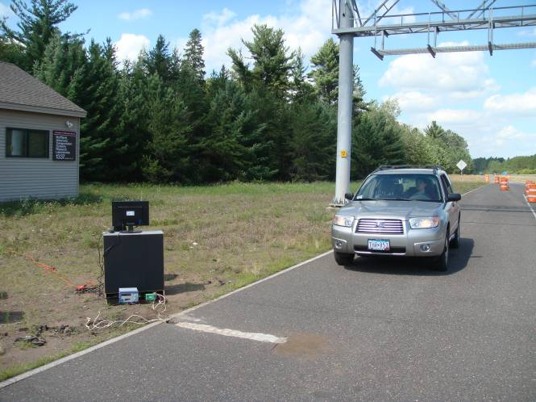
Road Test
Tested in NARSRL outdoor research facility
Embedded
Sensors
1.2m
Sensors array
We are dealing with some issues of sealing etc.

Slide 20
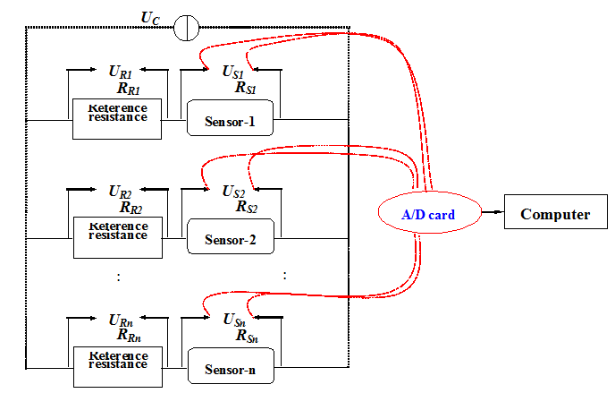
Road Test
Measurement system

Slide 21
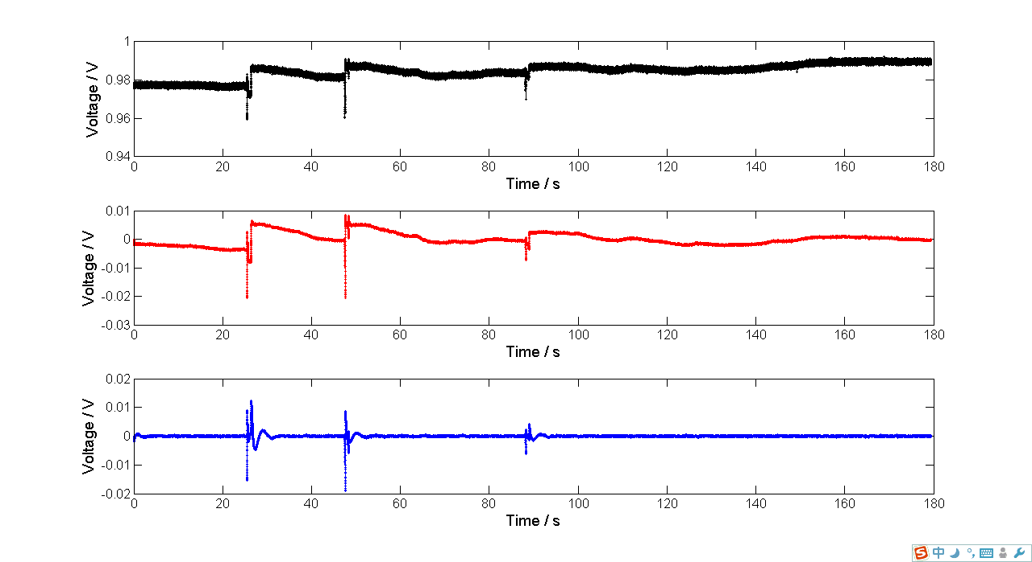
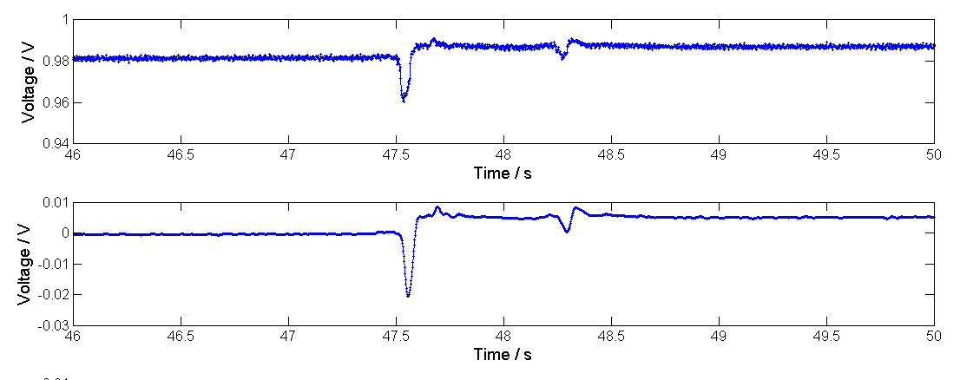
Road Test Results
From the Nickel-particle/cement self-sensing sensors

