Slide 1
Manual Web Accessibility Testing Laura Carlson z.umn.edu/manual-testing
Notes:
Hello, and welcome to my talk, “Manual Web Accessibility Testing”. My name is Laura Carlson. I'm happy to be contributing to the Accessibility Ambassadors today.
The slide deck, links, and references that we’ll cover in this session are all online. The link is z.umn.edu/manual-testing.

Slide 2
About Me
She/her pronouns
IT Professional, UMD ITSS
Began web accessibility work 1998
Invited Expert in the W3C's Accessibility Guidelines Working Group
Notes:
About Me: Let's not talk too much about me. Just a few details:
My pronouns are she/her.
I have shoulder length light brown hair, blue eyes, and glasses.
I am an IT Professional, with UMD’s Information Technology Systems and Services (ITSS).
I began web accessibility work 1998.
I’m an Invited Expert in the W3C's Accessibility Guidelines Working Group. That’s the group that authors the rules for W3C’s Web Content Accessibility Guidelines (WCAG), which serves as the accessibility standard for the University of Minnesota.

Slide 3
Agenda
What is manual testing?
How automated and manual testing complement each other.
Validating auto tool results
5 manual testing checks
Notes:
Agenda: In this session, we're going to talk a bit about:
What manual testing is
How automated and manual testing complement each other.
Validating auto tool results
Then I’ll share 5 manual checks.

Slide 4
Defining the Term: Manual Web Accessibility Testing
Notes:
Let’s define the term, “Manual Web Accessibility Testing”.
It is testing by a person, to apply human judgement to tests that can’t be fully evaluated automatically.
It involves combing through a site by hand to catch issues.
More Information
Checking a website accessibility falls into 2 essential categories automated and manual.
The automated part of the process is relatively straightforward. It’s simply a matter of leveraging the auto tools for diagnosing non conformance with WCAG 2.1.
The next and indispensable manual step tends to be open-ended.
No matter how good automated tools are, still most accessibility testing is done manually, by a tester who is familiar with accessibility principles and guidelines.
Use tools to assist in testing, but also keep in mind that you'll need to check the results of those tools manually, and also will have to evaluate the site, using your knowledge and experience with web accessibility.
Disadvantages of manually testing:
Results may be limited to a person’s experience.
Human error is subjective to what the manual tester may see or miss.
Takes much longer than automated testing.
A manual audit is much more thorough and, unlike automated testing, includes checking the content against all WCAG 2.1 criteria at a required level.

Slide 5
Auto and Manual Testing Complement Each Other
Notes:
Automated and manual testing complement each other. They both should be used to assess the level of accessibility of a website.
More Information
Including manual testing as part of your web accessibility strategy creates a more balanced and comprehensive approach to accessibility compliance when paired with reliable automated testing.

Slide 6
How are they complementary?
Automated testing reduces work.
Manual testing catches things auto testing can’t.
Auto testing catches ~30-50% of accessibility issues.
Notes:
So, how are they complementary? Auto testing helps reduce the work needed for manual testing.
Manual testing helps catch things auto testing can’t catch. Those things are things that require human judgment.
Auto testing catches around 30-50% of accessibility issues.
More Information
Auto tools are incredible resources. They help reduce the work needed for manual testing. They are great for:
Catching simple “pass/fail” issues.
Reducing the initial time checking a page for problems.
Monitoring status/progress across sites.
Remediation guidance is typically built into auto tools.
Sole reliance on auto tools as sole indicators of accessibility conformance gives a false sense of security. When barriers require human judgment, manual evaluation is required.
To be effective, accessibility checkers should form part of a wider process. A comprehensive approach, including testing by people with different abilities and skills as well as evaluation by individuals knowledgeable in the field of accessible web design is best. Manual testing is an unavoidable method for catching accessibility issues that automated solutions are not able to detect.
Examples: Is Automated Testing Possible?
Alternative text: Yes
Alternative text accuracy: No
Color contrast: Not all
Use of color: No
Empty links: Yes
Form labels: Yes
Form label accuracy: No
Keyboard accessibility: No
Page title: Yes
Page title accuracy: No
Page language declaration: Yes
Skip link accuracy: No
Table structure: Yes
Heading present: Yes
Label accuracy: No
Video caption accuracy: No

Slide 7
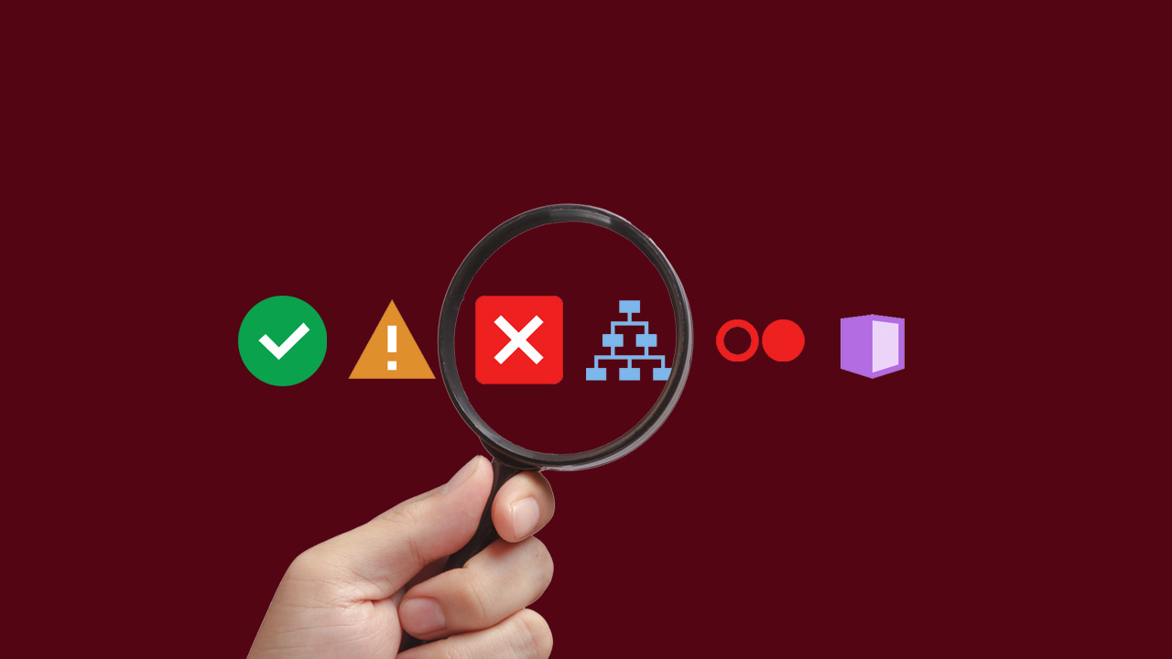
Validate Auto Tool Results
Notes:
Validate Auto Tool Results. For instance, Pope Tech/WAVE checks a web page against a set of rules that identify possible issues for people who have disabilities. It classifies each issue as an:
Error
Alert
Structural Element or
ARIA

Slide 8
1st Fix Errors Identified by Pope Tech
Pope Tech Errors are almost certainly accessibility issues.
Error rule set (22 rules)
Pope Tech/WAVE documentation:
Helps you learn
Provides info on how to fix issues
Notes:
Before doing manual testing, 1st correct errors identified by auto tools such as Pope Tech. Pope Tech errors are almost certainly accessibility issues. Make them a priority to fix. Pope Tech currently checks for 22 Errors in its rule set. I’ve listed them in a document that is linked in the references.
The Pope Tech/WAVE documentation will help you learn and provide information on how to fix issues. Its documentation will link to the applicable WCAG 2.1 Success Criterion and tell you:
The algorithm in English
What it means
Why it matters
How to fix it

Slide 9
Other Pope Tech Flags
Alerts (42 rules)
Structural Elements (22 rules)
ARIA (10 rules)
Notes:
Other Pope Tech Flags. In addition to Errors, Pope Tech has other rules sets that are flagged. They include Alerts, Structural Elements, and ARIA. They all should be checked manually. Pope Tech/WAVE’s documentation provides details to help you understand each rule and figure out how to proceed.
Alerts are highly suspicious. Pope Tech currently checks for 42 Alert rules in its rule set. Structural Elements identify any structural HTML such as headings and lists. If used properly, these items can enhance accessibility. You need to make sure they are implemented correctly. Pope Tech currently checks for 22 structural rules. ARIA is an abbreviation for Accessible Rich Internet Applications. Not all HTML elements have accessibility built into them, so ARIA is used to add accessibility if needed. Most ARIA items require a manual review to know if they're used properly. Also check if you even need ARIA. The 1st rule of ARIA is: “If you can use a native HTML element or attribute instead of an ARIA role, state or property, then do so.” Very often ARIA is pasted from other code and isn’t needed or even working as it should. Pope Tech currently checks for 10 ARIA rules.
I’ve listed all these rule in documents that are linked in the references.
More Information
ARIA roles, states, and properties lets developers extend semantics to custom page layouts and widgets, which either don’t already have implicit roles and behaviors coded into the markup, or don’t have implicit roles that accurately communicate their purpose. For instance some JavaScript, dynamic, and interactive elements can’t be seen by screen readers, and this is where ARIA can help. ARIA is essentially a set of extensions to HTML that can help make web content and controls more usable.
Example of using ARIA when you don't need ARIA is using aria-label on a button, and that button already has a text equivalent to the aria-label value:
<!-- nonsense -->
<button aria-label=foo>foo</button>
<!-- not nonsense -->
<button>foo</button>
HTML is widely supported and relatively easy to use. ARIA is not a replacement for semantic HTML. ARIA a last resort.
The WebAIM Million survey found that homepages with ARIA present averaged 41% more detected errors than those without ARIA. While ARIA is designed to make web pages more accessible, if used incorrectly, it can do more harm than good.

Slide 10
Favorite Manual Testing Areas
Keyboard Access
Reflow
Straw Test
Images
Color and Contrast
Notes:
I’m going to touch on my 5 favorite areas for manually testing. They are:
Keyboard Access
Reflow
The Straw Test
Images
Color and Contrast
These checks do not encompass all the tests needed. But they can help get you started.

Slide 11
1. Keyboard Access
Notes:
Section 1 is Keyboard Access. Testing with only a keyboard may be the most important part of manual testing. Many assistive technologies use the keyboard to interact with a website.
Keyboard testing is done to make sure that all content can be accessed, used, and engaged with by a person who can’t use a mouse.

Slide 12
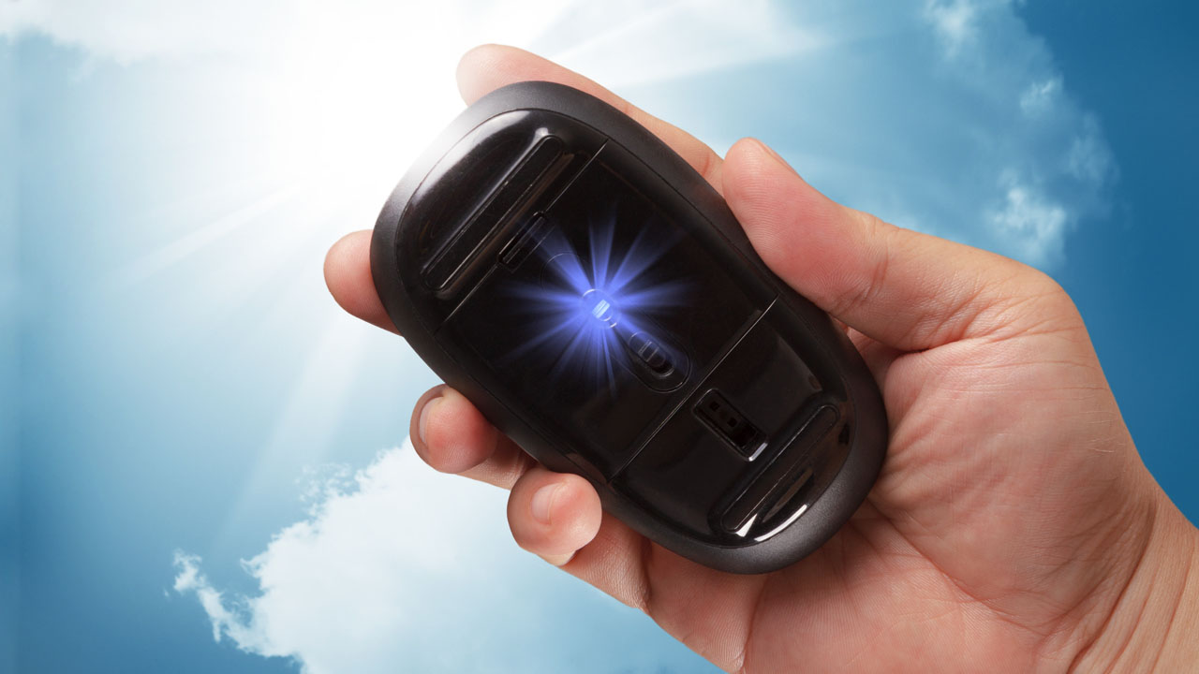
Throw Your Mouse Out the Window
Notes:
So, how do you test keyboard accessibility?
I wrote an article a while back called, “Throw Your Mouse Out the Window”. That’s pretty much the gist of it. The link to that article is in the references document. The idea is that you don’t use a mouse or trackpad and make sure all functionality is available by only using the keyboard.
If you are testing with a Mac for the 1st time:
Press Control + F7 to enable full keyboard accessibility.
In Safari:
Select Preferences > Advanced > Accessibility.
Then check “Press Tab to highlight each item”.

Slide 13
Keystrokes Used
Key | Action
Tab | Forward
Shift + Tab | Backwards
Enter / Return | Opens a link, activates buttons
Spacebar | Toggles checkbox values, activates buttons
Arrow Keys | Scrolls content, moves/selects radio buttons in a group. Sometimes moves between interactive menu items or tab panels.
Notes:
Keystrokes Used:
Tab key takes you forward, and Shift Tab takes you backwards.
Enter / Return opens a link, activates buttons.
The spacebar toggles checkbox values & activates buttons.
Arrow keys scrolls content, moves/selects radio buttons in a group. Sometimes it moves between interactive menu items or tab panels.

Slide 14
Things to Check
Logical order
Focus indicator
Actionable controls
Drop-down menus and pop-ups
No keyboard traps
Notes:
Some Things to Check: Ensure movement of the Tab key follows a logical order. For English languages, the order should be from left to right and from top to bottom. Make sure the focus indicator is always noticeable. A focus indicator is the visible outline given to focusable elements such as buttons and links. If you loose sight of it is an issue.
Check actionable controls, such as links, buttons, and form fields. If you have drop-down menus or pop-ups, make sure that you can open and close them with just the keyboard. Make sure you can navigate away from, as well as to, all parts of the website by keyboard only. Be sure there are no keyboard traps. Check widgets. Often, they are not accessible.
WebAIM has a good tutorial on keyboard testing. The link is in the references.

Slide 15
2. Reflow
Notes:
Section 2 is Reflow. This test is to ensure content can be enlarged without horizontal scrolling. Horizontal scrolling is pure evil for people with low vision. This is WCAG Success Criterion 1.4.10.
More Information
Dr. Wayne Dick ran a critical experiment for our WCAG Low Vision Task Force and elucidated the results and impact in his groundbreaking article “Operational Overhead Caused by Horizontal Scrolling”. It was instrumental in establishing the 1.4.10 Success Criterion. The link to Wayne’s article in the references document.

Slide 16
One Way to Test Reflow
Set viewport to 1280 x 1024 pixels.
Zoom in up to 400%.
Content should reflow.
All information and functionality must be available and fully legible.
Exceptions: maps, videos, images, data tables.
Notes:
One Way to Test Reflow: Adjust your browser viewport to 1280 pixels wide by 1024 pixels high. You can use a tool called the Web Developer Toolbar to set viewport size. A link to it is in the references document. Then zoom from in from 100% to 400%. In most browsers, you can zoom either through the browser's user interface, menu options, or by using the Control or Command key with the + key.
At each zoom level, check that information is not lost. Make sure dialogs, accordions, tooltips, menus, and such are usable at up to 400% without horizontal scrolling. The exceptions are parts of the content which require 2-dimensional layout for use or meaning such as maps, videos and images, which generally rely on a certain aspect ratio to be intelligible. Even some data tables may not fit and are also exempt.
This is one way to test reflow. Other methods are linked in the references.
More Information
Starting with a desktop browser at 1280px wide and zooming to 400% provides a mobile view of 320 pixels.
Responsive web design is the most effective method of of allowing people to zoom in to 400%.

Slide 17
3. The Straw Test
Notes:
Section 3 is the Straw Test. It can help make sure related content is in close-proximity. This is important to help unearth layout and design challenges for people with low vision.

Slide 18
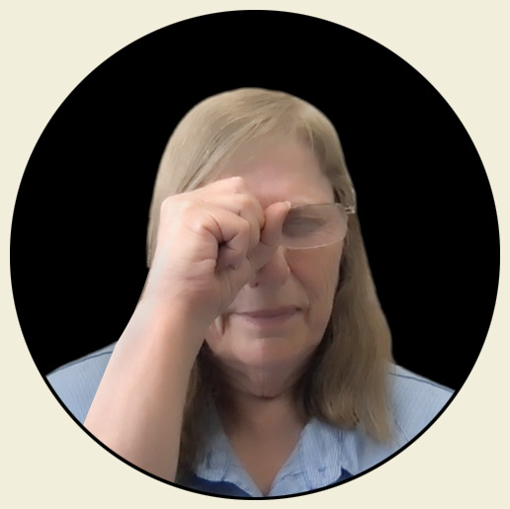
The Straw Test
Hold up your hand like you're holding on to a straw.
Hold it up like you're making a fist & look through.
Make the straw tiny.
Close your other eye.
Look through the straw examine web pages and interfaces.
Verify that you don’t lose context.
Notes:
To conduct a Straw Test, take either your left hand or your right hand and hold it up like you're holding on to a straw. And I mean like, not a milkshake straw but one of those little coffee stir sticks. Hold it up like you're making a fist and look through. Make the straw as tiny as you can. Close your other eye.
Look through the straw and examine your web pages and interfaces. Go through task flows while looking through the straw.
For instance, go through the motions of filling out a form while you're looking through the straw. It can particularly challenging and is very easy to lose context.
More Information
One of the most important functional needs for a screen magnifier users is to have well-placed calls to action and flexibility in interfaces.
I wrote up some information for the W3C Low Vision Task Force on the Point of Regard and Proximity of Controls. The link is in the references document.
The W3C has a video that includes a Straw Test. That link is also in the references.

Slide 19
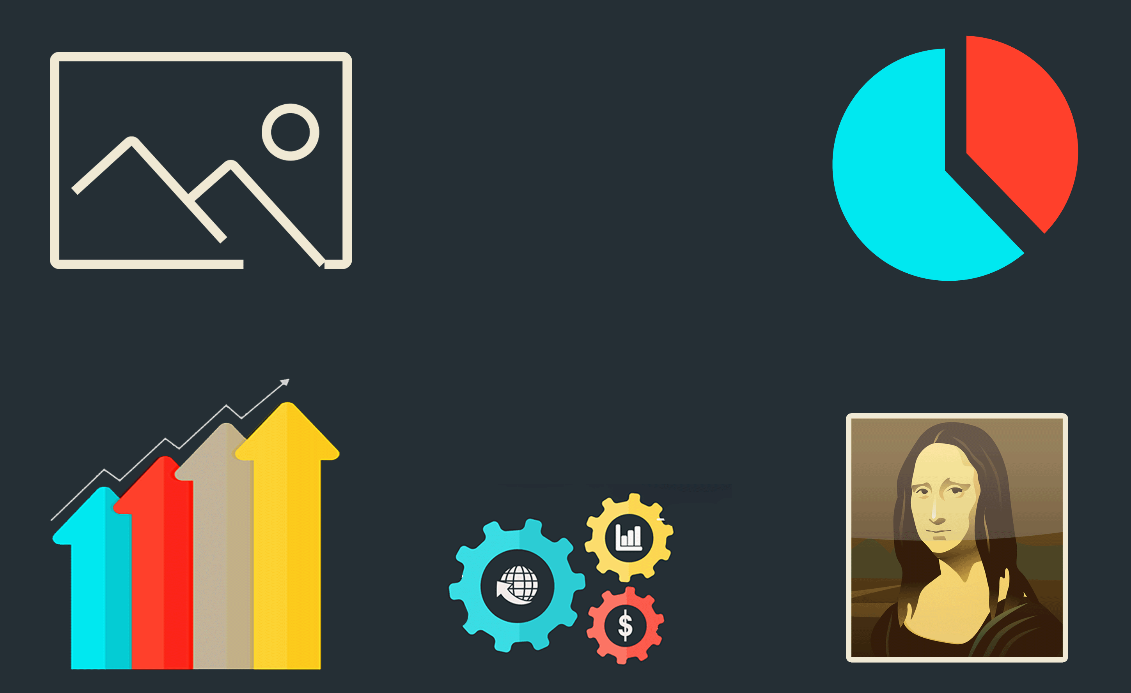
4. Images
Notes:
Section 4 is Manual Checks for Images. Verifying that text alternatives are meaningful can only be accomplished by manual review. They must appropriately describe the content and/or purpose of the image. This is covered under WCAG Success Criterion 1.1.1.

Slide 20
Image Short Text Alternatives
Ensure accuracy.
If an image is informative and if it is:
a picture, use a name or short description.
text, repeat that text word-for-word.
complex data, provide an overview.
a symbol, identify its essence or purpose.
a functional image, emphasize action or link purpose.
Notes:
Image Short Text Alternatives: Ensure that alt text is accurate and succinct. If an image is informative and if it is:
A Picture: verify the alt text is a name or short description.
Text: make sure that text is repeat text word-for-word.
Complex Data: provide an overview. (And you will also need a long description, which I will talk about in the next slide.)
A Symbol: identify its essence or purpose.
A Functional Image, emphasize action or link purpose.
More Information
If an image is “primarily intended to create a specific sensory experience, then text alternatives at least need to provide descriptive identification of the non-text content.” (WCAG 1.1.1)
Avoid using title attributes on images. Check
“Using the HTML title attribute – updated March 2020” by Steve Faulkner. The link is in the references document.

Slide 21
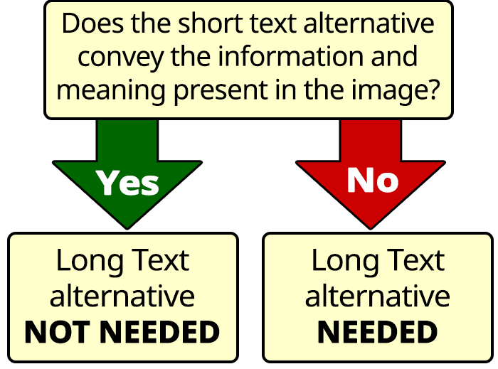
Long Text Alternatives for Images
Long Description: Long text alternative decision tree
Notes:
Long Text Alternatives for Images: If a short text alternative does not provide a text equivalent for an image, a long description is also required to provide supplemental content via a secondary mechanism. You can:
Link to the long description.
Place the description on same page and put location info in the alt attribute. The refences document links to more options.
More Information
2 types of images that may need a long text alternative:
Complex Data Images: charts, graphs, and diagrams. They allow sighted users to understand data and data relationships. These visual representations can convey a vast amount of non-text content. In addition to a short text equivalent, for many data images it may be necessary to provide more detailed information or supplemental content in the form of a long text alternative. The National Center for Accessible Media's Effective Practices for Description of Science Content within Digital Talking Books provides useful information on writing long descriptions for complex data. The link is in the references document. Pictures: includes visual representations of objects, artwork, people, scenes, abstractions, etc. This non-text content can convey a significant amount of information visually or provide a specific sensory experience to a sighted person. Descriptions of what a picture looks like can be useful to those who are interested in the subject matter or the visual qualities of an image and who would otherwise be deprived of the content.
The document “3 Tips for Writing Long Descriptions of Pictures” is available in the refences document and provides information on that topic.
When a long description is provided on the same web page as an image, its location can be described using the alt attribute of the image. The location information needs to be clear and accurate to help users locate the content.
Example :
Number of subscribers. Described under the heading: 'Graph Description: Subscriber Increase’
Then the heading would be:
<h4>Graph Description: Subscriber Increase</h4>
[full long description]
The W3C has a good document and more options for providing long descriptions. That link is in the references document.

Slide 22
Purely Decorative Images
Ensure that pure decoration or redundant images use a null attribute alt="" .
If an image has a purpose, then a user should be aware that it is there and what its intended purpose is.
Null alt attribute
Completely ignored by assistive technologies.
Prevents a person who is blind from knowing about and sharing the image.
Notes:
Purely Decorative Images: Ensure that pure decoration or redundant images use a null attribute alt="".
If an image has a purpose, then a user should be aware that it is there and what its intended purpose is.
A null alt attribute will:
Be completely ignored by assistive technologies.
Prevents a person who is blind from knowing about and sharing the image.
So, seriously consider if an image is purely decorative. If it isn't, try to concisely explain what the image is in the context of the document's purpose without overly duplicating the text in which the image is embedded.
More Information
Whenever a null alt attribute is used the author is deciding that informing a user who is blind that the image on the page isn't important or worthwhile for them to know about. The fact an image is there is completely hidden from them.
Ultimately, it is about treating people with visual disabilities as visitors who access content differently, but equally.
Treat them fairly and on an even footing: "deciding" that they likely don't want to know that an image is on the page is a serious decision to make.
Let's try to do our best to treat people with visual disabilities with that same kind of respect - afford them a textual glance of the image that all sighted users will make when a page first loads (and avoid going into too much detail, because few sighted users are going to study the image thoroughly).

Slide 23
5. Color and Contrast
Notes:
Section 5 is Color and Contrast. In this section we’ll talk about manual checks for color alone, text contrast, and non-text contrast.

Slide 24
Color Alone
“If I take color away from this page is any important information lost?”
Ensure stylistic information alone (such as bolding alone) isn’t used either.
Use text, icons, symbols, or patterns in addition to color.
Notes:
Color Alone: Ensure color is not used as the only way of conveying meaning or information. This is WCAG Success Criterion 1.4.1.
Ask yourself, “If I take color away from this page is any important information lost?”
Make sure that stylistic information alone (such as bolding alone) isn’t used either as screen readers generally do not present stylistic information to the end user. Use text, icons, symbols, or patterns in addition to color.
More Information
Example: don’t just use red to indicate a negative number. Make sure there is another way to show this, by including a minus sign in front of the negative number
If color alone is used to convey information, automated tools can’t detect the problem. Another example: if a form field turns red to indicate that the user needs to add additional information, WAVE (and other tools) won’t see this as an issue but users who can’t perceive color may have trouble understanding why they’re unable to complete the form.
Accessibility guidelines do not prohibit any specific color or color combination, such as red and green. However, they do require that "color is not used as the only visual means of conveying information, indicating an action, prompting a response, or distinguishing a visual element". Ensure that color-reliance is tested for and avoided.
Color use in graphs and charts is particularly challenging to make accessible .
Although some screen readers can be configured to announce , <b>/<i> and <strong>/<em> and <u> elements are not normally pronounced by default. As it says in JAWS Techniques for Examining Text Formatting:
"The default behavior of JAWS is to speak all text using the same voice. JAWS does not distinguish between different types of fonts or font attributes such as bolding or underlined text.”
That link is in the references document.

Slide 25
Text Contrast
Verify text contrast on overlaid & embedded images.
Use an eyedropper tool such as the Colour Contrast Analyser.
Notes:
Text Contrast. Make sure that proper text contrast levels are met for text overlaid or embedded in images. This is WCAG Success Criterion 1.4.3.
Use an accurate eyedropper tool such as the Color Contrast Analyzer by The Paciello Group. The link to that is in the references document.
More Information
To define contrast, WCAG relies on a formulation called a contrast ratio. It is a 2-number figure that ranges from 1:1 to 21:1. The first number refers to the relative luminance - a measure of brightness - of the lighter color. The second reflects the relative luminance of the darker shade.
Relative luminance, is a numerical description of a color’s brightness. WCAG provides a mathematical formula for translating RGB values into relative luminance.
Text and images of need a contrast ratio of at least 4.5:1.
Large text - at least 18 point (typically 24px) or 14 point (typically 18.66px) and bold requires a contrast ratio of at least 3:1.

Slide 26
Non-Text Contrast
2 types of non-text content:
User Interface Components - includes form fields, links and buttons.
Graphical Objects that convey meaning.
Ensure 3:1 contrast ratio or more against adjacent colors.
Notes:
Non-Text Contrast: There are 2 types of non-text content to check:
The first is User Interface Components. This includes form fields, links and buttons.
The 2nd is Graphical Objects required for understanding. For example a warning icon.
Make sure they have a contrast ratio of at least 3:1 against adjacent colors. This is WCAG Success Criterion 1.4.11. Again, to test use a manual tool such as TPG's Colour Contrast Analyser.
More Information
User interface components includes the visual information that identifies a component as well as its state. Both need to meet the contrast ratio. This typically means that the outer edge of a component will need to be distinguishable from the background, as will any indicators for focus, selection or other states. The WCAG 1.4.11 Non-text Contrast Understanding document provides extensive explanations of how contrast can be achieved for both common components and customized widgets.
For every important graphical object, whether it be a UI component or a non-interactive object, the parts of the graphic that make it understandable must meet a 3:1 contrast with the neighboring information. Again, the WCAG Understanding document provides a range of examples for everything from monochrome icons to pie charts with different colored wedges. Considerations for such things as gradients and infographics are also discussed.
If the page contains dynamically changing elements or styles, make sure you trigger and test these - for instance, if text inputs have a different visual presentation when they are focused, or if an error message is shown after attempting to submit an incomplete form, ensure that you test these states of the form as well.
In some cases, it's necessary to think about more than one contrast ratio per element. For example, the color of a button must contrast clearly against its background, and the button's text label must also contrast well against the button's color.

Slide 27
Summary and Thank You!
Notes:
So, in this session we’ve discussed:
The definition of manual testing,
How auto and manual testing complement each other,
Validating auto tool results, and
5 manual checks.
There are many more manual checks. But these should help get you started.
Thank you!

