Slide 1
Mark Chmielewski
November 4, 2019
ECE 1001

Slide 2
Presentation Goals
Company Background
Culture
Saturn Business Focus
The Entrepreneur
Technology-Past and Future
Parting Thoughts

Slide 3
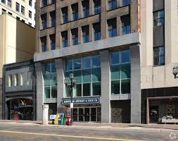
Location
Duluth – 314 W. Superior St. – Torrey Bldg

Slide 4
Saturn Systems Overview
Custom Software Manufacturing
Saturn founded as an entrepreneur startup
Founded in 1990 in Duluth, Minnesota
Around 60 Employees-Mostly Computer Scientists, Quality Assurance

Slide 5
What We Do
Custom Software Development
Staff Augmentation/projects
System Design/Architecture
Web applications
Mobile Applications
Device Control
Systems Integration
Many industries and technologies

Slide 6
Why Software?
Software allows businesses to function more efficiently
Generates revenue
Reduces costs
Increases competitive position
Meets regulatory requirements

Slide 7
Saturn’s Niche
U.S. alternative to Off-Shoring
50% MN, 50% Rest of Nation
Saturn Systems Model
High Quality / Low risk / Lower Cost
High Skill Niche
A bench of readily available developers

Slide 8
Staff Profile
Computer Science and related 4 year degrees
Recruit from UMD, UWS, Michigan Tech and Northern Michigan
People who have demonstrated ability to perform at a high level – top students

Slide 9
Saturn Culture
Respect, honesty and integrity
Technically challenging work
Transparency and communications
Perks and flexibility
Teamwork
Always Learning-Mentoring and Masters
Produce the Highest Quality Product

Slide 10
Awards
Inc. 5000 fastest growing private companies 5 consecutive years
Star Tribune Top 150 Minnesota Workplaces-3 consecutive years
Minnesota Business Magazine 100 Best Companies to Work For-3 consecutive years

Slide 11
Clients
Established Companies
RSM
Siemens
United Piping – Duluth
Startups/Entrepreneurs
Mastodon-Universal EHR
Fasetto-Device Networking

Slide 12
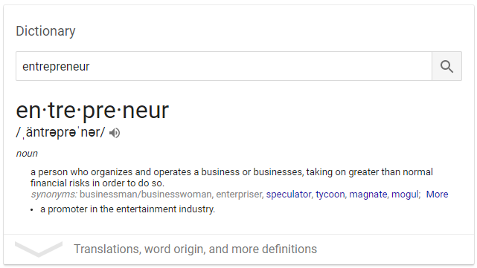
What’s an Entrepreneur?

Slide 13
Entrepreneur Examples
Amazon – Jeff Bezos
Facebook – Mark Zuckerberg
Apple – Jobs & Wozniak
Harry Potter – J.K. Rowling
Adam Neumann - WeWork

Slide 14
What Does it take to be an Entrepreneur?
Believe in your idea
Sell, sell, sell people on your idea
Not afraid to try. Not afraid to fail
Have a big motor-willing to work hard
Willing to make painful current sacrifices for future gain
Be agile in your thought process
Learn how to compromise. The world is shades of grey.
Be willing to take calculated financial risks

Slide 15
Entrepreneur-The Daily Grind
Build your business with the right(best) people – Don’t settle for average
Develop and maintain an awesome work culture
Continually improve production processes and efficiencies
Produce the highest quality/best value products
Minimize debt and maximize cash flow and profit
Transition planning-knowing when to hand over control
Grooming the next generation of leaders
Realizing accumulated capital

Slide 16
Entrepreneur-Giving Back
Philanthropy
UMD Computer Science Scholarship
Duluth Superior Area Community Foundation – Saturn Systems Scholarship
Volunteering in the community

Slide 17
Engineering and CS Employment Outlook
Very Bright Employment Outlook
Companies will continue to invest in hardware and software technologies to innovate, reduce costs and increase profits
Engineers Will be Scarce and Coveted
Very Challenging Degrees
Many high school grads are not prepared for the challenge
Many low/medium skill jobs will be replaced with machines

Slide 18
Technology Shapes the Future
Technology power and capabilities will revolutionize society at a rapid pace
Self driving cars, trucks and planes
Continued manufacturing automation, agricultural bots, delivery bots, drones, robot miners
Networks of small, lethal war machines, e-warfare
Block Chain Technology-business transactions, security
Factory grown food
Custom medical treatments for cancer/heart disease/diabetes
Software that writes and tests itself

Slide 19
Parting Thoughts
Commitment to Your Degree Program
Study First. Study Hard.
Those with the best record get the best jobs
Work For Companies Where You are the Rock Star
Revenue Employee vs. Overhead
Tech and Engineering Companies
Don’t be Afraid to Take Risks
Move to Another Region if necessary

Slide 20
Parting Thoughts
Build and maintain relationships with family, friends and co-workers
Be a good listener
Learn how to compromise
Understand others motivations, fears
Don’t be Afraid to Take Calculated Risks

Slide 21
Parting Thoughts
Understand your Strengths and Weaknesses
Be honestly self introspective
Apply your strengths, work on your weaknesses
Become Involved in Your Community
Volunteer
Get to know people outside your normal (comfort) social groups
Always Keep Learning, Always
Stay relevant in your career
Stay informed about what’s happening in the world
Stay curious

Slide 22
Questions?

