Slide 1
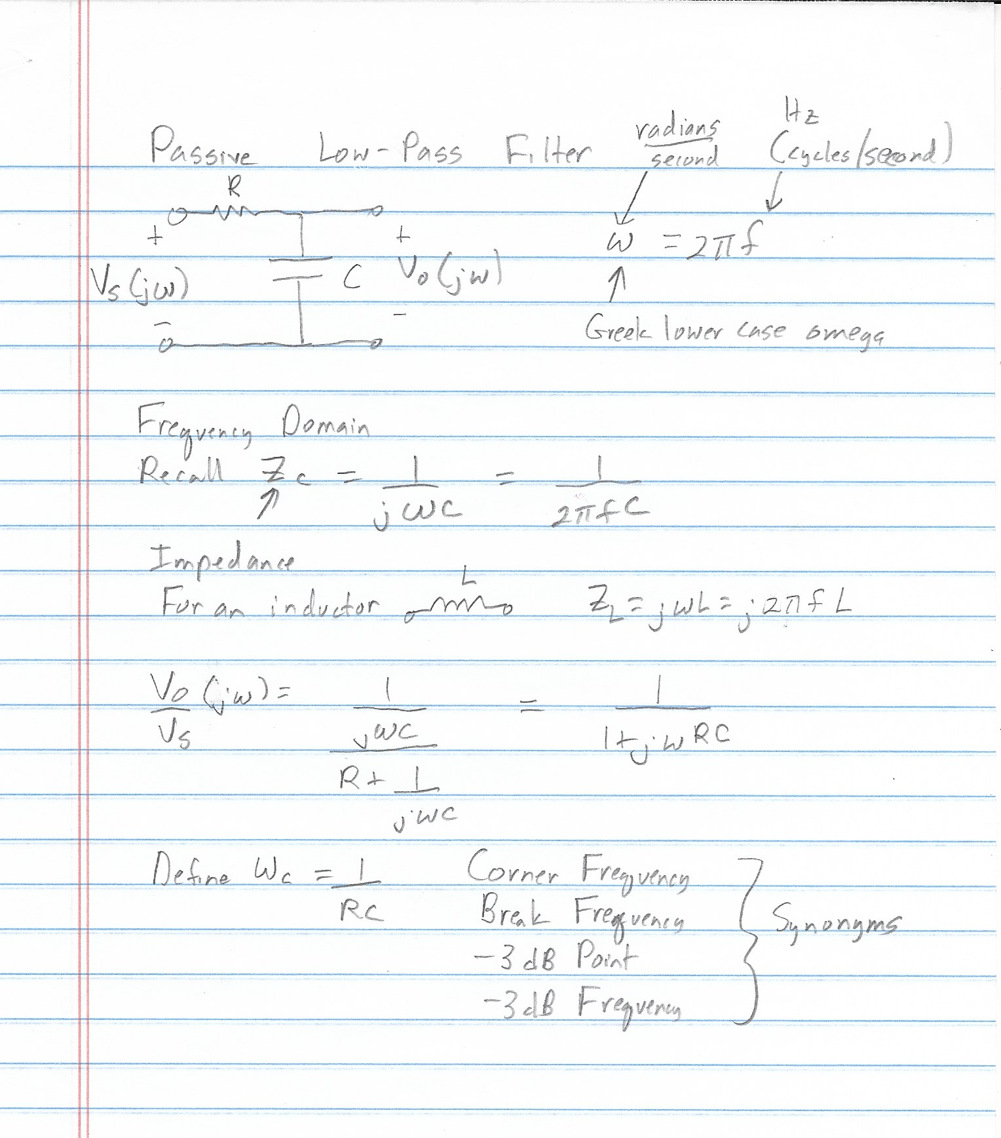
15 September 2021
Frequency Domain Analysis-Passive Circuits
Frequency Dependent Circuits-LPF
Bode Plots
J is a 90 degree phase shift
j

Slide 2
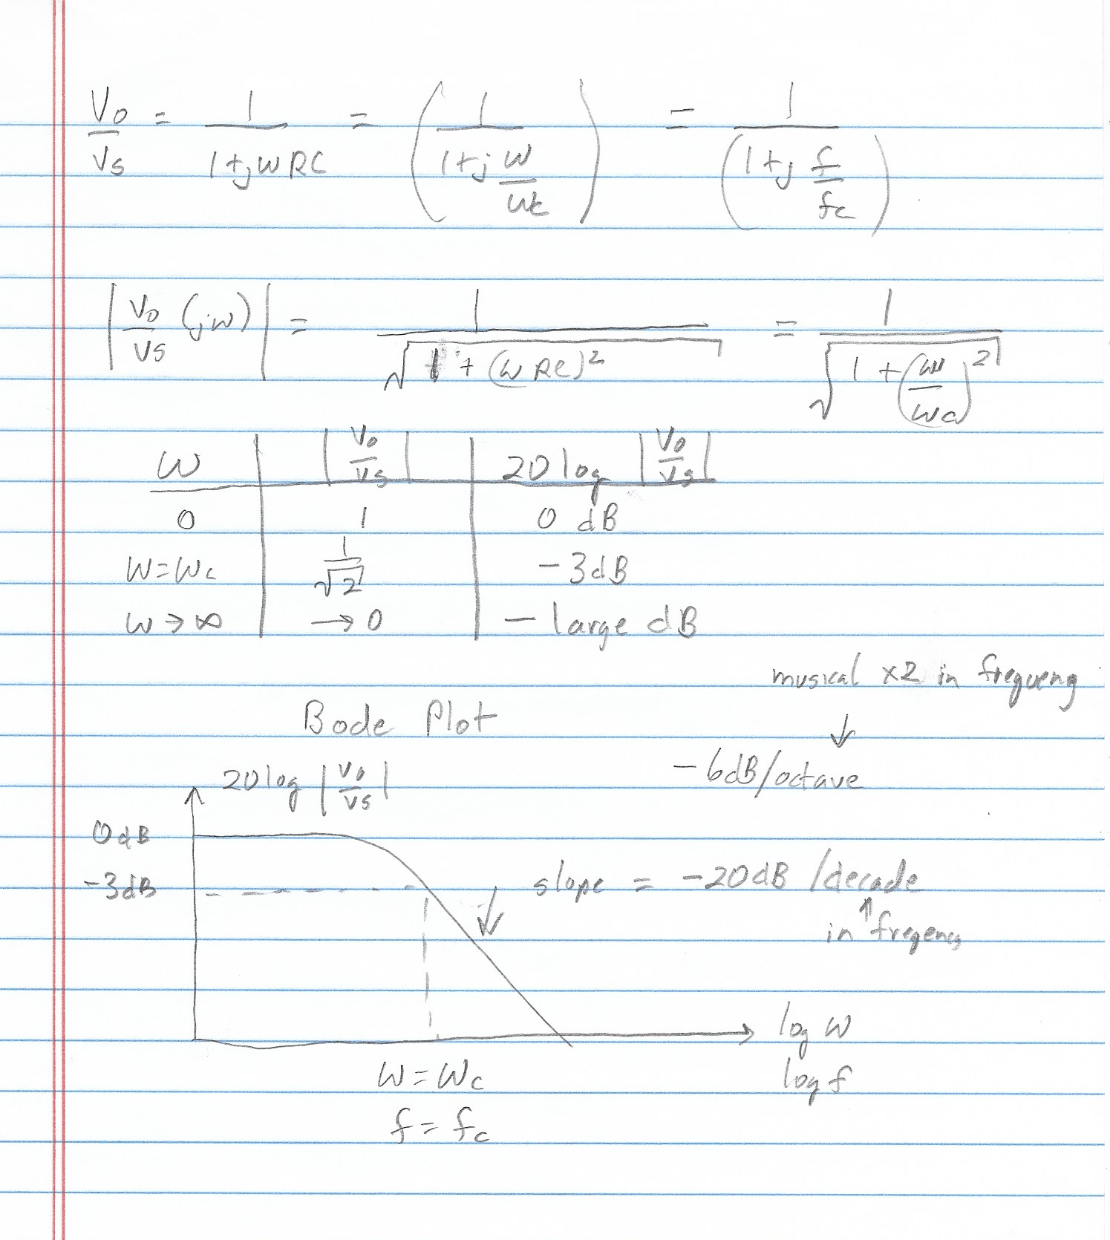

Slide 3
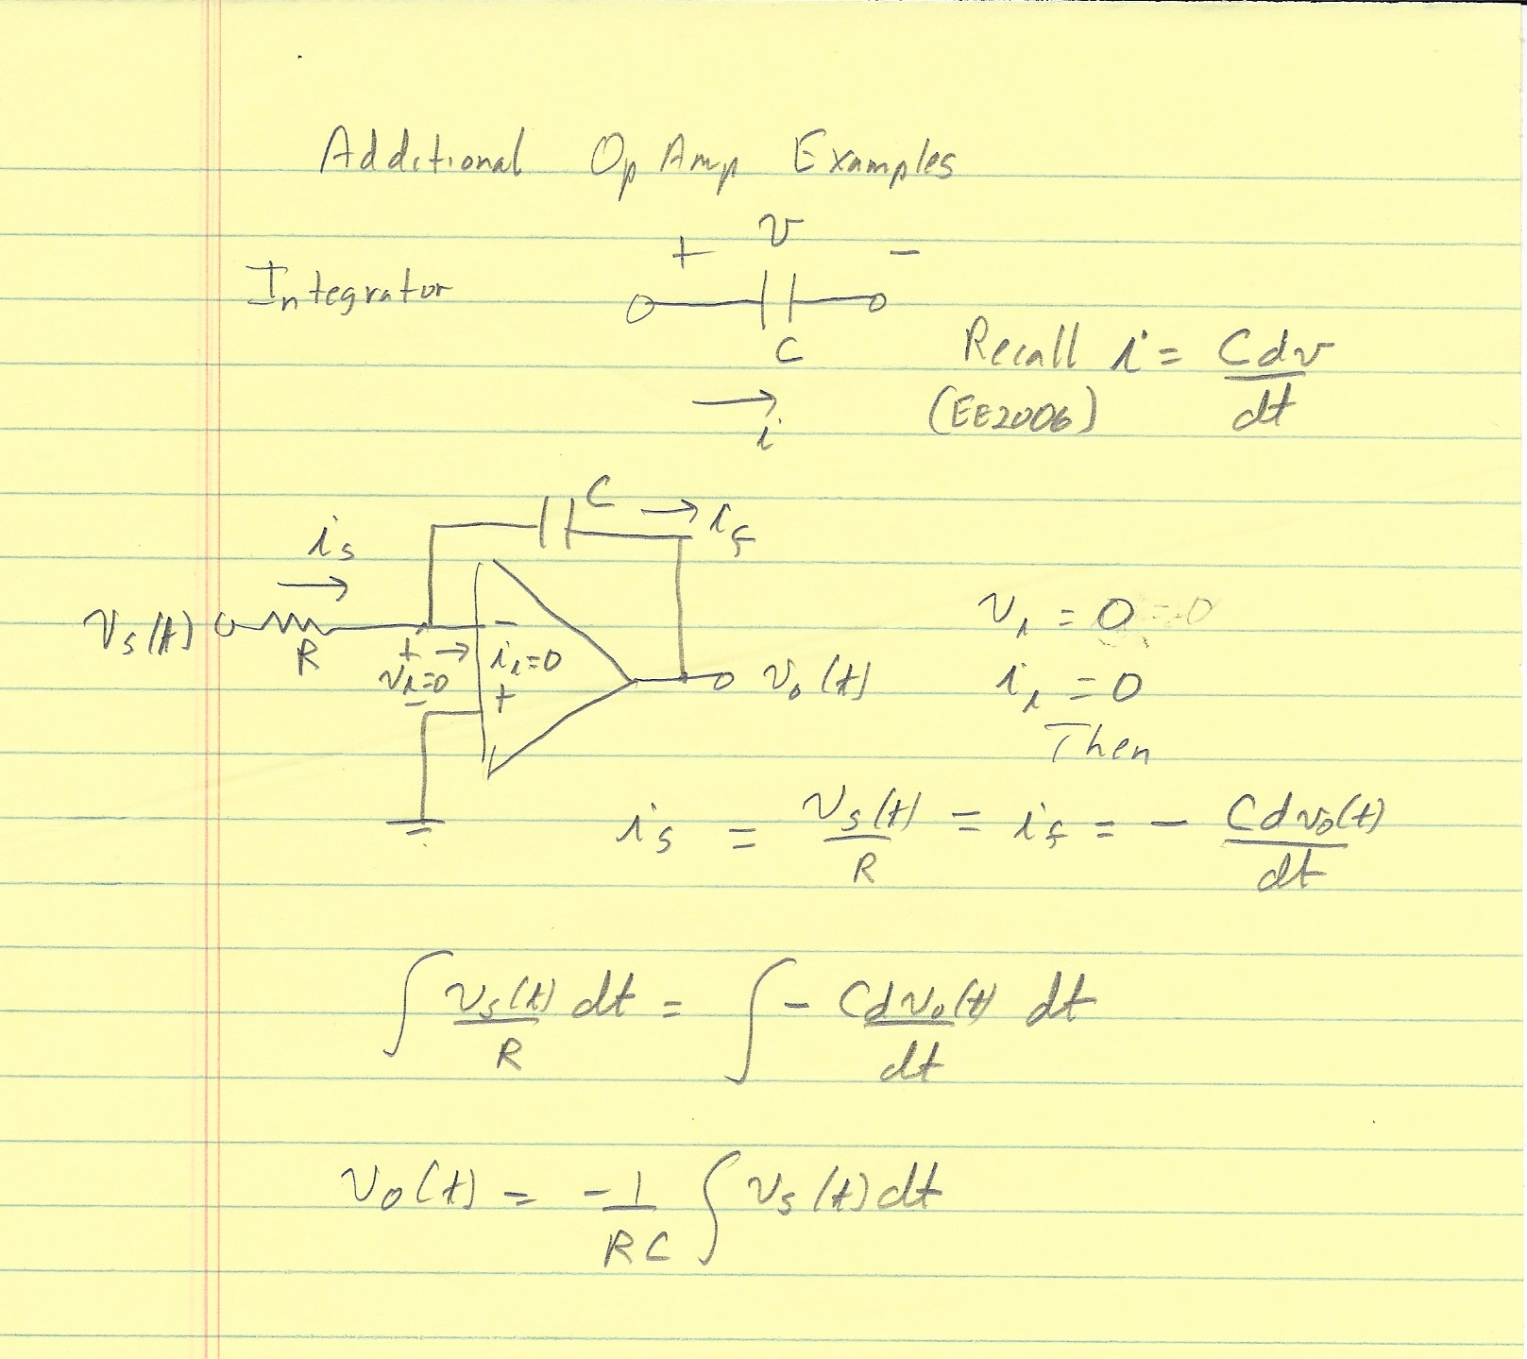

Slide 4
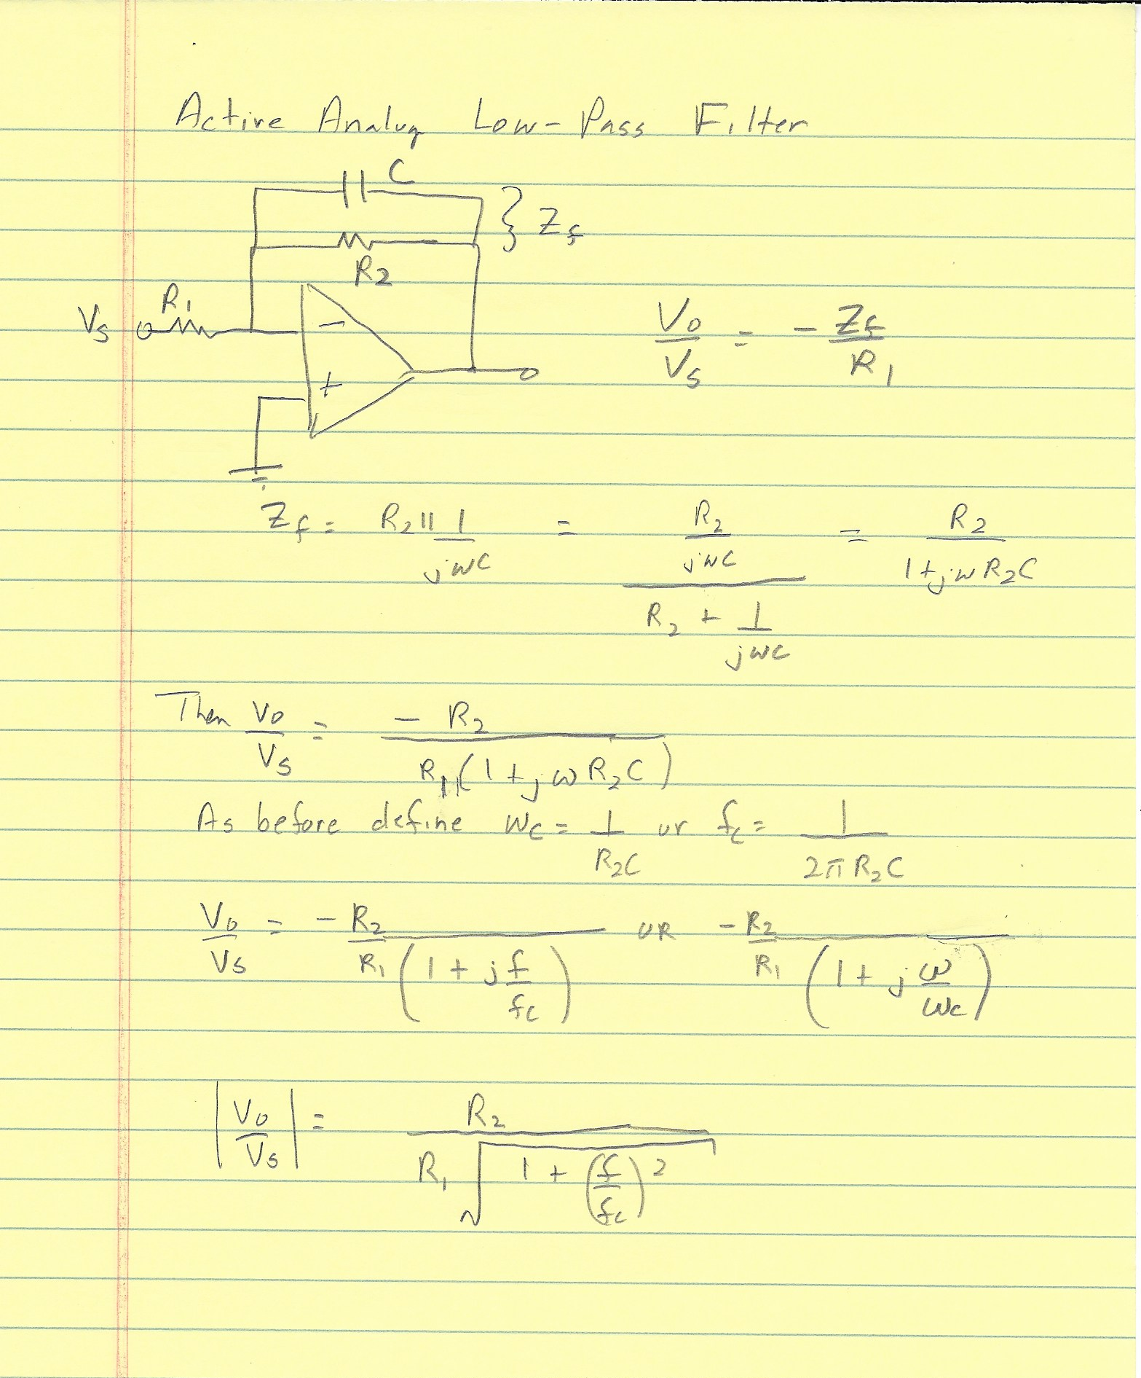

Slide 5
