Slide 1
REVIEW BASIC EE 2006 CONCEPTS
1 September 2021
SOURCES FOR SPICE
FET VIDEO High-k_Metal_Gate_animation_640X480.wmv
NOTATION AND SIGN CONVENTIONS
USE LINEAR SUPERPOSITION
“WAR OF THE CURRENTS” https://en.wikipedia.org/wiki/War_of_the_currents
https://www.politics-prose.com/book/9780761354871
SINUSOIDAL STEADY STATE
PHASORS

Slide 2
To: EE 2212 Class
From: Stan Burns
1 September 2021
Re: SPICE
An evaluation version of SPICE (PSPICE) is available from a variety of sources such as https://pspice-student.informer.com/9.1/
https://www.pspice.com/academic-user
or from ORCAD (Version 16.1)
https://www.orcad.com/orcad-academic-program
or from Analog Devices LT SPICE
https://www.analog.com/en/design-center/design-tools-and-calculators/ltspice-simulator.html
Both PSPICE and LT SPICE are resident on MWAH 391 and MWAH 102 computers
Also as of 15 December 2020, Analog Devices has listed a version for MAC 10.9+ . Haven’t tested it but for those of you MAC users, let me know.
For most of our circuit simulations, I will use SPICE 9.1 and/or LT SPICE since that is what is resident on MWAH computers (WINDOWS-based computers). I will supplement other versions as appropriate as we use the tools.
The basic engines are similar based on solving sparse matrices. Key differences are in the GUIs (Graphical User Interface) and the model libraries available on the free versions.
I would appreciate feedback on what you used. The various versions are somewhat platform dependent based on your system’s specifications such as memory, etc.

Slide 3
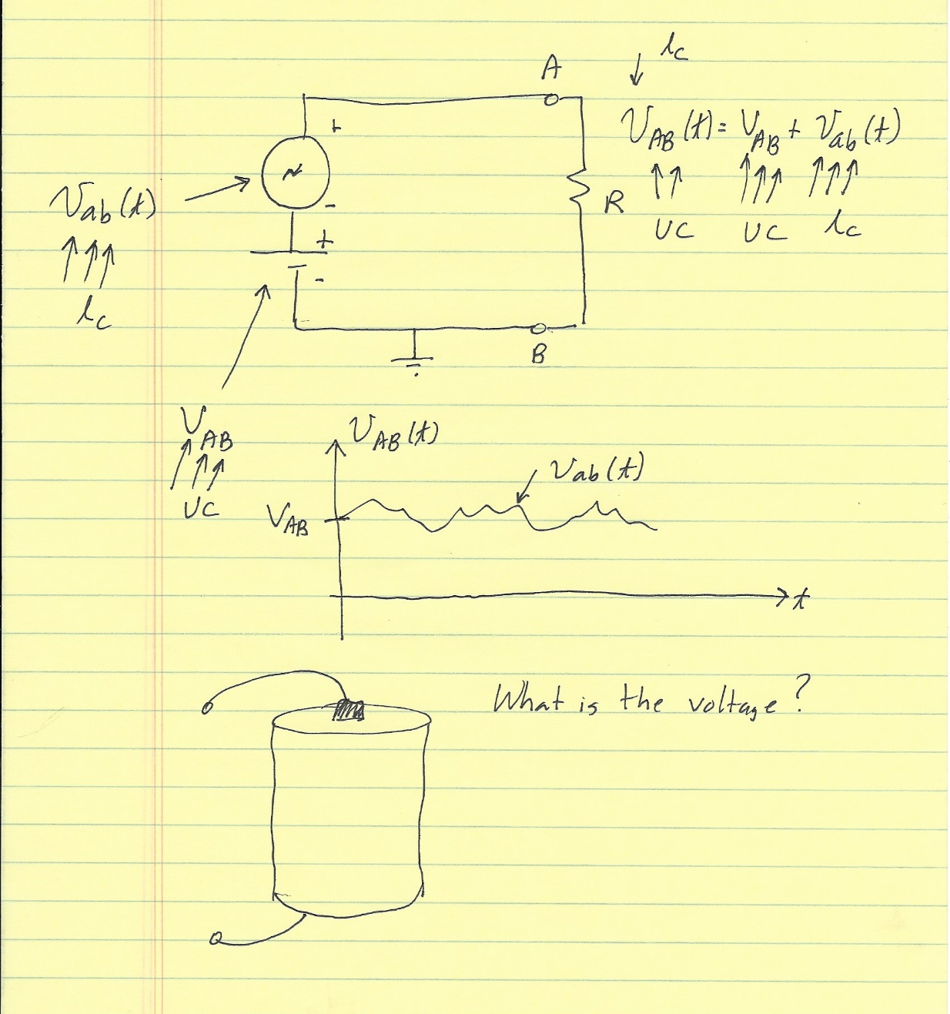
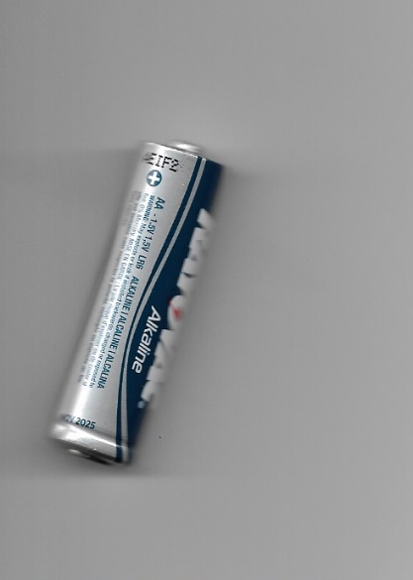

Slide 4
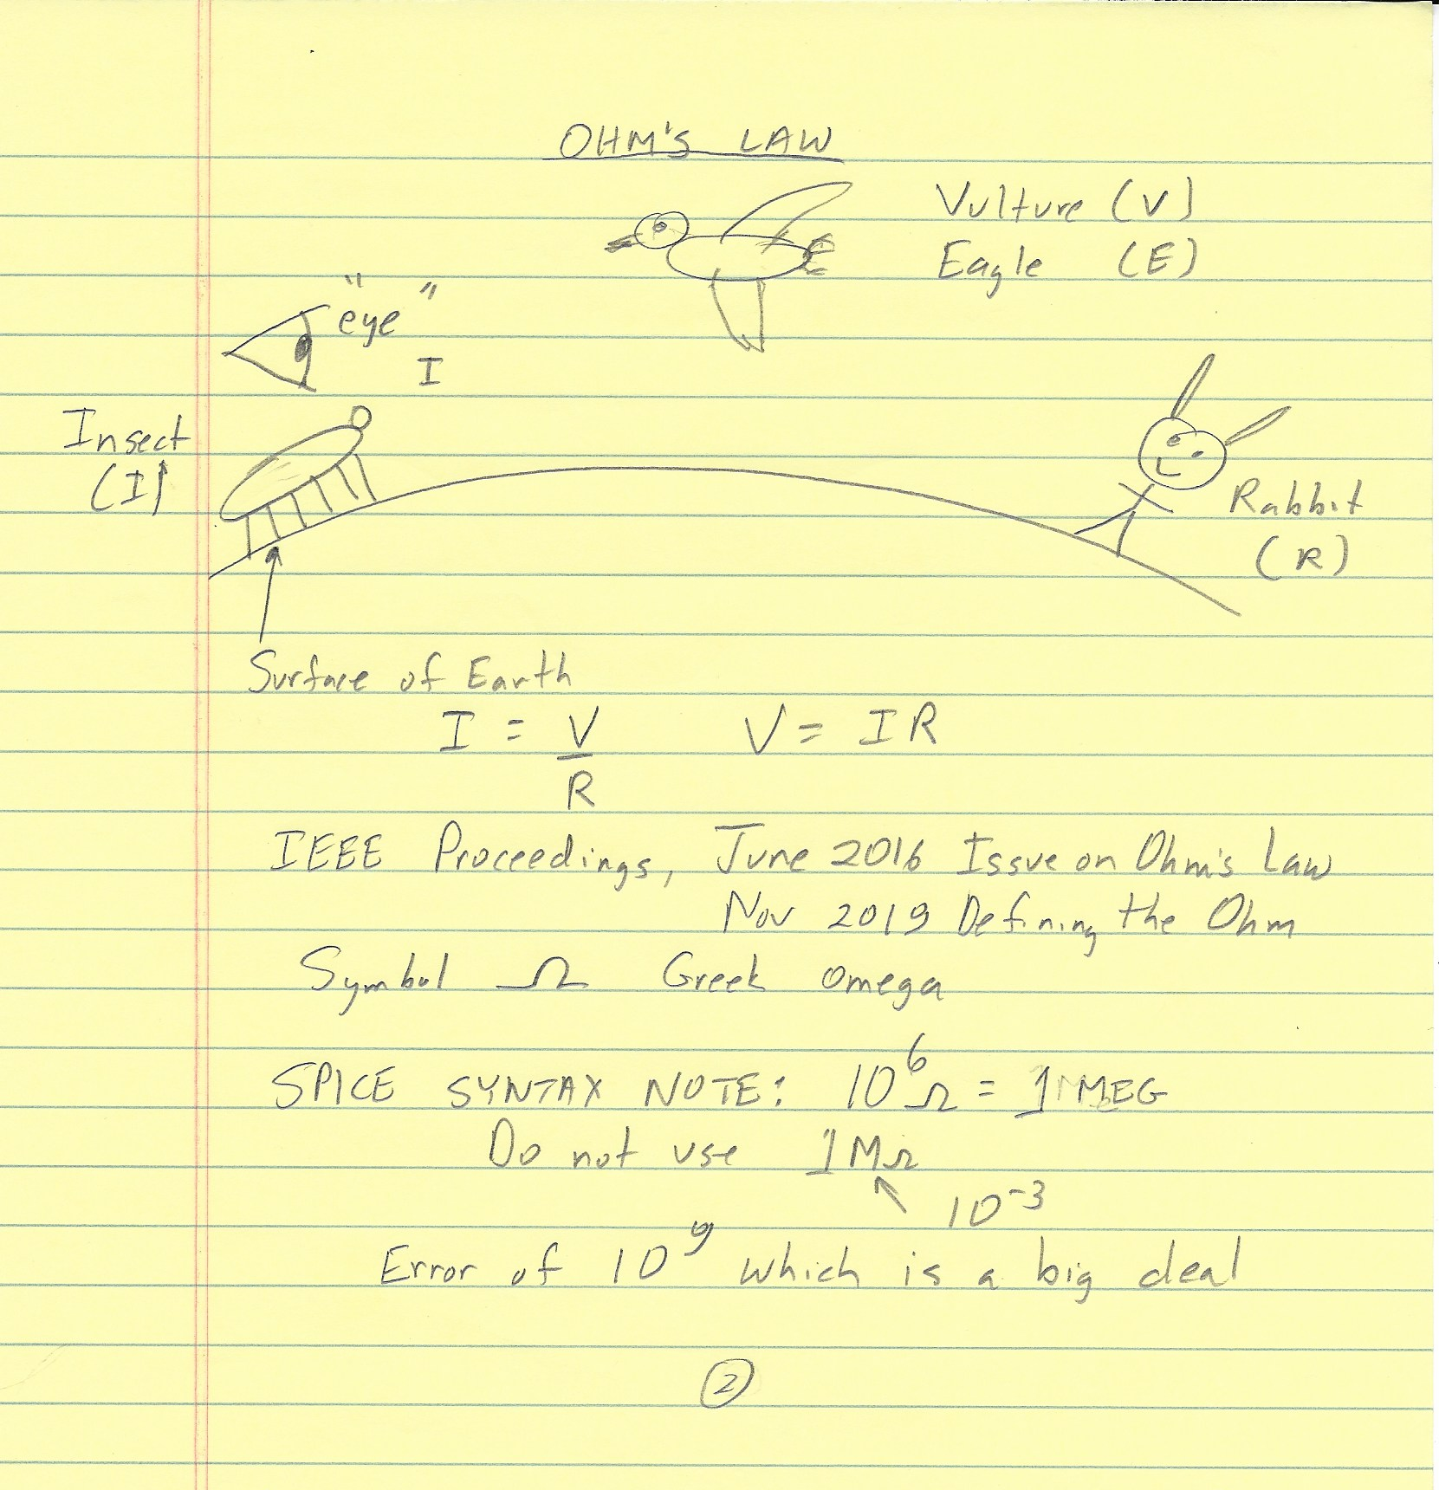

Slide 5
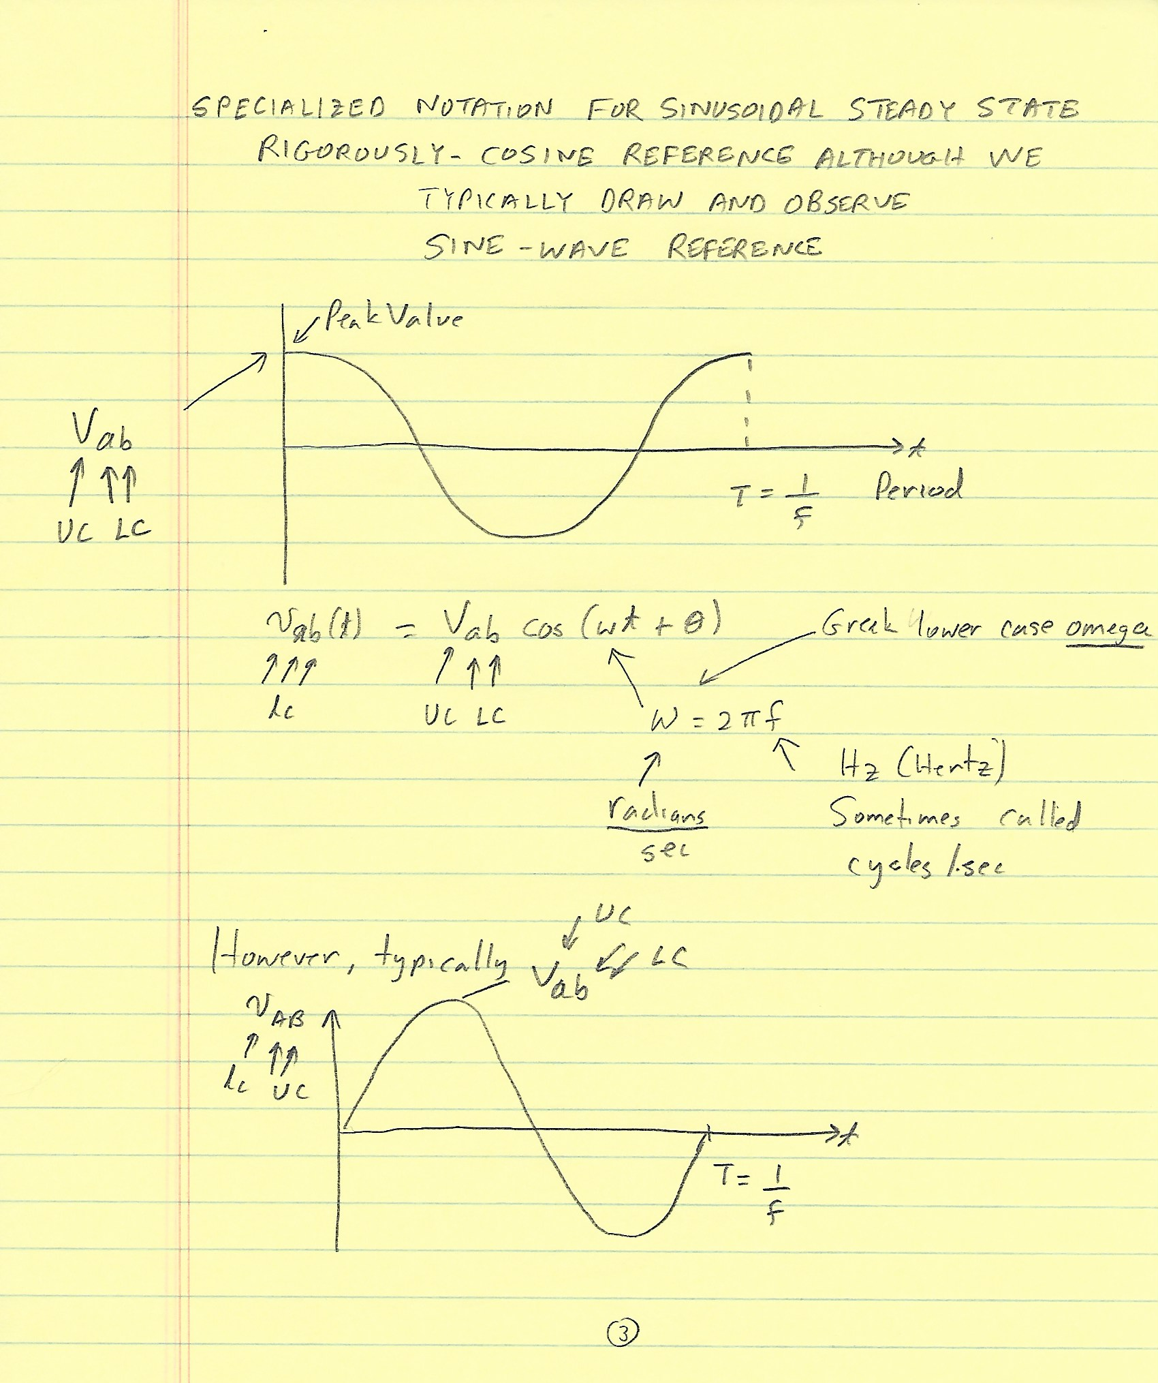

Slide 6
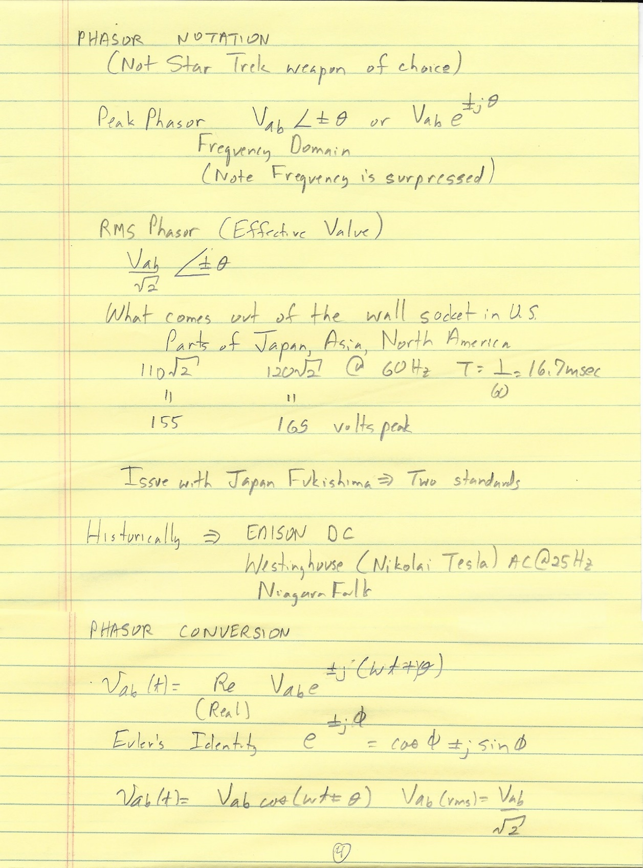
Standards.docx
StarTrekPhasor.jpg

