Slide 1
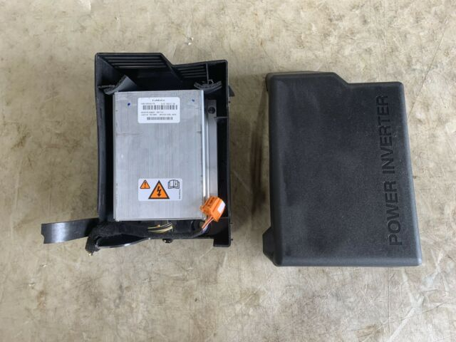
2016 Ford F150 Power Inverter
Brett Johnson

Slide 2
What is it and what does it do?
Able to convert 12VDC to 120-240VAC Sin wave.
Steps down 12VDC to 5VDC for phone charging
Provides Power to a receptacle outlet in the cab and in bed
Can power low or high draw items such as air compressors, small MIG welders,

Slide 3
Specs
Input-12VDC
Output 120-240VAC
Power-400-2000W
Current ratings vary depending on if your using 120V or 240V outlet.

Slide 4
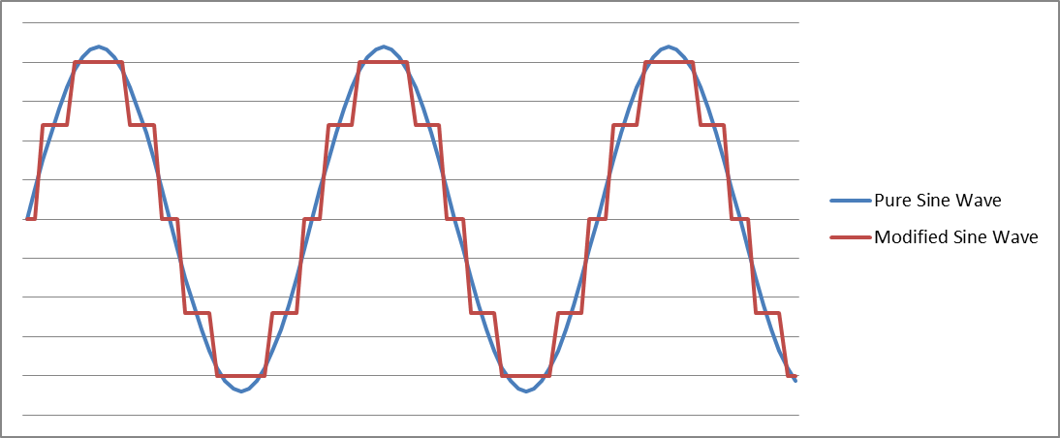
Background
Ford claims this to be a Sin wave inverter
Connecting an oscilloscope to the outlet however we see interesting results
Pure sin wave or Modified sin wave?

Slide 5
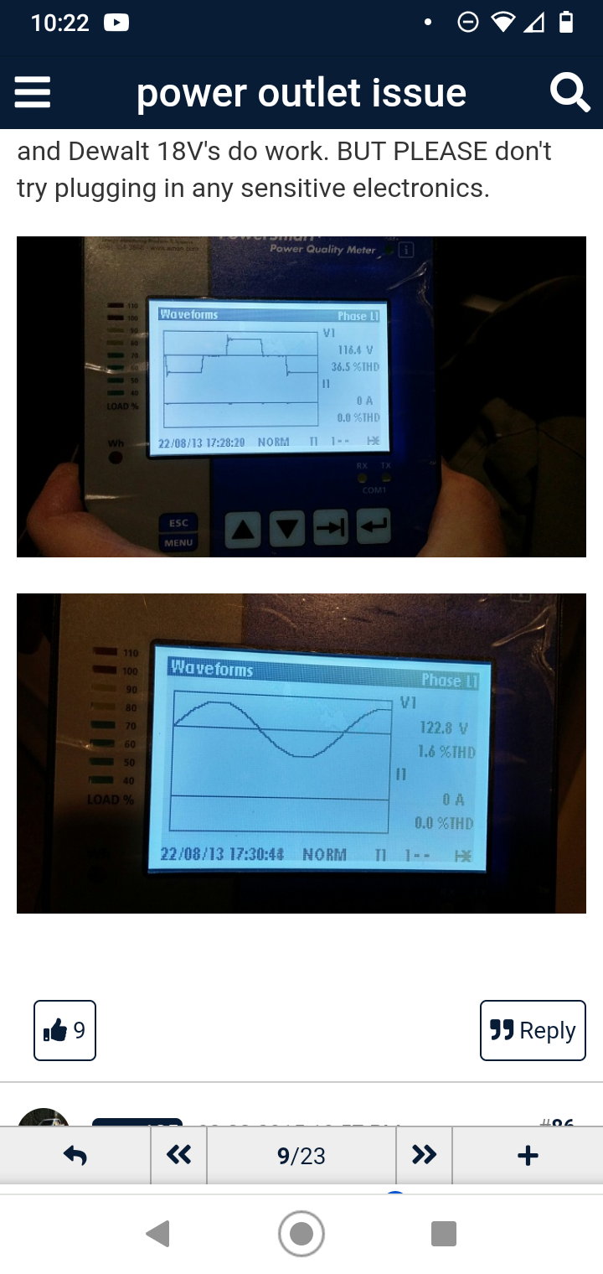
Oscilloscope measurements
Very bad modified sin wave
Don’t plug in sensitive electronics

Slide 6
Circuit Diagrams
Fords specific circuit diagrams are not shared with the public
Wiring diagrams are made available.
Included is a similar simplified circuit that we can assume would be used.

Slide 9
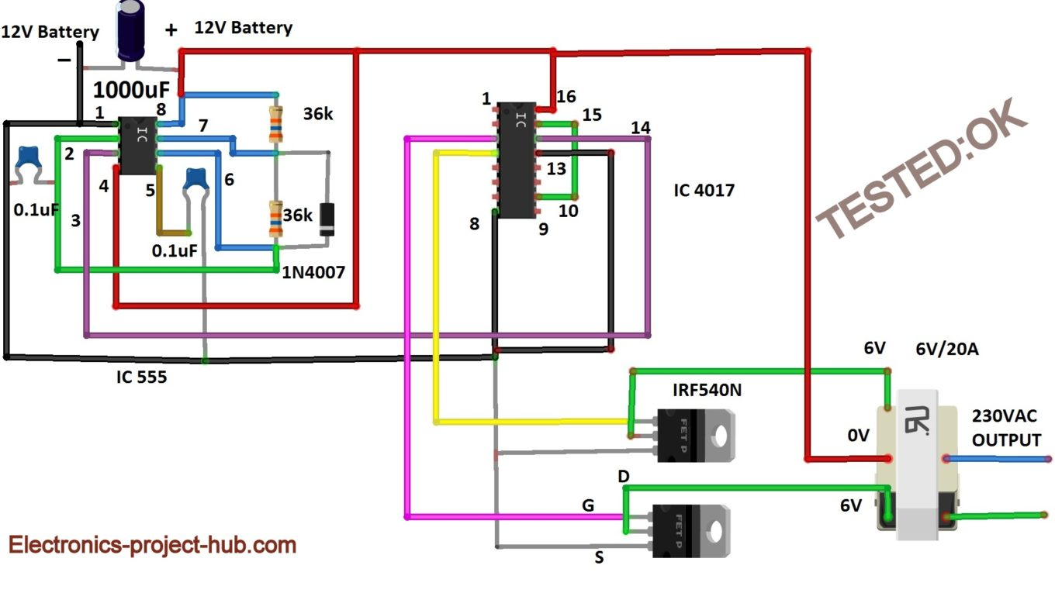

Slide 10
Issues
Issues charging high end drill batteries due to poor sin wave.
Lots of noise in signal
Hard on sensitive electronics many wont even run

