Slide 1
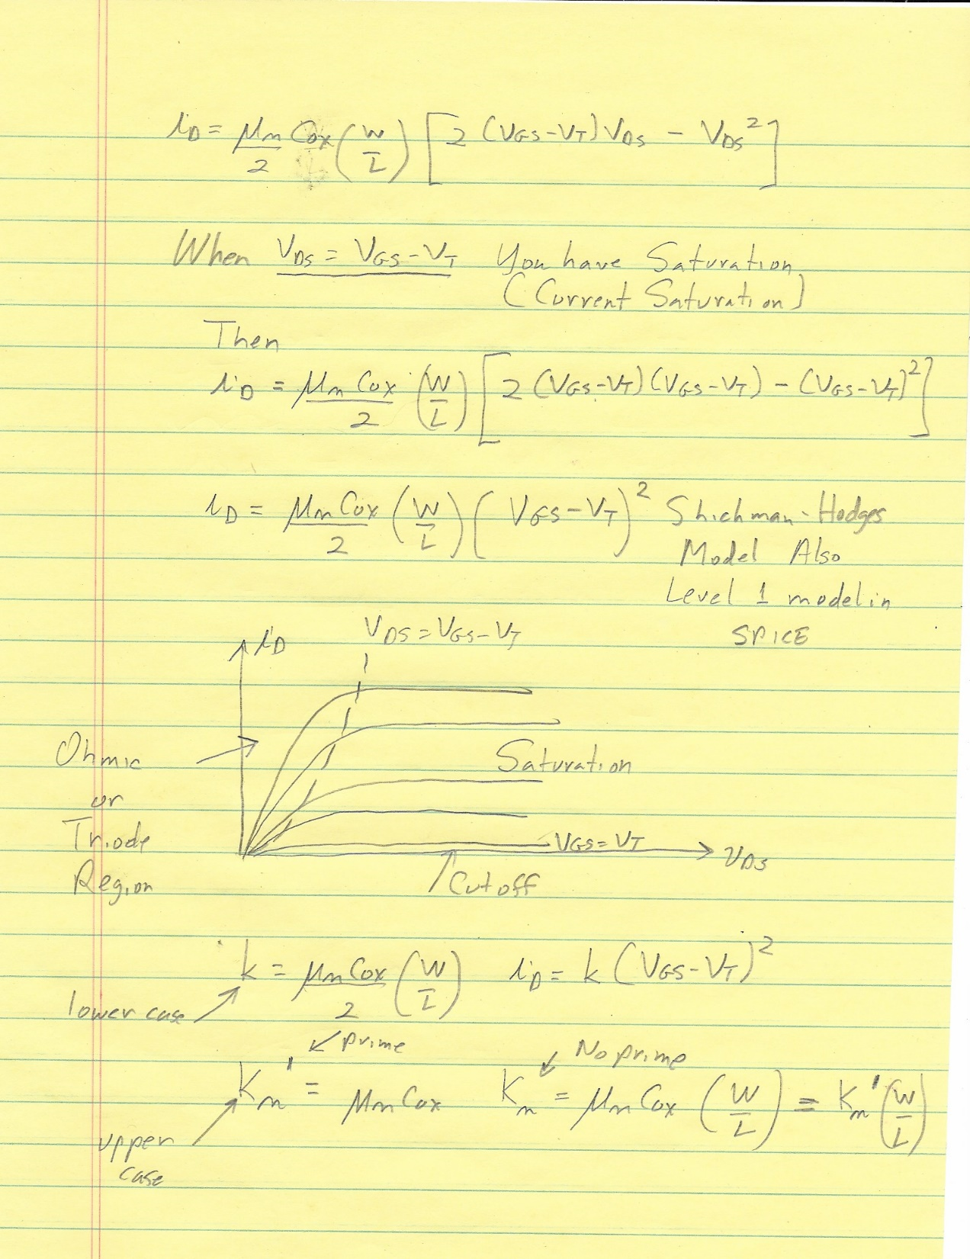
20 and 22 October 2021
Continue With FET Modeling
Channel Length Modulation (LAMBDA, λ)
Small-Signal Model Development

Slide 2
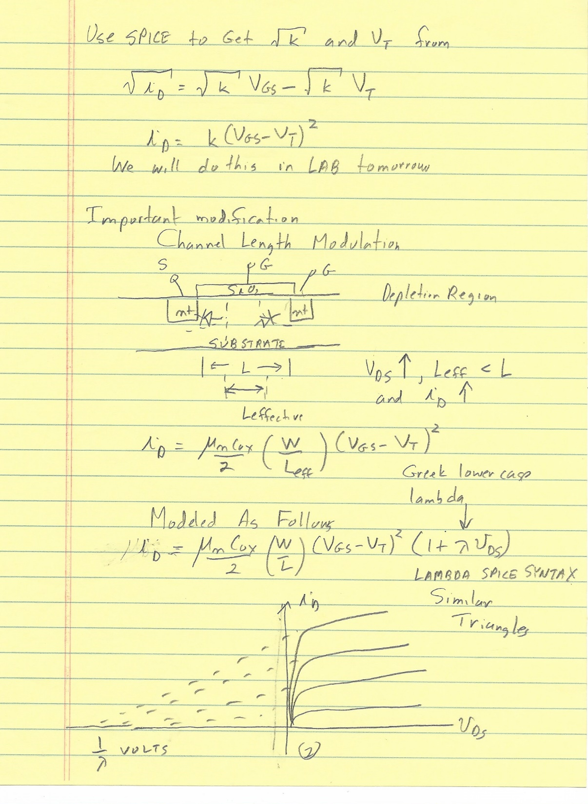
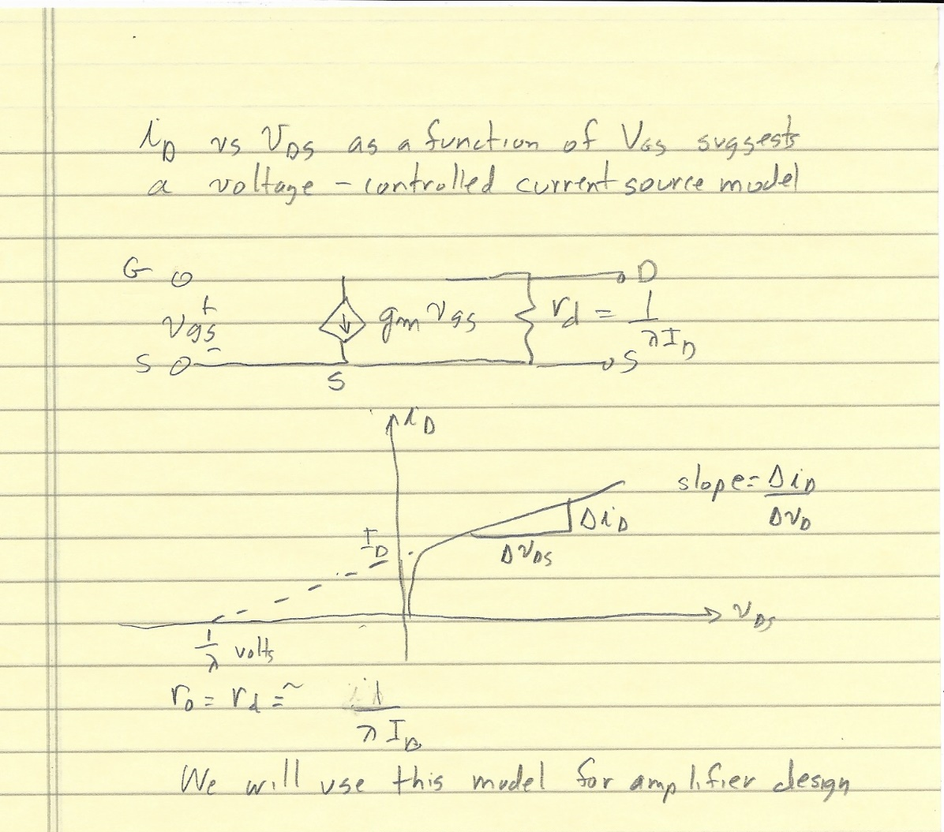

Slide 3
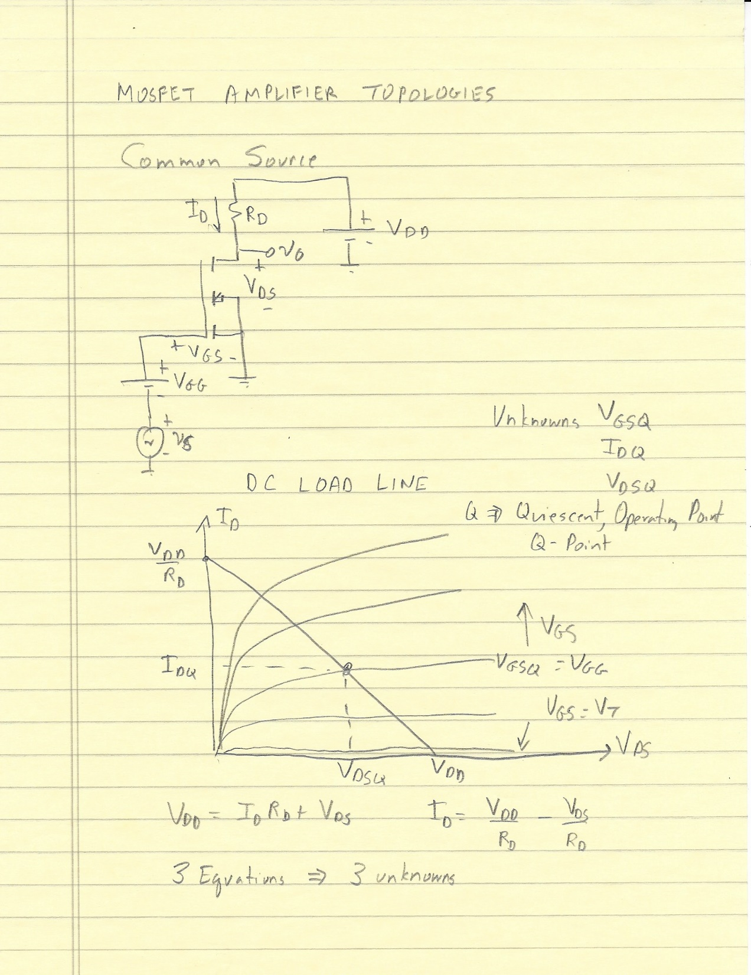

Slide 4
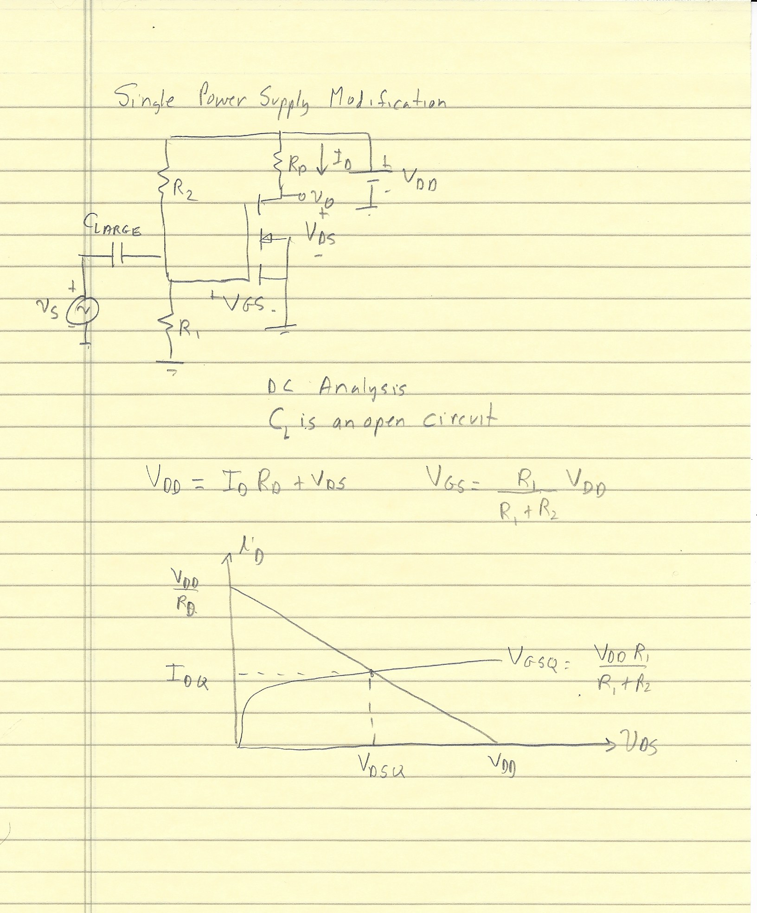

Slide 6
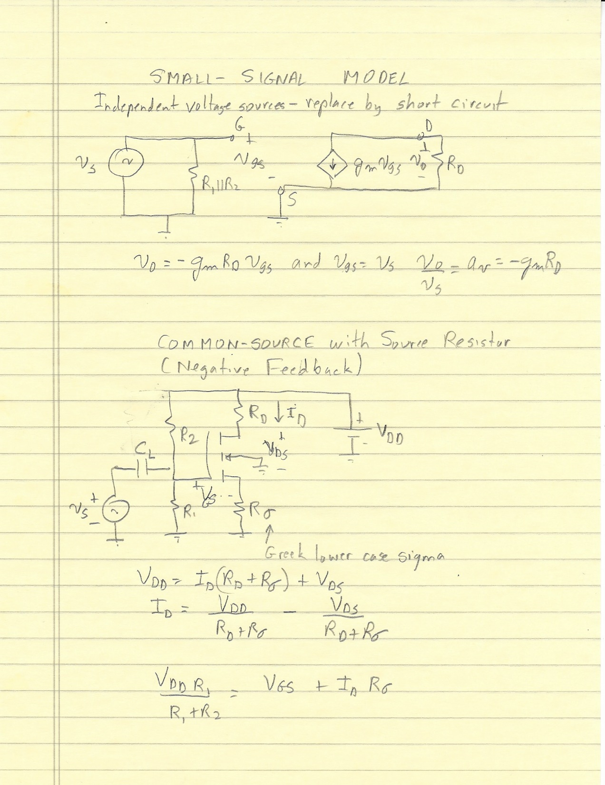

Slide 7
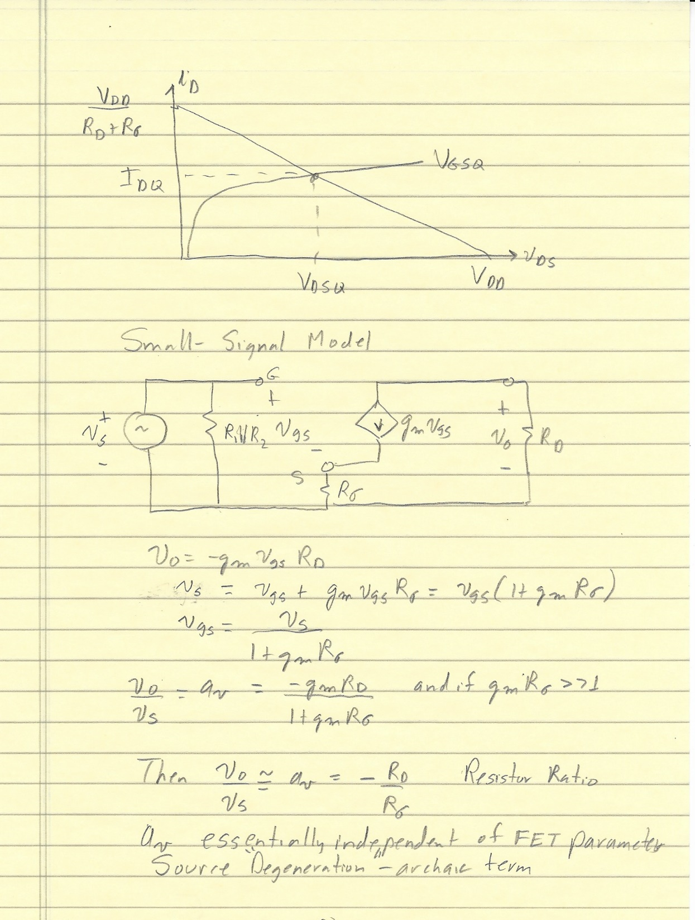
Common-Gate and Common-Drain (Source Follower) Friday and/or Monday Coming Attractions

