Slide 1
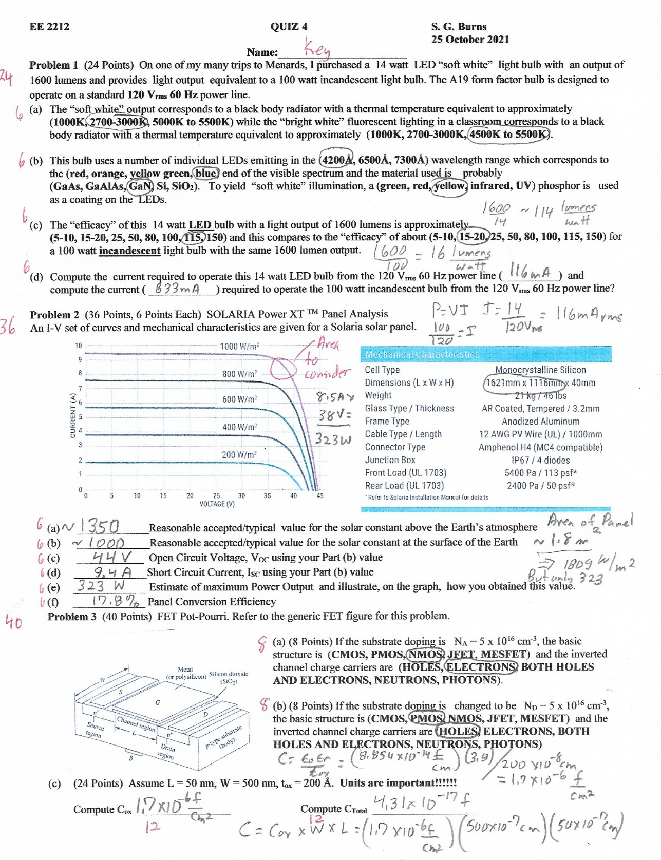
27 October 2021
Go Over QUIZ 4
CG Input Impedance and Matching
CMOS
SPICE CMOS INVERTER (GATE)

Slide 2
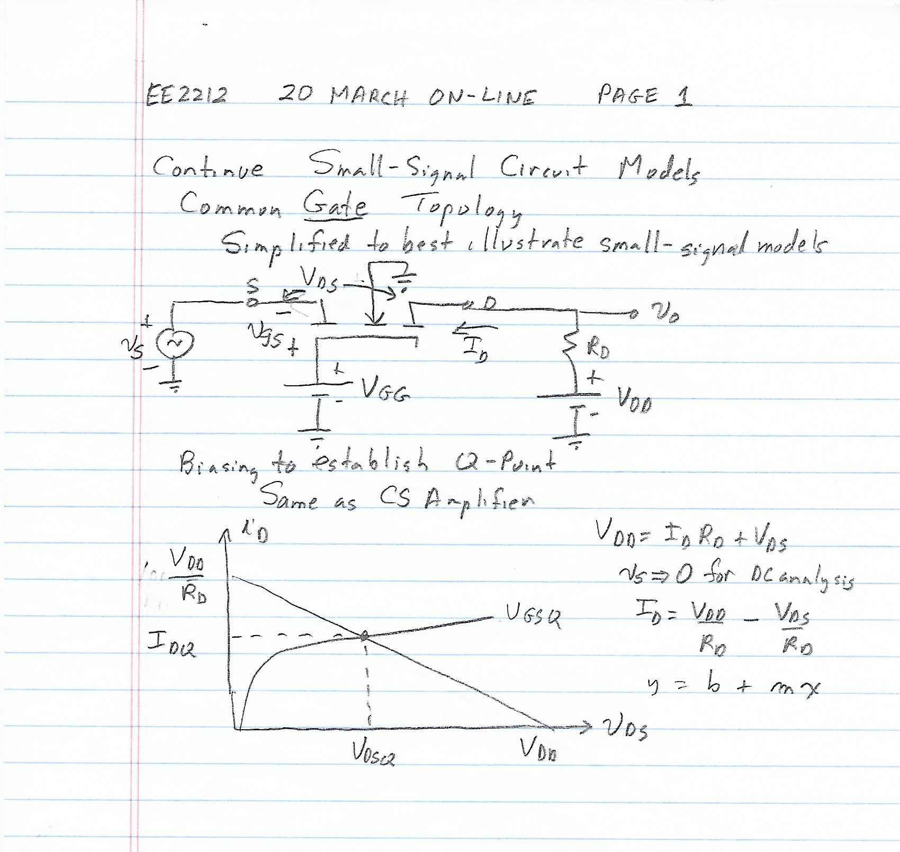
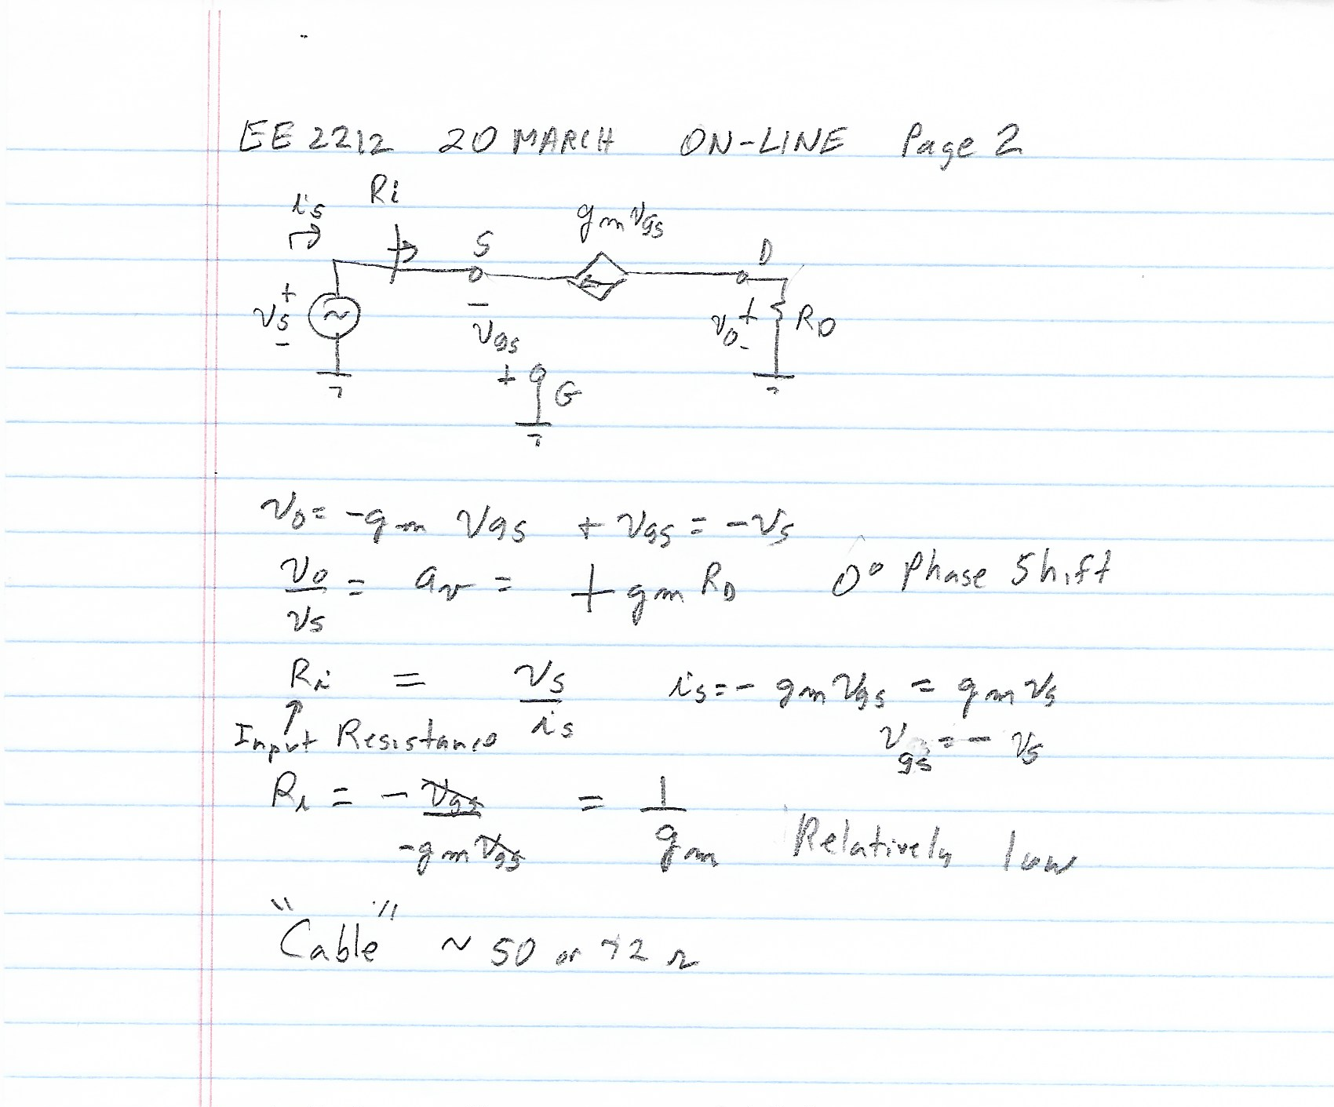

Slide 3
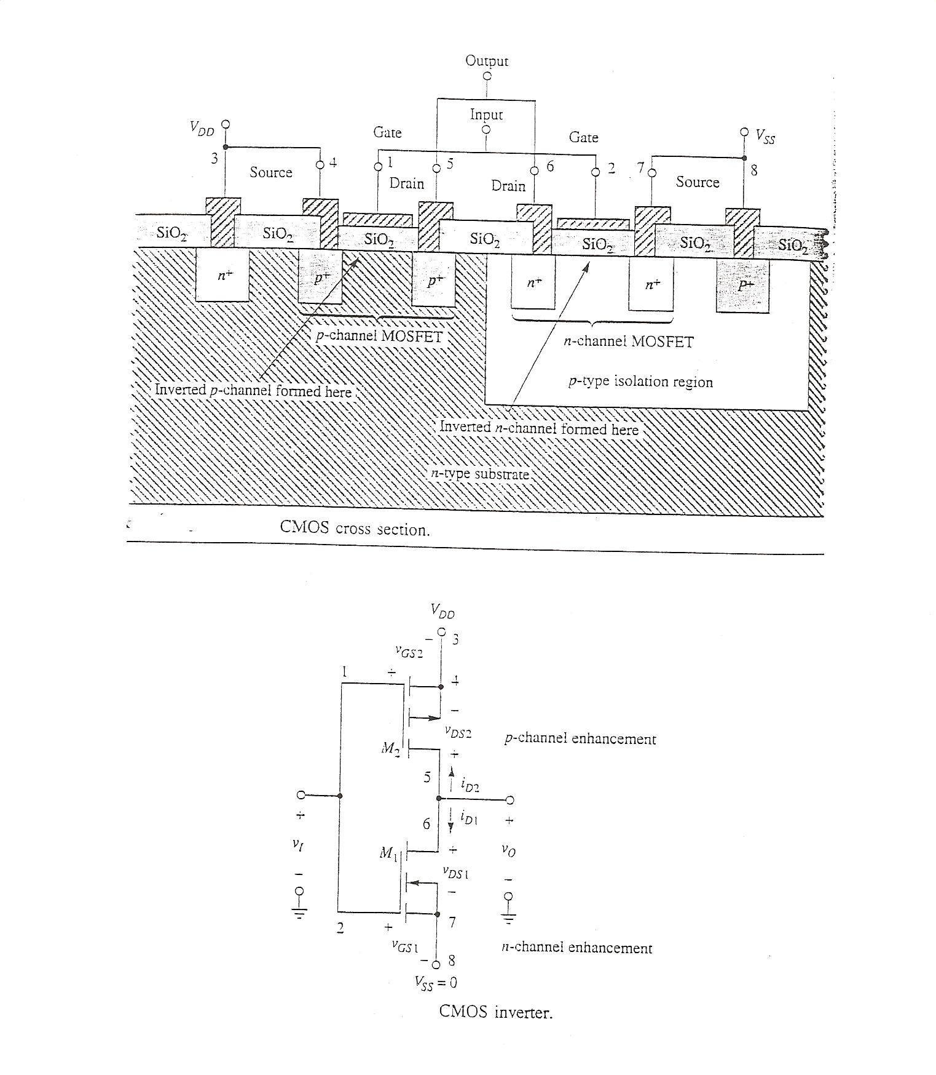
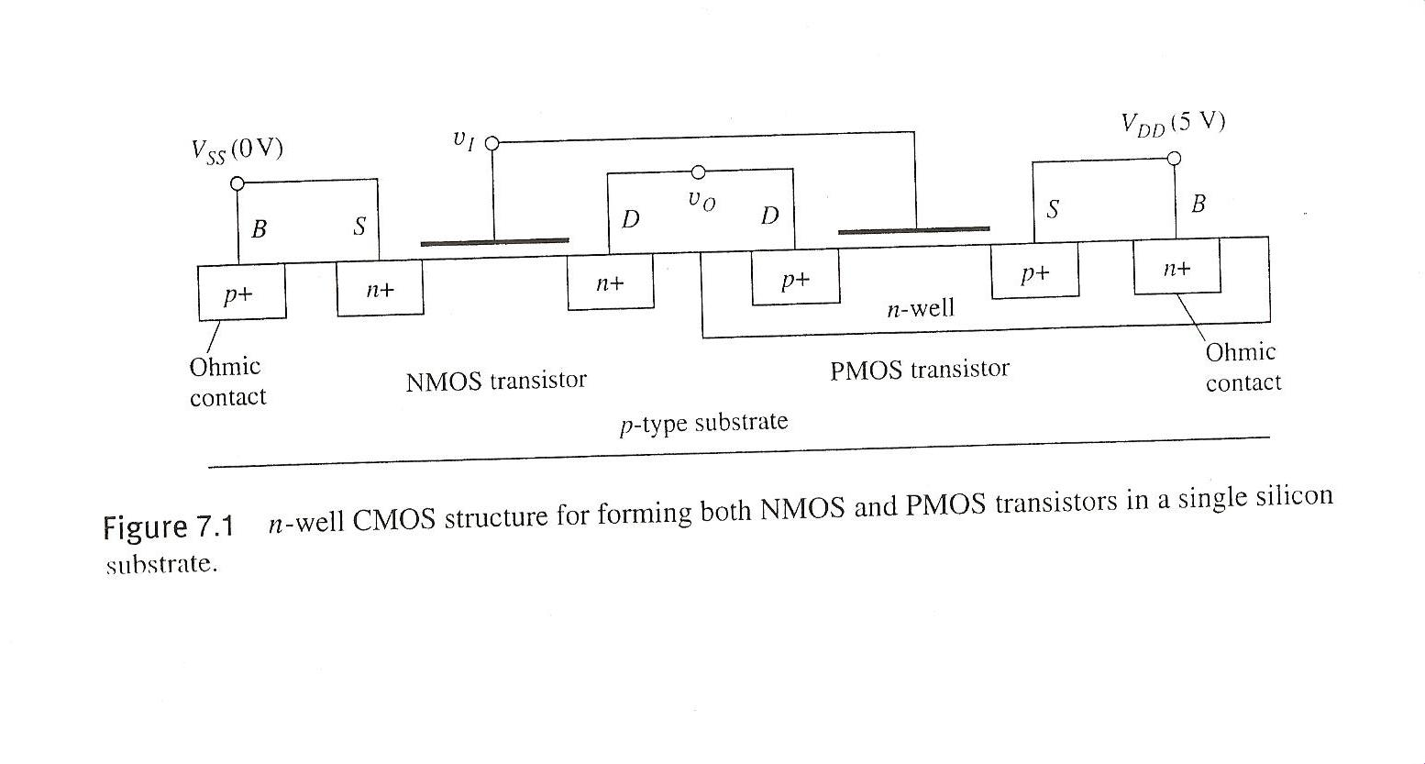

Slide 4
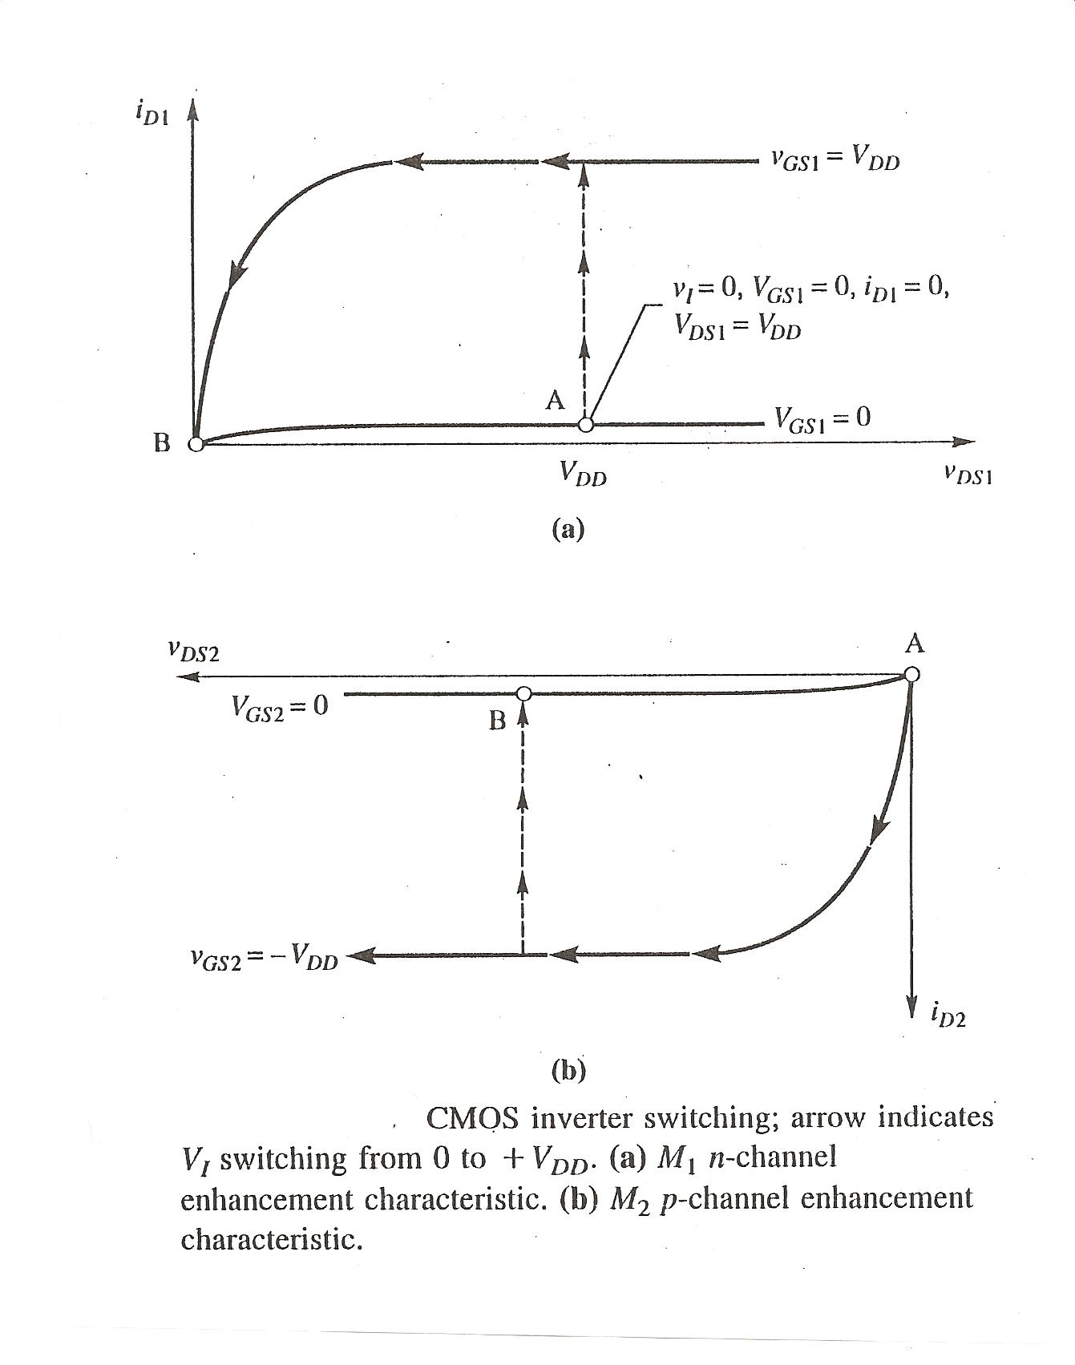

Slide 5
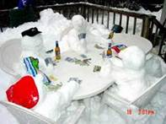
How to spend your Fall Break if Duluth weather were normal-From a good friend at Motorola

