Slide 1
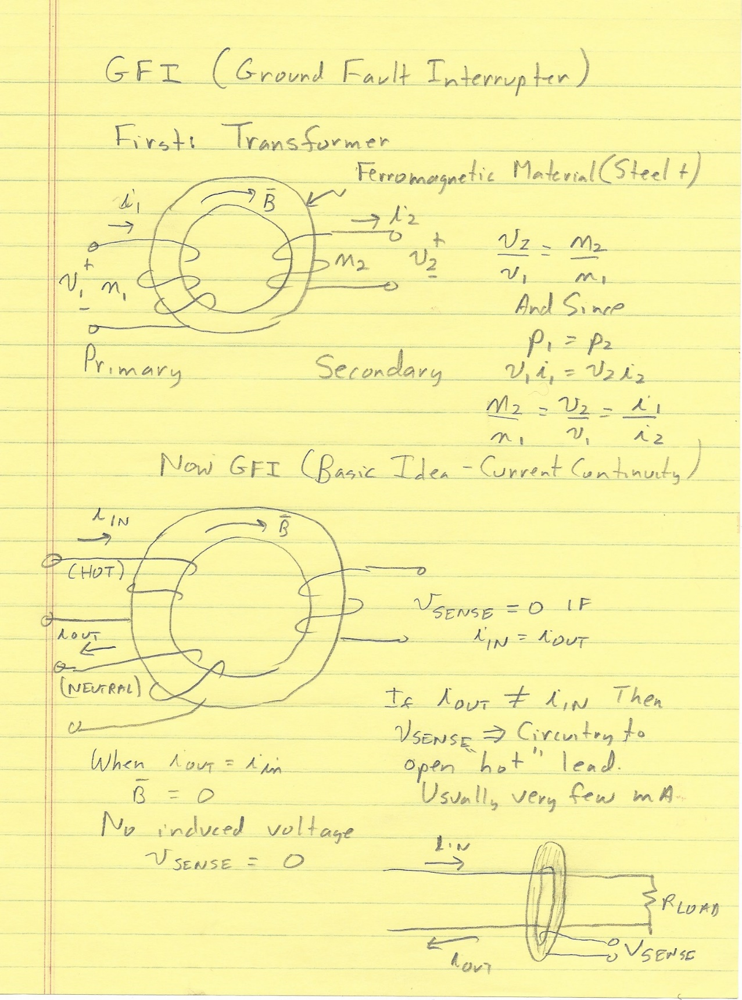
EE 2212 8 September 2021
Transformers
GFI
Dependent Sources
Time Domain Analysis
Introduction to SPICE Transient Analysis
Start the Decibel and Cascaded Systems

Slide 2
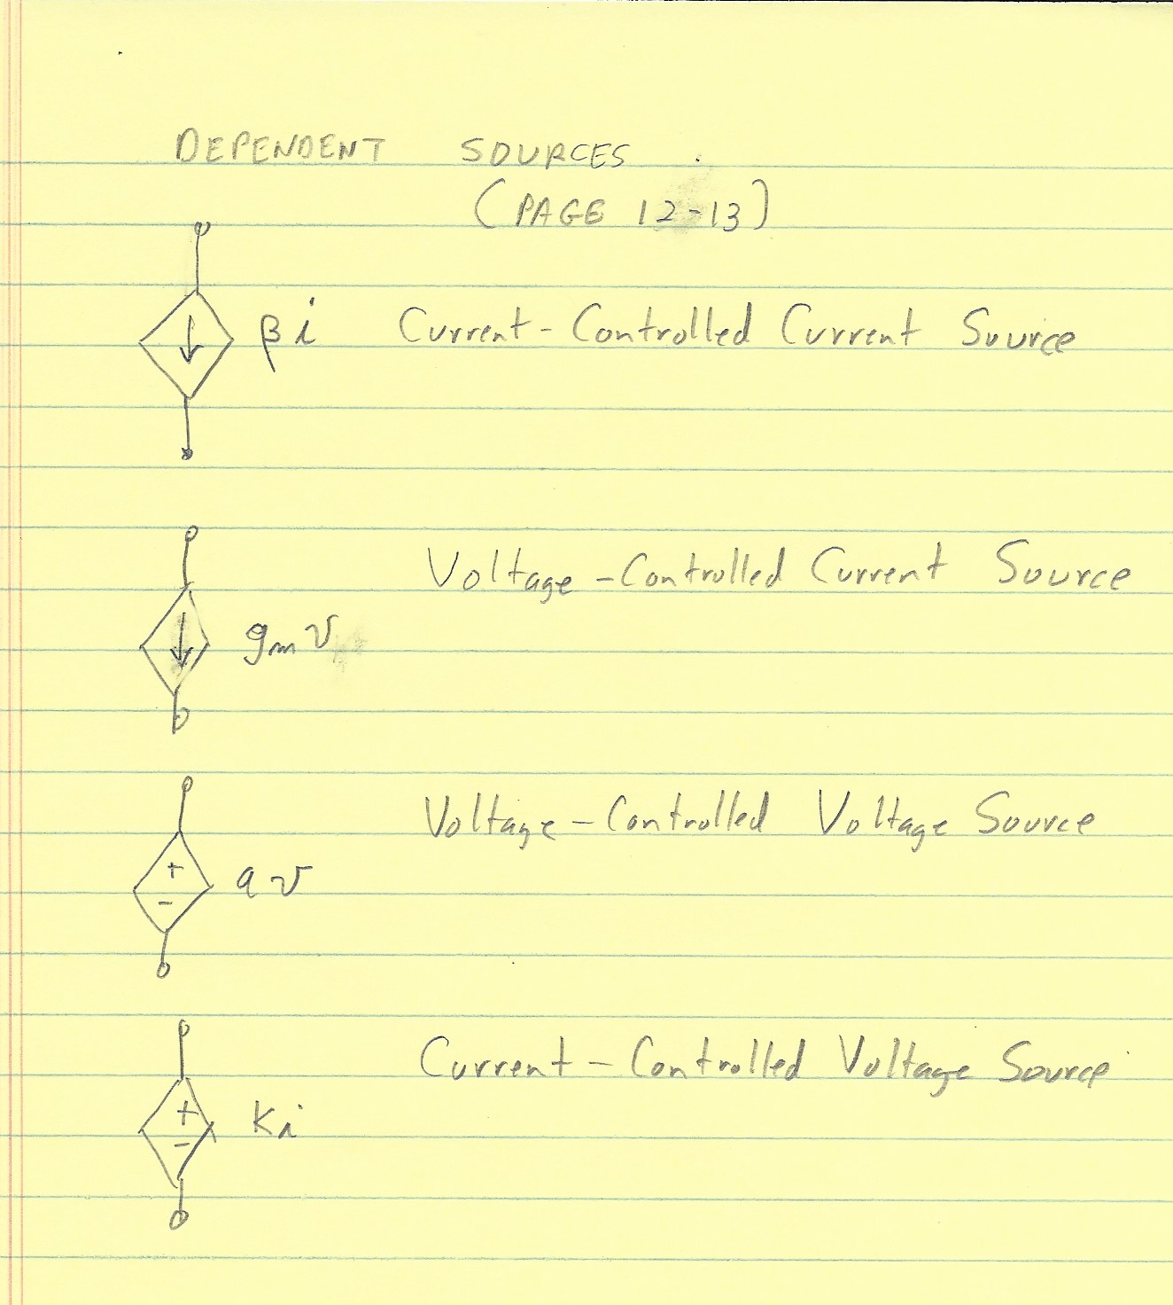

Slide 3
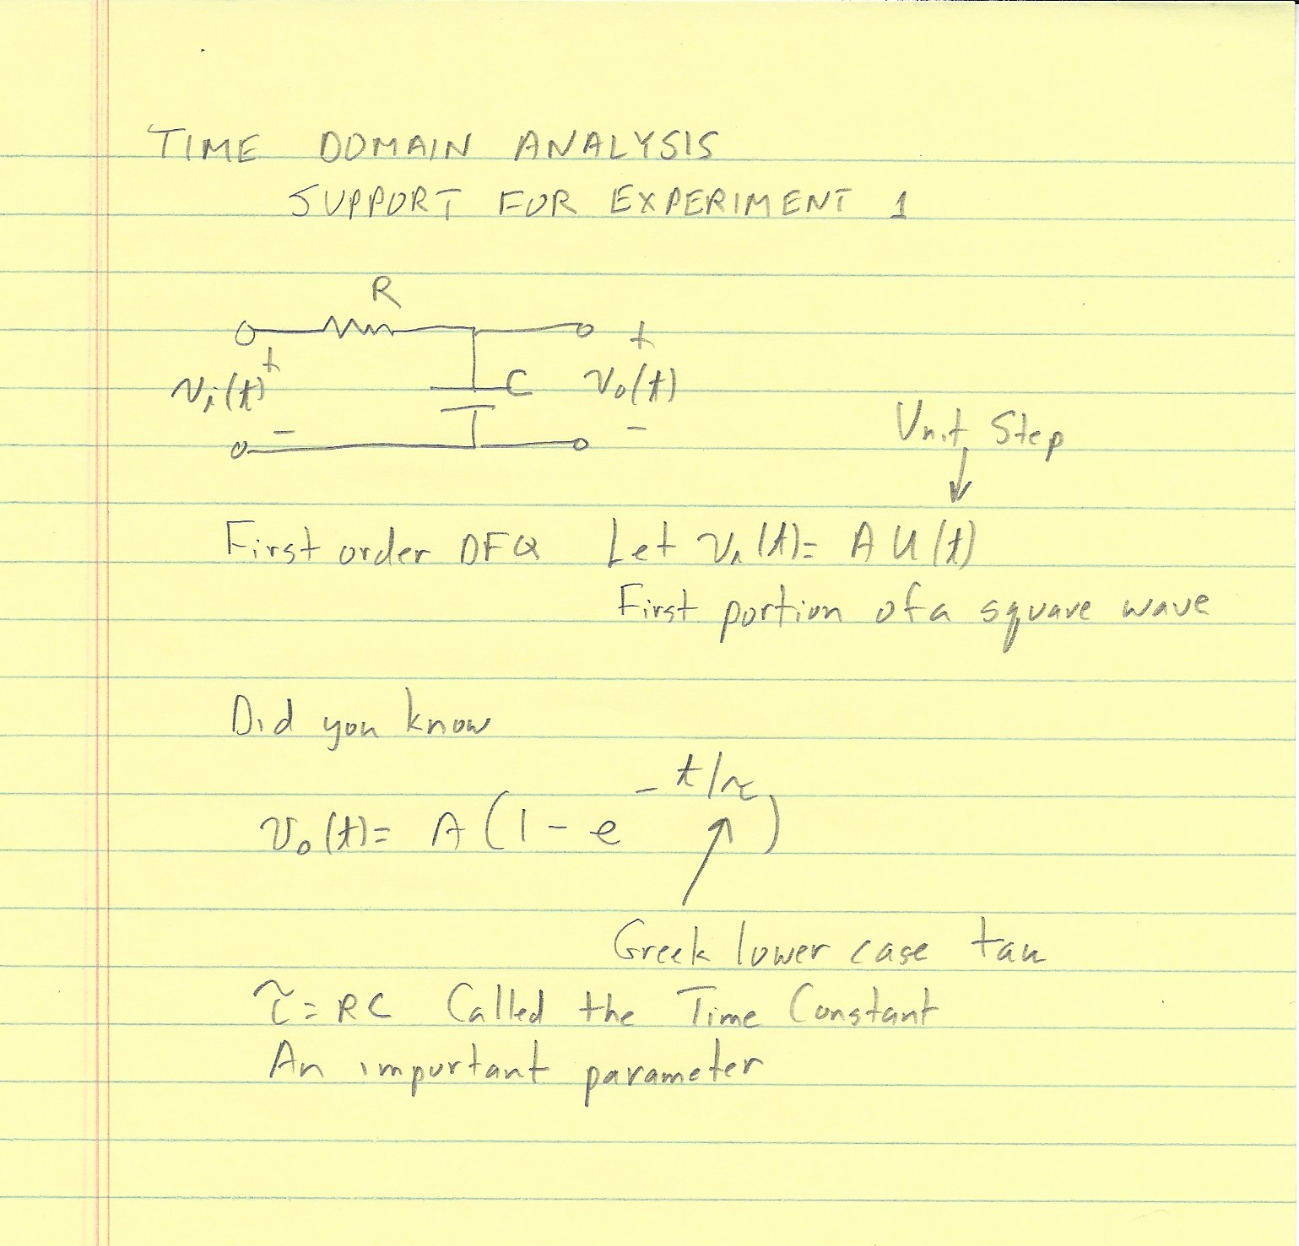

Slide 4
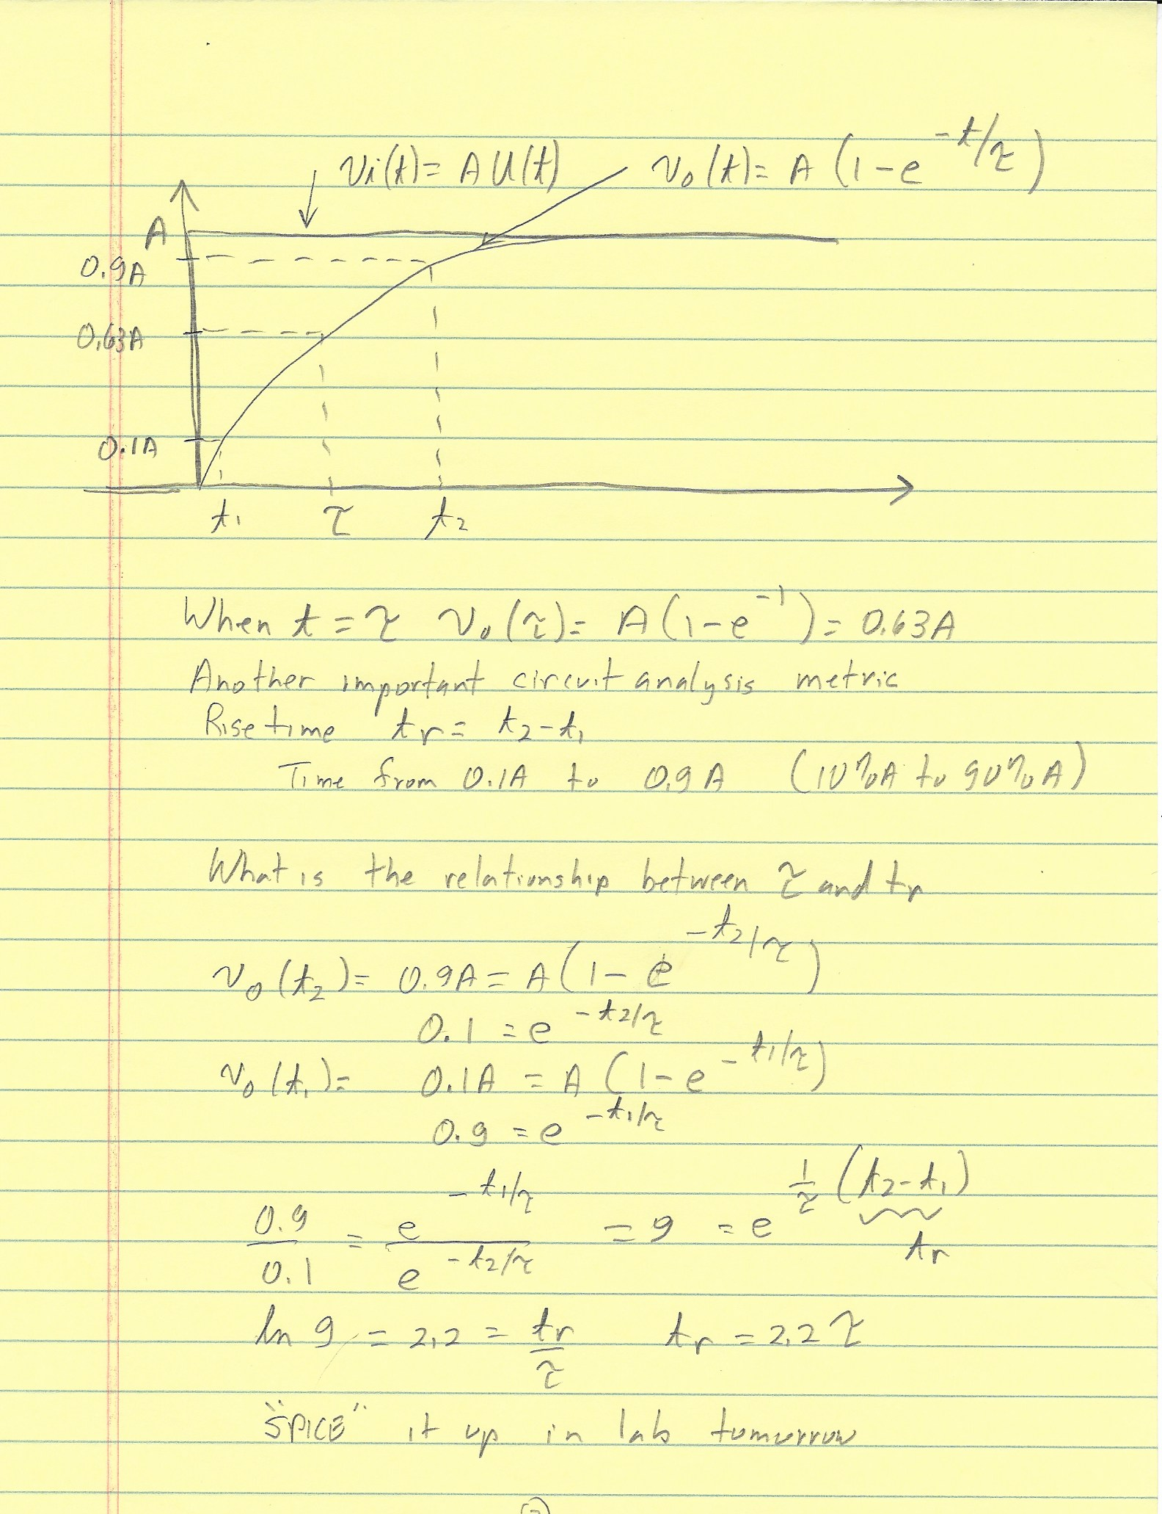
Demonstrate the use PSPICE 9.1 Simulation

Slide 5
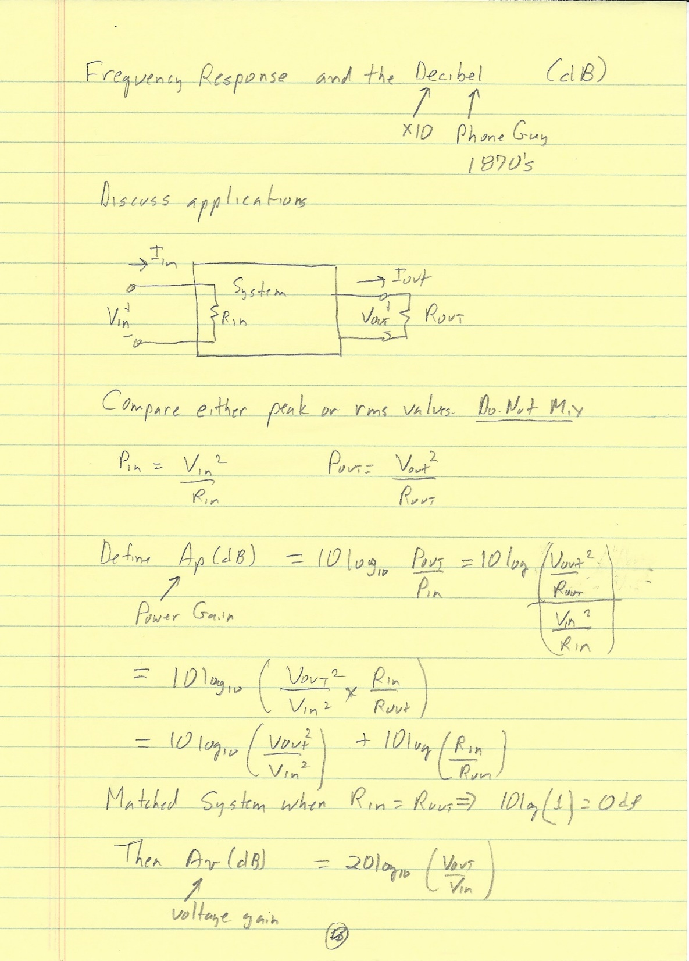

Slide 6
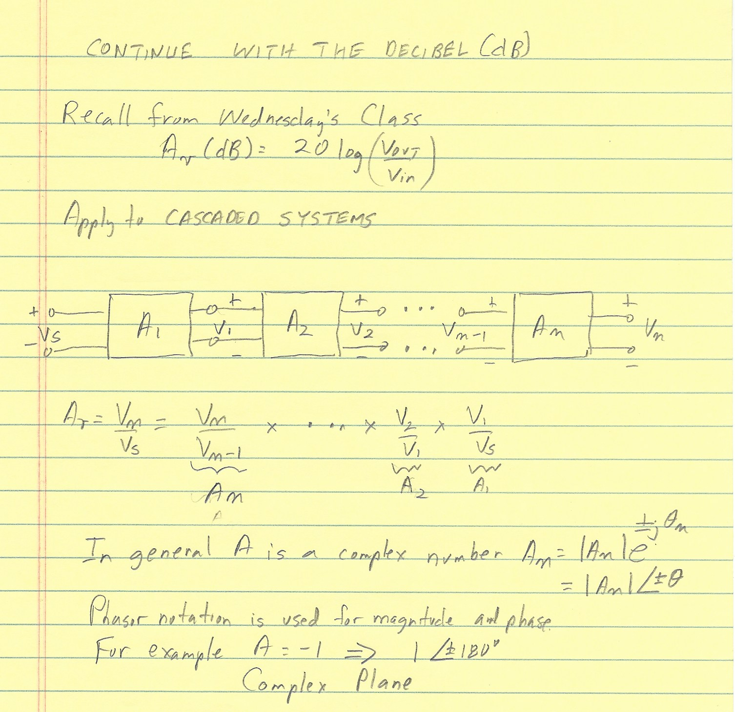
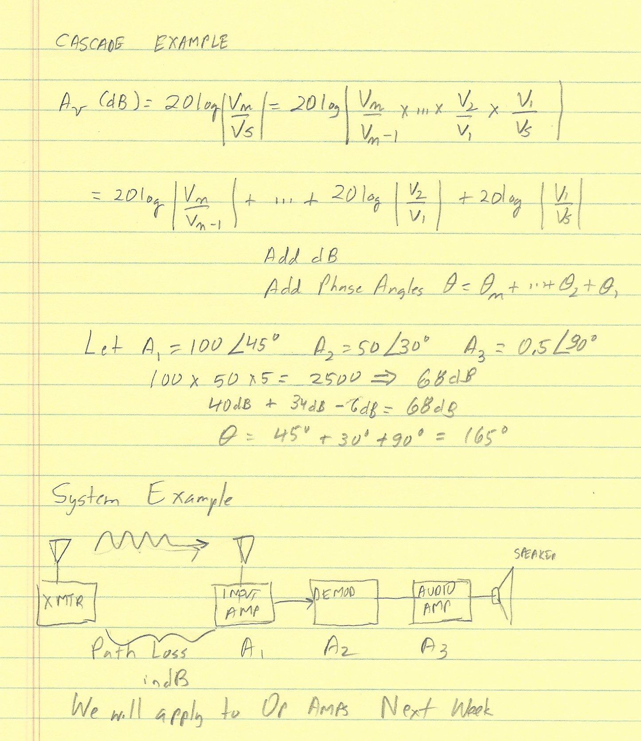

Slide 7
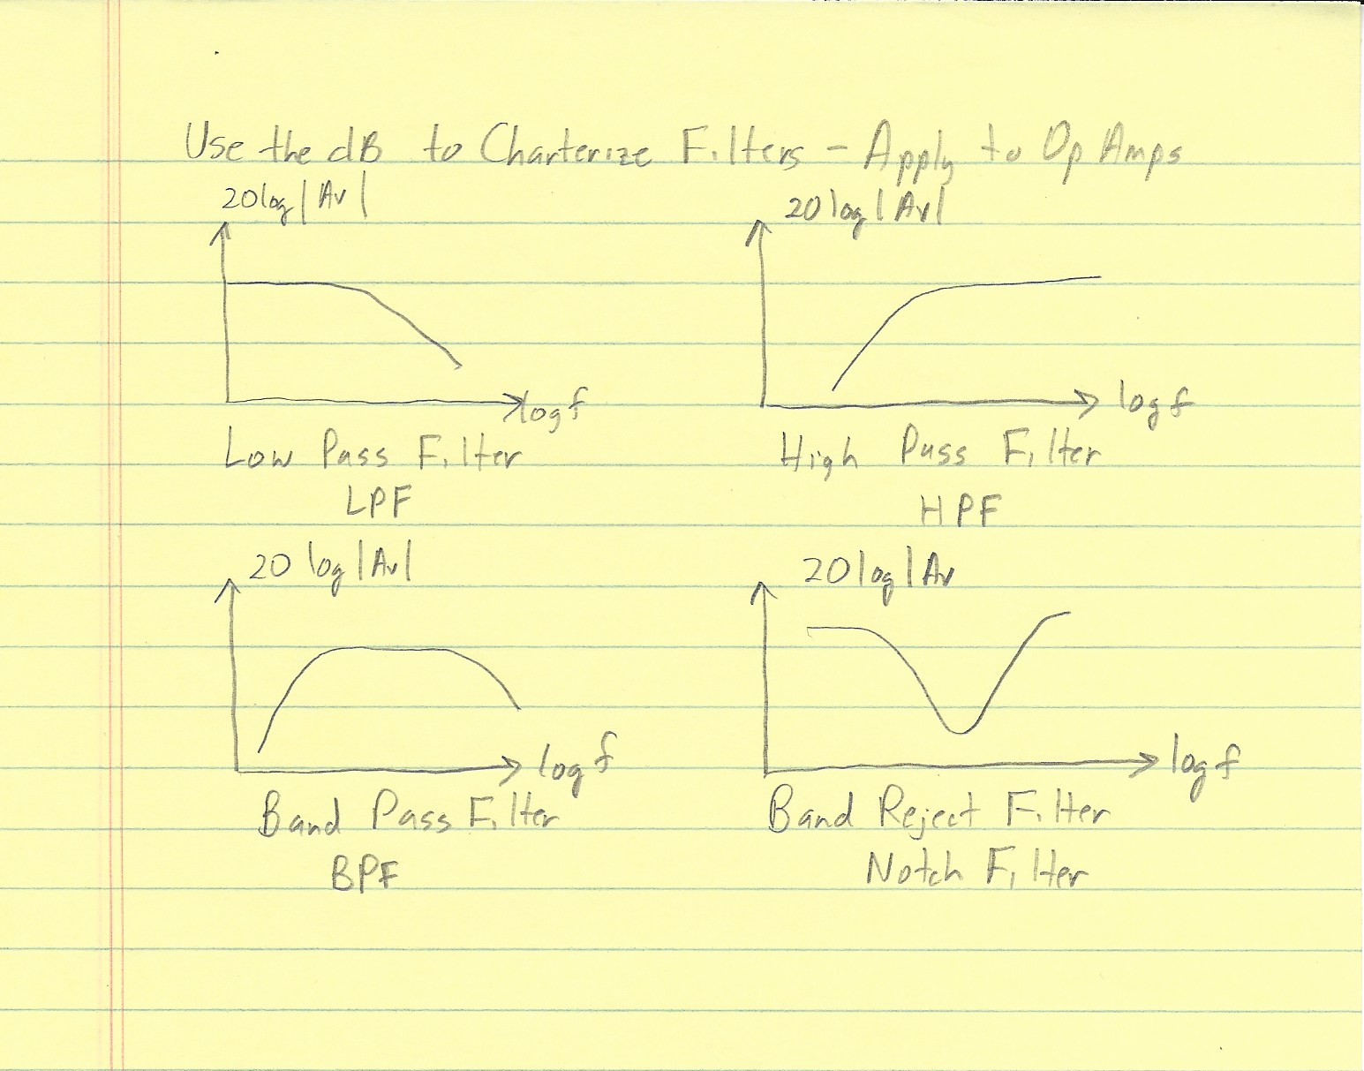

Slide 8
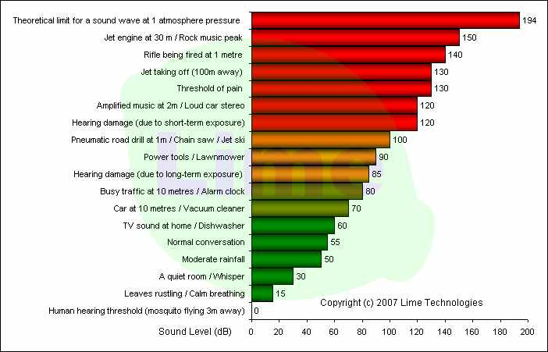

Slide 9
