Slide 1
JBL Charge 3
Shane Boe

Slide 2
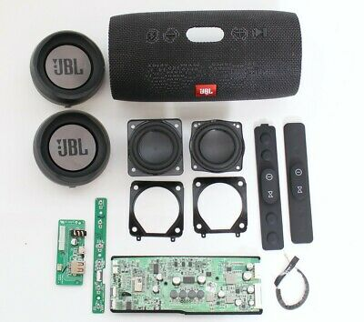
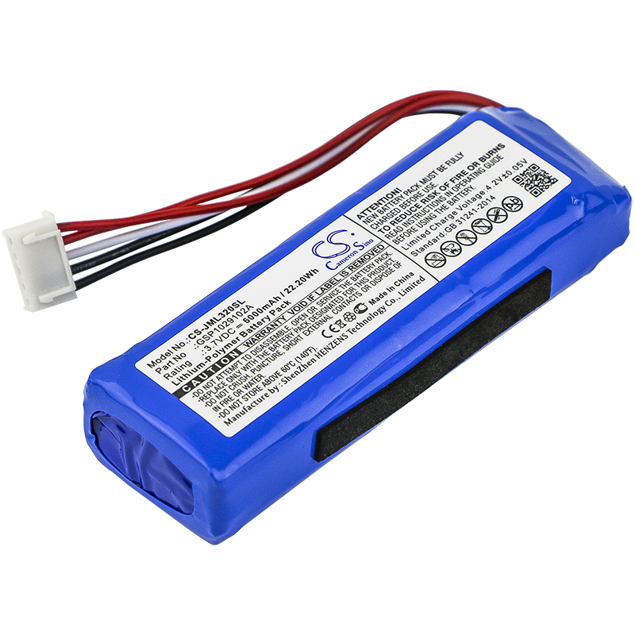
Base product and deconstruction

Slide 3
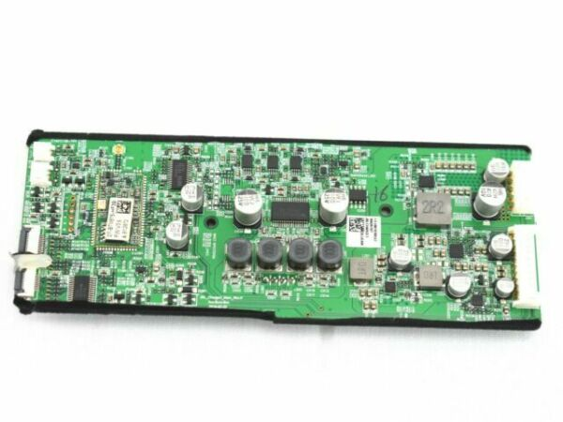
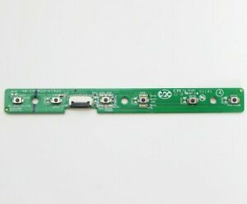
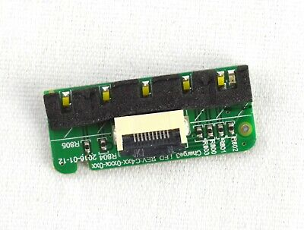
4 base circuit boards
Motherboard Circuit
Micro USB charger circuit board
Button Keyboard circuit
Charge indicator board

Slide 4
Circuit page 1

Slide 5
Circuit page 2

Slide 6
Circuit page 3

Slide 7
Circuit page 4

Slide 8
Circuit page 5

Slide 9
Circuit page 6

Slide 10
Circuit page 7

