Slide 1
Megaphone
Quintin Ruhland

Slide 2
Information
Electric megaphones are handheld public address systems or electronic devices that amplify the human voice or any other sound like a regular acoustic megaphone
They consist of a microphone for converting sound waves into electrical audio signals.
They also come with an amplifier for increasing the audio signal’s power.
The loudspeaker in an electronic megaphone converts the audio signal into sound waves again.
The shape of a microphone has a direct impact on the range of projection. Narrower horns have to concentrate the sound more sharply than the wide horns.

Slide 3
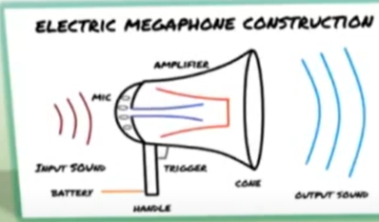
Megaphone
A megaphone is used to amplify a person's voice or other sounds in a given direction
Commonly used in sporting events, or anywhere to address large crowds
Can amplify to more than 90 dB
Rated power output of 35W

Slide 4
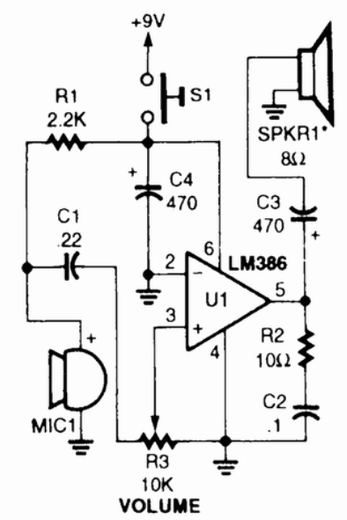
Circuit diagram
This is a very simple loudspeaker amplifier which uses as an IC LM386, which is one of the most versatile amplifiers. The LM386, an operational amplifier receives the signal of MIC1 is a microphone which amplifies it and sends it to SPKR1 which is an 8-ohm speaker mounted in a cone to further amplify the audio signal.

Slide 5
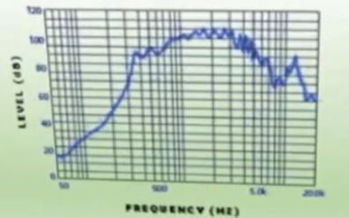
Frequency response
4500-6000 Hz somewhat flat meaning it will be good for inputting human voice frequencies, not good for trying to amplify musical instruments

Slide 6
Specs of Megaphone
3-Way Power Source – 8, size D batteries; included rechargeable battery; 120-volt AC.
Megaphone Specifications:
Output – 35 Watts maximum Operating Time – Approximately 6 hours Audio Range – Up to 800 meters/0.5 mile Recharging Time – Approximately 2 hours depending on remaining power Weight – 2.5 kg/6.7lb without batteries Speaker Diameter – 30 cm/11.8” Length – 47 cm/18.5”
Wireless Modular Specifications:
Carrier Frequency – 170 to 247MHz Emission Type – FM (F3E) Sensitivity – 5uV (SINAD) Frequency Stability – +/- 0.005% @ 25 degrees C/77 degrees F Operating Temperature – - 10 degrees to 50 degrees C/14 degrees to 122 degrees F Maximum modulation – +/- 25KHz Image Rejection – More than 70dB De-Emphasis – 50us Frequency Response – 50Hz to 15KHz Dynamic Range – 100dB Operating Range – 30 to 50 meters/98 to 164 feet in open field

