Slide 1
SEMICONDUCTOR DEVICE FABRICATION
AN OVERVIEW
Presented to
EE 2212
Text Section 2.11 Supplement
17 and 20 September 2021

Slide 2
OUTLINE
Dimensions and Units
What is a Monolithic (“Single Stone”) Integrated Circuit (IC)?
Chip Shortage and Ramifications
Fabrication and Integrated Circuit Overview
Historical Perspectives
Photolithography
Basic process sequence
Packaging
Basic Processing Steps Summary
Other Devices and Technologies

Slide 3
DIMENSIONS AND UNITS
1 micrometer (1 μm) = 10⁻⁶m = 10⁻⁴cm
1 Å = 10⁻¹⁰m = 10⁻⁸cm (Å =Angstrom)
10,000 Å = 1 μm = 1000 nm
1 nanometer (1 nm) = 10⁻⁹ m = 10 Å
Wavelength of visible light 0.4 μm(violet) to 0.7 μm(red)
{400 nm to 700 nm, 4,000 Å to 7,000 Å }
1 mil = 0.001 inch = 25.4 μm
Sheet of notebook paper about 4 mils = 100 μm
1 human hair = 75 μm to 100 μm = 75,000-100,000 nm
Atomic spacing in a crystal ~ 3 to 5 Å
Fingernail growth rate about 1-3 μm/hour (Not personally verified)
Aggressive production minimum feature sizes, tens of nm or less, iPhone 12, A14 processor, 7 nm (70 Å or about 15 atoms wide), 5 nm imminent
14 nm in state-of-the-art memory from Micron
Speed of Light c= 3x10⁸m/sec = 300 m/μsec = 0.3 m/nsec (About 1 foot/nsec)
3 GHz clock speed
T = 0.33 nsec
Signal or Photon Travels About 4 inches

Slide 4
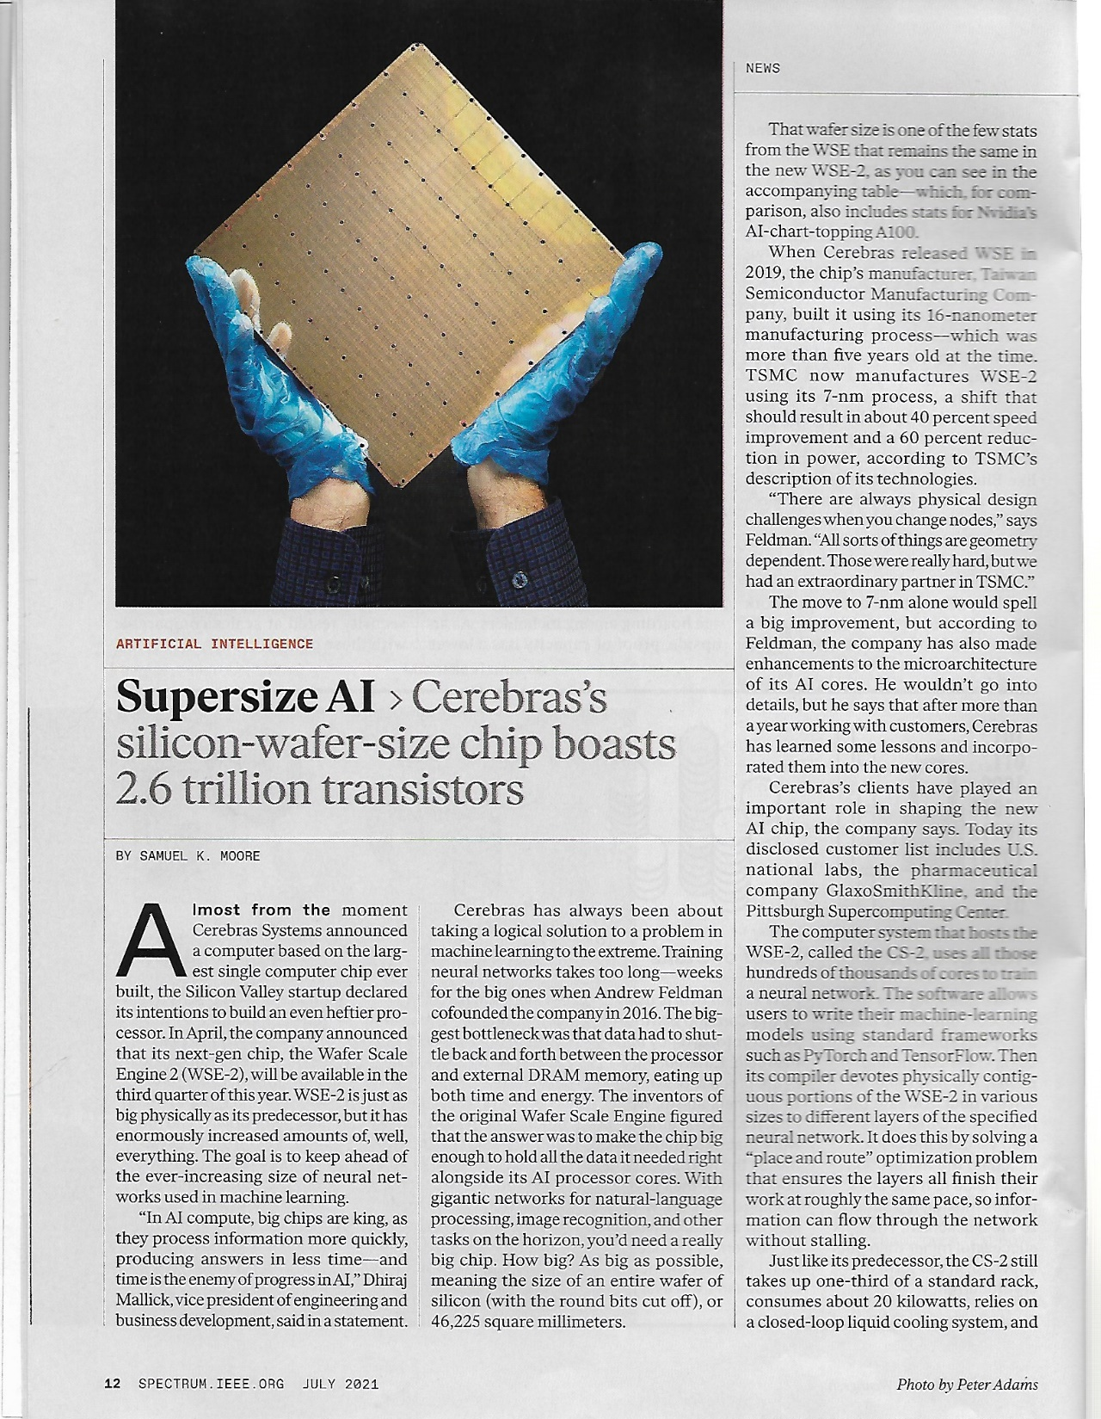

Slide 5
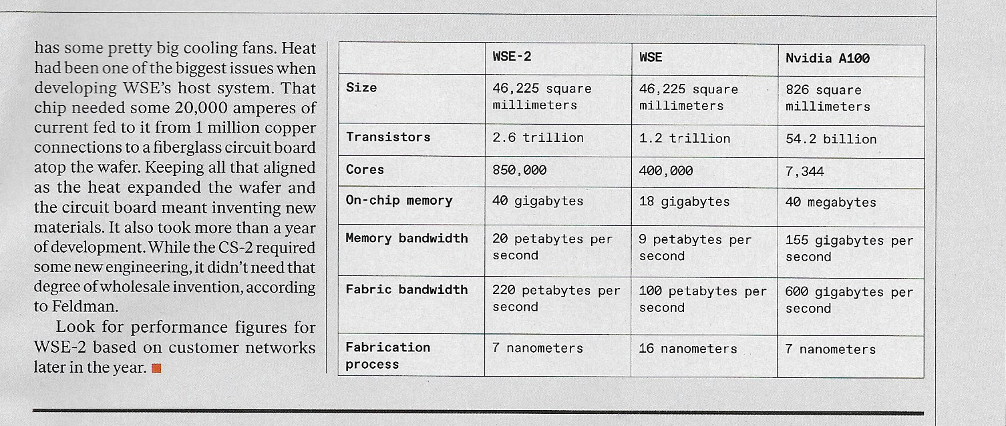
1 TeraByte = 1000 GigaBytes
1 PetaByte = 1000 TeraBytes = 1,000,000 GigaBytes
Giga = 10^9 Tera = 10^12 Peta = 10^15

Slide 6
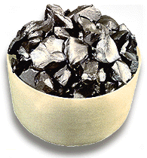
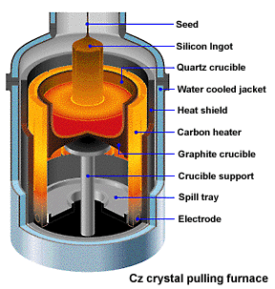
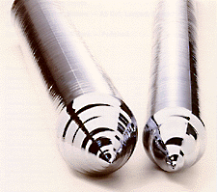
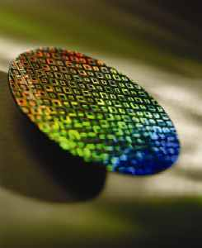
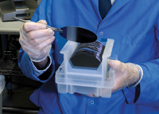
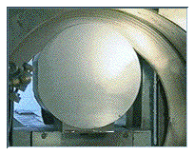
IC Fabrication Overview
Procedure of Silicon Wafer Production
Raw material ― Polysilicon nuggets purified from sand
Up to you. Keep in touch.
Si crystal ingot
Up to you. Keep in touch.
Crystal pulling
A silicon wafer fabricated with microelectronic circuits
Final wafer product after polishing, cleaning and inspection
Slicing into Si wafers using a diamond saw
6
Notes:
(1) Raw material from sand and made into the polysilicon nuggests
(2) The polysilicon nuggets are placed into the quartz crucible. Quartz crucible, surrounded by graphite heater, 1600degree C. Metling it rotated. The melted nuggets can be pulled out slowly using a crystal seed. The crystal seed the shape is long thin needle. When it pull out and colled and formed the cylinder shpaed inget. The ingot is single crystal slicon.The diameter of the ingot is deciced by the temperature when melting and the rotating speed when it pulled out.
Pure crystal cylindar ingets.temparatue and rate decide the diameter

Slide 7
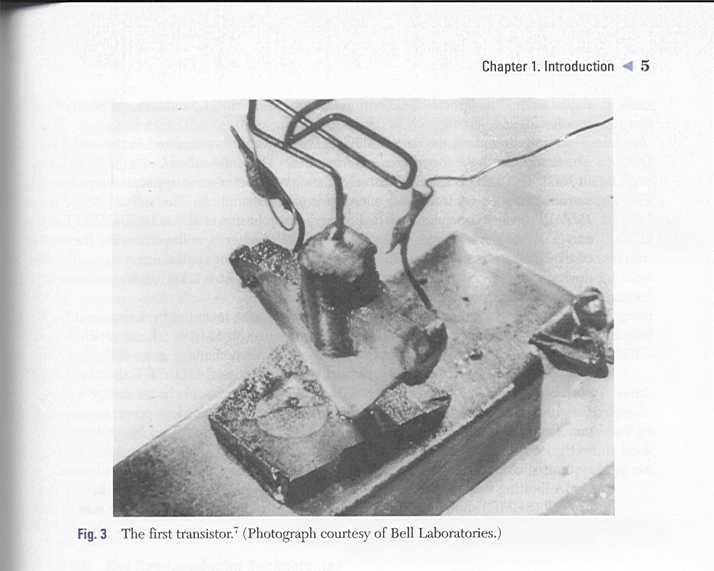
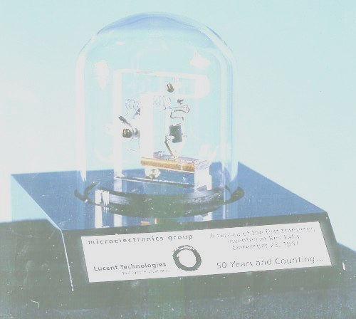

Slide 8
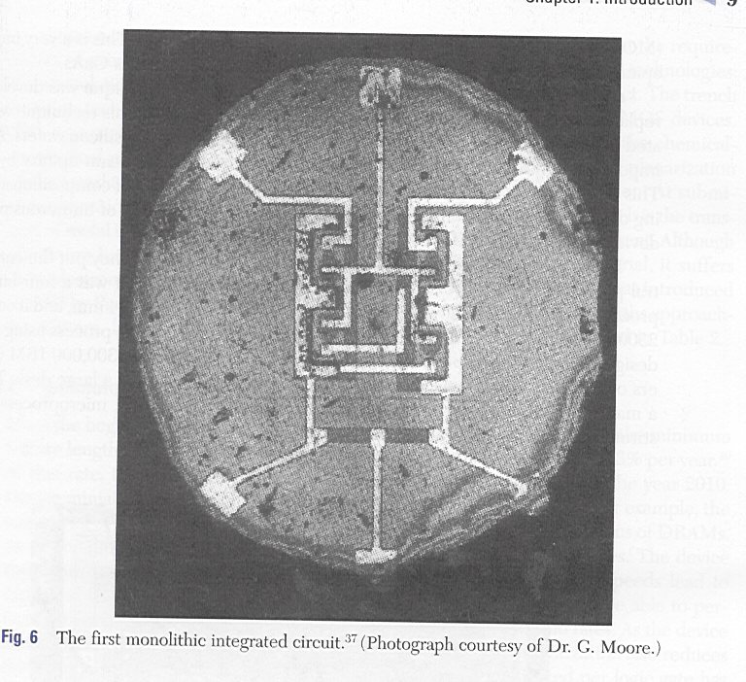

Slide 10
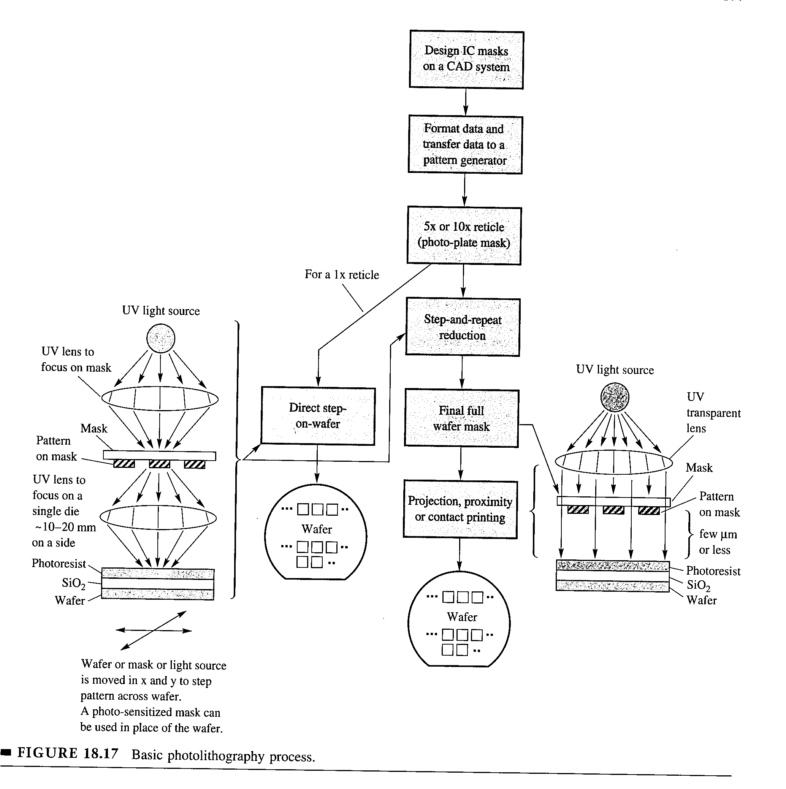

Slide 11
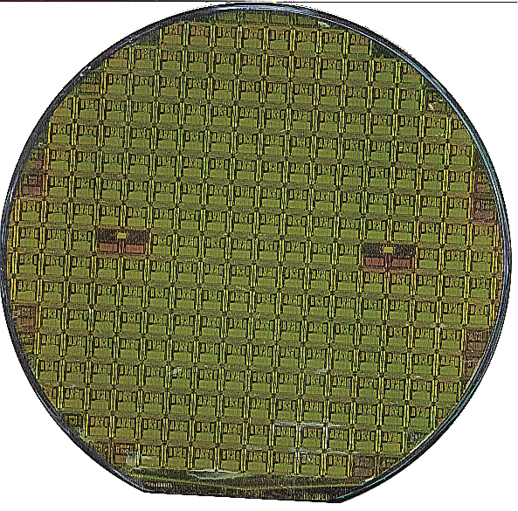
Stanley G. Burns
UMD-ECE

Slide 12
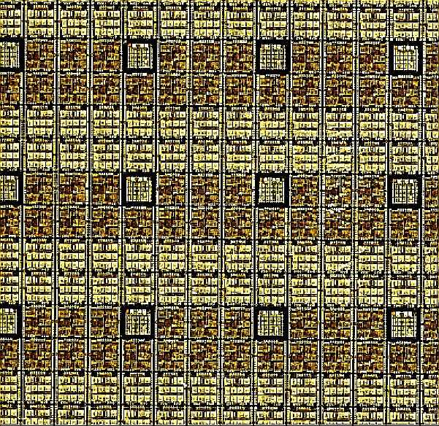

Slide 13
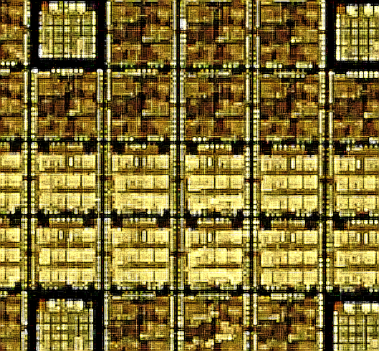
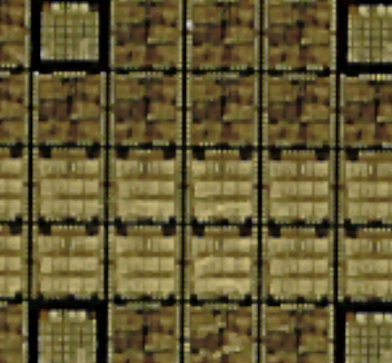

Slide 14
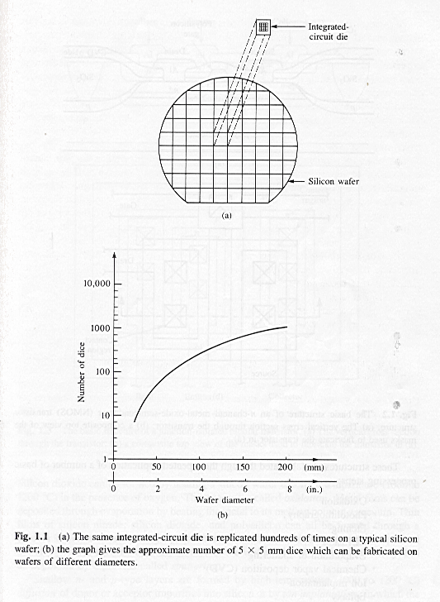

Slide 15
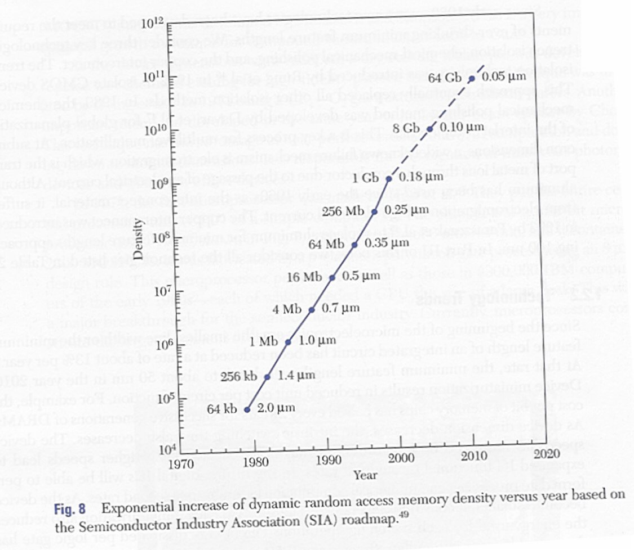
<$30
256 GB
14 nm Micron Memory, 7 nm Apple iPhone 11

Slide 16
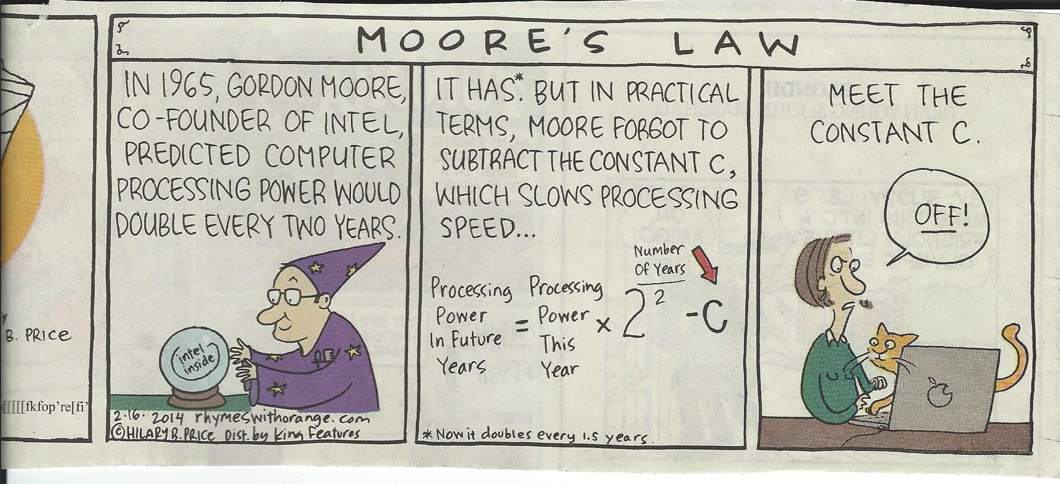
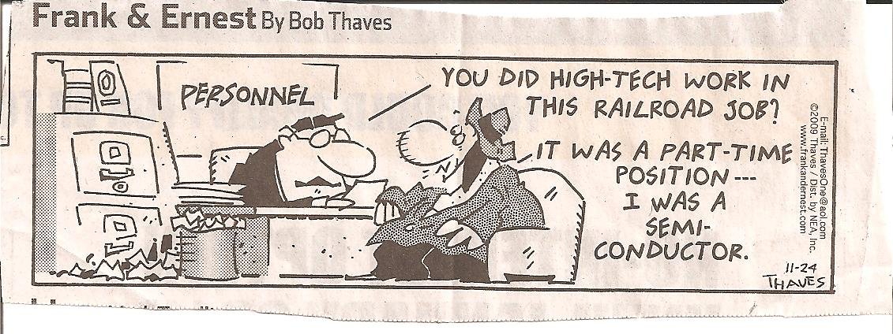

Slide 17
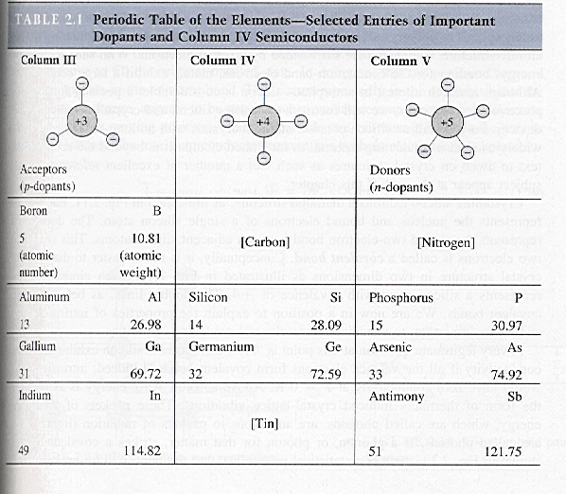

Slide 18
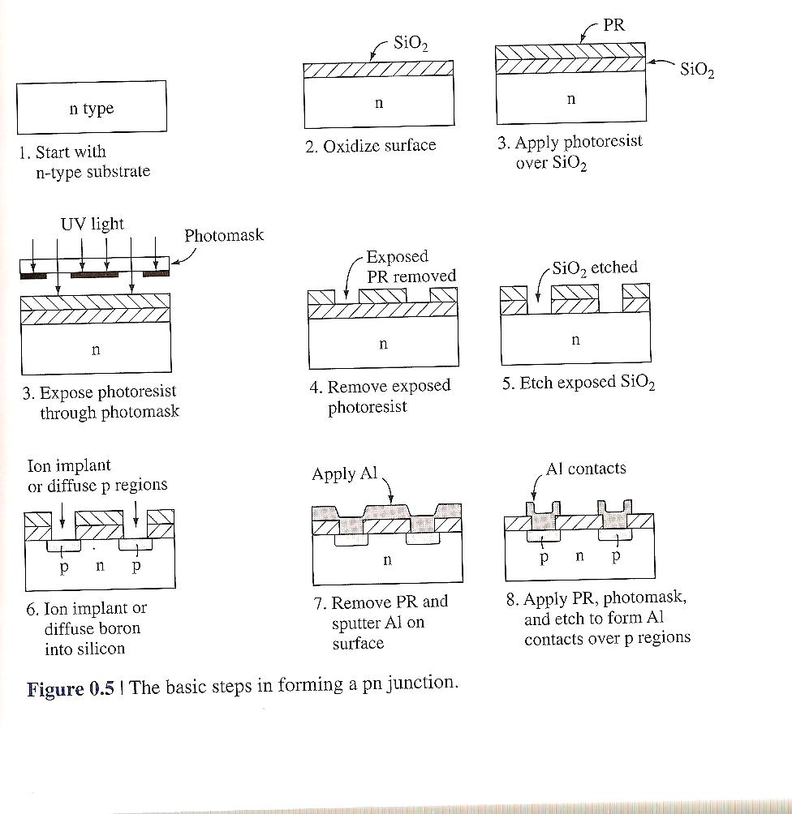

Slide 19
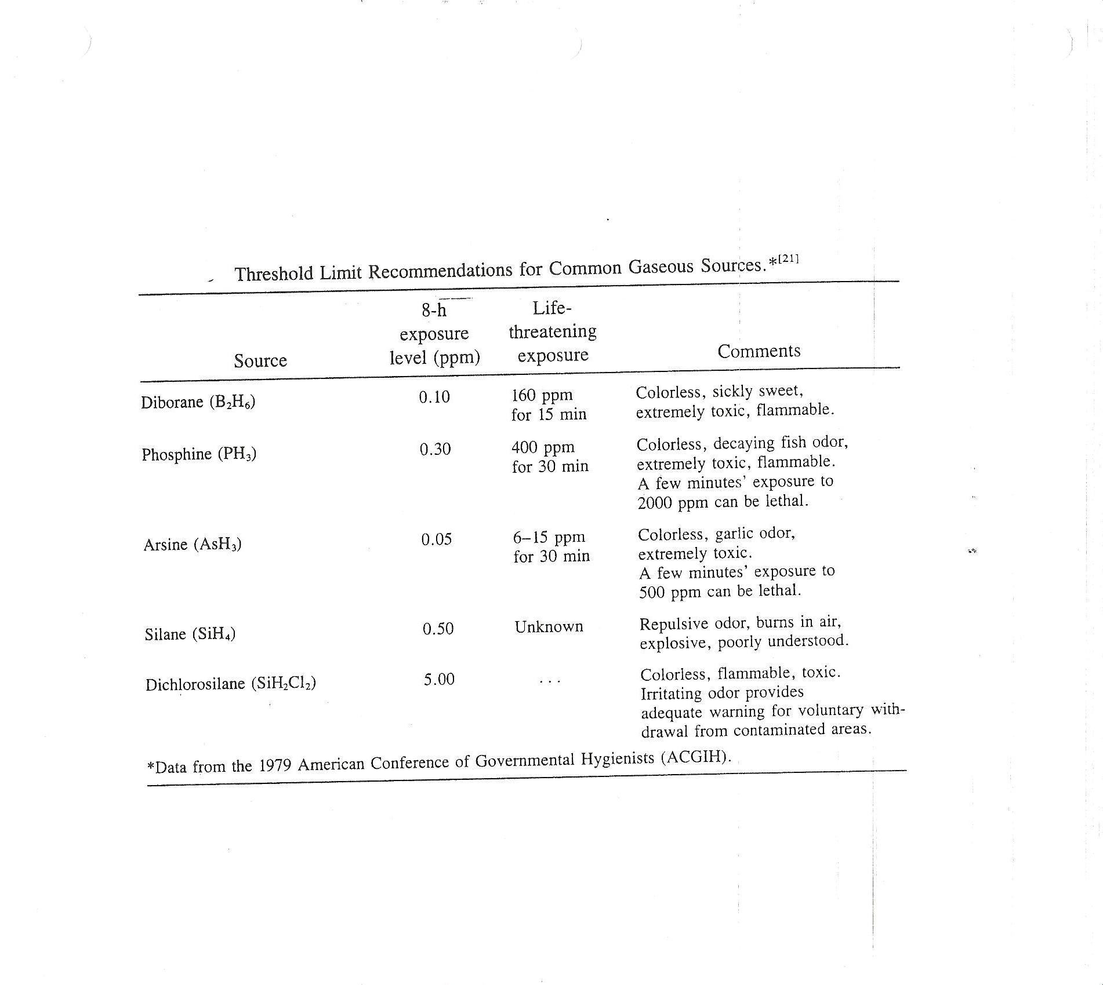

Slide 20
BASIC PROCESSING STEPS
Design Then
Repeated Application Of:
Oxidation and/or Nitridation
Photolithography
Wet Etching (Chemical)
Dry Etching (Plasma)
Ion Implantation and/or Diffusion
Evaporation
Sputtering
Plasma Assisted Deposition
Epitaxy
Many Processing Steps are at temperatures to 1200°C

Slide 21
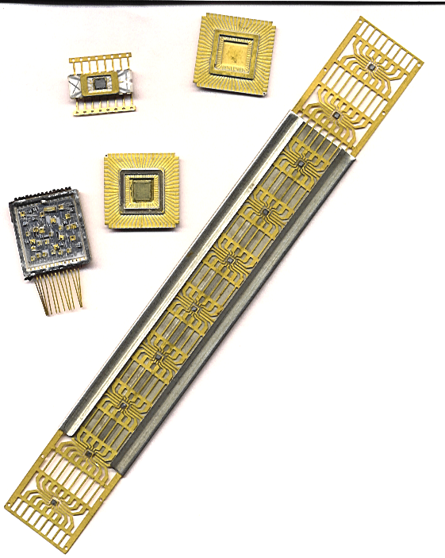

Slide 22
OTHER DEVICES AND TECHNOLOGIES
Thin-Film Transistors (TFT) for displays and cameras
Displays-Liquid Crystal Displays (LCD), Plasma, LED Backlit, OLED Emissive Displays, etc. Television, computer, and smart phone screens
Photonic-Light Emitting Diodes (LED), Organic Light Emitting Diodes (OLED), LASERS, Optical Chips, etc.), Lighting
Photovoltaics-Conventional Crystalline and Flexible Thin-Film
Devices and Systems on Flexible Substrates. Next generation of smart phones
Micro-Electro-Mechanical Systems (MEMS) integration of mechanical elements, sensors, actuators, and electronics on a common silicon substrate through microfabrication technology. Automotive, medical, personal electronics

Slide 23
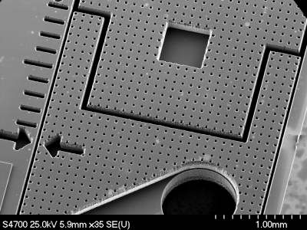
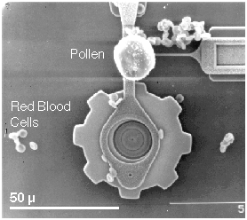
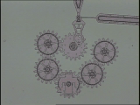

Slide 24
Challenges in the Semiconductor Industry For EE Graduates
Design devices
Design circuits and systems
Device modeling
System design and fabrication
Circuit/system simulations
Testability
Materials (Si, III-V, Graphene
How small? Nanomaterials?
How large? Wafer Scale?
Speed and performance, for analog, digital and mixed-mode applications
Increased functionality
Biological integration
Optoelectronic integration
Displays
Sensors including “Wearables)
MEMs (Design/Application)
Non-traditional substrates
Packaging
Process development
Process Control
“Tool” and plant design
Cradle to grave materials handling

