Slide 1
VACUUM TUBE GUITAR AMPLIFIER
WITH BLUETOOTH AND POWER SCALING
Presenters: Nick Hill, Adam Schmolling, Allan Bekkala
Advisor: Dr. Stanley Burns
Date: 04/26/2016

Slide 2
ABSTRACT
This project was to design and construct an AB style vacuum tube guitar amplifier that has Bluetooth connectivity as well as the ability to scale the volume output without losing power tube distortion. The Bluetooth connectivity allows the user to stream background music into the amplifier, while an audio mixer allows the background music and guitar signal to be mixed. The user also has the option of choosing between a GZ 34 tube rectifier and a solid-state full wave bridge rectifier.
The amplifier outputs 35 watts (rms) to a 2 x 12 speaker enclosure. The amplifier head can be connected to any cabinet with an impedance of 4, 8, or 16 (as the amplifier has an impedance selector switch). The preamplifier consists of 3, 12AX7 tubes, and the power amplifier consists of 2, EL34 tubes. The rectifier tube, as mentioned above, is a GZ34. The guitar signal and backing music are mixed with a tube based summing amplifier (also a 12AX7 tube), and the respective volumes of both signals can be controlled.
This senior design project is a culmination of 2 semesters worth of work. In retrospect the project has been 80% design, and 20% actual construction. We have constructed the enclosures for both the amplifier head and the speakers. We have wired up the entire circuit. The end result has been an excellent guitar amplifier, which has applications all across the music industry.

Slide 3
INTRODUCTION
Goal:
To design a high quality valve amplifier based on the Marshall JTM-45
Features:
1. Bluetooth connectivity
  a. To enable the user to play along with a backing track via smartphone
2. Dual rectifier
  To enable the user to alternate between a solid state and tube based rectifier
3. Power-scaling
  a. To allow for more power tube distortion at a lower volumes
4. Meets all environmental and health standards
a. Follow the National Electrical Code
b. Lead-free solder

Slide 4
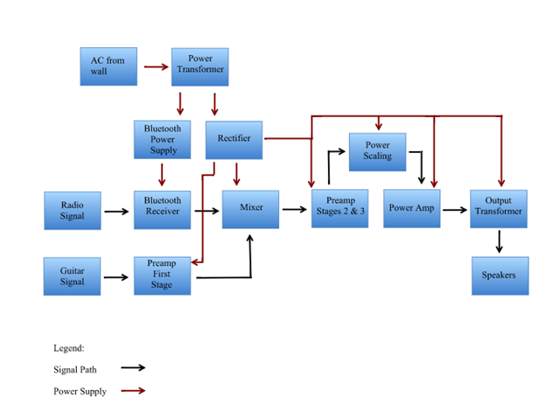
OVERALL DESIGN

Slide 5
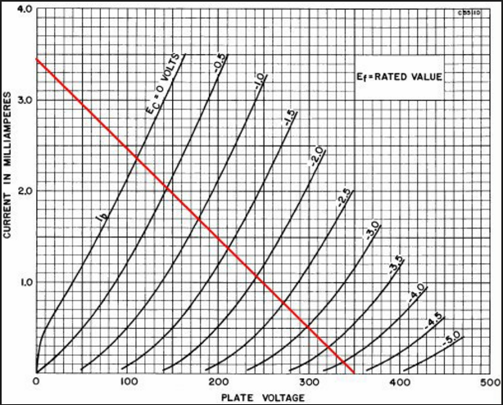
TUBE BASICS

Slide 6
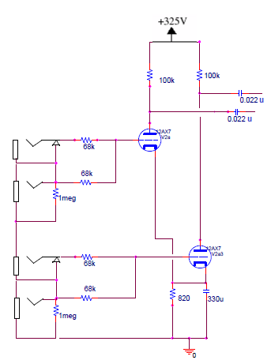
PRE-AMP DESIGN

Slide 7
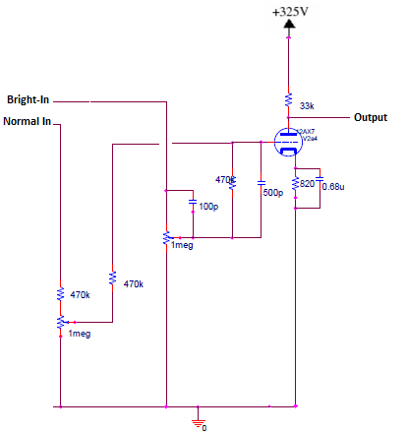
12AX7 VOLTAGE AMPLIFIER

Slide 8
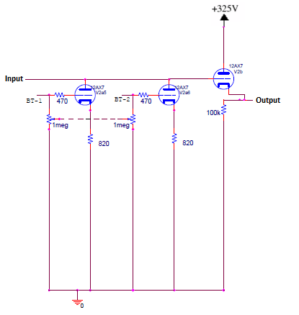
MIXER & CATHODE FOLLOWER

Slide 9
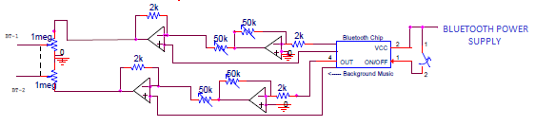
BLUETOOTH CONNECTIVITY

Slide 10
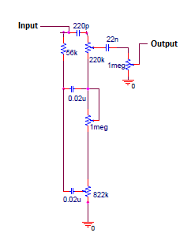
TONE STACK

Slide 11
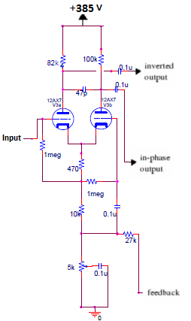
LONG TAILED PAIR PHASE INVERTER

Slide 12
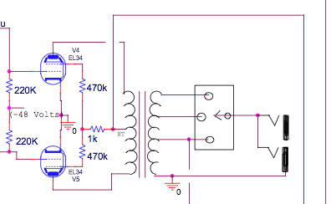
PUSH-PULL POWER AMPLIFIER

Slide 13
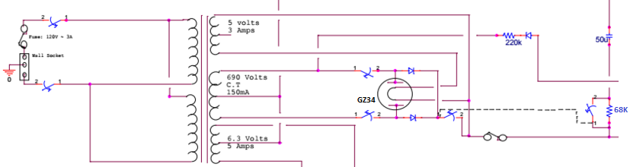
POWER SUPPLY

Slide 14
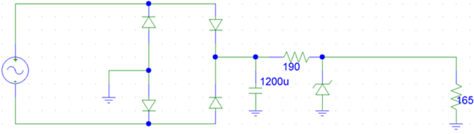
Design: Voltage Regulator / Rectifier for Bluetooth IC
Pre-Testing Design
Voltage regulator and rectifier for RN-52 Bluetooth chip (note: capacitor value has been changed due to design specs. The value is now 2000uF.)
Calculations:
Vrms = 6.3 => Vpeak = 6.3*SQRT(2)
Limiting Resistor Needed: R = [(Vpeak - diode_voltage_drop - Zener_Voltage)/(current) = [(8.9 - 1.4 - 3.3)/(0.02)]*0.9 = 189 Ohms

Slide 15
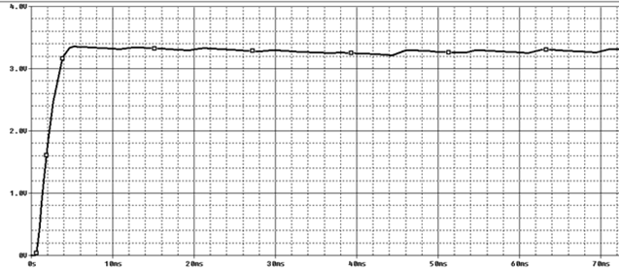
Design: Voltage Regulator / Rectifier for Bluetooth IC
Figure 3-1: Simulated output voltage of the voltage regulator / rectifier circuit for the RN-52 Bluetooth chip using a 2000uF capacitor

Slide 16
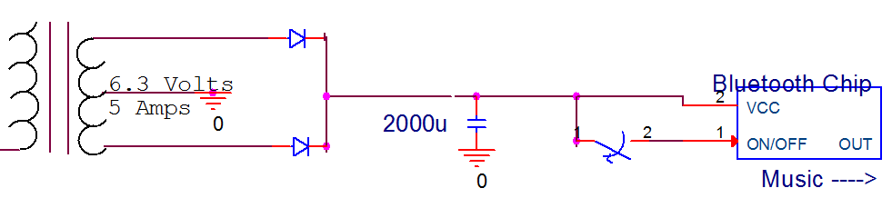
Design: Voltage Regulator / Rectifier for Bluetooth IC
Post Testing Design

Slide 17
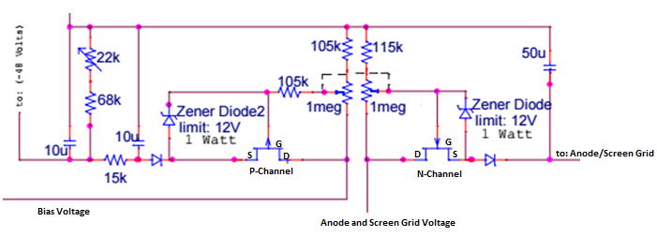
POWER SCALING

Slide 18
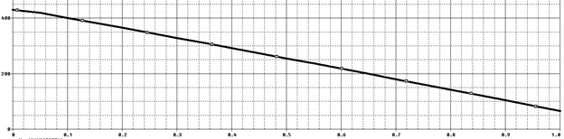
Power Scaling Simulation:
Anode and Screen Grid Voltage Control

Slide 19
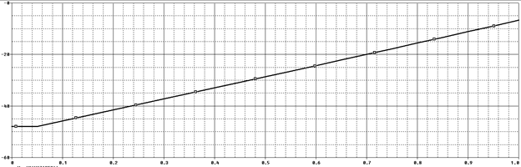
Power Scaling Simulation:
Bias Voltage Control

Slide 20
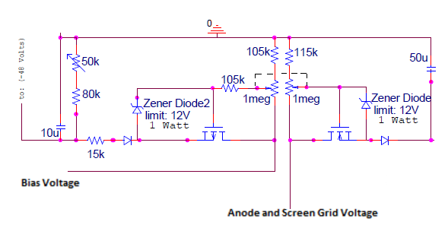
POWER SCALING
A MORE DEFINITIVE MODEL FOR PSPICE SIMULATION

Slide 21
Simulations:

Slide 22
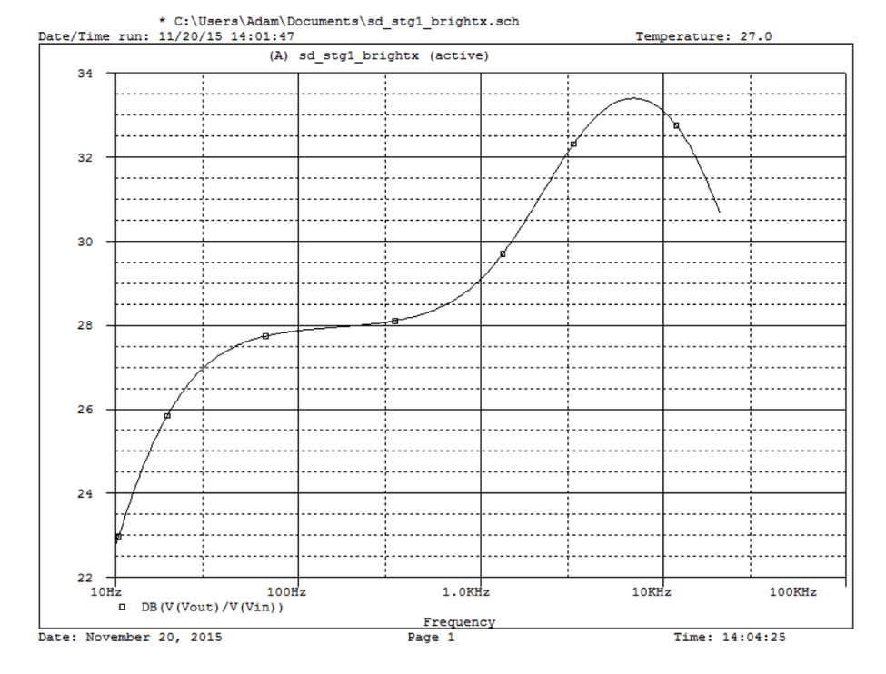
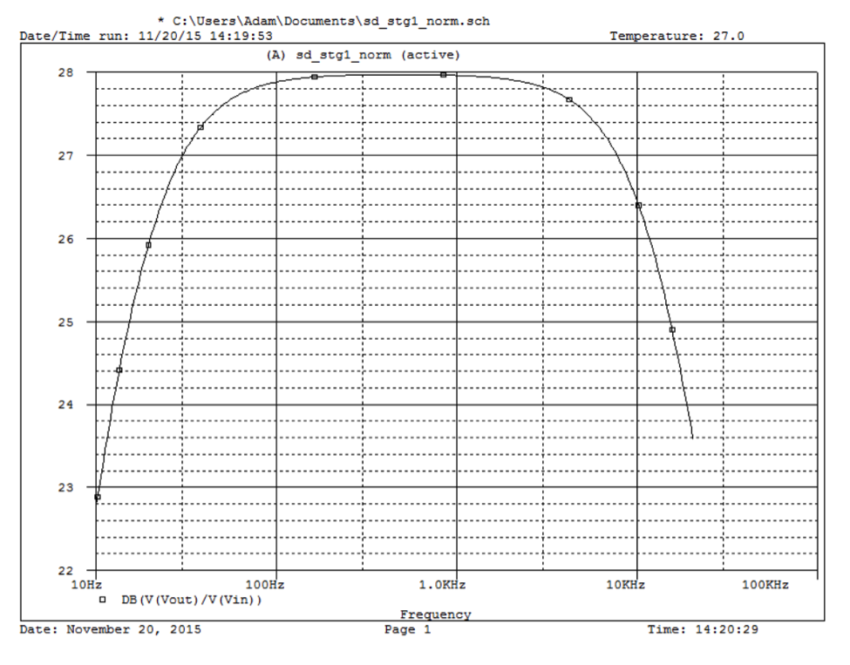
Simulations: stage 1 frequency Response (Bright and Normal Channels).

Slide 23
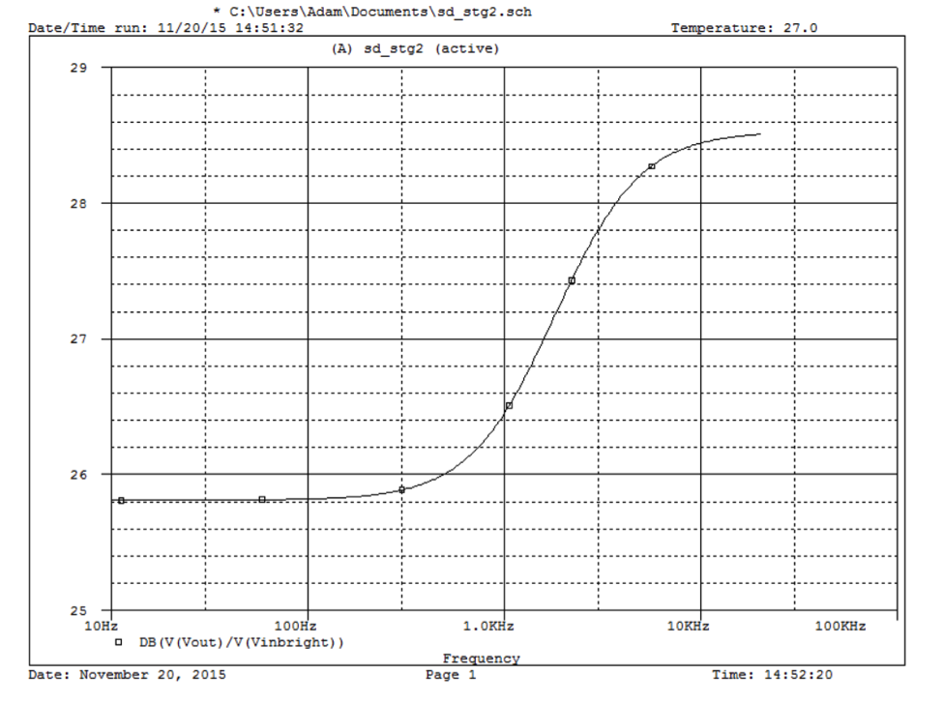
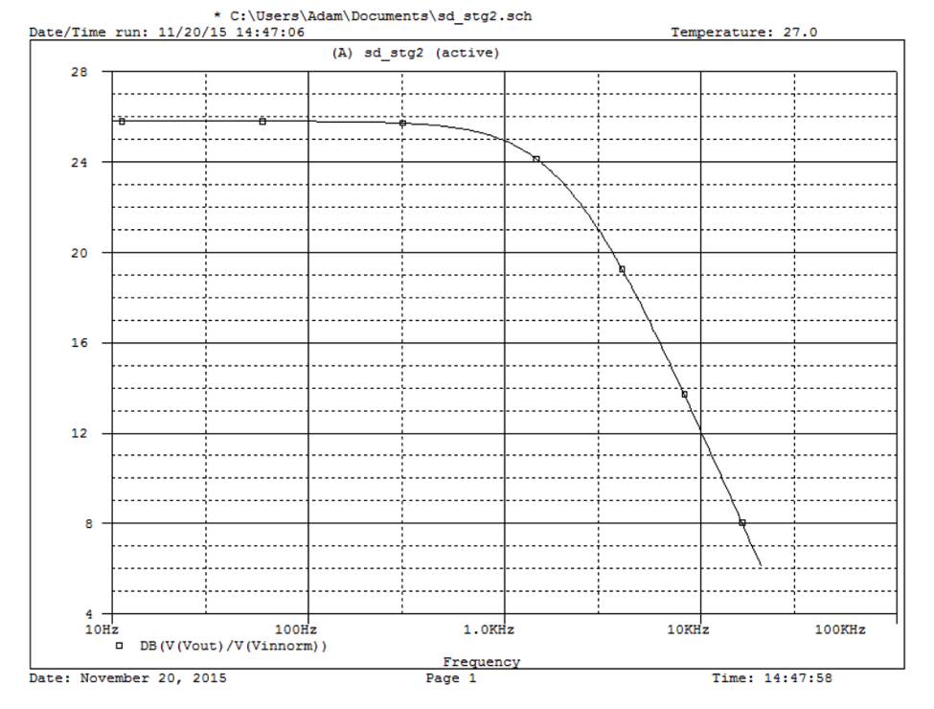
Simulations: Stage 2 Frequency Response (Bright and Normal Channels)

Slide 24
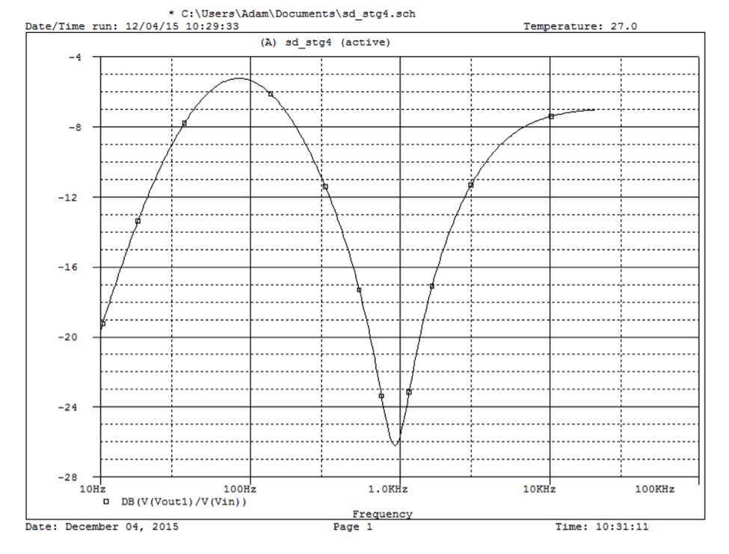
Simulations: Stage 4 Frequency Response (Stage 3 was flat)

Slide 25
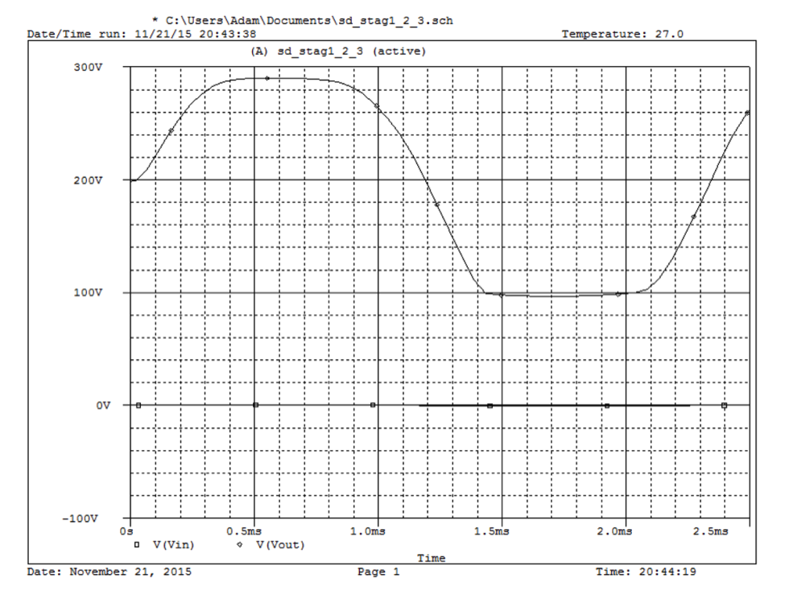
Simulations: Overall Amplifier Transfer Characteristic

Slide 26
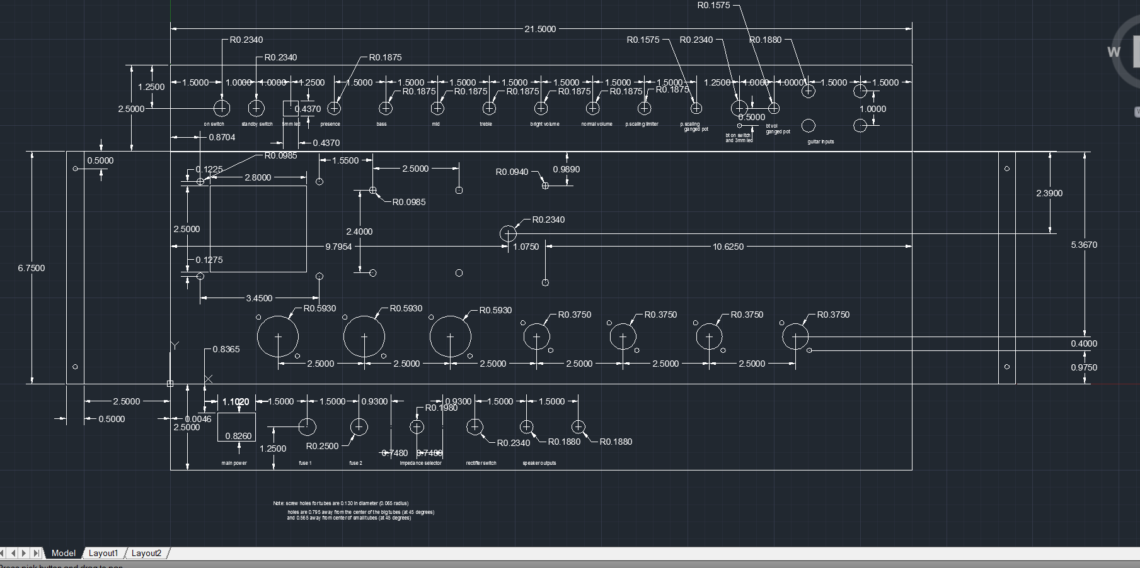
Design: Chassis Layout

Slide 27
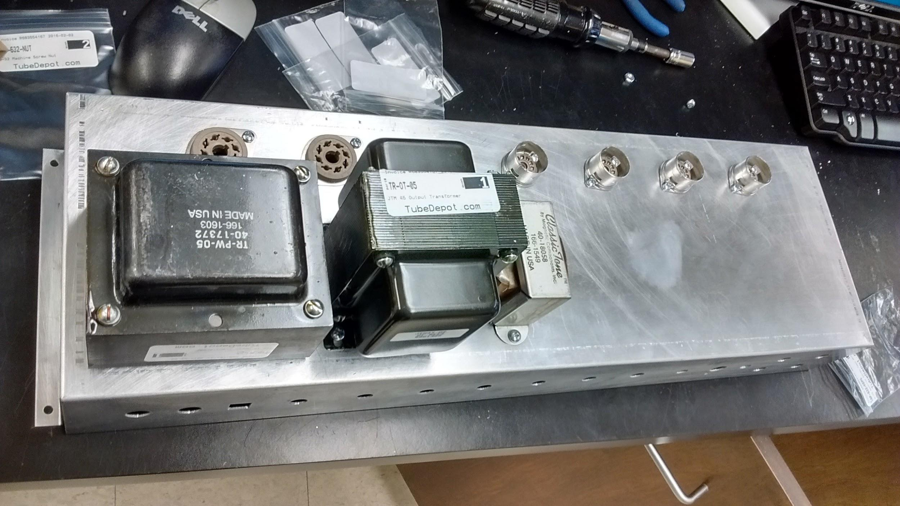
Construction: Chassis

Slide 28
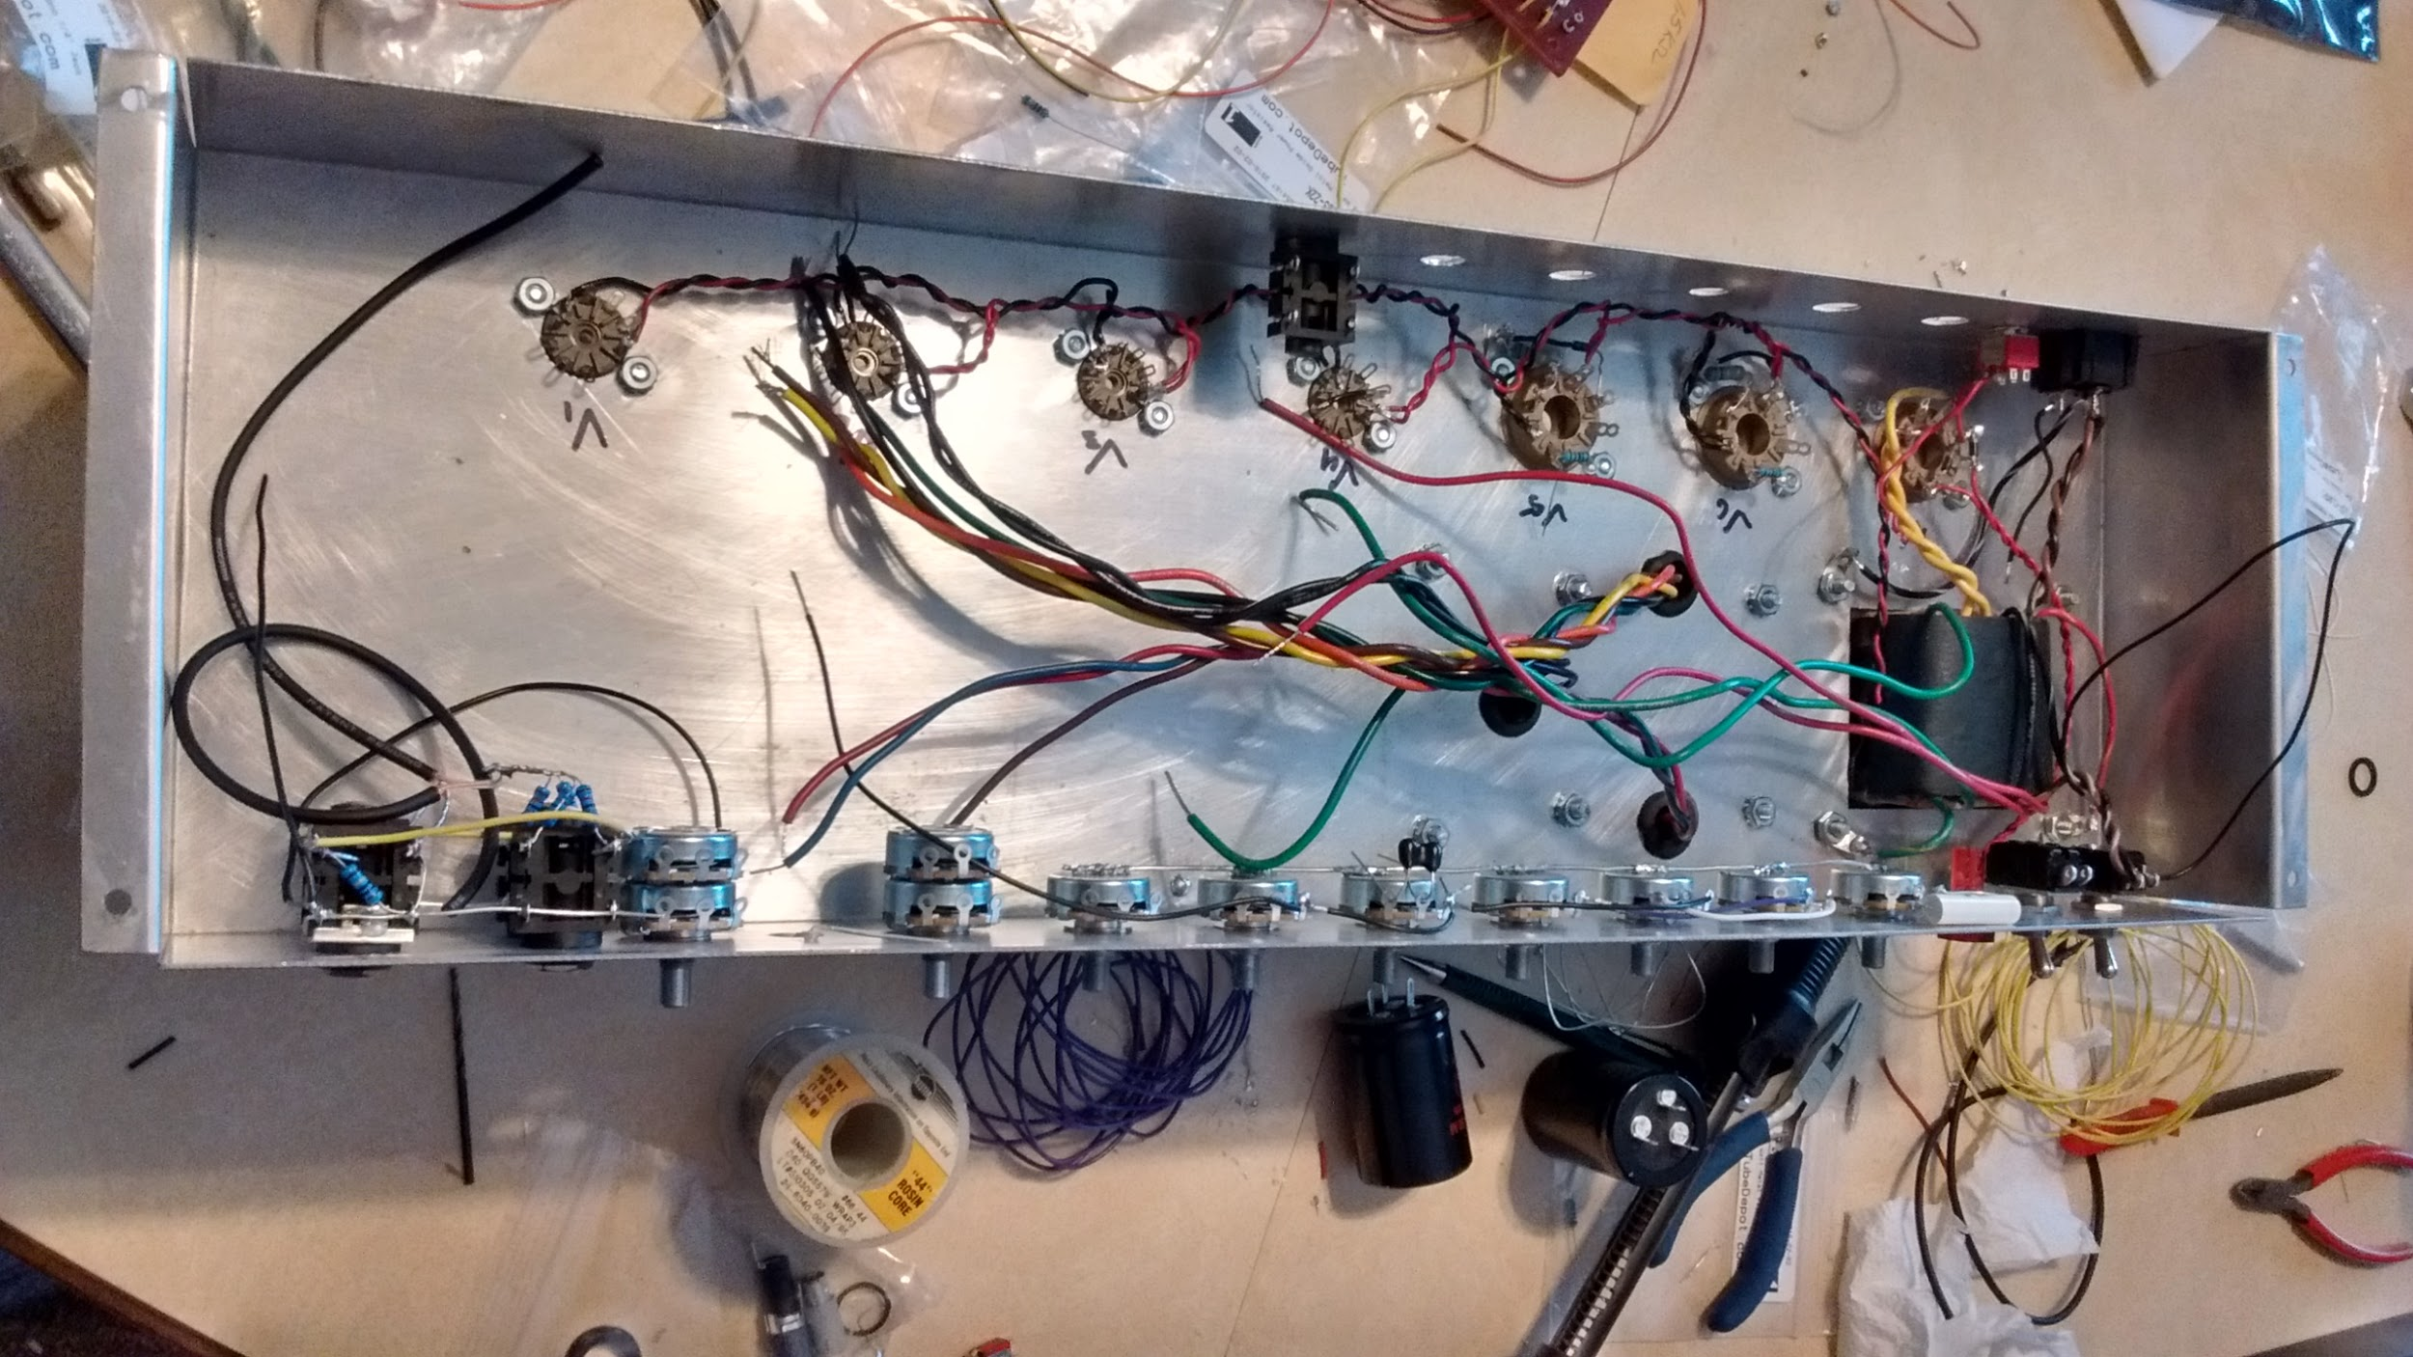
Construction: Wiring

Slide 29
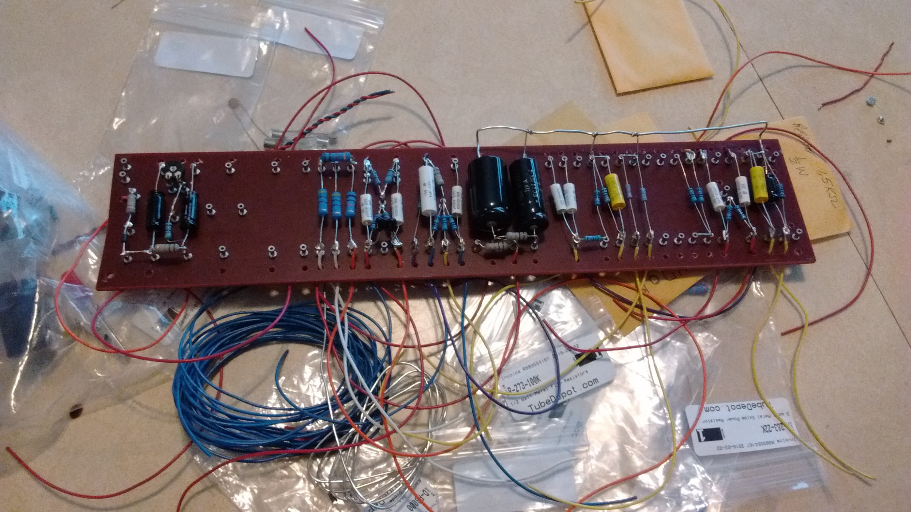
Construction: Wiring

Slide 30
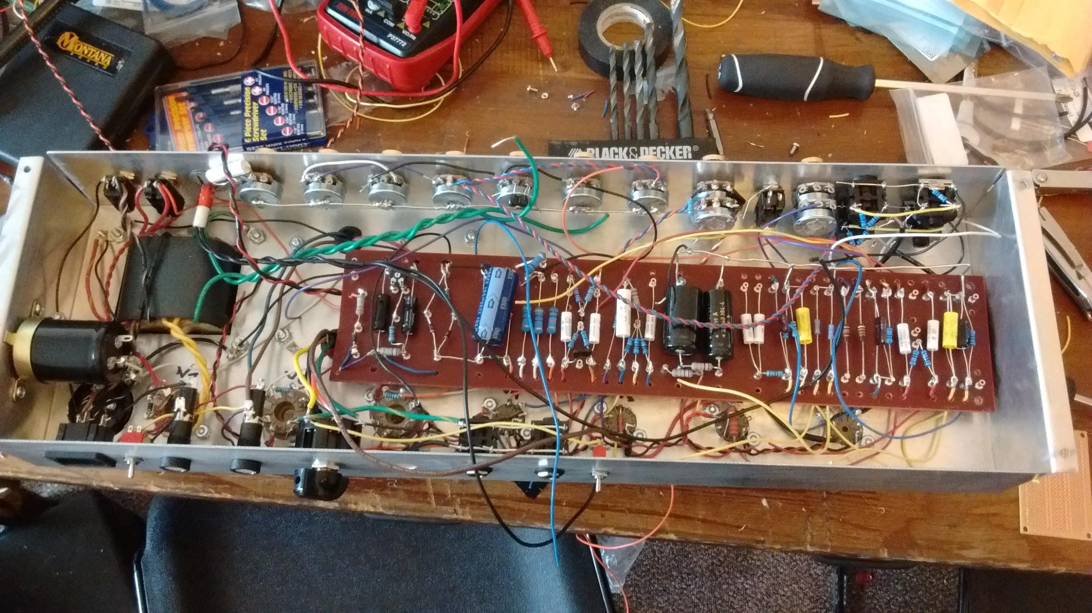
Construction: Wiring

Slide 31
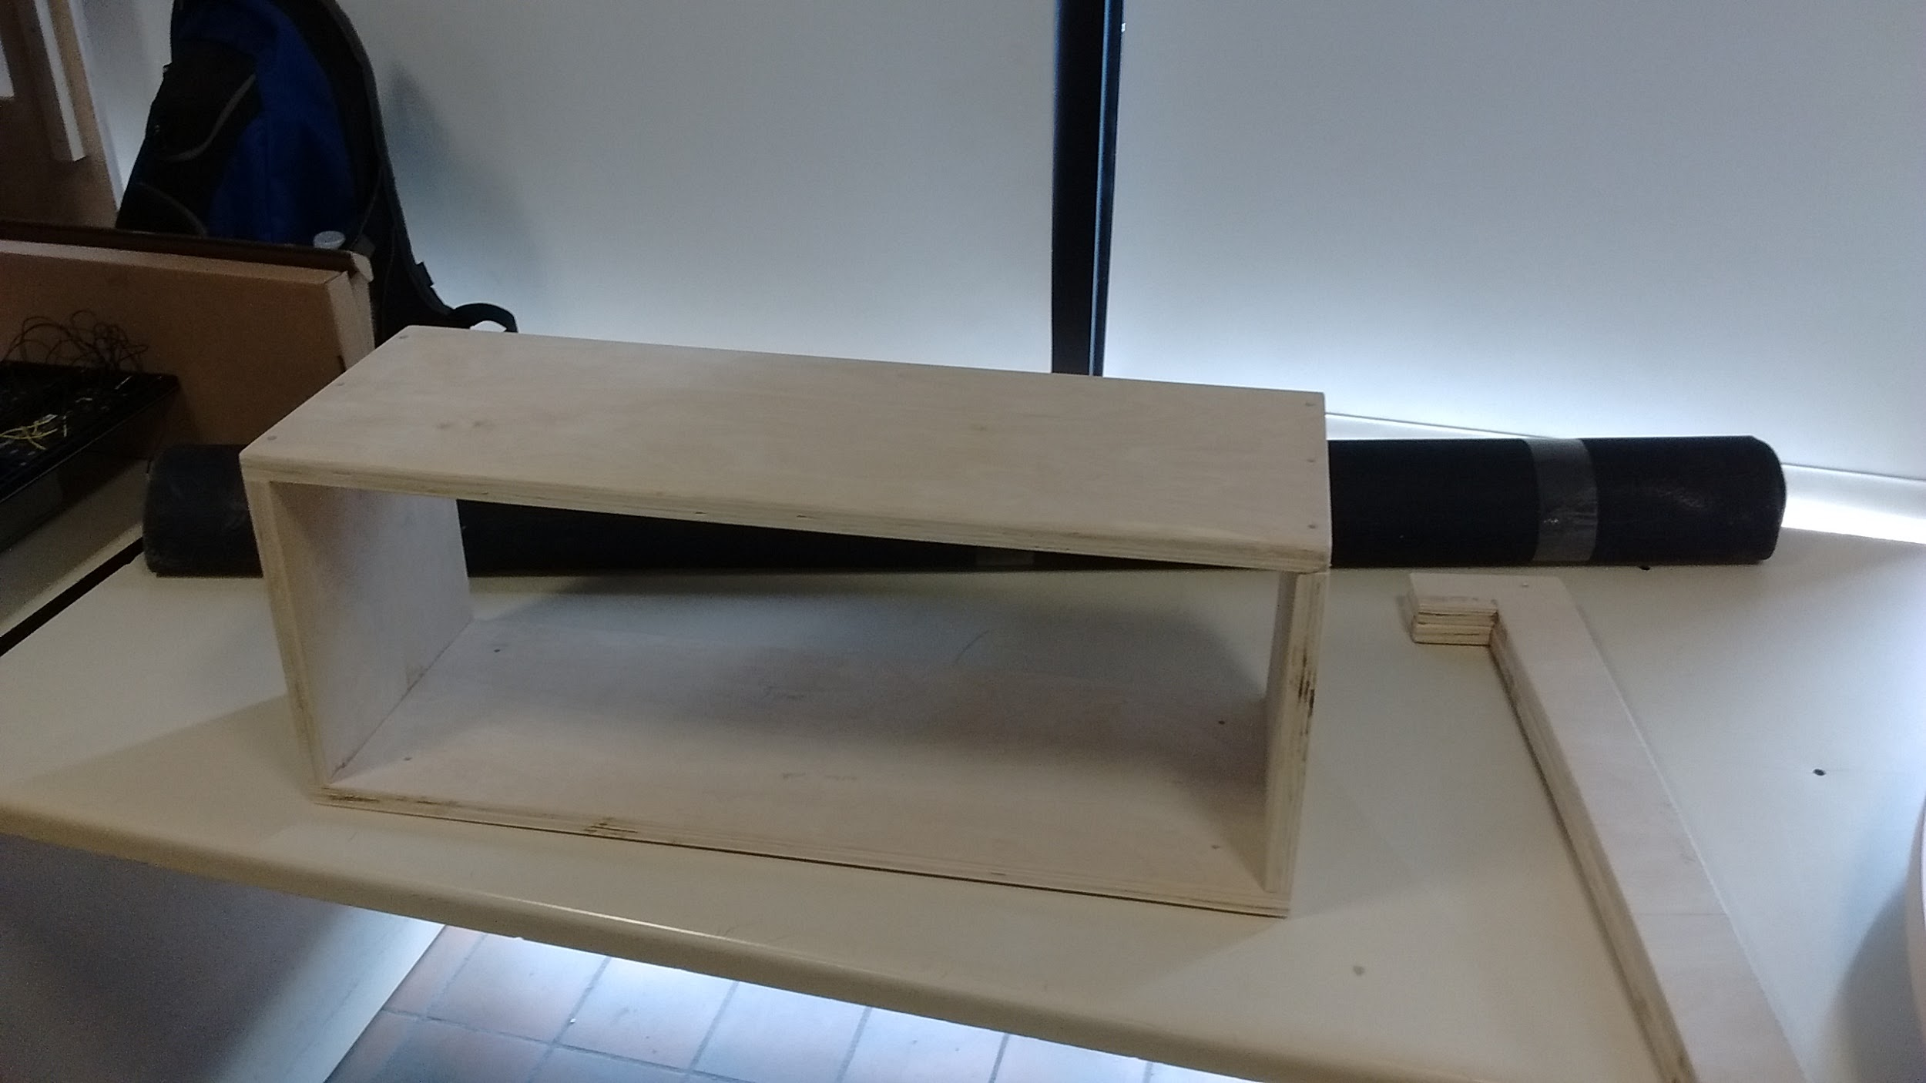
Construction: Tolex Process

Slide 32
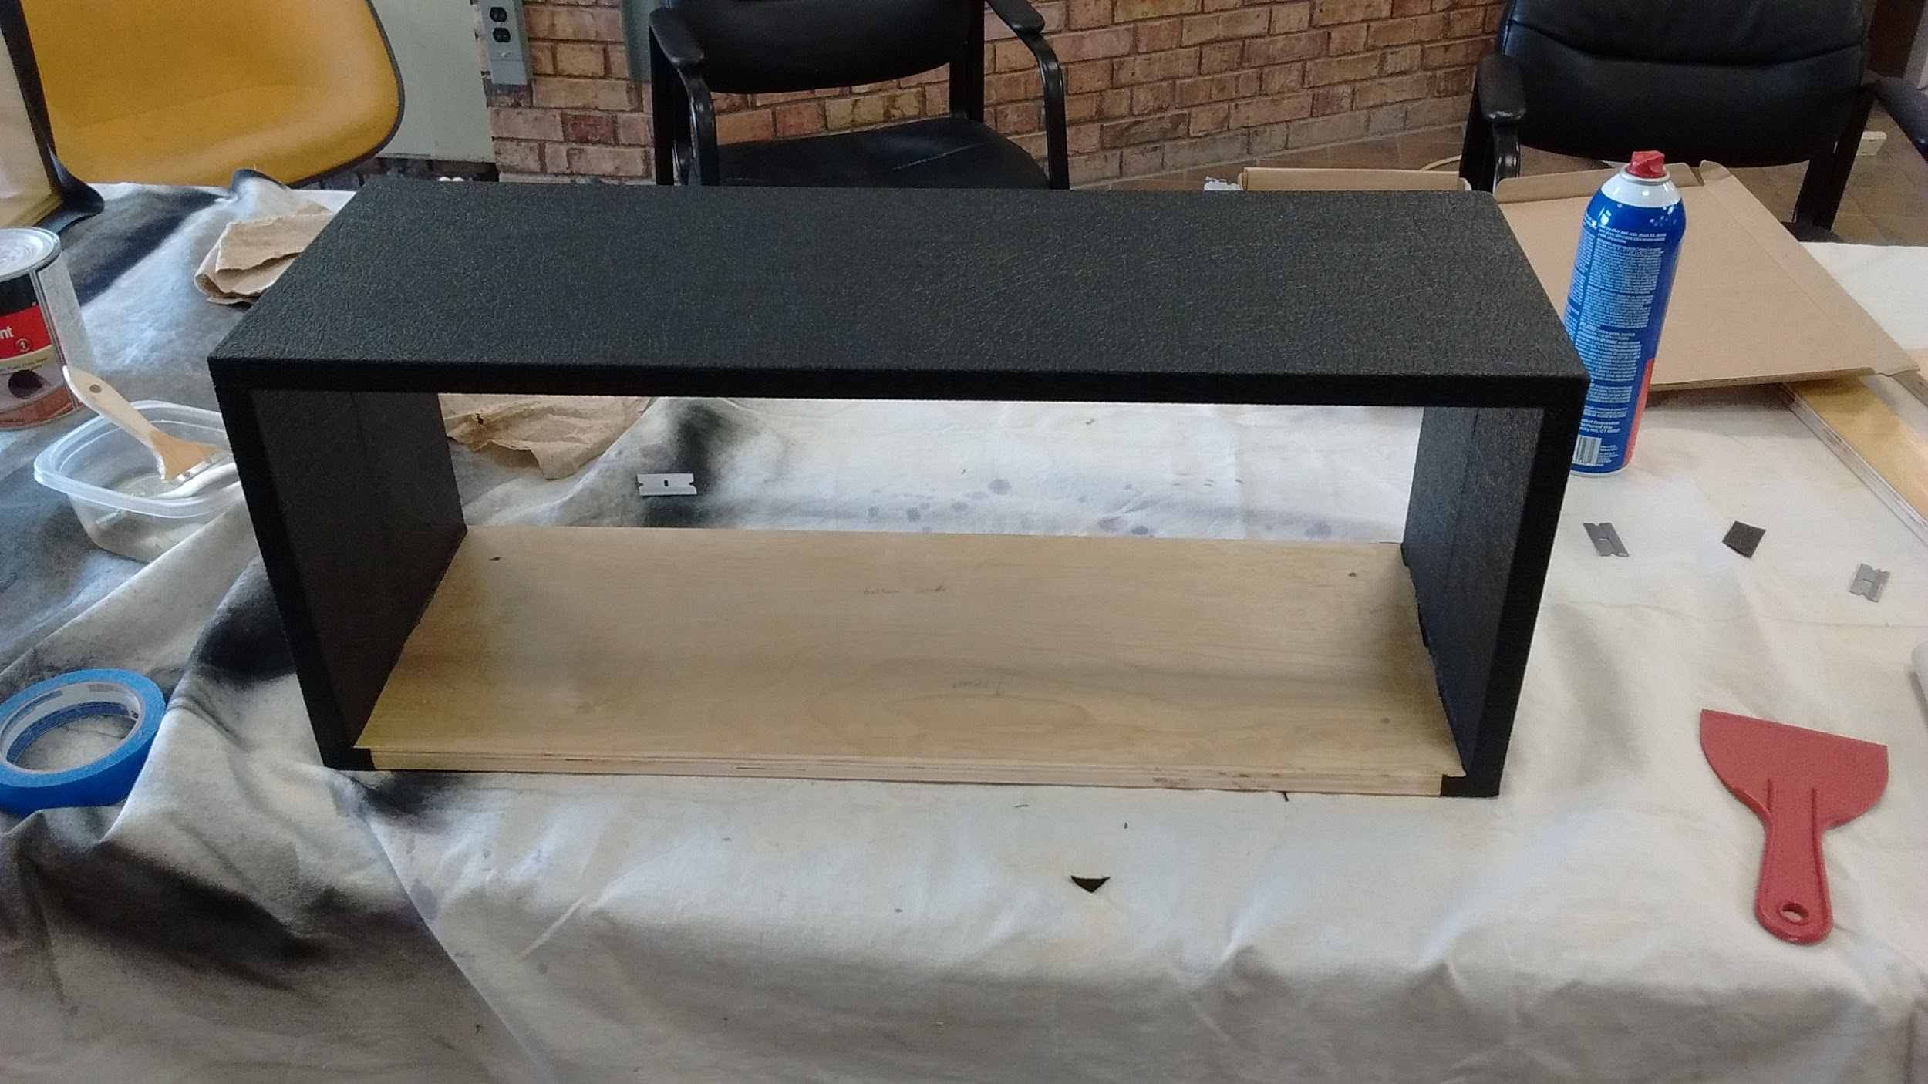
Construction: Tolex Process

Slide 33
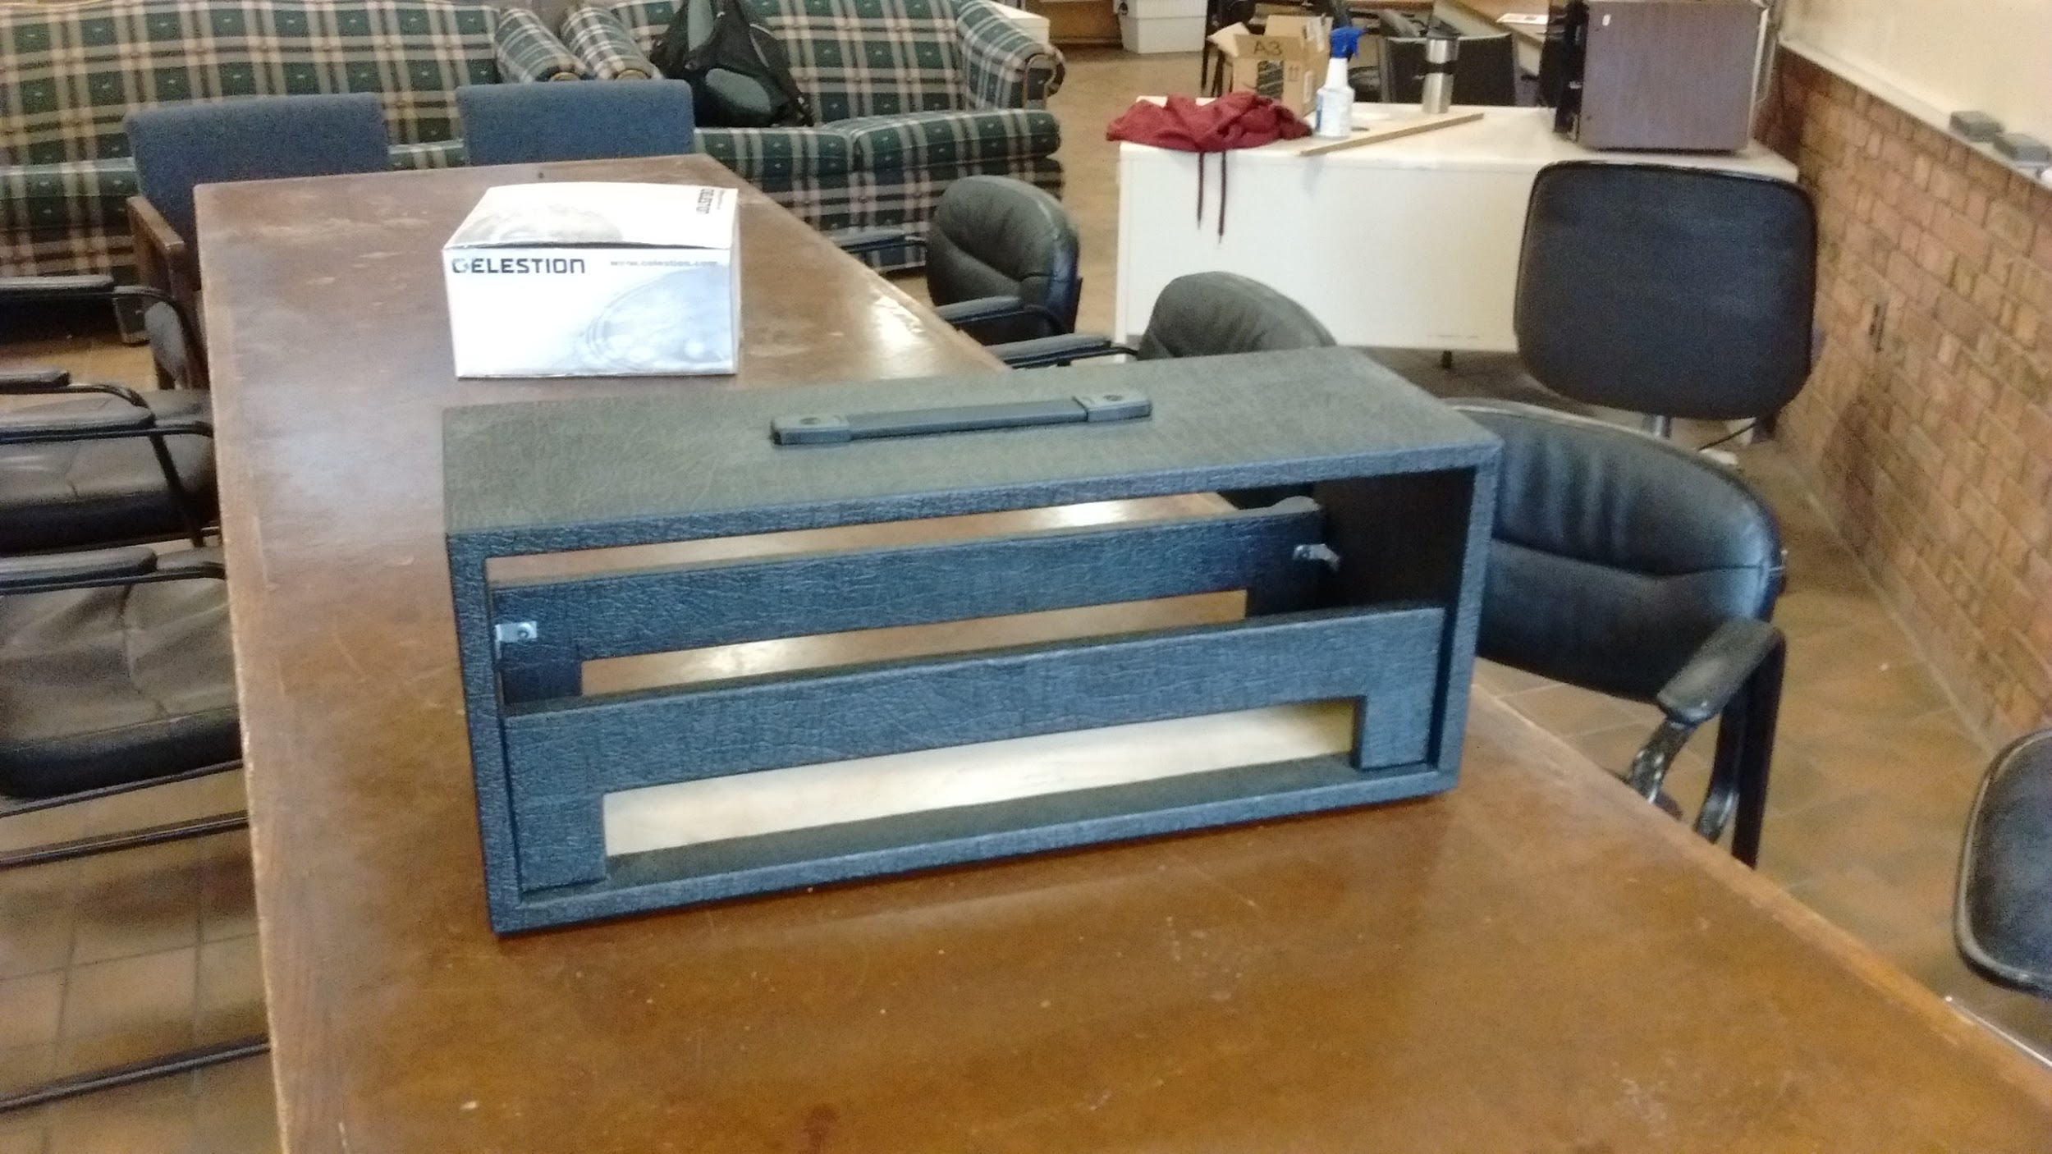
Construction: Amp Enclosure

Slide 34
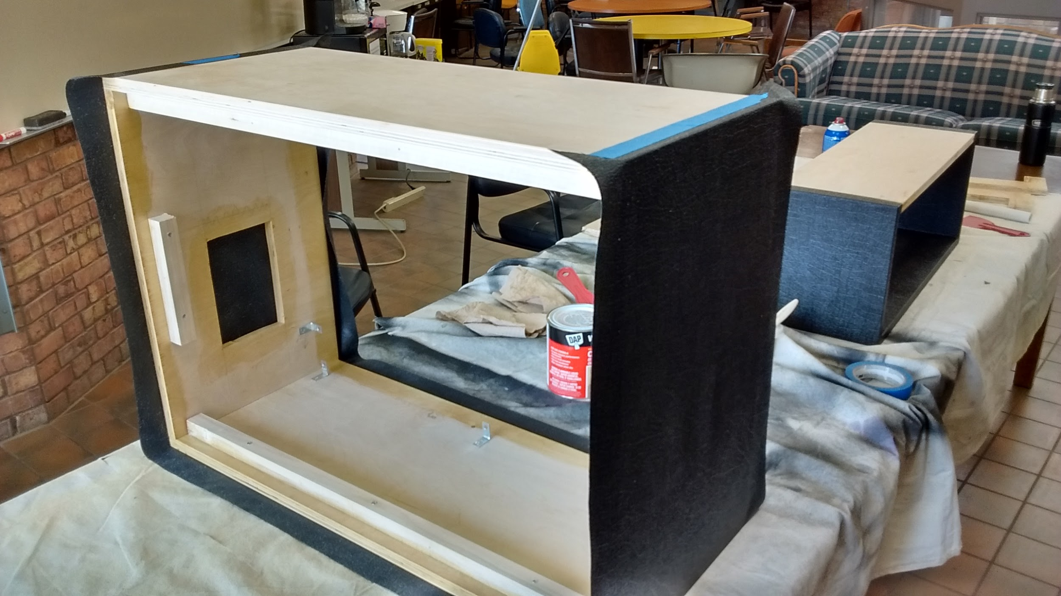
Construction: Speaker Cabinet

Slide 35
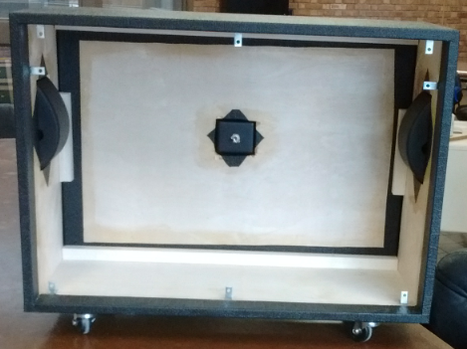
Construction: Speaker Cabinet

Slide 36
Problems:
Diode trouble!
Diodes kept burning out when power was turned on
Needed to switch to a full wave rectifier

Slide 37
Problems:
Next the amp was exhibiting a significant amount of background hum.
Output transformer center tap needed to be relocated.

Slide 38
Problems:
Abnormally large bias voltage (-200V as opposed to -56V)
Found missing ground connection to bias potentiometer.

Slide 39
Problems:
Bluetooth module is fried:
Eventually order new module

Slide 40
Areas of Concern
Economic Concerns
Environmental Concerns
Manufacturability
Ethical Concerns
Health and Safety
Social Concerns

Slide 41
Summary:
We set out to build a guitar amplifier with with the following features, and that is what we present to you.
Power Scaling
Dual Rectifier
Bluetooth Connectivity
35 Watts rms of output power
Quality sound

Slide 42
Future Additions:
If we were able to include more in this design.
Wi-Fi Connectivity
Built in wireless system (between guitar and amp)
Plasma speaker (just for looks)
Custom faceplate, glass viewing window, cooling fans
Separate output stages for guitar and Bluetooth signal
  Secondary tap on output transformer
  Separate amplifier for the Bluetooth signal

Slide 43
Special Thanks To:
Dr. Stanley Burns
Sean Dumm
Lyndon Ramrattan
Anthony McMahon
Archer Racing
UMD Mechanical Engineering Department
Shey Peterson

Slide 44
QUESTIONS?

