Slide 1
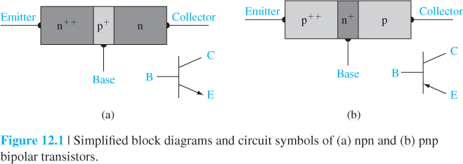
10 and 12 November 2021 BJT Part 1, Chapter 17, Start Page 550
Operation involves both electrons and holes, so is called “bipolar”
Junction E-B is forward biased, so electrons from the E (emitter) to the B (base)
Junction B-C is reverse biased, so minority carrier electron concentration in B region at the B-C edge is close to zero.
In the B region, there is large gradient of electron (minority carrier) concentration; the electron injected from E region will diffuse across the B region into the B-C space charge region
An electric field due to the B-C reverse bias will sweep the electrons to the C (collector) region
The B regions must be thinner than the minority carrier diffusion length in order to make as many electrons as possible to reach the C region.

Slide 2
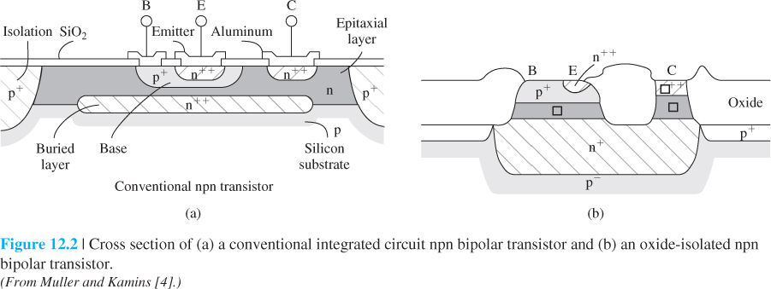
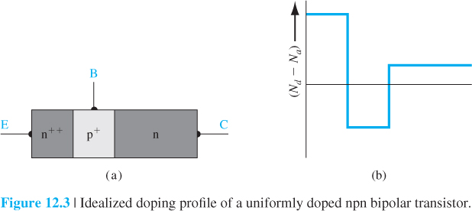

Slide 3
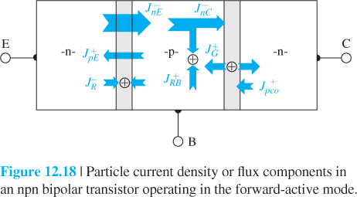

Slide 4
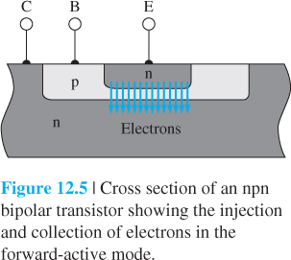
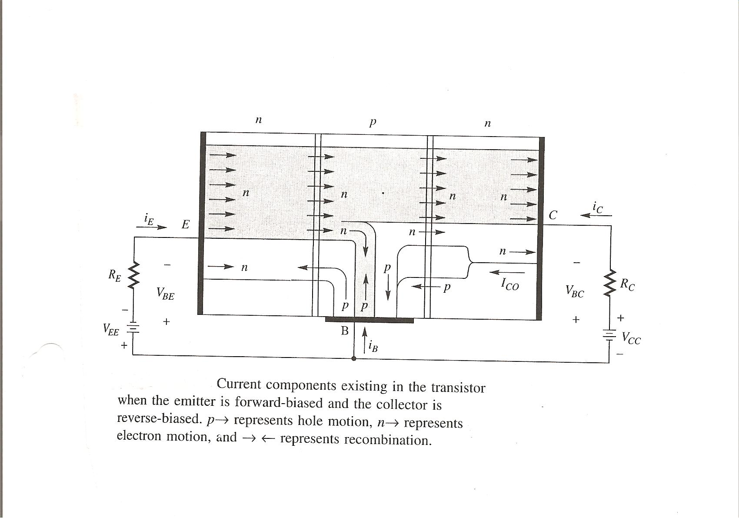

Slide 5
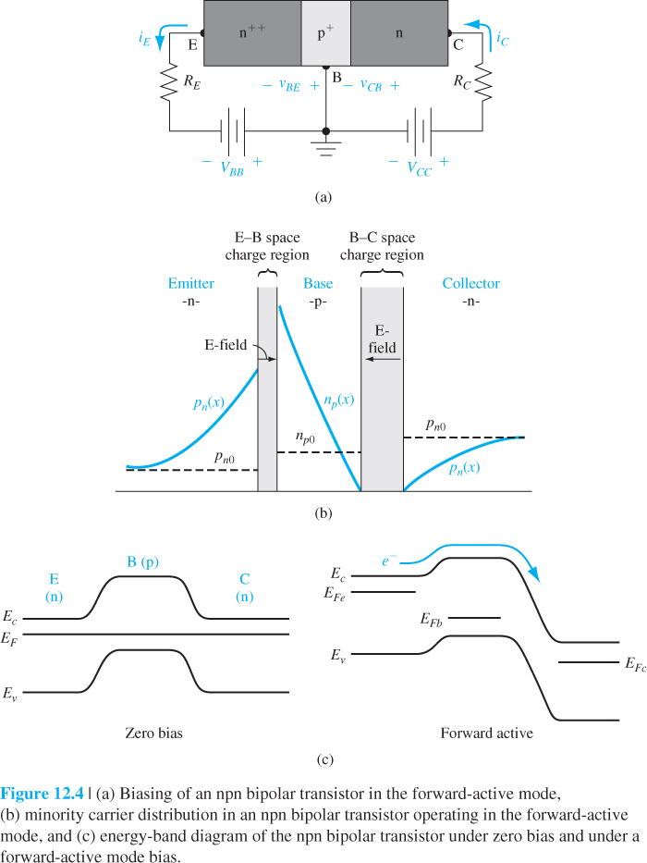

Slide 6
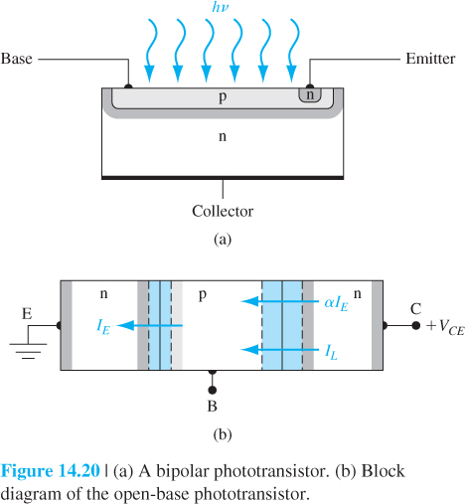
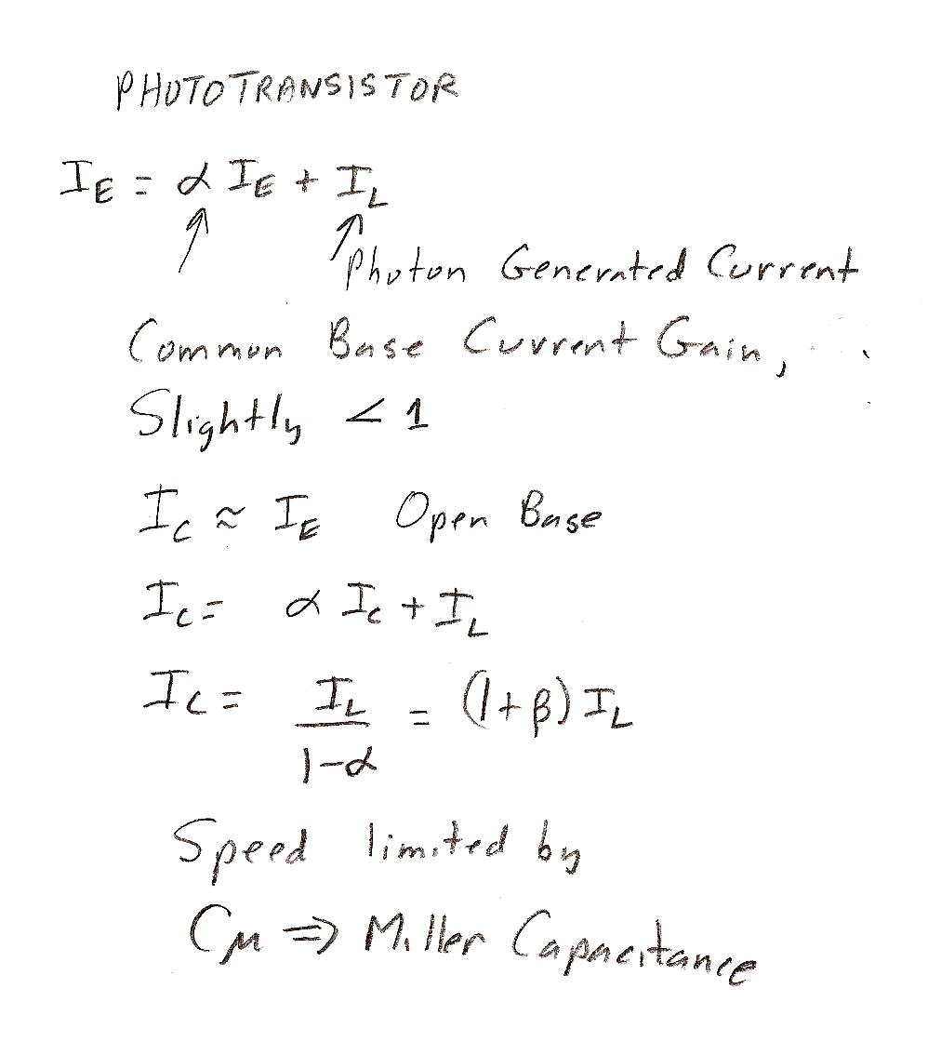

Slide 9
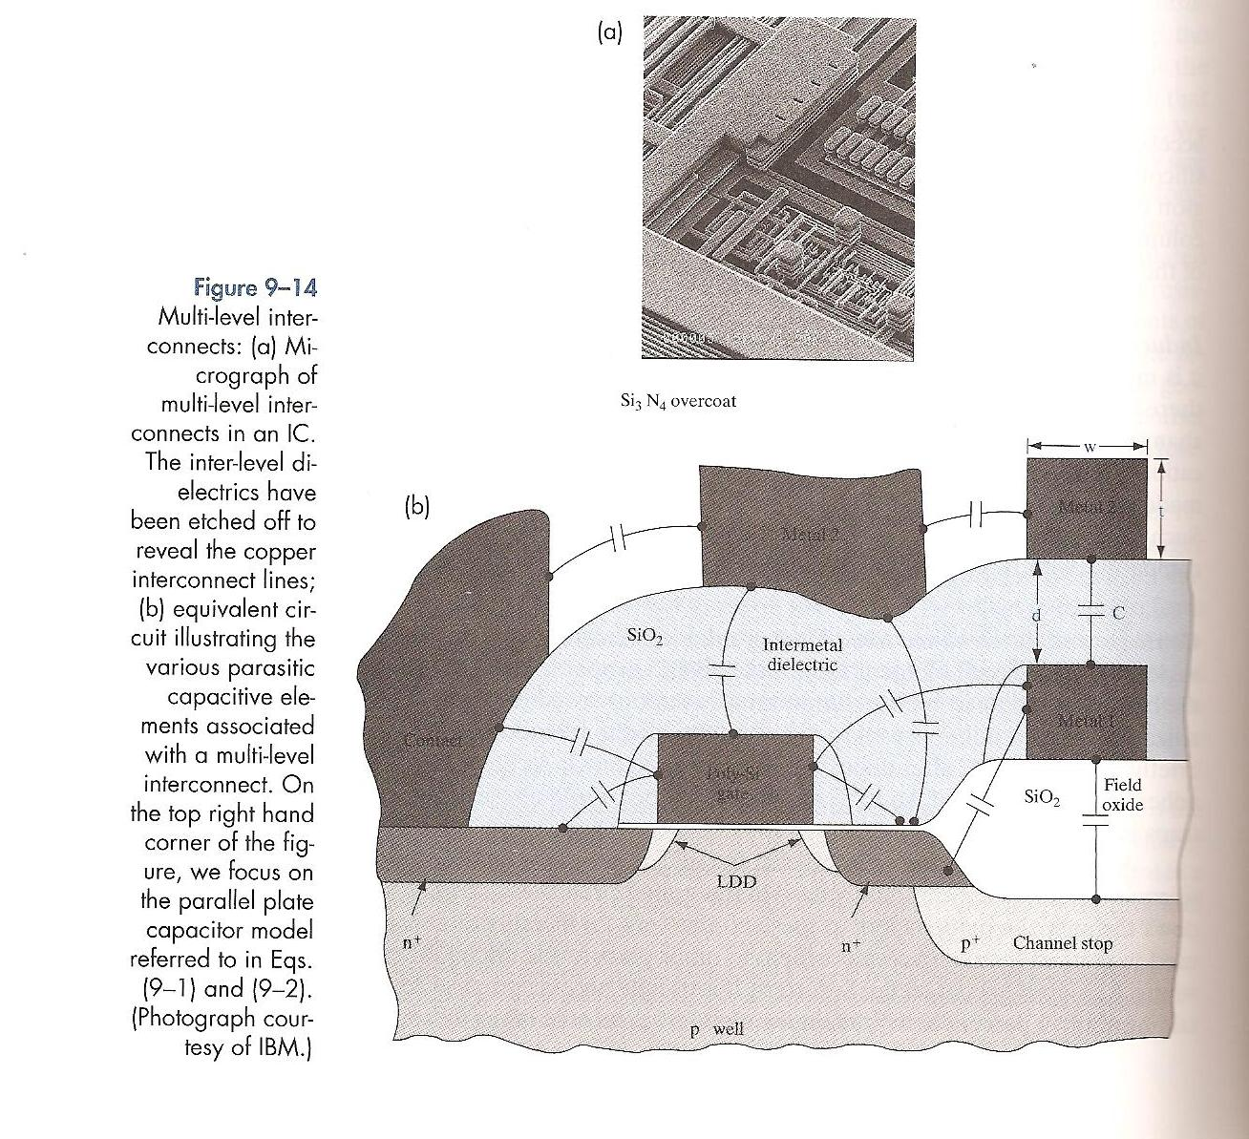

Slide 10
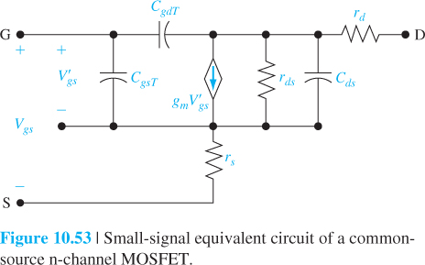
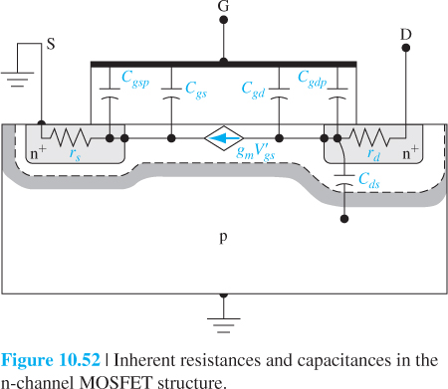
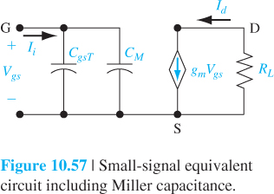

Slide 11
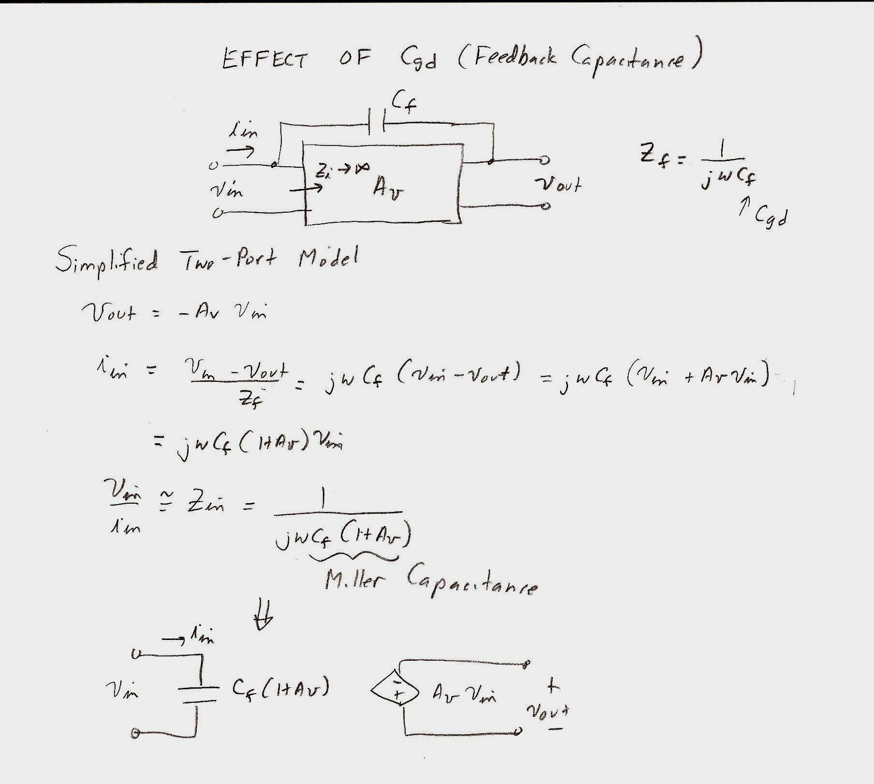
Cf Could Be Either Cgd for a FET or Ccb (Cu) for a BJT

Slide 12
