Slide 1
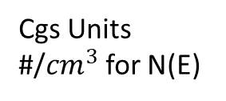
Carrier Concentration Statistics
10 and 13 September 2021
Supplements Examples 2.2 and 2.3 in The Text Without Gory Arithmetic
Density of States (DOS)
Cgs Units
#/${cm}^{3}$ for N(E)
Number of electrons and holes available for conduction N(E) Fabrication and Processing
current-voltage characteristic of semiconductors
System and Circuit Design
Number of energy states as a function of energy [density of states, g(E)]
Occupation probability of energy states [distribution function, f(E)]
Justification for Including Some Semiconductor Physics Before We Proceed beyond Chapters 1 and 2:
We have some idea of specifications we want for an electronic or photonic device
We realize that we have to dope or in some way modify Si or perhaps a III-V material properties
We recognize that the underlying physics provides a framework for this property modification (Rules?)
We will be then be able to address the appropriate technologies for manufacturing a device
1
Notes:
1

Slide 2
The Distribution Function
Distribution function: the probability that a quantum state at the energy E will be occupied by an electron.
N (E): the number density, i.e., the number of particles per unit energy per unit volume
g (E): the density of states, i.e., the number of quantum states per unit energy per unit volume
2
Notes:
2

Slide 3
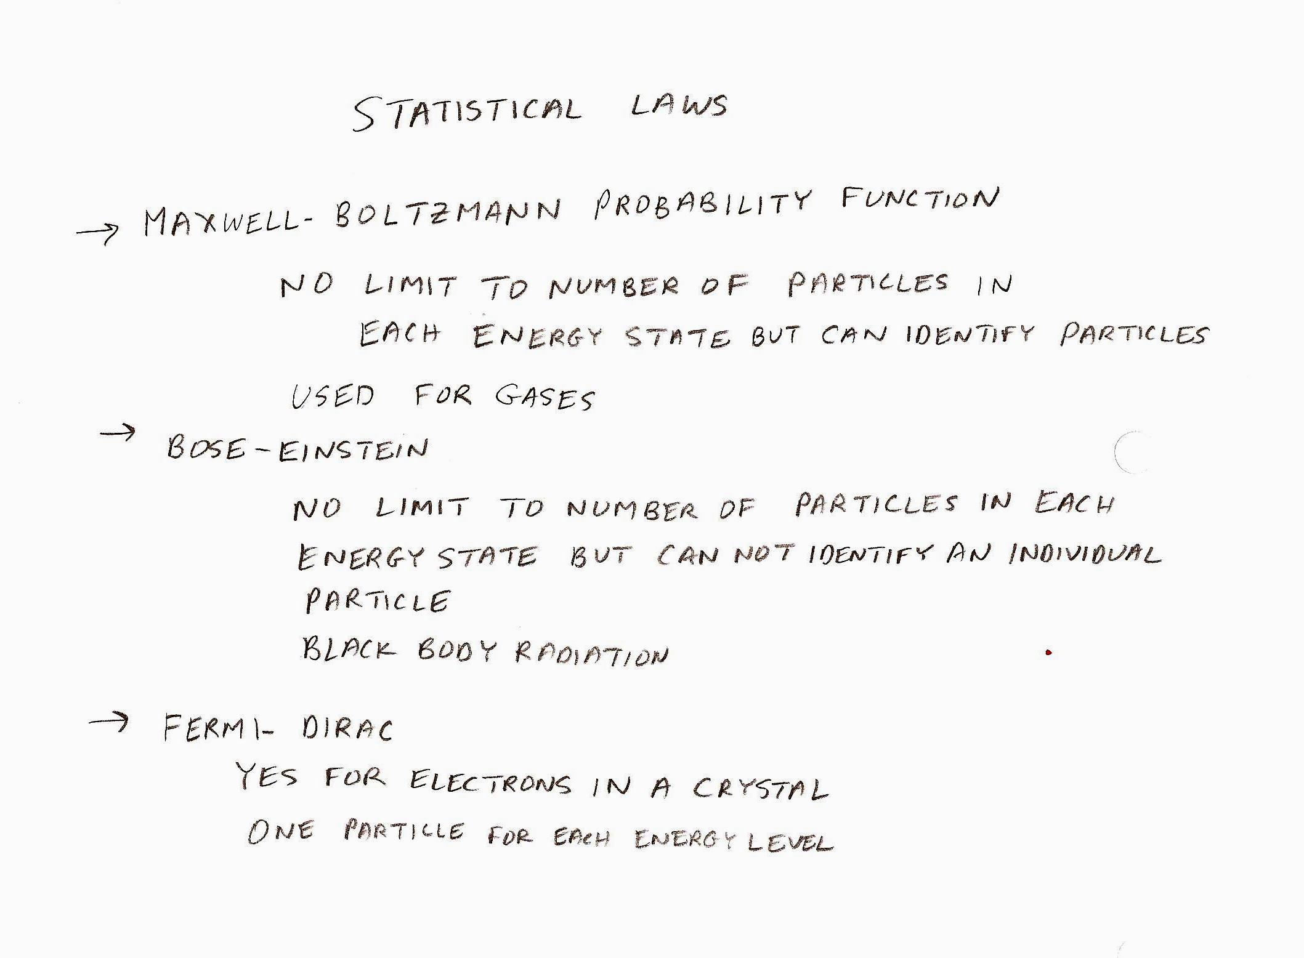

Slide 4
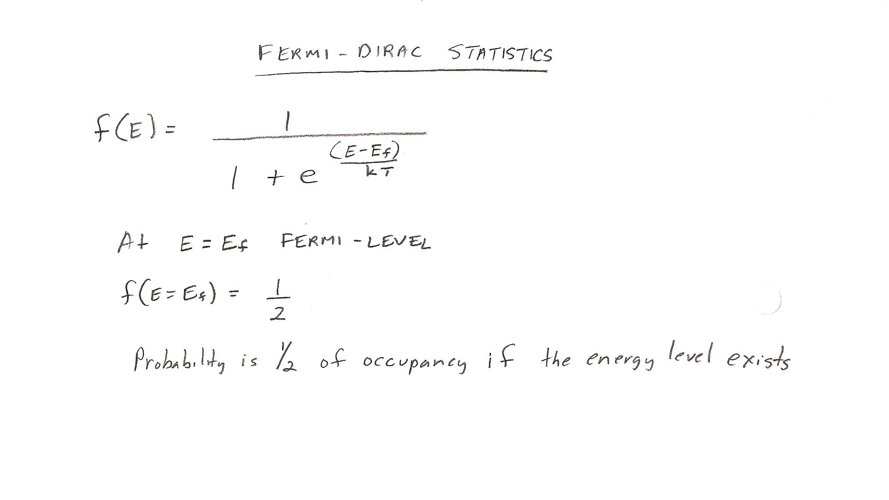

Slide 5
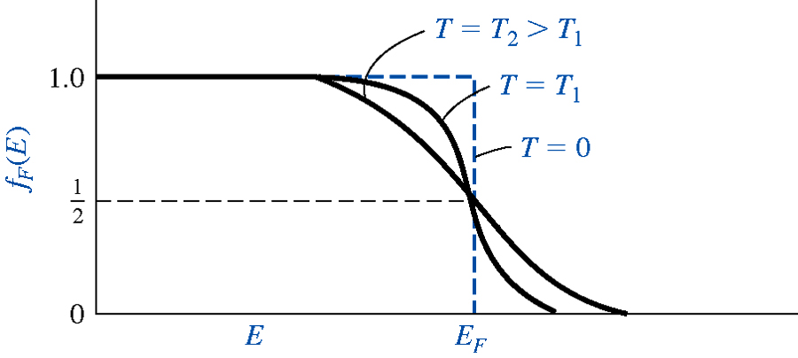
The Fermi-Distribution Function (2)
At T > 0 K,
5
Notes:
5

Slide 6
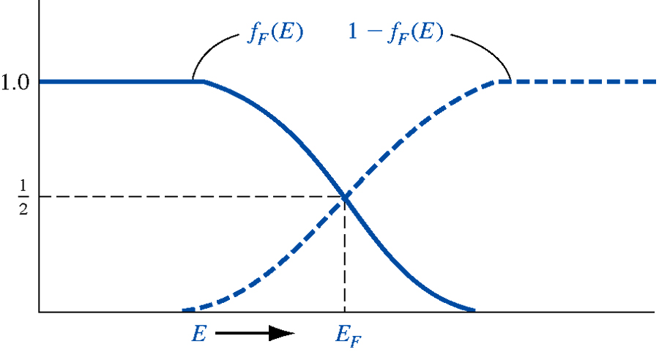
The Fermi-Distribution Function (3)
Probability of empty state (hole occupation probability)
6
Notes:
6

Slide 7
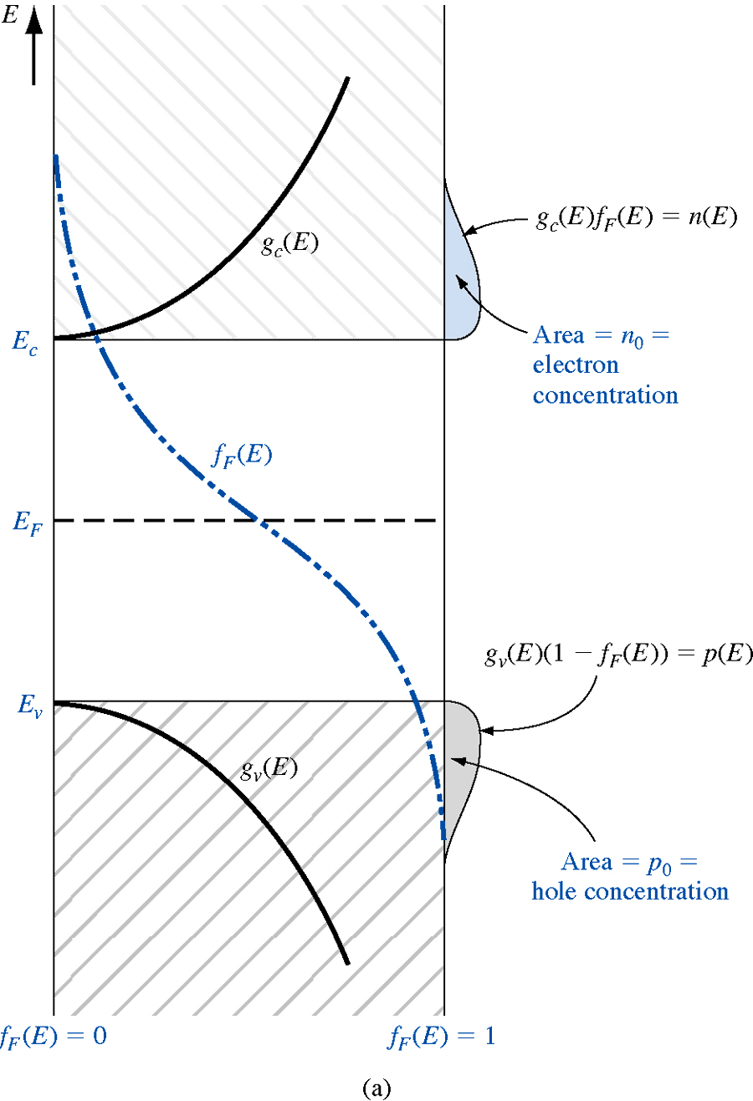
Distribution of Electrons and Holes in Equilibrium
7
7

Slide 8
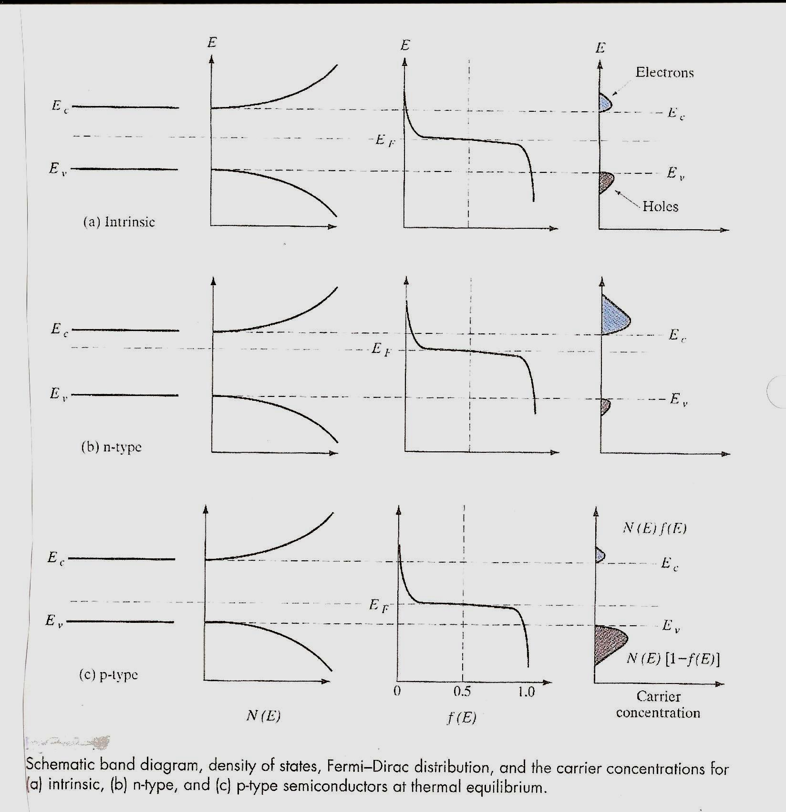

Slide 9
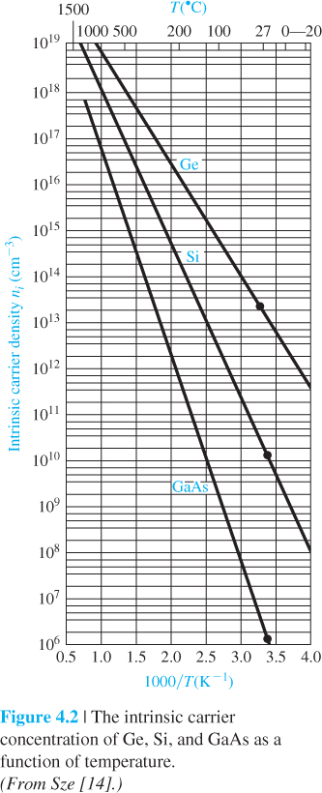
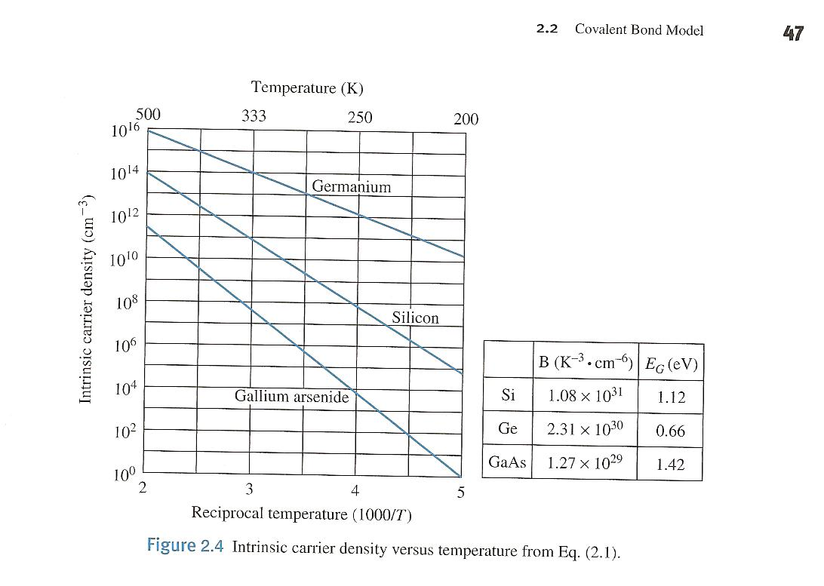

Slide 10
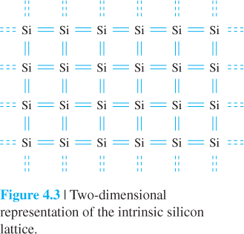
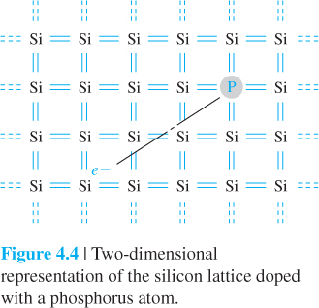
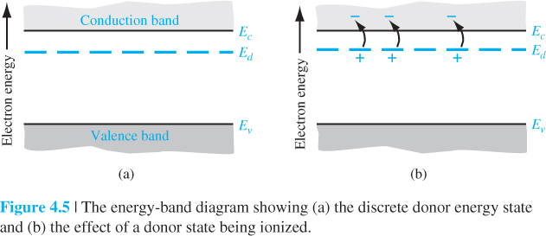

Slide 11
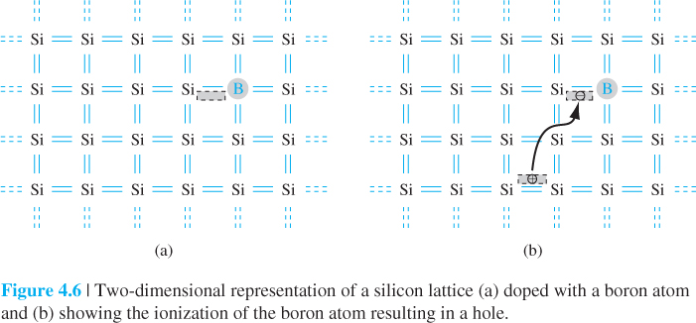
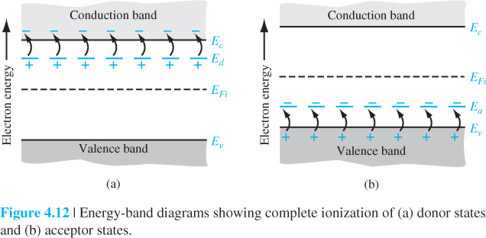

Slide 12
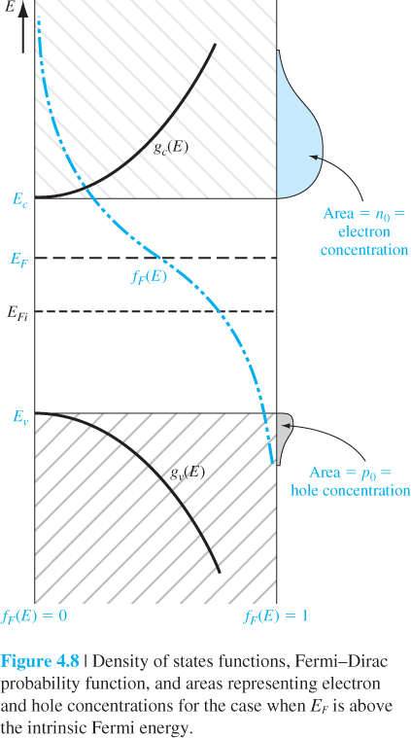
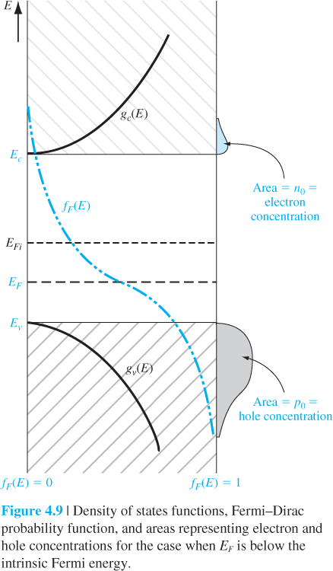

Slide 13
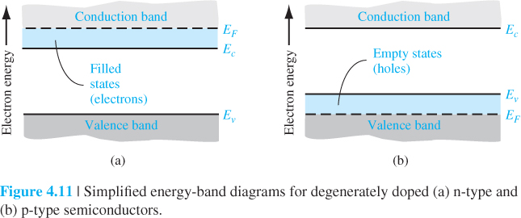

Slide 14
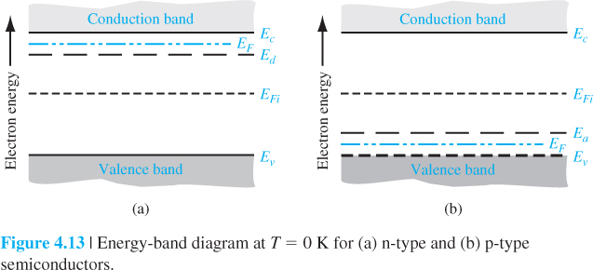
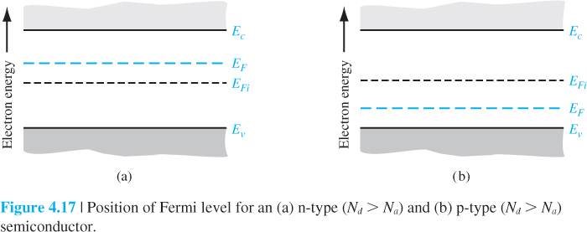

Slide 15
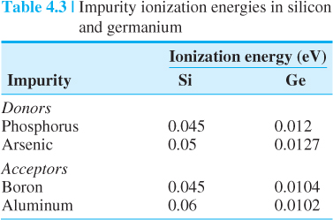
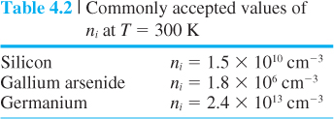
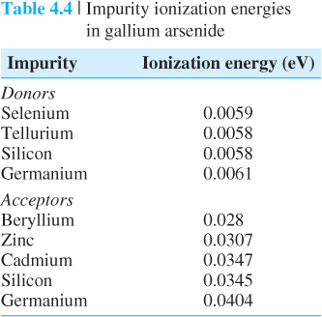
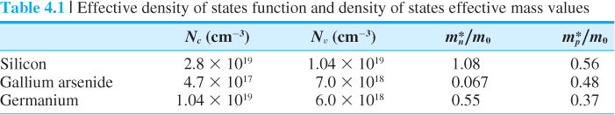

Slide 16
