Slide 1
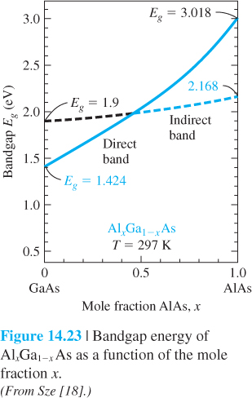
11 and 13 October
Photonics-PPT#2
LED LASER LIGHTING
One More slide on “Bandgap” Engineering From PPT#1

Slide 2
Photon Emission in Semiconductor
Conduction band
When an electron meets a hole, it falls into a lower energy level, and releases energy in the form of a photon.
The wavelength of the light depends on the band gap of the semiconductor material
E_{C}
Photon
E_{F}
E_{g}
E_{V}
Valence band
Semiconductor materials: Si, Ge, GaAs, InGaAs, AlGaAs, InP, SiGe, etc

Slide 3
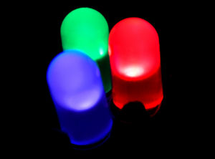
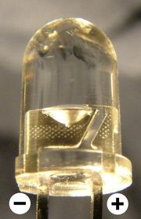
Light-Emitting Diodes (LEDs)
Light-emitting diode (LED) is a semiconductor diode that emits incoherent light over relatively wide spectral range when electrically biased in the forward direction of the p-n junction.

Slide 4
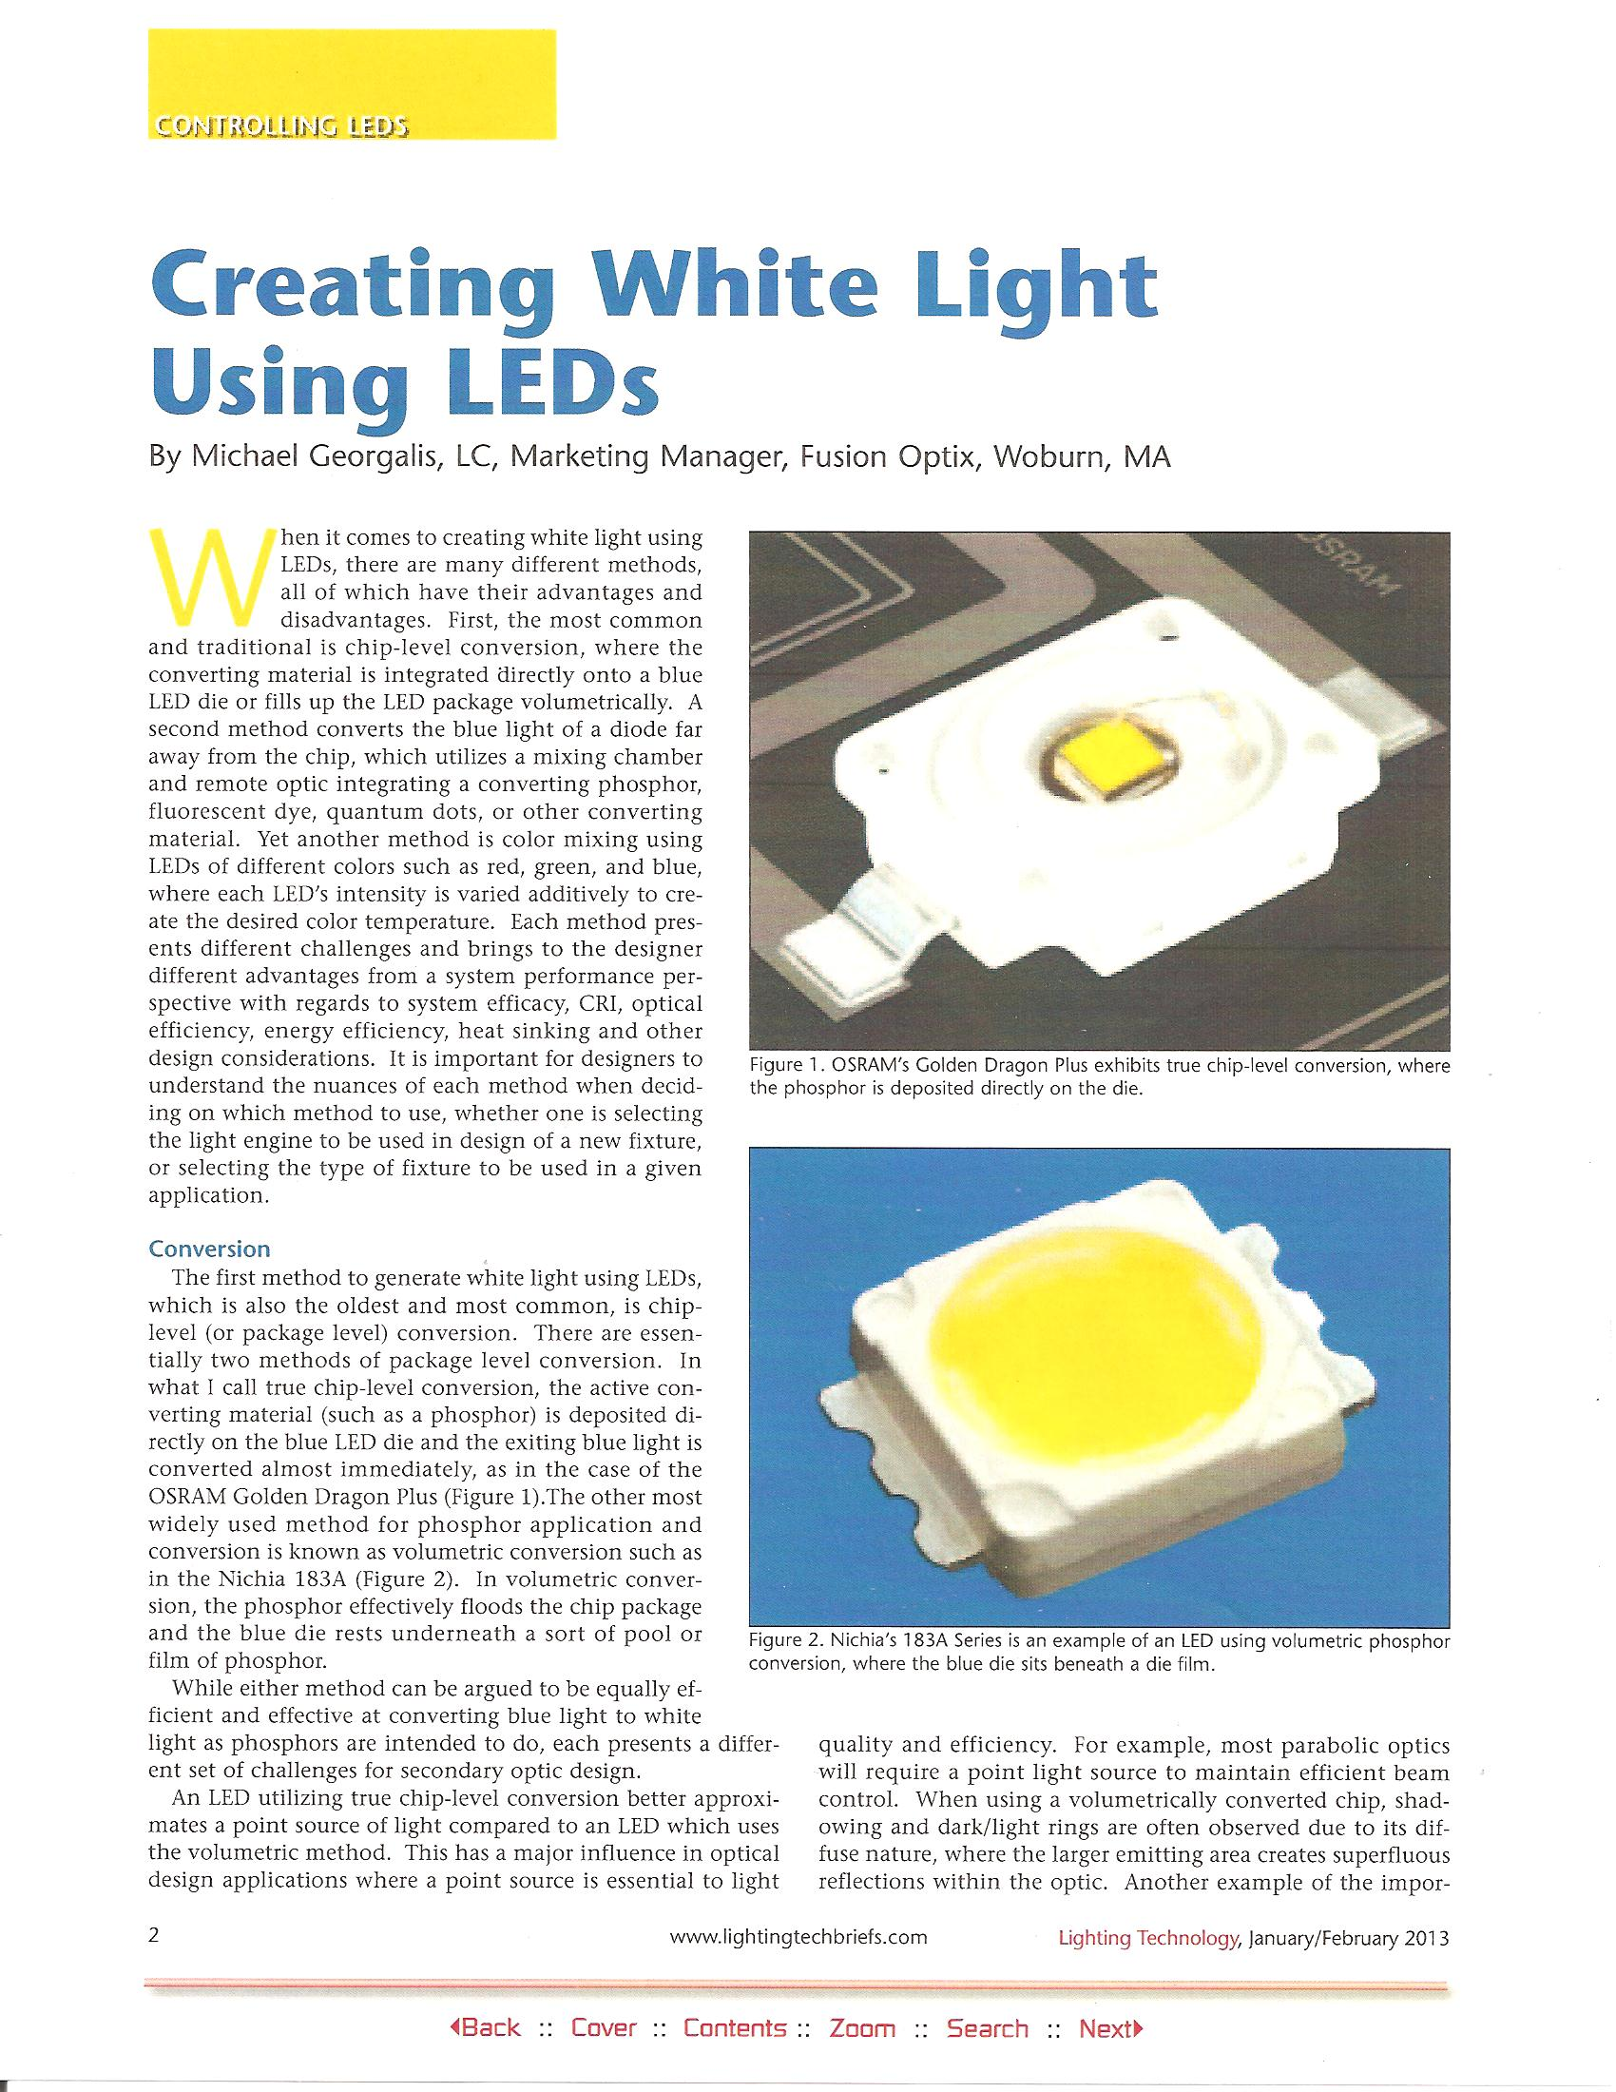

Slide 5
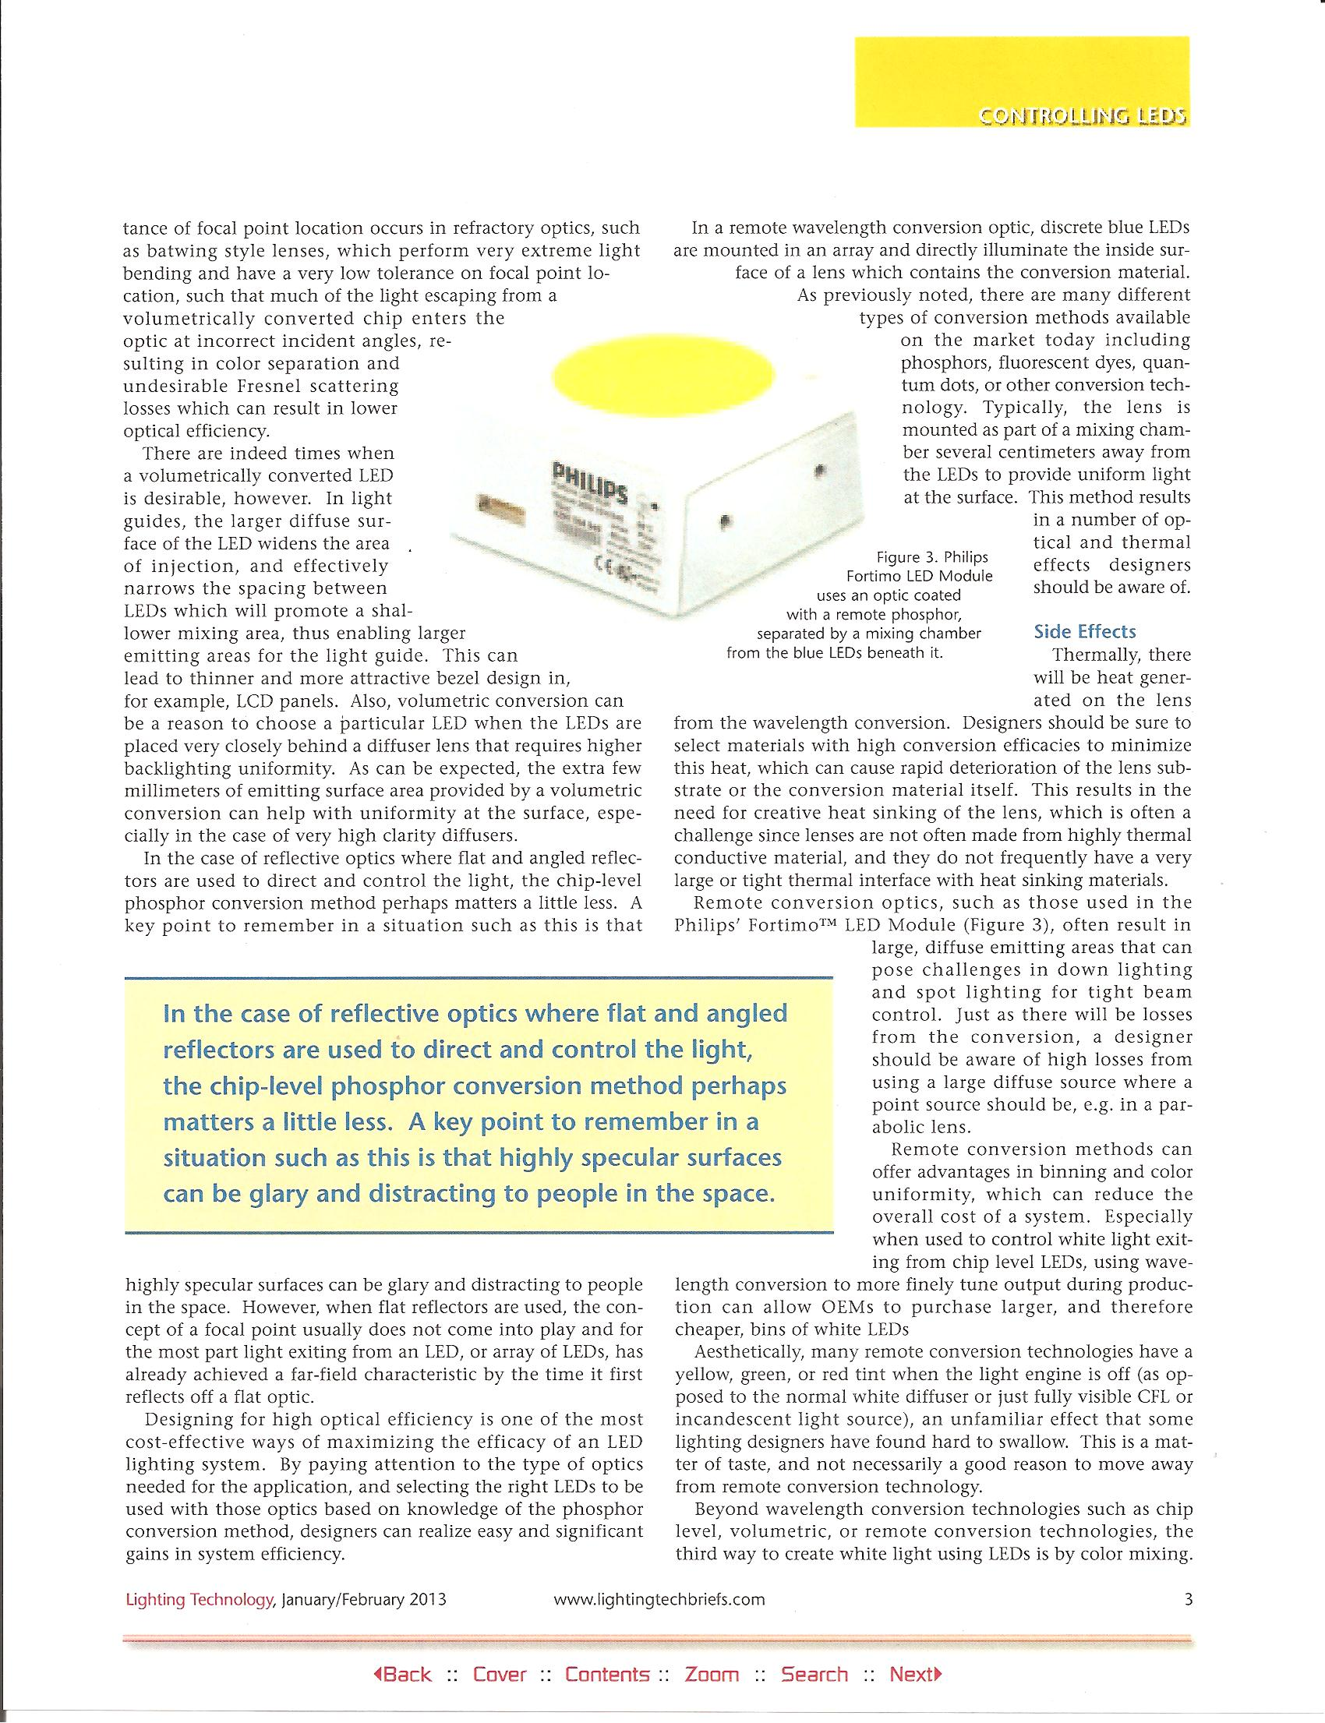

Slide 6
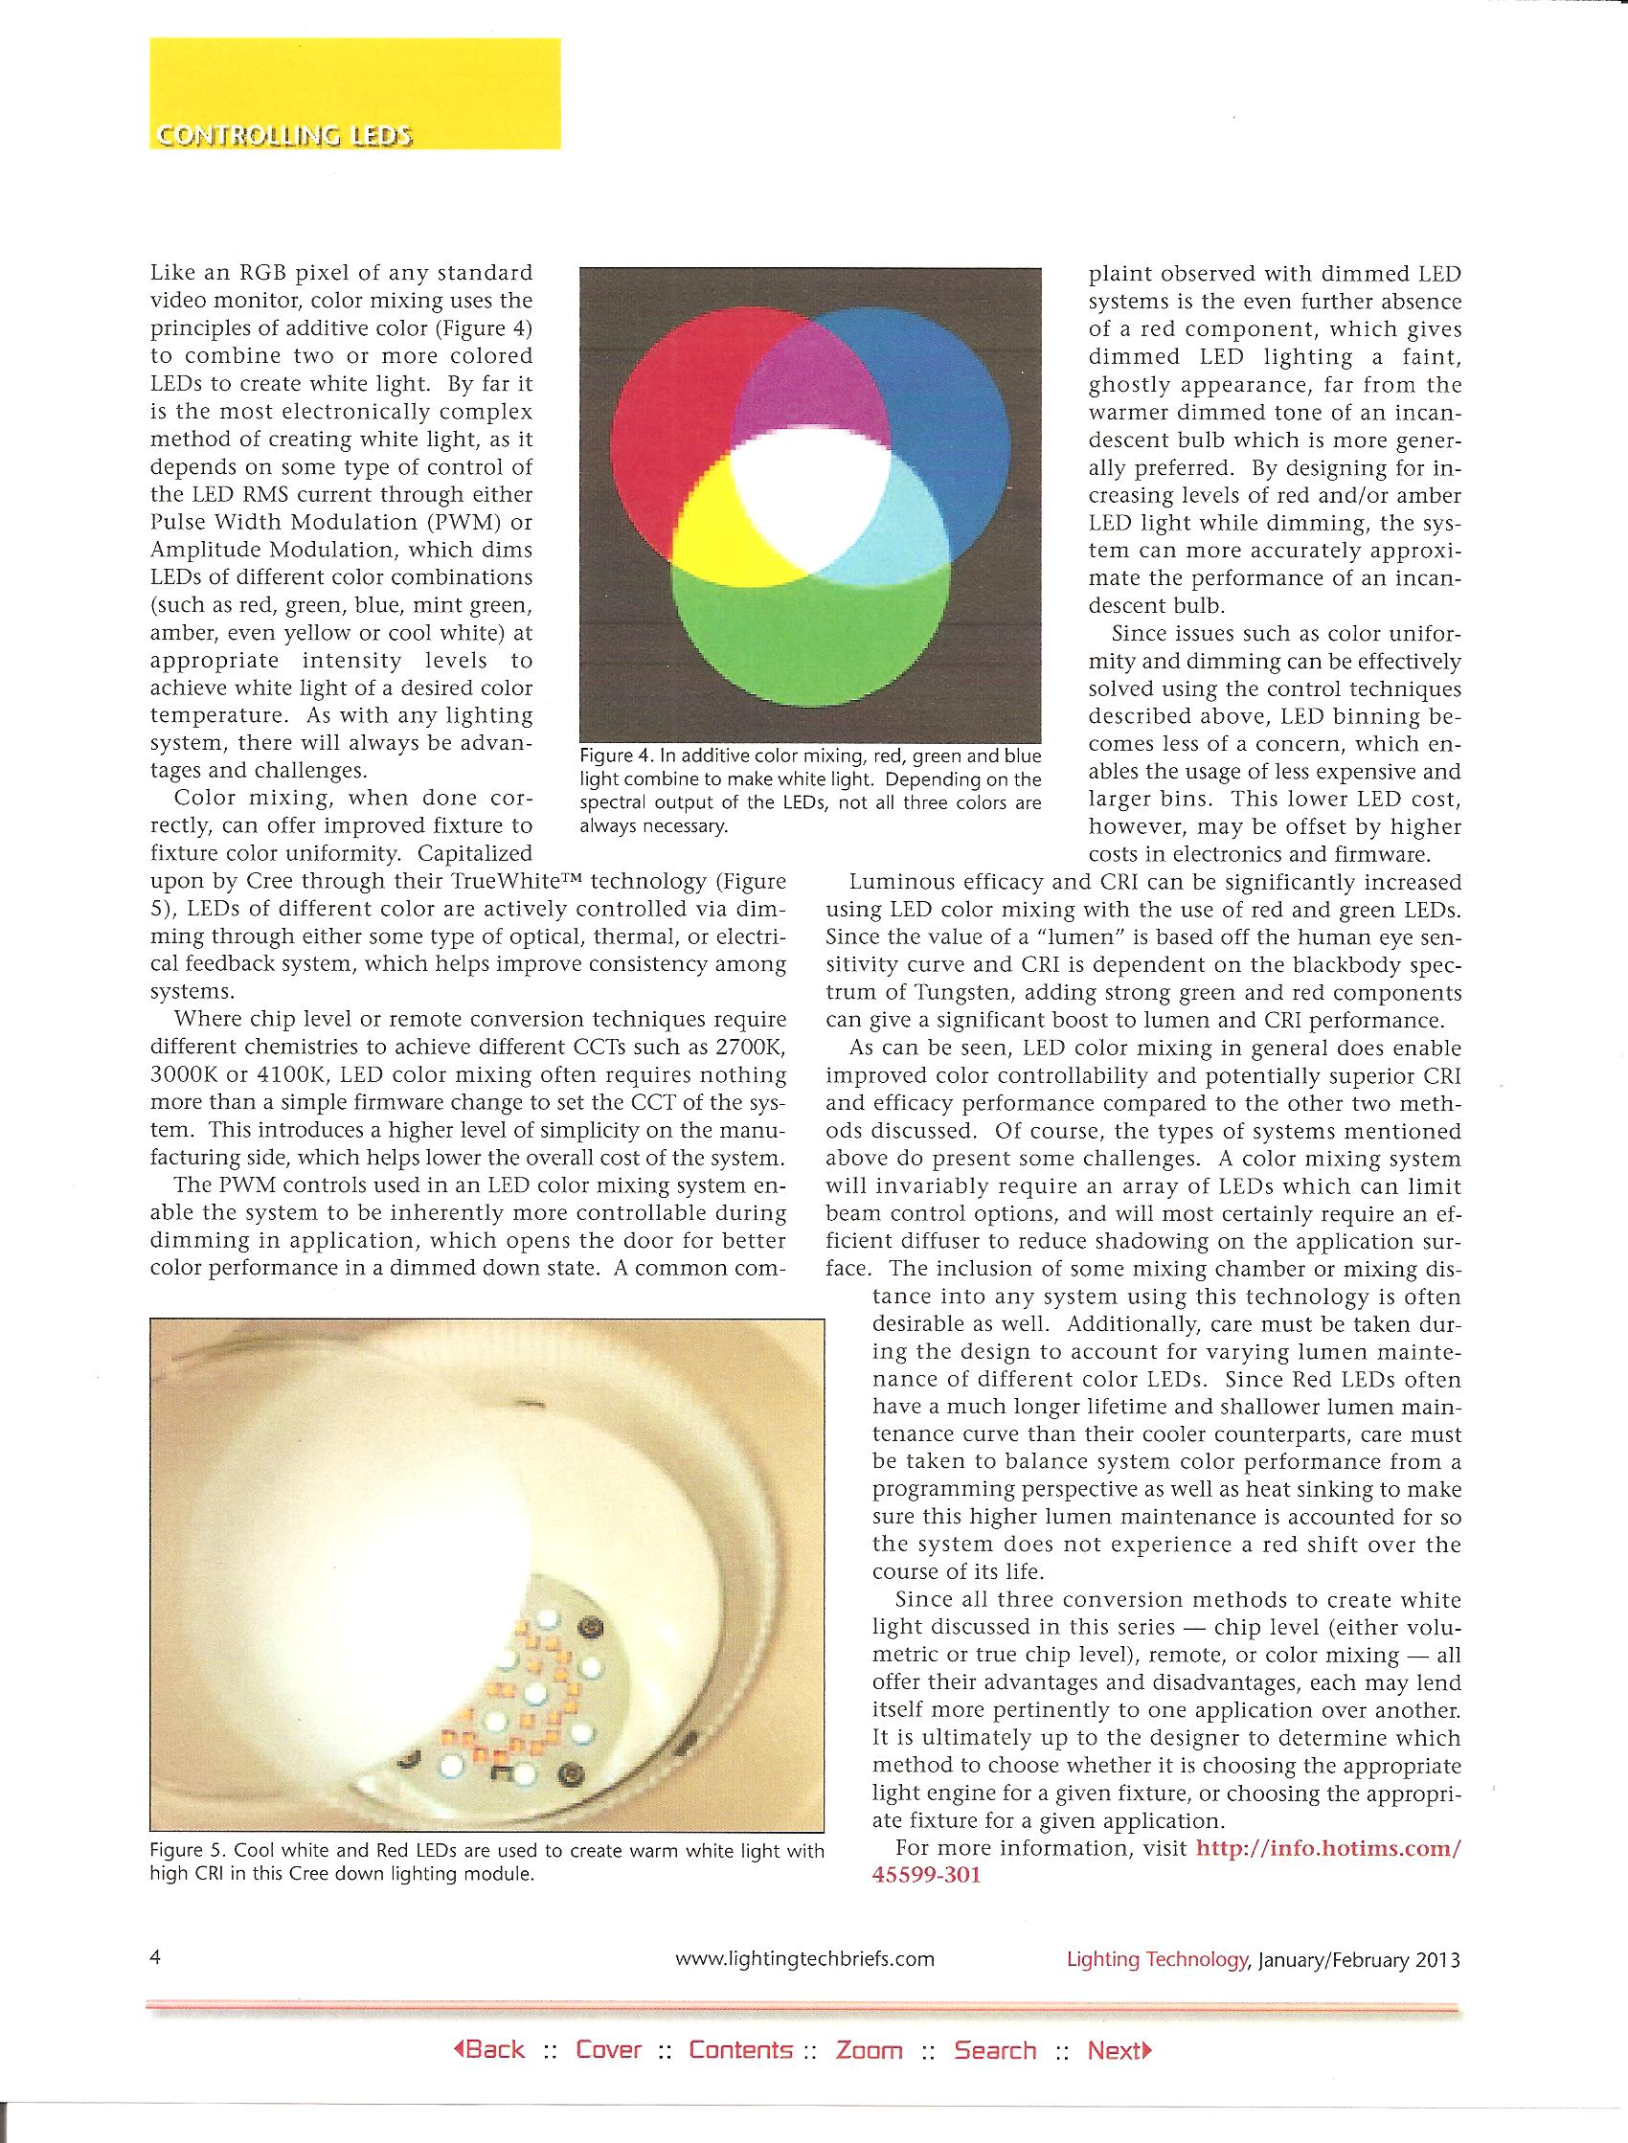

Slide 7
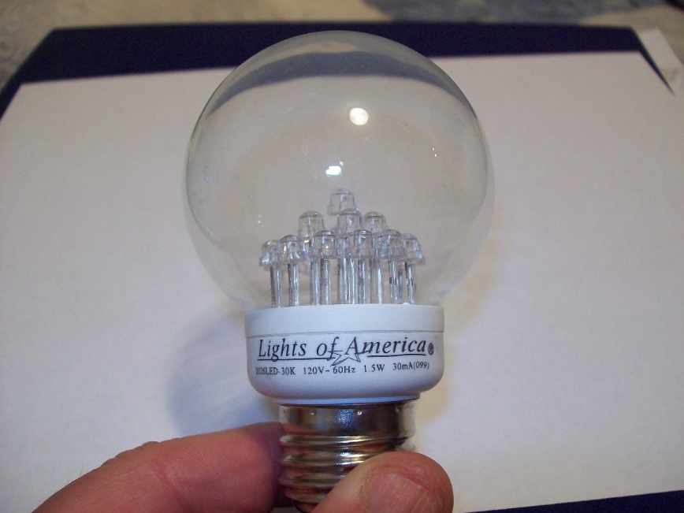
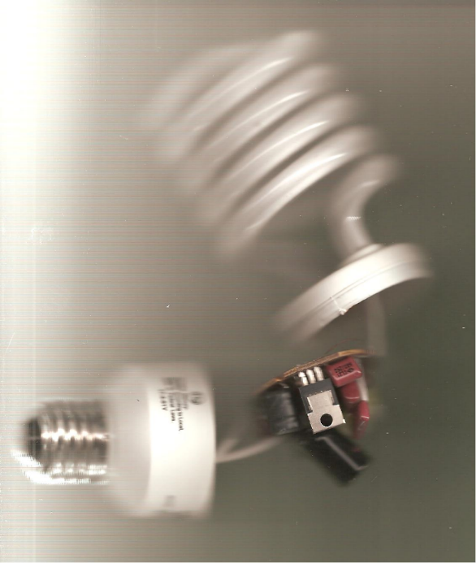
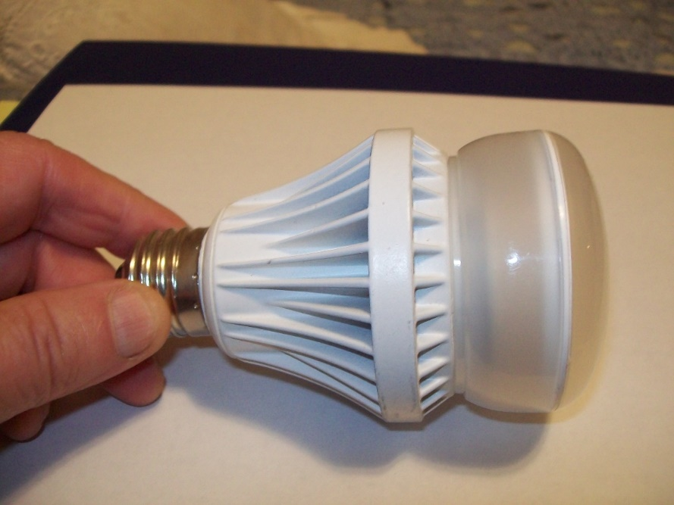


Slide 8
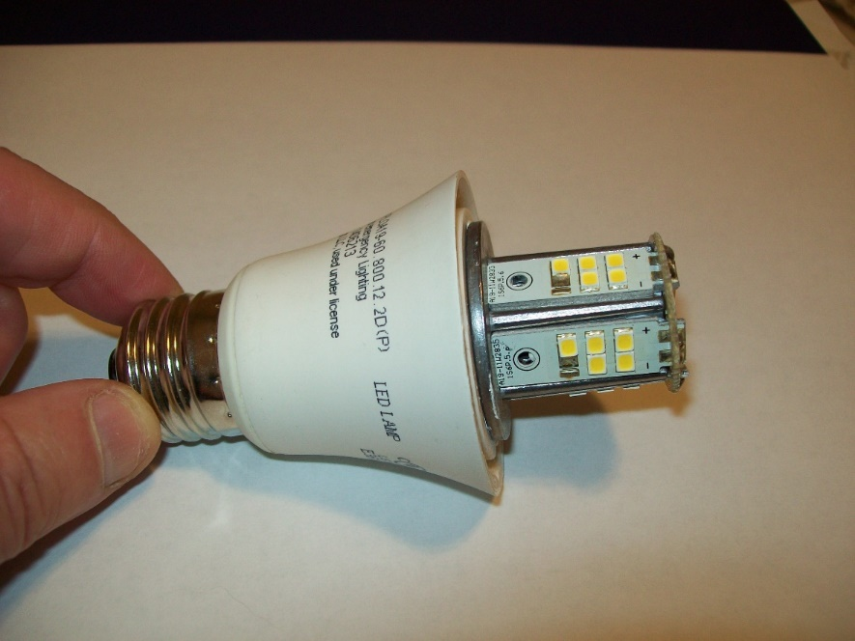
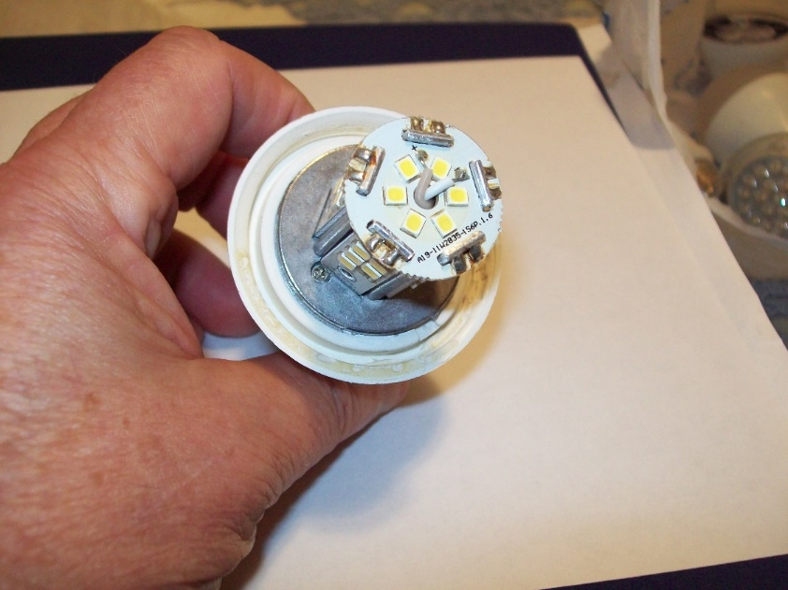
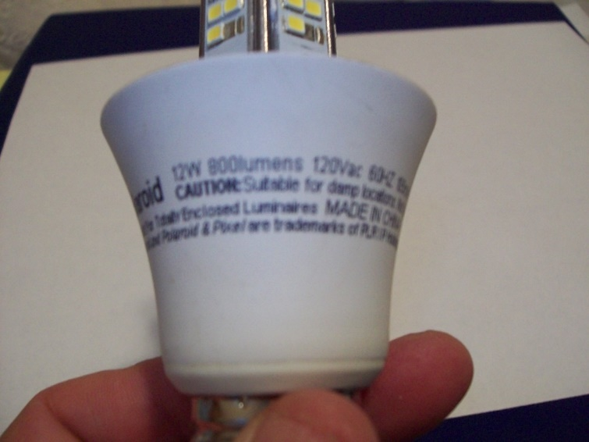

Slide 9
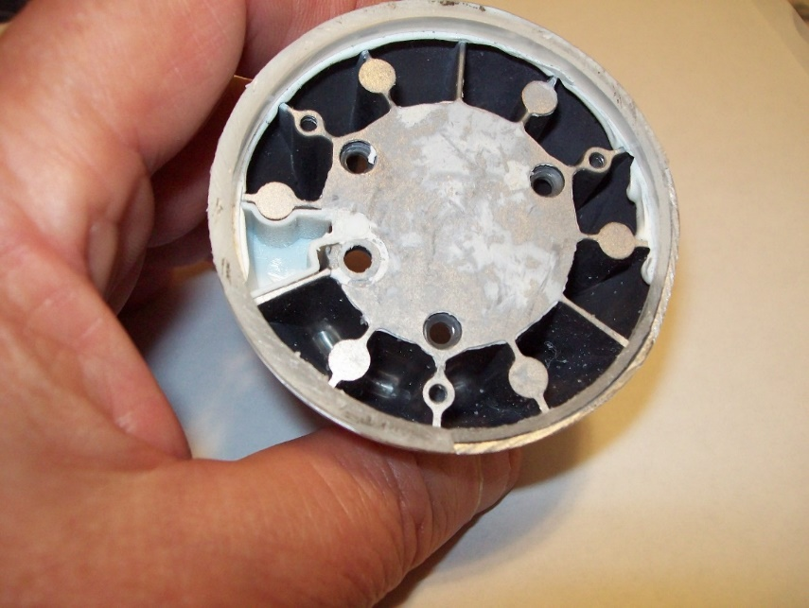
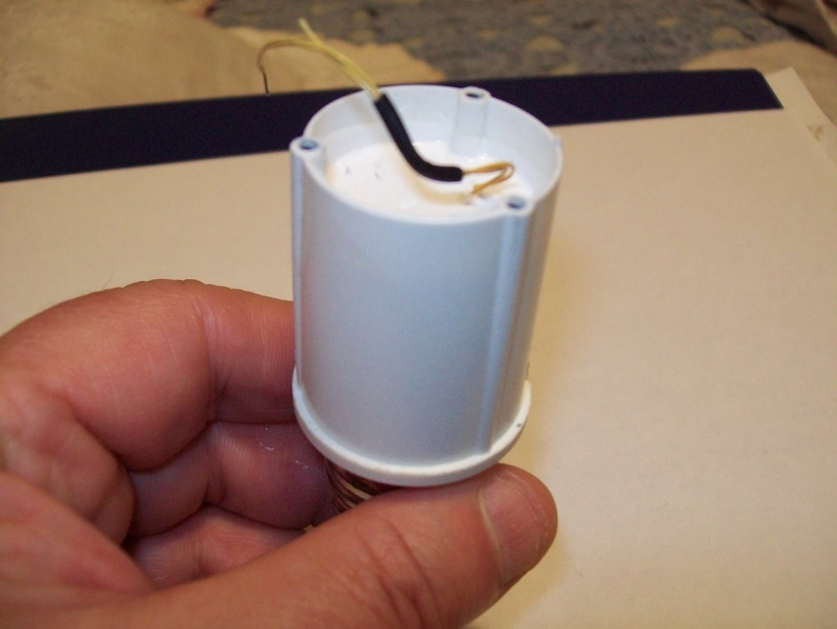

Slide 10
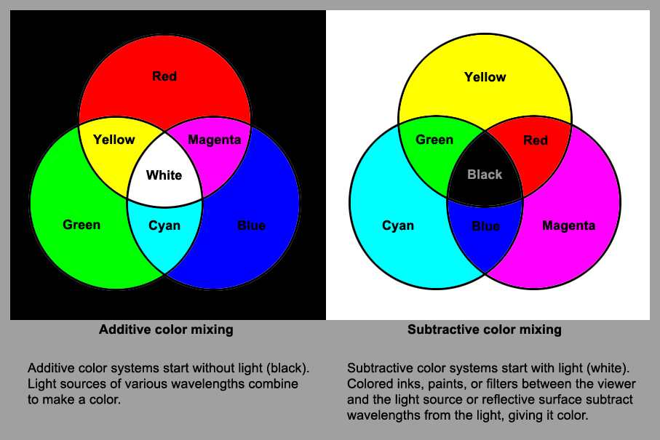
Displays, Imaging
CYMK (Cyan, Magenta, Yellow, Black) Printing
Also Watercolor, Oil, Acrylic Painting

Slide 11
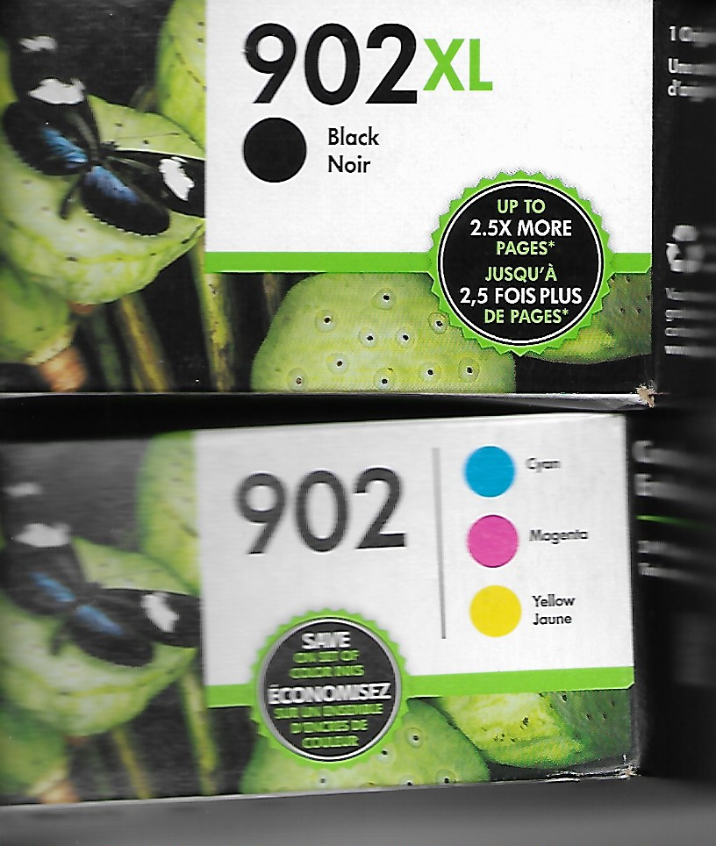

Slide 12
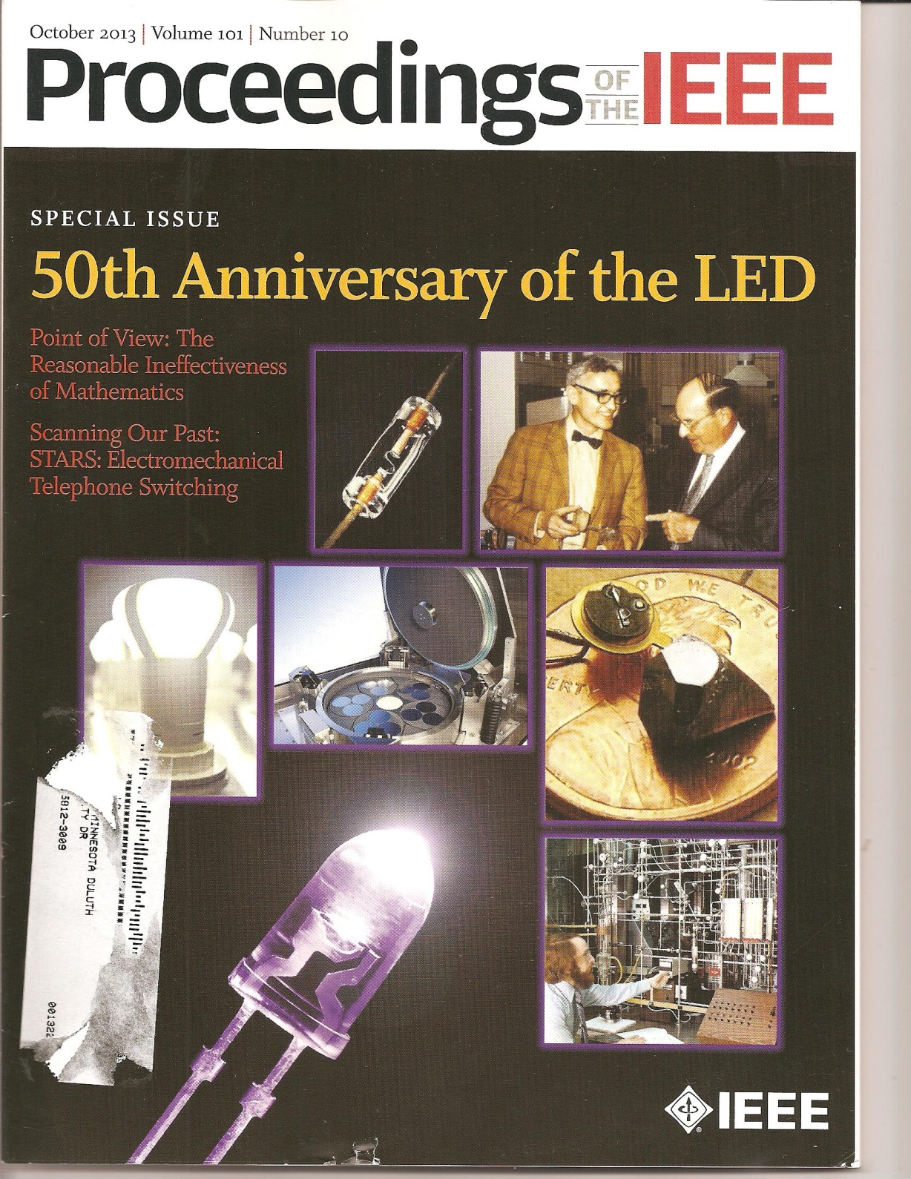

Slide 13
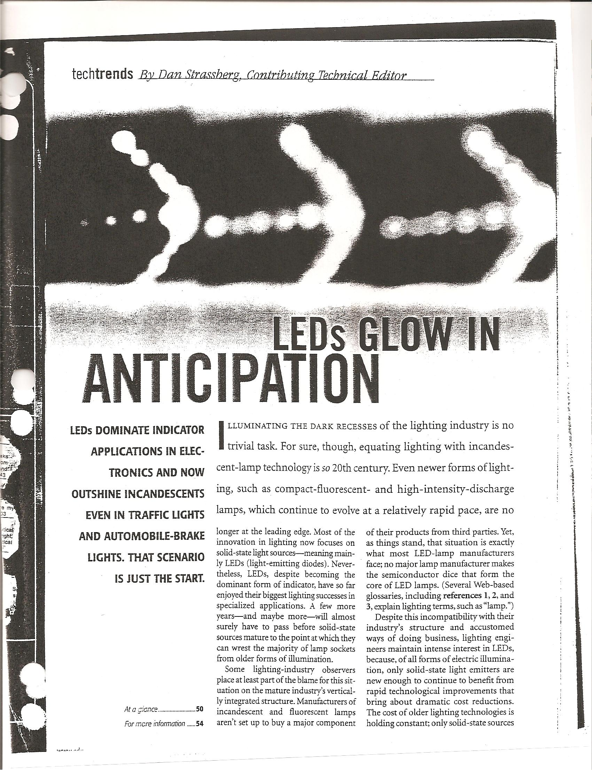

Slide 14
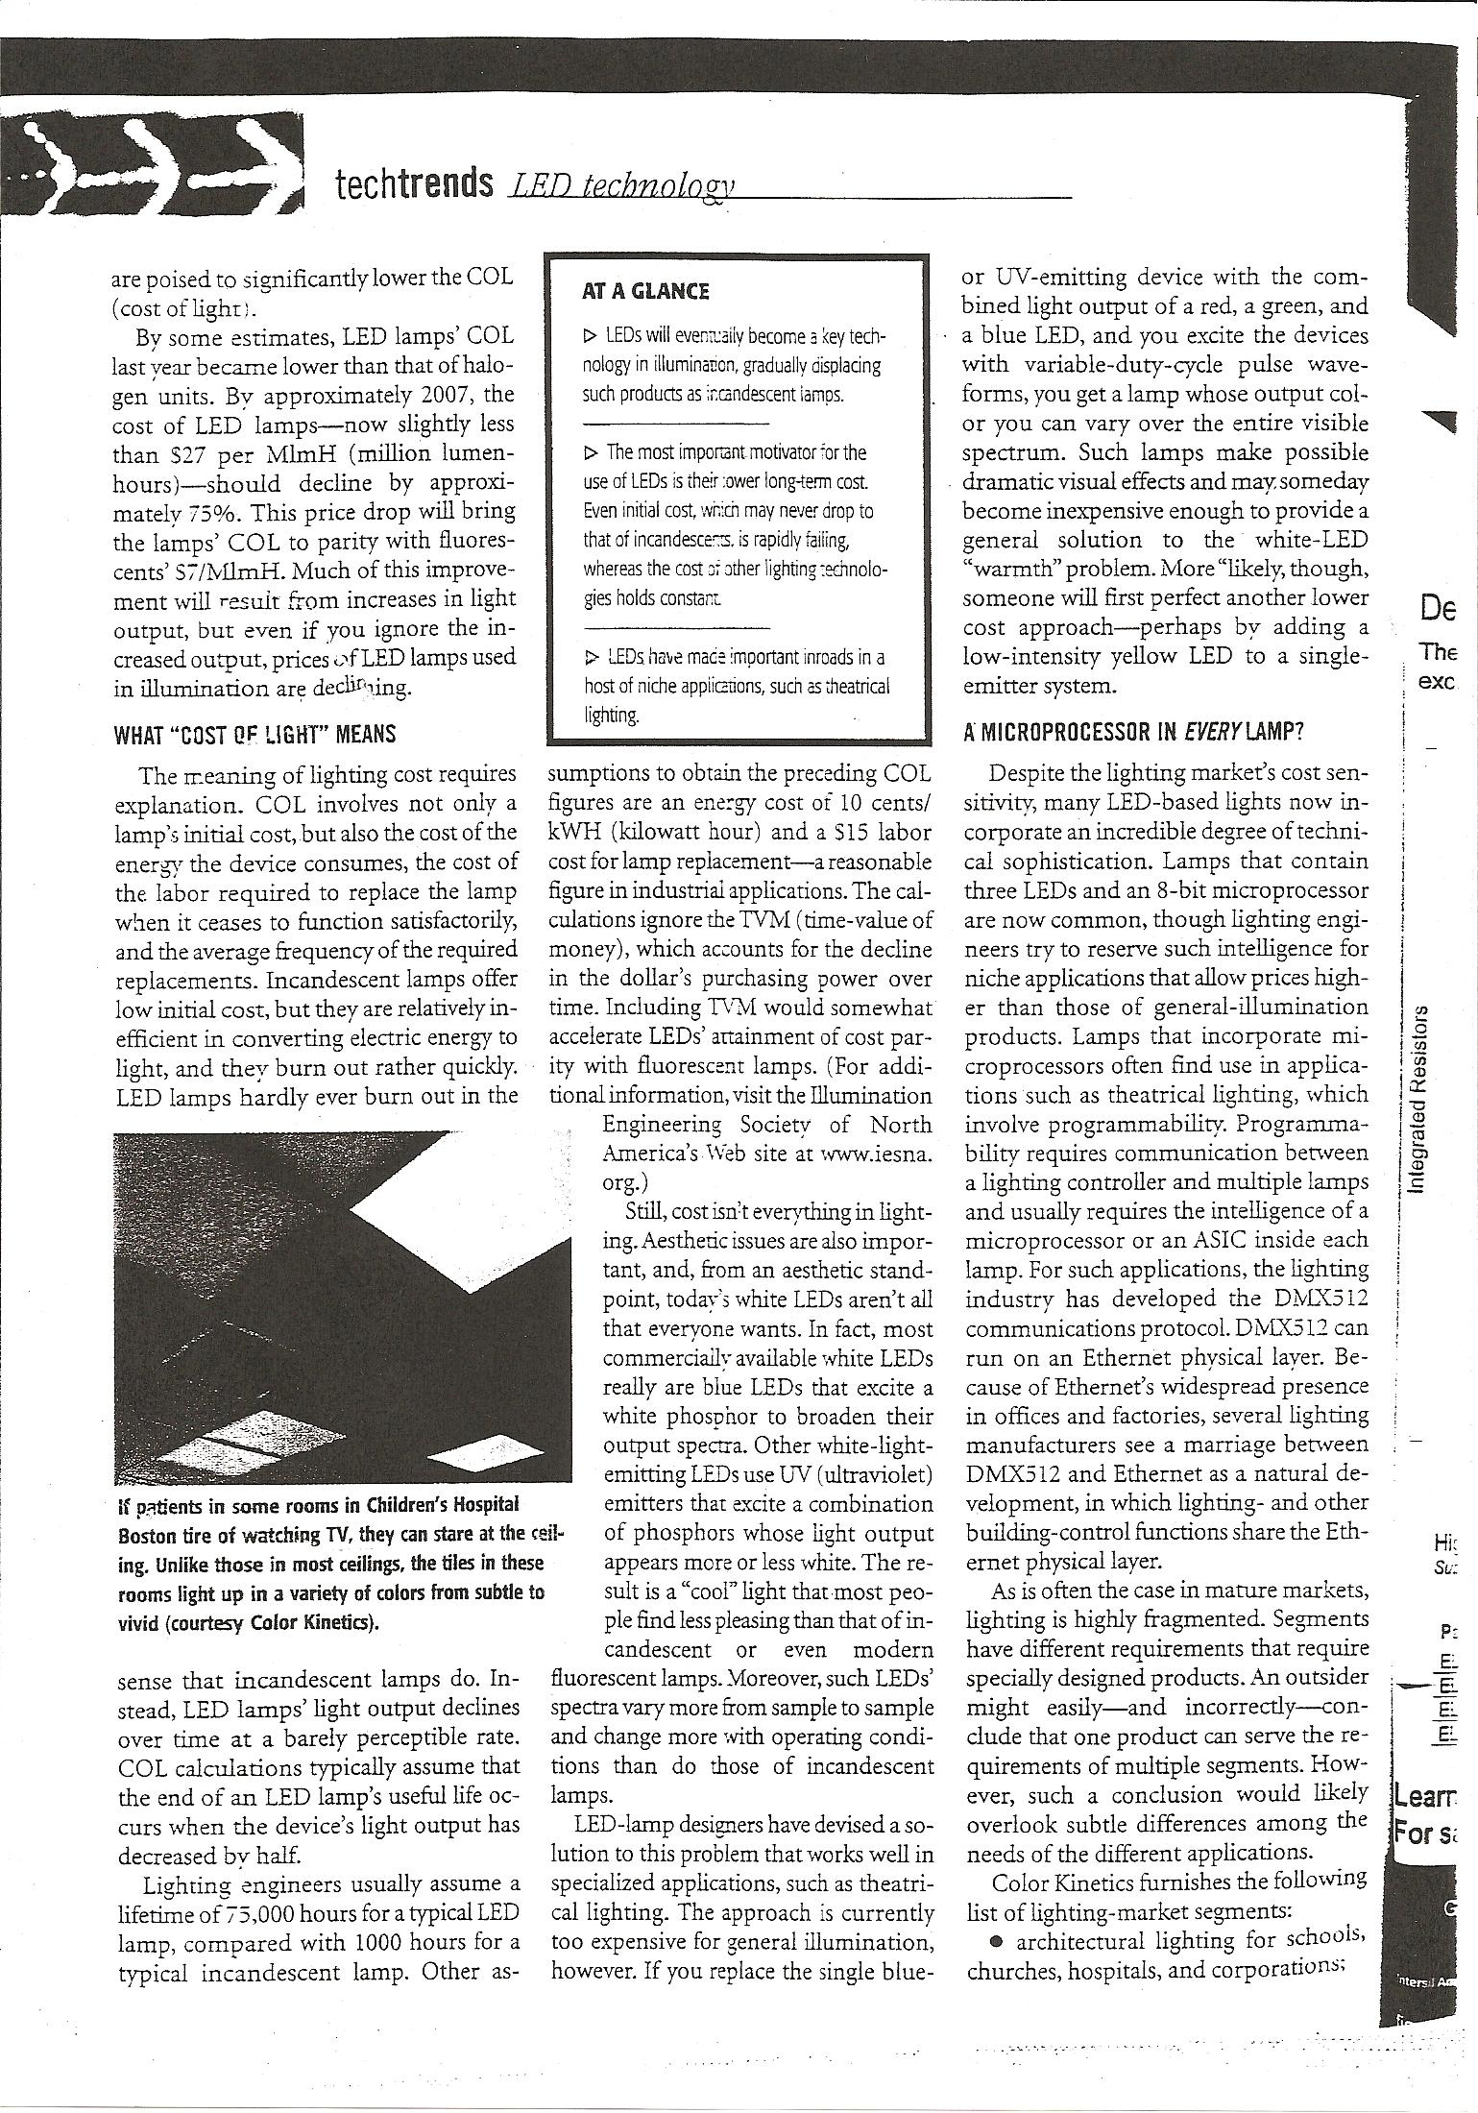

Slide 15
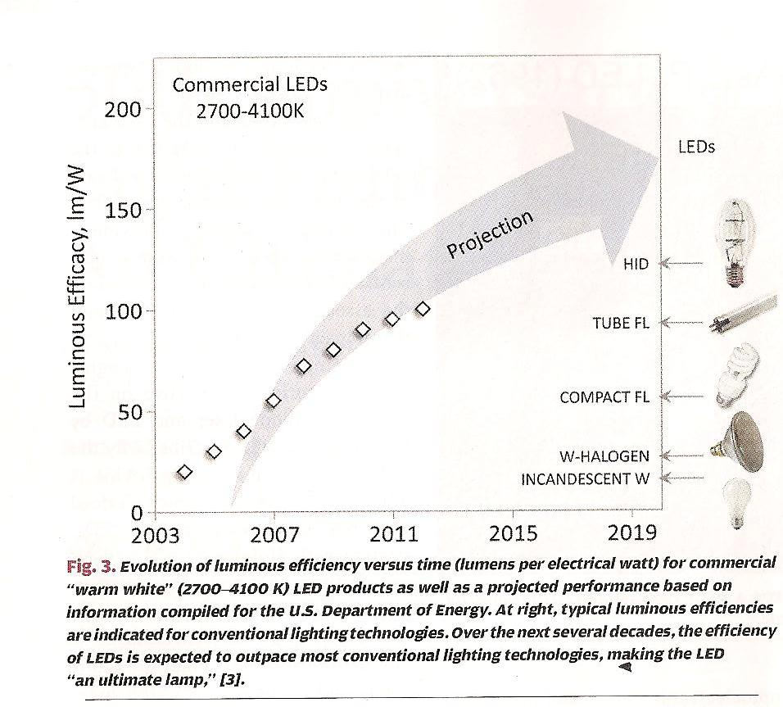
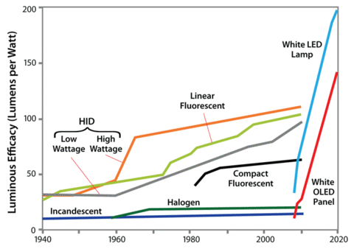

Slide 16
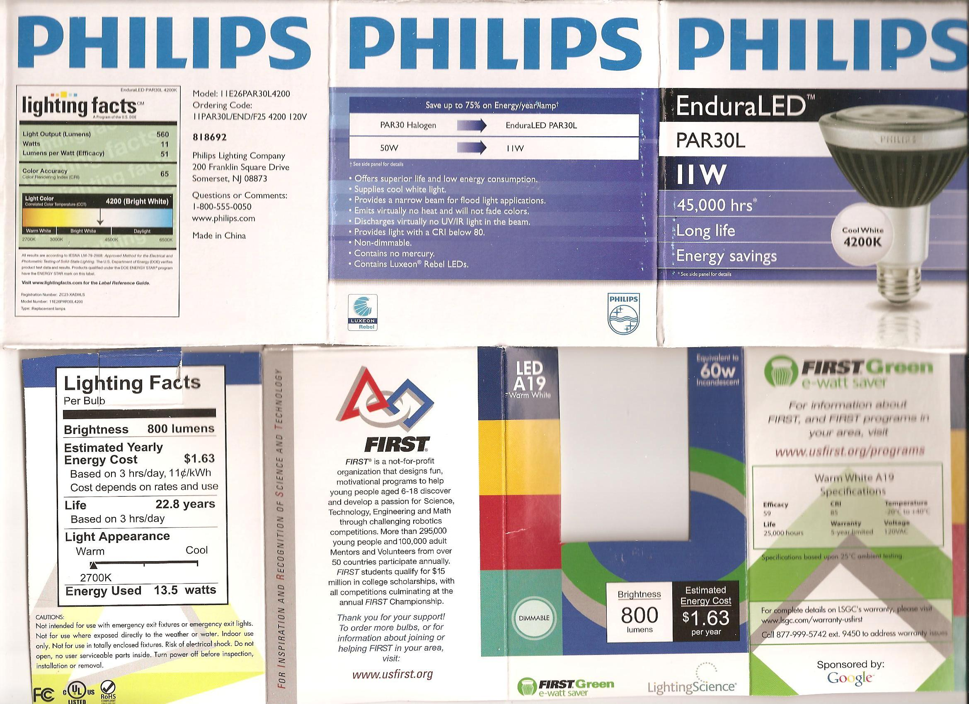

Slide 20
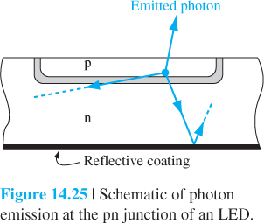
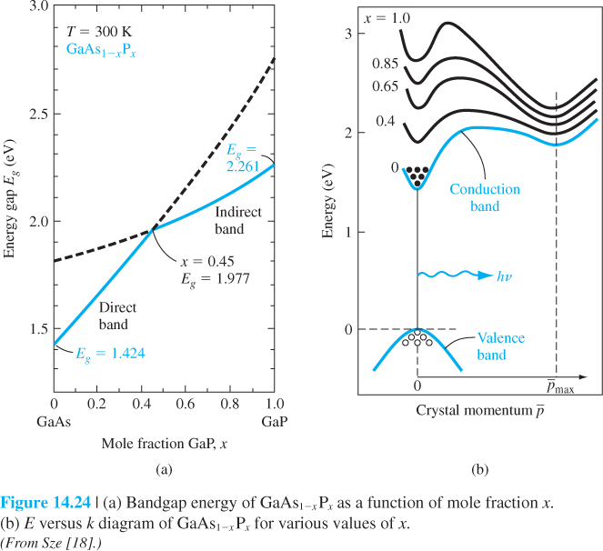

Slide 21
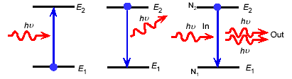
Laser Diodes
Lasers (Light Amplification by Stimulated Emission)
Photon emission processes:
Absorption
Photodetectors
Spontaneous emission
LEDs
Stimulated emission
Lasers

Slide 22
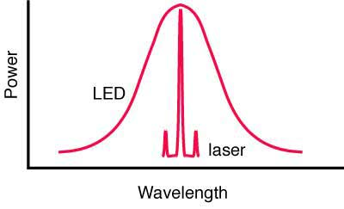
Laser Cavity Design
Total reflector
Current
Partial reflector
GaAs N+
GaAs P+
Electrodes
Laser cavity design:
Laser medium is similar to LEDs,
Extra components a in laser cavity are the mirrors at two facing planes (facets) for lasing mode selection.
The laser light is monochromatic and coherent due to the mode selection in the cavity design

Slide 23
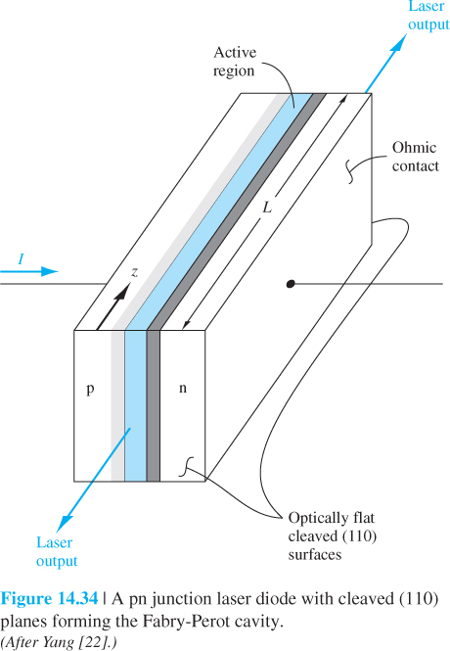
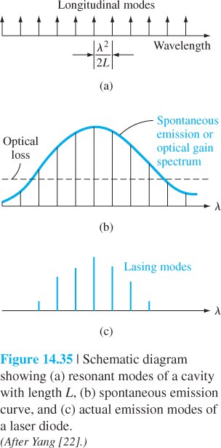
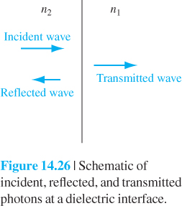

Slide 24
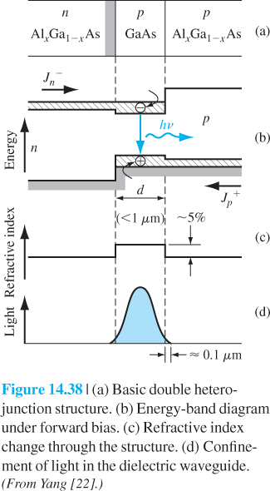

Slide 25
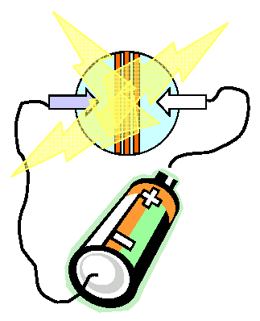
Application of QWs — Diode Laser
Light
Light
Electrode
Electrode
p-AlGaAs
n-AlGaAs
GaAs
Conduction band
Band gap
Valence band
+V
Disadvantages:
Emission wavelength depends on material
Very difficult to generate more than one color per laser
Difficult to generate long wavelength, i.e., colors in the mid- to far- infrared region
25
25

Slide 26
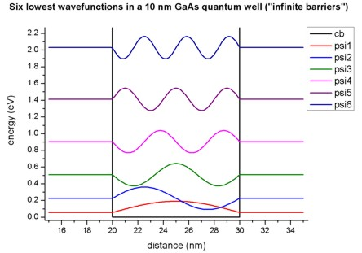
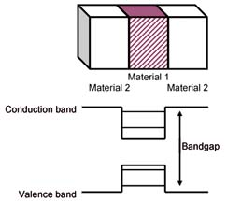
Semiconductor Quantum Wells (QWs)
A narrow gap semiconductor is sandwiched between layers of a wide band gap
semiconductor
Quantum confinement takes place when the well thickness is comparable to De
Broglie wavelength of the particle
Electron movement is confined in the quantum well growth direction
Examples: GaAs/AlAs, InGaAs/AlInAs.
26
26

Slide 27
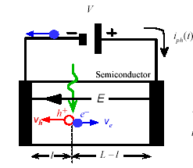
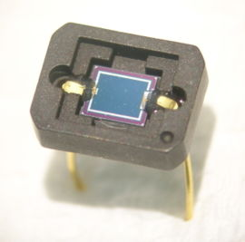
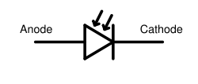
Photo Diodes (PDs)
PD symbol:
A photodiode is a semiconductor diode that functions as a photodetector. It is a p-n junction or p-i-n structure. When a photon of sufficient energy strikes the diode, it excites an electron thereby creating a mobile electron and a positively charged electron hole

Slide 28
