Slide 1
Vacuum Systems
Evaporation
Parts 2, 3,and 4
Chemical Vapor Deposition (CVD)
Plasma-Enhanced Chemical Vapor Deposition (PECVD)
Metal
Organometallic CVD (MOCVD )
Molecular Beam Epitaxy (MBE)
15 and 18 October 2021
Deposition Techniques-Part 1

Slide 2
Overview of Thin Film Deposition Systems
Materials to be deposited in microelectronic processing:
  Metals
  Dielectrics: silicon dioxide and silicon nitride
  Si and poly-Si
Several methods are currently used for thin film deposition:
  Evaporation (vacuum system, low pressure)
  Sputtering (vacuum system, low pressure)
  Chemical vapor deposition (CVD) (at reduced or atmospheric pressure)
  Epitaxy (at reduced or atmospheric pressure)
  Molecular Beam Epitaxy (MBE, Low pressures)
Thin film:
  Less than 1μm thick
  Up to the thickness of hundreds of atoms (atom size 5-10Å)

Slide 3
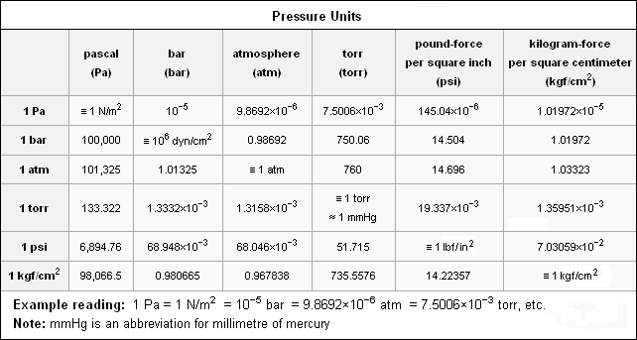
Meteorological
1 atm expressed as about 1000 mbar
30 inches of Hg

Slide 4
Evaporation
Process:
  Metal material is heated to the point of vaporization
  Evaporate to form a thick film covering the surface of wafer
  To control the composition of the deposited material, evaporation is performed under vacuum condition
Advantages:
  Highest purity due to low pressures
  Just about anything can be evaporated
Disadvantages:
  Poor step coverage,
  Forming alloys can be difficult
  Requires high temperatures

Slide 5
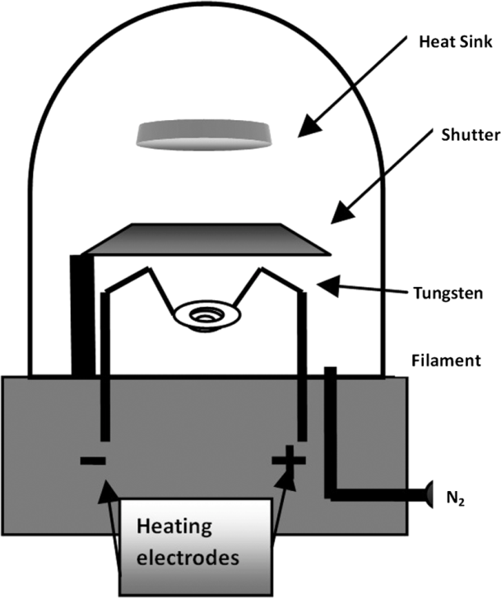
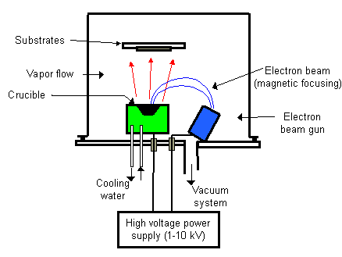
Evaporation Systems
substrate
Filament Evaporation
Electron-beam evaporation
  Small loops of metal to be evaporated are hung from a filament formed of a refractory metal such as tungsten (W)
  High-density beam of electrons, with an energy up top 15 keV, is focused on a source target containing the material to be deposited

Slide 6
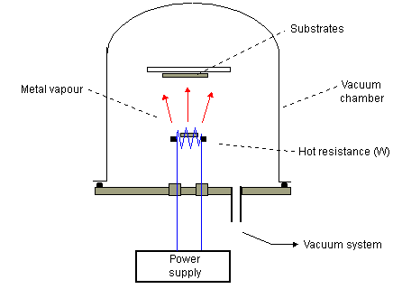
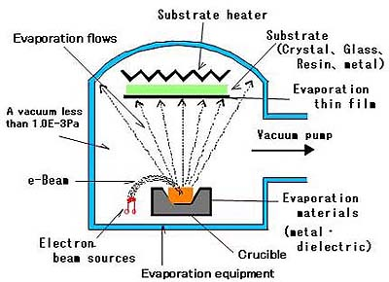

Slide 7
Kinetic Gas Theory of Evaporation
Evaporation is based on the concept that there exists a finite “vapor pressure” above any material
Based on the ideal gas law, for one mole gas:
P: pressure
V: volume
N_{av}: Avogadro’s number (6.02×10²³/mol)
The rate of formation of the thin film layer is determined from the impingement rate of gas molecules
m : the mass of molecule (kg)
The time required to form one monolayer surface:
N_{s}: number of molecules per unit area (cm⁻²)
The concentration of gas molecules:

Slide 8
Mean Free Path
Mean free path: average of the gas molecule travels before it collides with another molecule
d: the diameter of the gas molecule
In order to control the composition of the deposited material, evaporation is performed under vacuum (low pressure) condition. Thus the gas molecules have long mean free path inside the evaporation chamber, which causes poor step coverage and shadowing problem.

Slide 9
Calculation of Deposition time for an Evaporation Process
Monolayer deposition time:
Calculation based on impingement rate :
N_{s} is the surface density assuming close and orderly packing of deposited atoms; d is the diameter of each atom
Calculation based on deposition rate :
R is the deposition rate in terms of thickness per unit time
Proof of consistency between the two ways to do the calculation:
N_{v} is the volume density assuming close and orderly packing of deposited atoms and
9

Slide 10
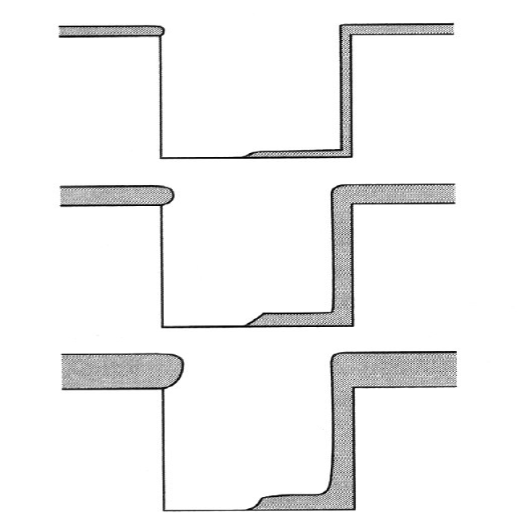
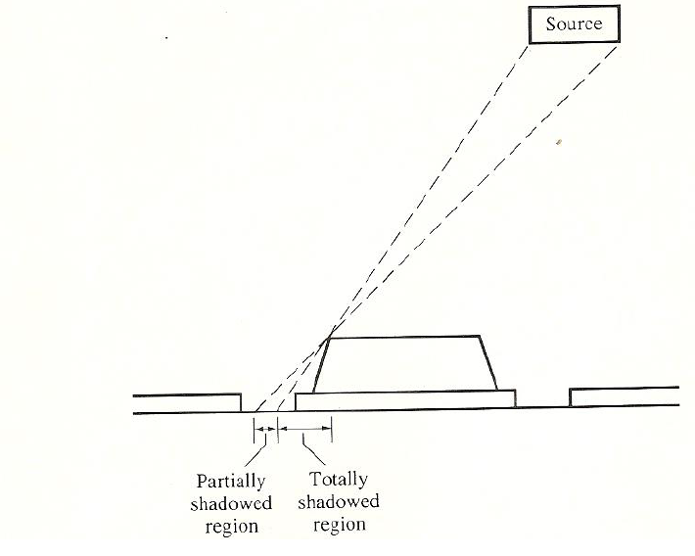
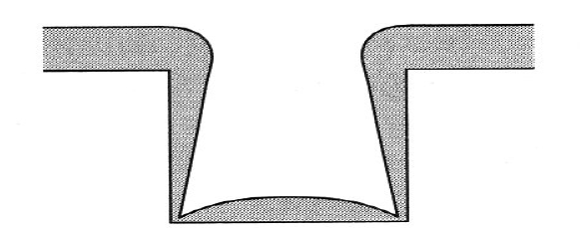
Shadowing and Step Coverage
Poor step coverage caused by shadowing
Shadowing caused by long mean free path
Rotation of wafer substrate holder may help to minimize the this effect

Slide 11
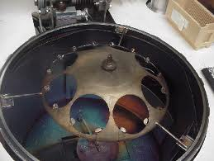
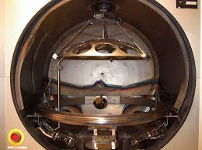
Ways to Improve Step Coverage
Rotate the wafer. However, the deposition rate on the side walls is still less than the rate on the flat surface.
Standard evaporation cannot be used to form a continuous film over features with AR>1, and is very marginal for 0.5< AR<1.
Heat the wafer. The heat elements could be banks of infrared lamps or low intensity refractory metal coils behind the planetaries. Atoms reaching the wafer can diffuse across the surface before they chemically bond and become part of the growing film.

Slide 12
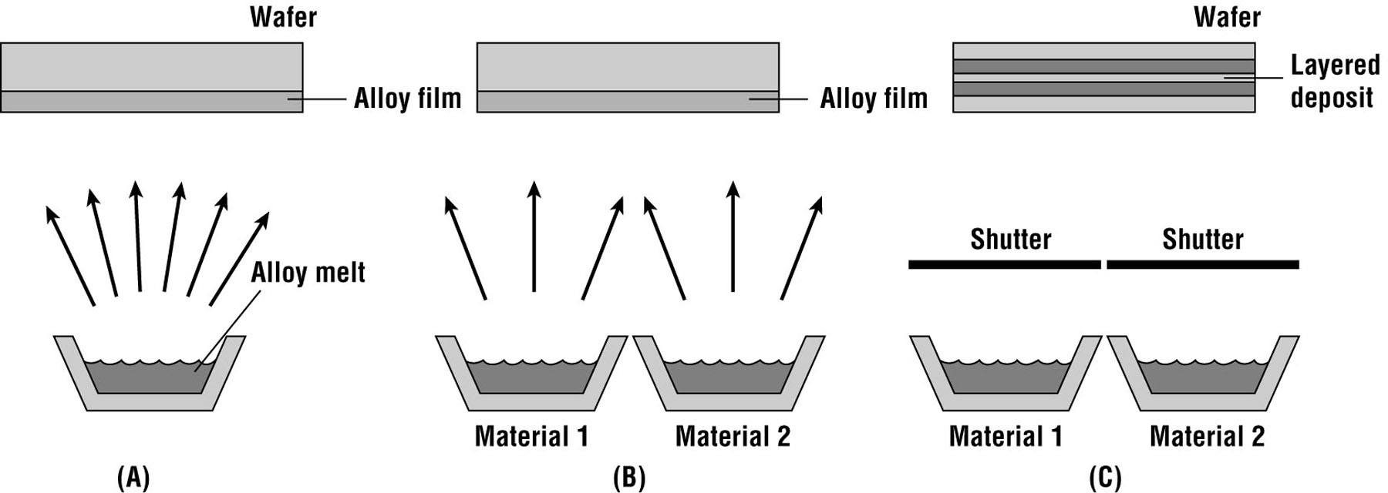
Evaporation of Multicomponent Films
Single-source evaporation, for materials with very similar vapor pressure, such as Al and Cu, or GaAs
Multisource simultaneous evaporation, for materials with very different vapor pressure. The composition is controlled by the different temperatures for each crucible. Example, TiW
Multisource sequential evaporation. After deposition is complete, an alloy can be formed by elevating the sample temperature to allow the components to interdiffuse.

Slide 13
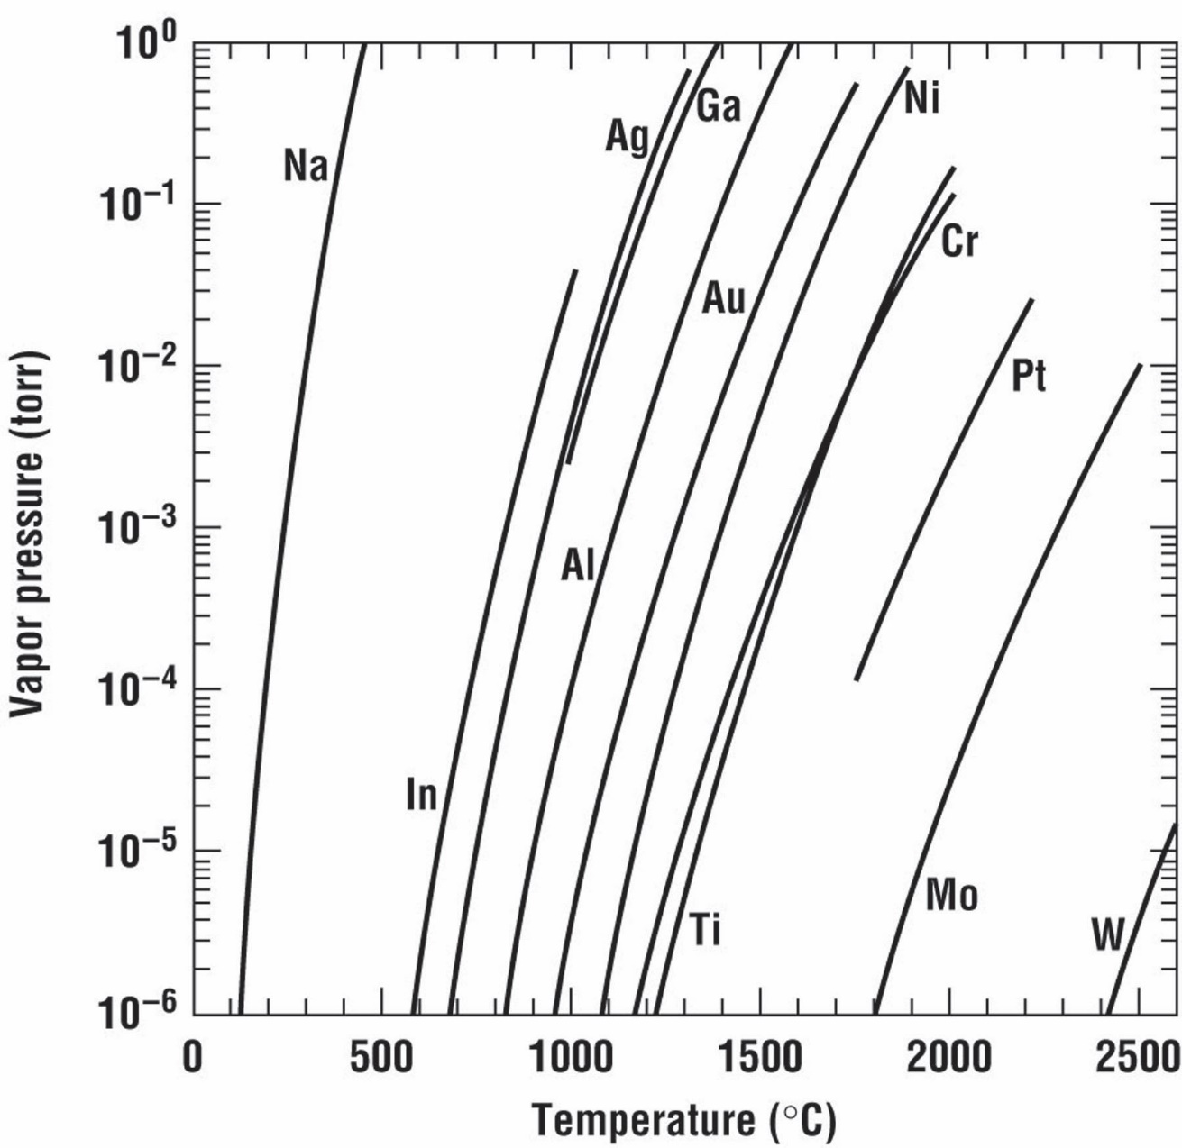
Vapor pressure curves for some commonly evaporated materials (data adapted from Alcock et al.).

