Slide 1
Overview of Sputtering System
Applications (low pressure process)
Thin film deposition
Metals (DC sputtering)
Dielectrics: silicon dioxide and aluminum oxide (RF sputtering)
Alloys (Al-Cu-Si)
Etching
Sputter yield
Sputtering Technologies
DC (diode) sputtering
RF (radio frequency) sputtering
Magnetron sputtering
Reactive sputtering
18 and 20 October
Deposition Part 2

Slide 2
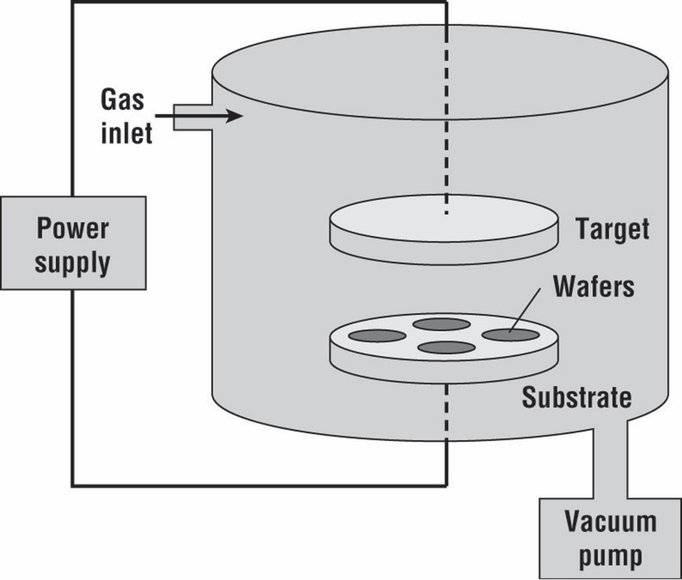
Basic Sputtering System
DC or RF

Slide 3
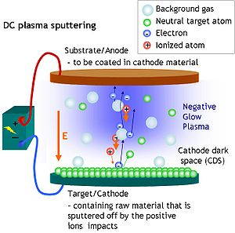
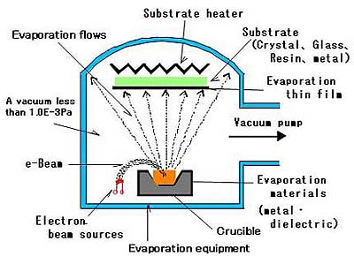

Slide 4
Mechanisms of Sputtering
Sputtering is a process that atoms are ejected from a solid target material due to bombardment of the target by energetic particles
Reflected ions and neutral atoms
Incident ions
Secondary electrons
+
Sputtered ions from the target material
Surface
Target material
Ions with very low energy may be reflected away from the surface.
Ions with energy less than 10eV, could also be adsorbed to the surface, giving up their energy as heat.
Ions with energy above about 5keV, will penetrate into the material and transfer their energy to atoms in the target material.
Ions with medium energy, transfer part of energy to heat and use the other part of energy for physical rearrangement of the target surface. The atoms of the target materials will be ejected out.

Slide 5
Sputter Yield
Sputtering process is characterized by sputter yield (S), which is a measure of efficiency of sputtering
Sputter yield depends on:
the energy of incident ions
the mass of incident ions
the mass of target atoms
the binding energy of atoms in the target
the incident angle of ions

Slide 6
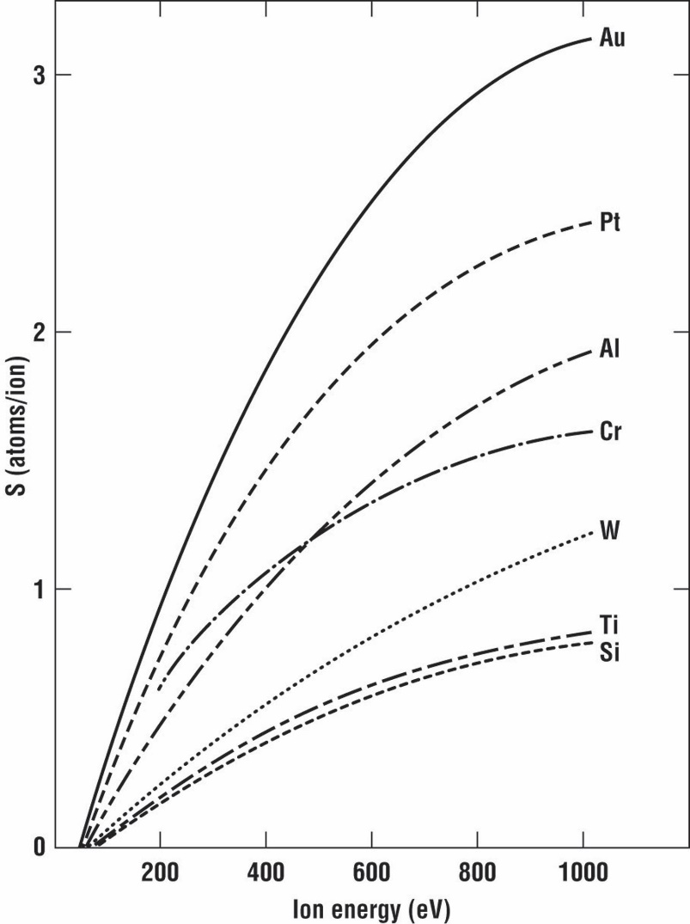
Sputter Yield (Cont’d)
For each target material, there exists a threshold energy, below which no sputtering occurs

Slide 7
DC and RF Sputtering System
DC sputtering:
Used for sputtering metal materials, such as Al, Ti, and Au. The target acts as the cathode in a diode system
DC or RF
RF sputtering:
Used for dielectric materials, such as SiO₂, and Al₂O_{3.}
(Using DC sputtering for dielectric material will cause the buildup of positive charges on the target. The alternating potential voltage can avoid the charge buildup)

Slide 8
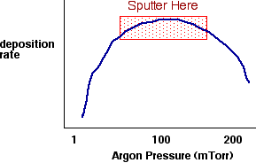
Pressure Effect
Optimal pressure is around 100mTorr
(1Torr =133Pa)
Compromise between
increasing number of Ar ions
increasing scattering of Ar ions with neutral Ar atoms
How to increase the number of Ar ions without increasing the pressure?
Magnetron sputtering

Slide 9
CVD-Various Techniques
Atmospheric pressure CVD (APCVD) – CVD at atmospheric pressure
Low-pressure CVD (LPCVD) – CVD at sub-atmospheric pressures
Ultrahigh vacuum CVD (UHVCVD) – CVD at very low pressure, typically below 10⁻⁶ Pa (~10⁻⁸ torr)

Slide 10
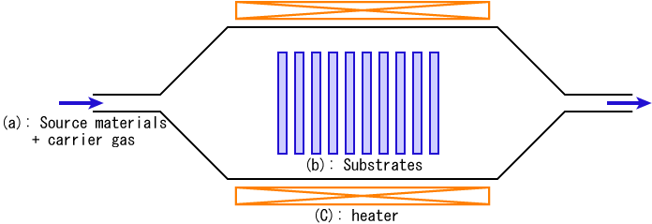

Slide 11
Polysilicon
Polycrystalline silicon is deposited from trichlorosilane (SiHCl₃) or silane (SiH₄), using the following reactions:[
SiH₃Cl → Si + H₂ + HCl
SiH₄ → Si + 2 H₂
Silicon Dioxide
SiH₄ + O₂ → SiO₂ + 2 H₂
SiCl₂H₂ + 2 N₂O → SiO₂ + 2 N₂ + 2 HCl
Si(OC₂H₅)₄ → SiO₂ + byproducts
Silicon Nitride
Silicon nitride is often used as an insulator and chemical barrier in manufacturing ICs. The following two reactions deposit silicon nitride from the gas phase:
3 SiH₄ + 4 NH₃ → Si₃N₄ + 12 H₂
3 SiCl₂H₂ + 4 NH₃ → Si₃N₄ + 6 HCl + 6 H₂
Or to deposit SiNH:
2 SiH₄ + N₂ → 2 SiNH + 3 H₂
SiH₄ + NH₃ → SiNH + 3 H₂
Metals
WF₆ → W + 3 F₂
WF₆ + 3 H₂ → W + 6 HF
Similar reactions for Al using triisobutylaluminium (TIBAL) [Organometallic compounds]
Molybdenum, Tantalum, Titanium-Recall we discussed “silicides” earlier this semester.

Slide 12
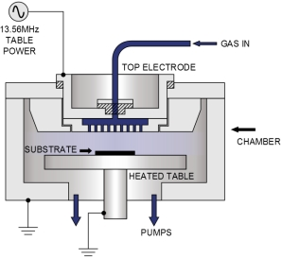

Slide 13
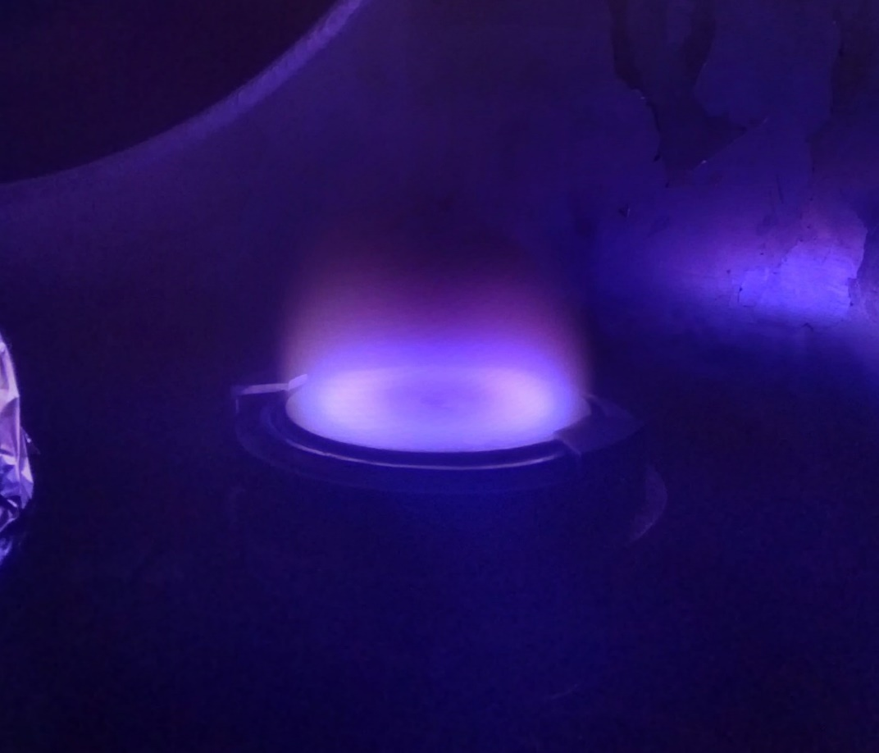
A process that uses ions of an inert gas to dislodge atoms from the surface of a crystalline material, the atoms then being electrically deposited to form an extremely thin coating on a glass, metal, plastic, or other surface.

Slide 14
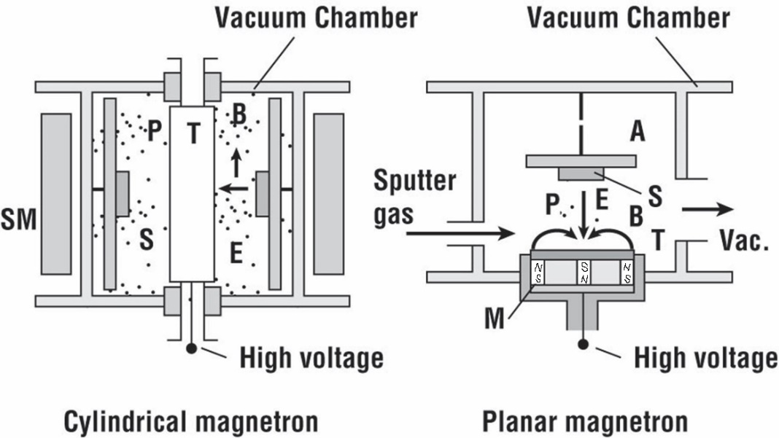
Designs of Magnetron Sputtering System
SM: solenoid magnet
M: magnet
E: electric field
B: Magnetic field
T: Target
P: Plasma
S: Substrate
Advantages:
Could be used together with DC or RF
Higher sputter efficiency due to the increase of ionization of Ar atoms
Higher sputter rate under lower pressure (10⁻⁵ or 10⁻³ Torr)
Increase probability of electrons striking Ar atoms

Slide 15
Parameters for Magnetron Sputtering
Deposition pressure : 10⁻⁵ to 10⁻³ Torr
Pressure for DC or RF Sputtering: ~ 0.1 Torr
Pressure for evaporation: ~ 0.01 Torr
Deposition rate : 0.2 ~ 2 μm/min
10 times higher than DC or RF sputtering
Deposition rate for evaporation is 2 ~5 μm/min
Deposition temperature: 100 to 150ºC
Evaporation temperature is above 1000ºC

Slide 16
Reactive Sputtering
Sputtering metallic target in the presence of a reactive gas mixed with inert gas (Ar)
A mixture of inert +reactive gases used for sputtering
oxides – Al₂O₃, SiO₂, Ta₂O₅ (O₂)
nitrides – TaN, TiN, Si₃N₄ (N₂, NH₃)
carbides – TiC, WC, SiC (CH₄, C₂H₄, C₃H₈)
Chemical reaction takes place on substrate and target
Can poison target if chemical reactions are faster than sputter rate
Adjust reactive gas flow to get good stoichiometry without incorporating excess gas into film

Slide 17
Comparison between Evaporation and Sputtering
Evaporation | Sputtering
Low energy atoms (~ 0.1 eV) | High energy atoms/ions (10 –20 eV) Better adhesion
Low pressure, high vacuum Directional in nature Lower impurity | Higher pressure for DC/RF, but much lower pressure for magnetron sputtering Poor directional Argon atoms implanted in the film
Poor step coverage | Better step coverage
Point source, poor uniformity | Parallel plate source, better uniformity
For compound materials and alloys, different components evaporate at different rate, which leads to poor stoichiometry | For compound materials, all components sputtered with similar rate, which helps maintain stoichiometry
Physical process | DC, RF, and magnetron sputtering are physical processes Reactive sputtering is chemical process

Slide 19
Chemical vapor deposition (CVD)
Physics and Chemistry in CVD process
Atmospheric CVD (APCVD)
Low pressure CVD (LPCVD)
Plasma-enhanced CVD (PECVD)
Metal organic CVD (MOCVD)
19

Slide 20
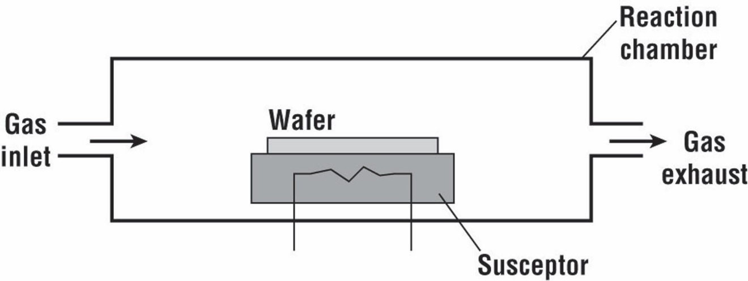
Simple CVD Reactor
Temperature of the susceptor should be maintained, which is more challenging for PECVD system.
Cooling system inside the susceptor in PECVD: plasma discharge increased the susceptor temperature. Cooling is performed by circulating a coolant through a tube inside the susceptor in order to sustain the susceptor temperature for large-area and high rate deposition. (YB Lim, et al., Int. J. Precis. Eng. Man., 13(7), 2012)

Slide 21
Physics and Chemistry in the Reactor
CVD Process:
Introduce reactive gases to the chamber
Thermal decomposition of the gases through heat or plasma
Gas absorption by substrate surface
Reaction takes place on substrate surface and film is firmed
Transport of volatile byproducts away form substrate
Exhaust waste
Example: SiH₄ (g)→ Si (s) +2H₂ (g) (for polysilicon)
Physics and chemistry involved:
(1) Dilution of the SiH₄
The decomposition of silane gas (SiH₄) around the susceptor decreased the deposition rate and concentration of silane along the length of the reactor;
The silane can be mixed with in an inert carrier gas, i.e., H₂, to improve the uniformity of deposition;
The surface will have concentration of vacancies brought by H_{2.}
(2) Homogeneous and Heterogeneous reaction
Homogeneous: atoms of the solid are released from the gas (undesired)
Heterogeneous: atoms of the solid form on the wafer surface (preferred)

Slide 22
Physics and Chemistry in the Reactor (2)
Example: SiH₄ (g)→ Si (s) +2H₂ (g)
(3) Other reactions in the reactor
SiH₄ (g)→ SiH₂ (s) +H₂ (g)
SiH₄ (g)+ SiH₂ (g) → Si₂H₆ (g)
SiH₆ (g) → HSi₂H₃(g)+H₂(g)
How to judge which reaction is dominant?
The equilibrium constant for each reaction.
(4) Gas flow:
Gas flow determines the transport of the various chemical species in the chamber
Important for temperature distribution
(5) Temperature effects:
Deposition rate
Uniformity
Hot wall batch CVD reactor: for large batch processes, excellent temperature control, but low deposition rate

Slide 23
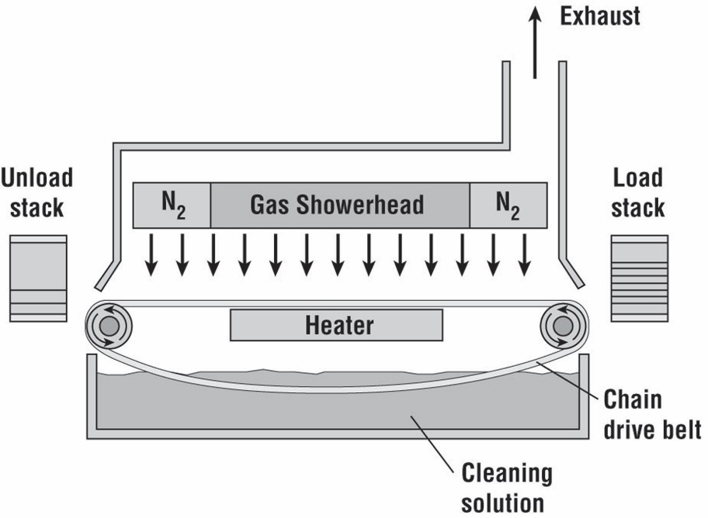
Atmospheric CVD (APCVD)
Features:
High reaction rate, poor uniformity and purity
Run at atmospheric pressure
Used for thick dielectrics with deposition rate higher than 1000Å/min
Example: SiH₄ (g) + O₂ (g)→ SiO₂ (s) +2H₂ (g)

Slide 24
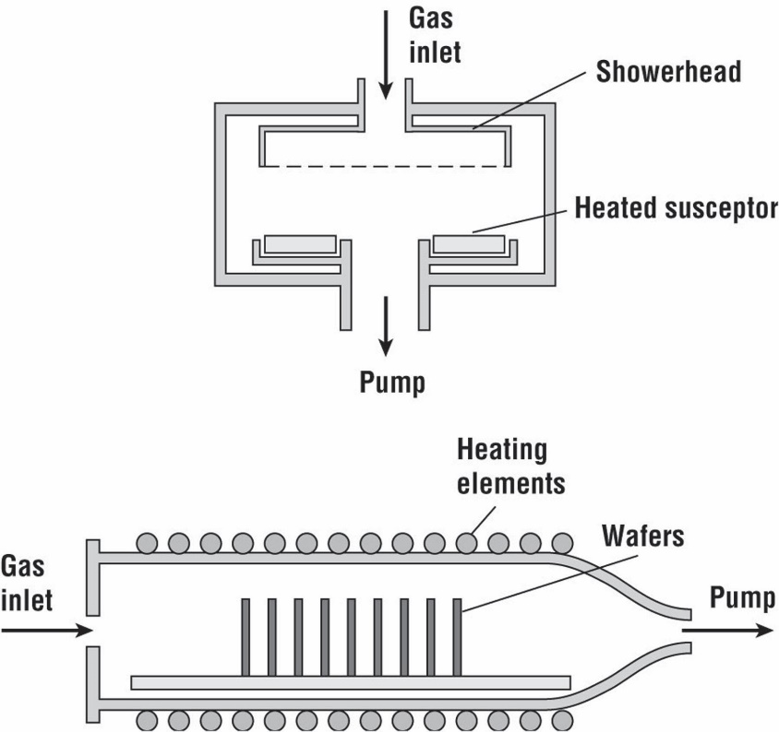
Low Pressure CVD (LPCVD)
Features:
Hot wall system and cold wall systems:
Hot wall system: uniform temperature distributions, but has deposition on the walls
Cold wall system: with reduced deposition on the walls
Used for polysilicon and dielectrics (mostly in hot wall systems)
Good purity, low deposition rate than APCVD
Low pressure in the chamber (0.1 to 1.0 Torr)
Temperature 550 ~ 650ºC

Slide 25
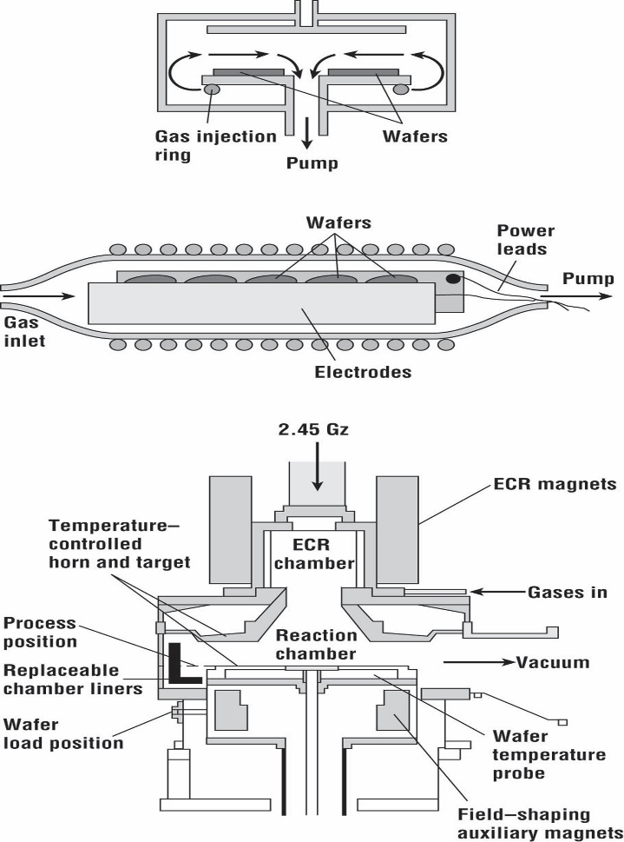
Plasma Enhanced CVD (PECVD)
Features:
Deposit at low substrate temperature
Used to deposit dielectrics over Al or GaAs
Use plasma to enhance the decomposition and reaction in the CVD
Very good at filling small features
May induce plasma damage
Plasma may increase the substrate temperature, so cooling on the substrate is important
Temperature can be as low as 120ºC

Slide 26
Metal Organic CVD (MOCVD)
Features
Use gaseous organic precursors
Advantages: highly flexible—> can deposit semiconductors, metals, dielectrics
Disadvantages: highly toxic, very expensive source material, environmental disposal
costs are high.
Uses: dominates low cost optical (but not electronic) III-V technology, some metallization

Slide 27
Summary on CVD
 | APCVD | LPCVD | PECVD | MOCVD
Advantages | High growth rate at atmospheric pressure | Low pressure, high purity | Low temperature Good for filling small features | flexible
Disadvantage | Poor purity | Low growing rate | Plasma damage | Toxic, expensive source materials
Materials | Thick dielectric materials | Poly-Si and dielectric materials | Dielectrics over Al or GaAs | III-V materials
27

Slide 28
Epitaxy
What is it: deposition of a crystalline overlayer on a crystalline substrate.
Requirement: the substrate must act as seed crystal with preferred crystal orientation
Application: to deposit single-crystal silicon (30~100 μm), compound semiconductors and semiconductor heterojunctions
Epitaxy methods:
Vapor phase epitaxy (VPE) (very common)
Molecular beam epitaxy (MBE)
Process:
Wafer cleaning: to remove native oxide and any residual impurities and particles
RCA cleaning procedure: (1) remove organic residues (SC-1); (2) remove thin oxide layer; (3) remove metallic contaminations (SI-2)
Epitaxy growth

Slide 29
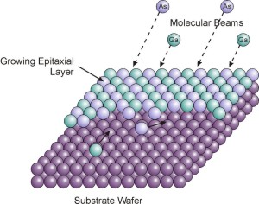
Molecular Beam Epitaxy (MBE)
MBE process:
The crystalline layer is formed by deposition from a thermal beam of atoms or molecules.
Deposition is performed in ultrahigh vacuum conditions (10⁻¹⁰ Torr)
Substrate temperature: 400 ~ 900ºC
Application:
Growth thickness with atomic resolution
Good growth quality for semicondutor heterostructures

Slide 30
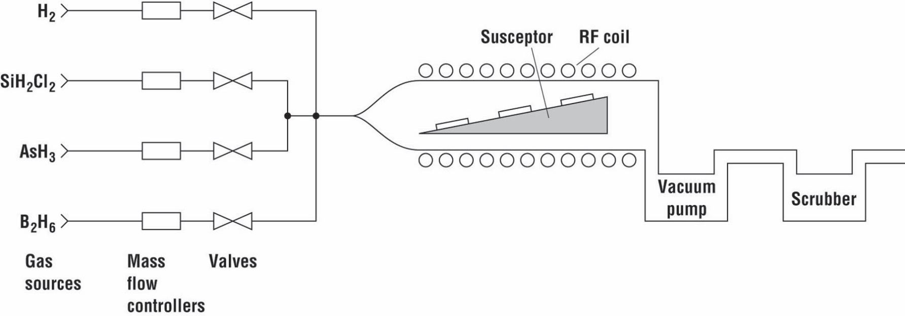
Vapor Phase Epitaxy (VPE) Process
A simple VPE system.
VPE steps:
Gas phase decomposition;
Transport to the surface of the wafer;
At the surface:
(3) Adsorb;
(4) Diffuse;
(5) Decompose
(6) By-product desorb

Slide 32
