Slide 1
22 October 2021
Chemical vapor deposition (CVD)
      Physics and Chemistry in CVD process
      Atmospheric CVD (APCVD)
      Low pressure CVD (LPCVD)
      Plasma-enhanced CVD (PECVD)
      Metal organic CVD (MOCVD)
1

Slide 2
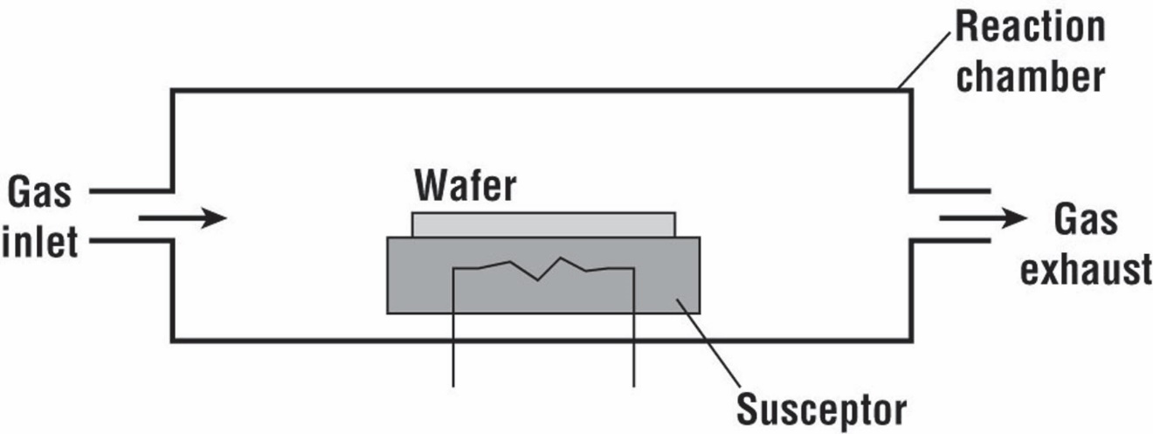
Simple CVD Reactor
Temperature of the susceptor should be maintained, which is more challenging for PECVD system.
Cooling system inside the susceptor in PECVD: plasma discharge increased the susceptor temperature. Cooling is performed by circulating a coolant through a tube inside the susceptor in order to sustain the susceptor temperature for large-area and high rate deposition. (YB Lim, et al., Int. J. Precis. Eng. Man., 13(7), 2012)

Slide 3
Physics and Chemistry in the Reactor
CVD Process:
Introduce reactive gases to the chamber
Thermal decomposition of the gases through heat or plasma
Gas absorption by substrate surface
Reaction takes place on substrate surface and film is firmed
Transport of volatile byproducts away form substrate
Exhaust waste
Example: SiH₄ (g)→ Si (s) +2H₂ (g) (for polysilicon)
Physics and chemistry involved:
(1) Dilution of the SiH₄
The decomposition of silane gas (SiH₄) around the susceptor decreased the deposition rate and concentration of silane along the length of the reactor;
The silane can be mixed with in an inert carrier gas, i.e., H₂, to improve the uniformity of deposition;
The surface will have concentration of vacancies brought by H_{2.}
(2) Homogeneous and Heterogeneous reaction
Homogeneous: atoms of the solid are released from the gas (undesired)
Heterogeneous: atoms of the solid form on the wafer surface (preferred)

Slide 4
Physics and Chemistry in the Reactor (2)
Example: SiH₄ (g)→ Si (s) +2H₂ (g)
(3) Other reactions in the reactor
SiH₄ (g)→ SiH₂ (s) +H₂ (g)
SiH₄ (g)+ SiH₂ (g) → Si₂H₆ (g)
SiH₆ (g) → HSi₂H₃(g)+H₂(g)
How to judge which reaction is dominant?
The equilibrium constant for each reaction.
(4) Gas flow:
Gas flow determines the transport of the various chemical species in the chamber
Important for temperature distribution
(5) Temperature effects:
Deposition rate
Uniformity
Hot wall batch CVD reactor: for large batch processes, excellent temperature control, but low deposition rate

Slide 5
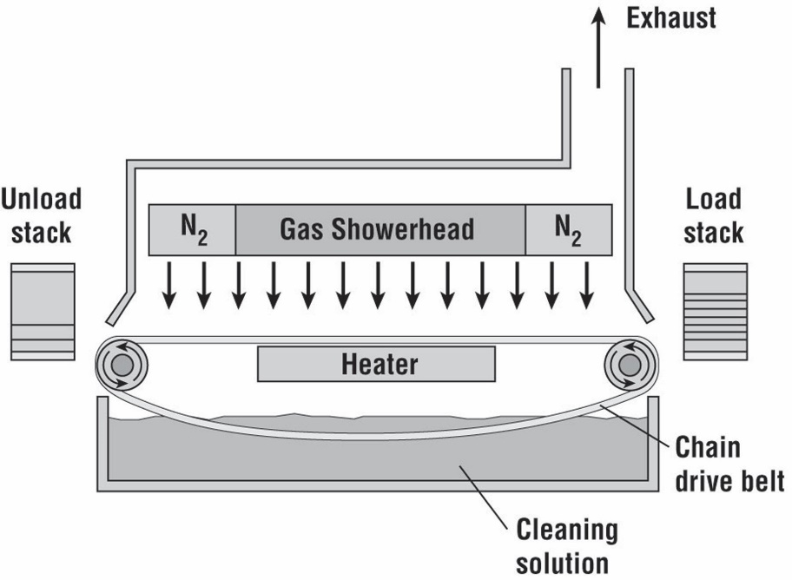
Atmospheric CVD (APCVD)
Features:
High reaction rate, poor uniformity and purity
Run at atmospheric pressure
Used for thick dielectrics with deposition rate higher than 1000Å/min
Example: SiH₄ (g) + O₂ (g)→ SiO₂ (s) +2H₂ (g)

Slide 6
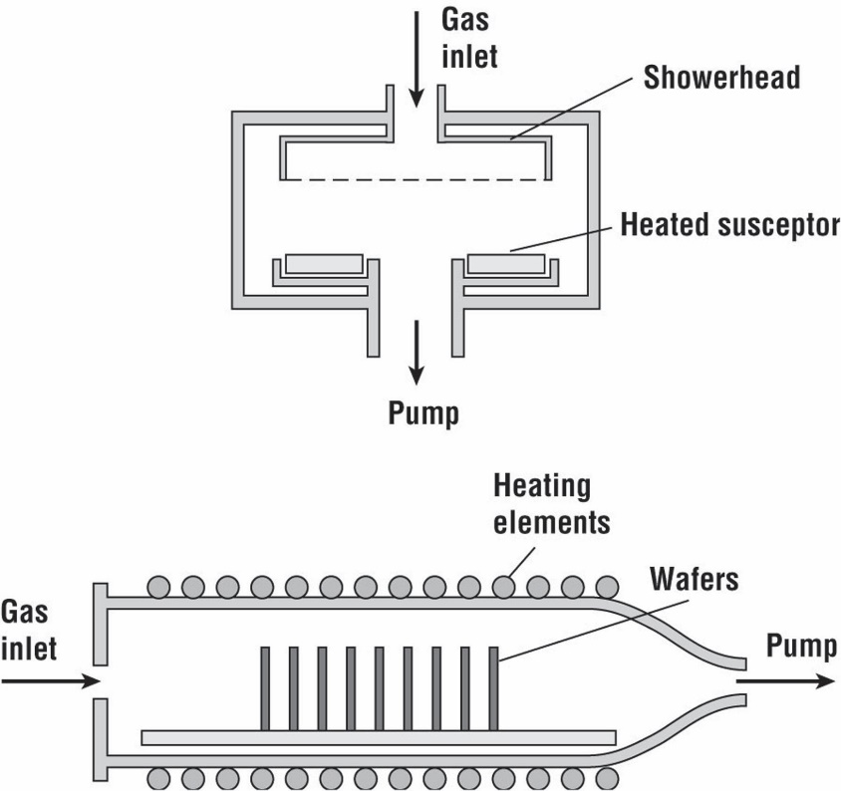
Low Pressure CVD (LPCVD)
Features:
Hot wall system and cold wall systems:
  Hot wall system: uniform temperature distributions, but has deposition on the walls
  Cold wall system: with reduced deposition on the walls
Used for polysilicon and dielectrics (mostly in hot wall systems)
Good purity, low deposition rate than APCVD
Low pressure in the chamber (0.1 to 1.0 Torr)
Temperature 550 ~ 650ºC

Slide 7
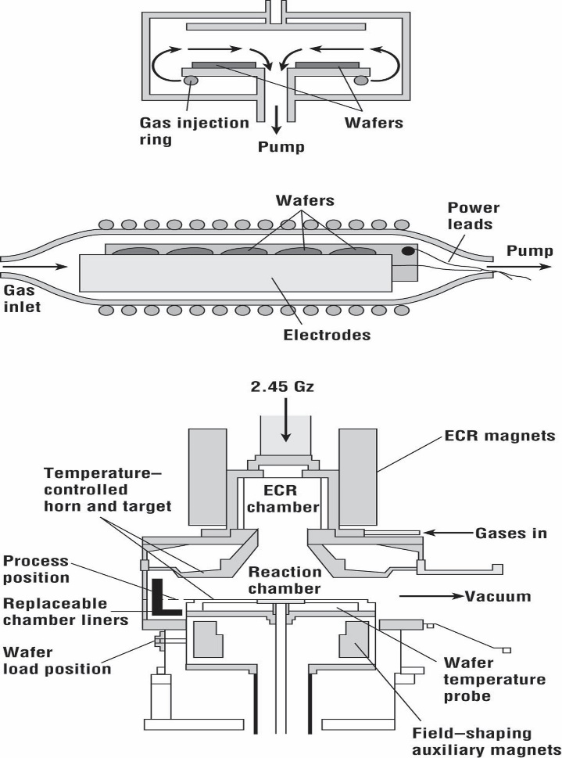
Plasma Enhanced CVD (PECVD)
Features:
Deposit at low substrate temperature
Used to deposit dielectrics over Al or GaAs
Use plasma to enhance the decomposition and reaction in the CVD
Very good at filling small features
May induce plasma damage
Plasma may increase the substrate temperature, so cooling on the substrate is important
  Temperature can be as low as 120ºC

Slide 8
Metal Organic CVD (MOCVD)
Features
Use gaseous organic precursors
Advantages: highly flexible—> can deposit semiconductors, metals, dielectrics
Disadvantages: highly toxic, very expensive source material, environmental disposal
costs are high.
Uses: dominates low cost optical (but not electronic) III-V technology, some metallization

Slide 9
Summary on CVD
 | APCVD | LPCVD | PECVD | MOCVD
Advantages | High growth rate at atmospheric pressure | Low pressure, high purity | Low temperature Good for filling small features | flexible
Disadvantage | Poor purity | Low growing rate | Plasma damage | Toxic, expensive source materials
Materials | Thick dielectric materials | Poly-Si and dielectric materials | Dielectrics over Al or GaAs | III-V materials
9

Slide 10
Epitaxy
What is it: deposition of a crystalline overlayer on a crystalline substrate.
Requirement: the substrate must act as seed crystal with preferred crystal orientation
Application: to deposit single-crystal silicon (30~100 μm), compound semiconductors and semiconductor heterojunctions
Epitaxy methods:
Vapor phase epitaxy (VPE) (very common)
Molecular beam epitaxy (MBE)
Process:
Wafer cleaning: to remove native oxide and any residual impurities and particles
  RCA cleaning procedure: (1) remove organic residues (SC-1); (2) remove thin oxide layer; (3) remove metallic contaminations (SI-2)
Epitaxy growth

Slide 11
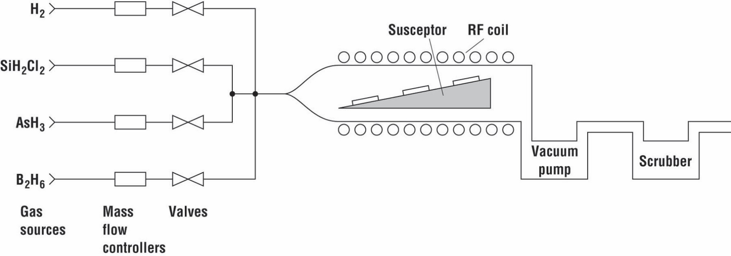
Vapor Phase Epitaxy (VPE) Process
A simple VPE system.
VPE steps:
Gas phase decomposition;
Transport to the surface of the wafer;
At the surface:
(3) Adsorb;
(4) Diffuse;
(5) Decompose
(6) By-product desorb

Slide 12
Example: Single-Crystal Si Growth by VPE
Problem with SiH4 (silane) for single-crystal Si:
Silane can decompose to form particles in gas even at low temperature (600ºC).
Gases introduced into the system:
SiH₂Cl₂, H₂, AsH_{3,} B₂H₆
Reaction:
SiH₂Cl₂ (g₎↔ 2HCl (g) +Si (s)
Doping of epitaxial layer:
Lightly doped epitaxy layer are ofen grown on the more heavily doped substrate
Solid state diffusion: dopants can diffuse from the substrate
Gas phase autodoping: impurities desorb from the wafer and re-adsorb
elsewhere on the wafer
Defects in epitaxy growth:
Dislocations (line defect)
Stacking faults (plane defect)

Slide 13
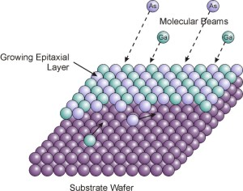
Molecular Beam Epitaxy (MBE)
MBE process:
The crystalline layer is formed by deposition from a thermal beam of atoms or molecules.
Deposition is performed in ultrahigh vacuum conditions (10⁻¹⁰ Torr)
Substrate temperature: 400 ~ 900ºC
Application:
Growth thickness with atomic resolution
Good growth quality for semicondutor heterostructures

