Slide 1
Oxidation Chapter 4
24 and 27 September 2021
Thermal oxidation process
Modeling for oxidation
Factors influencing oxidation rate
Oxidation systems
Measurement of silicon dioxide thickness
Temperature: 900 ~1200 ºC
Two Basic Reactions (Justifications for Each)
Dry oxidation: Si (solid) + O₂ (gas) → SiO₂
Wet oxidation: Si (solid) + 2H₂O (vapor) → SiO₂ + 2H₂
Growth of SiO₂ on Si:
Si is consumed (oxidized) as the oxide thickness increases
The resulting oxide “expands” during growth
The final oxide layer is approximately 54% above the original silicon surface and 46% below the original surface as we will now show

Slide 2
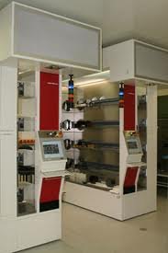
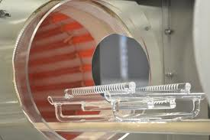
Oxidation System
Oxidant is introduced in gaseous form.
High-impurity O₂ is used for dry oxidation
Water vapor is introduced by passing oxygen through a bubbler containing deionized water heated to 95ºC.

Slide 3
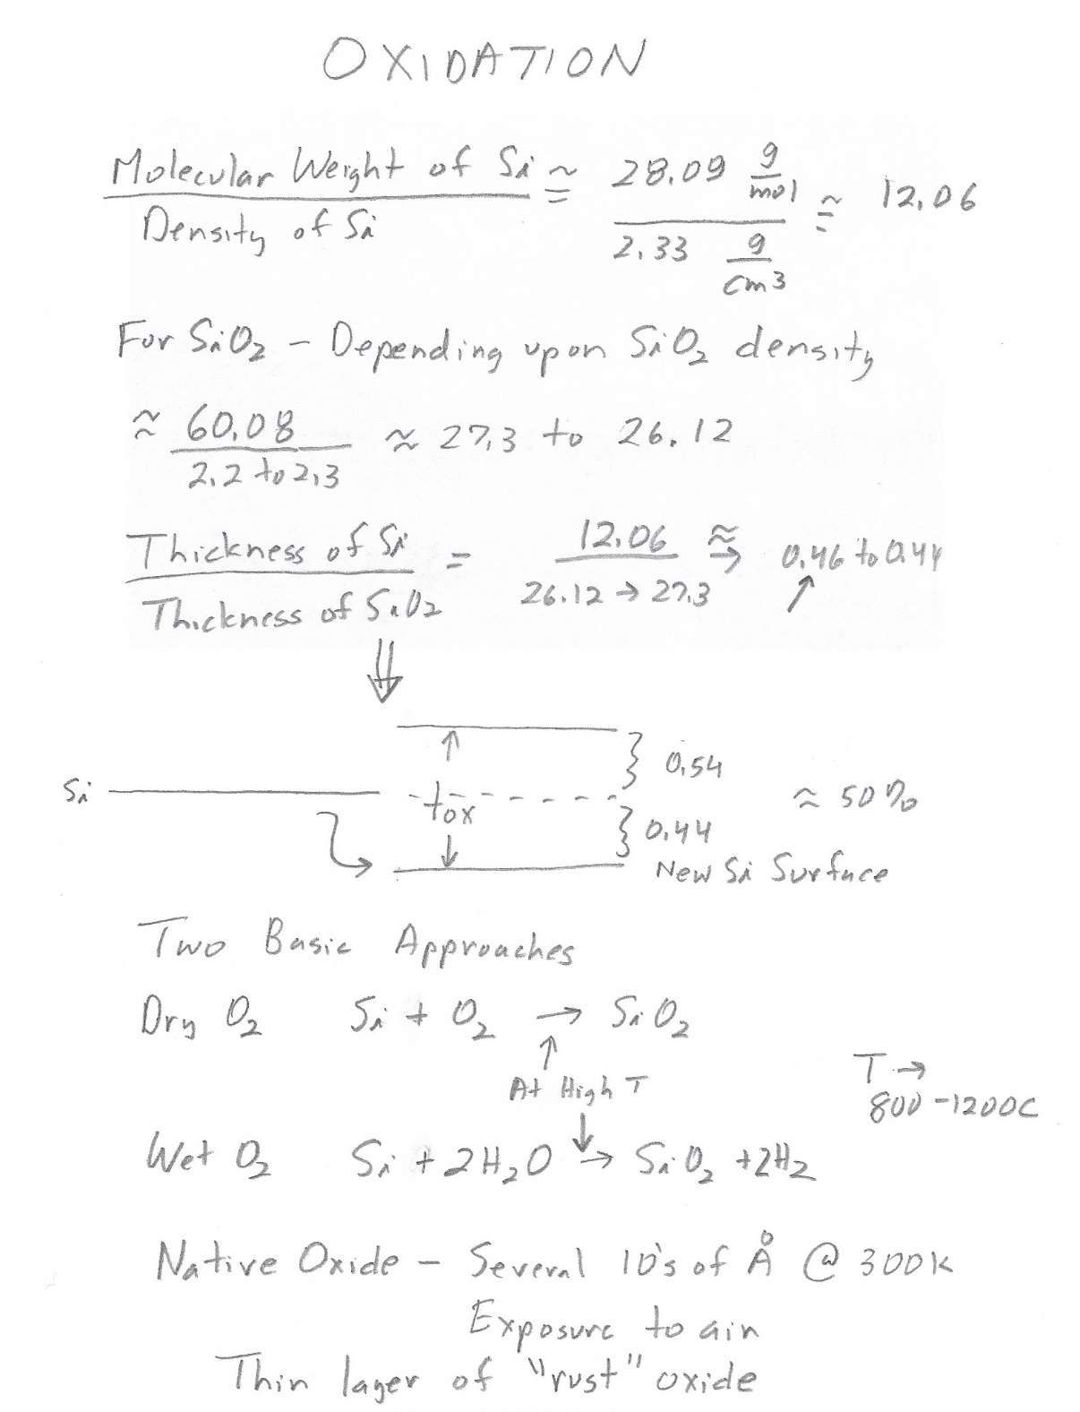

Slide 4
J

Slide 5
Modeling for Oxidation-Duplicate of Previous Slide
N_{o}
J
Concentration, N
N_{i}
SiO₂
Si
X_{o}
Distance from surface, x
X_{o}: thickness of the oxide at a given time
N_{o}: oxygen concentration at the SiO₂ surface (cm⁻³)
N_{i}: oxygen concentration at the SiO₂-Si interface (cm⁻³)
J: oxygen flow per unit area, i.e., the flux (cm⁻²s⁻¹)

Slide 6
o
o
o
o
o
t
o
o

Slide 7
Duplicate of Previous Slide
In order for the oxidation to occur, oxygen must reach the SiO₂-Si interface.
As the oxide grows, oxygen must pass through more and more oxide, and the growth rate decreases as time goes on
The oxidation model is built upon the diffusion of oxygen through the existing SiO₂ layer
Diffusion equation:
Flux is proportional to the oxidizing species:
If M is the volume concentration of molecules of the oxidizing species

Slide 8
More DFQ Solution Details
Solve the differential equation:
letting
and
The above equation becomes
With the initial condition:
the solution comes out as:
t is the time taken to grow the additional thickness (X_{o}-X_{i})
The SiO₂ at any time t is solved as:
For short time with
(B/A) is called linear growth rate constant
For long time with
B is called parabolic rate constant

Slide 9
Factors Influencing Oxidation Rate
Temperature
Wet and dry oxidation
Pressure
Crystal orientation
Impurity doping
Pressure: both linear and parabolic rate constants are proportional to N_{o}, the oxidant concentration at the top SiO₂ surface, and N_{o} is proportional to the pressure
Doping: Phosphorus doping increases the linear rate constant without altering the parabolic rate constant. Boron doping increases parabolic rate constant but has little affect on the linear rate constant. This is due to the impurity redistribution during oxidation.

Slide 11
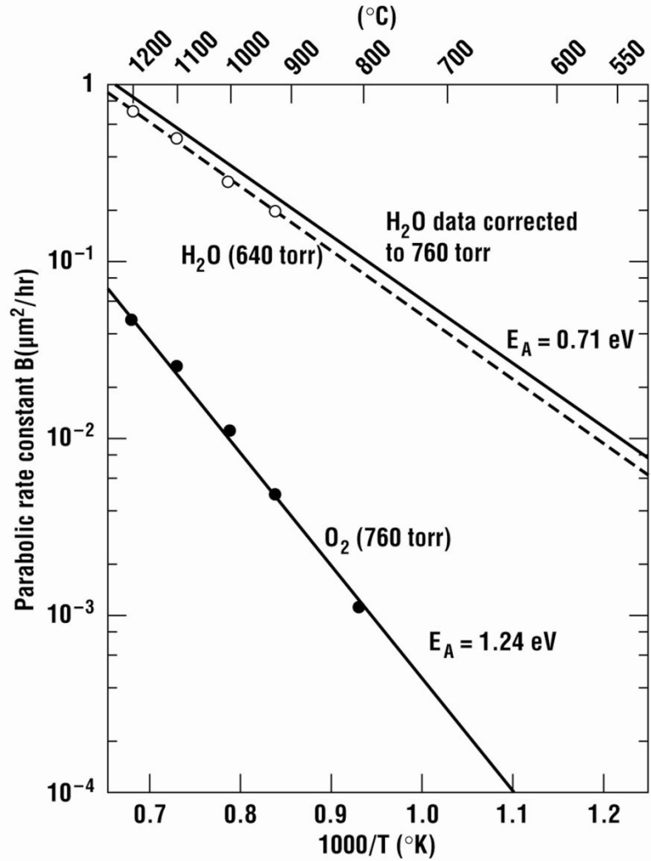
Factors Influencing Oxidation Rate (1)
Diffusion coefficient
Unit of D: cm²/sec
Plot of the B oxidation coefficient. The wet parameters depend on the H₂O concentration and therefore on the gas flows

Slide 12
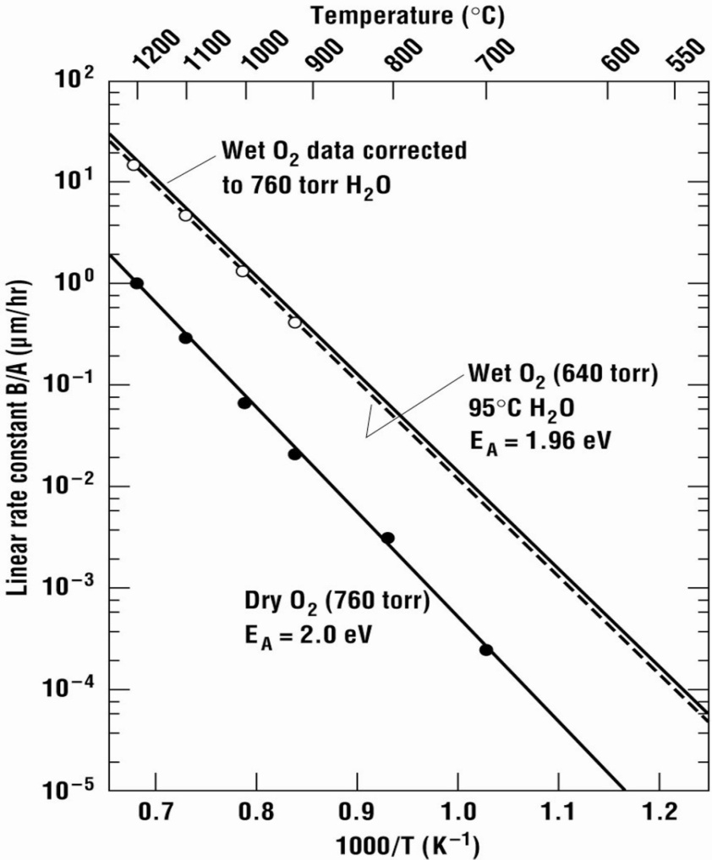
Factors Influencing Oxidation Rate
Temperature:
Plot of the parabolic rate constant B versus temperature.
Plot of the linear growth rate constant B/A versus temperature.

Slide 13
Factors Influencing Oxidation Rate (3)
Wet and dry oxidation: water vapor has a much higher solubility than oxygen in SiO₂.
Slower growth results in a denser, high-quality oxide.
Crystal orientation: the crystal orientation changes the number of silicon atoms and bonds available at the silicon surface, which influences the oxide growth rate and the quality of Si-SiO₂ interface
Values for Coefficient Do and Activation Energy E_{A}
 | Wet |  | Dry
 | D₀ (μm/hr) | E_{A} (eV) | D_{o}(μm/hr) | E_{A}(eV)
<100> Silicon | 9.7×10⁷ | 2.05 | 3.71×10⁶ | 2.00
<111> Silicon | 1.63×10⁸ | 2.05 | 6.23×10⁶ | 2.00

Slide 14
Diffusivities Into SiO2

Slide 19
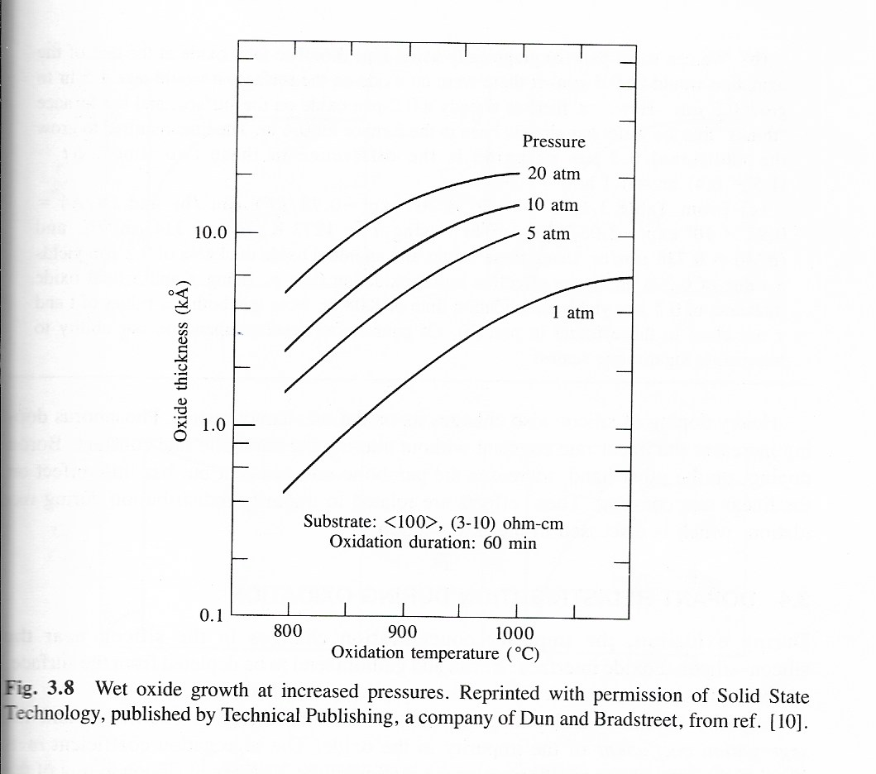

Slide 21
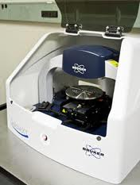
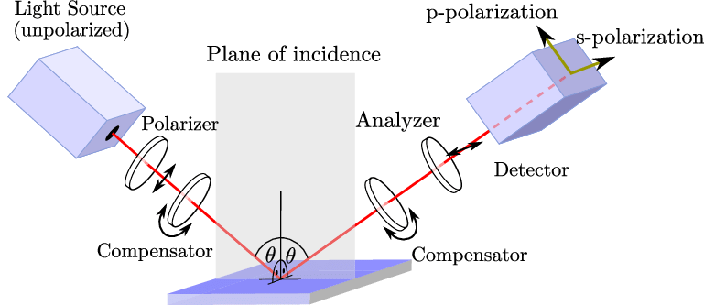
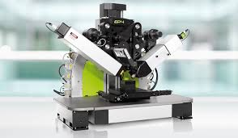
Measurement of Silicon Dioxide
Through color of reflected light
Mechanical surface profiler
Ellipsometer
Ellipsometer (Accurion.com)
Stylus profiler (Druker.com)

