Slide 1
EE 5621
30 August and 1 September 2021
ADMINISTRATIVE
Stanley G. Burns-Professor
Self Introductions COURSE SYLLABUS KEY POINTS
“Office Hours” by ZOOM
E-Mail sburns@d.umn.edu
Syllabus SyllabusEE5621Fall2021.htm
QUIZ ZERO
Scan/image and submit to sburns@d.umn.edu by 11:10 today

Slide 2
NAME
(Help me with pronunciation and nicknames)
HOBBIES AND OTHER FUN ACTIVITIES
(NON-TECHNICAL AND TECHNICAL)?
WHAT DID YOU DO OVER Summer Recess? WORK (Where?), TRAVEL (Where?), ETC.
Are you all set for being on-line for EE 5621? Issues?
IS THERE ANY DISCIPLINES WITHIN EE OR RELATED FIELDS THAT ARE OF PARTICULAR INTEREST TO YOU AT THE PRESENT TIME?
GET OUT YOUR CRYSTAL BALL. WHAT ARE YOUR PROFESSIONAL ASPIRATIONS LOOKING OUT TEN YEARS TO THE YEAR 2031?

Slide 3
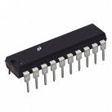
Semiconductor Manufacture Process
Design
Fabrication (Semiconductor Foundry)
Package
An example of packaged Semiconductor chip
Testing
3

Slide 4
Microelectronic Technologies Nanoscale Also used
The collection and ordering of those unit processes for making a useful product are called a technology.
Microelectronics and Nanoelectronics are qualitative terms
Microelectronics is normally associated with integrated circuits (IC). However, the microelectronics technologies could also be applied to make other types of solid-state devices.
The unit processes for making ICs include photolithography, oxidation, doping, thin film deposition, and etching.
The technology required to built the IC is independent of the density of transistors on the wafer. The density of transistors is defined by the photomask.
One of the most fundamental changes in the fabrication process that allows the technology evolution is the minimum feather size that can be printed on the chip.
4

Slide 5
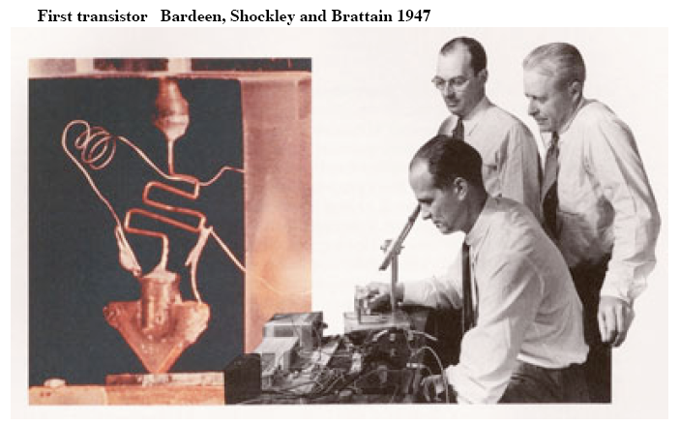
Semiconductor Industry Milestones
• 1942 - Very pure silicon and germanium were manufactured
• 1947 - PN junction diodes was invented
• 1947 - The junction transistor was invented at Bell Lab by Bardeen, Brattain and
Schockley
• 1958 - Integrated circuits (ICs) were invented by
Kilby at TI
• 1962 - First commercial integrated circuits
• 1962 - Semiconductor industry surpasses $1-billion
in sales
• 1963 - First MOS IC
• 1963 - CMOS initial development
• 1965 –“Moore’s Law” presented by Intel co-founder Gordon E. Moore
• 1971 - Microprocessor initial development
• 1978 - Semiconductor Industry passes $10-billion.
• 1985 - Intel 80386DX
• 1985 - 200mm silicon wafers introduced
• 1986 - 1Mbit DRAM
• 1988 - 4Mbit DRAM
• 1989 - Intel 80486DXTM
• 1990’s-2000’s Intel Pentium Series
• 2009 - Intel demonstrated the first working 32 nm processor
2012/15 – Micron 14 nm memory
2020 Current Hot Topics-Down to < 5 nm Memory, Quantum Structures and
Computing, Photonics, Graphene Structures
5

Slide 6
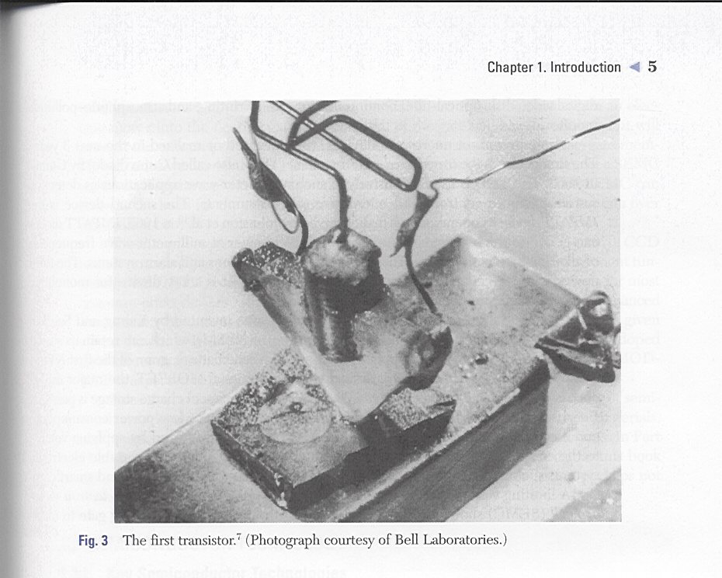
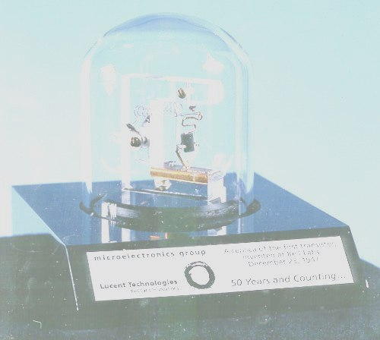

Slide 7
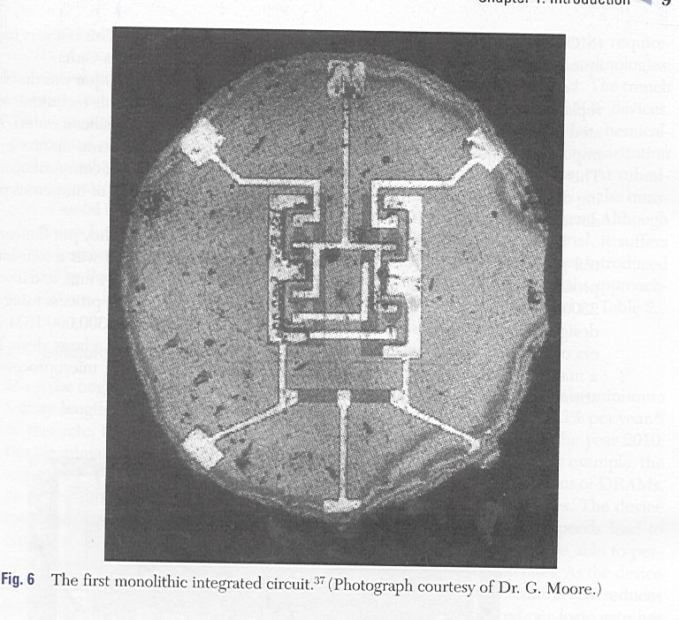

Slide 9
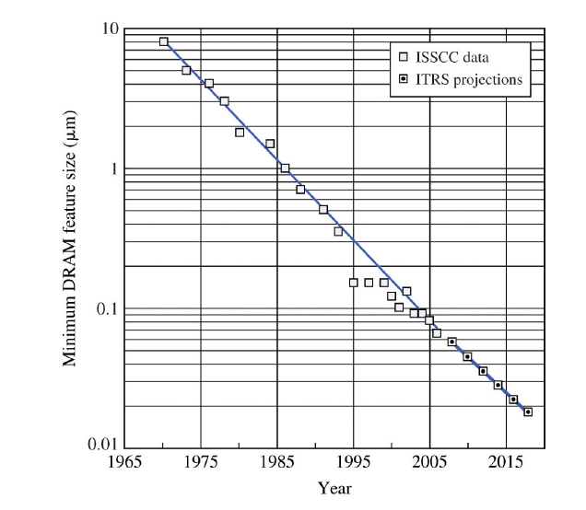
Device Becomes Ever Smaller
Smaller feather size leads to more transistors per unit area (high density) and higher speed
Intel demonstrated the first working 32 nm processor in 2009
2012 feature sizes 22 nm, advanced R&D to 14 nm, 2019 7 nm Apple
9

Slide 10
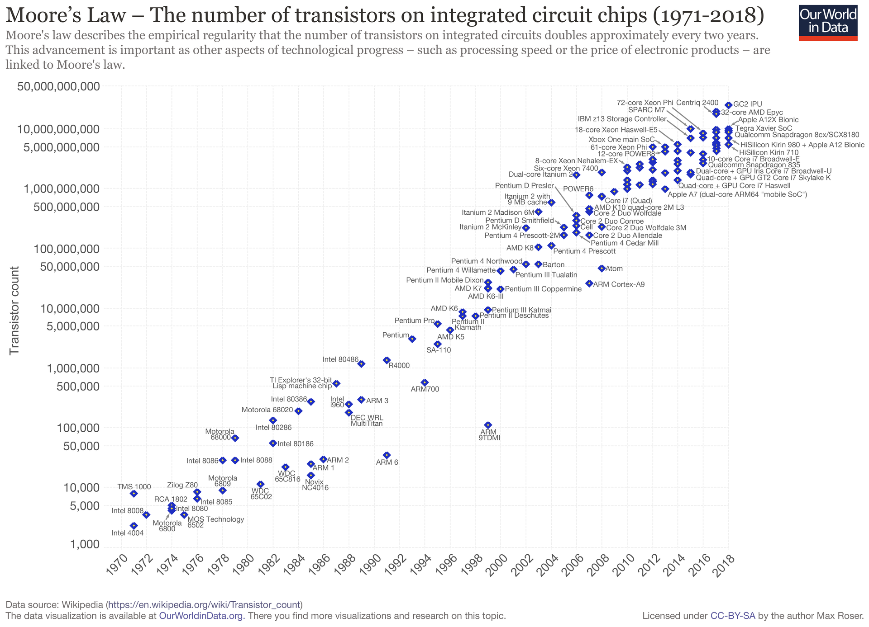

Slide 11
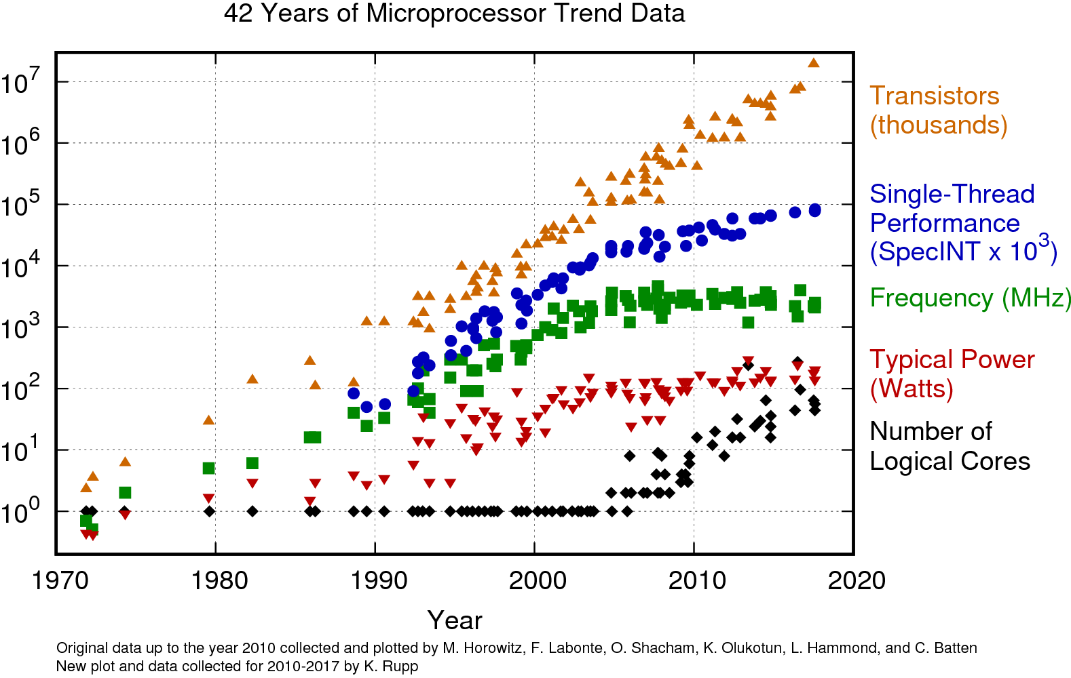

Slide 12
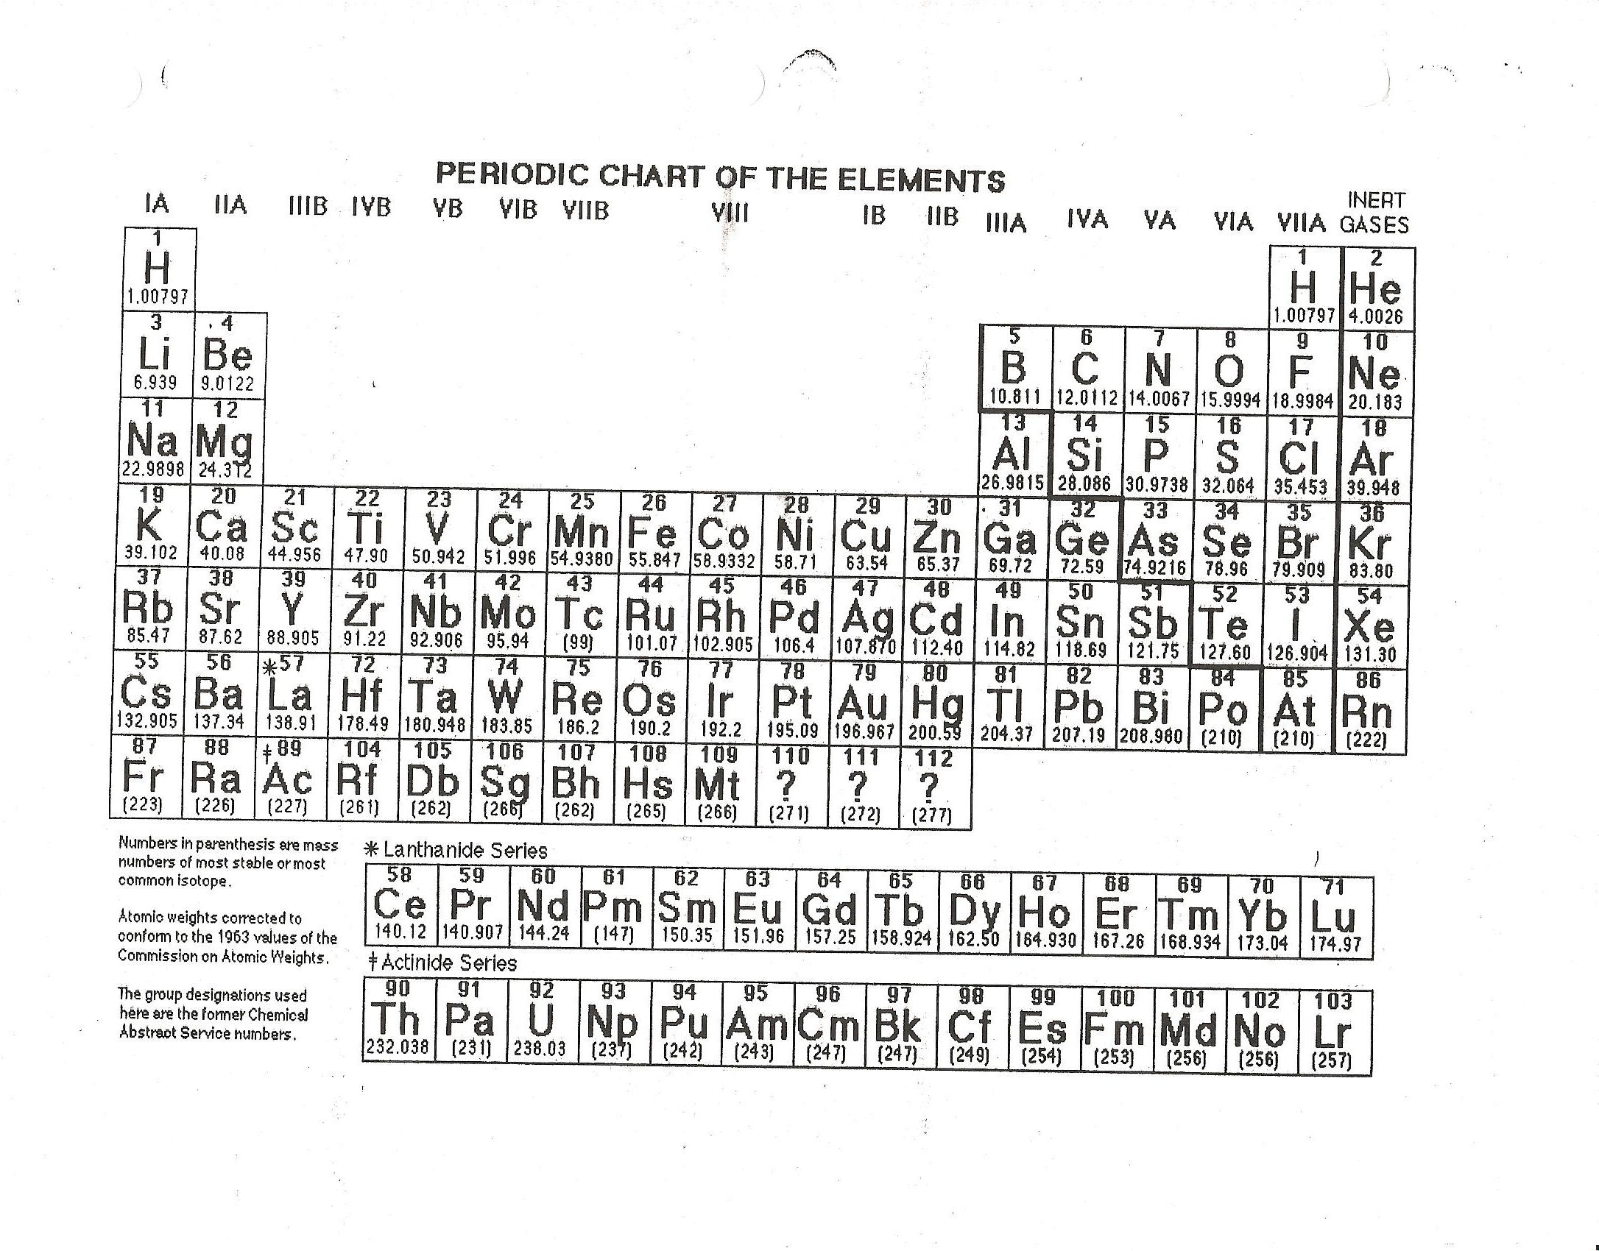

Slide 13
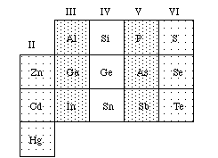
Semiconductor Materials
Elements: Si, Ge
III-V compounds: AlAs, GaAs, InAs, InP
II-VI compounds: CdS, CdSe, ZnS,
Si is today’s most important semiconductor
material
Low cost
easily oxidized to form SiO₂ insulating layer
High Eg, can be used in high temperature
GaAs and InP are used for optoelectronic
applications
Periodic table of semiconductors

Slide 14
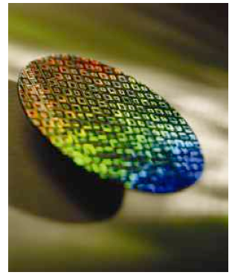
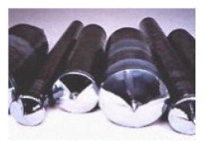
Semiconductor Industry Development Trend
Trend: smaller, faster, and cheaper
Ways to achieve:
Better quality of fabrication materials, e.g., very pure semiconductors and large single crystals
New materials (such as graphene, carbon nano tube)
New design concepts and new theories on semiconductor physics
New fabrication technology
Micro- and nano- technology
Energy efficient devices
Quantum computing
14

Slide 15
OTHER DEVICES AND TECHNOLOGIES
Thin-Film Transistors (TFT) for displays and cameras
Displays-Liquid Crystal Displays (LCD), Plasma, LED Backlit, etc. OLED, Television, computer, and smart phone screens
Photonic-Light Emitting Diodes (LED), Organic Light Emitting Diodes (OLED), LASERS, Optical Chips, etc.), Lighting
Photovoltaics-Conventional Crystalline and Flexible Thin-Film
Devices and Systems on Flexible Substrates. Next generation of smart phones
Micro-Electro-Mechanical Systems (MEMS) integration of mechanical elements, sensors, actuators, and electronics on a common silicon substrate through microfabrication technology.
Automotive, medical, personal electronics
Quantum Computing

Slide 16
Challenges in the Semiconductor Industry For Electrical Engineers
Design devices
Design circuits and systems
Device modeling
System design and fabrication
Circuit/system simulations
Testability
Materials
How small? Nanomaterials?
How large? Wafer scale VLSI
Speed and performance, for analog, digital and mixed-mode applications
Increased functionality
Biological integration
Optoelectronic integration
Displays
Sensors
MEMs (Design/Application)
Non-traditional substrates
Packaging
Process development
Process Control
“Tool” and plant design
“Cradle to grave materials handling”

