Slide 1
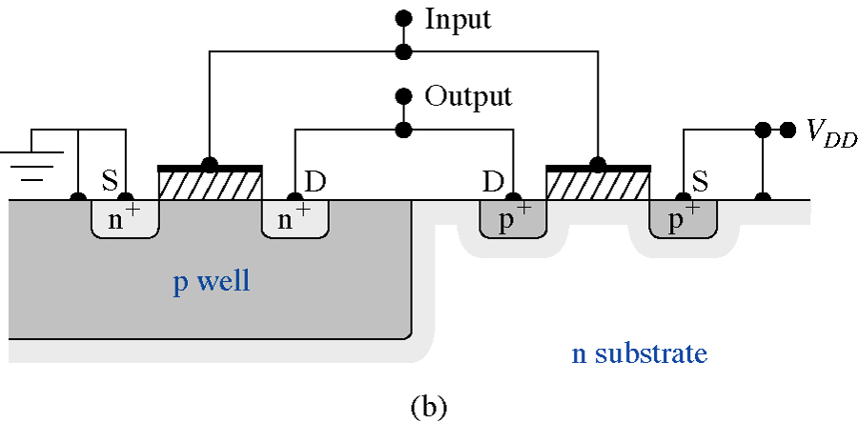
CMOS Technology
5 and 8 November
MOS2
CMOS
LOCOS
Parasitics
Complementary metal–oxide–semiconductor (CMOS)
1
Notes:
1

Slide 2
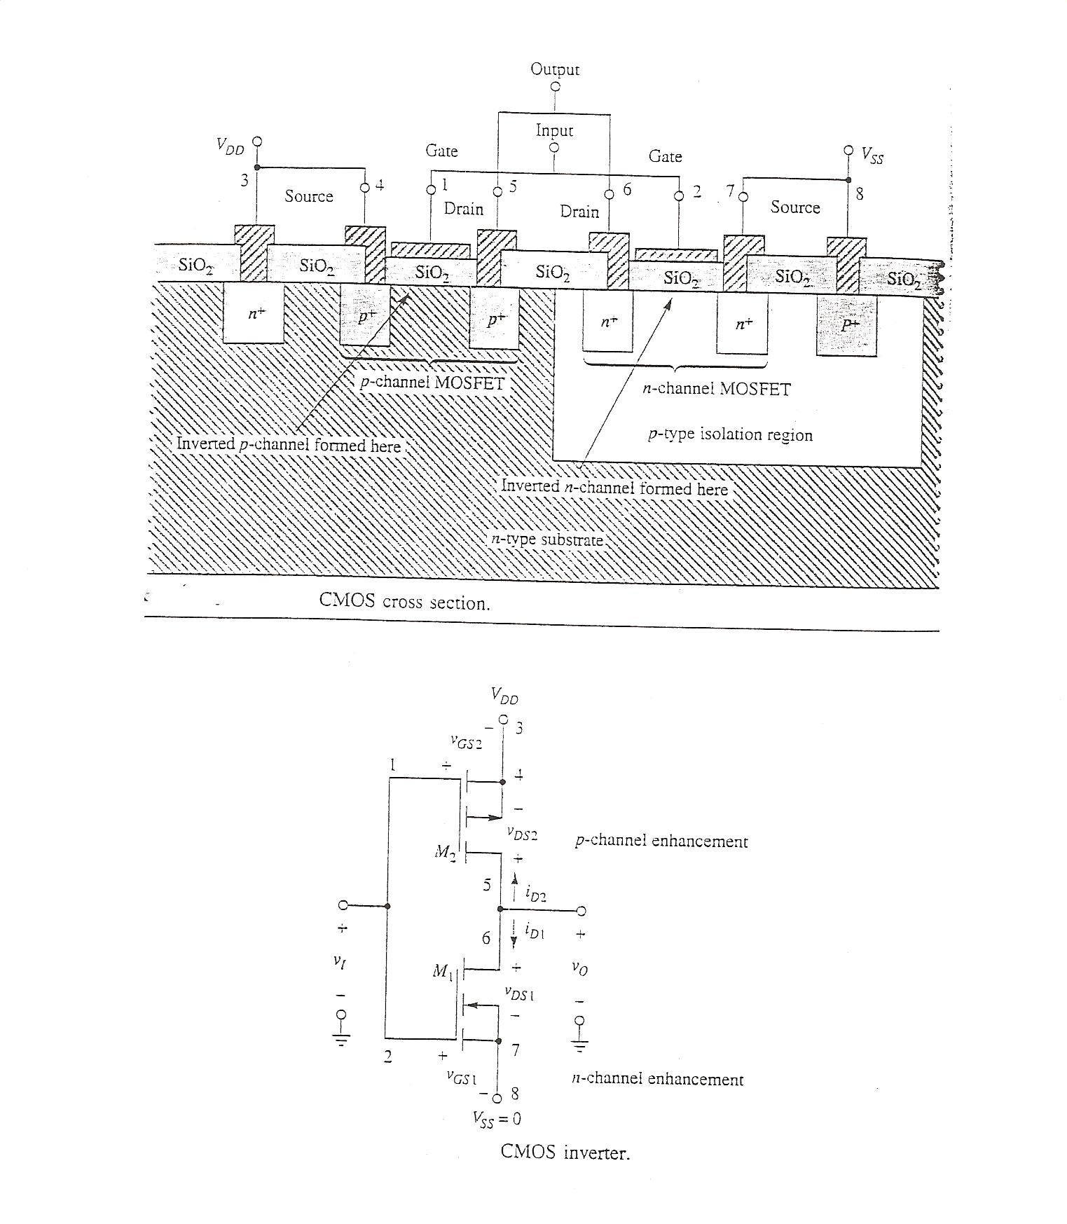

Slide 3
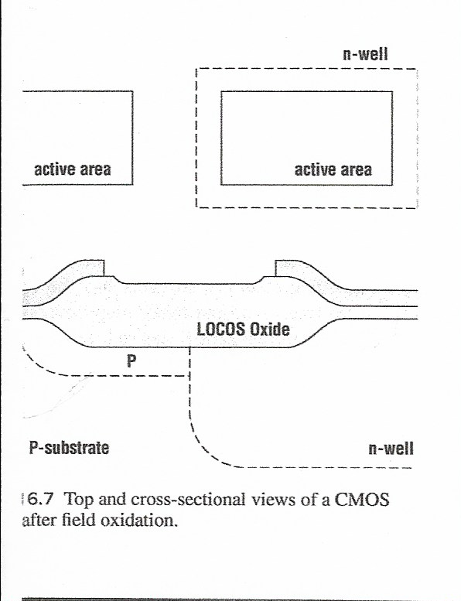
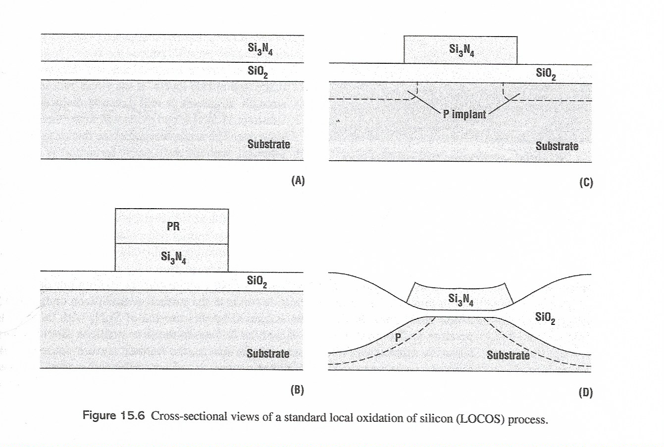

Slide 4
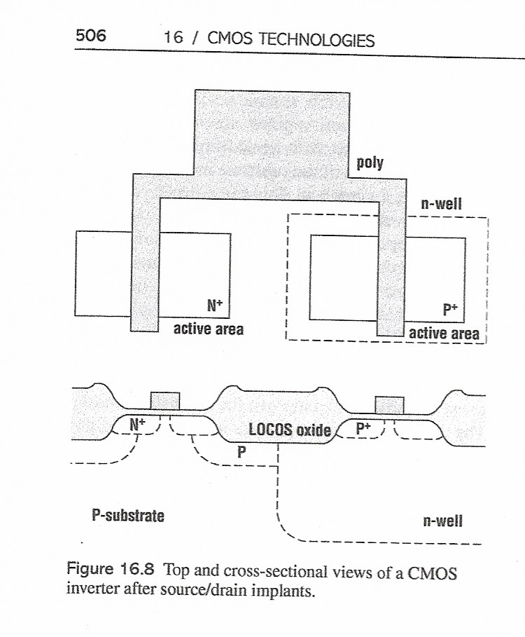

Slide 5
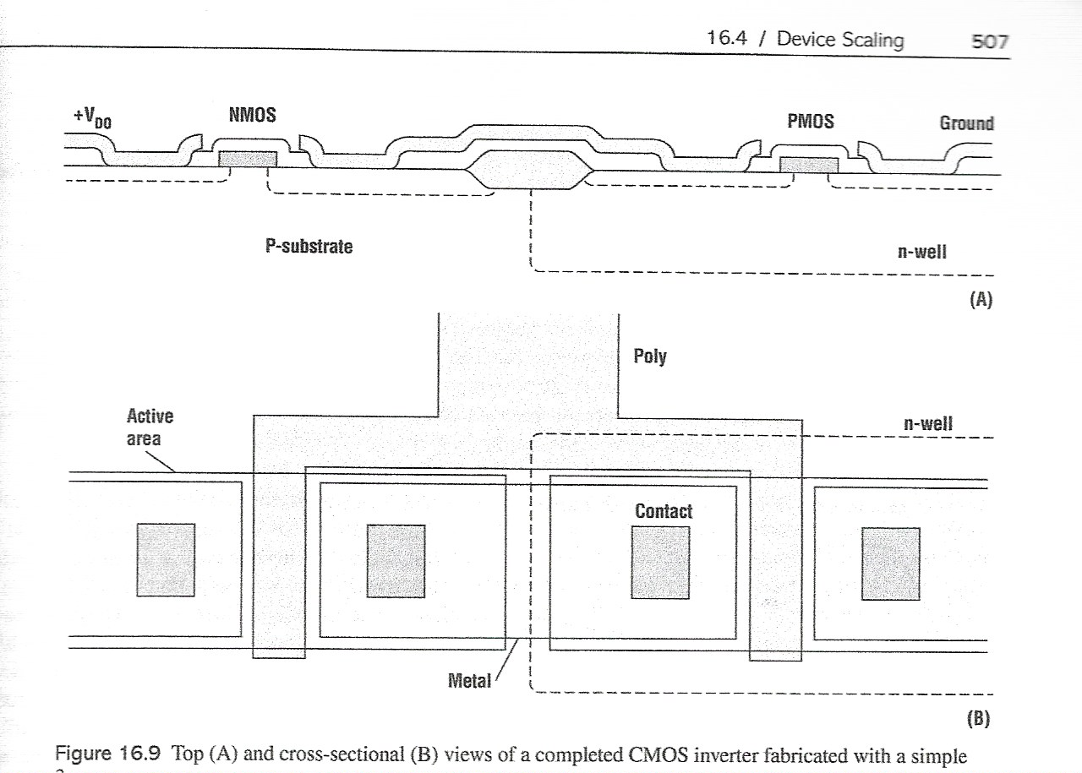

Slide 6
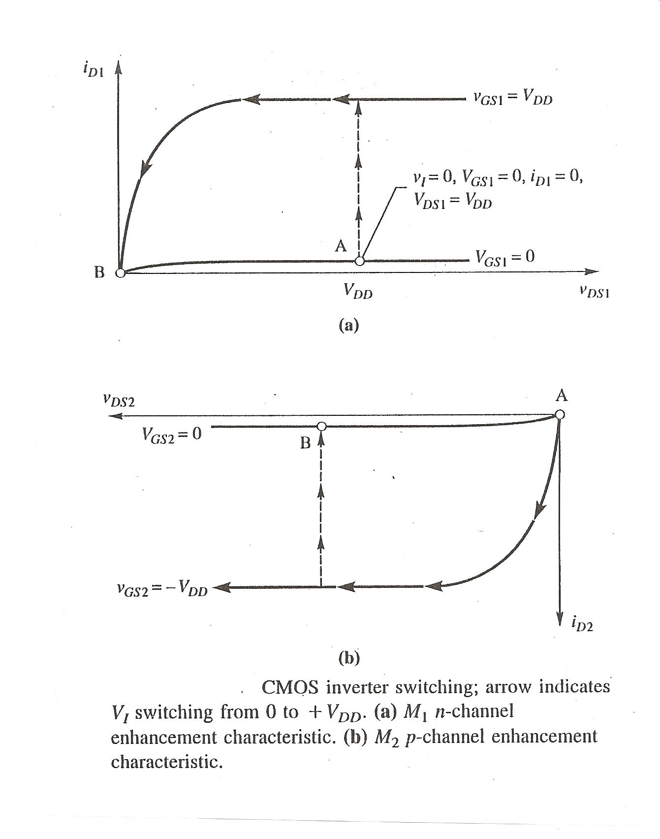

Slide 7
