Slide 1

Advanced photovoltaics
Jacob Passolt
12/3/21

Slide 2
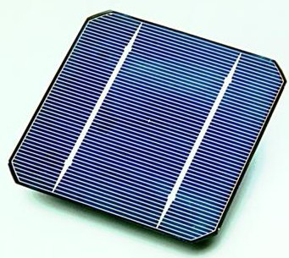
Outline
Background Information
Gallium Arsenide
Multijunction Solar Cells
Perovskites
Organic Solar Cells
Quantum Dots

Slide 3
Background Information

Slide 4
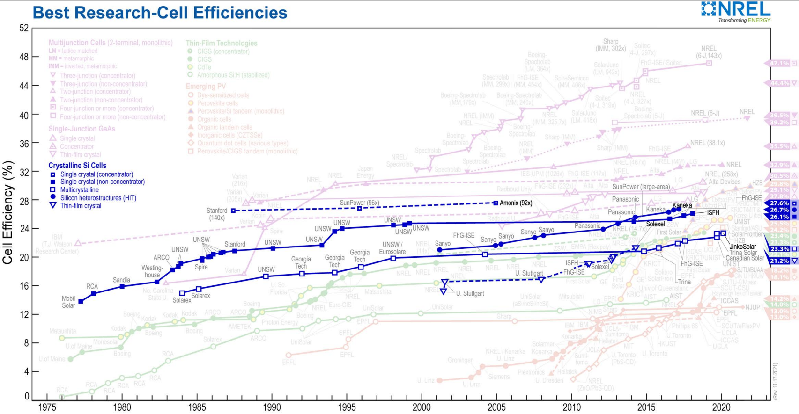
Current Solar Cell Technology
Over 90% of solar panels are crystalline silicon solar cells
Silicon solar cells last over 25 years while retaining 80% power output
Silicon is a mature technology and efficiencies have mostly leveled out
Focused on cheaper modules

Slide 5
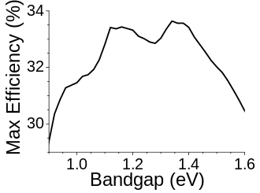
Shockley-Queisser Limit
The energy bandgap of the material used is a factor to it’s efficiency
The ideal bandgap for a solar cell is about 1.34eV with 33.7% efficiency
Solar cells only absorb the light with higher energy than the bandgap of the semiconductor material

Slide 6
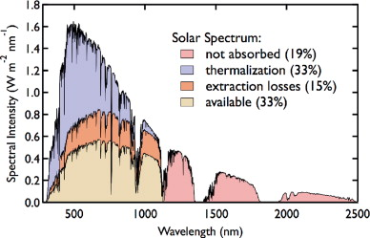
Silicon on the Shockley-Queisser limit
Silicon has a bandgap of 1.1eV
Silicon has an indirect bandgap
Maximum Theoretical efficiency for silicon is about 29%
Most losses come from recombination

Slide 7
Gallium Arsenide Solar Cells

Slide 8
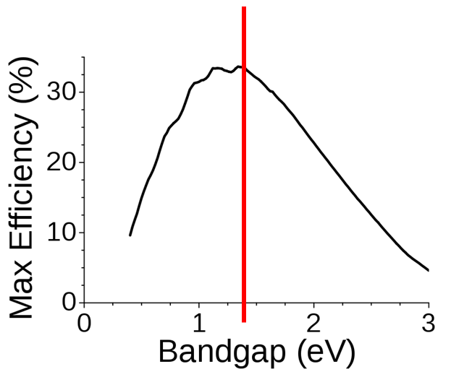
Gallium Arsenide
GaAs has an energy bandgap of 1.42eV
GaAs has a direct energy bandgap
Higher Electron Mobility than silicon
Better performance at high temperatures

Slide 9
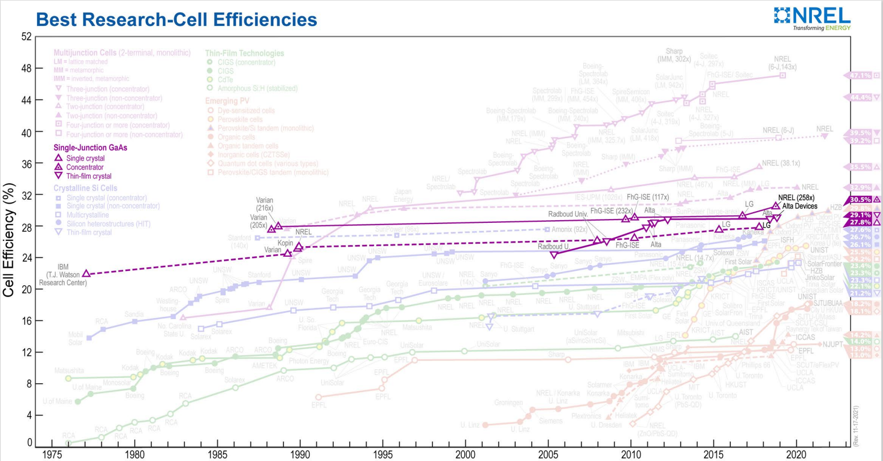
Gallium Arsenide
Maximum theoretical efficiency of 33.5%
Most losses come from light absorption, very little recombination loss
Manufacture of high-quality compound semiconductors is expensive
Higher costs limit uses to specialty uses such as satellite power systems.

Slide 10
Multijunction Solar cells

Slide 11
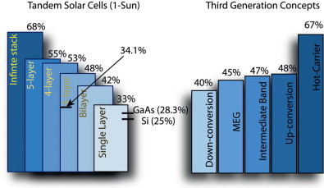
Multijunction Solar Cell
Use multiple layers of solar cells made of III-V semiconductors
A multijunction solar cell can surpass the Shockley-Queisser Limit of the individual subcells
Also known as tandem solar cells

Slide 12
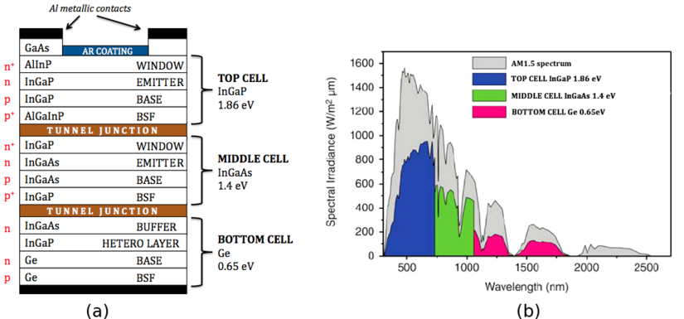
Multijunction Solar Cells
Each subcell has a different energy bandgap
Each subcell is specialized to absorb a certain range of light.
Higher bandgap cells absorb smaller wavelength light

Slide 13
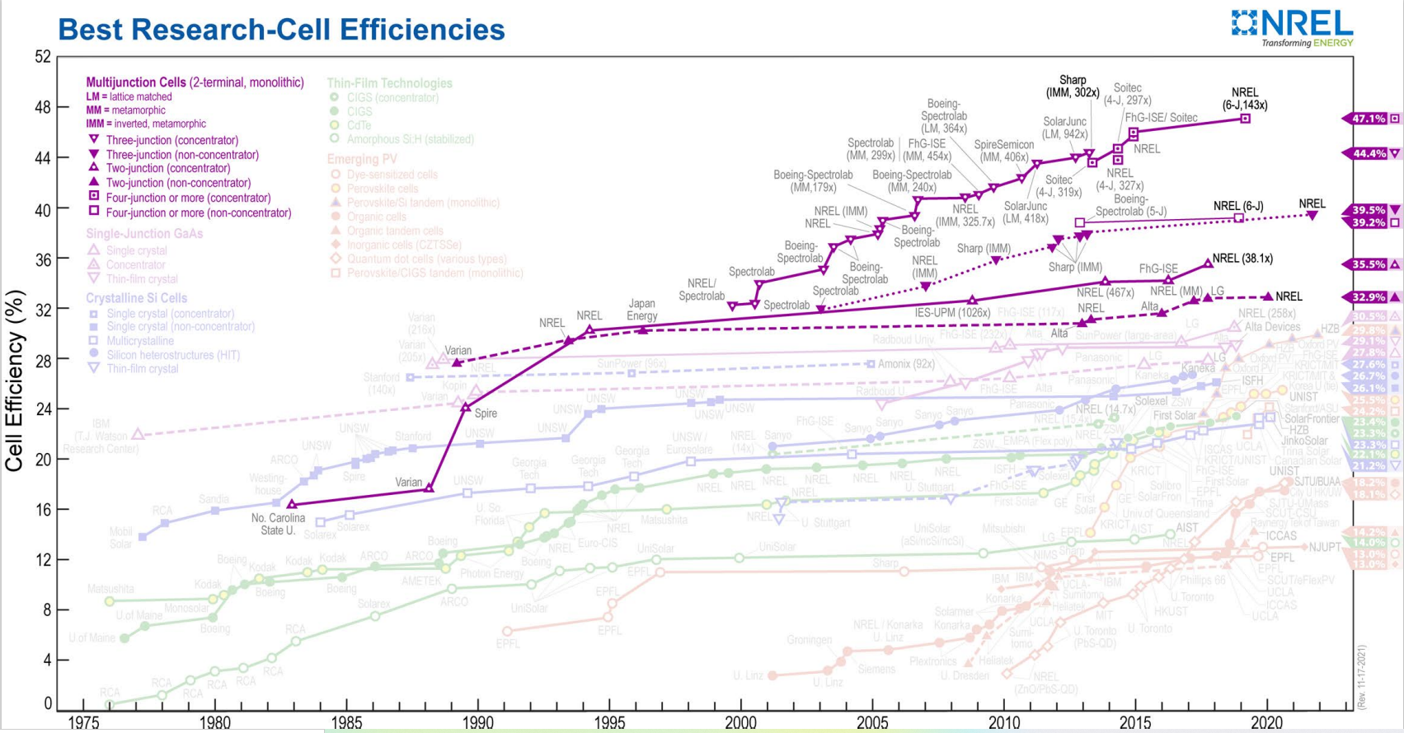
Multijunction Solar Cells
Highest efficiency solar cells available today
Almost 50% conversion efficiency
Very expensive
Used for niche applications

Slide 14
Perovskite

Slide 15
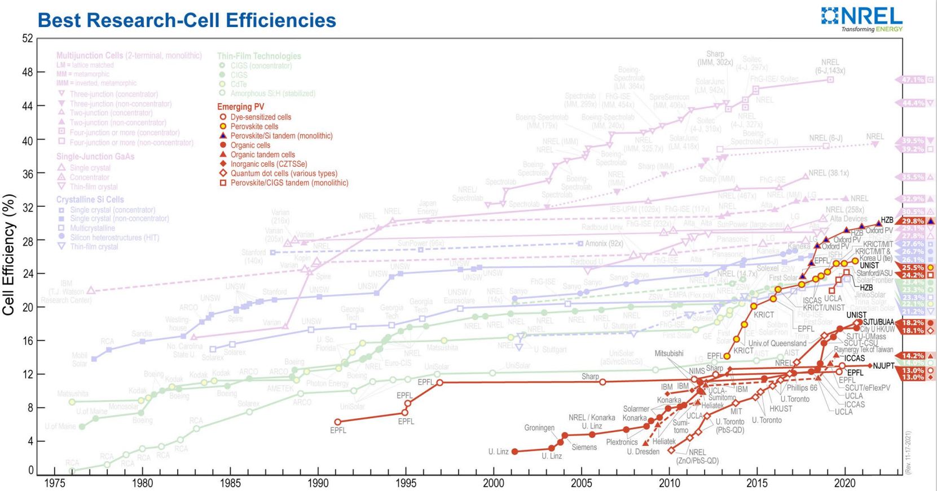
Perovskite Solar Cells
New solar cell technology first discovered in 2006
Initial efficiencies were only 3%
Current efficiencies are over 25%
Thin film solar cells

Slide 16
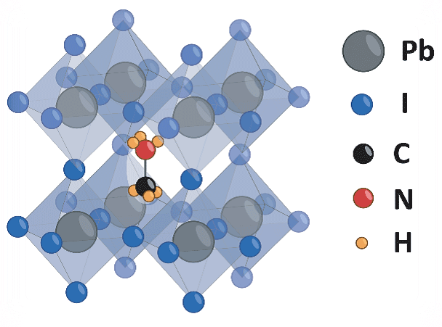
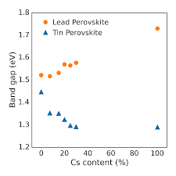
Perovskite Solar Cell
They do not use typical semiconductor materials
  Metal-Halide crystal lattice
Perovskite materials are cheap
  Cells are made using a thin film of the perovskite material
The bandgap can be tuned depending on how the crystal is made

Slide 17
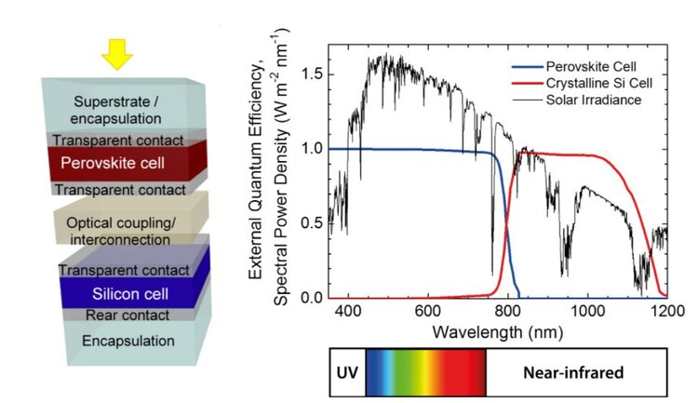
Perovskite-Silicon Tandem Solar Cells
Bandgap can be adjusted by changing the halide content of the perovskite crystal
Current record for efficiency is 29.8%
Theoretical Maximum efficiency of 44%

Slide 18
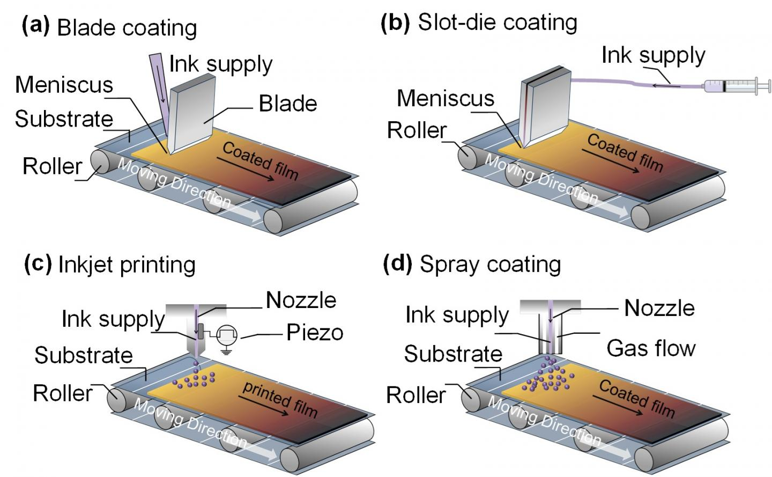
Perovskite
Perovskites applied as a wet solution
They don’t energy intensive melting or refining processes like Silicon of GaAs

Slide 19
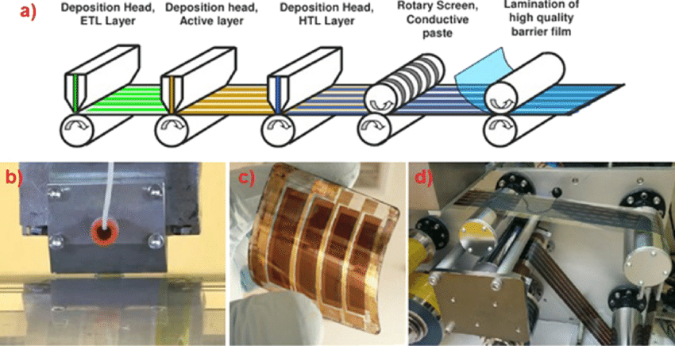

Slide 20
Perovskite Challenges
Long term cell instability
  Light and heat cause degradation and reduce cell efficiency
Lead content of perovskite active materials
  Lead based perovskites are the most stable and most efficient
Currently research is being done to better understand the mechanisms for perovskite degradation
Current perovskites have proven to maintain efficiency for over 1000 hours
Encapsulation of the cells prevents the lead content from being an environmental hazard

Slide 21
Future tech

Slide 22
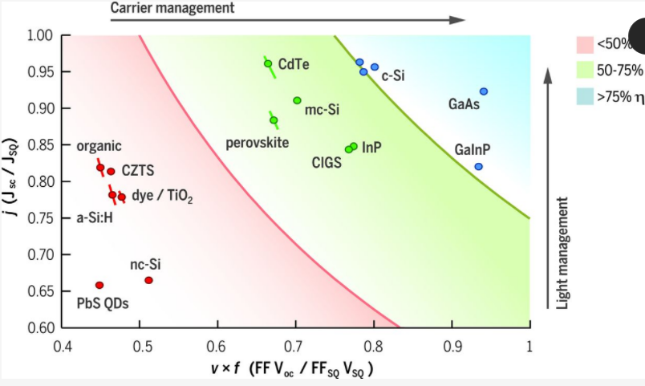

Slide 24
Organic Solar Cells
Advantages
Disadvantages
Thin film, lightweight, and flexible solar cells
Can be produce through print type processes
They have a tunable bandgap
Potential to be transparent
Low efficiencies compared to silicon cells
The cells suffer from photochemical instability

Slide 25
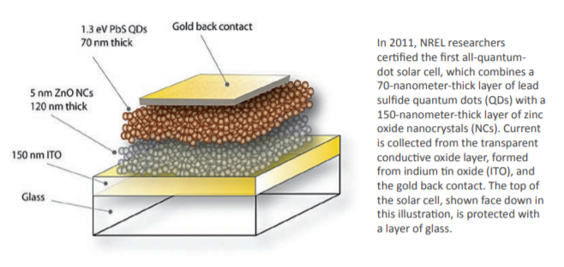
Quantum Dot Solar Cells
Quantum dots are small spheres of a semiconductor material that are only a few nanometers in diameter
MEG (Multiple Exciton Generation): High energy photons generate multiple electrons

Slide 26
Summary
Advanced Photovoltaics:
  Gallium Arsenide
  MultiJunction Cells
  Perovskites
  Organic Solar Cells
  Quantum Dots

Slide 27
References
Conibeer, Gavin. “Third-Generation Photovoltaics.” Materials Today, Elsevier, 12 Oct. 2007, https://www.sciencedirect.com/science/article/pii/S136970210770278X.
R, Yasodharan, et al. “Investigation and Influence of Layer Composition of Tandem Perovskite Solar Cells for Applications in Future Renewable and Sustainable Energy.” Optik, Urban & Fischer, 14 Apr. 2020, https://www.sciencedirect.com/science/article/abs/pii/S0030402620305593.
Bellini, Emiliano. “Unist, EPFL Claim 25.6% Efficiency World Record for Perovskite Solar Cell.” Pv Magazine International, 6 Apr. 2021, https://www.pv-magazine.com/2021/04/06/unist-epfl-claim-25-6-efficiency-world-record-for-perovskite-solar-cell/.
https://www.energy.gov/eere/solar/solar-photovoltaic-cell-basics
https://www.nrel.gov/docs/fy13osti/59015.pdf
Calderone, Len. “Quantum Dot Solar Cells Are Coming.” AltEnergyMag, https://www.altenergymag.com/article/2018/05/quantum-dot-solar-cells-are-coming/28547.
https://ieeexplore.ieee.org/stamp/stamp.jsp?arnumber=9210081
https://www.science.org/doi/10.1126/science.aad4424
L. A. Zafoschnig, S. Nold and J. C. Goldschmidt, "The Race for Lowest Costs of Electricity Production: Techno-Economic Analysis of Silicon, Perovskite and Tandem Solar Cells," in IEEE Journal of Photovoltaics, vol. 10, no. 6, pp. 1632-1641, Nov. 2020, doi: 10.1109/JPHOTOV.2020.3024739.

Slide 28
5 Key Concepts
Shockely-Queisser Limit: Maximum Efficiency for a single junction solar cell with a certain energy bandgap
How the energy bandgap of a semiconductor relates to the light it absorbs
How perovskite solar cells differ from traditional solar cells (materials, manufacture, application)
The advantages vs disadvantages of different solar technologies
How Multiple Exciton Generation can surpass the Shockley-Queisser Limit

