Slide 1
Beyond Moore’s Law
How to deal with the size and speed limitations we are encountering
Josh Anderson
11/22/21

Slide 2
Outline
What is Moore’s Law
Current Sizes and Speeds
Size Constraints and Solutions
Speed Constraints and Solutions
Summary
References
Possible Final Exam Topics and Questions

Slide 3
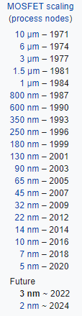
What is Moore’s Law
Moore’s Law is the observation made by Gordon Moore, one of the founders of Intel, that the number of transistors in an integrated circuit doubles roughly every two years.
Moore’s Law is still holding up, but we are reaching a point where our transistors are so small and our processing speeds are so fast that we are running into physical issues.

Slide 4
Current Sizes
While IBM unveiled a 2-nm chip earlier this year, current industry standards are 7-nm for most consumer chips, with some higher end ones being in the 5-nm range.
With silicon’s atomic size at about 0.2 nm, this new IBM chip has transistors a mere 10 atoms wide!

Slide 5
Current Speeds
With current processor speeds sitting at around 3.5 to 4 GHz, each core of a processor has roughly 3.5 to 4 billion chances to carry out instructions per second.
Individual transistors can operate even faster, with current switching times in the picoseconds (10^-12).

Slide 6
Sizing Constraints - Lithography
To make transistors, the typical industry standard currently is to use UV light in the lithography process.
However, due to the destructive effects of UV radiation on the substrates, there are issues with getting decent yields the smaller we make our chips.
A further problem lithographically is being able to scale down the contacts and interconnects in a way that doesn’t dramatically increase resistance, and thus delay

Slide 7
Possible Solutions - Lithography
Semi-damascene: this is a subtractive process where you etch into the wafer then apply your interconnect material. This is different than the single and dual-damascene processes currently in use since it removes the chemical mechanical polishing (CMP) step. This process could allow for new materials other than copper, which could allow for smaller interconnects without larger resistances.

Slide 8
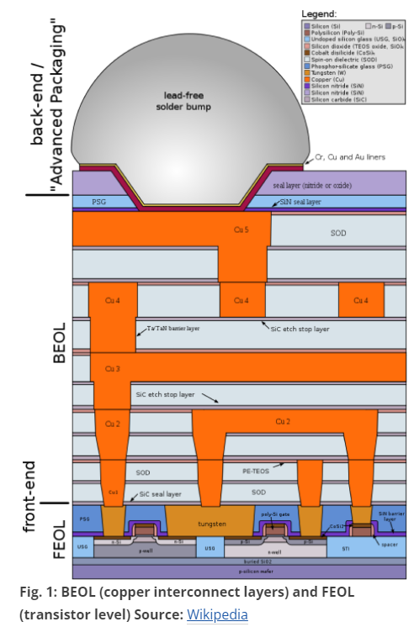

Slide 9
Possible Solutions - Lithography
Supervias: these vias would be able to bypass layers, allowing for less interconnects and lower resistances. This leads to higher speeds as well as smaller transistors.
Graphene interconnects: graphene has the potential to have a lower resistivity and higher current density than copper. However, it is a potentially toxic and difficult and expensive to manufacture.

Slide 10
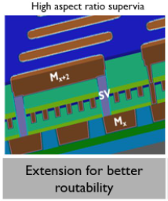

Slide 11
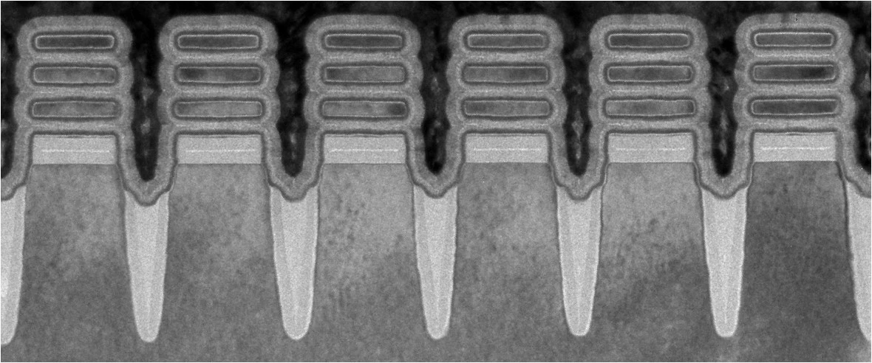
Sizing Constraints - Atomic Spacing
As previously mentioned, our current transistors are approaching just a few atoms wide.
Obviously this creates a problem since making anything smaller than a few atoms is difficult, much less a working transistor.
Electron microscope image of the individual transistors of IBM’s 2-nm chip

Slide 12
Possible Solution - Atomic Spacing
Quantum Transistors: this method uses quantum bits (qubits) and quantum tunneling instead of typical wires and binary bits to transmit data. One possible method is to use nuclear spins to create an entanglement state inside the nuclei of atoms, effectively using individual atoms as transistors. By creating a material that was full of these atoms with spin, we could have an IC full of single-atom transistors. This would also allow for long distance travel of the quantum information.

Slide 13
Speed Constraints - Transmission
When using wires in order to connect electrical components, there is a slight delay in having to transmit the energy through the wire. Typically this is negligible since it is a very small delay.
However, since we use wires to connect everything together in ICs and there are millions if not billions of wires, these delays can account for slower speeds than theorised.

Slide 14
Possible Solution - Transmission
Stackable transistors: also called 3-D transistors, these are essentially transistors stacked upon transistors. This results in a more efficient design as getting the same processing power without stacking would require more distance the signals would have to travel. These chips also run cooler which helps to keep costs down, but they are rather expensive to manufacture.

Slide 15
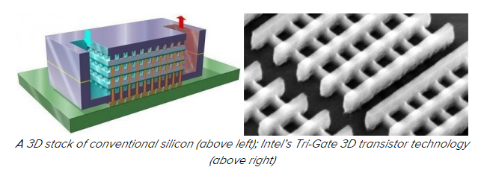
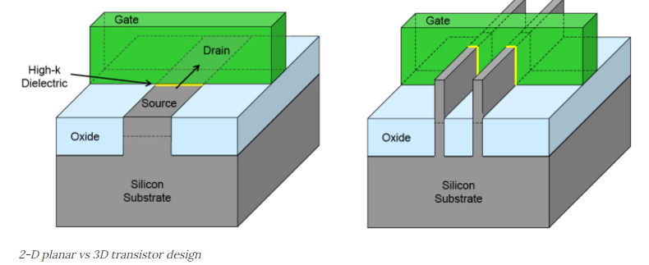

Slide 16
Speed Constraints - Electron Speed
The very basis of electricity is the movement of charged particles, typically electrons, to perform tasks. Since these particles have mass though, they take time to move.
While they do move quite fast, they still only move at roughly 1% the speed of light, leaving a lot of room for improvement.

Slide 17
Possible Solution - Electron Speed
Photon-based Computing: one of the primary quantum computing methods is photon based. This uses photons to both operate the gate and send and receive data. If fully implemented, it would remove the need for electrons and wires in any circuit and would be able to complete instructions magnitudes faster than current conventional transistors.

Slide 18
Speed Constraints - Switching
Transistors have typically been able to speed up thanks to their gates becoming thinner. Yet since about 2006, with the development of the 45-nm chip, transistor gates have been about a single silicon atom thick.
This seems to be a tough hurdle to jump, since designing something to work reliably with parts smaller than an atom is difficult.

Slide 19
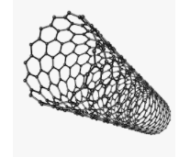
Possible Solution - Switching
Carbon nanotubes: while other materials may also be able to produce a faster switching speed than silicon, carbon nanotubes are one of the most promising. Carbon nanotubes have been shown to switch roughly 5 times faster than silicon transistors, but they haven’t been widely implemented so this number could change.

Slide 20
Summary
To summarize, there is no clear path on how to go beyond Moore’s Law. There are, however, several promising solutions to deal with the problems arising from the physical limitations of our current design and manufacturing processes. Whether we come up with new, more advanced manufacturing techniques, better materials that allow us to process faster, or new methods allowing us to go to the atomic or subatomic level, Moore’s Law may have slowed down but it isn’t dead.

Slide 21
References
Wang, Ning C., et al. “Replacing Copper Interconnects with Graphene at a 7-Nm Node.” 2017 IEEE International Interconnect Technology Conference (IITC), 2017, https://doi.org/10.1109/iitc-amc.2017.7968949.
Paolillo, Sara, et al. “Ruthenium Direct Etch Scatterometry Solution for Self-Aligning Semi-Damascene.” Metrology, Inspection, and Process Control for Microlithography XXXIV, 2020, https://doi.org/10.1117/12.2550366.
“Breaking the 2NM Barrier.” Semiconductor Engineering, 24 May 2021, https://semiengineering.com/breaking-the-2nm-barrier/.
Choi, Charles Q. “New Optical Switch up to 1000x Faster than Transistors.” IEEE Spectrum, IEEE Spectrum, 15 Oct. 2021, https://spectrum.ieee.org/optical-switch-1000x-faster-transistors.
Ibm. “IBM's New 2-Nm Chips Have Transistors Smaller than a Strand of DNA.” New Atlas, 7 May 2021, https://newatlas.com/computers/ibm-2-nm-chips-transistors/.
“Semiconductor Quantum Transistor Opens the Door for Photon-Based Computing.” Joint Quantum Institute, 5 July 2018, https://jqi.umd.edu/news/semiconductor-quantum-transistor-opens-door-photon-based-computing.
Bourassa, Alexandre, et al. “Entanglement and Control of Single Nuclear Spins in Isotopically Engineered Silicon Carbide.” Nature Materials, vol. 19, no. 12, 2020, pp. 1319–1325., https://doi.org/10.1038/s41563-020-00802-6.
Garisto, Daniel. “Light-Based Quantum Computer Exceeds Fastest Classical Supercomputers.” Scientific American, Scientific American, 3 Dec. 2020, https://www.scientificamerican.com/article/light-based-quantum-computer-exceeds-fastest-classical-supercomputers/#.
John Timmer - Jan 19, 2017 8:15 pm UTC. “Carbon Nanotube Transistors Push up against Quantum Uncertainty Limits.” Ars Technica, 19 Jan. 2017, https://arstechnica.com/science/2017/01/carbon-nanotube-transistors-push-up-against-quantum-uncertainty-limits/.

Slide 22
Possible Topics or Questions
Temporary “stop-gap” solutions to allow us to continue developing faster ICs without simply adding more transistors.
If quantum computing were to become more widely available, what are a few advantages and disadvantages that could come with this?
Using other semiconductor materials, how small could we make transistors if they were made with the same amount of atoms?
What are some non-physical drawbacks of the possible solutions, such as efficiency and economic viability?
One of the larger problems with reducing transistor size is being able to reduce the size of interconnects without dramatically increasing the resistance. Are there other materials that could replace copper in future interconnects?

