Slide 1
Devices used for grid scale AC to DC and DC to ac power conversion
By: Khun Myo
12/06/2021

Slide 2
Outline
How does a powered grid work?
HVDC Benefits compared to HVAC
Applications for HVDC
Thyristors
The importance of thyristors
Types of HVDC converters
Insulated Gate Bipolar Transistors (IGBT)
Gate turn off thyristors
Voltage source converters (VSC)
Summary
5 Key points

Slide 3
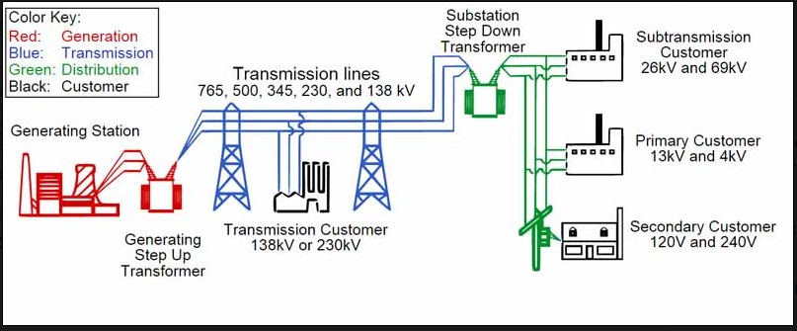
How does a power grid work?
Definition: An electric “Power Grid” is an interconnected system that delivers generated powers to consumers. A power grid consists of three main components, a powerplant, transmission system, and distribution system.
https://www.electricaleasy.com/2016/01/electrical-power-grid-structure-working.html

Slide 4
HVDC benefits compared to HVAC
HVDC requires fewer conductors than HVAC transmission.
-2 conductors per DC circuit, compared to 3 conductors per 3 phase AC circuit.
Smaller towers, hence requires lesser right-of-way
More efficient than AC for transmitting large amount of power over great distances.
- HVDC transmission losses are quoted at 3.5% per 1000km , whereas for AC, it sits at 6.5% at the same voltage.

Slide 5
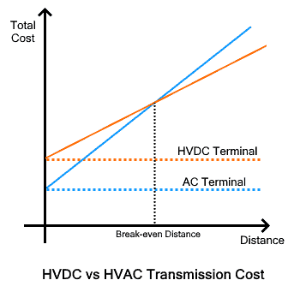
HVDC benefits cont.
HVDC line becomes cheaper than HVAC over a specific distance, which is known as the break-even distance.
Break even distance is 600km for overhead lines.

Slide 6
Applications for HVDC
Connecting remote generation
Interconnecting grid
Connecting offshore wind
Power from shore
Connecting remote loads

Slide 7
Thyristors
What is a thyristors?
-Thyristor is a semiconductor device that is made up of four layer that is alternating between P-type and N-type. (P-N-P-N)
-Thyristors has three terminals, anode(positive terminal), cathode(negative terminal), and the gate.
-Main function of a thyristors is to control electric power and current by acting as a switch.

Slide 8
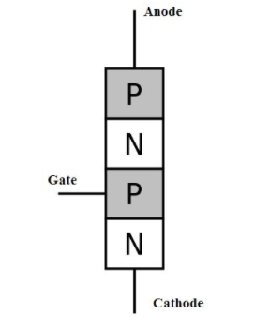
Thyristors cont.
https://www.watelectronics.com/basics-of-scr-construction-working-its-applications/

Slide 9
The importance of thyristors
Thyristor is the heart of converter station and an important component in HVDC transmission lines.
Thyristors converts AC to DC in a HVDC transmission at either end of the transmission link.
Makes it easy to control power flow in a transmission line.

Slide 10
Types of HVDC converters
There are two main types of electronic HVDC converters.
- Line-commutated converters(LCC) also known as current source converter
-Voltage-source converter(VSC)
Line-commutated converters are built using electronic switches that can only be turned on. Since 1970s, Line-commutated converters have switched from using mercury valves to thyristors till present day.
Voltage-source converters are built with switching devices that allows it to be turned off and on. Voltage-source converters was first introduced in 1997, and uses transistors, usually the insulated-gate bipolar transistor(IGBN).

Slide 11
Insulated Gate Bipolar Transistor
IGBT is a three-terminal power semiconductor device mainly used as an electronic switch. The development of IGBT resulted in high efficiency and fast switching.
IGBT combines the advantages of MOSFETS and BJTs for use in power supply and motor control circuits.
MOSFETS provide fast switching speeds, and BJT provides voltage and current capabilities.

Slide 12
Insulated Gate Bipolar transistor cont.
The model shows the what transistors are
Used to build the IGBT. This model consists of N-channel MOSFET and PNP transistor.

Slide 13
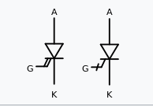
Gate turn-off thyristor (GTO)
A special type of thyristor. As opposed to normal thyristor, GTOs are fully controllable switches which can be turned on and off.
Turn on is done through a positive current flow between gate and cathode terminal.
Turn off is accomplished through negative voltage pulse between gate and cathode terminal.

Slide 14
Voltage source converters (VSC)
VSCs are used in HVDC from 1997 – present day.
VSCs uses IGBTs or GTO rather than thyristors
It is also self commutating, which means it does not require AC on receiving end of line, as it can generate AC voltages on its own.
This gives independent rapid control of both active and reactive power.

Slide 15
Summary
Thyristor is the heart and the work force in a grid-scale AC-DC power conversion
-They are used in current source converters, or line-commutated converters.
Insulated Gate Bipolar Transistor is a design combination of between BJTs and MOSFETS, making it an ideal semiconductor switching device.
-IGBTs are also used for Voltage Source converter
VSCs can generate AC voltages without the need to rely on an AC system.

Slide 16
5 key points
What are some of the benefits of using HVDC over HVAC?
What is the function of a thyristor?
What roles does thyristors play in transmission lines?
The difference between current source converter, also known as line commutated converters and voltage source converter.
What are some features of insulated gate bipolar transistors?

Slide 17
Reference
https://www.electricaleasy.com/2016/01/electrical-power-grid-structure-working.html
https://www.electricaleasy.com/2016/02/hvdc-vs-hvac.html
https://www.watelectronics.com/basics-of-scr-construction-working-its-applications/
https://mdesemiconductor.com/what-is-a-thyristor-types-of-thyristors-and-their-uses/
https://en.wikipedia.org/wiki/HVDC_converter
https://en.wikipedia.org/wiki/Insulated-gate_bipolar_transistor
https://www.electronics-tutorials.ws/power/insulated-gate-bipolar-transistor.html
https://en.wikipedia.org/wiki/Gate_turn-off_thyristor
https://www.entsoe.eu/Technopedia/techsheets/voltage-source-converters
https://top10electrical.blogspot.com/2015/11/applications-of-high-voltage-dc.html
https://www.electricaltechnology.org/2020/06/advantages-of-hvdc-over-hvac-power-transmission.html
https://www.abb-conversations.com/2015/11/thyristors-the-heart-of-hvdc/#:~:text=High%20voltage%20direct%20current%20(HVDC,converts%20AC%20and%20DC%20current.

