Slide 1
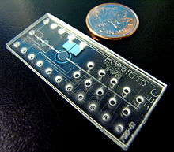
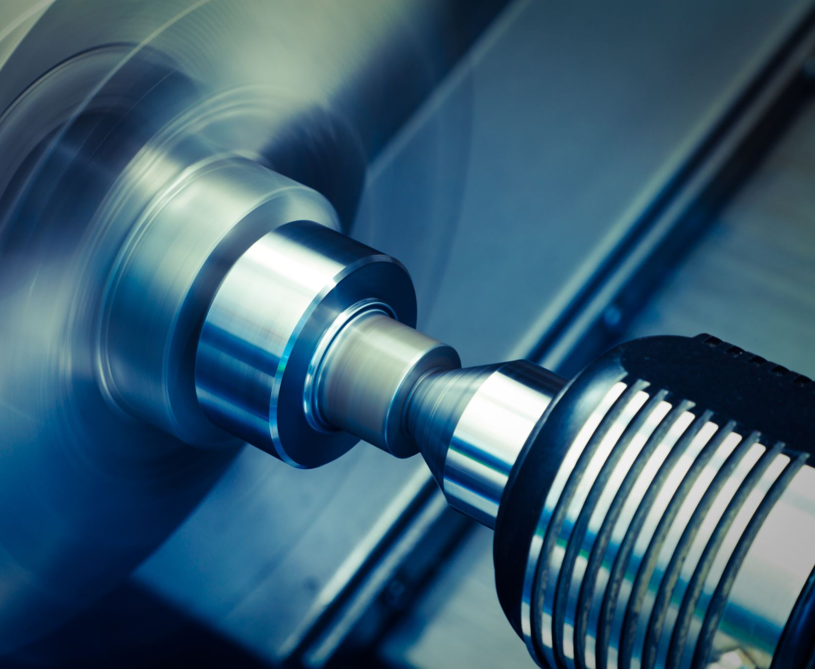
MEMs, FABRICATION Presentation
Bontu Hordofa
11/24/2021
This Photo by Unknown Author is licensed under CC BY-SA

Slide 2
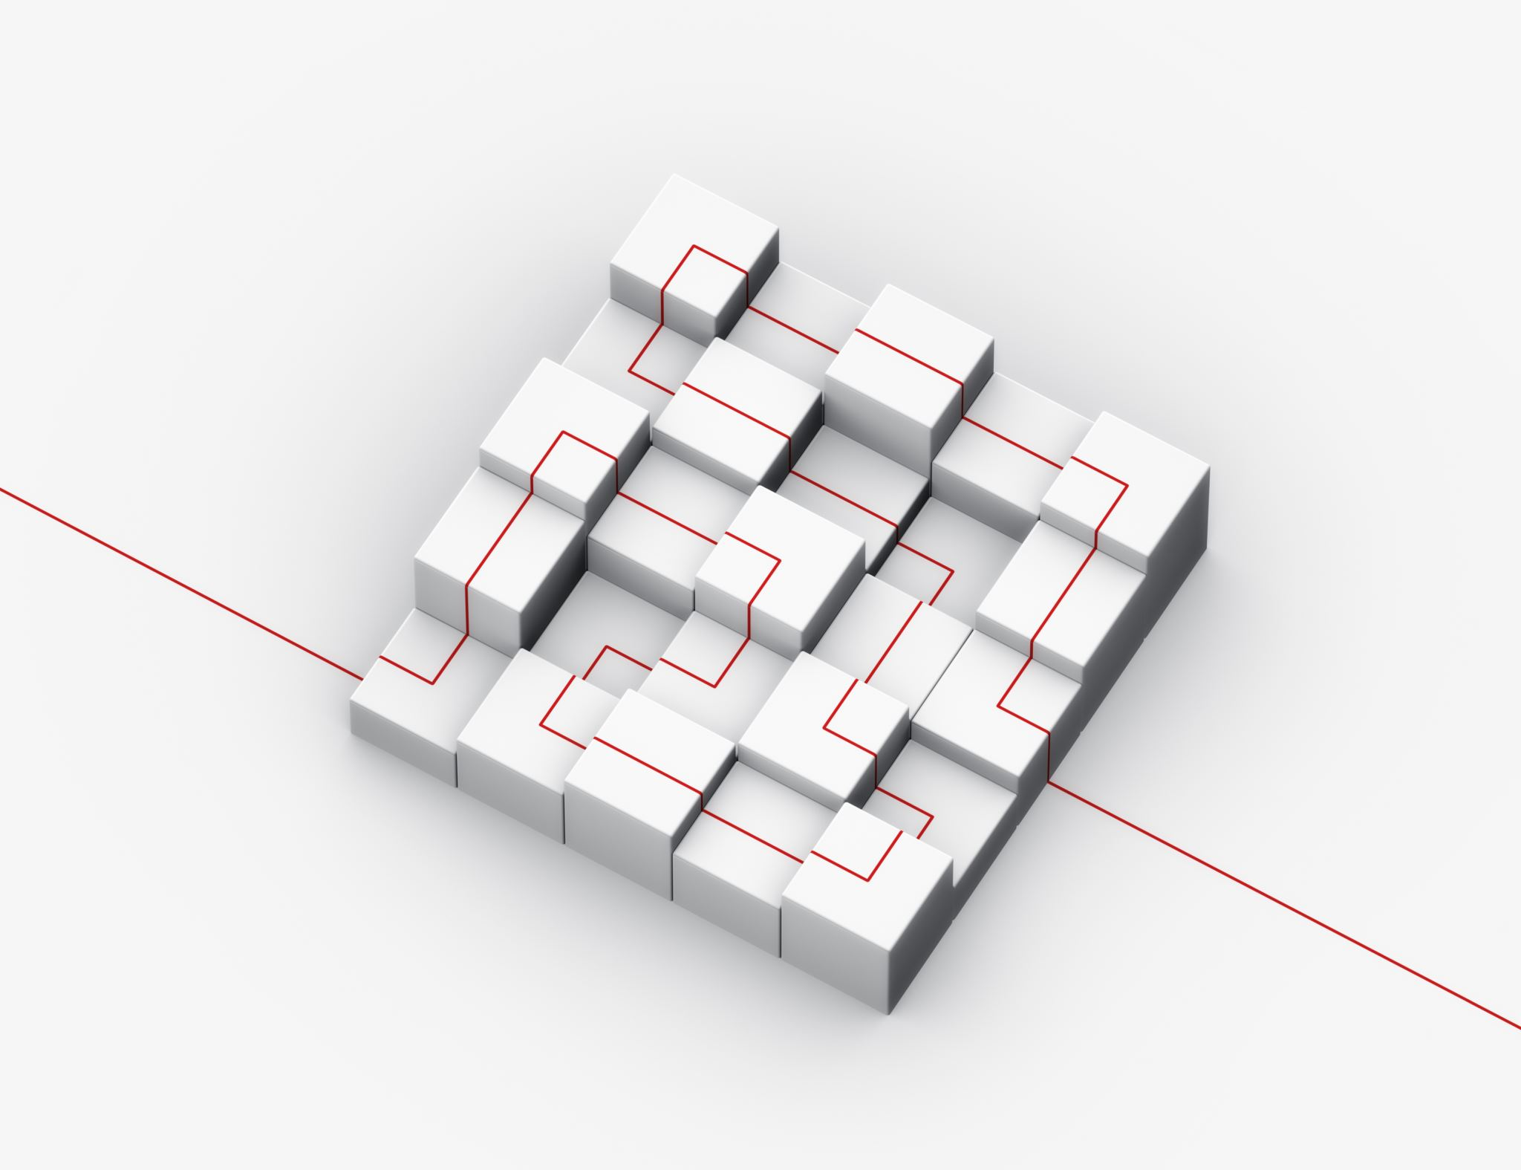
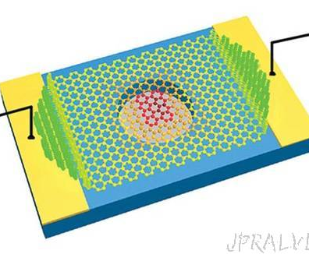
Abstract:
This presentation will discuss what MEMS are, the fabrication, the preparation of a mems system. And go in details on the steps to the fabrication of mems alongside packaging types as microelectromechanical systems strongly depends on the reliability of MEMS packaging.
This Photo by Unknown Author is licensed under CC BY-NC-ND

Slide 3
Outline
Definition
MEMs System
MEMs Fabrication process
Packaging
MEMs applications and Benefits
Summary
References

Slide 4
Introduction
Micro-electro-mechanical systems, or MEMS, is a technology that in its most general form can be defined as miniaturized mechanical and electro-mechanical elements
Nearly invisible to human eye
Made up of components between 1-100 micrometers in size 1 millionth of a meter, about a thickness of a hair

Slide 5
MEMS SYSTEM
MEMs System is a system of miniaturizing devices and structures using microfabrication technique
It is a system of
Micro sensors: that senses the environment and converts the environment variable into an electrical circuit
Micro actuators: is what works to produce a change in the environment
And other microstructures fabricated together on a common silicon substrate.
Fabrication of MEMs device involves the basic IC fabrication methods along with the micromachining process involving the selective removal of silicon or the addition of other structural layers

Slide 6
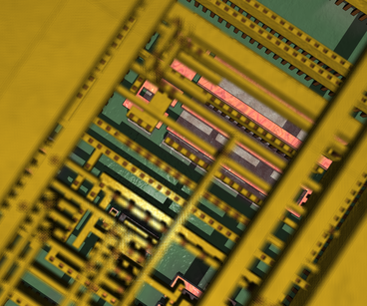
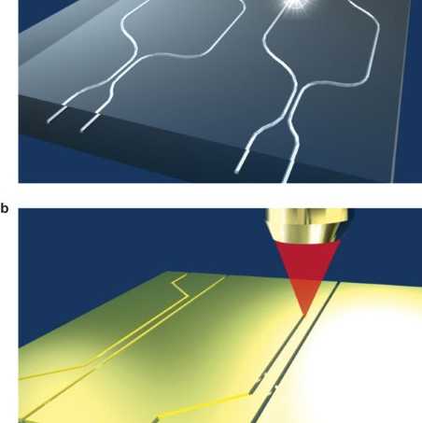
Steps to Fabrication of MEMs
Steps of MEMs Fabrication using
Bulk Micromachining
Surface Micromachining
LIGA Technique
This Photo by Unknown Author is licensed under CC BY
This Photo by Unknown Author is licensed under CC BY-SA
This Photo by Unknown Author is licensed under CC BY-SA-NC

Slide 7
Steps to Fabrication of MEMs using Bulk Micromachining
circuit design and drawing
simulating the circuit and modeling it on CAD
photolithography, insulating silicon dioxide over
Removing unused silicon, using wet or dry etching of Hydrofluoric acid, Potassium Hydroxide and Nitric acid
Joining wafers to for 3 D structure either using fusion or anodic bonding
Assembling the MEMs device on a single silicon chip
Ensure protection to packaging

Slide 8
Steps to Fabrication of MEMs using Bulk Micromachining
circuit design and drawing
simulating the circuit and modeling it on CAD
photolithography, insulating silicon dioxide over
Removing unused silicon, using wet or dry etching of Hydrofluoric acid, Potassium Hydroxide and Nitric acid
Joining wafers to for 3 D structure either using fusion or anodic bonding
Assembling the MEMs device on a single silicon chip
Ensure protection to packaging

Slide 9
Steps to Fabrication of MEMs using Surface micromachining
Deposition of the temporary layer using low-pressure chemical vapor deposition
Deposition of the spacer layer
Detaching of the layer using the dry etching technique
Form structural layer using chemical deposition of phosphorus-doped polysilicon
Reveal underlying layer using dry etching
Remove oxide and spacer layers
Ensure protection to packaging

Slide 10
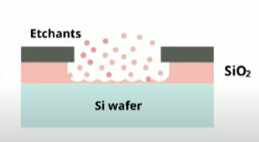
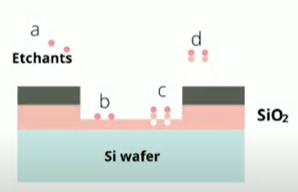
Steps to Fabrication of MEMs using Surface micromachining
Wet Etching
Dry Etching
Chemical Etching: A Tour Through The Process (3D Animation) – YouTube [Play video]

Slide 11
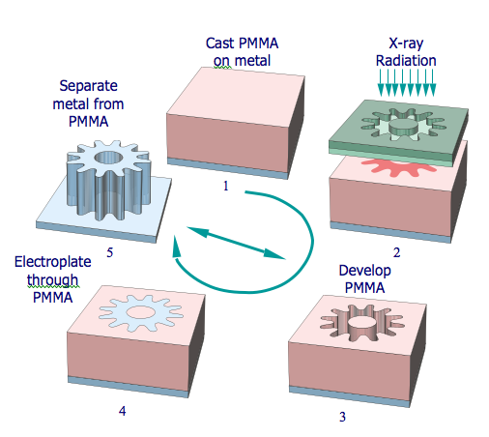
Steps to Fabrication of MEMs using LIGA TECHNIQUE
This is a non-silicon-based process that requires X-ray radiation
Deposition of a layer of Titanium, copper or Aluminum
Deposition of a thin layer of Nickel
Add PMMA
Aligning a mask over the surface and exposing the PMMA to x-ray radiation**
Place PMMA based structure into an electroplating bath wherein the Nickel is plated on the removed PMMA areas.
Reveal the required structure

Slide 12
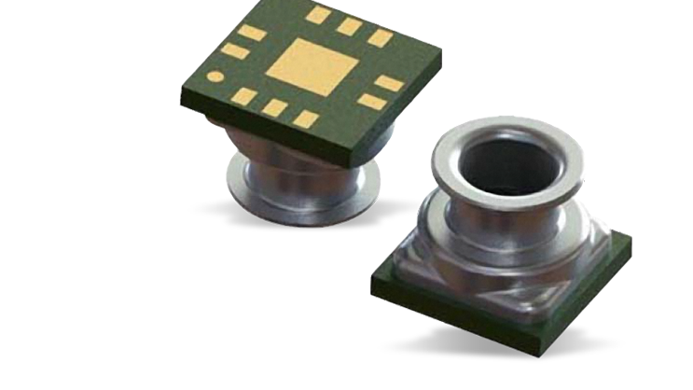
MEMS Packaging
There are three types of MEMs Packaging's
Ceramic:
Protect devices from moisture intrusion
Suitable for harsh environments resistant to chemicals
Expensive
This Photo by Unknown Author is licensed under CC BY-SA

Slide 13
MEMS Packaging
Metal:
Strong
Easy to assemble
Plastic
Light
Costs less
Issues with moisture absorption , reliability issue

Slide 14
MEMS application and Benefits
Automotive airbag sensor
Medical Pressure Sensor:
Electronic, communication
Bio MEMs device
Inkjet Printer Header
Biosensors
MEMS application on Automotive airbag sensor
First commercial devices using MEMS
Deceleration is sensed by a change in voltage
Electronic control unit sends signal to trigger explosively fill the airbag
Initial airbag tech vs MEMS use
Medical Pressure Sensor:
Most successful application
Monitor blood pressure
The early external blood pressure sensors were expensive and needed to be recalibrated for reuse

Slide 15
MEMS application and Benefits
Reduced cost and time of manufacturing.
Easy to integrate into systems or modify
Fabricated in large arrays
Fast & reliable
Cheaper.

Slide 16
Summary
Conclusion, MEMS or Micro-Electro-Mechanical systems is a process technology used to create small integrated devices that combines both mechanical and electrical components. They are fabricated using integrated circuit (IC) batch processing techniques. They are made up of components between 1 -100 micrometers. MEMS devices can be fabricated by three generic routes: Bulk machining, Surface micromachining and LIGA technique. MEMS fabrication uses semiconductor manufacturing processes such as ion etching, diffusion, oxidation and so on with specialized micro machining techniques. Both the electronics and mechanical parts that control them are built in the same piece of silicon.
Advancement of microelectromechanical systems depends on reliability of MEMS packaging and those three types of packages that are commonly used in MEMS technology: ceramic, metal and plastic packages are stated on this presentation.

Slide 17
Reference
Fabrication of MEMS with Different Techiniques & Advantages (elprocus.com) Advantage [3]
What is a print head and how does it work? (largeformatscanners.com) Inkjet Printer Header
Paper Title (use style: paper title) (jetir.org)
https://www.twi-global.com/technical-knowledge/faqs/faq-how-are-mems-micro-electro-mechanical-systems-made
4 Types of MEMS (Microelectromechanical Systems) Explained (hitechnectar.com)
https://infoteh.etf.ues.rs.ba/zbornik/2014/radovi/ELS/ELS-1.pdf [MEMS Packaging]
MEMS Microphones, the Future for Hearing Aids | Analog Devices
https://electronics360.globalspec.com/article/8638/detailing-mems-fabrication-techniques

Slide 18
A list of five key concepts/ questions
What is the typical thickness range of a MEMs device?
What are few advantages of MEMS?
Which one of the 3 types of MEMS packaging is most suitable for harsh environments?
The application of MEM in medical devices and automobile
Which of the MEMS fabrications is a non-silicon-based process?
Why is the packaging of MEMs very important?

Slide 19
The End
Thank you

