Slide 1
Nanoscale Lithography
Lithography techniques and technology at the nano scale.
Zachary Thom
11/22/2021

Slide 2
Outline
Modern MOSFET sizing
3 dimensional transistors
Ramifications for the lithography process
Nanoscale lithography
Electron Beam
Atomic Layer Deposition
Atomic Layer Etching
Plasma ALE
Thermal ALE

Slide 3
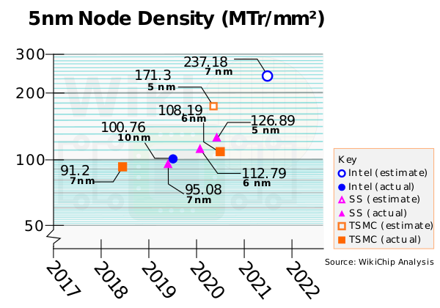
Todays Transistors
Transistor sizing is growing continuously smaller, pushing the boundary of current MOSFET fabrication techniques and design.
In order to produce smaller node sizes the design of transistors had to be changed.
https://en.wikichip.org/wiki/5_nm_lithography_process
Notes:
Decreasing the gate channel length creates the issue “drain induced barrier lowering” increasing the source to drain leakage current and decreasing transistor performance.

Slide 4
Modern MOSFET design
Planar (2D)
22nm and above
3D transistors
FinFet transistors
14-5nm
Nanosheet and Nanowire transistors
3nm

Slide 5
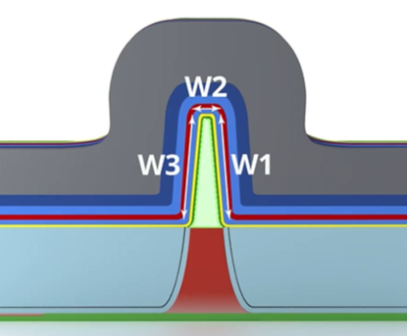
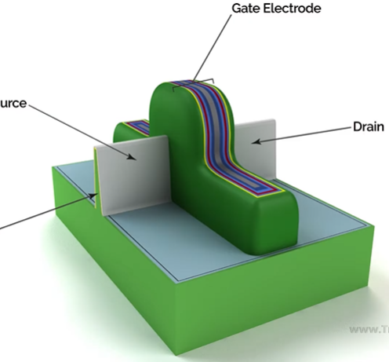
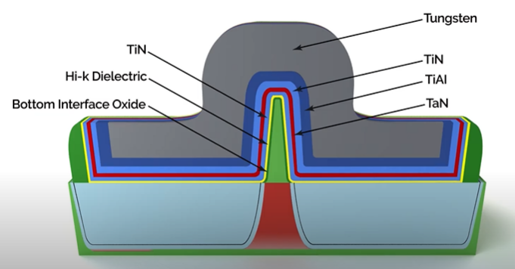
FinFets
A FinFet is defined by its 3 dimensional “fins” and gate channels.
A FinFet can have 2 or 3 gates
Increasing the dimensions of the gate that contact the channel between the source and drain increases the control over that region
Early FinFets favored several fins in order to further increase current density. Later generations opt for less fin numbers and taller fins.
Notes:
The multiple gates provide greater control over the depletion region of the fet.
Allows for much faster switching time and greater current density
With this the gate oxide issue as seen before is overcome.

Slide 6
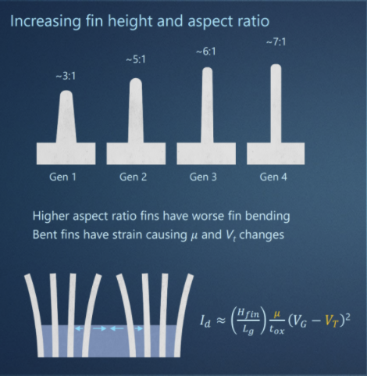
Characteristics of The FinFet
Equation for $I_{D}$ in saturation region for classical MOSFET:
$$I_{D,sat}=\frac{μ_{p}⋅C_{0}x}{2}⋅\frac{w}{L}⋅{\left(v_{G_{s}}−v_{T}\right)}^{2}$$
For FinFet:
$$I_{D,sat}≈\left(\frac{H_{fin}}{L_{g}}\right)\frac{μ}{t_{0x}}{\left(v_{Gs}−v_{T}\right)}^{2}$$
https://semianalysis.com/samsung-foundry-3nm-gate-all-around-process-node-3gae-delayed-to-2024/

Slide 7
Ramifications For The Lithography Process
New transistor designs each have more and more complex requirements for fabrication.
For the FinFets specifically in order to fabricate the very thin and tall silicon gates requires immense precision during manufacturing.
Many previous techniques are not accurate or reliable enough to preform at the needed level of precision and scale.
Many lithography methods are unable to etch or deposit monolayers (<.5nm).
Notes:
New transistor designs each have more and more complex requirements for fabrication.
For the FinFets specifically in order to fabricate the very thin and tall silicon gates requires immense precision during manufacturing.

Slide 8
Electron Beam Lithography
An extension of photolithography, uses light in order to transfer a geometric pattern from a photomask onto a substrate.
Also called ‘Direct Write lithography’.
These systems us a small electron beam in order to cut through a photomask and expose a pattern.
This is done like a printer, one pixel at a time.
Stencils can also be used with a wider e beam to expose many pixels at once but is not as reliable.
Notes:
E-Beam is excellent for prototyping different transistor designs

Slide 9
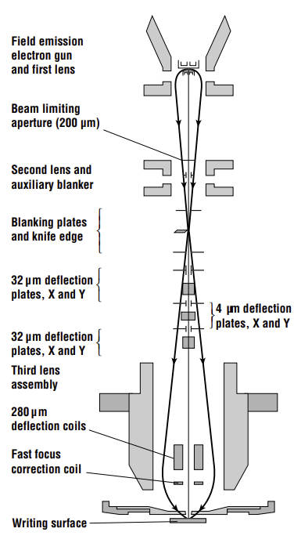
Electron Beam Lithography
The electron stream current density needs to be specific for each material and is given by
$$J_{c}=AT^{2}e^{−E_{w}jKT}$$
After the stream of a specified current density is created it needs to be formed into a narrow beam, this is done using a series of electrostatic lenses, apertures, and knife edges. The final spot diameter is given by
$d^{2}=d_{o}^{2}+d_{s}^{2}+d_{c}^{2}$
Notes:
A is Richardson’s constant for the material (typically 10–100 A/cm2 -K2 ) and Ew is the effective metal work function. These electrons are accelerated and some fraction of them are collected. The measure of the collected electron energy is the brightness, b. Although an increase in the emitted current density also generally increases b, if the increase in Jc decreases the collection efficiency, the percentage increase in the brightness is not as large as the percentage increase in the current density.

Slide 10
Atomic Layer Deposition
A subclass of chemical vapor deposition (CVD)
A film is grown by exposing a surface to alternating gaseous species.
These reactants are inserted happens sequentially, unlike CVD
Also unlike CVD, ALD is self-limiting

Slide 11
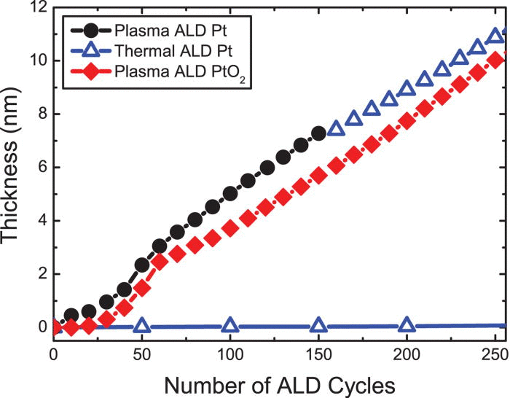
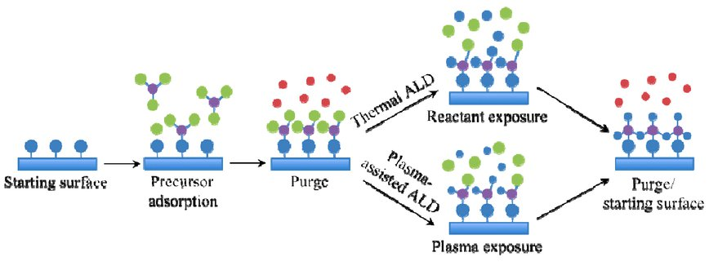
Atomic Layer Deposition
There are serval ALD process modes, however the most common are thermal and plasma-enhanced ALD.
Thermal ALD operates at 150-300 C and occurs exclusively through surface reactions.
Plasma assisted ALE can operate at lower temperatures with compromising film quality. However it comes at a higher complexity and higher risk of damage to films.
Notes:
PEALD is useful for the growth of film on the substrates that are heat sensitive.
PEALD can also produce highly pure films than the films produced by thermal ALD
Other advantages of the PEALD are the wider choice of precursors, higher growth rate, and process versatility

Slide 12
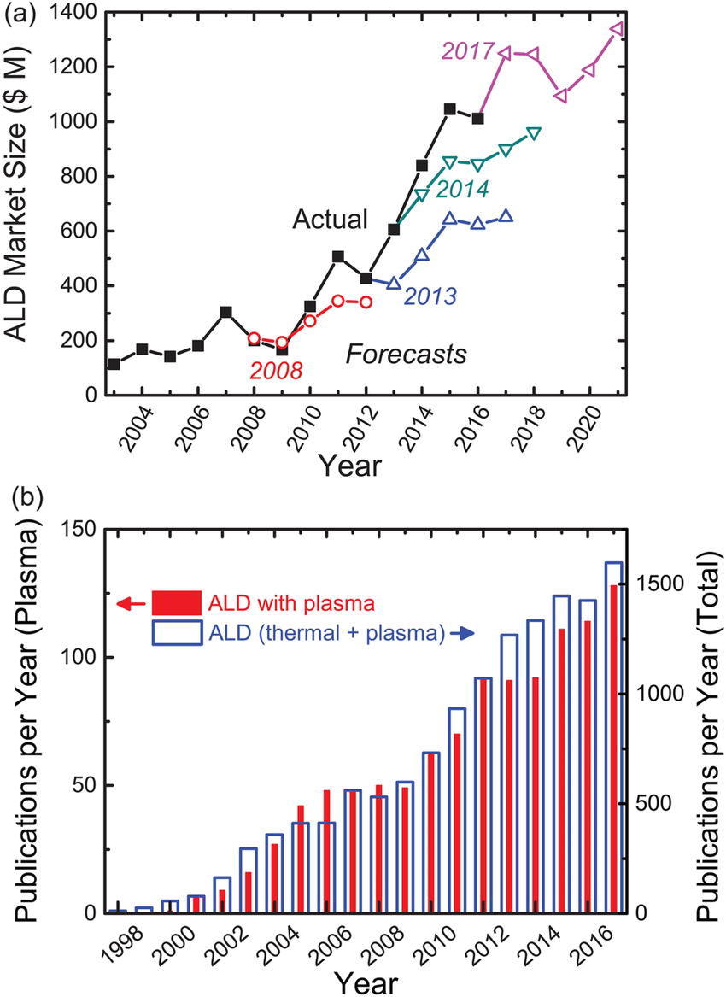
Atomic Layer Deposition
Advantages
Conformality in 3D applications
Uniformity of deposition layer
Step coverage
Low temp process
Disadvantages
Slow deposition rate
High material and energy waste
Economic viability

Slide 13
Atomic Layer Etching
The FinFet’s physical characteristics requires a high aspect-ratio etching method in order to create the silicon fins necessary for the source and drain.
Atomic Layer Etching(ALE) works in two main actions.
A method, either plasma or thermally induced, to chemically modify the top layer of the wafer surface.
A method to remove the altered top layer from the wafer surface.
Notes:
Aspect-ratio; fins have heights 4-7 times more than the width of the node

Slide 14
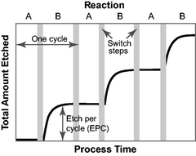
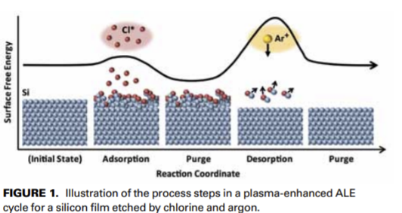
Plasma ALE
https://plasma.oxinst.com/technology/atomic-layer-etching
Process:
Dosing substrate with etching gas (Cl for example). The gas is plasma dissociated to enhance absorption rate. This reaction is self-limiting
Purging leftover gas
Bombarding the substrate with low energy inert ions that remove the surface layer of chemically altered atoms
Etching products removed from chamber
https://avs.scitation.org/doi/10.1116/1.4913379
Solid State Technology issue December 2013
Notes:
The directionality of the energetic ions and neutral atoms, the target layer can be removed

Slide 15
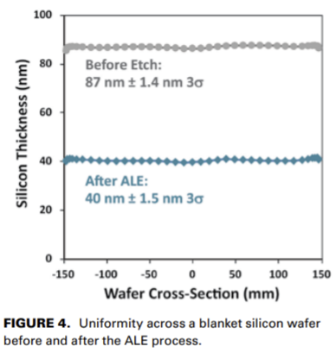
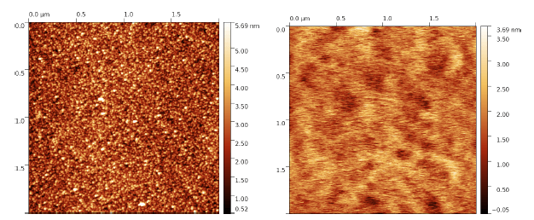
Plasma ALE
Advantages
Low damage
Precise depth control
Highly selective
Smooth surface after process
Anisotropic
Disadvantages
Slow unless continuous method is used
Continuous method trades speed for precision
Solid State Technology issue December 2013
https://plasma.oxinst.com/technology/atomic-layer-etching

Slide 16
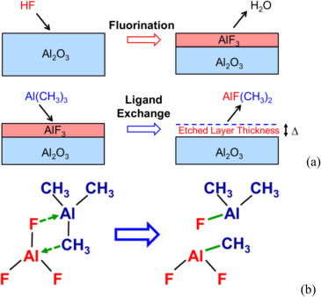
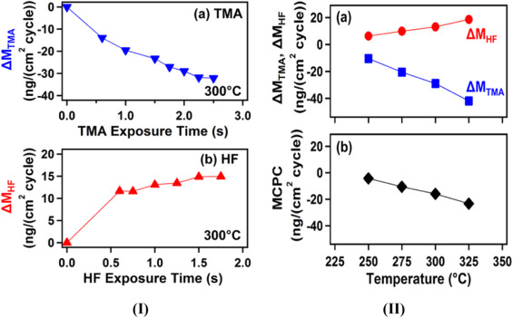
Thermal ALE
Fluorination Process:
Surface modification performed by dosing metal oxide with HF. Resulting in a self-limiting surface reaction and alter as a by product.
Cleaning residual fluorination byproducts.
The fluorinated metal oxide is dosed with $Al(CH_{3})_{3} (\text{trimethylaluminum}$) and a ligand exchange occurs, separating the fluorinated layer from the rest of the metal oxide.
The Metal oxide is washed.
https://www.sciencedirect.com/science/article/pii/S1002007118304623
https://www.sciencedirect.com/science/article/pii/S1002007118304623
Notes:
Ligand: an ion or molecule attached to a metal atom by coordinate bonding
Graphs show the influence of reactant exposure time and temperature
$T\text{rimethylaluminum}$(TMA)

Slide 17
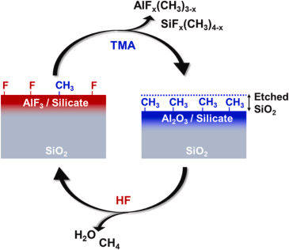
Thermal ALE
Thermal ALE processes are highly temperature dependent, most range from 200-250 degrees C.
Advantages
Isotropic
Self-limiting
Reactants can widely vary to accommodate many different metal oxides
Disadvantages
Cannot directly etch SiO2. another step must be added to the process to convert SiO2 into Al2O3 / Silicate
https://www.sciencedirect.com/science/article/pii/S1002007118304623

Slide 18
Summary
These nanolithography systems have been researched for many years and are just now becoming refined enough to be used in mass production of semiconductors.
The main prospect of these processes is the very fine detail they can produce in order to reliably create complex 3D structures at nm levels.
The main trade offs these processes is the length of them, complex setups and high energy or material waste.
Researchers are continuing working to increase the economic viability.

Slide 19
References
https://www.sciencedirect.com/science/article/pii/S1002007118304623
https://plasma.oxinst.com/technology/atomic-layer-etching
https://avs.scitation.org/doi/10.1116/1.4913379
https://web.archive.org/web/20170505142915/http://electroiq.com/wp-content/uploads/magazines/SolidStateTechnology_December_2013.pdf
https://semiengineering.com/etching-technology-advances/
https://www.halbleiter.org/pdf/en/Fundamentals/Fundamentals%20-%20Construction%20of%20a%20FinFET.pdf
https://semianalysis.com/samsung-foundry-3nm-gate-all-around-process-node-3gae-delayed-to-2024/
https://en.wikichip.org/wiki/5_nm_lithography_process
Fabrication Engineering at the Micro- and Nanoscale third ed. Stephen A. Campbell
https://www.youtube.com/watch?v=c-3p8moNXfI
https://www.youtube.com/watch?v=6LcTrp6SB3o

Slide 20
Basis for Questions
Differences between thermal and plasma ALE/ALD
What makes FinFets superior to planar MOSFETS?
What are some of the advantages and drawbacks to self-limiting reactions in lithography?
Given your previous knowledge of different lithography techniques and applications. What would be a good application for any of the techniques shown in this presentation?
Why will the 5nm process most likely be the last process to use FinFet technology?

