Slide 1
OLED Theory and Fabrication
How do they work and how are they manufactured?
Christian Larson
12/1/2021

Slide 2
Outline
How do OLED’s Work?
How are OLED’s manufactured?
What are the differed types of OLED’s?
What are the advantages to OLED’s?
What are the disadvantages to OLED’s?
Summary
References
Possible Questions for Final

Slide 3
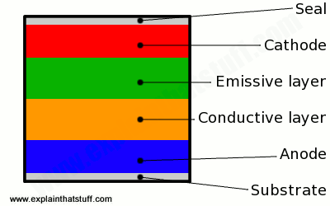
How do OLED’s Work?
Work very similar to traditional LED’s
Traditional LED’s use n or p type substrate
OLED’s organic molecules to produce electrons and holes
The emissive and Conductive layers are made of organic molecules

Slide 4
How do OLED’s Work?
How is light Created?
  Electrons enter the cathode
  Holes enter the anode
  The electrons and holes meet in the emissive and conductive layers
  Light is created when the electrons and holes meet
This process is called recombination

Slide 5
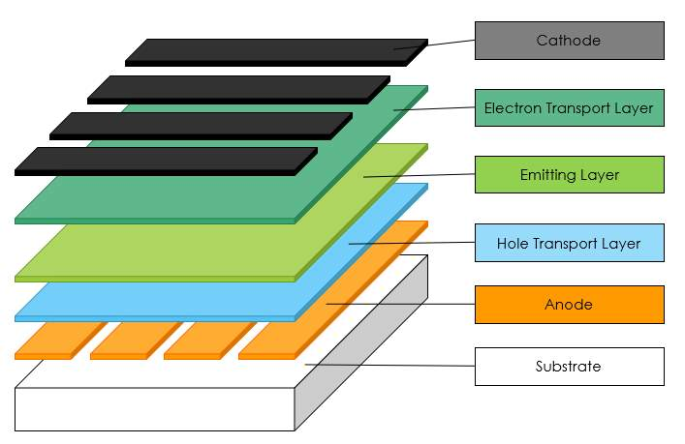
How are OLED’s manufactured?
The substrate: Used to support the OLED
  Commonly made out of glass, plastic and foil
The anode: Positive lead of OLED
  Commonly made out of indium tin oxide (ITO)
The Hole Transport Layer: Used to move holes to emitting layer
  Made out of p-type materials
The emitting layer: Where light is produces
  Made out of organic materials, type of material will change color of light

Slide 6
How are OLED’s manufactured?
The Electron transport Layer: Used to move electrons to emitting layer
  Mode of n-type materials
The cathode: Negative lead of OLED
  Commonly deposited with aluminum

Slide 7
How are OLED’s manufactured?
What different organic materials are used for the emitter layer?
  Different materials are used for the emitter layer to get different colors of light
Traditional organic materials were fluorescent organic compounds
  Fluorescent: Glow when light is applied
  Red is typically made with Platinum Octaethylporphyrin
  Green is typically made with Tris[2-phenylpyrideinato-C^2,N]Iridium(III)
  Blue is typically made with Diphenyl Sulfone Dimethyl Dihydroacridine

Slide 8
How are OLED’s manufactured?
How has technology advanced in OLED fabrication?
Red and green light are made using phosphorescent organic compounds
  Phosphorescent: Naturally fluorescent, even after light is removed
  Benefit to phosphorescent materials is they have greater quantum efficiency
  Blue phosphorescent material still in development

Slide 9
How are OLED’s manufactured?
OLED’s are commonly manufactured with vacuum sublimation
  Efficient in fabrication of multilayer devices
Other manufacturing techniques used are:
  Vacuum thermal evaporation
  Organic vapor phase deposition
  Inkjet-printing
  Transfer-printing

Slide 10
Types of OLED’s?
  Traditional OLED’s
    Use small organic molecules deposited on glass
  Light-Emitting Polymers(LEP’s) or polymer LED’s (PLEDS)
    Use large plastic molecules called polymers instead of organic material
    Usually, they are printed onto plastic
    This allows the OLED’s to be thinner and more flexible

Slide 11
Advantages of using of OLED’s?
  OLED’s are self-luminous and do not require a backlight
  Low Power (usually 2 - 10 volts dc)
  Low cost and easy fabrication
  Color sensitive
    Lots of organic materials to choose from for producing different colors of light
  Flexibility
    OLED’s printed on plastic are paving that way for flexible displays
  Very large energy savings with contrast to other light sources
  Very high viewing angle
    As high as 160 degrees, making displays better

Slide 12
Disadvantages of using of OLED’s?
  Highly susceptible to degradation by oxygen and water molecules
    Organic materials are very sensitive to oxygen and water molecules
    Biggest disadvantage to OLED’s is a short lifetime
  Low mobility of holes and electrons due to amorphous nature of the organic molecules.
  Low stability at high brightness levels
  Low device efficiency
  Difficulty in fabricating uniform, large-area lighting sources.
  Non-existent infrastructure.

Slide 13
Summary
  OLED’s differ from LED’s by having organic molecules as part of their construction
  Most common way to manufacture OLED’s is with vacuum deposition
  Way we get different colors of OLED’s is by changing the material used in the emitter layer
  Two types of OLED’s:
    Traditional OLED’s: Small molecules deposited on glass
    Polymer OLED’s: Large polymers printed on plastic
  Main advantage is OLED’s are self-luminous and do not require backlights
  Main disadvantage is OLED’s have a shorter life span

Slide 14
References
  Cen.Acs.Org, 2021, https://cen.acs.org/articles/94/i28/rise-OLED-displays.html. Accessed 29 Nov 2021.
  "Fabrication And Characterization Of Organic Light Emitting Diode (OLED)". Ukdiss.Com, 2021, https://ukdiss.com/examples/organic-light-emitting-diode.php. Accessed 29 Nov 2021.
  "OLED Introduction And Basic OLED Information | OLED-Info". Oled-Info.Com, 2021, https://www.oled-info.com/oled-introduction. Accessed 29 Nov 2021.
  “OLEDs (Organic LEDs) and LEPs (light-emitting polymers)”. Explainthatstuff.com, 2021, https://www.explainthatstuff.com/how-oleds-and-leps-work.html. Accessed 29 Nov 2021.
  Scholarworks.Rit.Edu, 2021, https://scholarworks.rit.edu/cgi/viewcontent.cgi?article=3763&context=theses. Accessed 29 Nov 2021.
  "The Importance Of Internships In College". Colleges Of Distinction, 2021, https://collegesofdistinction.com/advice/the-importance-of-internships-in-college/. Accessed 29 Nov 2021.

Slide 15
Possible final exam questions
  How to OLED’s work on a basic level?
  What is the main manufacturing method of OLED’s?
  How to we get different colors of OLED’s?
  What is one advantage of using OLED’s over LED’s?
  What is one disadvantage of OLED’s?

