Slide 1
SQUIDS & Joseph Junctions
By: Johnathan Machler
Due date: 04/20/2020

Slide 2
Timeline for the Discoveries
1911 Discovery of superconductivity by Heike Kamerlingh Onnnes Resistance of mercury cooled by liquid helium (4.2K) vanishes
1957 Bardeen, Cooper, Schrieffer describe superconductivity in BCS theory. Novelty is the Cooper pair: Two electrons of opposite spin and momentum bound by electron-phonon interactions
1962 Brian Josephson predicts the Josephson Junction: Two superconductors coupled by an insulating barrier

Slide 3
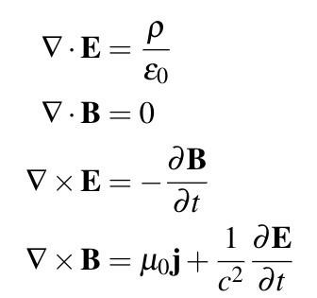
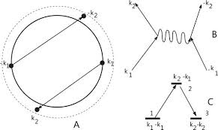
Background Physics
Condensed Matter
Superconductivity
Electrodynamics
Maxwell's Equations
Quantum Mechanics
Eigenstates
Junction Tunneling
Wavefunction

Slide 4
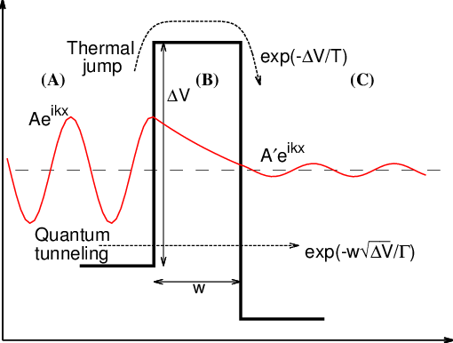
Tunneling explained
Potential wells on two sides
The electron travels through a junction
Amplitude and phase of wave function
Changes as it passes through junction
Potential well of the junction
Width of the junction

Slide 5
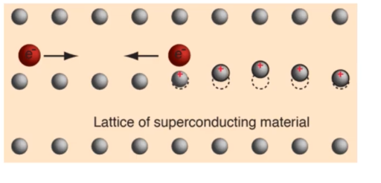
Rockstar Groupie Lattice Analogy:
Rockstar : Electron :: Fans : Lattice

Slide 6
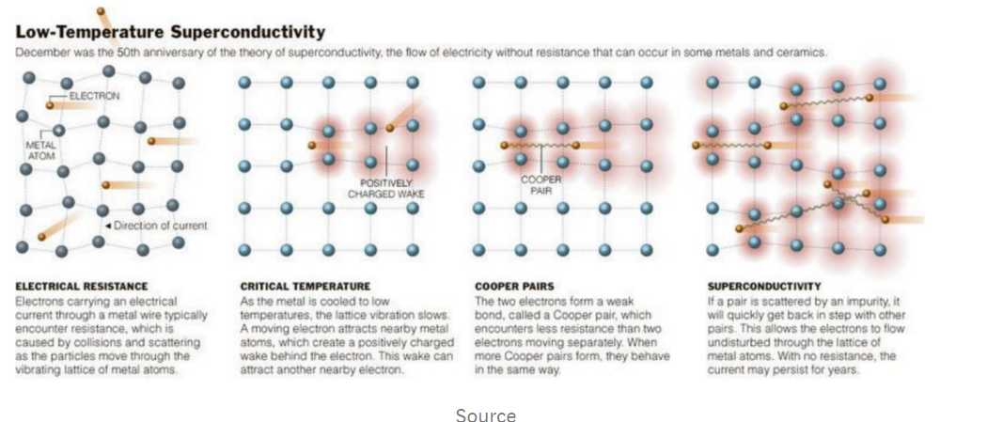
What is superconductivity?
Superconductivity is phenomenon where there is zero resistance often occurs in materials cooled to a certain curie temperature.

Slide 7
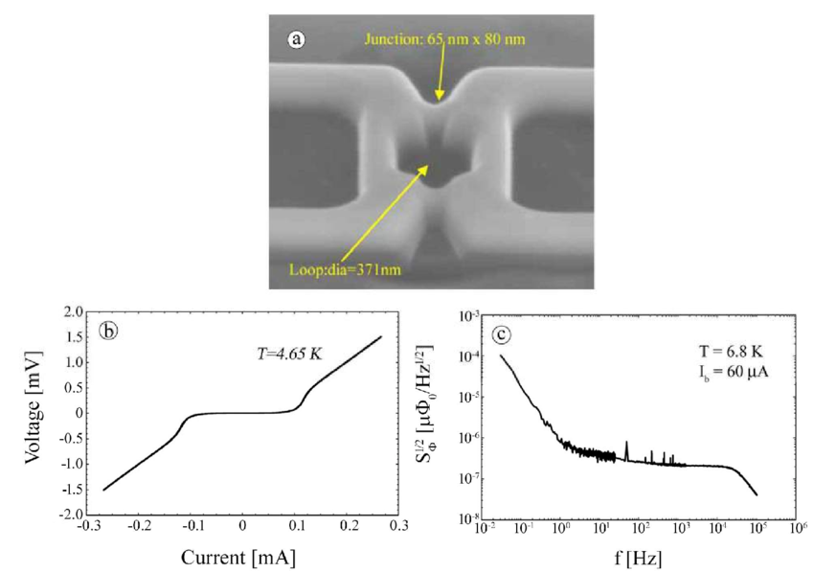
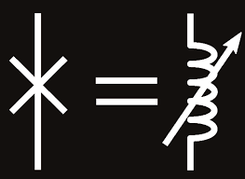
What is a joseph junction?
Physics: Josephson effect
Manufacturing: Dayem Bridge
Types: SIS, SNS, SSS
IV Characteristics
Variable inductance

Slide 8
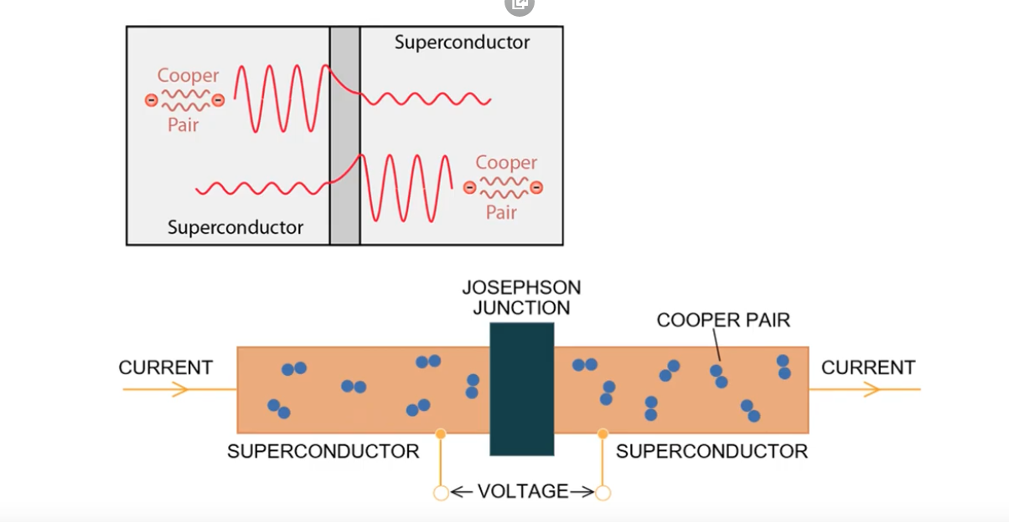
Interaction Dependencies
Interactions between Electrons in Critical Current
Depend upon:
Junction Size
Type of the Superconducting
Material Operating Temperature
Kink in the pip

Slide 9
Theories
Properties/ Explanations behind a Josephson Junction:
Spontaneous current arises when in a superconductor flows back and forth so long as the superconductivity persists. This is the first anomaly, a current without a voltage.
The Gestalt Aether Theory

Slide 10
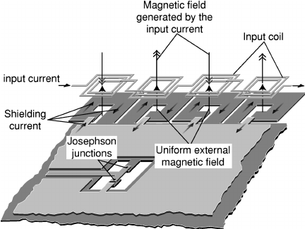
What are S Q U I D S?
SQUIDS = Superconductor + Joseph Junction
Pure Niobium or lead alloy with 10% gold or Indium.
Uses the same properties used to make a
Josephson Junction
Phase differences created by the circulated current
Around a ring can be used to measure quanta
Changes in flux correspond to changes in voltage

Slide 11
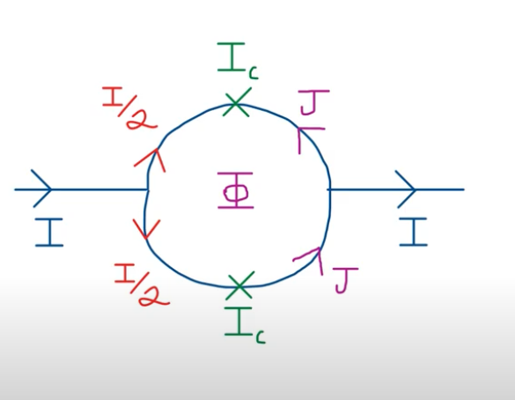
Explanation of how a SQUID works
Normally the two currents should be split
equally, but if there's a change in flux within the
middle, then the currents will adjust to cancel
or enhance the flux within the middle in
integer quanta. This comparison between wires
allows discrimination of the magnetic quanta traveling through the loop.
This is why it is called an interferometer.

Slide 12
Calculation of SQUID Measurements
Because of the excellent coupling of the thin-film gold modulation line to the SQUID itself, one can assume that the current induced in the SQUID ring is equal to half the current in the gold coil, and that the mutual inductance is, in fact, equal to about half the inductance (L) of the SQUID
This ‘ring’ can be thought of as a flux to voltage converter.

Slide 13
Applications of SQUIDs
Medicine to measure the production of electrical signals
Heart & Brain MRIs
Geosciences to find deposits of rare metals.
Recently the world’s largest deposit of silver was found using SQUIDS.
Quantum Computing
Dark Matter Detection

Slide 14
Applications of Josephson Junctions
Valuable in High Speed Circuits
Can be designed to switch in times of a few picoseconds.
Their low power dissipation makes them useful in high-density computer circuits where resistive heating limits the applicability of conventional switches.

Slide 15
Sensitivity of the junction
Threshold for SQUID:10⁻¹⁴ T
TMagnetic field of heart:10⁻¹⁰ T
TMagnetic field of brain:10⁻¹³ T

Slide 16
Conclusion
Many devices from one effect!
Why because of the nature of the wavefunction.

Slide 17
Citations
https://www.quora.com/What-is-the-Josephson-effect-1
https://www.youtube.com/watch?v=sNOpmTWlMwk
https://www.physics.wisc.edu/undergrads/courses/spring2020/407/experiments/squid/squid.pdf

