Slide 1
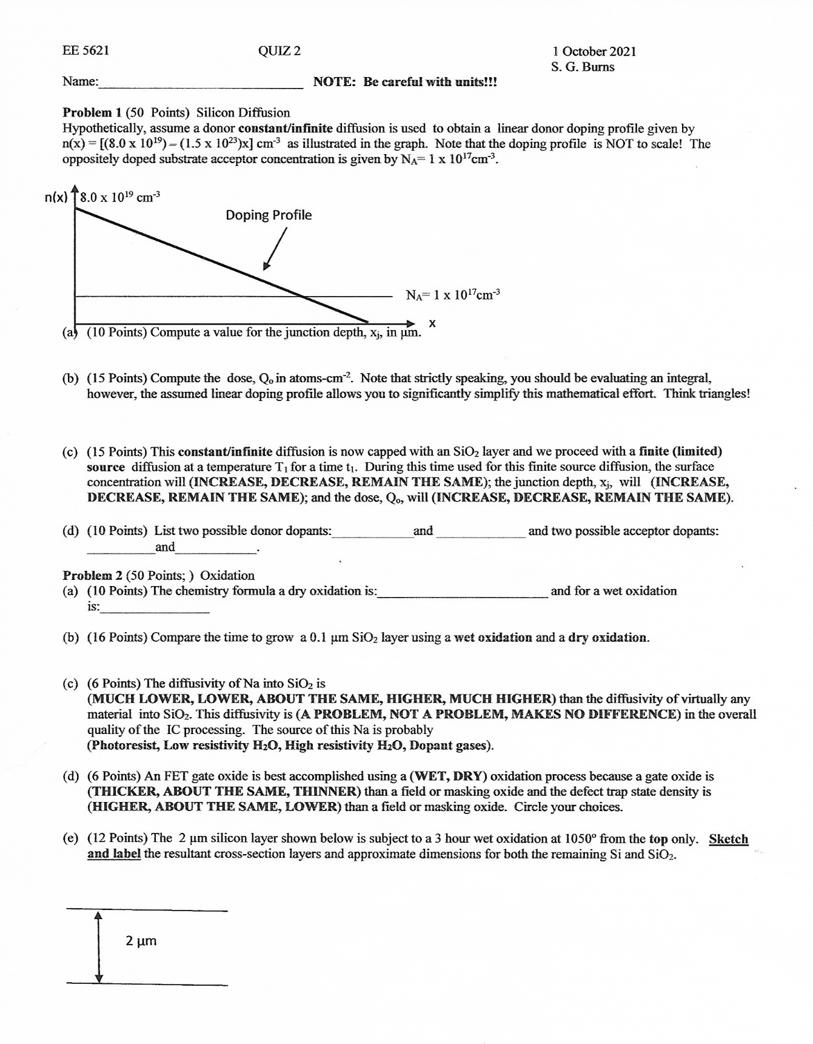
4 October 2021
QUIZ 2 Solutions And Discussion

Slide 2
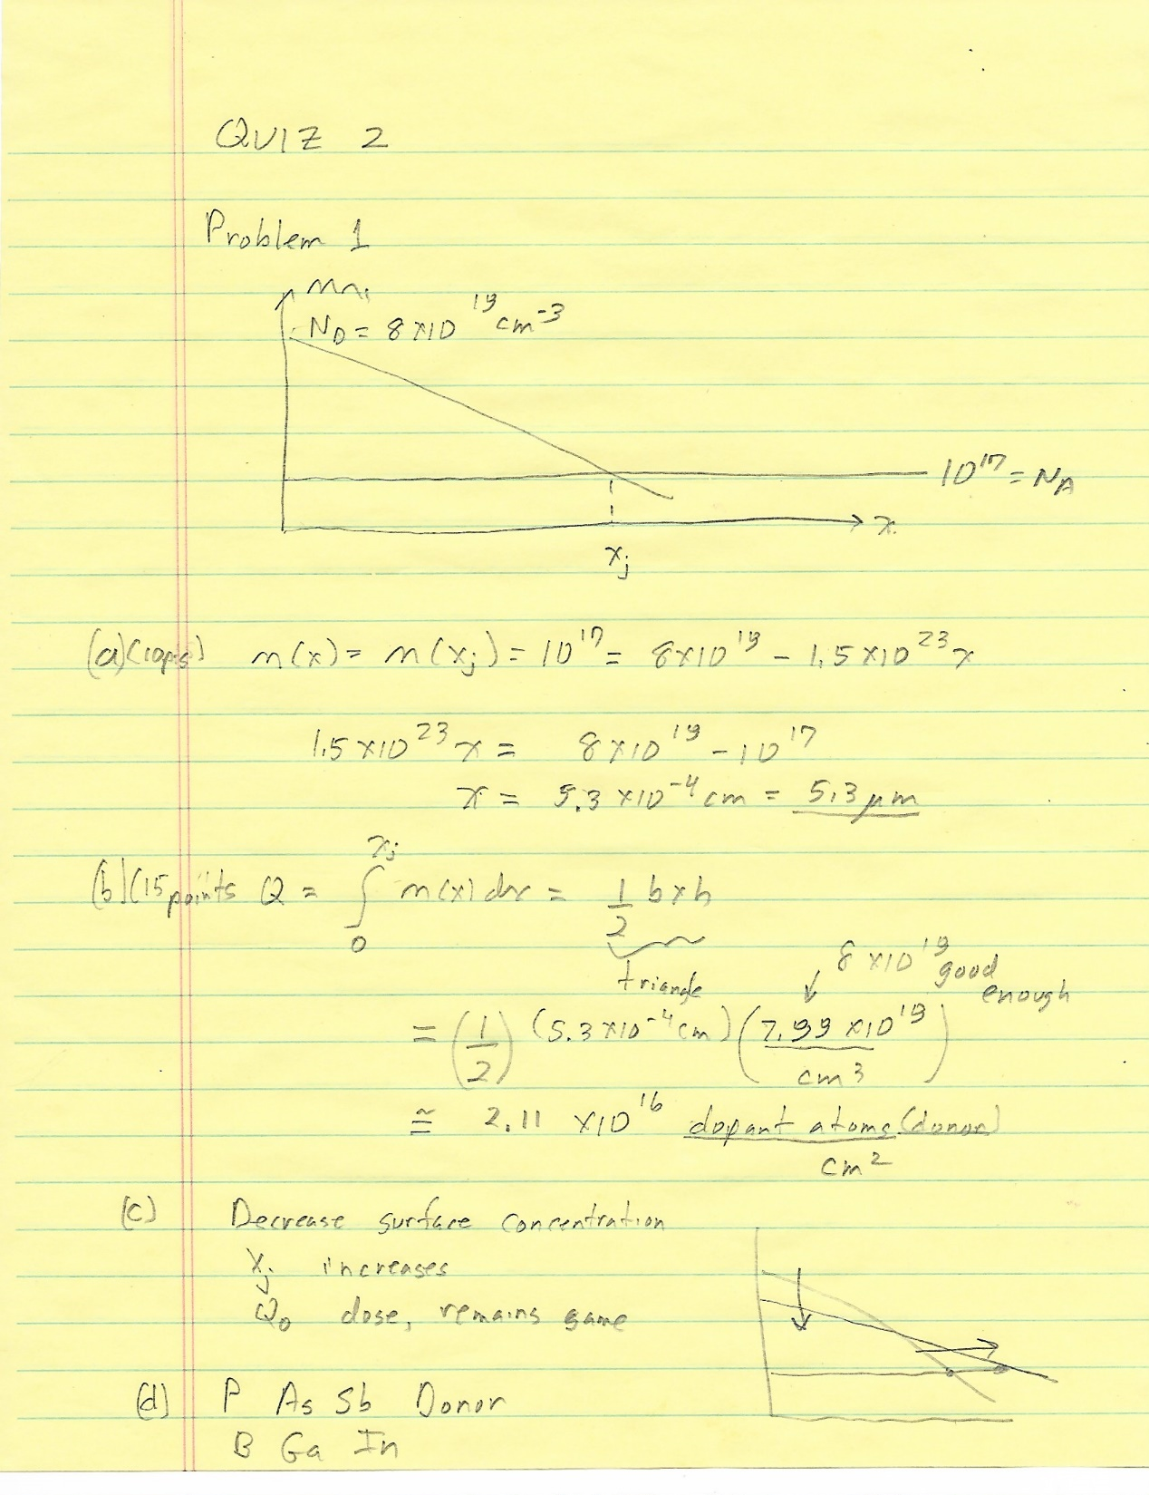

Slide 3
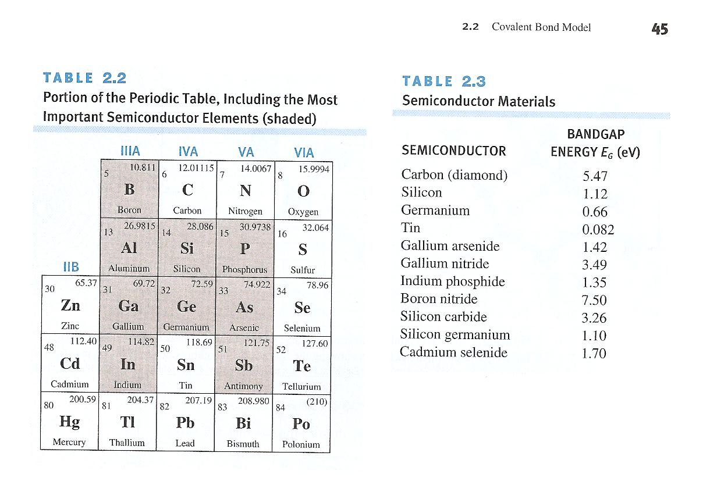

Slide 4
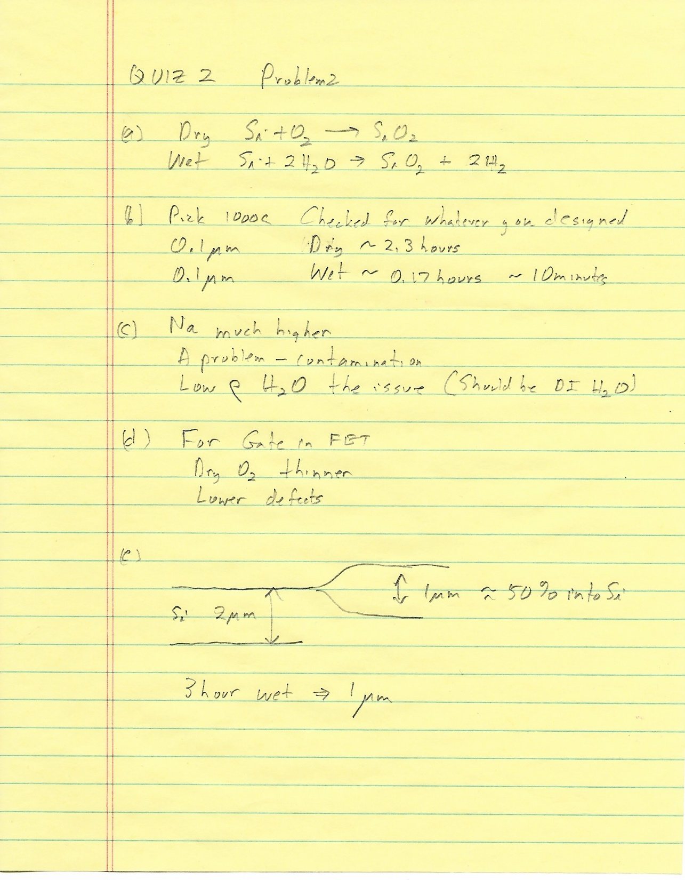

Slide 5
Diffusivities Into SiO2

Slide 8
