Slide 1
Rad hard devices and their application
By: Parker Liebl 12/8/21

Slide 2
Outline topics
What are rad hard devices?
What are the different ways we can make radiation protective devices?
How different areas result in different radiations
Challenges facing Rad hard devices
Space applications
Military applications
Nuclear applications
5 Key points

Slide 3
What are rad hard devices and why do we need them?
Rad Hard devices are any electronic device that is either built or designed to diminish the effects of radiation on these electrical components. These devices are required in numerous fields including space application, Military, Nuclear reactors.
This is because environments when there is high levels of radiation can cause 2 main types of effects.
Ionization Damage: This happens when high energy particles travel through the device causing charge carriers to be pushed out of the way. This will leaves concentrations of charge through the device.
Displacement Damage: This is when Radiation causes the atoms to be displaced from their original structure. This effects the lattice structure of the crystals and thus effects the electrical properties.

Slide 4
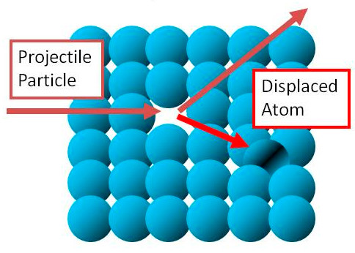
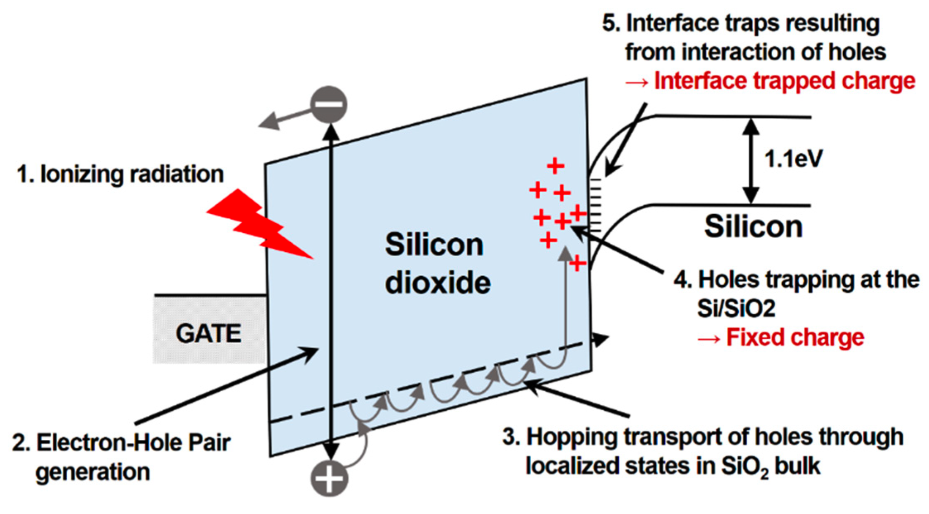
Radiation Damages

Slide 5
Different device effects

Slide 6
How do we make Rad hard devices?
There are 2 ways to make rad hard devices
Rad Hard by design: This option tries to find options where the effects of radiation can be minimized by design. For example instead of using regular RAM where the memory can get scrambled in high radiation, they have used MRAM (magnetoresistive RAM) which is able to store memory using magnets unaffected by even high amounts of radiation.
Rad Hard by Physical process: This includes things like shielding. Where they use a protective coating of depleted boron around the device. Shielding is the most widely used technique for radiation protection due to the relative ease it can be done. Manufacturing on insulators is also commonly used.

Slide 7
Rad Hard by design cont.
Triple mode redundancy (TMR): This form of radiation proof design tries to catch the possibility of radiation failure by looking at the returns of 3 components. If one component doesn’t line up it can be “outvoted” by the other 2 components. This is a highly reliable solution, but requires much more power.
Error corrective code (ECC) memory: Ionizing radiation can cause some bits to flip to the opposite state resulting in faulty memory. ECC combats this by using a library of redundant data to correct errors of the bits that are flipped. This is another extremely effective tool, but is limited by how much memory it is able to store.

Slide 8
Rad hard by process cont.
Shielding: This is done by coating the devices in metal. This does NOT make a device completely radiation protected, but rather just enhances the resistivity to the radiation. Recent developments have began to use oxidized metal powder (rusted metal) as a shielding agent. This has been able to reduce the weight required while also reducing gamma and neutron radiation by 300% and 225% respectively.
Manufacturing on insulators: As opposed to a normal wafer, creating a device on an insulating substrate as well as using more bipolar IC’s (instead of MOS) can result in the device radiation tolerance being increased by 200-300%. Another form of this that is also used is SOS (silicon on sapphire) This produces similar effects as SOI (silicon on insulators)

Slide 9
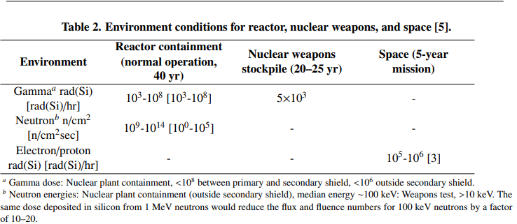
Different radiation in different places

Slide 10
Drawbacks of Rad Hard Devices
As with almost every new technology one of the biggest challenges facing the development is learning how to overcome the cost.
They require much more power due to requiring more transistors to turn on and off.
They are much slower than even consumer devices.
They are very difficult when trying to manufacture on insulating materials.
Another aspect to this field is how much variability there is. Devices are used in many different areas and have different requirements for each field. For example devices inside a nuclear reactor and in space have vastly different radiation requirements.

Slide 11
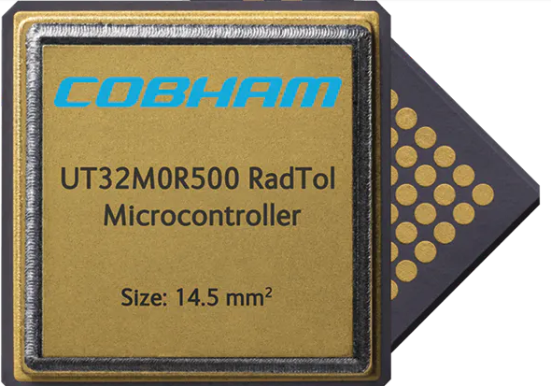
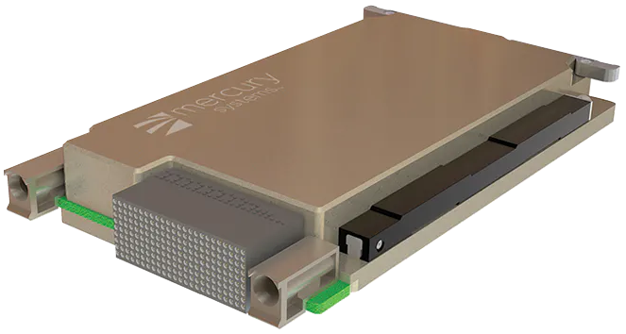
Space applications
Space is the biggest user of rad hard devices. Every satellite in space is exposed to space radiation from the van allen belts, solar flares, and naturally occuring cosmic rays
One application NASA is working on is creating satellite constellations. This requires satellites to have the capability to hand off their duties to other nearby satellites when one of them fails. This is very valuable in a field where just one of the parts needed can cost $50,000. Once this is completed this can help reduce cost and give a sort of security blanket around these space programs.

Slide 12
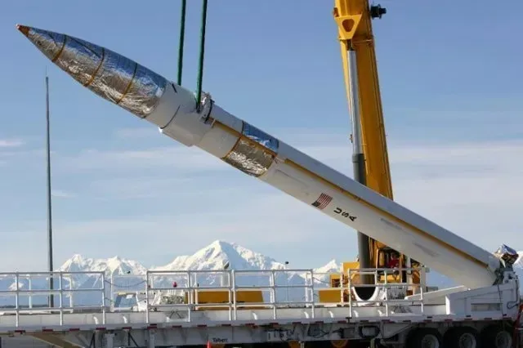
Military Applications
Intercontinental missiles are one of the newest military applications that require rad hard devices due to the high altitudes they travel. One Honeywell foundry for these is located in Plymouth, MN where they use rad hard by design techniques to supply the military with these highly specific devices.
The military is also on the lookout for a potential nuclear event. If it ever happens there is already a program in place to begin updating critical infrastructures to be radiation tolerant under such conditions.

Slide 13
Nuclear Applications
This is the least developed of all the applications for rad hard devices. That being said it also has what I think may be the most possibilities for the future.
The main goal of rad hard in reactors is to increase safety. In a reactor environment they use almost every form of rad protection from lead boxes around electronics to sensors for nearly every electronic. What is the best way to prevent further damage? Turn them off!!!
One example is in the aftermath of Fukushima events they have created a robot to be able to go into radiation zones and get vital information. The thought is that a similar robot could be developed to detect when an event begins to occur. The robot would then be tasked with shutting off the vital sensitive components to prevent any further damage.

Slide 14
5 Key points
What are the 2 different ways radiation can affect devices?
There are 2 ways to create a rad hardened devices. What are they?
What are the different types of radiation that can affect these devices?
What is the most widely used form of radiation hardening?
Where most rad hard devices are currently used? (One specific field)

Slide 15
References
https://www.militaryaerospace.com/computers/article/16707204/the-evolving-world-of-radiationhardened-electronics
https://www.draper.com/explore-solutions/rad-hard-design
https://www.baesystems.com/en-us/definition/what-are-radiation-hardened-electronics
https://info.ornl.gov/sites/publications/Files/Pub147829.pdf
https://www.osti.gov/servlets/purl/1238384
https://nepp.nasa.gov/mafa/talks/MAFA07_17_Keys.pdf
https://www.aerodefensetech.com/component/content/article/adt/features/articles/36071
https://phys.org/news/2020-02-smaller-lighter-shielding.html
https://www.ddc-web.com/resources/assets/images/Articles/2018/The_5_Approaches_for_Producing_Radiation_Hardened_Solutions.pdf

