Slide 1
Recent gallium Nitride Breakthroughs
Comparison for GaN and Si/SiC
Presentation by Tom Tomasiewicz
12/1/2021

Slide 2
outline
Basic Properties of GaN Compared to Si
Integration into New Advancements
Recent Power Applications Compared to SiC
Development
Photocatalytic Activity
Summary
References

Slide 3
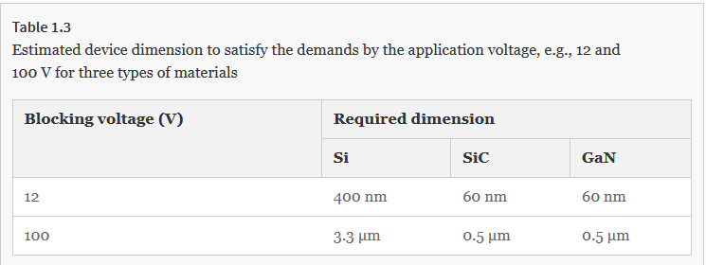
Comparison
Due to the much larger bandgap of GaN compared to Si (3.2 eV and 1.1eV respectively) there is a much larger thermal stability. With GaN being able to be made smaller while maintaining the same on-resistance as Si, the decrease in chip size could also decrease the overall on-resistance.
https://ieeexplore.ieee.org/document/9457525

Slide 4
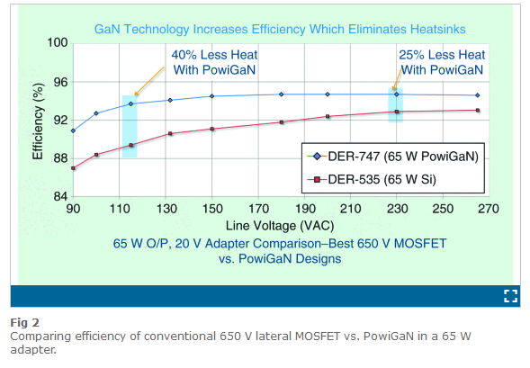
Comparison
Due to the smaller resistance loss, there is a reduction in heatsink size since less power will be lost.
The efficiency of GaN stems from the reduction in heatsink size due to the increase of power capabilities and switching loss from its small size.
The main concern is the expensive cost for GaN manufacturability such as crystal defects and cost.
Though there have been new manufacturing techniques to reduce the defects, the cost comparison is large… For now
https://ieeexplore.ieee.org/document/9457525

Slide 5
Basic Property Characteristics
Properties | Units | Si | SiC | GaN
Bandgap | eV | 1.12 | 2.4-3.26 | 3.39
Electron Mobility | cm²/(V⋅s) | 1500 | 460-980 | 2000
Hole Mobility | cm²/(V⋅s) | 450 | 20 | ~5 (Mg)*
Thermal Conductivity | W/(cm⋅°C) | 1.2 | 2.3-4.9 | 2.1
*P-Doping GaN has yet to excel, so far the best dopant is Mg.

Slide 6
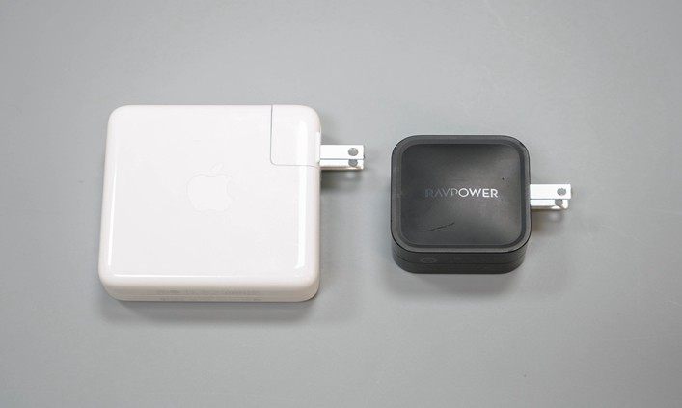
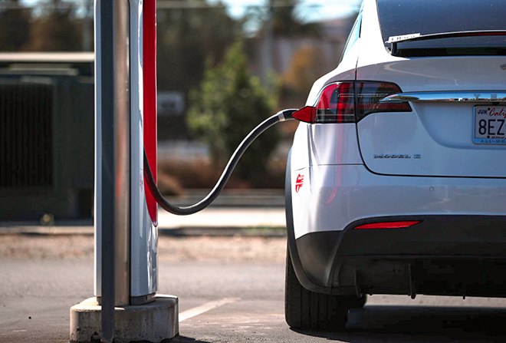
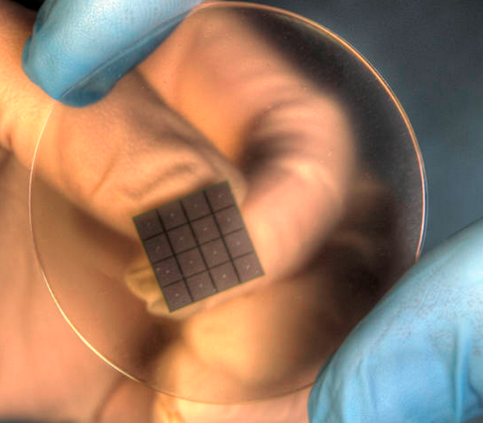

Integration
With more acceptance and research, GaN is going to become the future replacement of Si and potentially more.
Due to the high power nature of the device with the reduction in heatsink. More companies are starting to research the technology.
From wireless/cable charging, hybrid/electric vehicles, space application and satellites

Slide 7
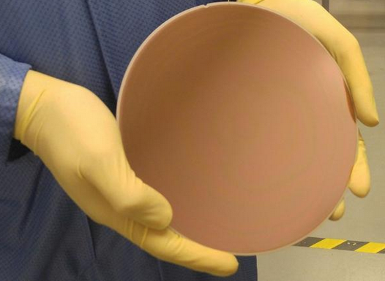
High power design
GaN is able to withstand large power designs, but the current devices we use are Silicon Carbide (SiC).
A recent discovery in Belgium, a 200mm wafer of GaN was able to perform in 1200V applications and having a hard breakdown at 1800V. The previous high application was 650V.
GaN buffer application is less expensive compared to SiC.
This high power commercial use is related to radio towers and renewable energy
https://www.eenewspower.com/news/gan-breakthrough-1200v-takes-sic

Slide 8
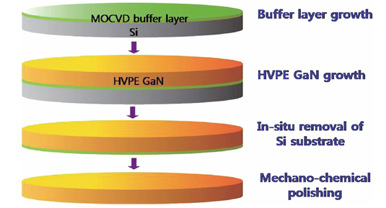
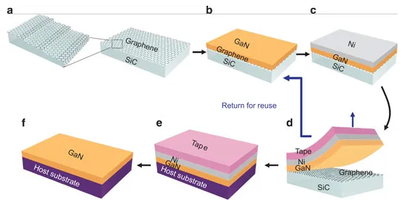
Development
MOCVD and HVPE Growth on Si/SiC
GaN can be grown on Si, SiC, sapphire, diamond and made from Bulk GaN
For the growth of GaN on Si/SiC a Ni layer is used.
The main ways GaN is formed is by growth onto a substate and buffer layer then using Ni as a means to “peel” off of off Si/SiC.
GaN Substrate Separation onto Graphene
http://www.semiconductor-today.com/news_items/2013/DEC/SAMSUNG_091213.shtml
https://semiengineering.com/gan-manufacturing-meets-big-silicon/

Slide 9
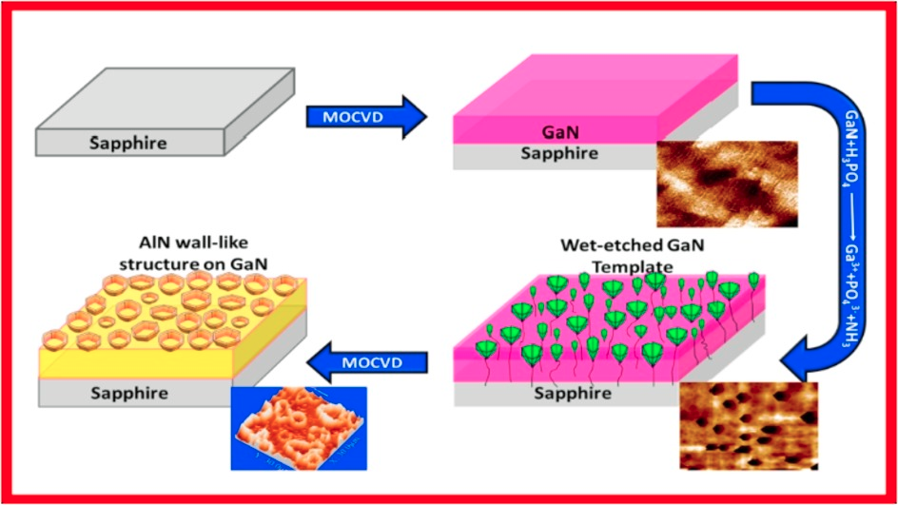
Development
Wet Etch MOCVD on Sapphire Substrate
Using Sapphire as a substate, MOCVD is used to grow GaN.
Sapphire is used due to its strong crystal properties.
AlN is made through wet etching and provides a buffer for after removal.
Being epitaxial, the wafer Is removed through the process of laser pulses to decompose the epitaxial layer off sapphire.
https://www.sciencedirect.com/science/article/abs/pii/S0749603618309534
https://aip.scitation.org/doi/10.1063/1.4986646

Slide 10
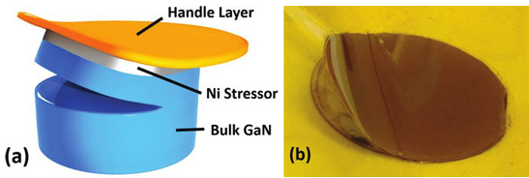
Development
Spalling with Ammonium Chloride (NH3Cl)
Bulk GaN provides another means to produce GaN films.
The GaN is originally made into a large crystal.
To remove layers, Nickel is used a bonding stressor.
To control the “peeling” location, Ammonium chloride is use to help increase the initial Ni bond.
https://aip.scitation.org/doi/10.1063/1.4986646

Slide 11
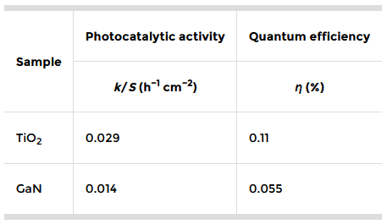
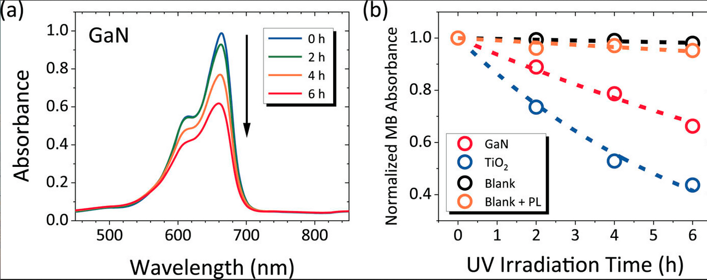
Photocatalytic Activity
Photocatalytic is the breakdown of toxic chemicals using light energy.
GaN on a sapphire substrate was compared to TiO2 in a quartz petri dish.
Using a UV LED focused through a quartz lens, Methane Blue was decomposed.
Even though GaN had 50% less activity, the absorption coefficient is greater than TiO2.
More development could provide future replacement of TiO2.
https://aip.scitation.org/doi/10.1063/5.0035628
https://aip.scitation.org/doi/10.1063/5.0035628

Slide 12
Summary
GaN has had many breakthroughs which has brought its attention for what it could potentially replace.
Having a large bandgap (3.2-3.4eV) and lower switching loss have allowed a greater efficiency due to the decrease in heatsink requirements.
The main advantage is the application to high power devices and its progression to smaller scale power use.
The cost is the main disadvantage, but with better manufacturing (defect control) and more research GaN could become more economic friendly.
The use of many different substrates (Si/SiC, sapphire, diamond, bulk GaN) to produce GaN films (MOCVD).
Uses in Photocatalysis.

Slide 13
References
Shimosako, N., & Sakama, H. (2021). Quantum efficiency of photocatalytic activity by GaN films. AIP Advances, 11(2), 025019. https://doi.org/10.1063/5.0035628
Balakrishnan, B. (2021). GaN Outperforms Silicon, Enters Mainstream [Expert View]. IEEE Power Electronics Magazine, 8(2), 76–78. https://doi.org/10.1109/mpel.2021.3075805
Arrow Electronics. (2020, January 21). Silicon vs. Gallium Nitride (GaN): Properties & Applications in Semiconductors. Arrow.com; Arrow.com. https://www.arrow.com/en/research-and-events/articles/gan-vs-silicon-semiconductor-materials-compared
Ueda, D. (2016). Power Gan Devices. Springer International Publishing Ag.
https://semiengineering.com/gan-manufacturing-meets-big-silicon/
http://www.semiconductor-today.com/news_items/2013/DEC/SAMSUNG_091213.shtml
https://www.eenewspower.com/news/gan-breakthrough-1200v-takes-sic
https://www.sciencedirect.com/science/article/abs/pii/S0749603618309534

Slide 14
Discussion
What method is used to separate GaN from Sapphire.
What element is used for P-Doping GaN.
What chemical compound is used to help strengthen the bonding for the buffer to initiate spalling?
If GaN replaced Si/SiC in small and large power applications, what would happen to Si/SiC?
Other than cost, what is the main issue GaN has in its development.
For photocatalytic purposes, what is the primary advantage that GaN posses?

