Slide 1
Using light emitting diodes for lighting
By: Grant Gorman and alec pahl
5/6/2013
Abstract: Light emitting diodes are semiconductor devices that emit light when a voltage is places across them. They have become increasingly popular in lighting applications because of their high efficiency and long lasting output.

Slide 2
Outline
What is a Light Emitting Diode?
Why Use LEDs?
LED Physics
Lighting Applications
Current Progress

Slide 3
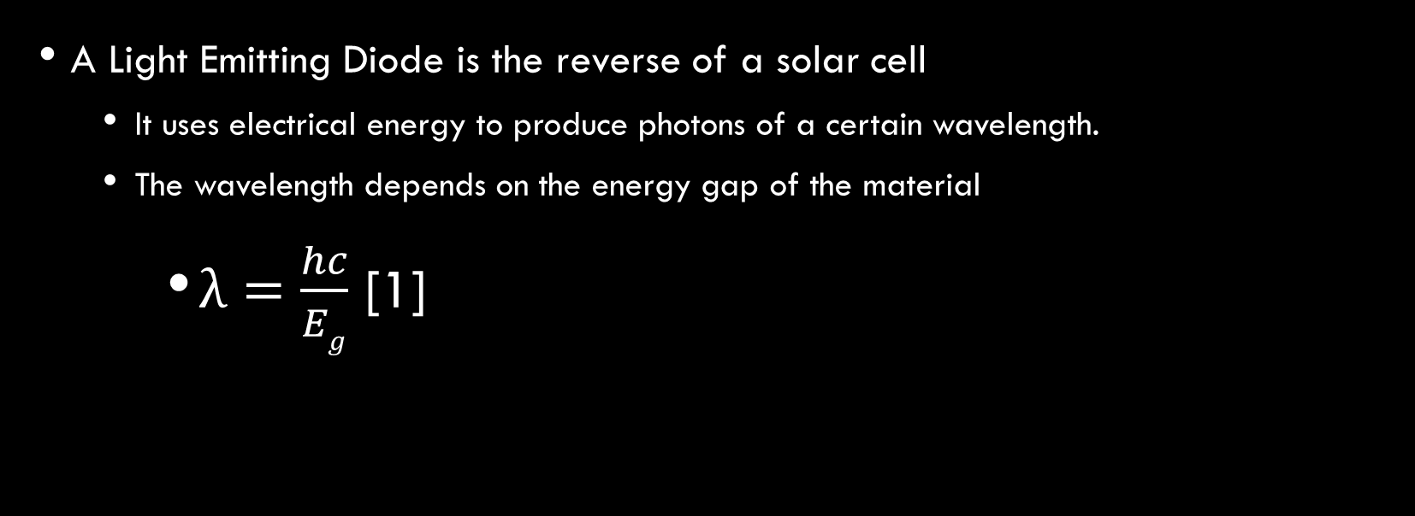
What is a light emitting diode?
A Light Emitting Diode is the reverse of a solar cell
  It uses electrical energy to produce photons of a certain wavelength.
  The wavelength depends on the energy gap of the material
    $λ=\frac{hc}{Eg}$ [1]

Slide 4
How does the light emitting diode work?
Current flows in the same way as a normal diode
However, normal diodes made from silicon or germanium are indirect band gap materials, and when the carriers recombine, they do not form a photon
A light emitting diode is a direct band gap material, and when the carriers recombine, they emit a photon.

Slide 5
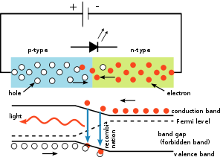
Physics of LEDs
When a voltage is applied across the pn junction of the diode, electrons and holes flow across the space charge region, becoming excess minority carriers.
These carriers then diffuse into the neutral semiconductor regions, recombining with the majority carriers.
In an LED, this process is direct from the band gap to the valence band, which causes a photon to be emitted. [1]
Figure 1: The basic process of photon generation [2]

Slide 6
Using Leds for lighting
Advantages
  More efficient: More light per unit of energy than incandescent bulbs
    80-100 lm/W for LED bulbs, compared to only 10-17 lm/W for incandescent. [5]
  Cool: Incandescent light sources can burn very hot, but a LED light source gives off little thermal heat. [6]
  Resistant to breakage: Rather than being made of glass and thin wires, LEDs are solid state devices and are far less fragile than an incandescent bulb or fluorescent. [6]
  Long Lasting: 30,000-50,000 hours for an LED, compared to 1,000 for incandescent or 8,000 hours for fluorescent. [2]
Disadvantage
  Expensive: Per lumen, LEDs have higher upfront costs. An A19 9 LED light bulb we found cost 12.97 for each bulb, while in the same store, a six pack of A19 incandescent bulbs cost 7.97. [7]

Slide 7
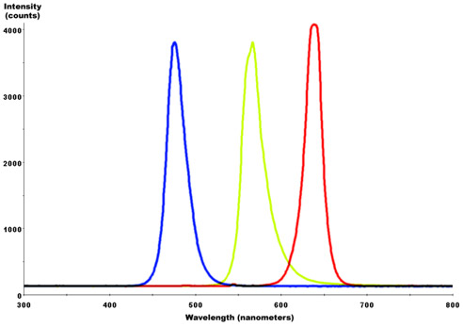
The Color of leds
LEDs, due to the materials available and the limited number of energy gaps, only give off light in certain wavelengths; they do not give off white light naturally.
Two different methods are used to generate white light
  RGB system: Mix Red, blue, and green LEDs together to create white light
  Phosphor system: Coat LEDs in a phosphor that shifts the color into the white spectrum.

Slide 8
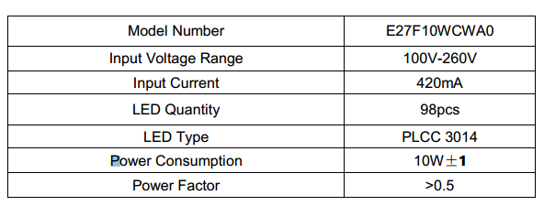
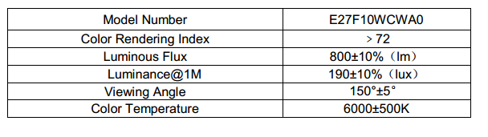

LED light bulb example
Lumens/Watt calculation:
$\frac{Luminous Flux}{\begin{aligned}Power \\ Consumption\end{aligned}}$
$\frac{800 lm}{10 W}$= 80 Lumens/Watt
Table 1: Sample Data Sheet of an A19 LED light bulb [4]

Slide 9
Operating above 100 percent efficiency?
Recent researchers at MIT found an interesting property of LEDs [8]
  Reducing power by a factor of 4 reduced light output by a factor of 2
  LEDs would use electrical power to use the heat of the lattice to excite electrons
  At very low voltages, the heat of the lattice generating photons is greater than the energy put into the diode
  30 picowatts of input power generated 70 picowatts of light energy.
  This also cools the air around the light

Slide 10
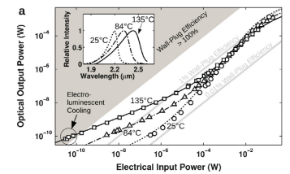
Input Power Vs Ouptput Power at extremely low inputs [8]

Slide 11
Conclusions
A Light Emitting Diode is a solid state semiconductor device that converts electrical power into light via the emission of photons
LEDs have many advantages in lighting today, due to their high efficiency and longevity
However, they are more expensive up front than incandescent and fluorescents at the moment, and so require additional research before completely replacing other forms of lighting.

Slide 12
References
Neamen, Donald A. Semiconductor Physics and Devices. 4th ed. New York, NY: McGraw Hill, 2012. Print.
"Light-emitting Diode." Wikipedia. Wikimedia Foundation, 05 Feb. 2013. Web. 02 May 2013. <http://en.wikipedia.org/wiki/Light-emitting_diode>.
"LED Lamp." Wikipedia. Wikimedia Foundation, 05 Jan. 2013. Web. 02 May 2013. <http://en.wikipedia.org/wiki/LED_lamp>.
Juan, Xiao. "LED E27 Light Bulb." Paralight.us. Para Light, 11 Aug. 2011. Web. 02 May 2013. <http://www.para.com.tw/>.
5. "Incandescent Lighting." Energy Efficiency and Renewable Energy. US Department of Energy, 22 Apr. 2013. Web. 02 May 2013. <http://www.eere.energy.gov/basics/buildings/incandescent.html>.

Slide 13
References
6. "In Depth: Advantages of LED Lighting." Energy & Power. N.p., n.d. Web. 02 May 2013. <http://energy.ltgovernors.com/in-depth-advantages-of-led-lighting.html>.
7. "Light Bulbs." Homedepot.com. Home Depot, n.d. Web. 02 May 2013.
8. Santhanam,, Parthiban B., Dodd J. Grey, Jr., and Rajeev J. Ram. "Thermoelectrically Pumped Light-Emitting Diodes Operating above Unity Efficiency." Phys. Rev. Lett. 108, 097403 (2012):. American Physical Society, 27 Feb. 2012. Web. 02 May 2013.
9. "LED (Light Emitting Diode) Bulbs." Bulbs.com. Bulbs.com, n.d. Web. 02 May 2013. <http://www.bulbs.com/learning/led.aspx>.

Slide 14
Key Concepts
LEDs are made of direct band gap materials such as GaP
Wavelength of the light emitted depends on the energy gap
Different materials give off different colors of light
LEDS are more efficient and last longer than other forms of lighting, but are more expensive upfront
MIT Resarchers have tested LEDs that have an efficiency of above 100 percent.

