Slide 1
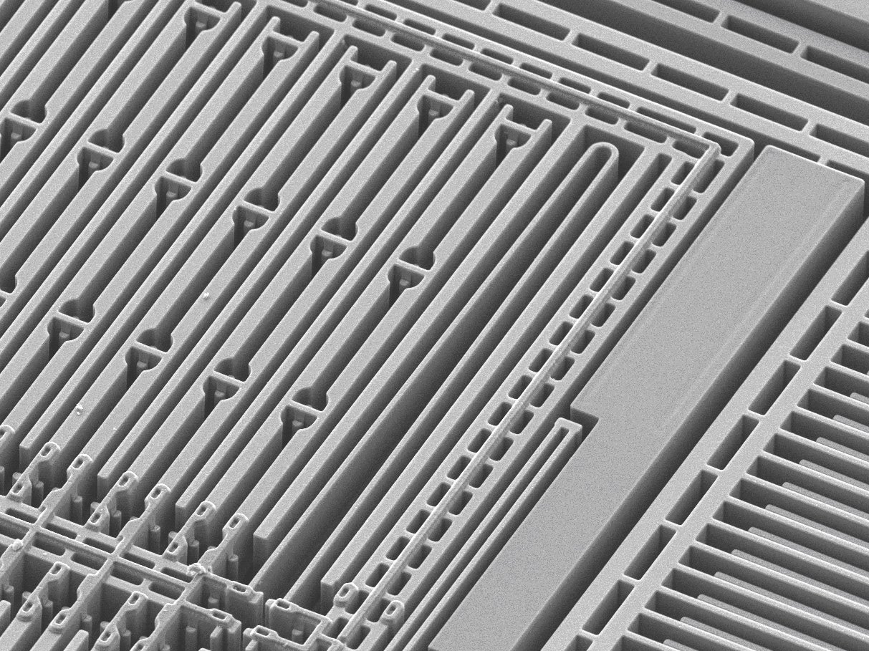
MEMS Devices, Sensors, etc.
EE 4611
Mark Anderson
4/22/2015
Abstract:
This report introduces MEMS and general classifications of MEMS. Examples of MEMS devices, sensors, and applications will be given along with a look at the past and a glimpse into the future of MEMS.

Slide 2
Overview
What are MEMS?
History of MEMS
MEMS Sensors
MEMS Devices
Some MEMS Applications
Future of MEMS
Summary/Conclusion

Slide 3
What are MEMS?
Micro-Electro-Mechanical Systems (MEMS)
Miniaturized mechanical and electro-mechanical elements (devices and structures)
Sizes range from millimeters to fractions of micrometers
Some parts of the device have some sort of mechanical functionality
A.K.A. Microsystems Technology or Micromachined Devices
Photo: http://

Slide 4
(Very Brief) History of MEMS
1959 - Richard Feynman, There’s Plenty of Room at the Bottom
1965 - Harvey C. Nathanson, Microelectronic Frequency Selective Apparatus, US Patent 3413573
1982 - Kurt Petersen, Silicon as a Mechanical Material
Photo: http://

Slide 5
MEMS Sensors
Turn physical phenomena into measurable electrical signals
Most (if not all) incorporate circuitry/components to interpret electrical signals
Some have no moving parts

Slide 6
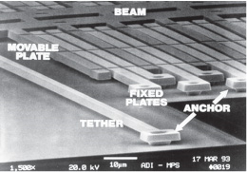
MEMS Sensors - Accelerometer

Slide 7
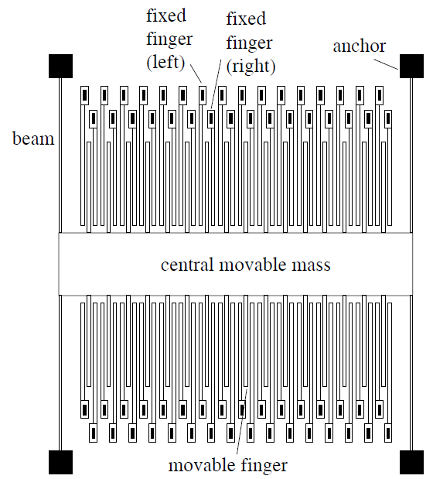
MEMS Sensors - Accelerometer

Slide 8
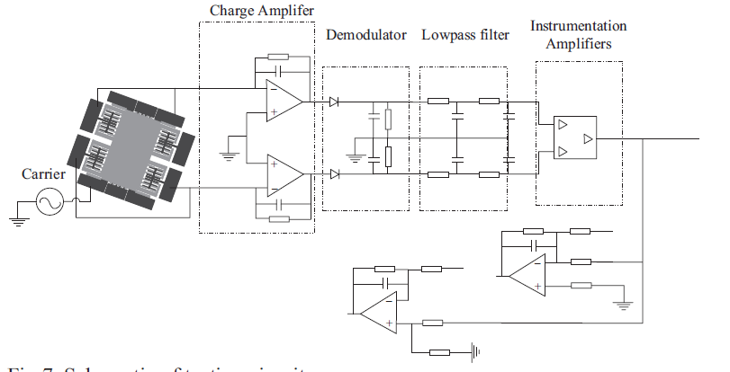
MEMS Sensors - Accelerometer

Slide 9
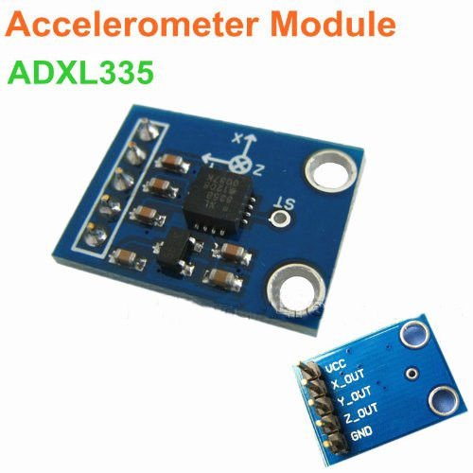
MEMS Sensors - Accelerometer
Analog Output Accelerometer Module
$2.70

Slide 10
MEMS Devices
Some are just scaled down versions of other systems
Use electric or electromagnetic principles to control mechanical effects
Commonly used in groups rather than individually

Slide 11
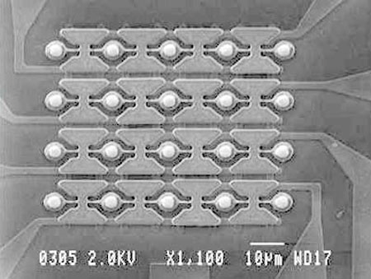
MEMS Devices - Micromirror Array

Slide 12
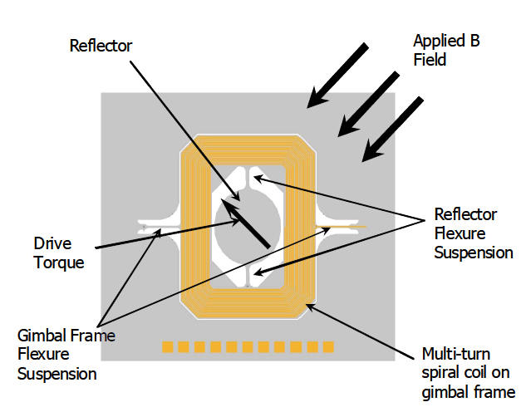
MEMS Devices - Micromirror Array

Slide 13
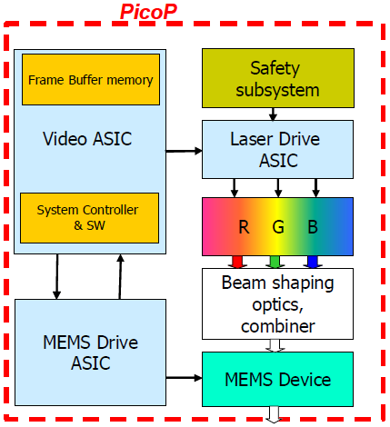
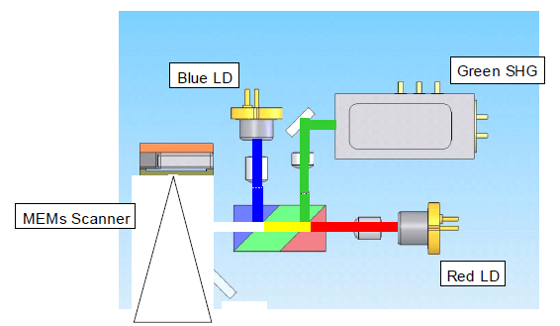
MEMS Devices - Micromirror Array

Slide 14
MEMS Devices - Micromirror Array
DLP Pico Projector
~$300

Slide 15
Some MEMS Applications
Vehicle Airbags (Accelerometers)
DLP Projector (Micromirror Array)
Cellphone Microphones (Microphone)
Blood Pressure Monitor (Pressure Sensor)
Digestible Camera (Camera Module)
Printers (Printheads)
Image Stabilization (Accelerometers)

Slide 16
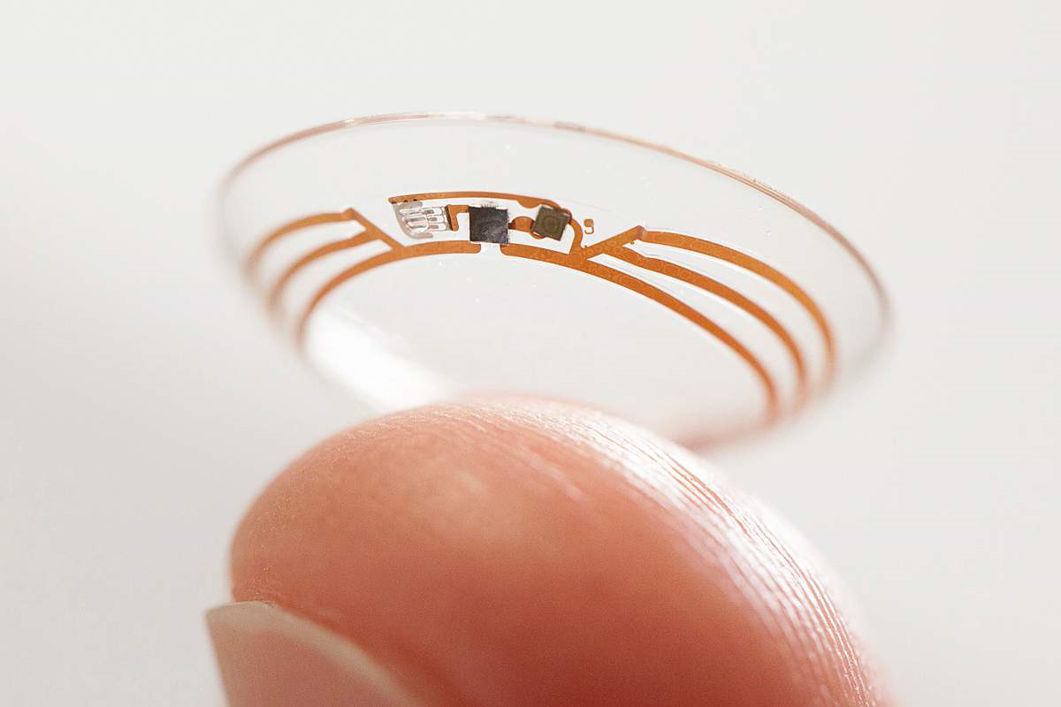
Some MEMS Applications
Google Smart Contact (Glucometer)

Slide 17
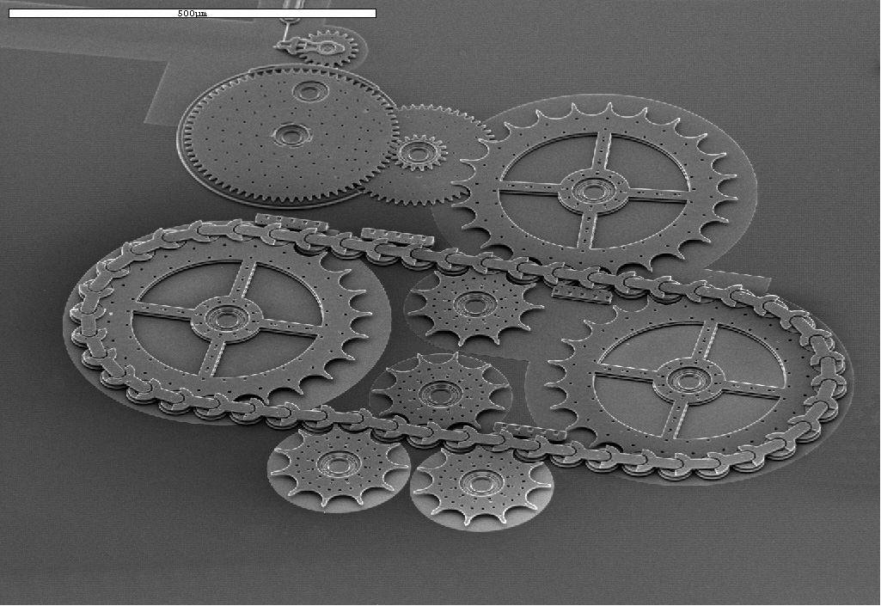
Some MEMS Applications
Microchain Drive
(Microchain & Gears)

Slide 18
Future of MEMS
Shrinking Devices – Low Power
Medicine
Robots & Drones
Cheaper Devices – Mass Production
Internet of Things (IoT)
Improving Quality – Better MEMS Technologies
Expanding Applications – New MEMS Technologies

Slide 19
Summary/Conclusion
The sizes of MEMS can range from millimeters to less than a micrometer.
MEMS use up small amounts of space and power.
MEMS are mass produced and are getting cheaper.
Some MEMS are smaller versions of other systems.
MEMS have a wide variety of applications.

Slide 20
References
Slide 1
Photo: http://qcn.stanford.edu/wp-content/uploads/2011/11/Kionix_MEMS_cross_branded.jpg
Slide 3
https://www.mems-exchange.org/MEMS/what-is.html
Slide 6
http://www.analog.com/library/analogdialogue/archives/43-02/mems_microphones.html
Slides 7 & 8
J. Xie, M. Song, W. Yuan, “A High Sensitivity Micromachined Accelerometer with an Enhanced Inertial Mass SOI MEMS Process,” NW Polytech. Univ. & Key Lab. Of Micro/Nano Sys. for Aerospace, Xi’an, China, April 2013
Slide 9
http://www.amazon.com/ADXL335-Accelerometer-angular-transducer-Arduino/dp/B00UPT24NW/ref=sr_1_6?s=industrial&ie=UTF8&qid=1429115969&sr=1-6&keywords=accelerometer

Slide 21
References
Slide 11
https://www.kth.se/en/ees/omskolan/organisation/avdelningar/mst/research/optics/mirrors-1.56919
Slides 12 & 13
W. O. Davis, R. Sprague, J. Miller, “MEMS-Based Pico Projector Display,” Microvision, Inc., Redmond, WA, August 2008
Slide 14
http://www.amazon.com/AAXA-P3-X-Projector-Minutes-Mini-HDMI/dp/B005TAXENQ/ref=sr_1_7?s=electronics&ie=UTF8&qid=1429135740&sr=1-7&keywords=pico+projector
Slide 16
http://time.com/3758763/google-smart-contact-lens/
Slide 17
http://www.sandia.gov/media/NewsRel/NR2002/chain.htm

Slide 22
Concepts
What makes a MEMS device a MEMS device?
Size range of MEMS devices
Examples of MEMS devices
Benefits of MEMS devices
Wide variety of applications for MEMS devices

